Slide 1

 | National University of Sciences & Technology (NUST) School of Electrical Engineering and Computer Science (SEECS) Department of Basic Sciences
Linear Algebra & Ordinary Differential Equations
MATH-121
Lecture # 13
Course Instructor: Dr Saira Zainab
Ph. # 03325193283
Email: saira.zainab@seecs.edu.pk
Office # 207, Faculty Block, SEECS
1

Slide 2
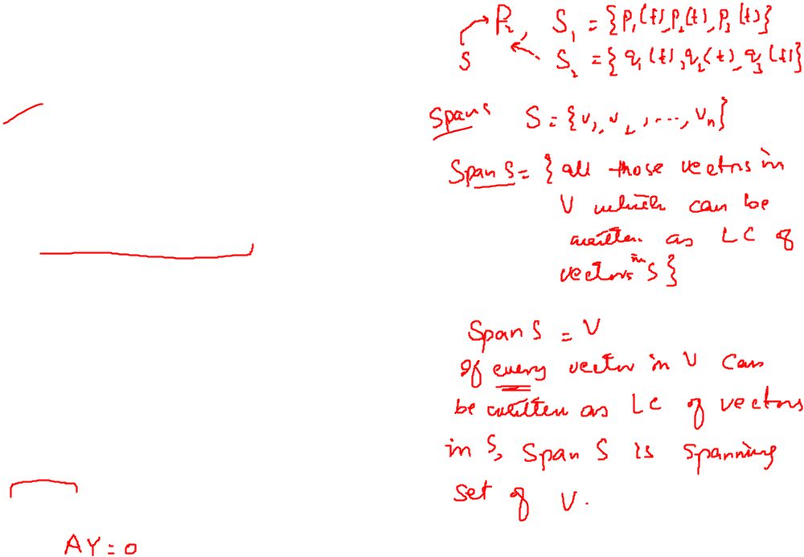
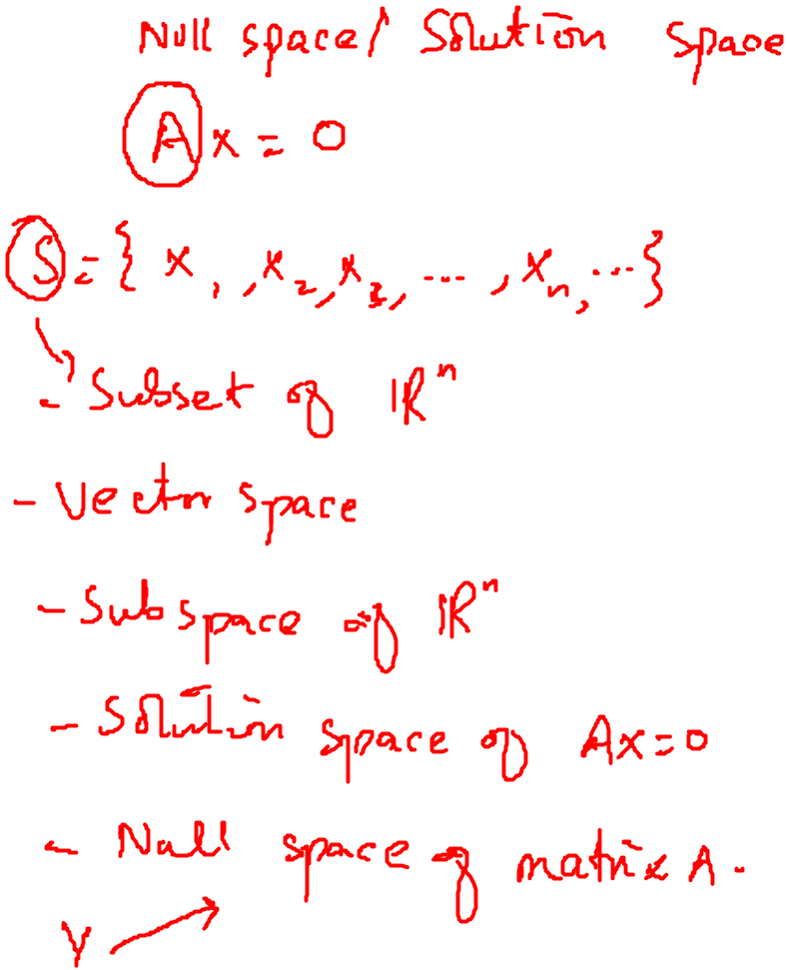
Recalling Previous Lecture

Slide 3
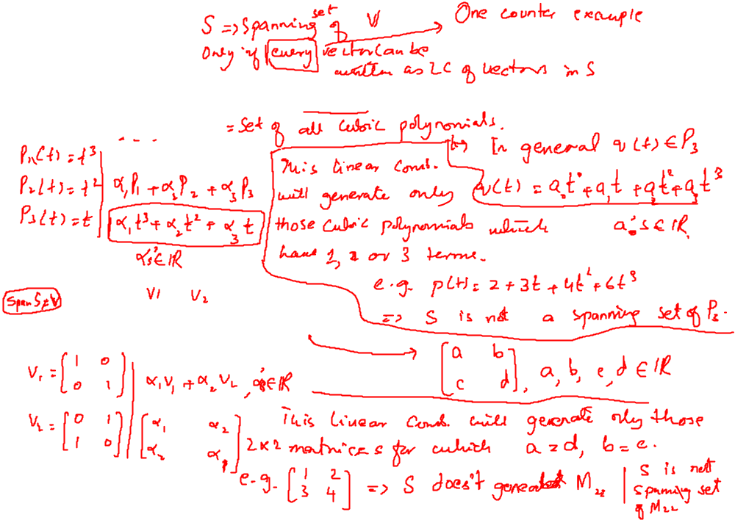
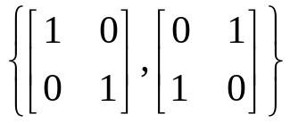
Examples
Explain why the following set is not a spanning set for the vector space.
1. S= {t³,t²,t}, V=P₃
2. S= , V= M₂₂

Slide 4
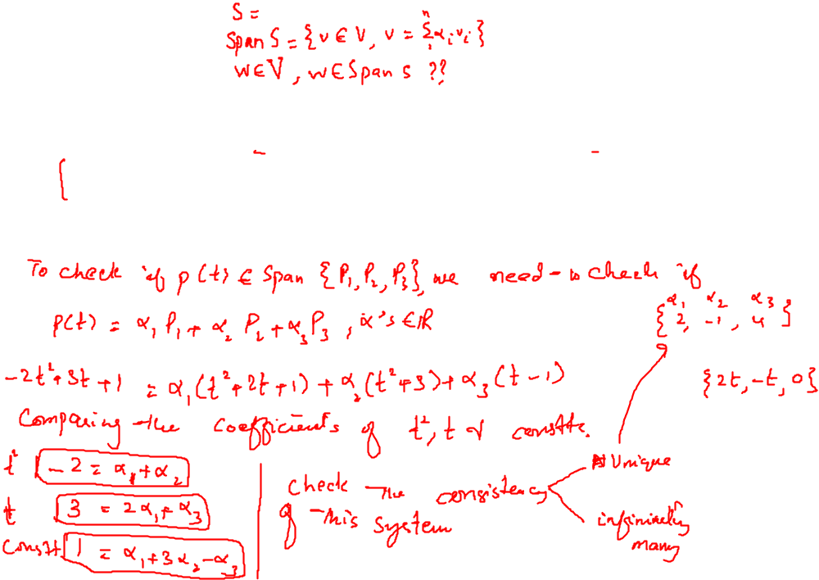
Examples
Another type of question that we encounter is;
For a given subset S of a vector space V, is the vector w of V in span S?
Remark: In general, to determine whether a specific vector v belongs to span S, we investigate the consistency of an appropriate linear system.
Example: Determine whether the given vector p(t)=-2t²+3t+1 in P₂ belongs to span {P₁(t), P₂(t), P₃(t)}, where P₁(t)=t²+2t+1, P₂(t) =t² +3 and P₃(t) = t - 1.

Slide 5
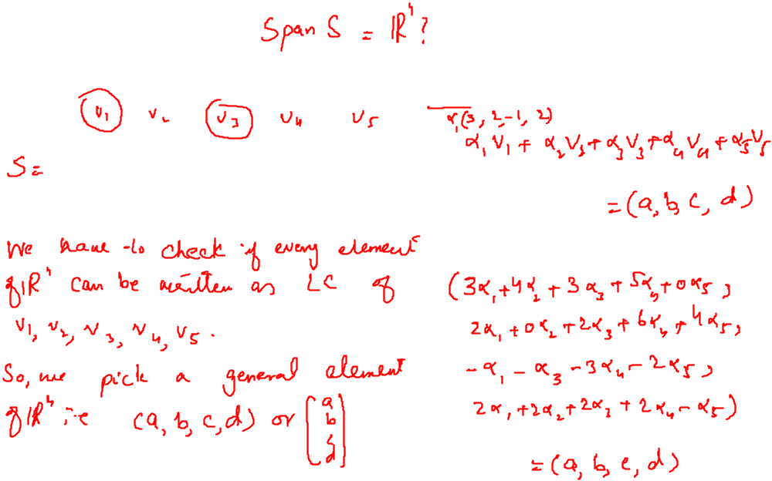

Examples
Determine if the following set of vectors span R⁴?

Slide 6
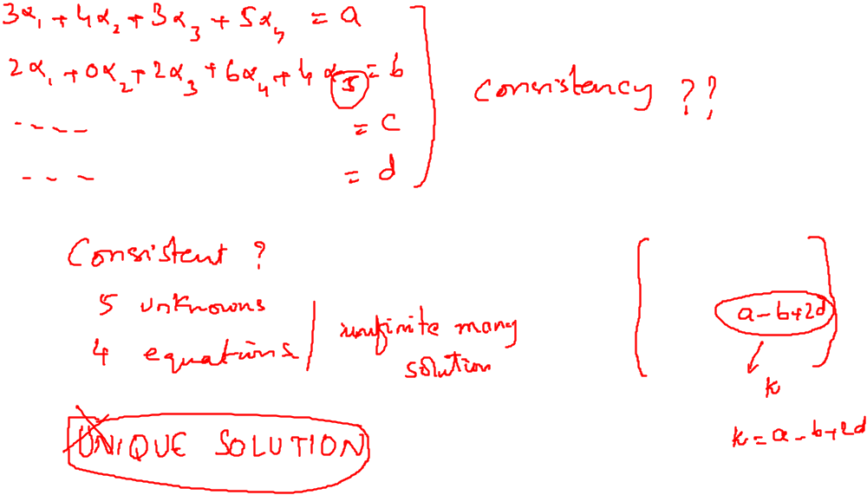
Examples

Slide 7
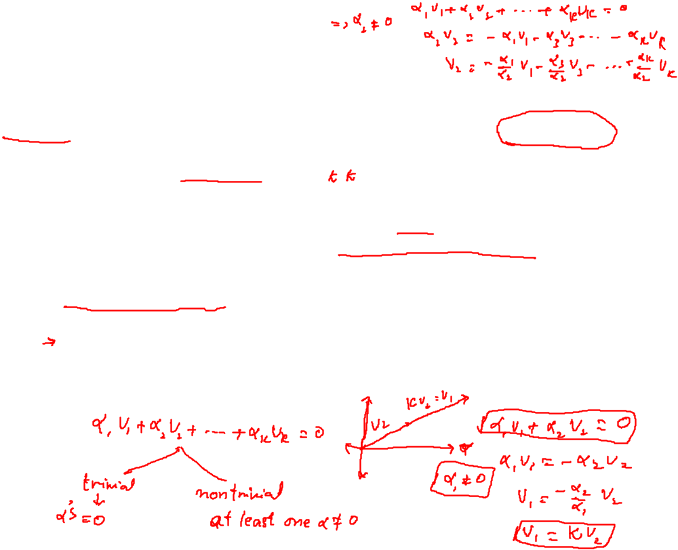

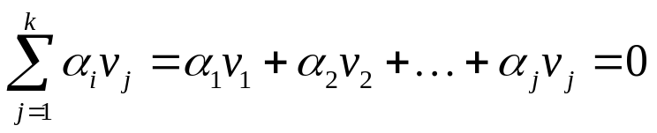


Linear Independence
The vectors v₁, v₂, ..., v_{k} in a vector space V are said to be linearly dependent if there exist constants , not all zero, such that ,
Otherwise, v₁, v₂, ..., v_{k} are called linearly independent. That is , v₁, v₂, ..., v_{k} are linearly independent if, whenever
then
If S = {v₁, v₂, ..., v_{k} }, then we also say that the set S is linearly dependent or
linearly independent if the vectors have the corresponding property.

Slide 8
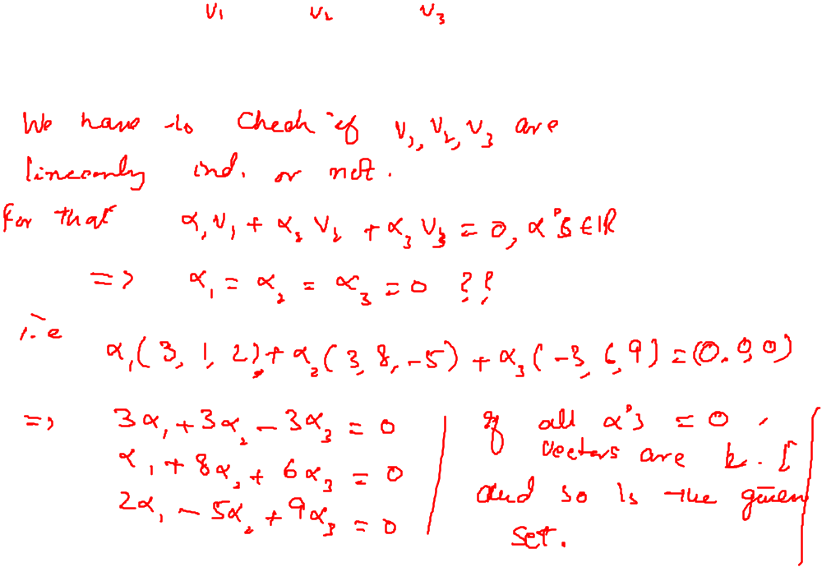
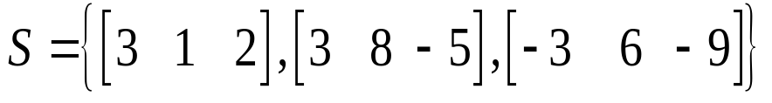
Examples
Determine whether the set
is a linearly independent set in R³.

