Slide 1

 | National University of Sciences & Technology (NUST) School of Electrical Engineering and Computer Science (SEECS) Department of Basic Sciences
Linear Algebra & Ordinary Differential Equations
MATH-121
Lecture # 13
Course Instructor: Dr Saira Zainab
Ph. # 03325193283
Email: saira.zainab@seecs.edu.pk
Office # 207, Faculty Block, SEECS
1

Slide 2
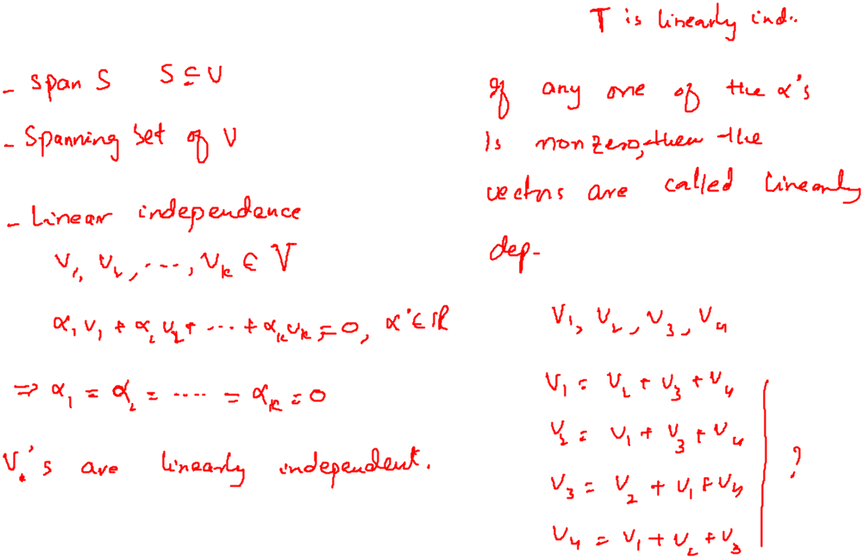
Recalling Previous Lecture

Slide 3
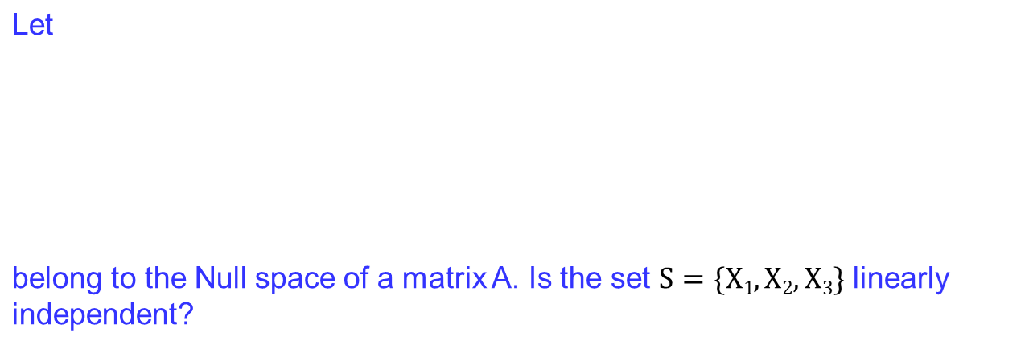
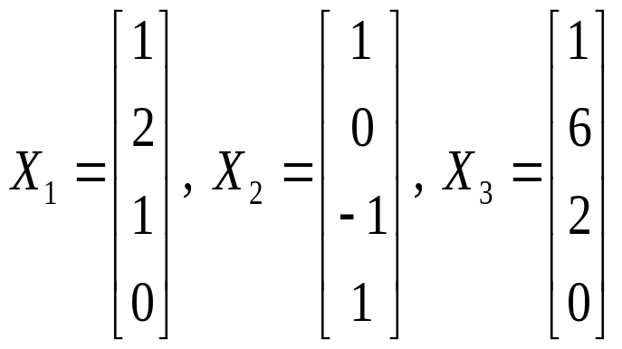
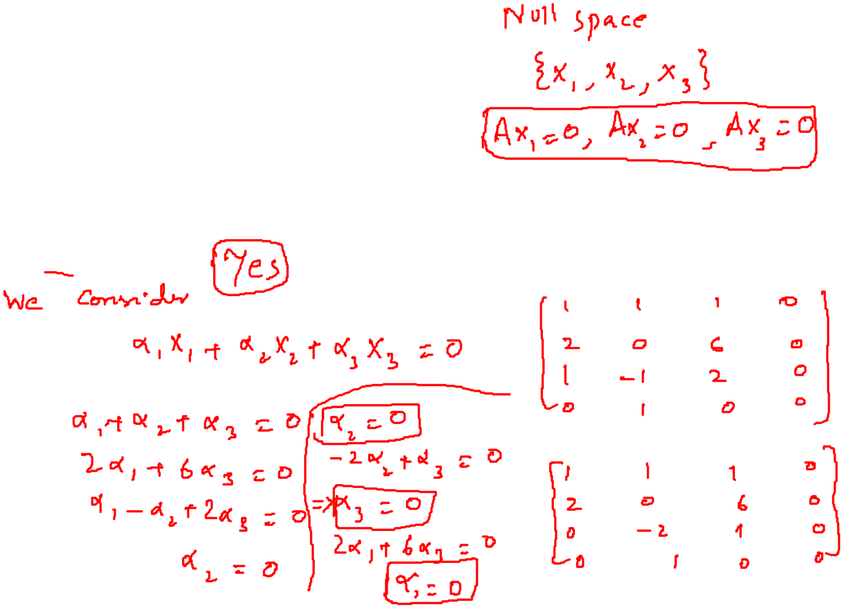
Examples

Slide 4
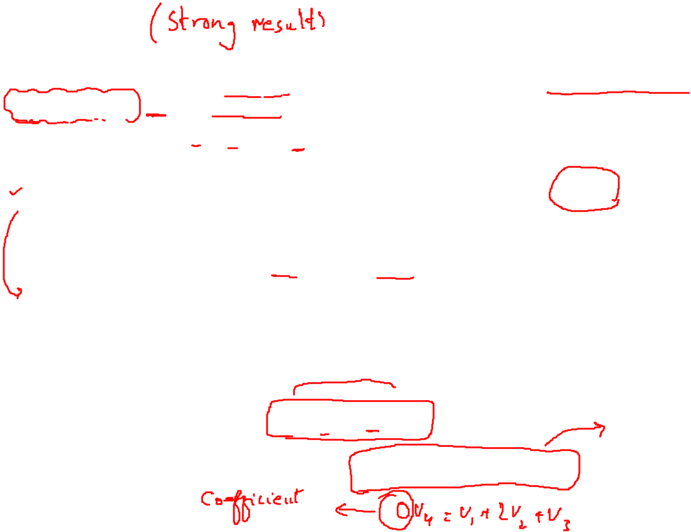
Theorem
The nonzero vectors v₁, v₂, …, v_{j} in a vector space V are linearly dependent if and only if one of the vectors v_{j} (j ≥ 2) is a linear combination of the preceding vectors v₁, v₂, …, v_{j-1}.
Remarks
1. We observe that the above Theorem does not say that every vector v is a linear combination of the preceding vectors.
2. Observe that if v₁, v₂, …, v_{j} are linearly independent vectors in a vector
space, then they must be distinct and nonzero.
Example
Let V=R³ and also v₁=[1 2 -1], v₂=[1 -2 1], v₃=[-3 2 -1] and
v₄=[2 0 0].
We observe that v₁ + v₂ + 0v₃ – v₄ =0.
So these vectors are linearly dependent. We then have
v₁ + v₂ + 0v₃ = v₄
How about writing these vectors as v₁ + 2v₂ + v₃ + 0v₄ = 0?

Slide 5
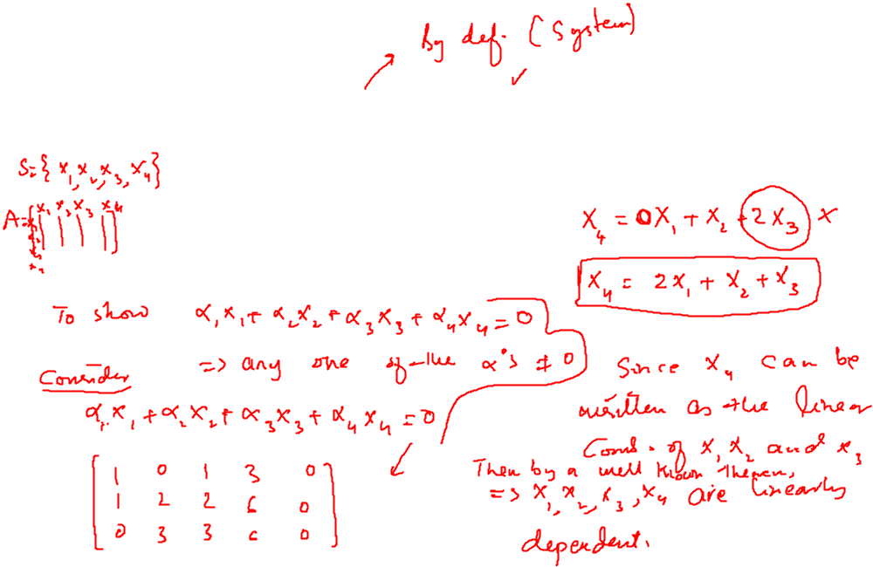
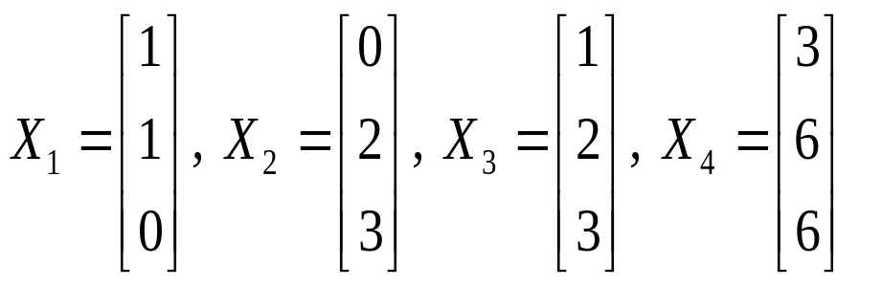
Examples
Check if the following vectors are linearly dependent? For those which are, express one vector as a linear combination of others.

Slide 6
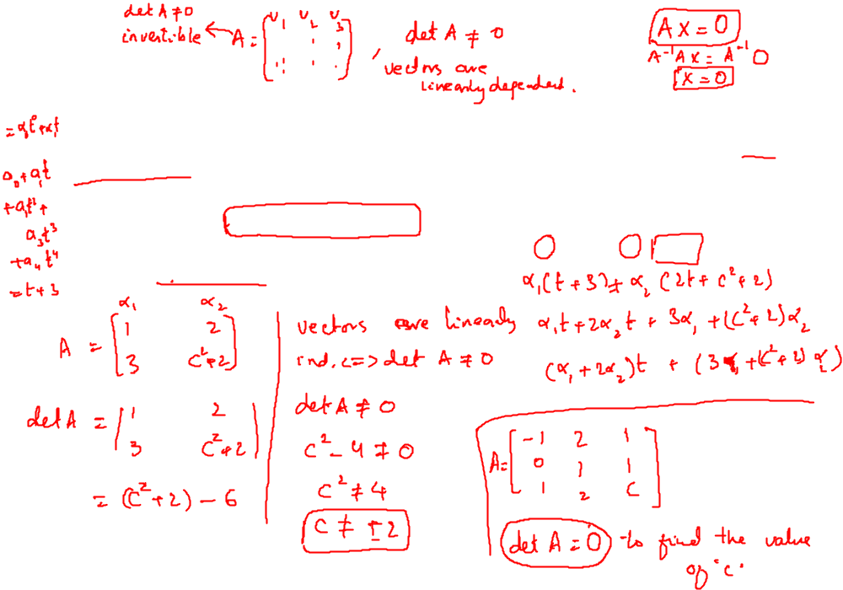

Theorem
Let S = v₁, v₂, v₃, …, v_{n} be a set of n vectors in R" (Rn). Let A be the matrix whose columns (rows) are the elements of S. Then S is linearly independent if and only if det(A) ≠0.
Example: For what values of ‘c’ , are the vectors [-1 0 1], [2 1 2] and
[1 1 c] in R³ linearly dependent?
Example: For what values of ‘c’ , are the vectors t+3 and 2t+c²+2 in P₄ are linearly independent?

Slide 7
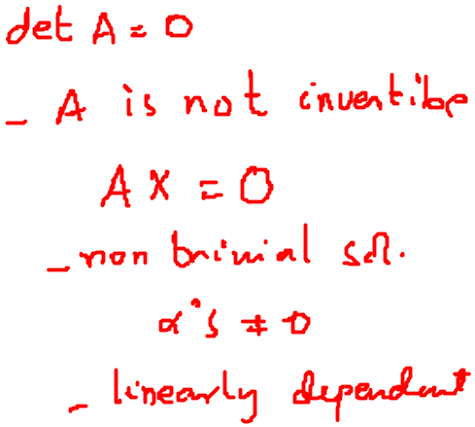
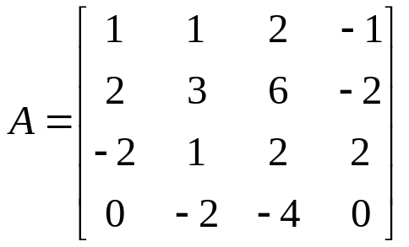
Examples
1. Find a set of vectors spanning the null space of
2. Do the polynomials
p(t)= t³+2t+1, q(t)= t²-t+2, r(t)= t³+2, s(t)= -t³+t²-5t+2
span P₃? Show the complete working.
3. Check if the following vectors are linearly dependent? For those which are, express one vector as a linear combination of others.
p(t)= 2t² + t + 1, q(t)= 3t² + t - 5, r(t)= t + 13

