Slide 1

 | National University of Sciences & Technology (NUST) School of Electrical Engineering and Computer Science (SEECS) Department of Basic Sciences
Linear Algebra & Ordinary Differential Equations
MATH-121
Lecture # 15
Course Instructor: Dr Saira Zainab
Ph. # 03325193283
Email: saira.zainab@seecs.edu.pk
Office # 207, Faculty Block, SEECS
1

Slide 2
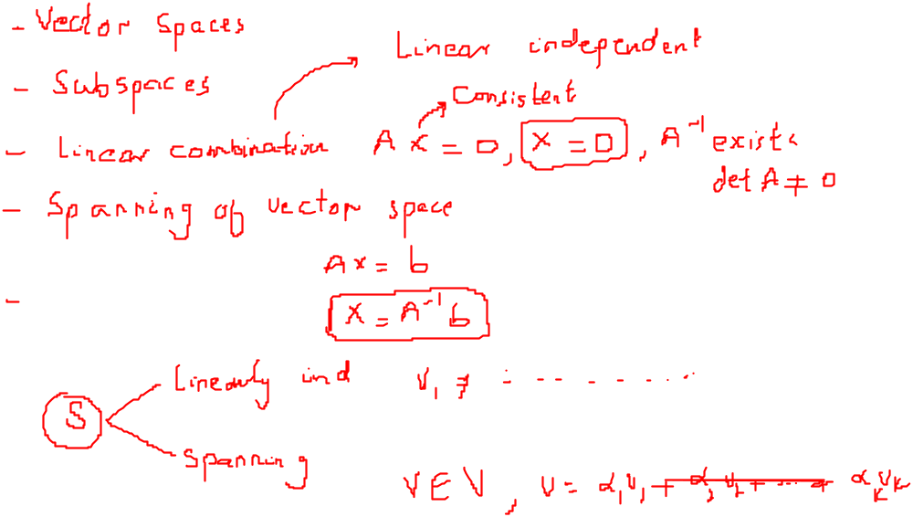
Recalling Previous Lecture

Slide 3
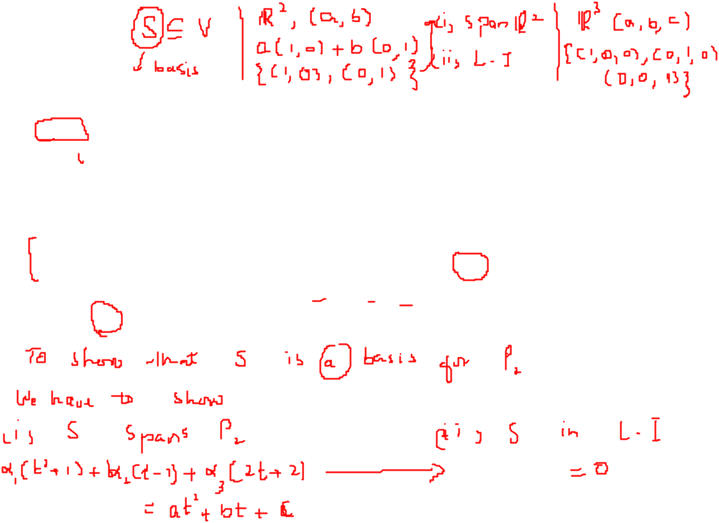
Basis
Definition: The vectors v₁, v₂, …, v_{k} in a vector space V are said to form a basis for V if
These vectors
span V and b) are linearly independent.
Remarks: If v₁, v₂, …, v_{k} form a basis for a vector space V, the they must be distinct and nonzero.
Example: The set of vectors {t^{n},t^{n-1},…t²,t,1} forms a basis for the vector space Pn called the natural or standard basis, for Pn.
Example: Show that the set S={ t²+1, t-1, 2t+2} is a basis for the vector space P₂.

Slide 4
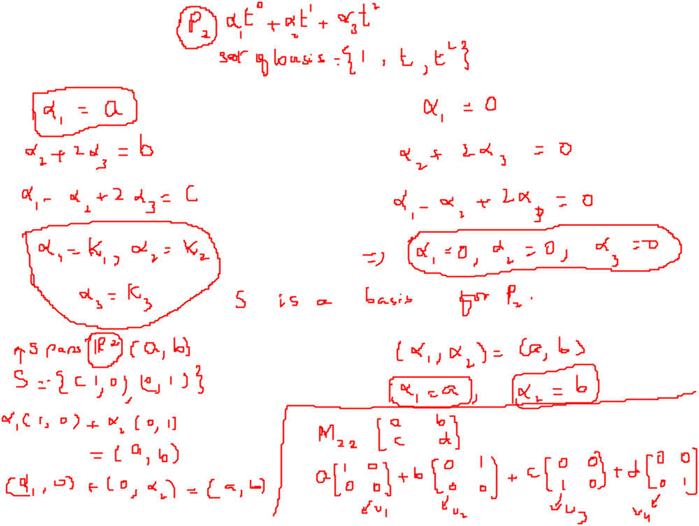

Example

Slide 5
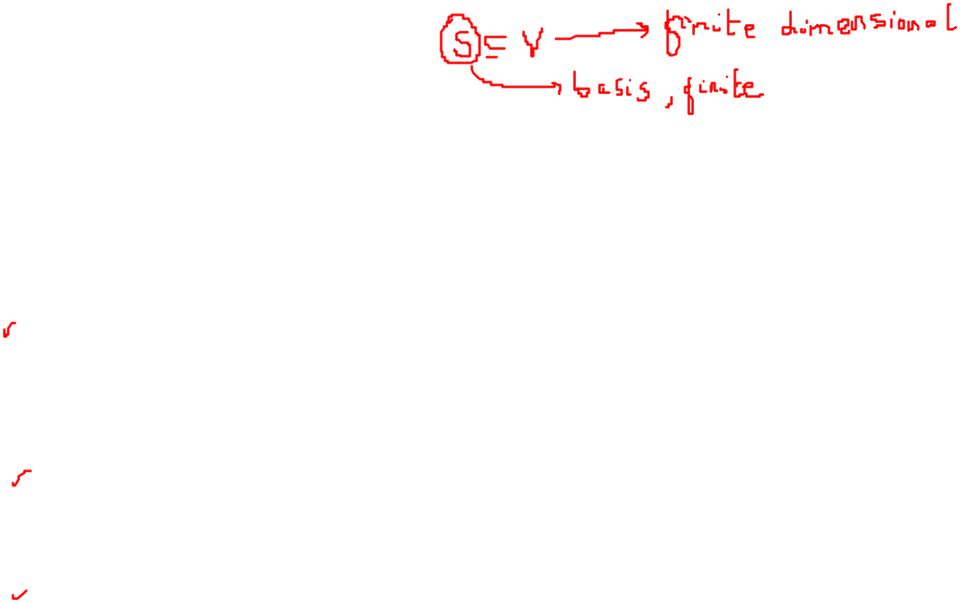
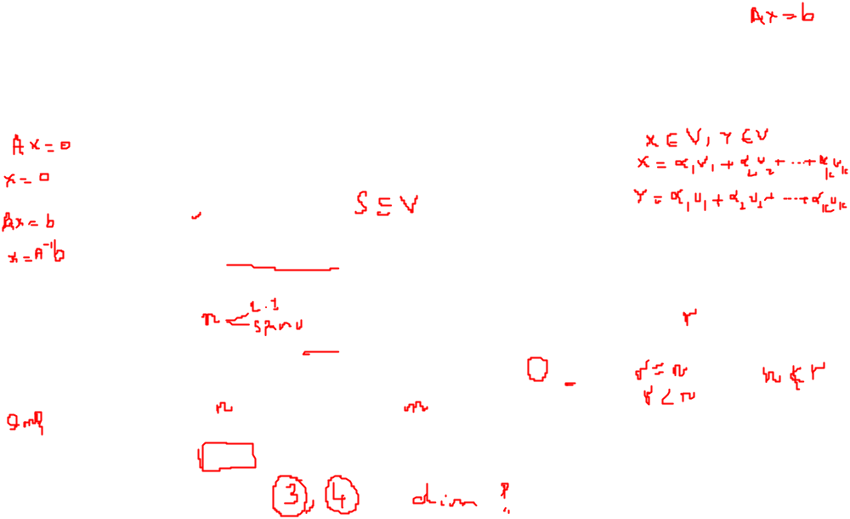
More about basis
Remark:
A vector space V is called finite dimensional if there is a finite subset of V that is a basis for V. If there is no such finite subset of V, then V is called infinite dimensional.
The basis for a non zero vector space is not unique.
Theorem:
If S= { v₁, v₂, …, v_{n}} is a set of nonzero vectors in a vector space V, then S is a basis for V if and only if every vector in V can be written in one and only one way as a linear combination of the vectors in S.
Theorem:
If S= { v₁, v₂, …, v_{n}} is a basis for a vector space V and T= { w₁, w₂, …, w_{r}} is a linearly independent set of vectors in V, then r ≤ n.
Corollary:
If S= { v₁, v₂, …, v_{n}} and T= { w₁, w₂, …, w_{m}} are two basis for a vector space V, then n=m.

Slide 6
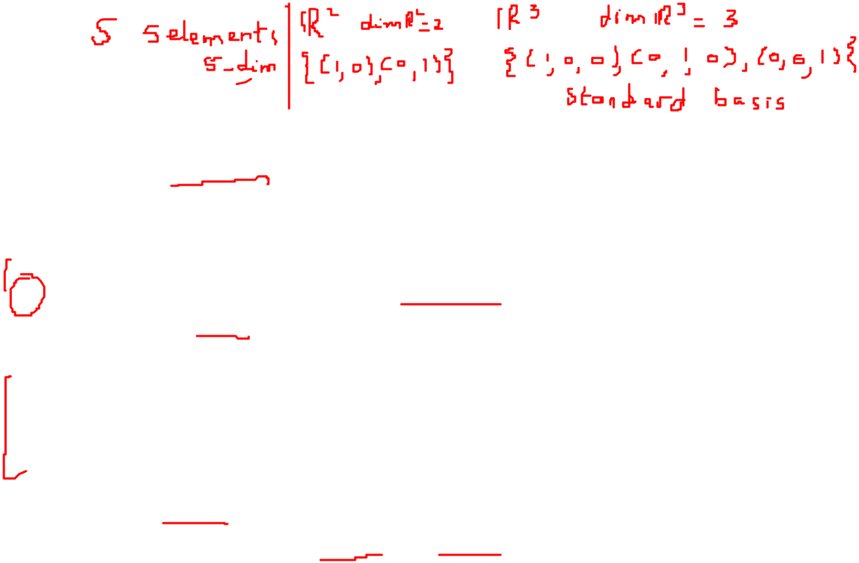
Dimension
Definition: The dimension of a nonzero vector space V is the number of vectors in a basis for V. We often write dim V for the dimension of V.
Facts:
We also define the dimension of the trivial vector space {0} to be zero.
A vector space V is called finite-dimensional if there is a finite subset of V that is a basis for V. If there is no such finite subset of V, then V is called infinite-dimensional.
If vector space V has dimension n, then any subset of m > n vectors must be linearly dependent.
If vector space V has dimension n, then any subset of m < n vectors cannot span v.
If W is a subspace of a finite-dimensional vector space V, then W is finite-dimensional and dim W ≤ dim V.

Slide 7
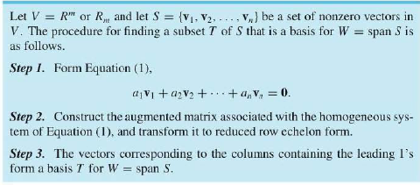
How to find basis from given set of vectors

Slide 8
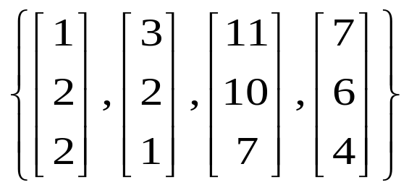
Examples
Find a basis for the subspace W of R³ spanned by
What is the dimension of W.

Slide 9
Examples

Slide 10

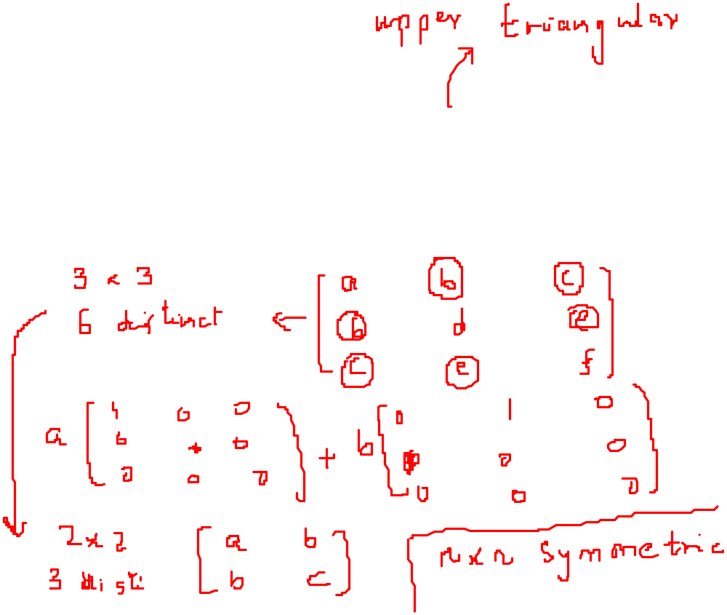
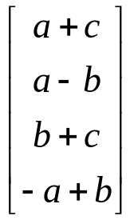
Examples
Find all values of ‘a’ for which
is a basis for R3.
2. Find a basis for the subspace W of M33 consisting of all symmetric matrices.
3. Find a basis for the subspace W of R⁴ consisting of all vectors of the form

