Slide 1

 | National University of Sciences & Technology (NUST) School of Electrical Engineering and Computer Science (SEECS) Department of Basic Sciences
Linear Algebra & Ordinary Differential Equations
MATH-121
Lecture # 17
Course Instructor: Dr Saira Zainab
Ph. # 03325193283
Email: saira.zainab@seecs.edu.pk
Office # 207, Faculty Block, SEECS
1

Slide 2
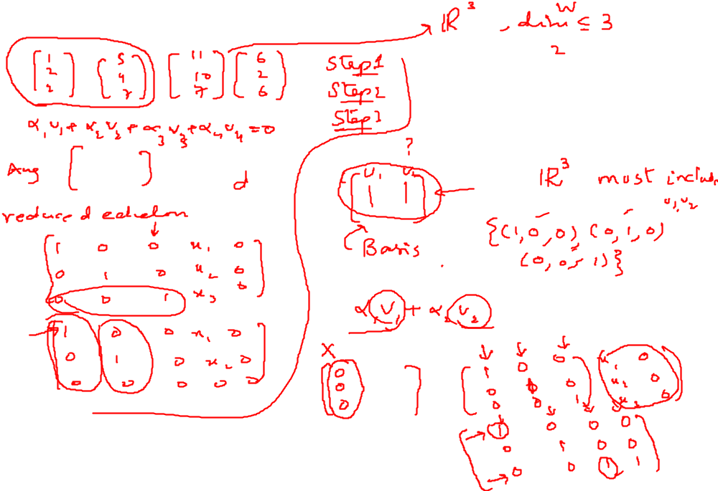
Recalling Previous Lecture

Slide 3
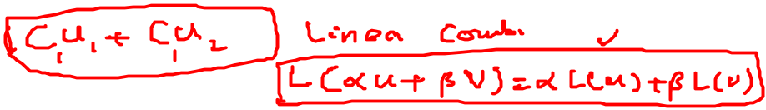
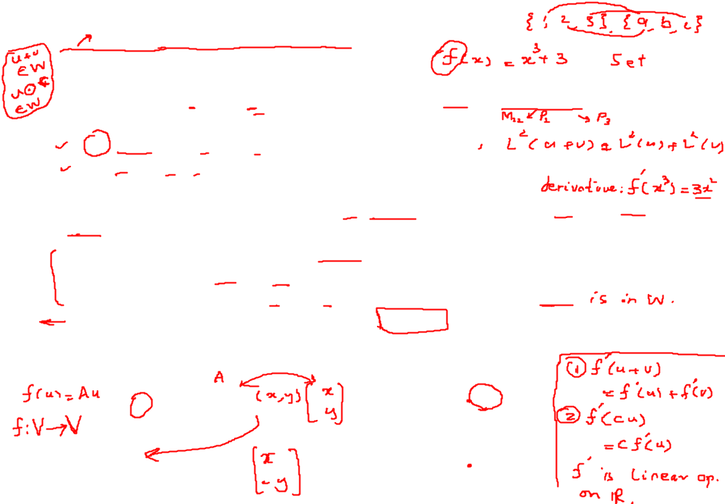
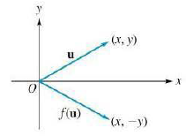
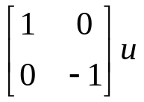

Linear Transformations
Definition: Let V and W be vector spaces. A function L : V →W is called a linear transformation of V into W if
(a) L(u + v) = L (u) + L(v) for every u and v in V.
(b) L(cu) = cL(u) for any u in V, and c any real number.
If V = W, the linear transformation L: V → V is also called a linear operator
on V.
Remarks: The operation + in u + v refers to the addition operation in V, whereas the + in L (u) + L(v) refers to the addition operation in W. Similarly, in (b) the scalar product cu is in V. while the scalar product cL(u).
Example: Every Matrix Transformation f(u)=Au is a linear transformation.
Let f: R² →R² be the matrix transformation called reflection with respect to the x-axis in R², defined by
f(u)=
If u= , then f(u)=?

Slide 4
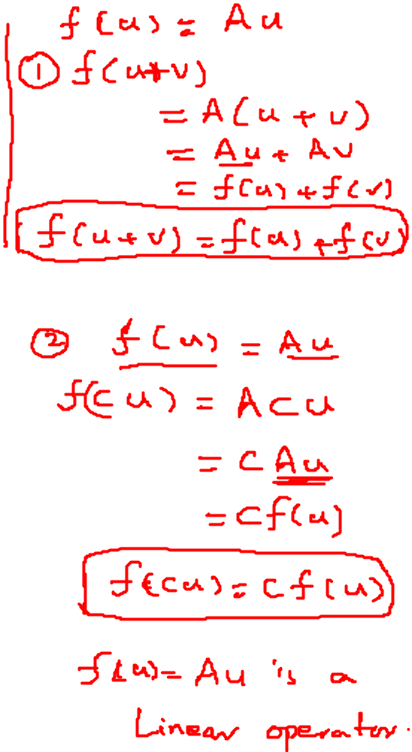

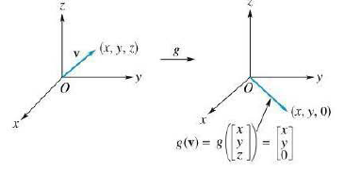
Example
Example: Matrix Transformation
Let f: R³ →R³ be the matrix transformation called dilation or contraction depending upon the value of scalar, defined by
where r is any real number. If r > 1, then f is called dilation; if 0 < r < 1, then contraction.

Slide 5
More about Linear Transformation
Theorem:
Let L: V→W be a linear transformation. Then
(a). L(0v)= 0w.
(b). L(u-v)=L(u)-L(v), for u,v in V.
Theorem:
Let L: V→W be a linear transformation of an n-dimensional vector space V into a vector space W. Let S={v₁, v₂,…, v_{n}} be a basis for V. If v is any vector in V, then L(v) is completely determined by { L(v₁), L(v₂),…, L(v_{n})}.
Remark:
This Theorem can also be stated in the following useful form:
Let L: V→W and L' : V→W be linear transformations of the n-dimensional vector space V into a vector space W. Let S={v₁, v₂,…, v_{n}} be a basis for V. If L' (v_{i}) = L(v_{i}) for i = 1,2, ..... n, then L' (v) = L(v) for every v in V; that is. if Land L' agree on a basis for V, then L and L' are identical linear transformations.

Slide 6
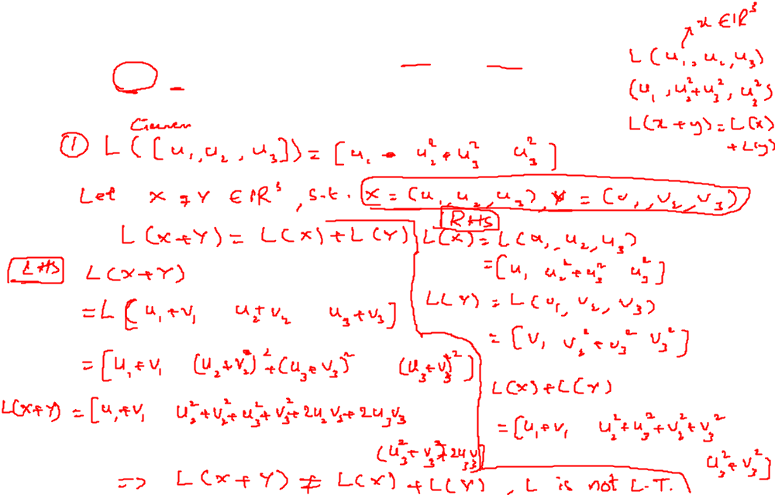

Examples
Which of the following functions are linear transformations:
L: R³ →R³ defined by

Slide 7
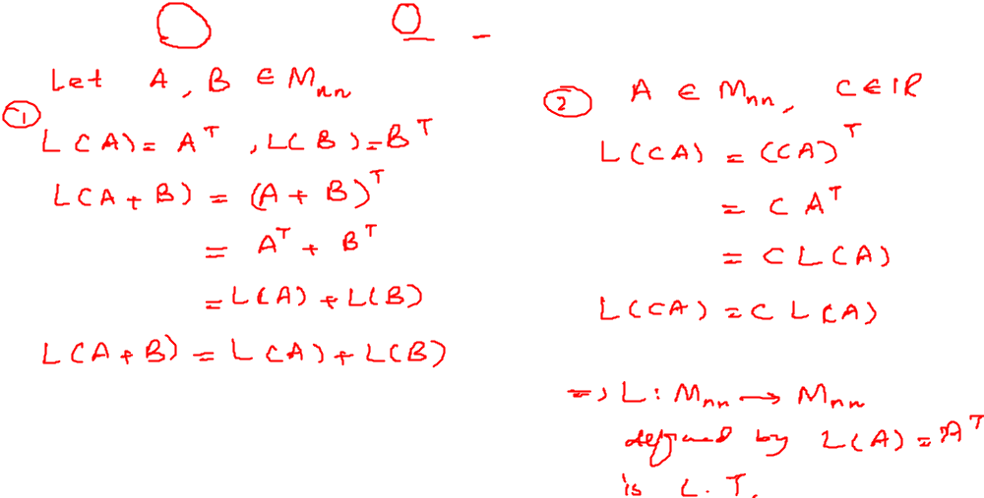
Examples
Which of the following functions are linear transformations:
L: M_{nn} →M_{nn} defined by L(A)=A^{T}.

Slide 8
Examples
Which of the following functions are linear transformations:
L: P₂ →P₃ defined by L(p(t))=t³p'(0)+t²p(0).

Slide 9
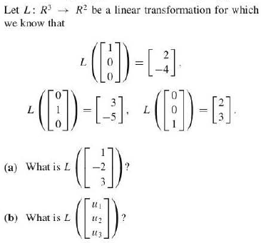
Examples

Slide 10
Examples
Let A be a fixed 3 x 3 matrix; also let L: M₃₃ →M₃₃ be defined by
L(X) = AX - AX, for X in M₃₃.
Show that L is linear transformation.

