Slide 1

 | National University of Sciences & Technology (NUST) School of Electrical Engineering and Computer Science (SEECS) Department of Basic Sciences
Linear Algebra & Ordinary Differential Equations
MATH-121
Lecture # 18
Course Instructor: Dr Saira Zainab
Ph. # 03325193283
Email: saira.zainab@seecs.edu.pk
Office # 207, Faculty Block, SEECS
1

Slide 2
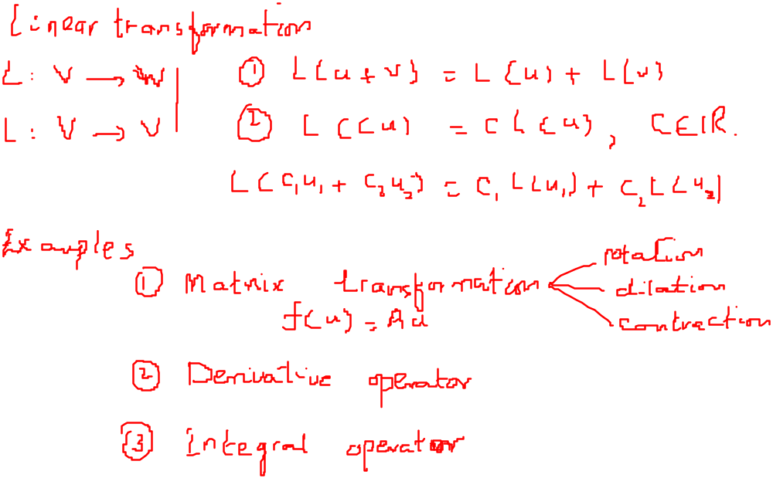
Recalling Previous Lecture

Slide 3
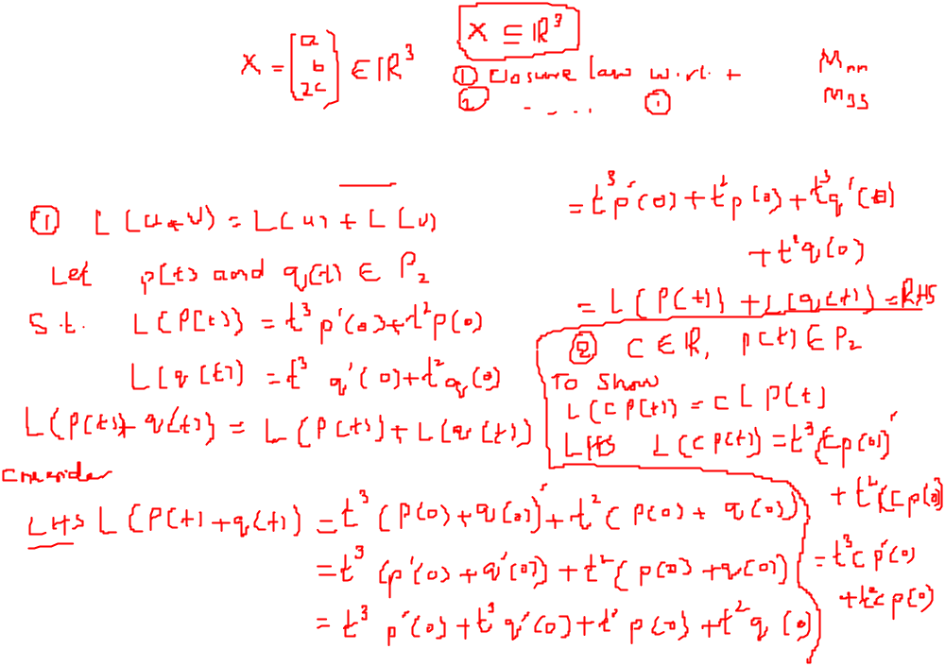
Examples
Which of the following functions are linear transformations:
L: P₂ →P₃ defined by L(p(t))=t³p'(0)+t²p(0).

Slide 4
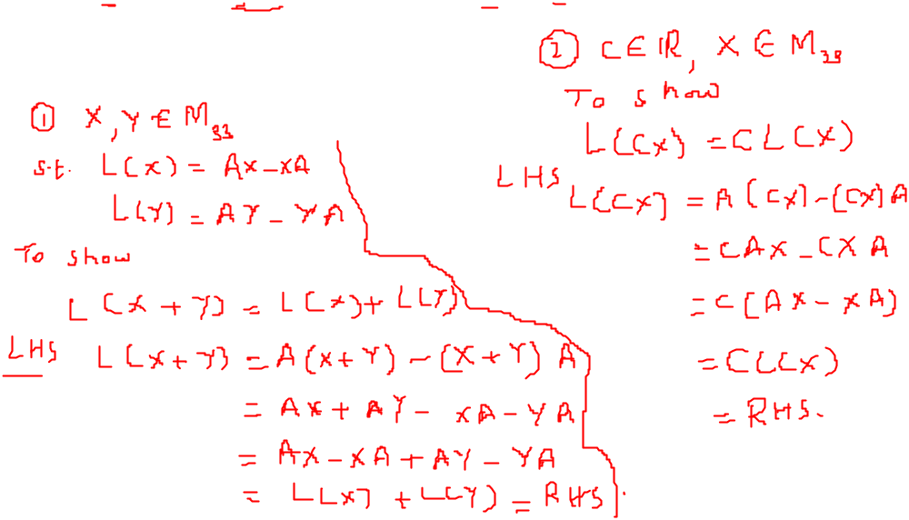
Examples
Let A be a fixed 3 x 3 matrix; also let L: M₃₃ →M₃₃ be defined by
L(X) = AX - XA, for X in M₃₃.
Show that L is linear transformation.

Slide 5
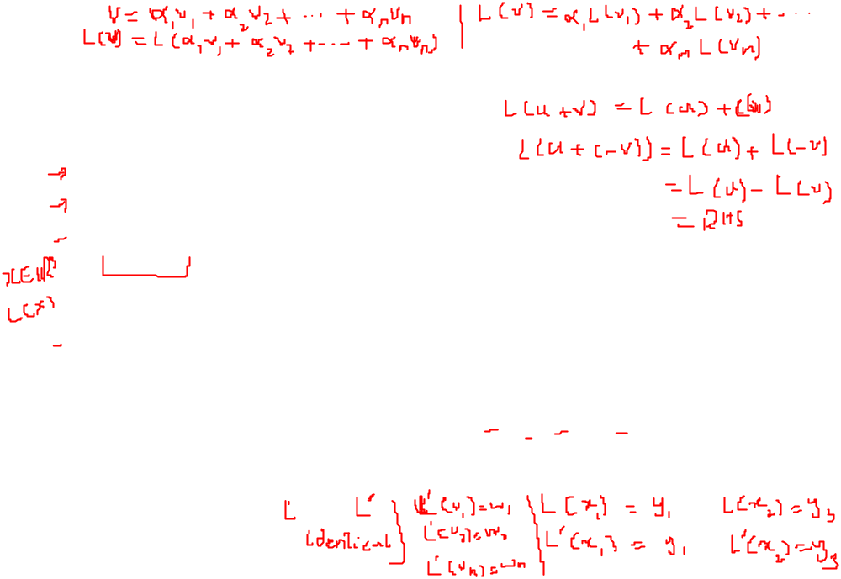
More about Linear Transformation
Theorem:
Let L: V→W be a linear transformation. Then
(a). L(0v)= 0w.
(b). L(u-v)=L(u)-L(v), for u,v in V.
Theorem:
Let L: V→W be a linear transformation of an n-dimensional vector space V into a vector space W. Let S={v₁, v₂,…, v_{n}} be a basis for V. If v is any vector in V, then L(v) is completely determined by { L(v₁), L(v₂),…, L(v_{n})}.
Remark:
This Theorem can also be stated in the following useful form:
Let L: V→W and L' : V→W be linear transformations of the n-dimensional vector space V into a vector space W. Let S={v₁, v₂,…, v_{n}} be a basis for V. If L' (v_{i}) = L(v_{i}) for i = 1,2, ..... n, then L' (v) = L(v) for every v in V; that is. if Land L' agree on a basis for V, then L and L' are identical linear transformations.

Slide 6
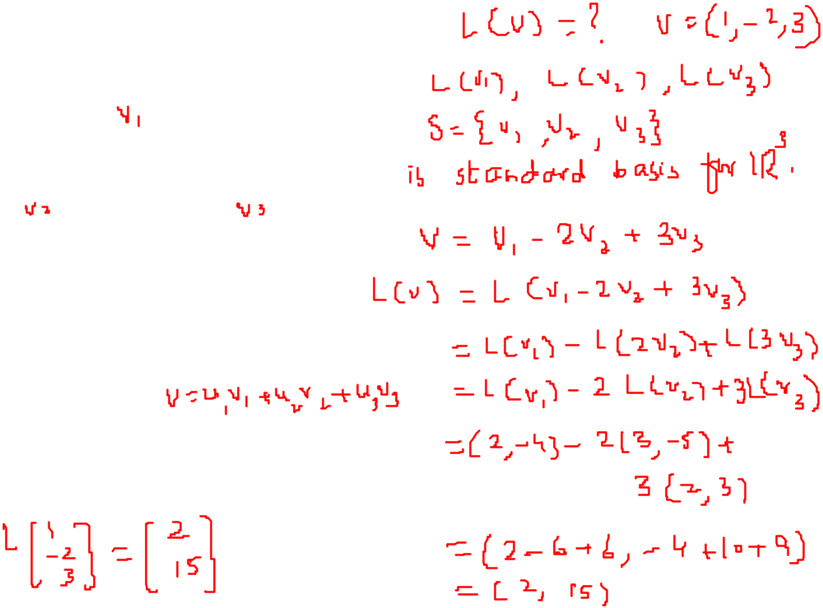
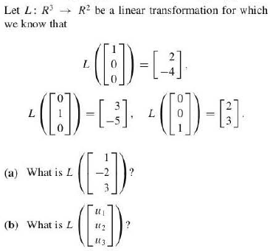
Examples

Slide 7
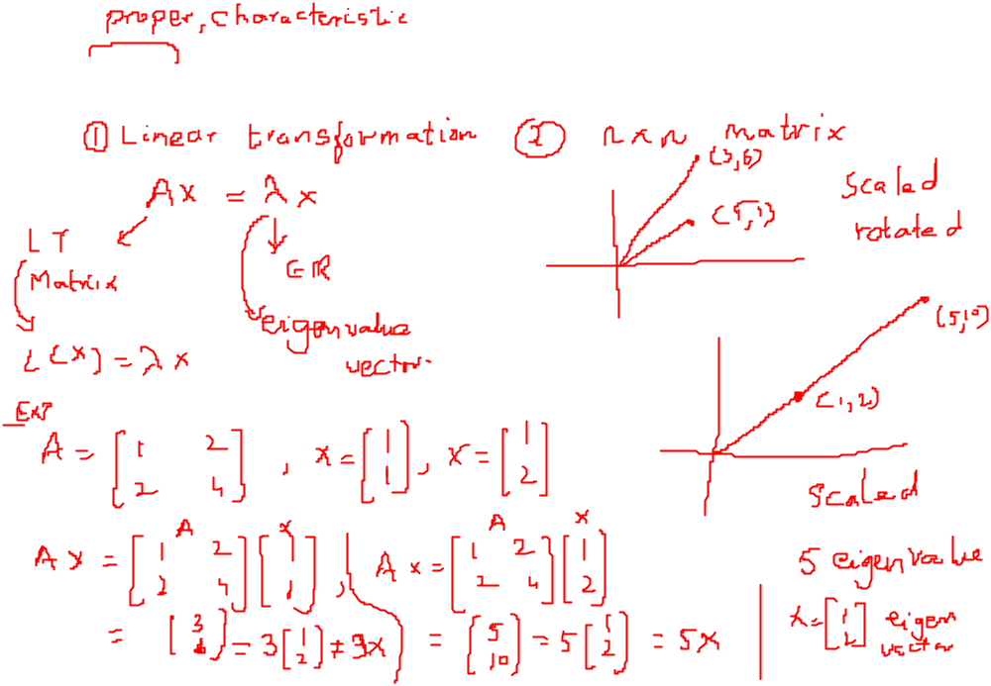
Eigenvalues and Eigenvectors

Slide 8
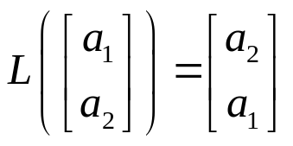
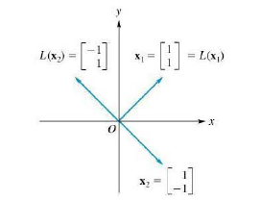
Eigenvalues and Eigenvectors
For a Linear Transformation
Definition: Let L: V→V be a linear transformation of an n-dimensional vector space V into itself. The number λ is called an eigenvalue of L if there exists a nonzero vector x in V such that
L(x)= λx.
Every nonzero vector x satisfying this equation is then called eigenvector of L associated with the eigenvalue λ.
Remark: The number λ can be real or complex and the vector x can have real or complex components.
Example: Let L: R²→R² be the linear operator defined by

Slide 9


Eigenvalues and Eigenvectors
For an n x n matrix
Definition: If A is an n x n matrix, we can consider the linear operator
I: R^{n}→R^{n}(C^{n} →C^{n})
defined by L(x)=Ax, for x in R^{n}(C^{n}).
If λ is a scalar(real or complex) and x≠0 a vector in R^{n}(C^{n})such that
Ax= λx.
Then we say that λ is an eigenvalue of A and x is an eigenvector of A associated with λ.
Some relevant definitions are
Characteristic Polynomial
Characteristic Equation
Theorem: Let A be an n x n matrix. The eigenvalues of A are the roots of the characteristic polynomial of A.

Slide 10
Eigenvalues and Eigenvectors

Slide 11
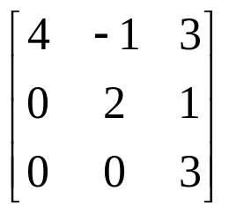
Examples
Find the characteristic polynomial of the following matrix.

Slide 12
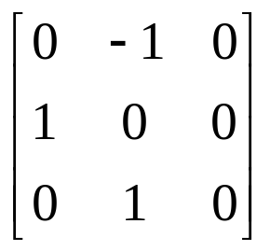
Examples
Find the eigenvalues and eigenvectors of the following matrix.

