Slide 1

 | National University of Sciences & Technology (NUST) School of Electrical Engineering and Computer Science (SEECS) Department of Basic Sciences
Linear Algebra & Ordinary Differential Equations
MATH-121
Lecture # 19
Course Instructor: Dr Saira Zainab
Ph. # 03325193283
Email: saira.zainab@seecs.edu.pk
Office # 207, Faculty Block, SEECS
1

Slide 2
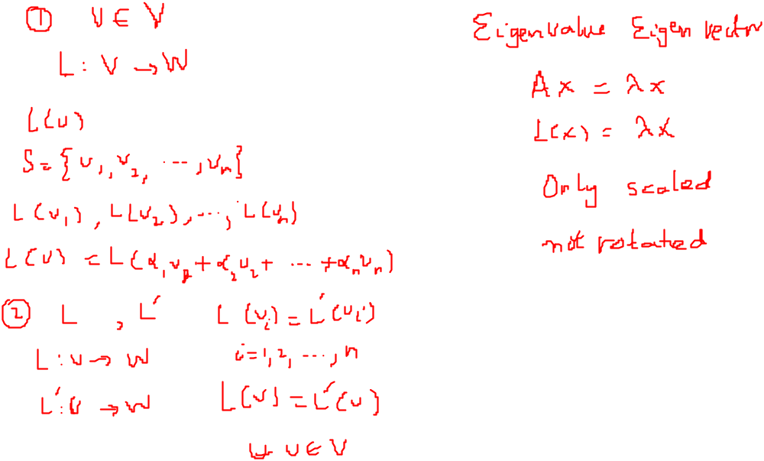
Recalling Previous Lecture

Slide 3
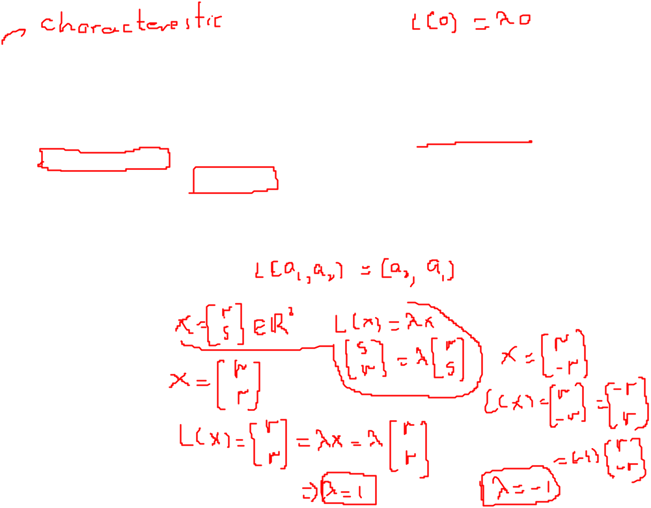
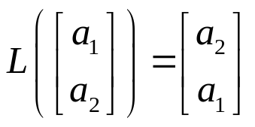
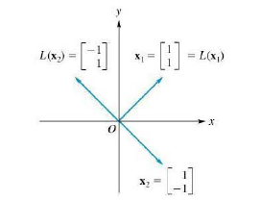
Eigenvalues and Eigenvectors
For a Linear Transformation
Definition: Let L: V→V be a linear transformation of an n-dimensional vector space V into itself. The number λ is called an eigenvalue of L if there exists a nonzero vector x in V such that
L(x)= λx.
Every nonzero vector x satisfying this equation is then called eigenvector of L associated with the eigenvalue λ.
Remark: The number λ can be real or complex and the vector x can have real or complex components.
Example: Let L: R²→R² be the linear operator defined by

Slide 4
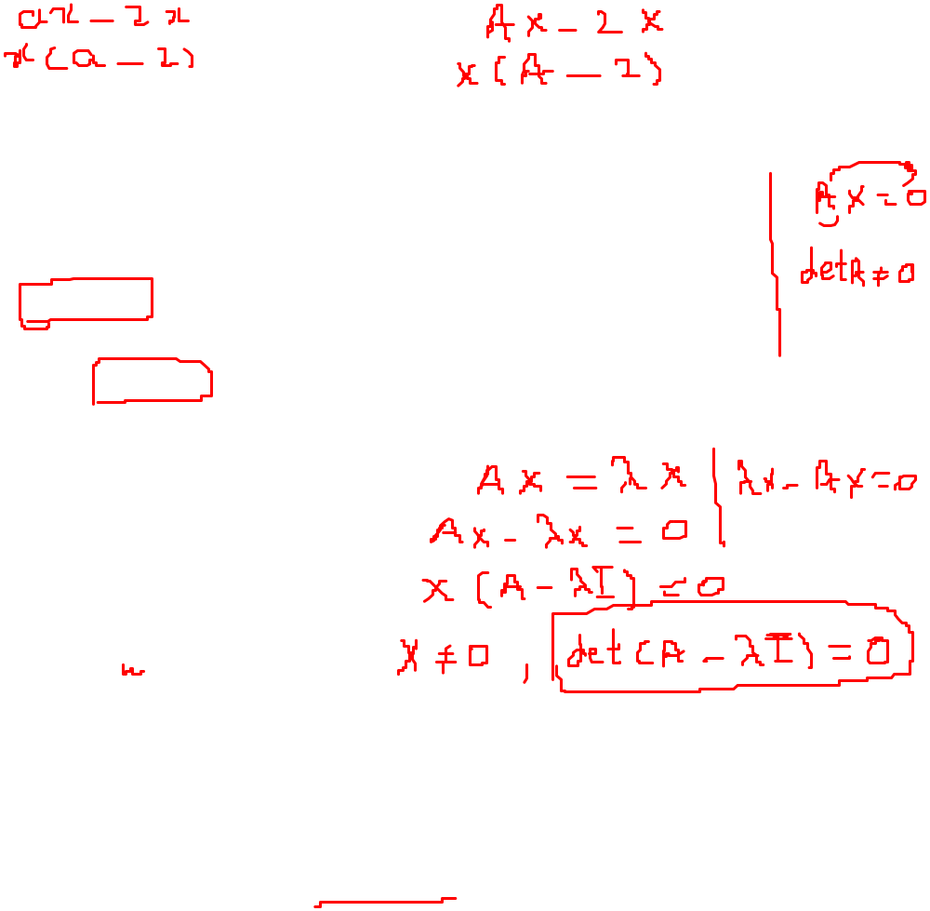


Eigenvalues and Eigenvectors
For an n x n matrix
Definition: If A is an n x n matrix, we can consider the linear operator
L: R^{n}→R^{n}(C^{n} →C^{n})
defined by L(x)=Ax, for x in R^{n}(C^{n}).
If λ is a scalar(real or complex) and x≠0 a vector in R^{n}(C^{n})such that
Ax= λx.
Then we say that λ is an eigenvalue of A and x is an eigenvector of A associated with λ.
Some relevant definitions are
Characteristic Polynomial
Characteristic Equation
Theorem: Let A be an n x n matrix. The eigenvalues of A are the roots of the characteristic polynomial of A.

Slide 5
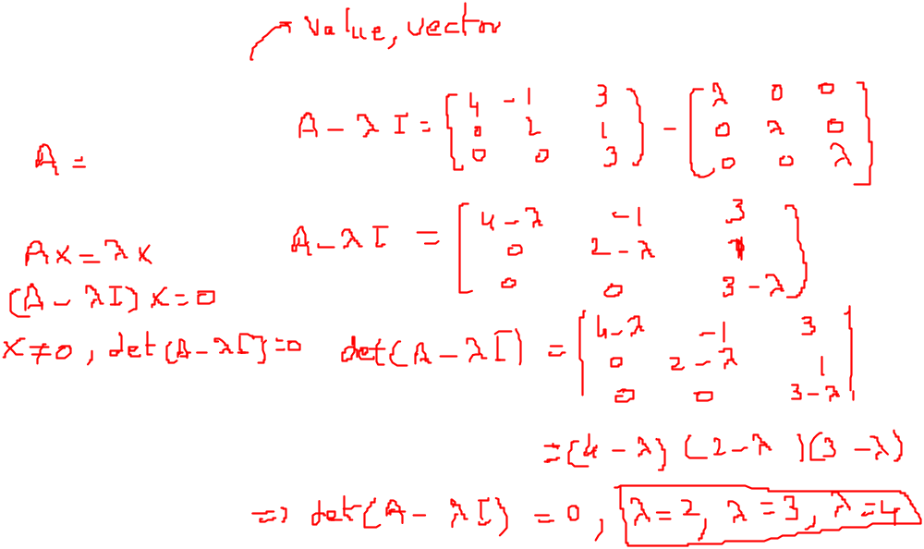
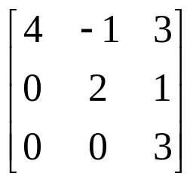
Examples
Find the characteristic polynomial of the following matrix.

Slide 6
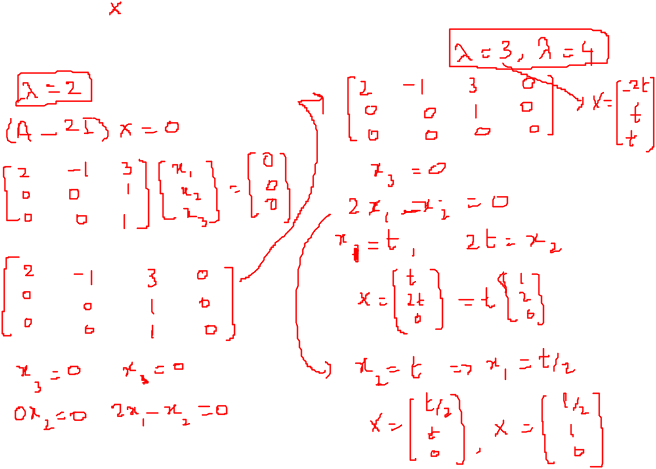
Eigenvalues and Eigenvectors

Slide 7
Eigenvalues and Eigenvectors
Remarks:
1.If x is an eigenvector of L associated with the eigenvalue λ [i.e. L(x)= λx],then
L(rx) = rL(x)=r(λx)= λ(rx)
for any real number r. Thus, if r ≠ 0, then rx is also an eigenvector of L associated with λ so that eigenvectors are never unique.
2. Symmetric matrices have real eigenvalues whereas anti symmetric has imaginary values. The eigenvectors of symmetric matrices are orthogonal.
3. The eigenvalues of the upper(lower) triangle matrix are on the main diagonal of the matrix.
4. The matrix and its transpose have same eigenvalues.
Warning: When finding the eigenvalues and associated eigenvectors of a matrix A, do not make the common mistake of first transforming A to reduced row echelon form B and then finding the eigenvalues and eigenvectors of B.

Slide 8
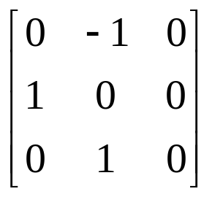
Examples
Find the eigenvalues and eigenvectors of the following matrix.

Slide 9
Eigenvalues and Eigenvectors

Slide 10
More about Eigenvalues and Eigenvectors
Remarks:
1.If matrix A is an eigenvalue λ, then the eigenvalues of A² will be λ², those of A³ will be λ³ and so on, A^{n} will have λ^{n} as its eigenvalues with same eigenvector.
2. If matrix A has eigenvalue λ₁ and matrix B has eigenvalue λ₂, then the matrix AB will have the eigenvalues λ₂ λ₁.
3. In a 2 x 2 matrix, the sum of eigenvalues is equal to the trace whereas the product of eigenvalues is equal to the determinant of the matrix.

