Slide 1

 | National University of Sciences & Technology (NUST) School of Electrical Engineering and Computer Science (SEECS) Department of Basic Sciences
Linear Algebra & Ordinary Differential Equations
MATH-121
Lecture # 2
Course Instructor: Dr Saira Zainab
Ph. # 03325193283
Email: saira.zainab@seecs.edu.pk
Office # 207, Faculty Block, SEECS

Slide 2
Quick overview of Matrices

Slide 3
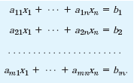
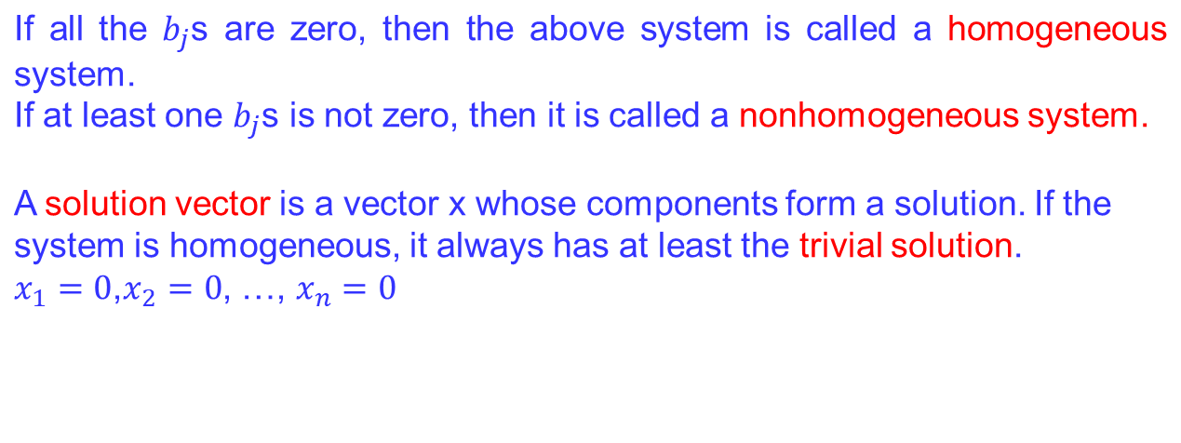
System of Linear Equations
A linear system of m equations in n unknowns is a set of equations of
the form
(1)

Slide 4
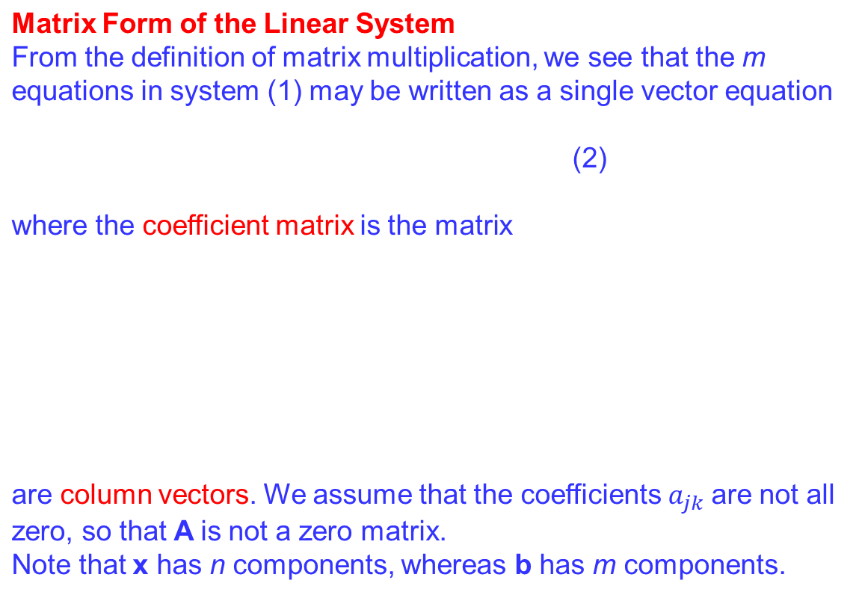
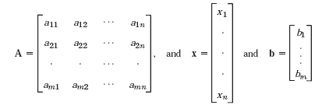
System of Linear Equations

Slide 5
System of Linear Equations

Slide 6
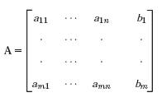
System of Linear Equations
The matrix
is called the augmented matrix of the system (1).
Note that the augmented matrix determines the system (1) completely because it contains all the given numbers appearing in (1).

Slide 7
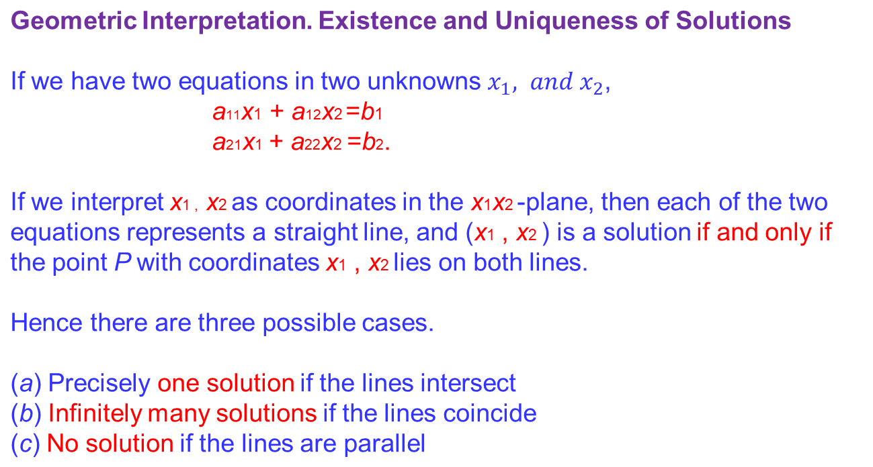
System of Linear Equations

Slide 8
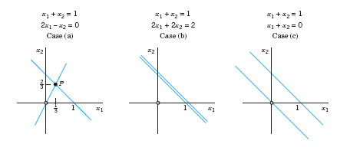
System of Linear Equations
Geometric Interpretation. Existence and Uniqueness of Solutions

Slide 9
Guassian Elimination Method
Procedure:
Gaussian elimination is a method for systematically solving a system of linear equations by progressively working through the equations using elementary row operations to eliminate variables from equations, one at a time eventually ending up with one equation in one unknown, two equations in two unknowns etc.
then solve for all the unknowns by
back substitution

Slide 10
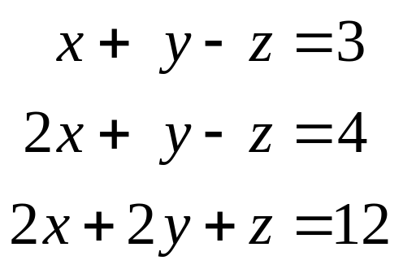
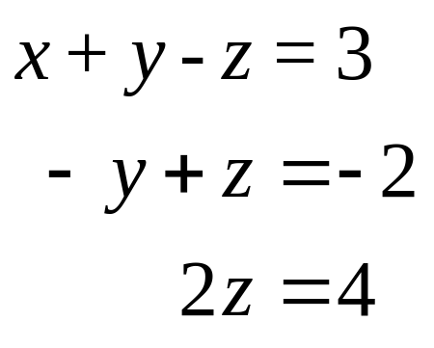
Example
After elimination:

Slide 11
Elementary row operations
Elementary Operations for Equations
Interchange of two equations
Addition of a constant multiple of one equation to another equation
Multiplication of an equation by a nonzero constant c
Elementary Row Operations for Matrices
Interchange of two rows
Addition of a constant multiple of one row to another row
Multiplication of a row by a nonzero constant c
Row-Equivalent Systems
Row-equivalent linear systems have the same set of solutions.

Slide 12
Elementary row operations
A linear system (1) is called over determined if it has more equations than unknowns, determined if m=n, and underdetermined if it has fewer equations than unknowns.
Furthermore, a system (1) is called consistent if it has at least one solution (thus, one solution or infinitely many solutions), but inconsistent if it has no solutions at all, as in Example 1, Case (c).

