Slide 1

 | National University of Sciences & Technology (NUST) School of Electrical Engineering and Computer Science (SEECS) Department of Basic Sciences
Linear Algebra & Ordinary Differential Equations
MATH-121
Lecture # 20
Course Instructor: Dr Saira Zainab
Ph. # 03325193283
Email: saira.zainab@seecs.edu.pk
Office # 207, Faculty Block, SEECS
1

Slide 2
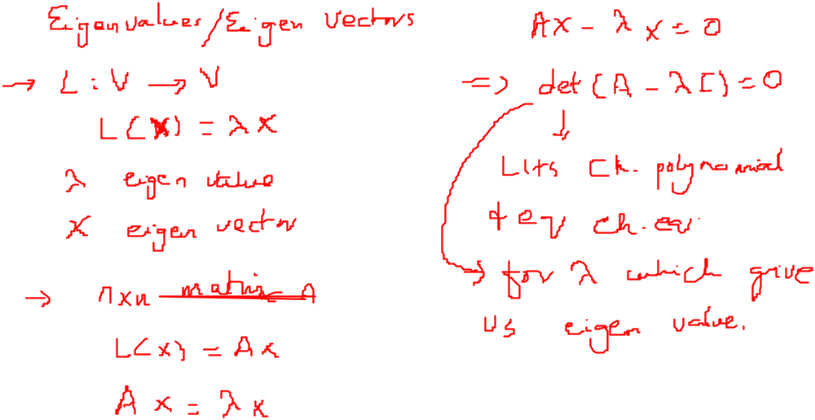
Recalling Previous Lecture

Slide 3
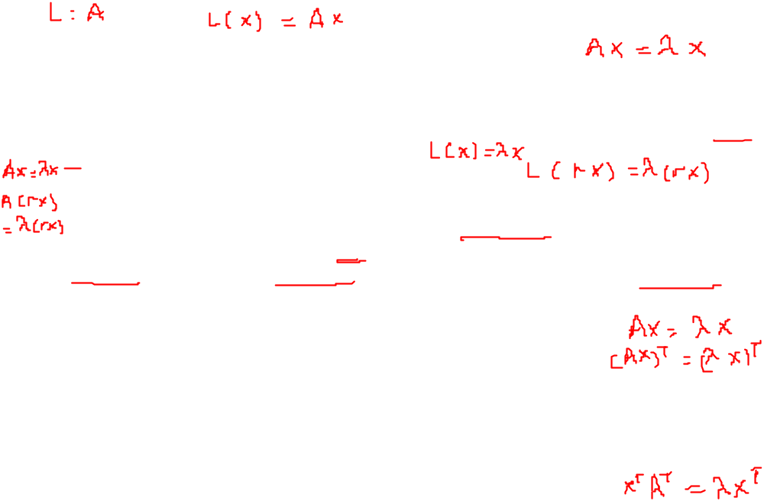
Eigenvalues and Eigenvectors
Remarks:
1.If x is an eigenvector of L associated with the eigenvalue λ [i.e. L(x)= λx],then
L(rx) = rL(x)=r(λx)= λ(rx)
for any real number r. Thus, if r ≠ 0, then rx is also an eigenvector of L associated with λ so that eigenvectors are never unique.
2. Symmetric matrices have real eigenvalues whereas anti symmetric has imaginary values. The eigenvectors of symmetric matrices are orthogonal.
3. The eigenvalues of the upper(lower) triangle matrix are on the main diagonal of the matrix.
4. The matrix and its transpose have same eigenvalues.
Warning: When finding the eigenvalues and associated eigenvectors of a matrix A, do not make the common mistake of first transforming A to reduced row echelon form B and then finding the eigenvalues and eigenvectors of B.

Slide 4
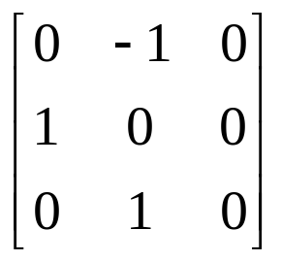
Examples
Find the eigenvalues and eigenvectors of the following matrix.

Slide 5
Eigenvalues and Eigenvectors

Slide 6
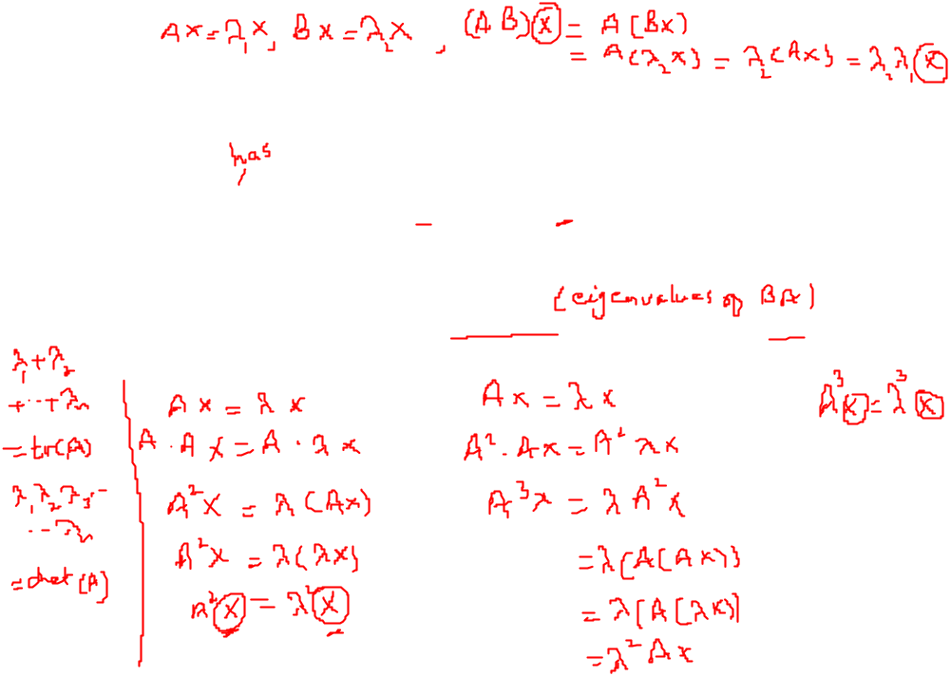
More about Eigenvalues and Eigenvectors
Remarks:
1.If matrix A is an eigenvalue λ, then the eigenvalues of A² will be λ², those of A³ will be λ³ and so on, A^{n} will have λ^{n} as its eigenvalues with same eigenvector.
2. If matrix A has eigenvalue λ₁ and matrix B has eigenvalue λ₂, then the matrix AB will have the eigenvalues λ₂ λ₁.
3. In a 2 x 2 matrix, the sum of eigenvalues is equal to the trace whereas the product of eigenvalues is equal to the determinant of the matrix.

Slide 7
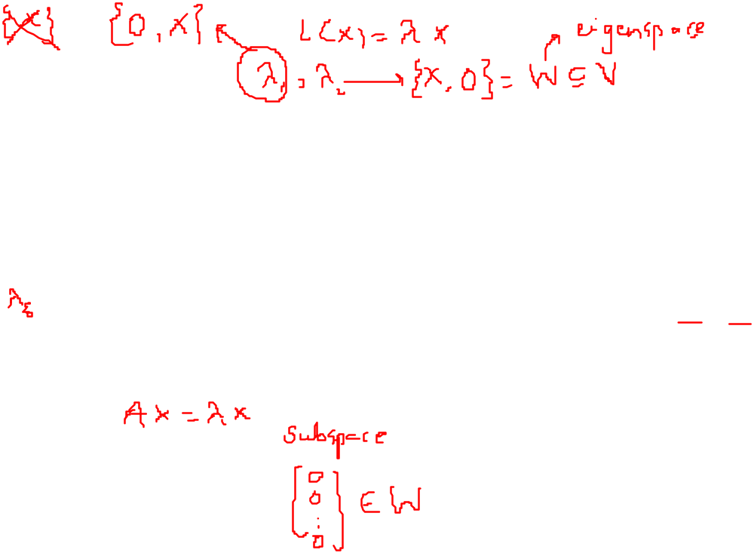
Eigen space
For Linear Transformation
Let L: V → V be a linear operator, where V is an n- dimensional vector space. Let λ be an eigenvalue of L. The subset of V consisting of 0V and all eigenvectors of L associated with λ is a subspace of V. This subspace is called the eigen space associated with λ.
For n x n matrix
Let A be an eigenvalue of the n x n matrix A. The subset of W of R^{n} (C^{n}) consisting of the zero vector and all eigenvectors of A associated with λ is a subspace of R^{n}(C^{n}). This subspace is called the eigen space associated
with λ.

Slide 8
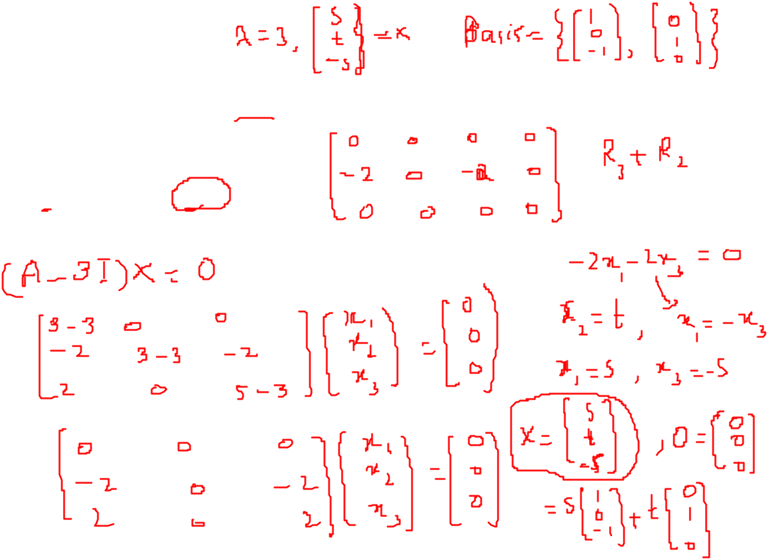
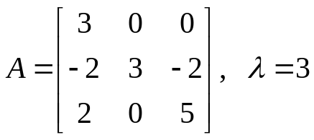

Eigen space
Find the basis for the Eigen space associated with the given eigenvalue given with the matrix.

