Slide 1

 | National University of Sciences & Technology (NUST) School of Electrical Engineering and Computer Science (SEECS) Department of Basic Sciences
Linear Algebra & Ordinary Differential Equations
MATH-121
Lecture # 21
Course Instructor: Dr Saira Zainab
Ph. # 03325193283
Email: saira.zainab@seecs.edu.pk
Office # 207, Faculty Block, SEECS
1

Slide 2
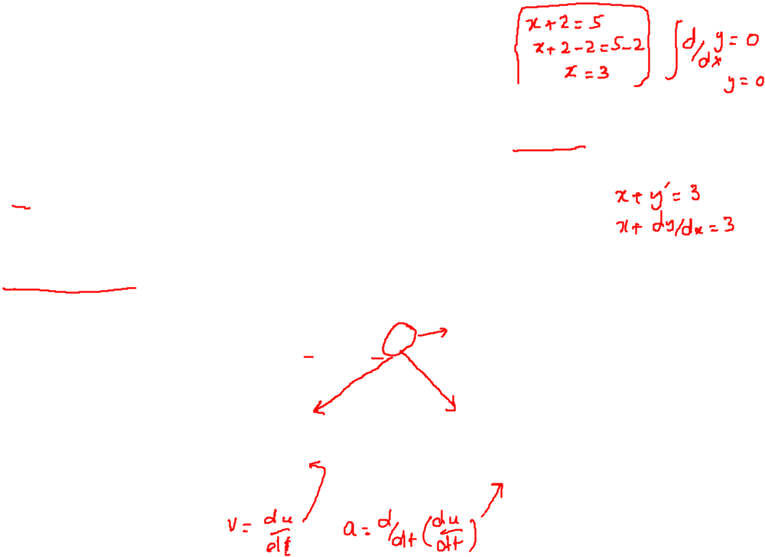

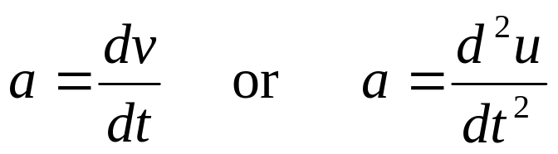
Definitions and Basic Terminology
Definition
An equation containing the derivatives of one or more dependent variables, with respect to one or more independent variables, is said to be a differential equation (DE).
Examples
There is one differential equation that everybody probably knows that is Newton’s 2nd law of motion. If an object of mass m is moving with acceleration a and being acted on with force F, then Newton’s 2nd law tells us
Since, we can write acceleration as

Slide 3
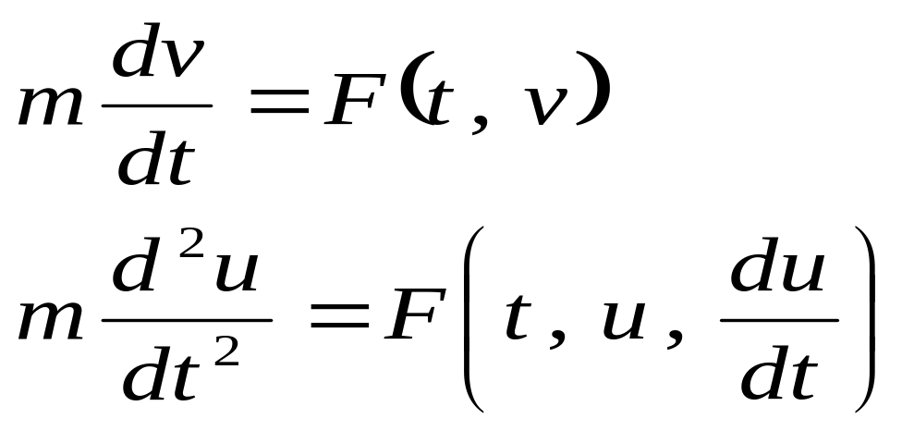
Definitions and Basic Terminology
So, with all these things in mind Newton’s 2nd law can now be written as differential equation in terms of either the velocity v or the position u of the object as follows:
These are actually the differential equations.

Slide 4
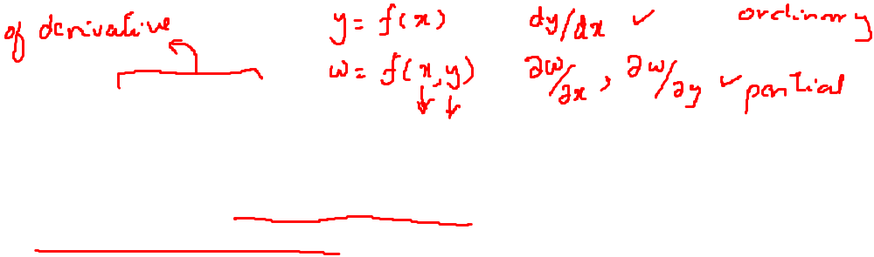
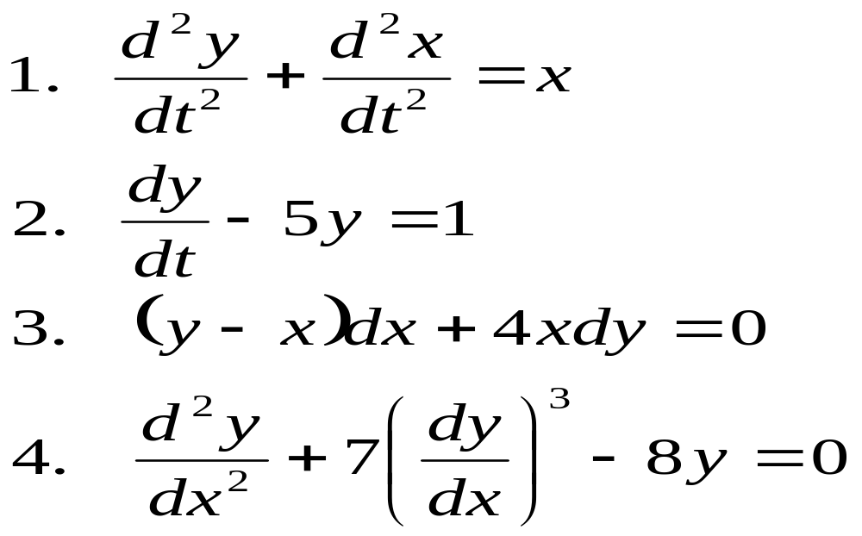
Classification by type
Ordinary differential equation
If an equation contains only ordinary derivatives of one or more variables with respect to a single independent variable, it is said to be an ordinary differential equation (ODE).
Examples

Slide 5
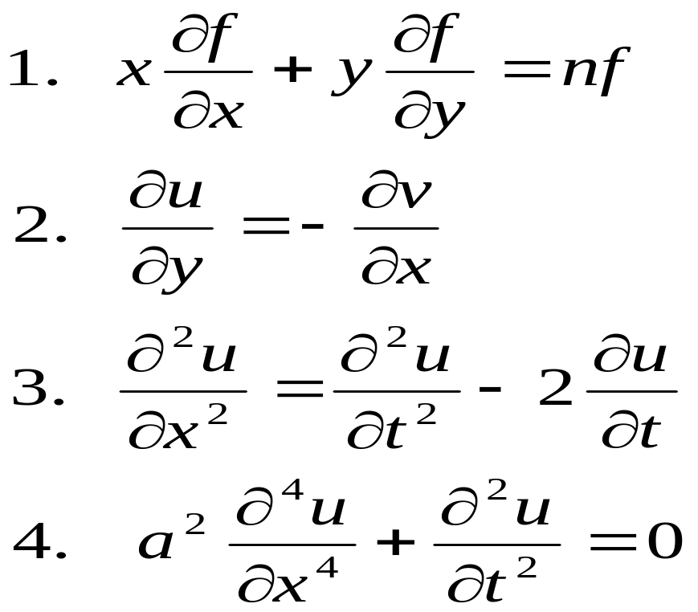
Classification by type
Partial differential equation
An equation involving partial derivatives of one or more dependent variables with respect to two or more independent variables is called a partial differential equation (PDE).
Examples

Slide 6
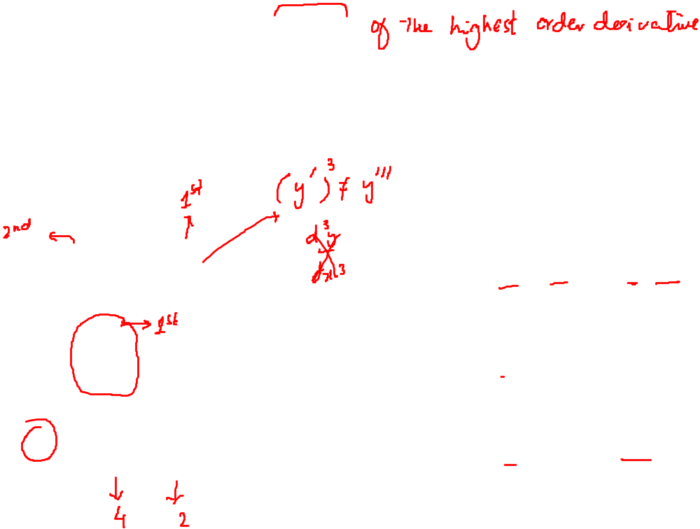
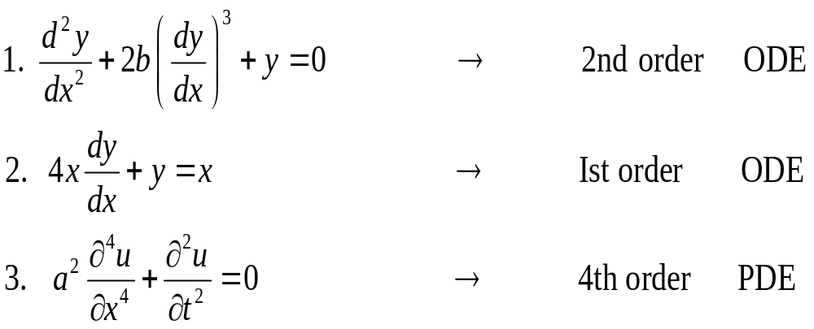
Classification by order
Definition
The order of a differential equation (either ODE or PDE) is the order of the highest derivative in the equation.
Examples

Slide 7
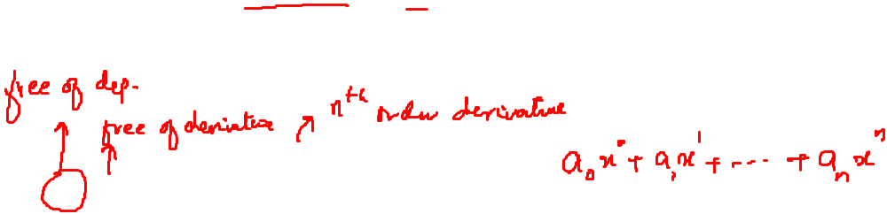
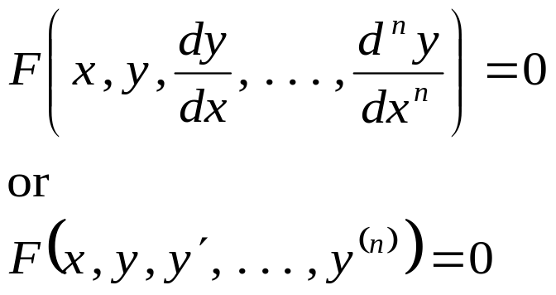
General Form of DE
In symbols, we can express an nth-order ordinary differential equation in one dependent variable by the general form

Slide 8
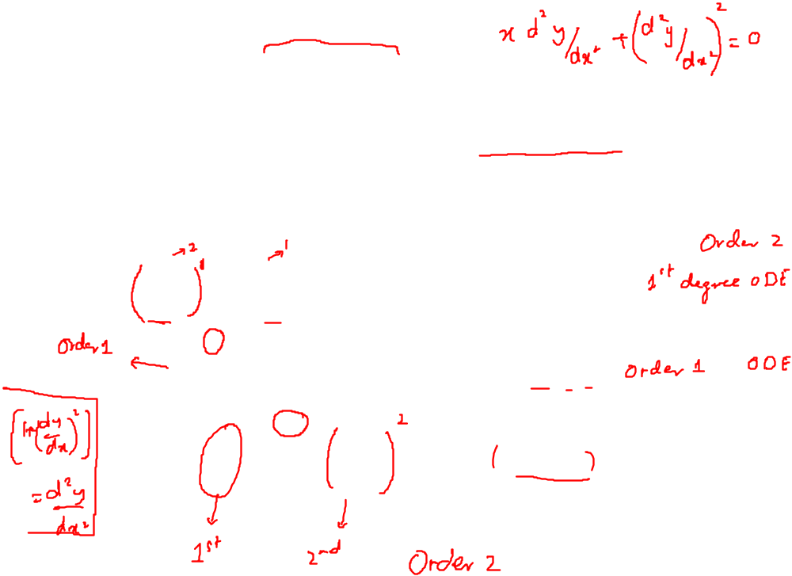
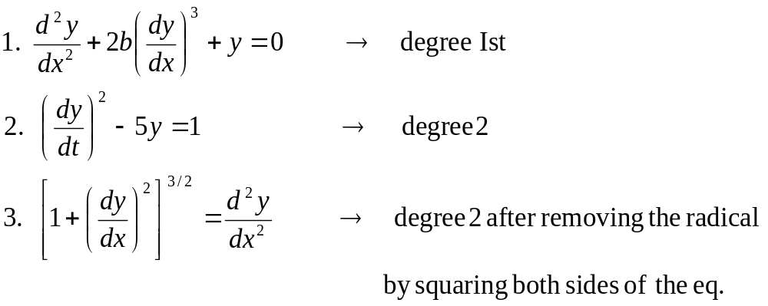
Classification by Degree
Definition
The degree of a differential equation is the greatest exponent of the highest order derivative that appears in the equation. (The dependent variable and its derivatives should be expressed in a form free of radicals and fractions).
Examples

Slide 9
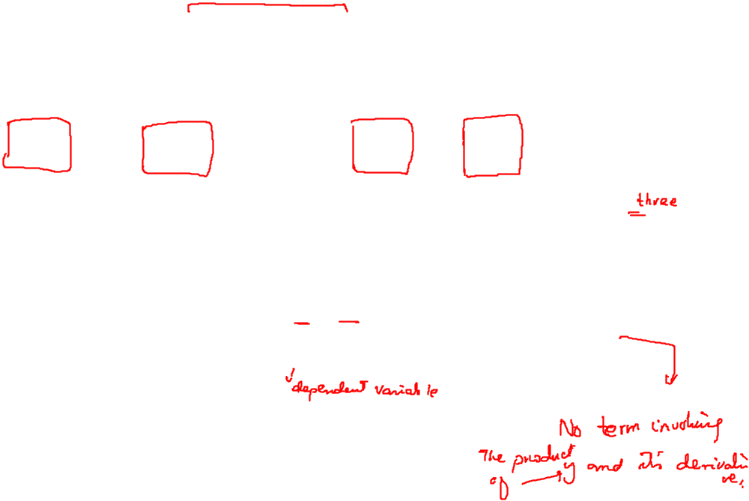
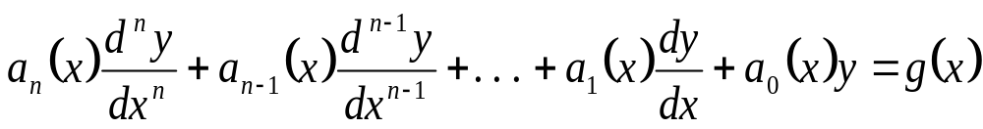
Classification by Linearity
Definition
A differential equation is said to be linear if it can be written in the form
It should be observed that linear differential equations are characterized by two
properties:
The dependent variable y and all its derivatives are of the first degree, i.e. the power of each term involving y is one.
Each coefficient depends on only the variable x or function of x only.
No transcendental function of (trigonometric, logarithmic, exponential) is involved in the equation.
Definition
An equation that is not linear is said to be non-linear.

Slide 10
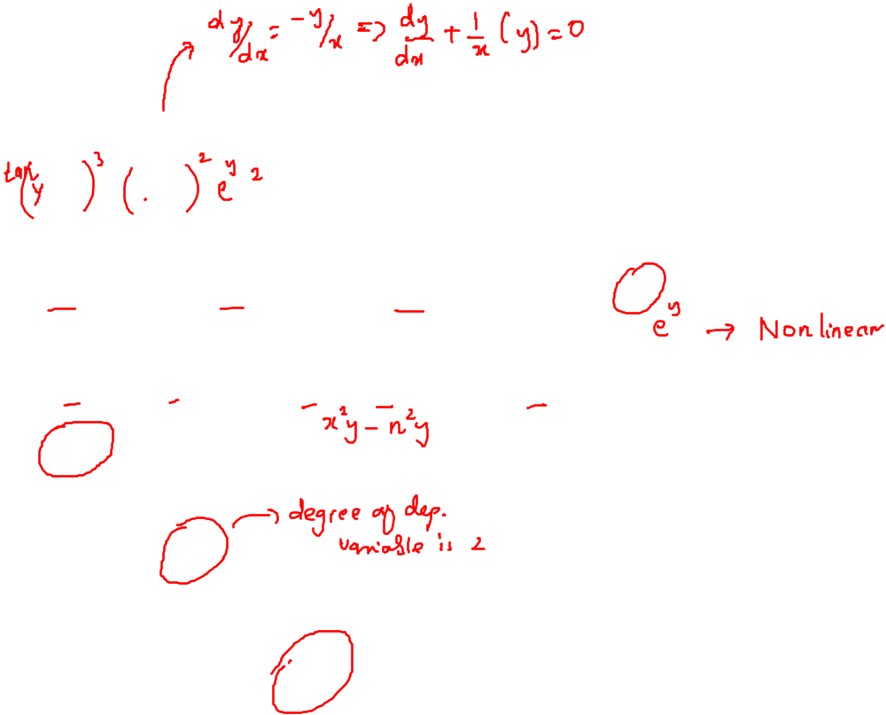
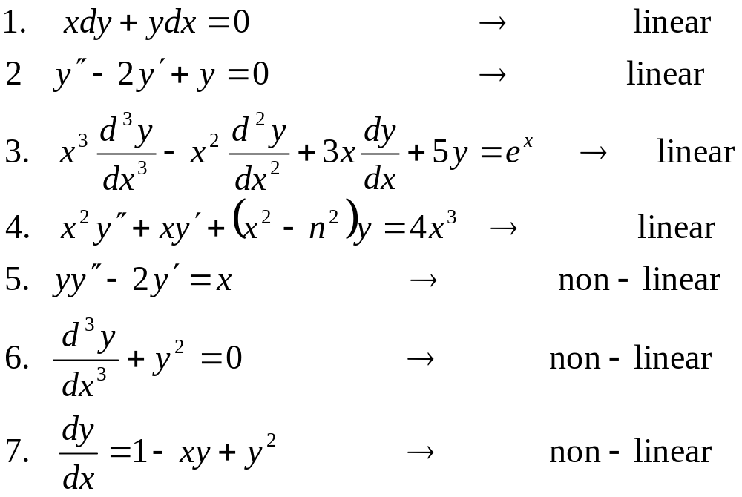
Examples

Slide 11
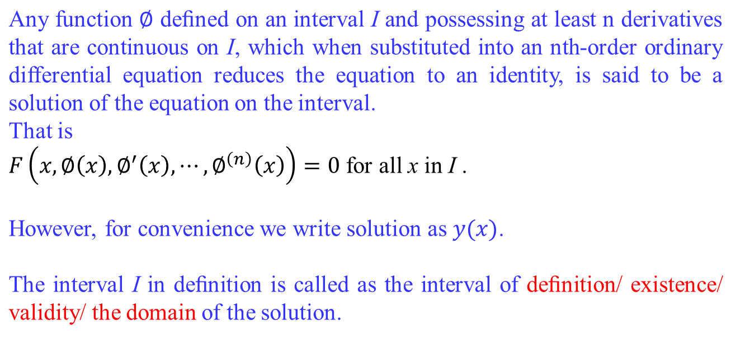
Solution of an ODE

Slide 12
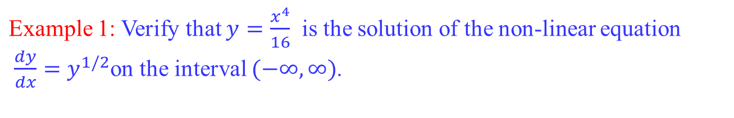
Veriﬁcation of a Solution

Slide 13
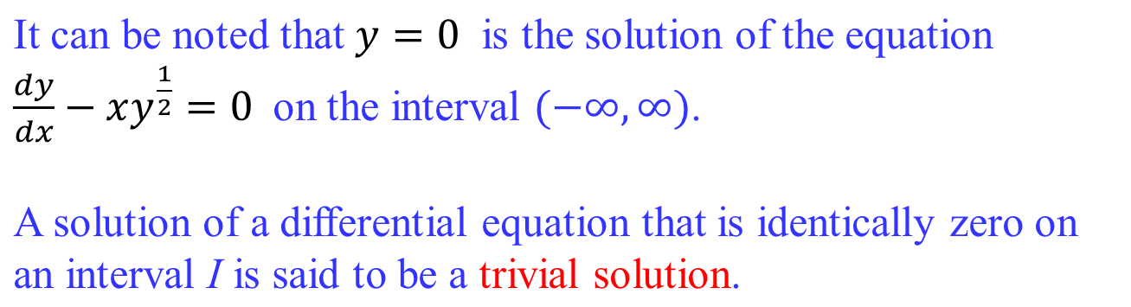
Veriﬁcation of a Solution

Slide 14
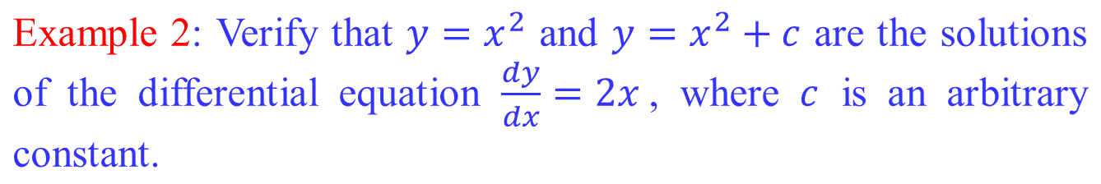
Veriﬁcation of a Solution

Slide 15
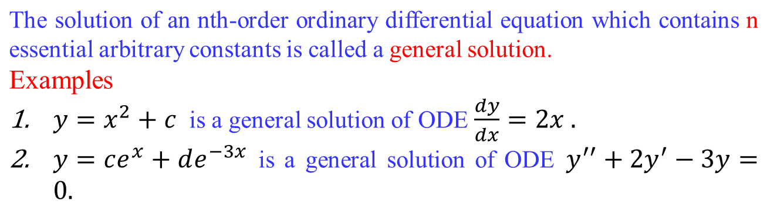
General Solution of an ODE

Slide 16
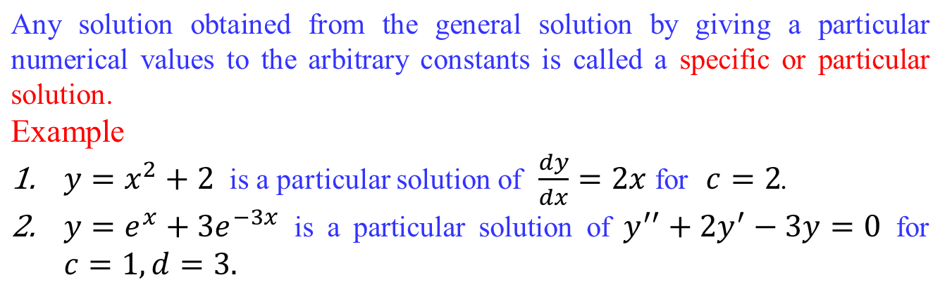
Particular Solution of an ODE

Slide 17
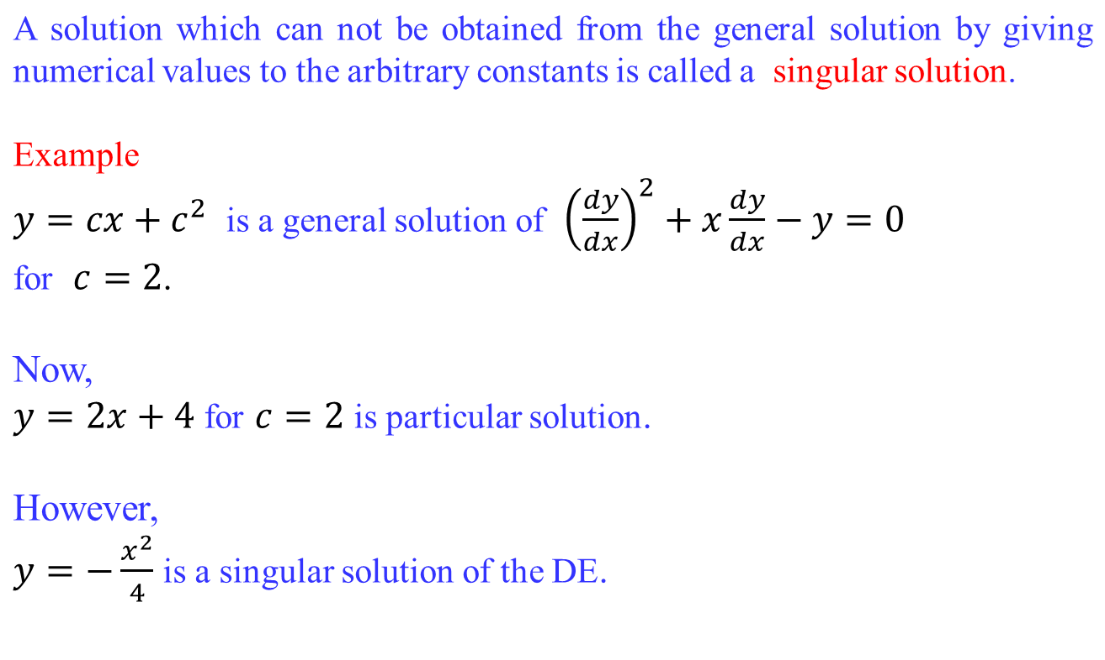
Singular Solution of an ODE

Slide 18
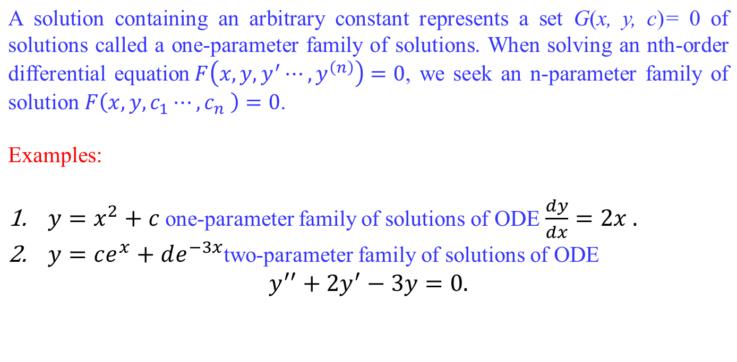
Families of Solution
Note:
This means that a single differential equation can possess an inﬁnite number of solutions corresponding to the unlimited number of choices for the parameter(s).

Slide 19
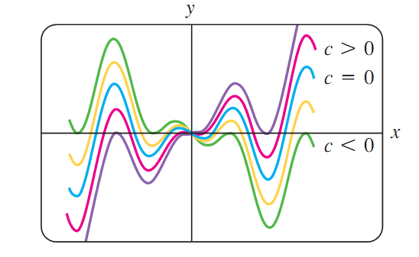
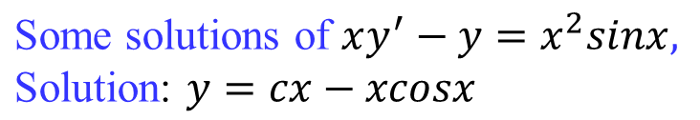
Families of Solution

Slide 20
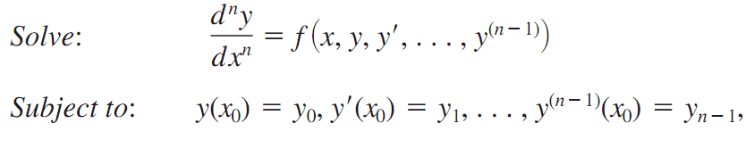
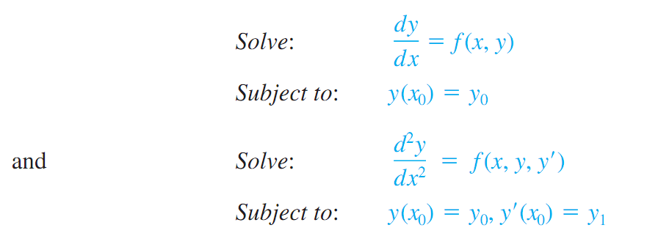
Initial Value Problems
The initial value problems arise in physical system, the nth order Initial Value Problem
First and second order Initial Value Problems

Slide 21
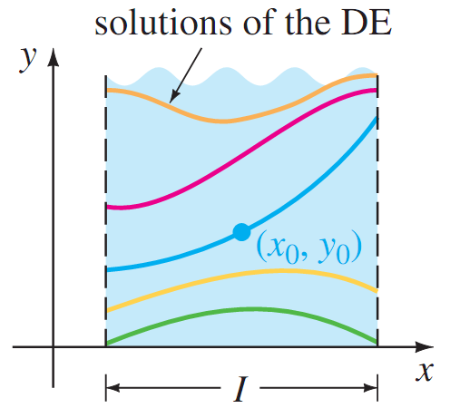
Initial Value Problems

Slide 22
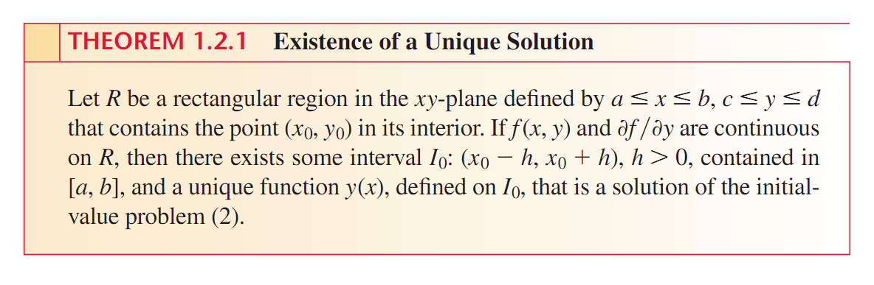
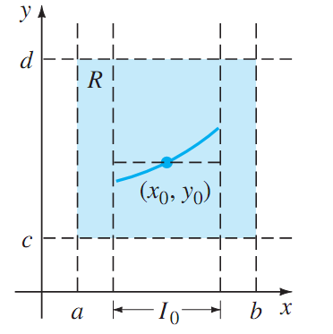
Existence and Uniqueness of the solution

Slide 23
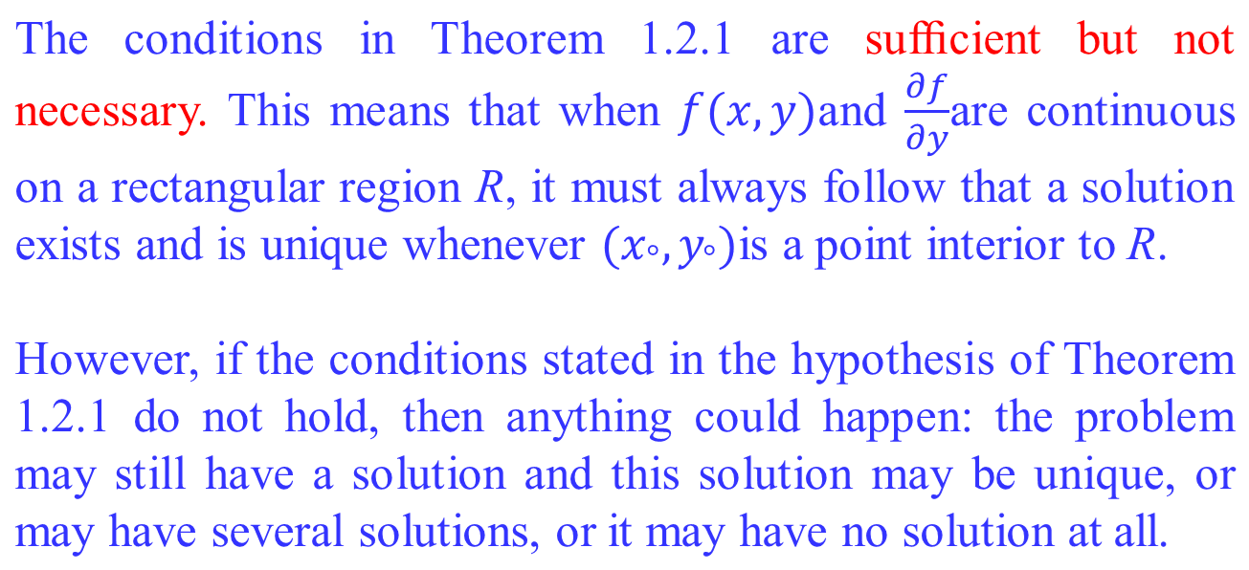
Important Remark

Slide 24



Problem Solution

Slide 25
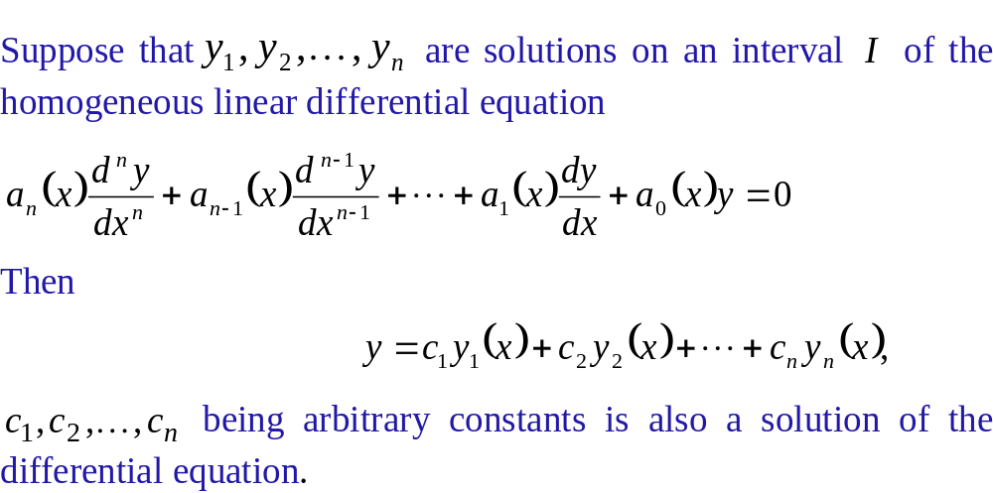
Superposition Principle

Slide 26
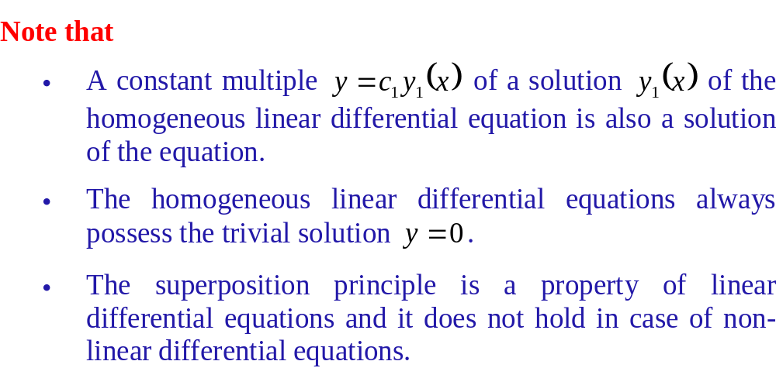
Superposition Principle

Slide 27
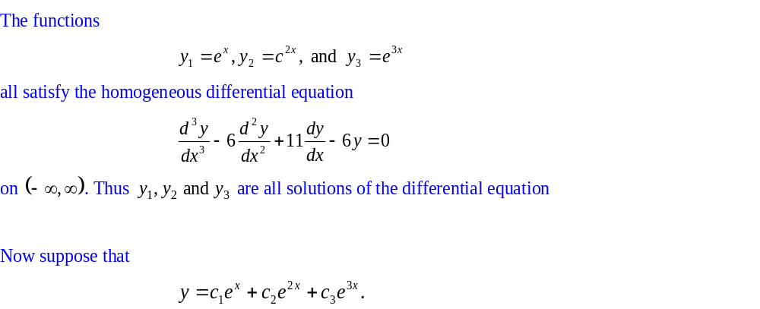
Examples
Example 1

Slide 28
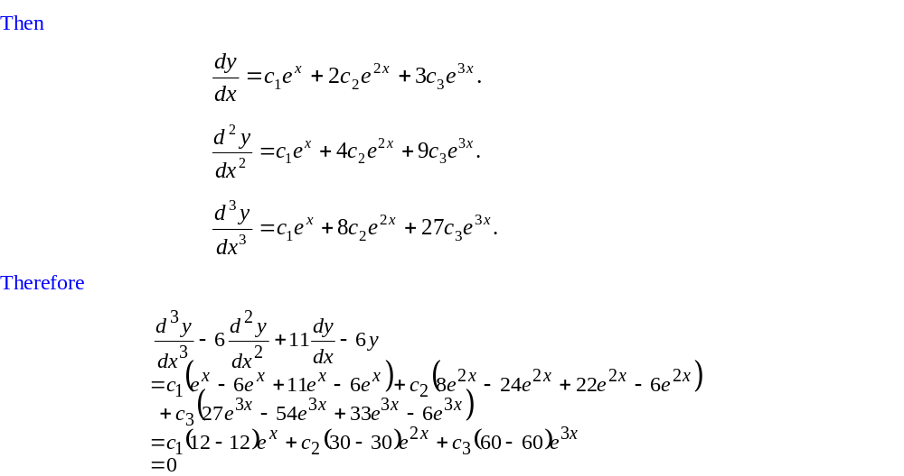
Examples

Slide 29
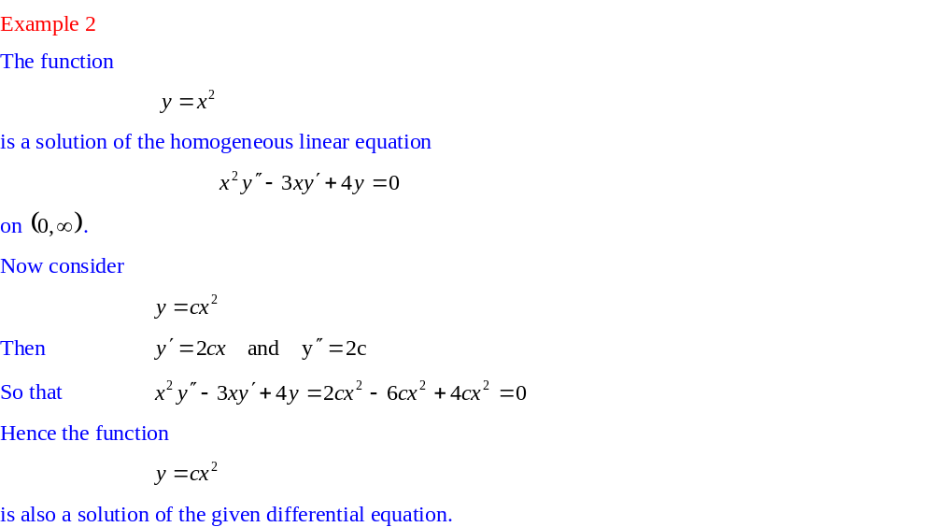
Examples

