Slide 1

 | National University of Sciences & Technology (NUST) School of Electrical Engineering and Computer Science (SEECS) Department of Basic Sciences
Linear Algebra & Ordinary Differential Equations
MATH-121
Lecture # 22
Course Instructor: Dr Saira Zainab
Ph. # 03325193283
Email: saira.zainab@seecs.edu.pk
Office # 207, Faculty Block, SEECS

Slide 2
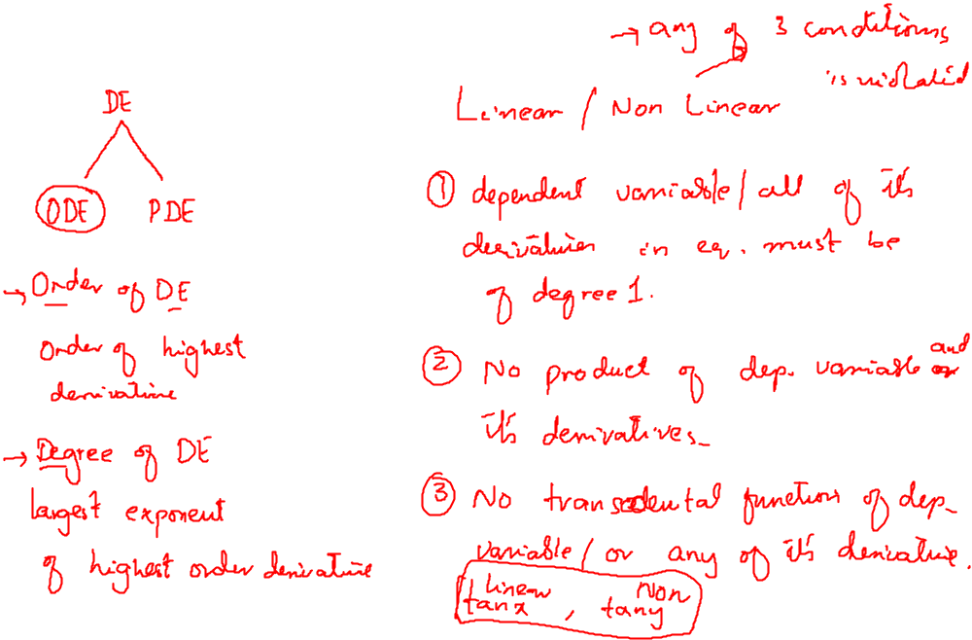
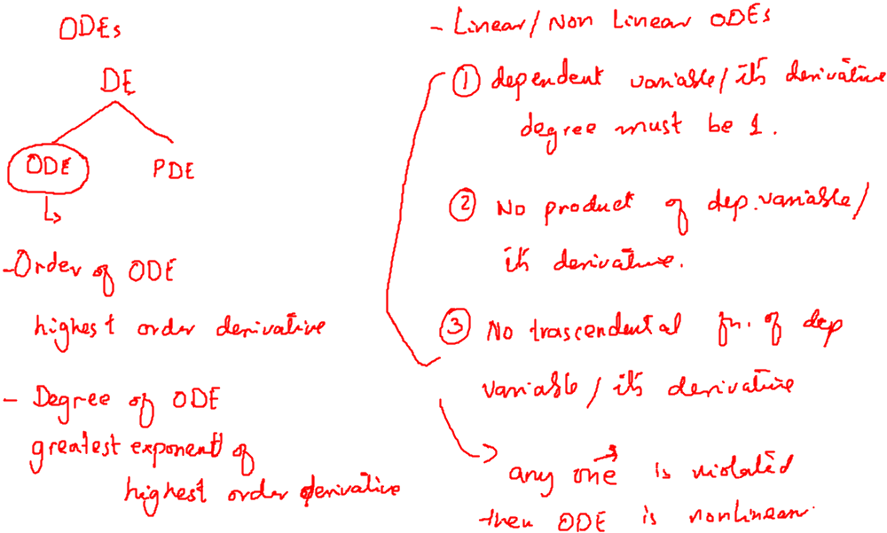
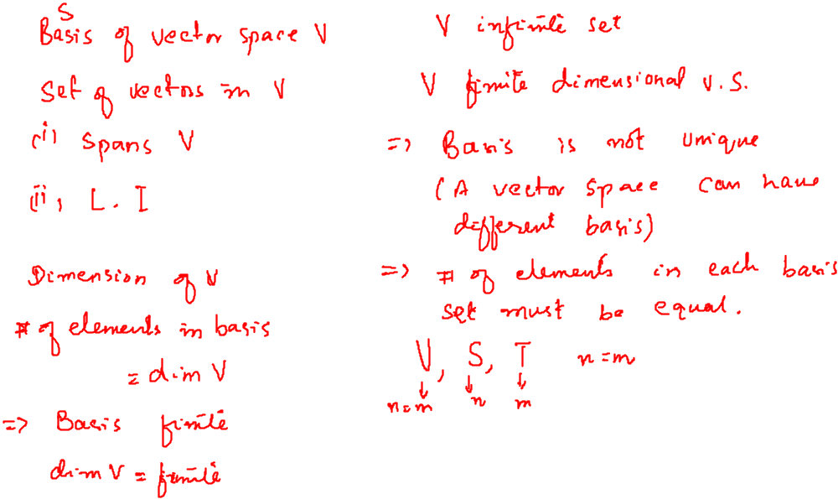
Recalling Previous Lecture

Slide 3
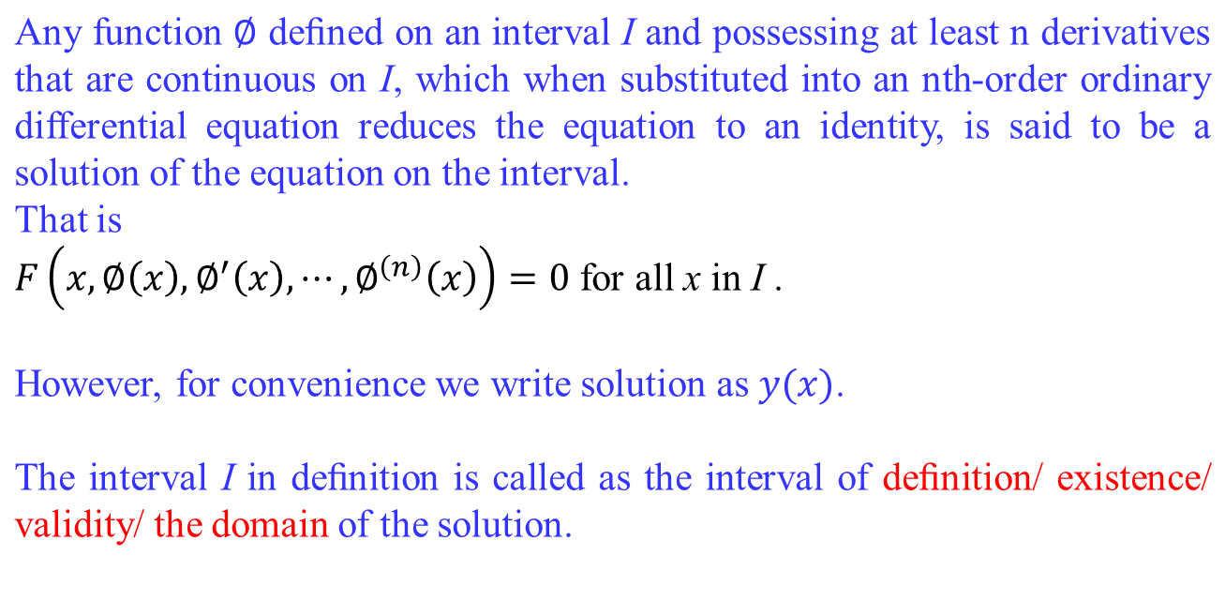
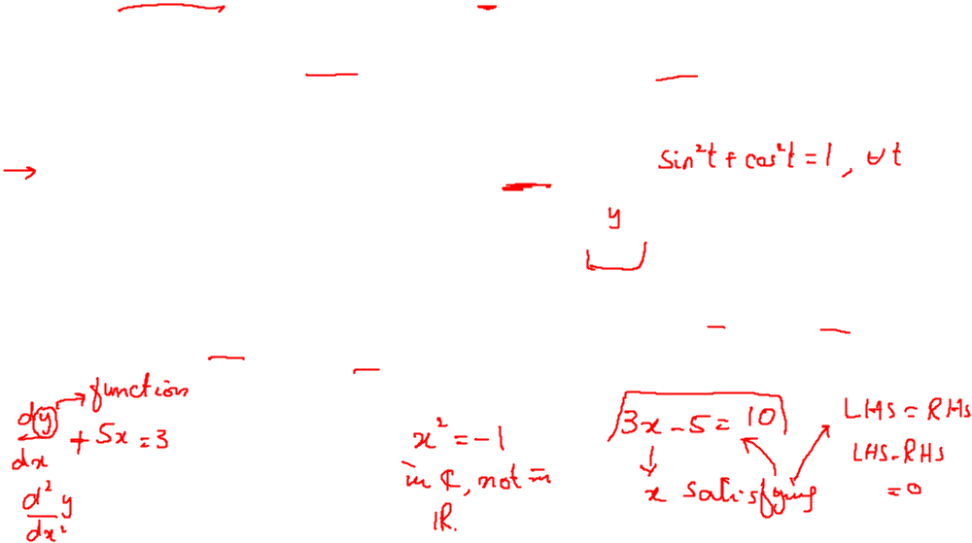
Solution of an ODE

Slide 4
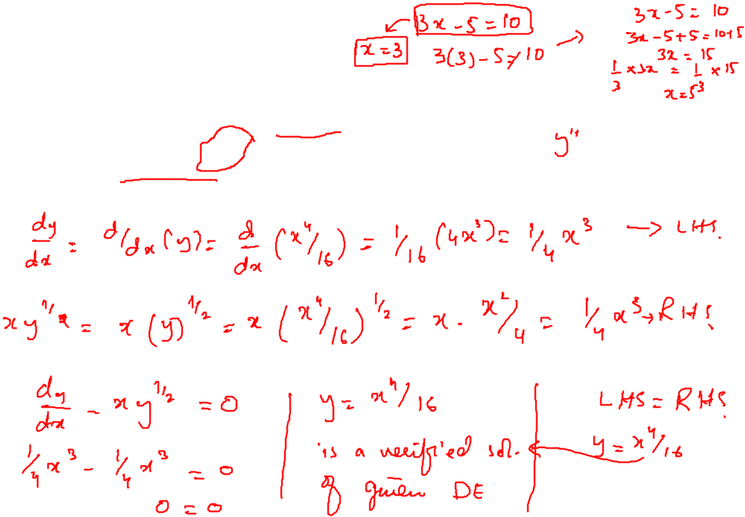
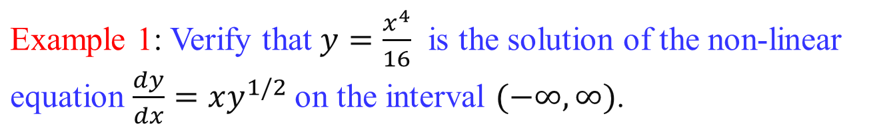
Veriﬁcation of a Solution

Slide 5
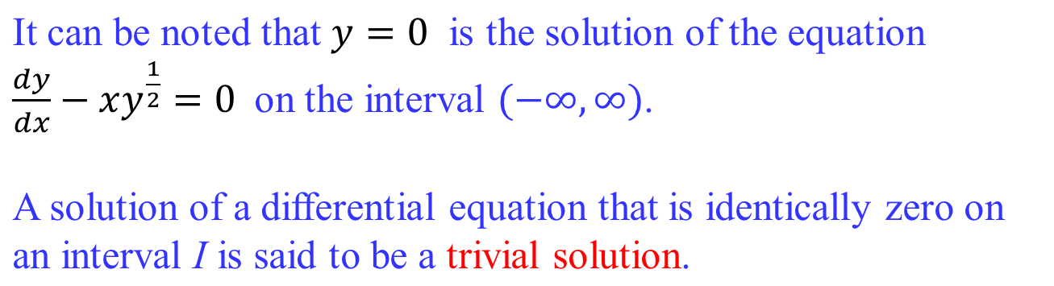
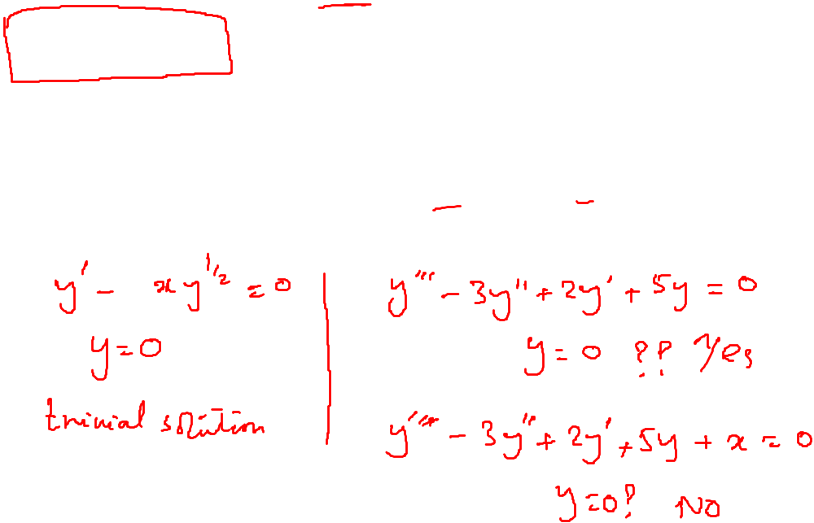
Veriﬁcation of a Solution

Slide 6
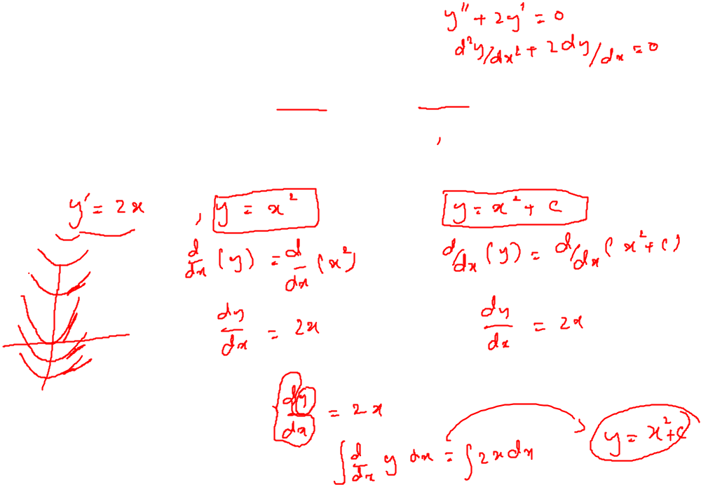
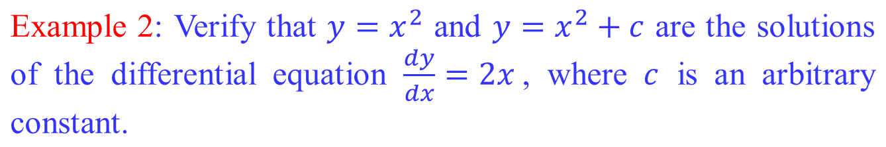
Veriﬁcation of a Solution

Slide 7
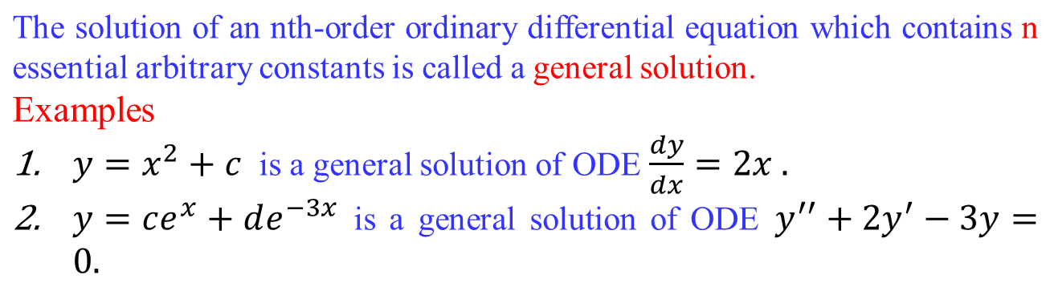

General Solution of an ODE

Slide 8
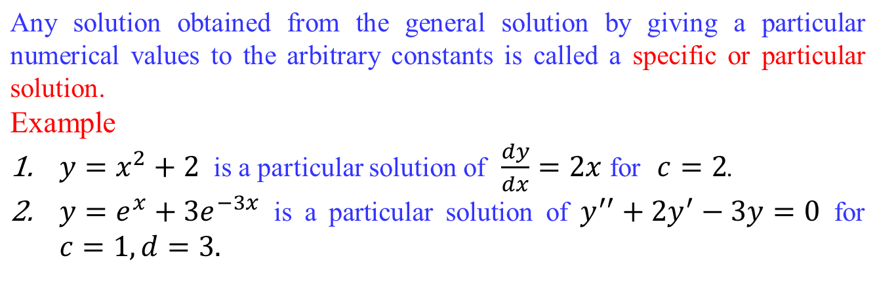
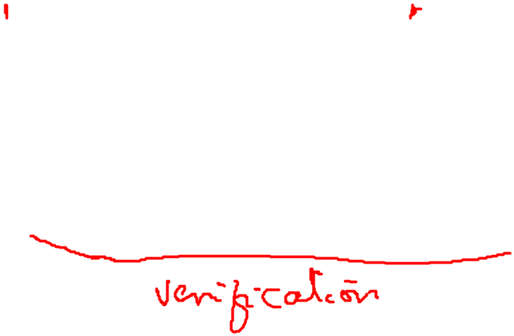
Particular Solution of an ODE

Slide 9
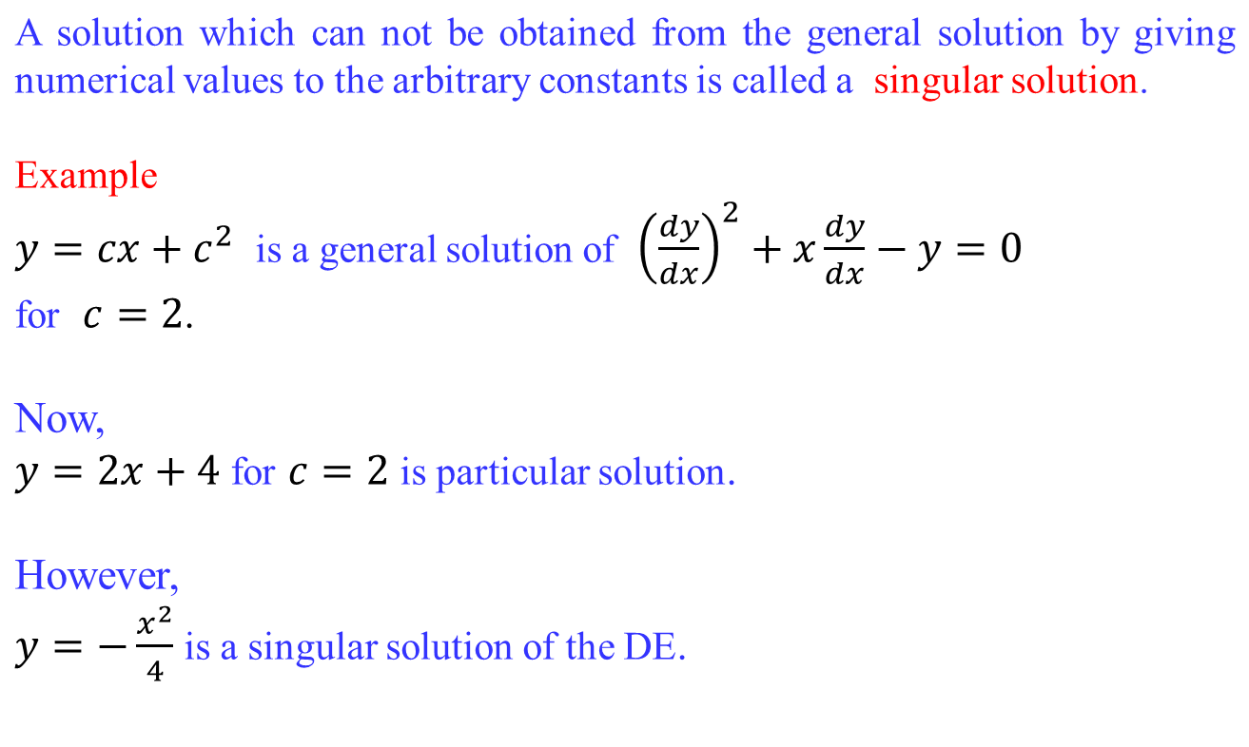
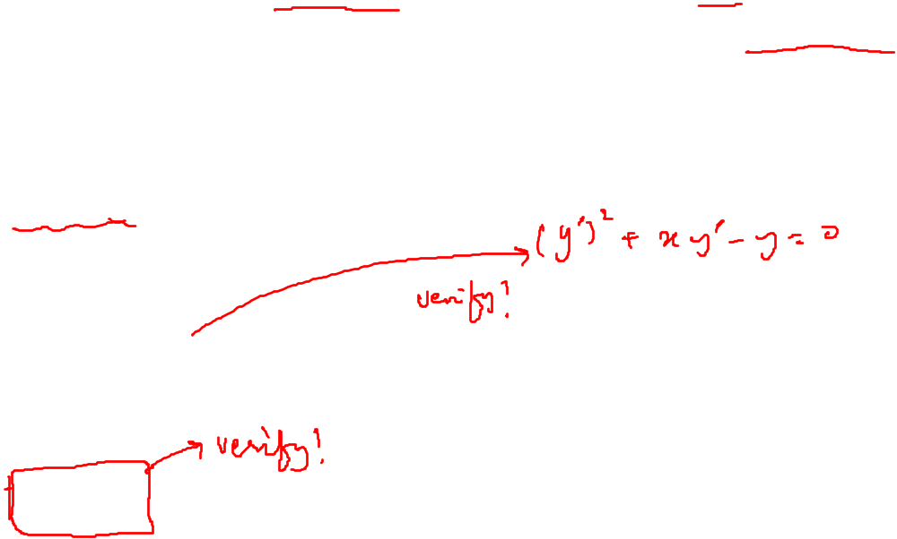
Singular Solution of an ODE

Slide 10
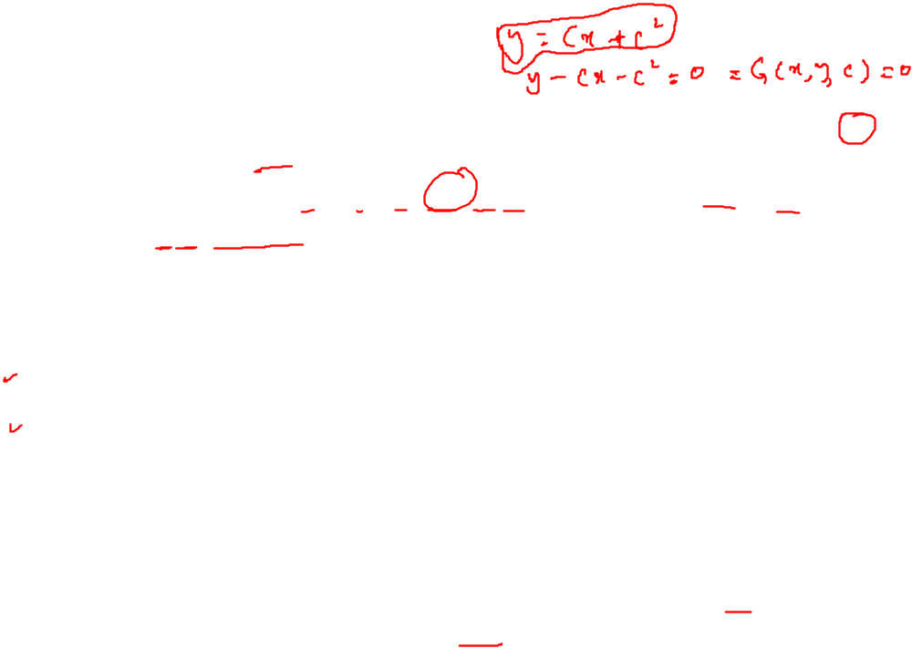
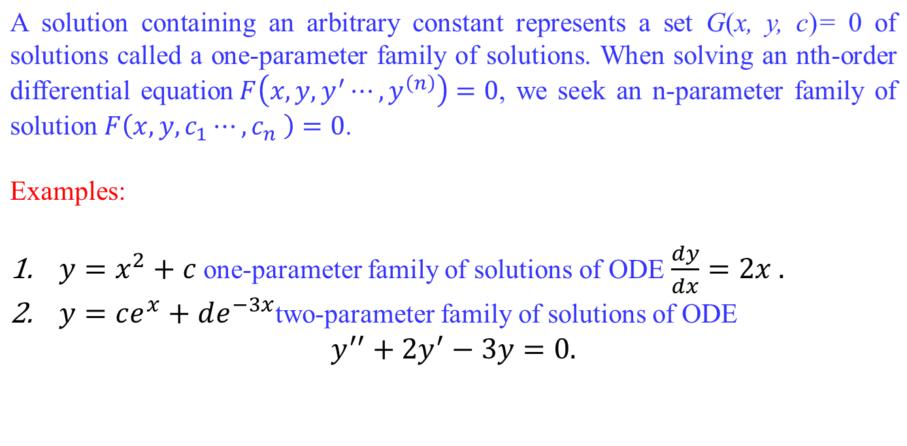
Families of Solution
Note:
This means that a single differential equation can possess an inﬁnite number of solutions corresponding to the unlimited number of choices for the parameter(s).

Slide 11
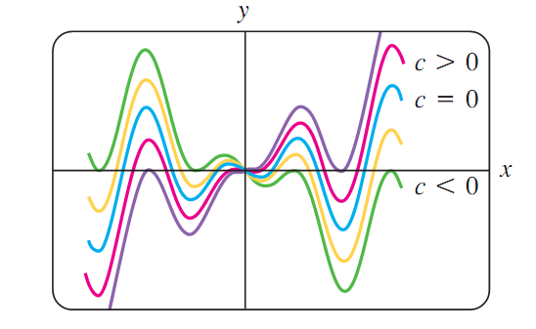
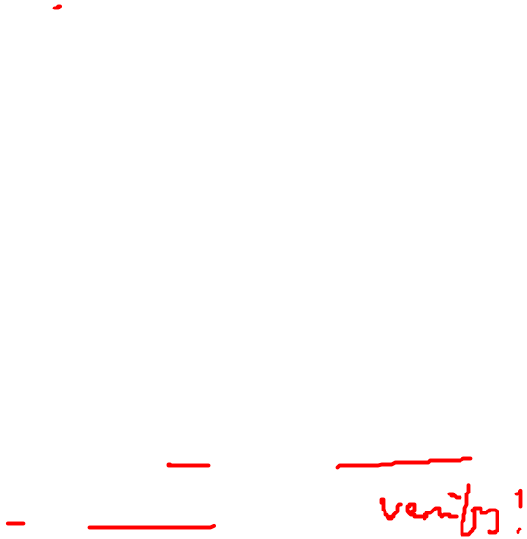
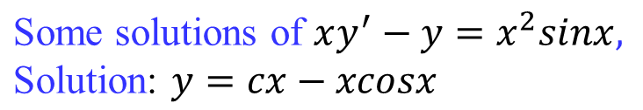
Families of Solution

Slide 12
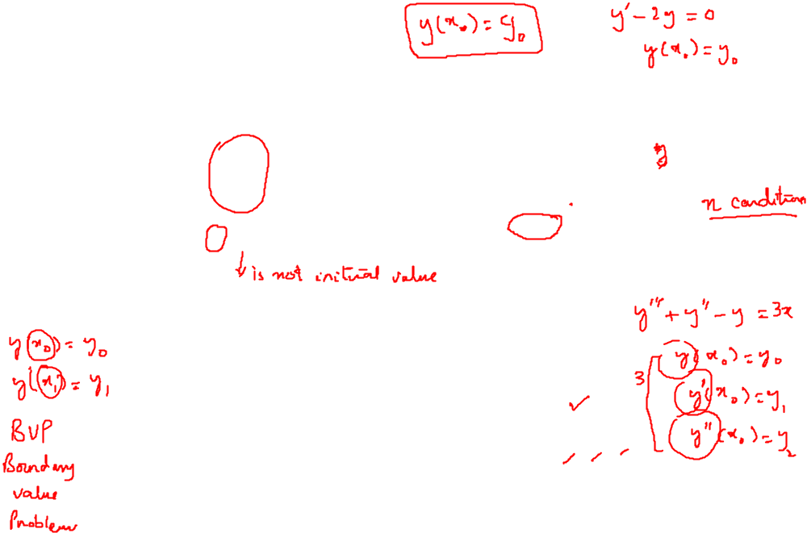
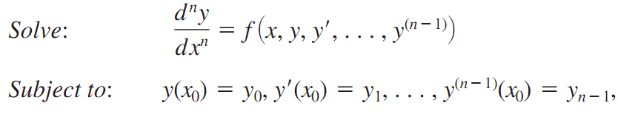
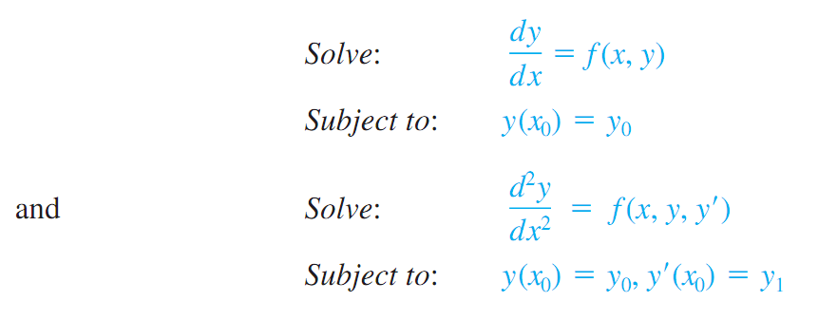
Initial Value Problems
The initial value problems arise in physical system, the nth order Initial Value Problem
First and second order Initial Value Problems

Slide 13
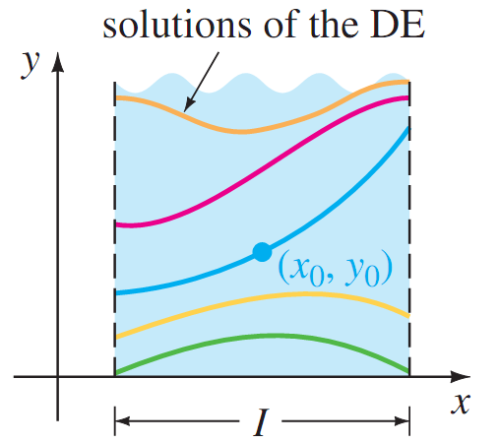

Initial Value Problems

Slide 14
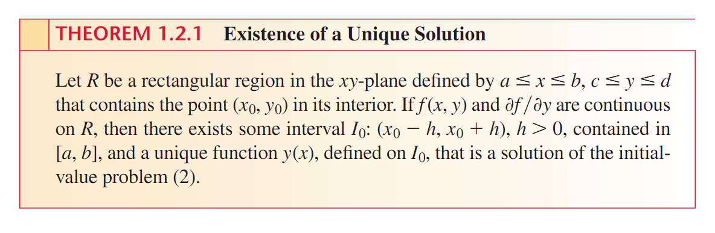
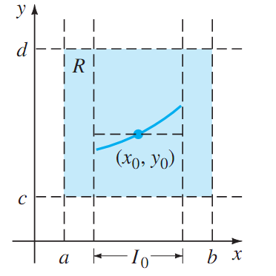
Existence and Uniqueness of the solution

Slide 15
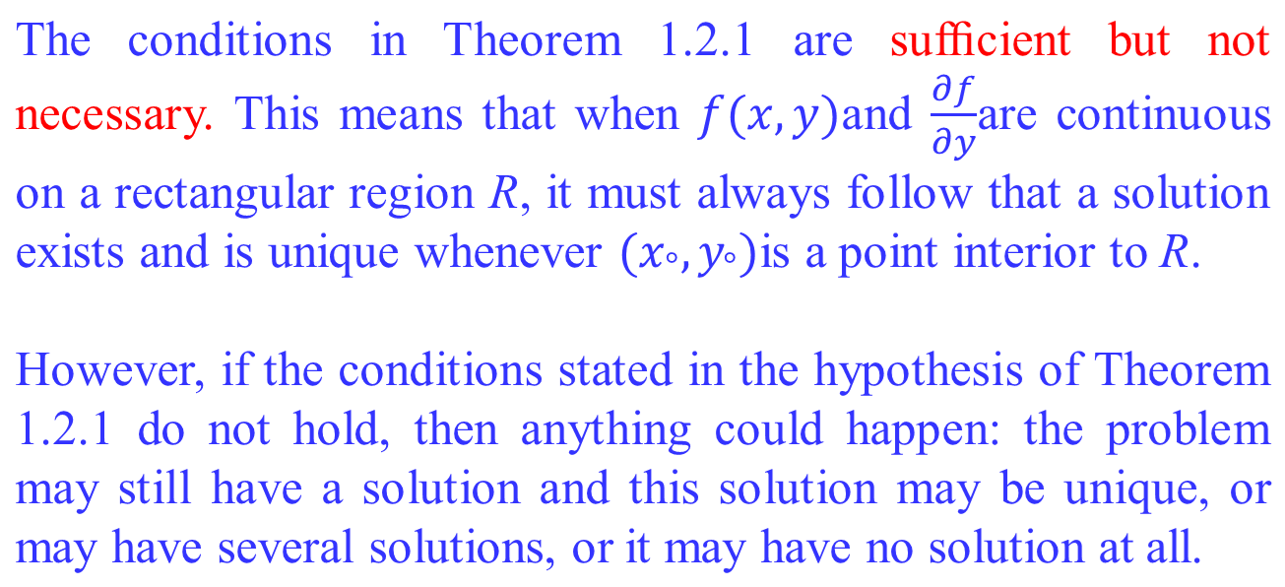
Important Remark

Slide 16



Problem Solution

Slide 17
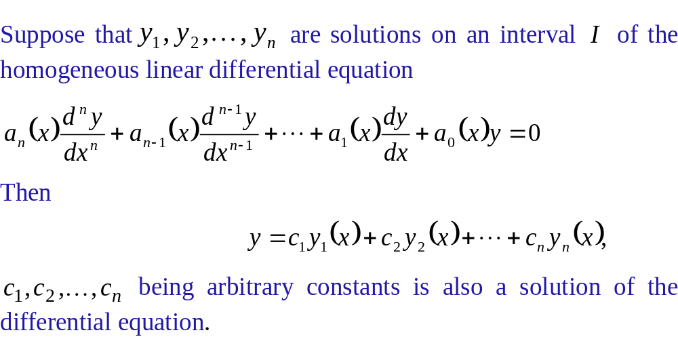
Superposition Principle

Slide 18
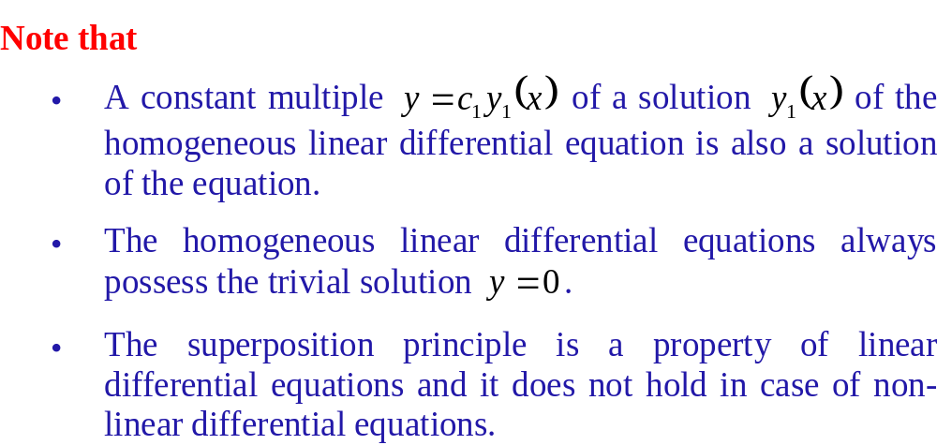
Superposition Principle

Slide 19
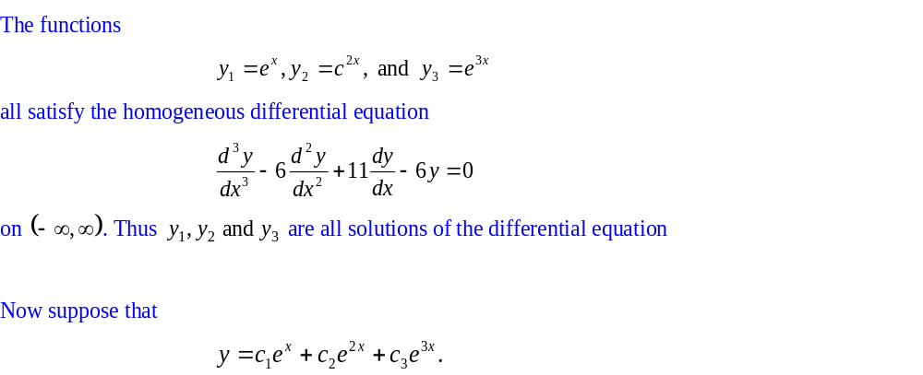
Examples
Example 1

Slide 20
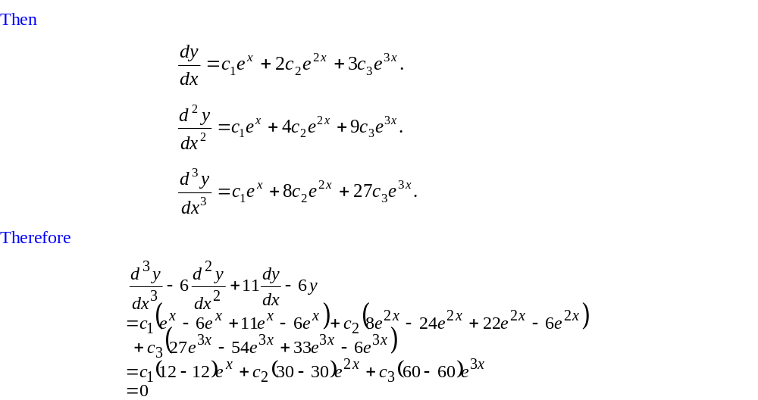
Examples

Slide 21
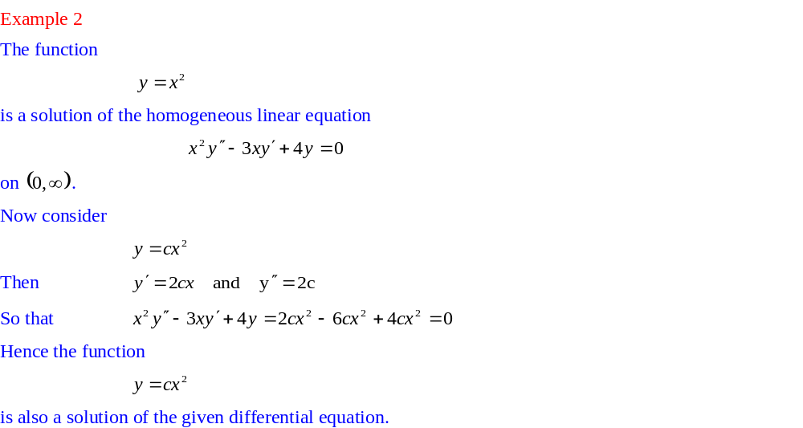
Examples

