Slide 1

 | National University of Sciences & Technology (NUST) School of Electrical Engineering and Computer Science (SEECS) Department of Basic Sciences
Linear Algebra & Ordinary Differential Equations
MATH-121
Lecture # 23
Course Instructor: Dr Saira Zainab
Ph. # 03325193283
Email: saira.zainab@seecs.edu.pk
Office # 207, Faculty Block, SEECS
1

Slide 2
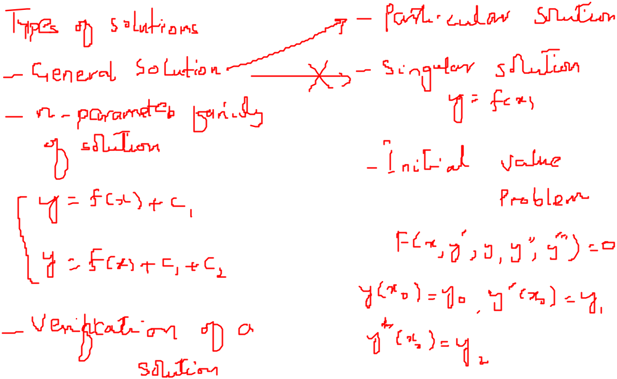
Recalling Previous Lecture

Slide 3
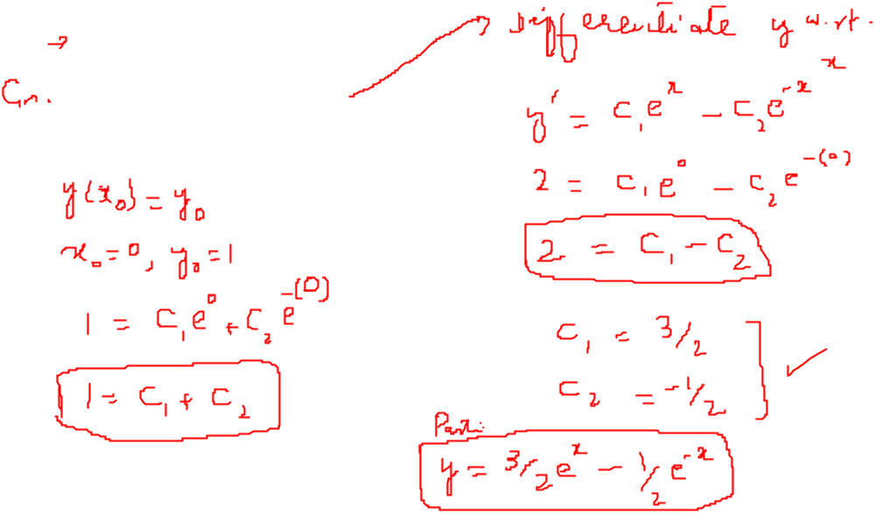



Problem Solution

Slide 4
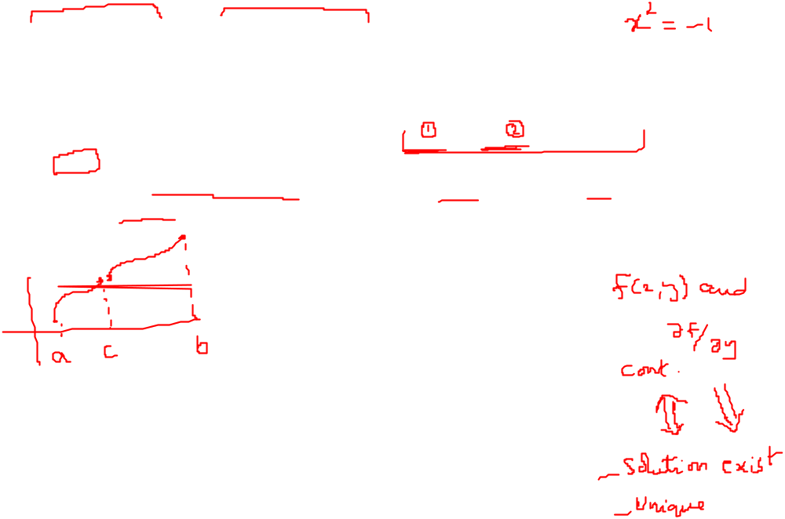
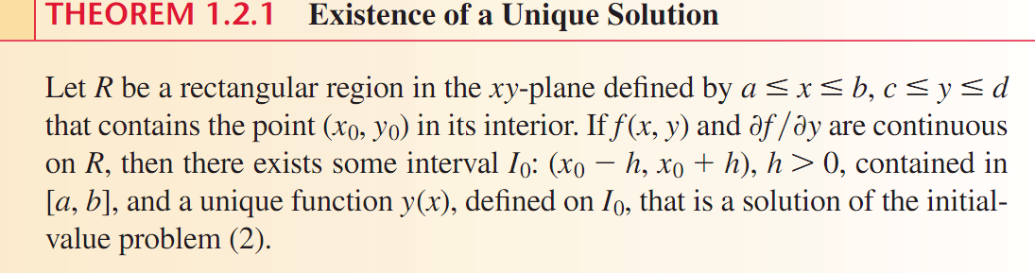
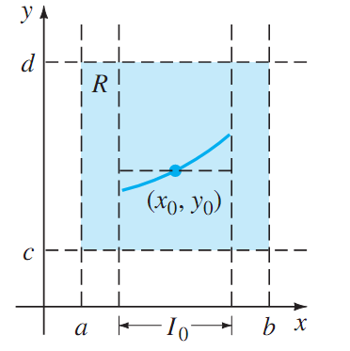
Existence and Uniqueness of the solution

Slide 5
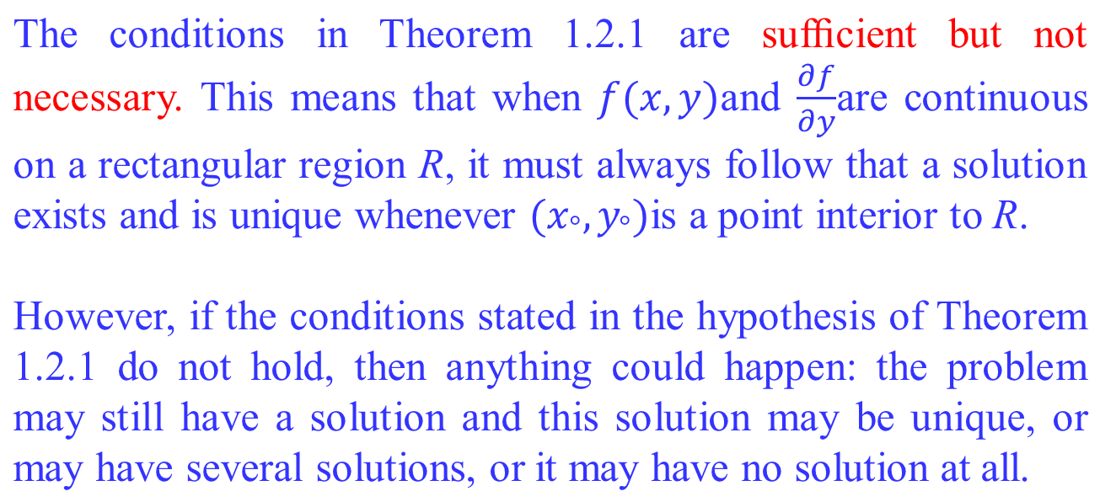
Important Remark

Slide 6
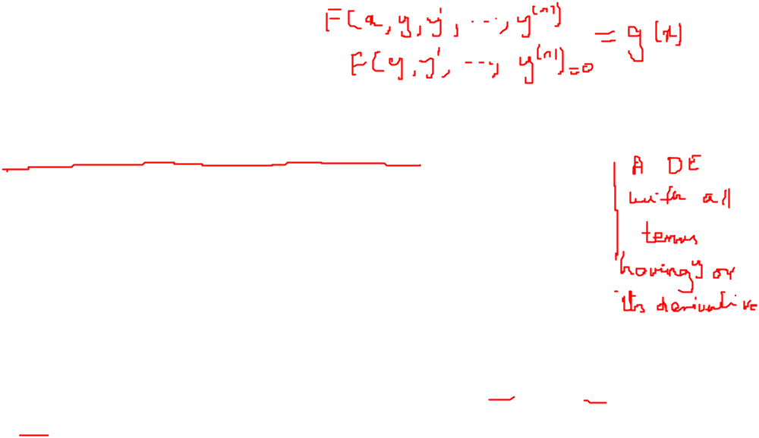
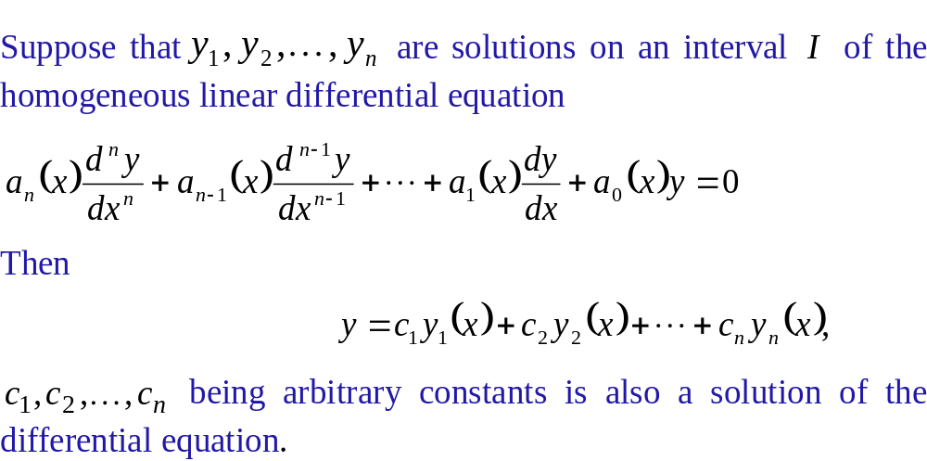
Superposition Principle

Slide 7
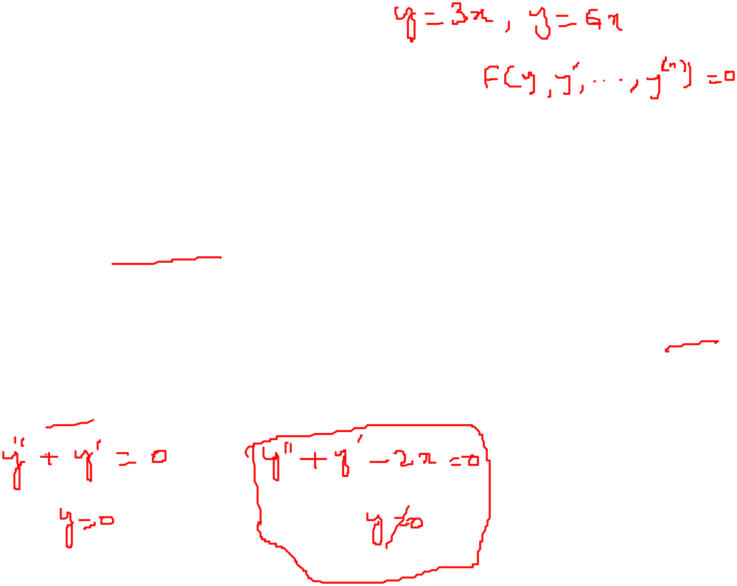
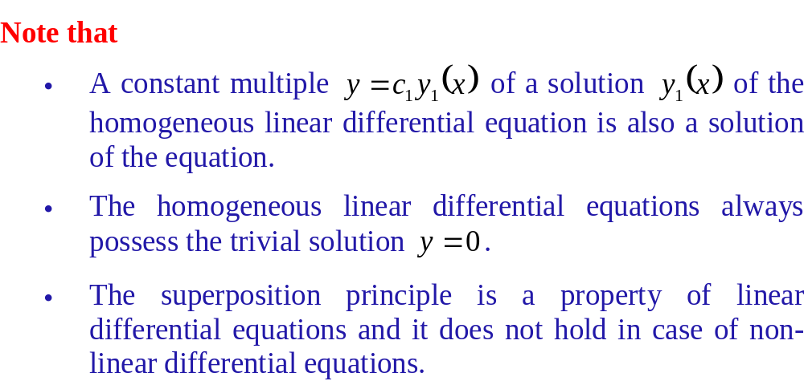
Superposition Principle

Slide 8
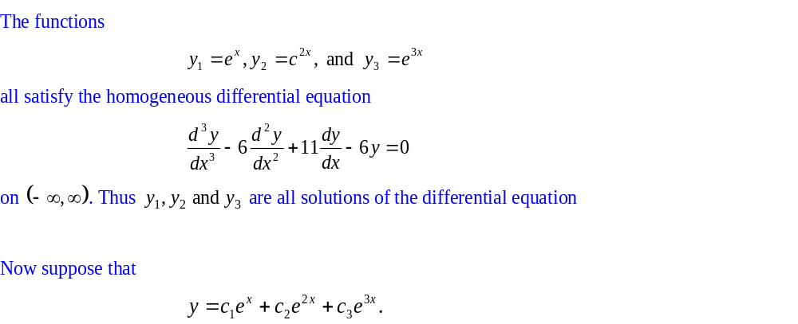
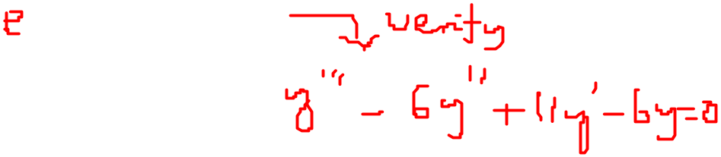
Examples
Example 1

Slide 9
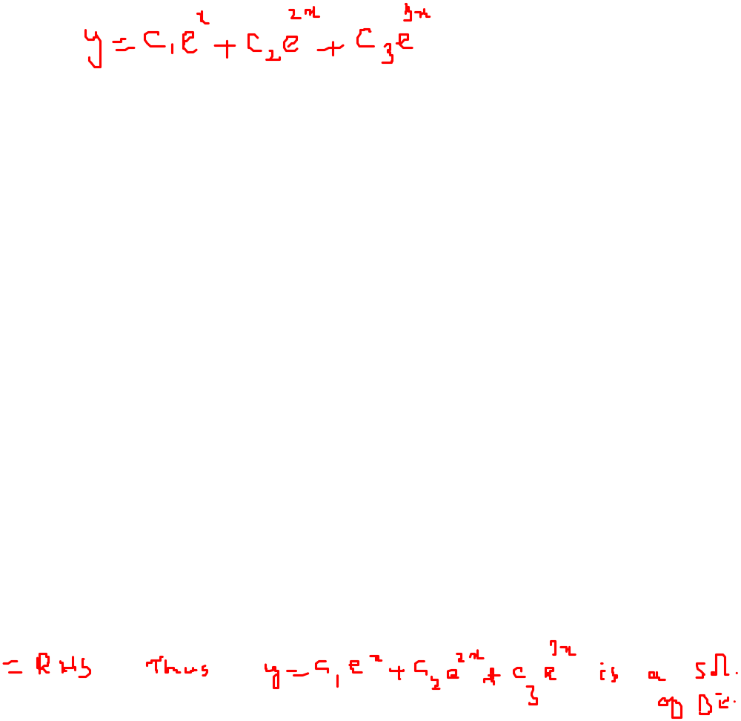
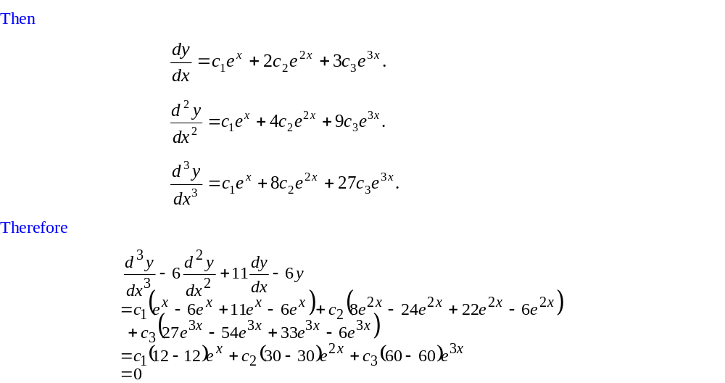
Examples

Slide 10
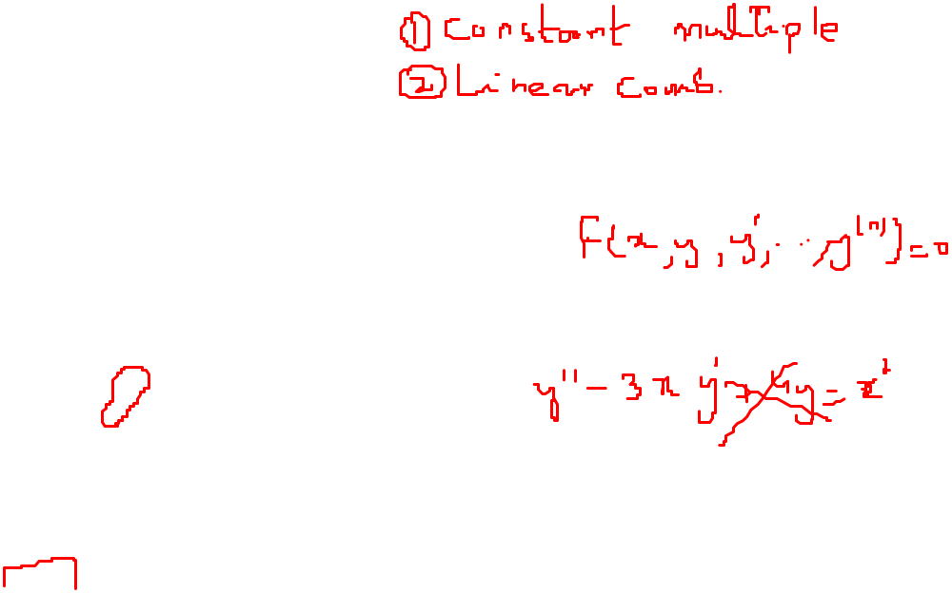
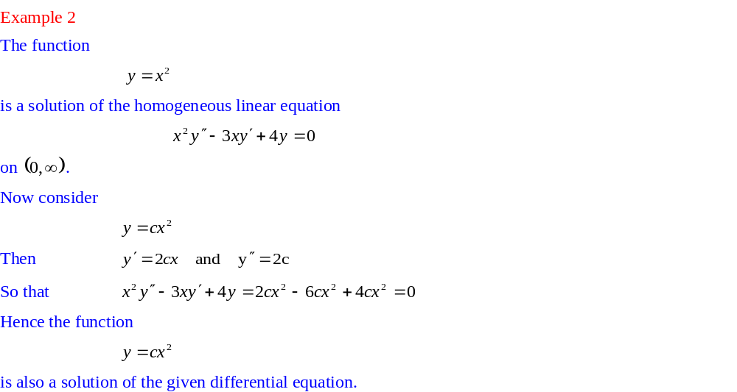
Examples

