Slide 1

 | National University of Sciences & Technology (NUST) School of Electrical Engineering and Computer Science (SEECS) Department of Basic Sciences
Linear Algebra & Ordinary Differential Equations
MATH-121
Lecture # 24
Course Instructor: Dr Saira Zainab
Ph. # 03325193283
Email: saira.zainab@seecs.edu.pk
Office # 207, Faculty Block, SEECS

Slide 2
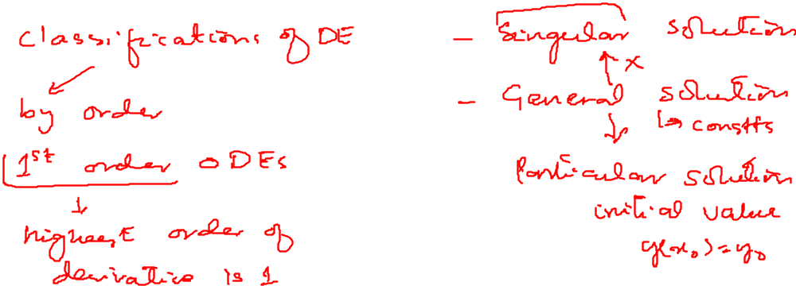
Recalling Previous Lecture

Slide 3
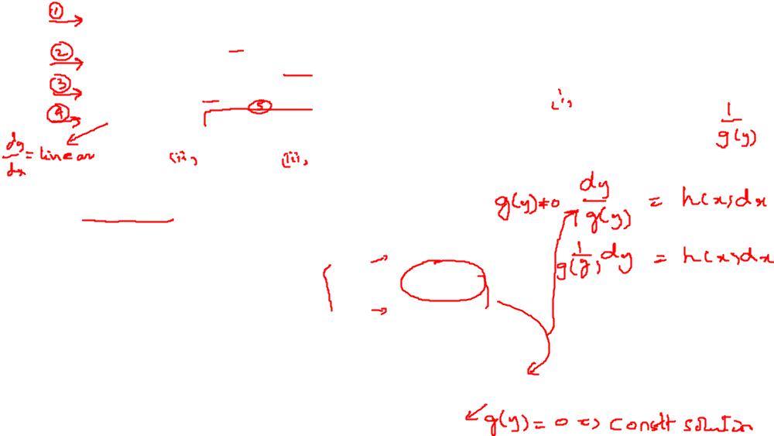
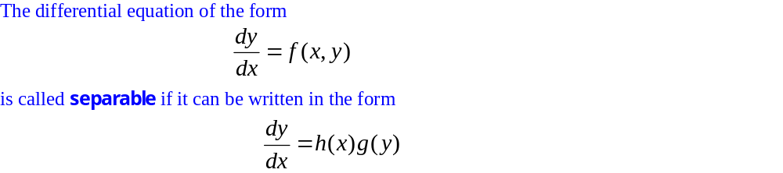
Ordinary Differential Equations of the First Order
Separable Equations
Equations Reducible to Separable Form
Homogeneous and Non-Homogeneous equations
Exact and Non-Exact Differential Equations
Linear and Non-Linear Differential Equations (Bernoulli’s equation, Ricatti Equation, Clairaut’s equation)
Separable Equations

Slide 4
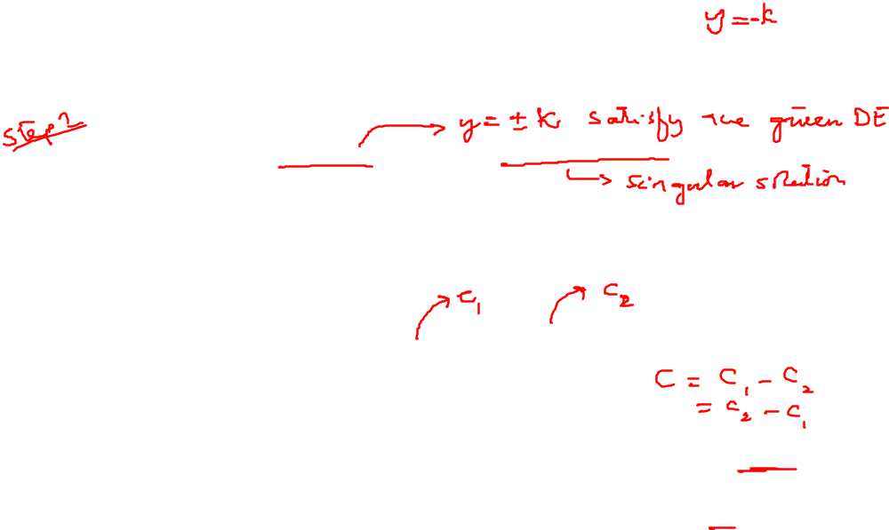
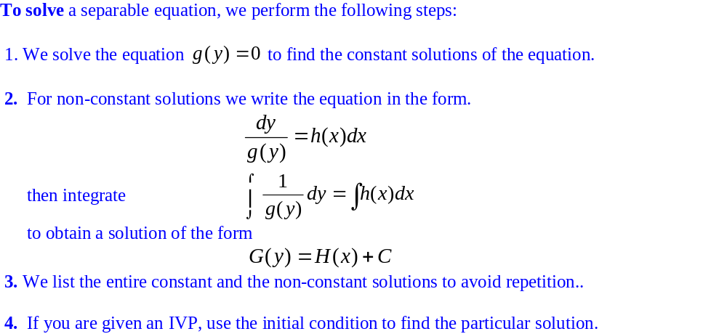
Separable Equations

Slide 5
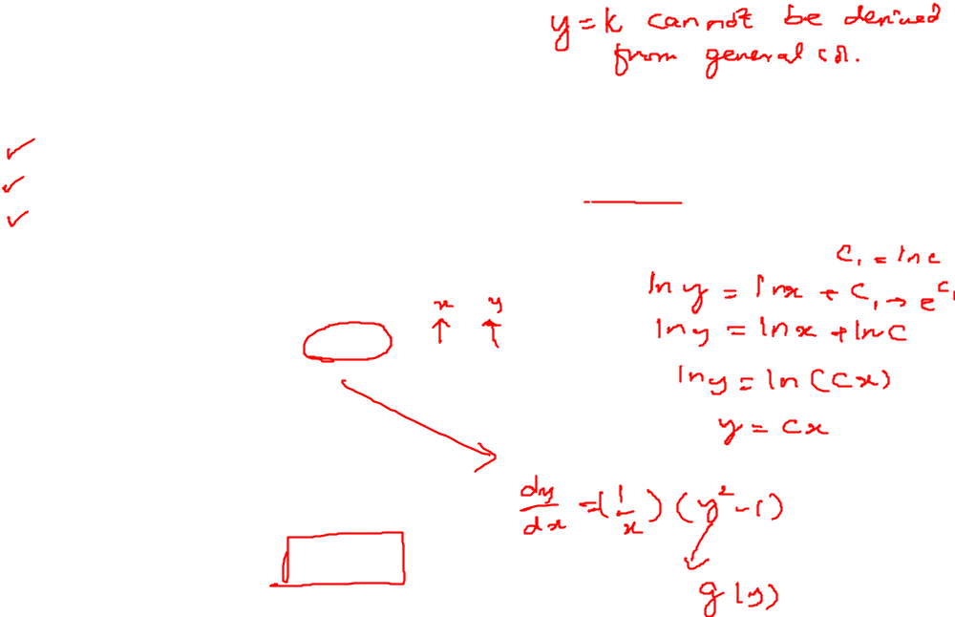
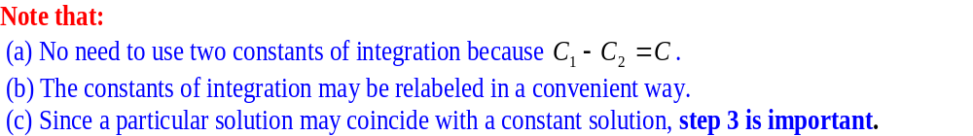
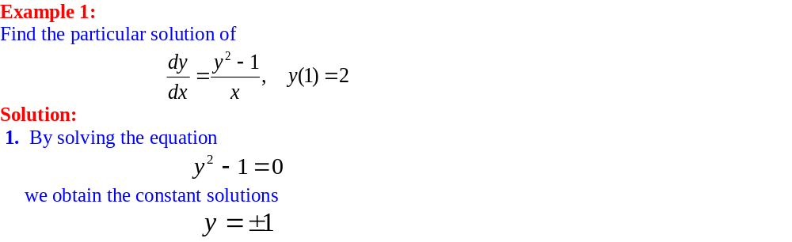
Separable Equations

Slide 6
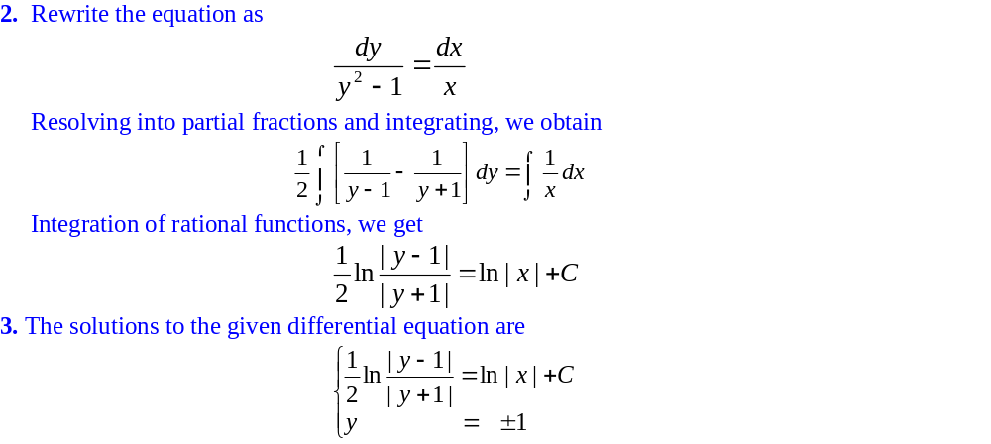
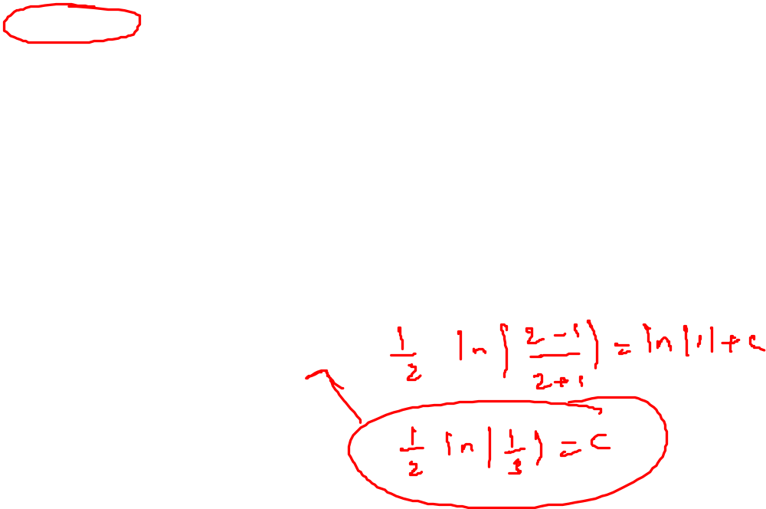
Separable Equations

Slide 7
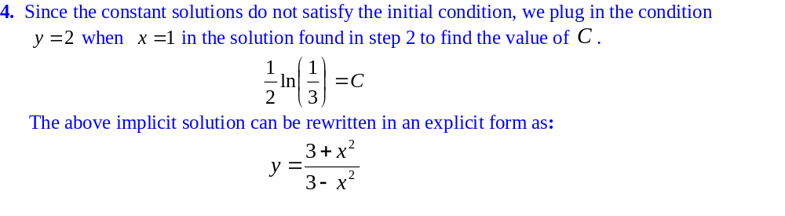
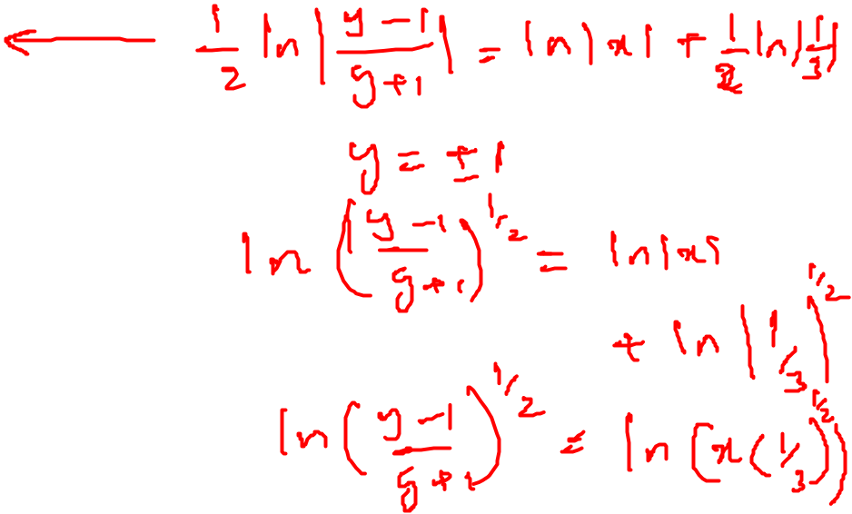
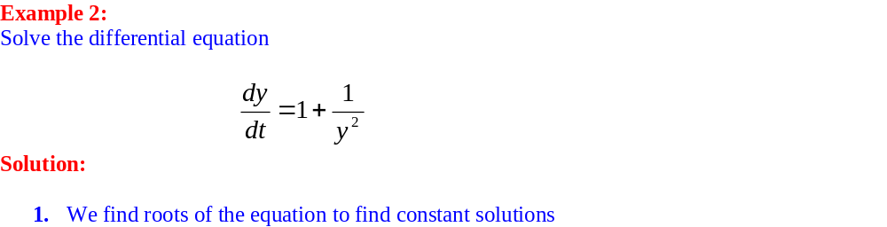
Separable Equations

Slide 8
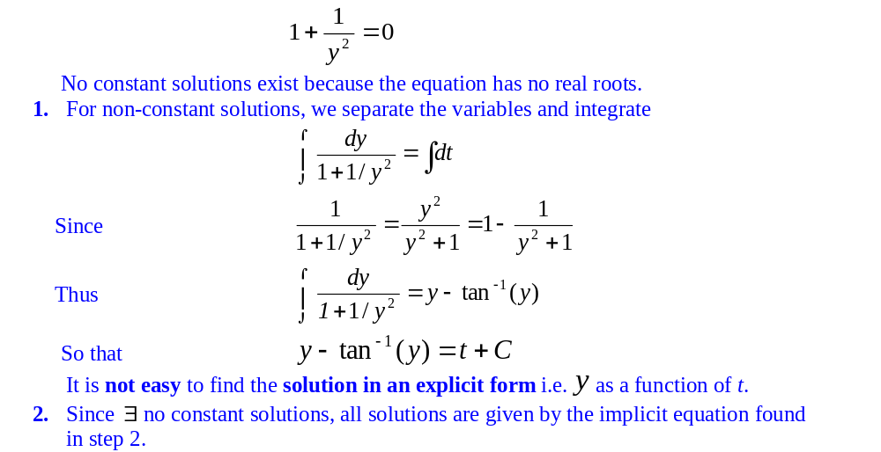
Separable Equations

Slide 9
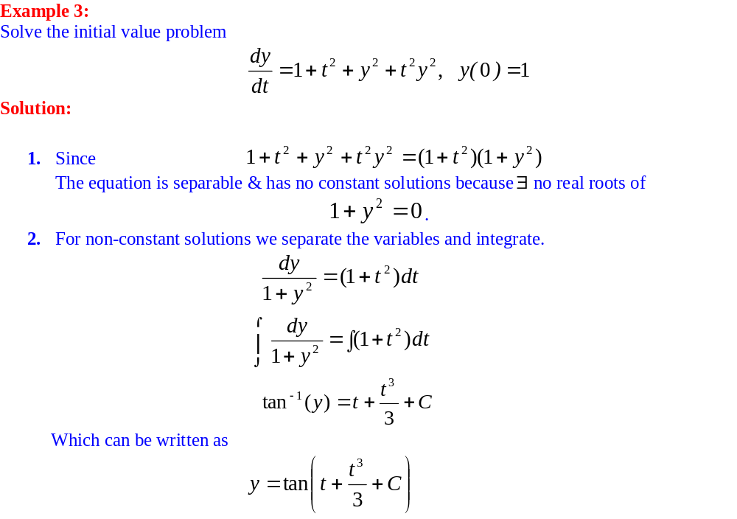
Separable Equations

Slide 10
Separable Equations

Slide 11
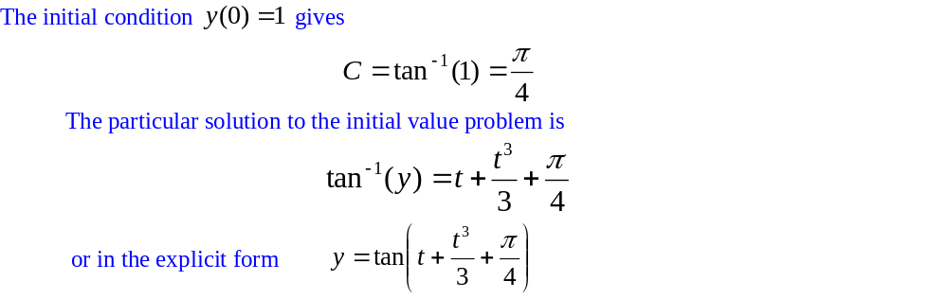
Separable Equations

Slide 12
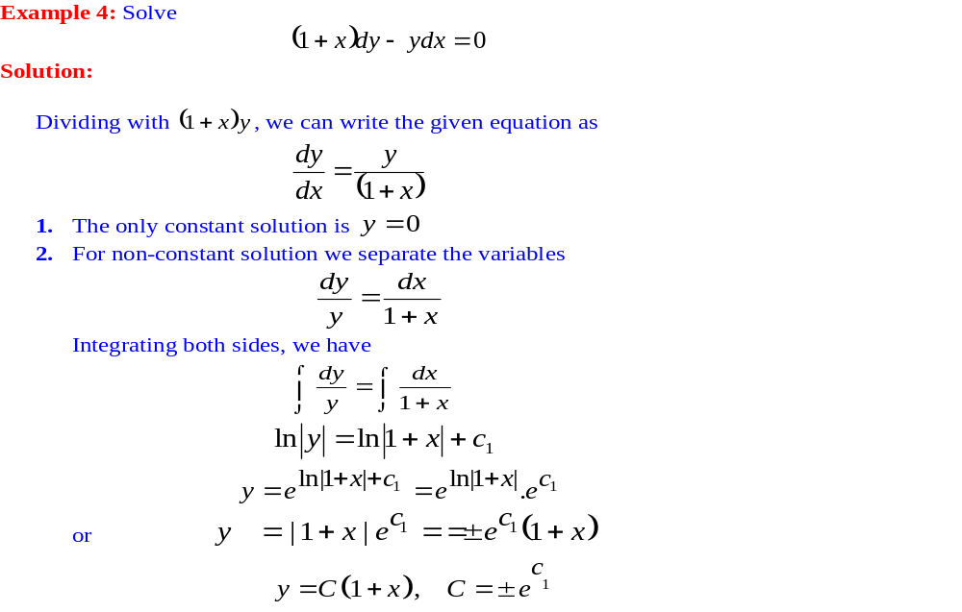
Separable Equations

Slide 13
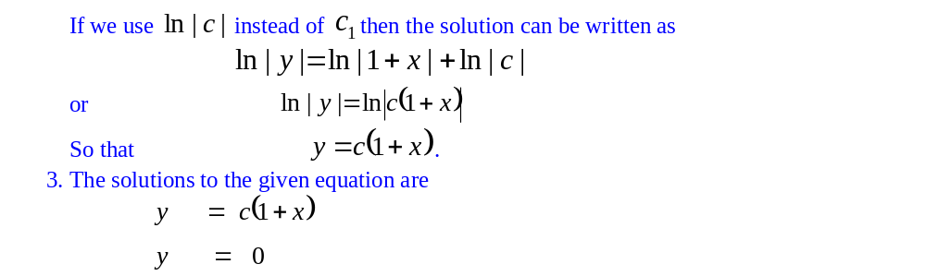
Separable Equations

Slide 14
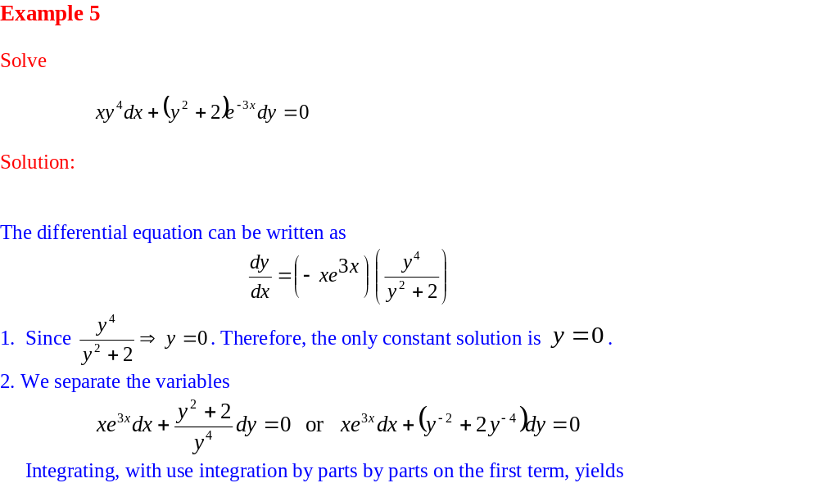
Separable Equations

Slide 15
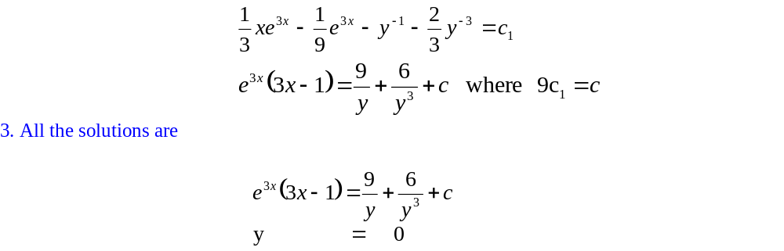
Separable Equations

Slide 16
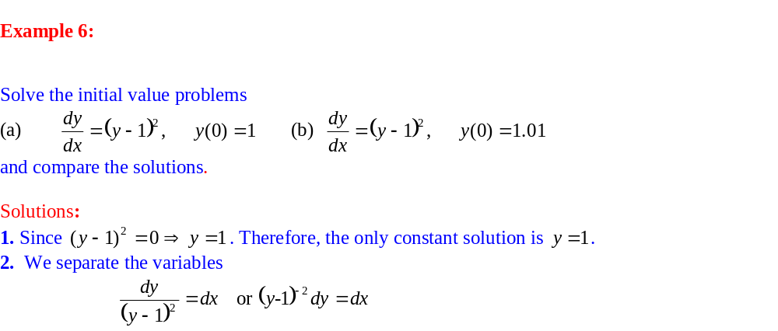
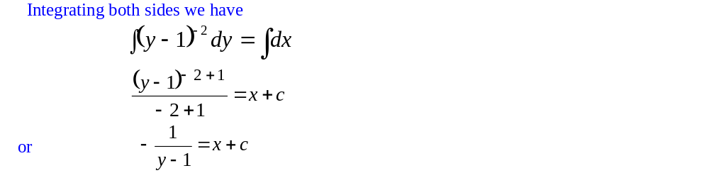
Separable Equations

Slide 17
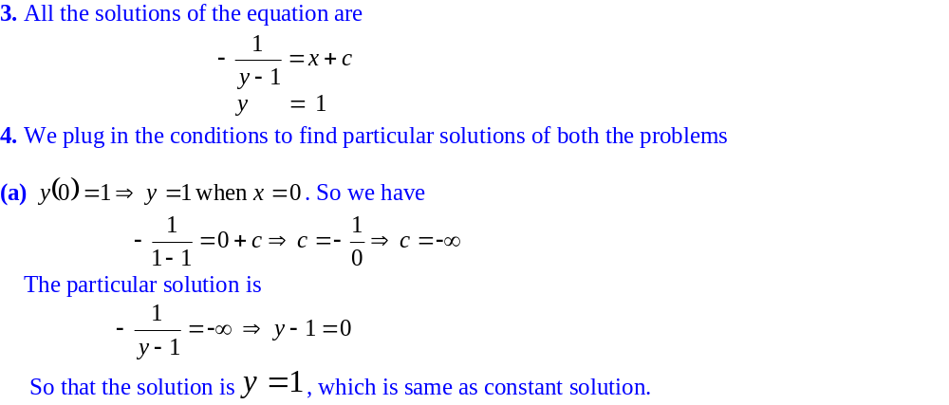
Separable Equations

Slide 18
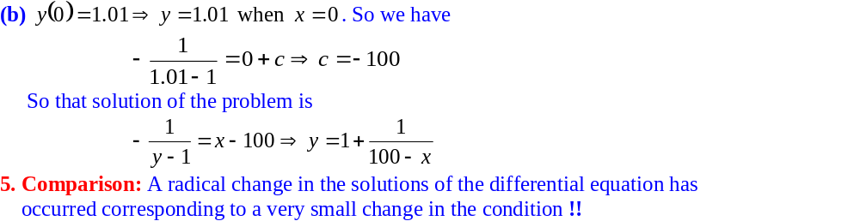
Separable Equations

Slide 19
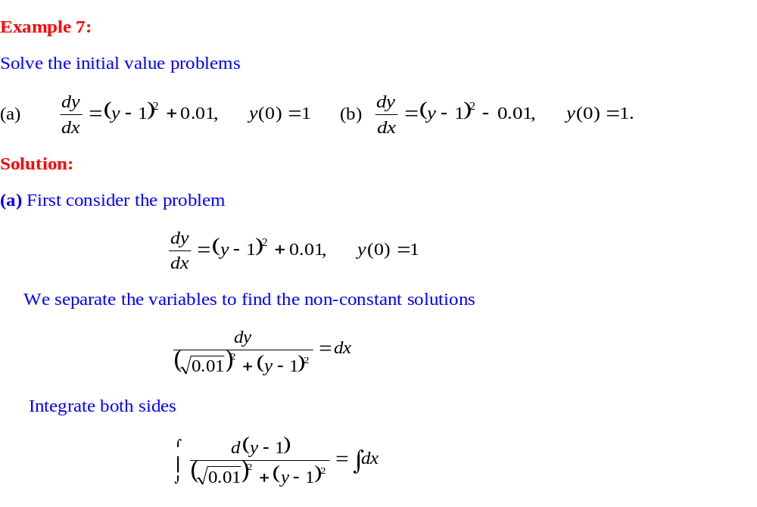
Separable Equations

Slide 20
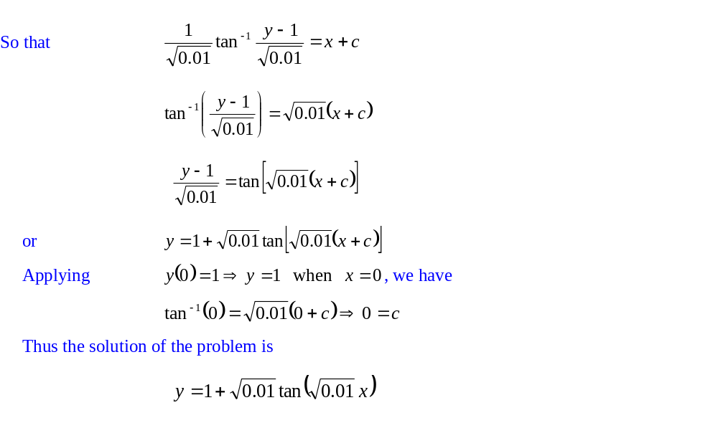
Separable Equations

Slide 21
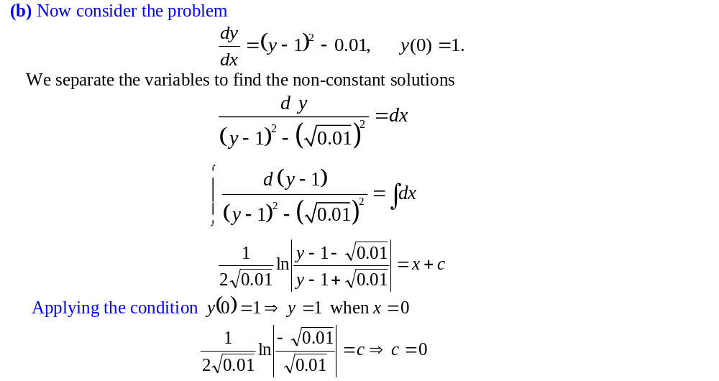
Separable Equations

Slide 22
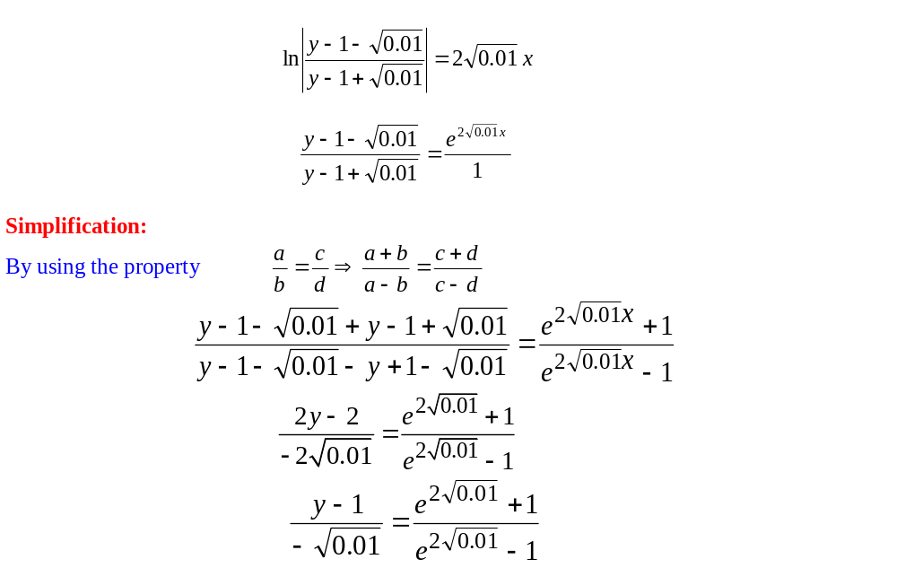
Separable Equations

Slide 23
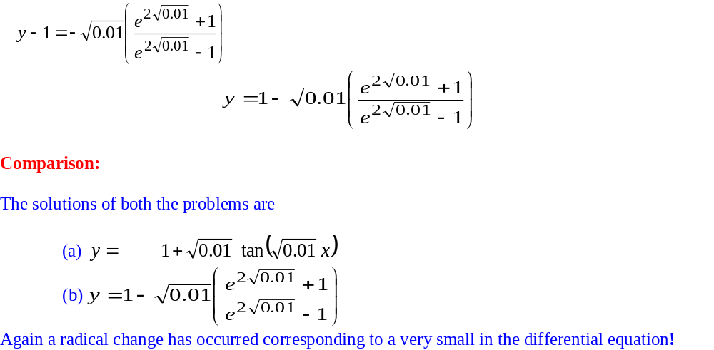
Separable Equations

Slide 24
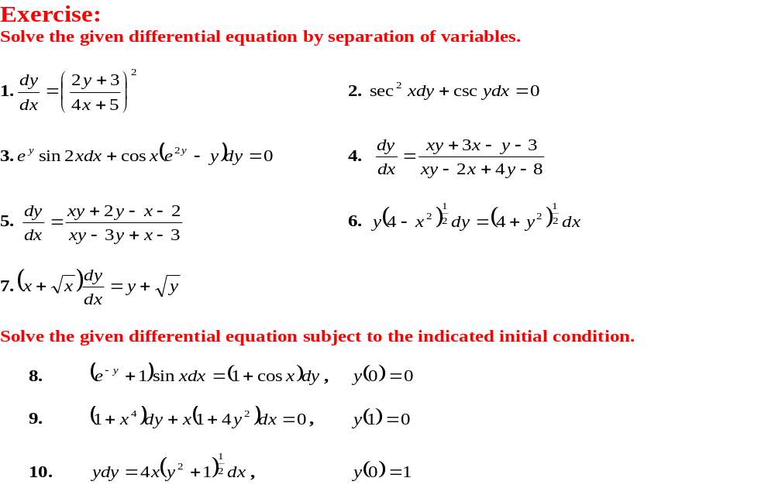
Exercises

