Slide 1

 | National University of Sciences & Technology (NUST) School of Electrical Engineering and Computer Science (SEECS) Department of Basic Sciences
Linear Algebra & Ordinary Differential Equations
MATH-121
Lecture # 25
Course Instructor: Dr Saira Zainab
Ph. # 03325193283
Email: saira.zainab@seecs.edu.pk
Office # 207, Faculty Block, SEECS

Slide 2
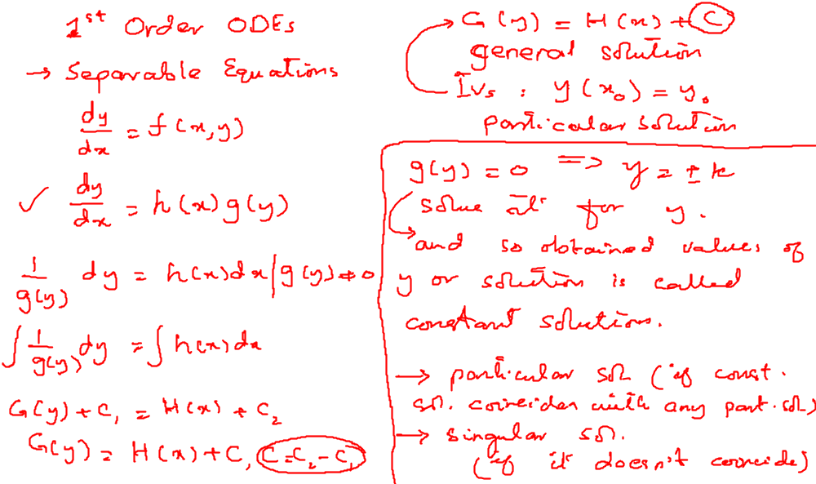
Recalling Previous Lecture

Slide 3
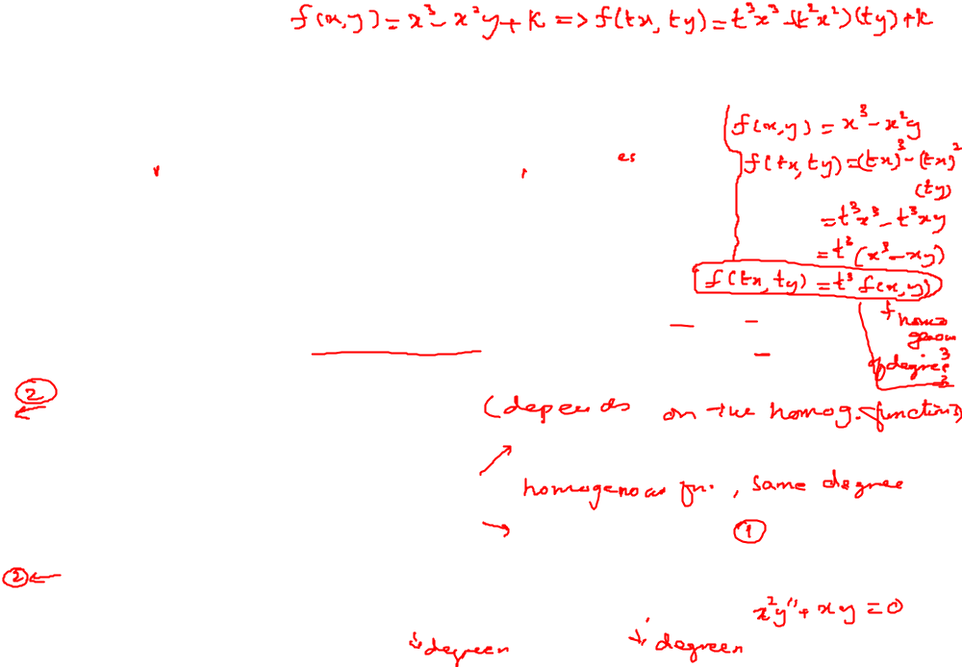
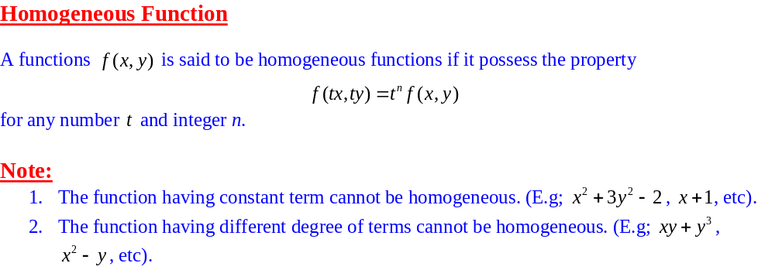
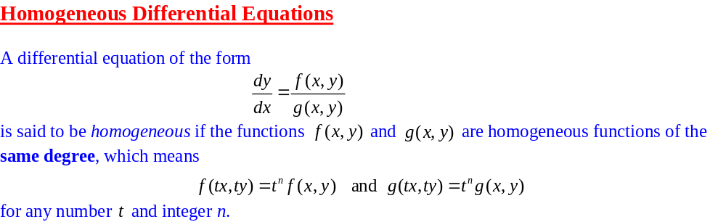
Ordinary Differential Equations of the First Order

Slide 4
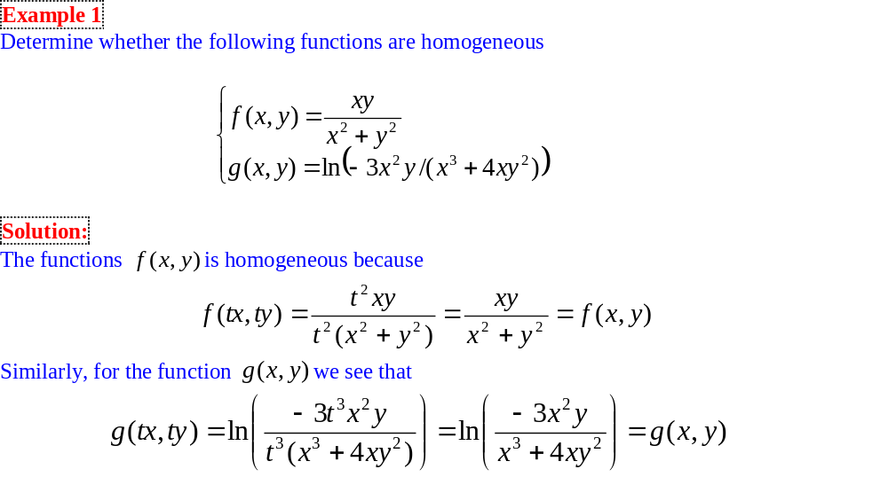
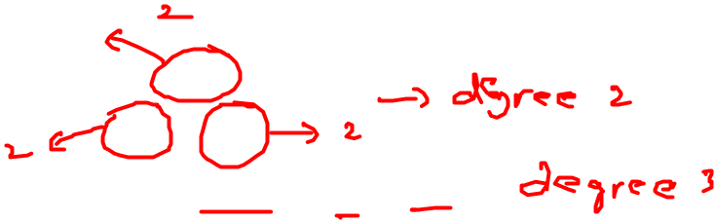
Homogeneous Differential Equations

Slide 5
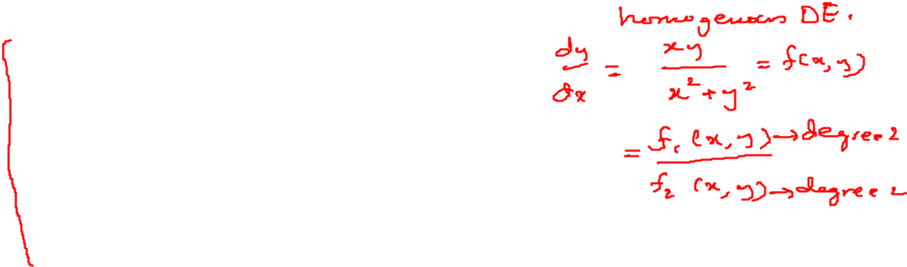
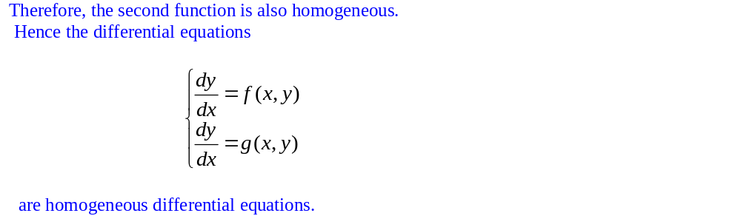
Homogeneous Differential Equations

Slide 6
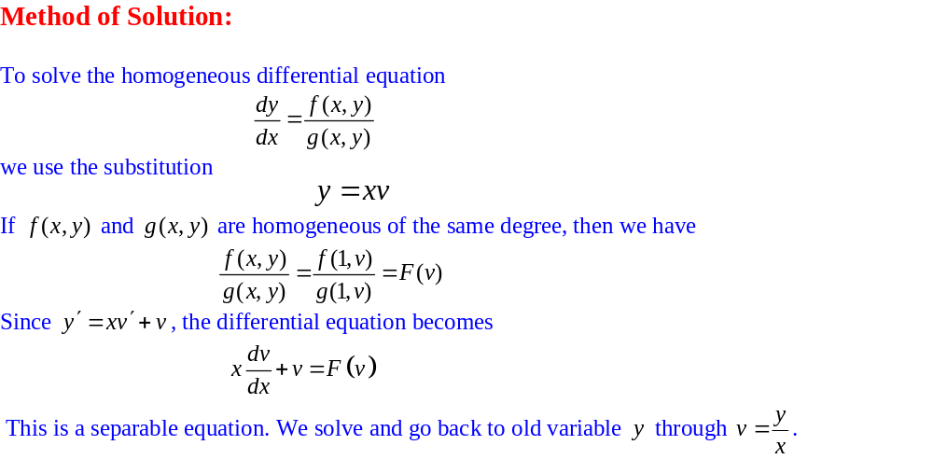
Homogeneous Differential Equations

Slide 7
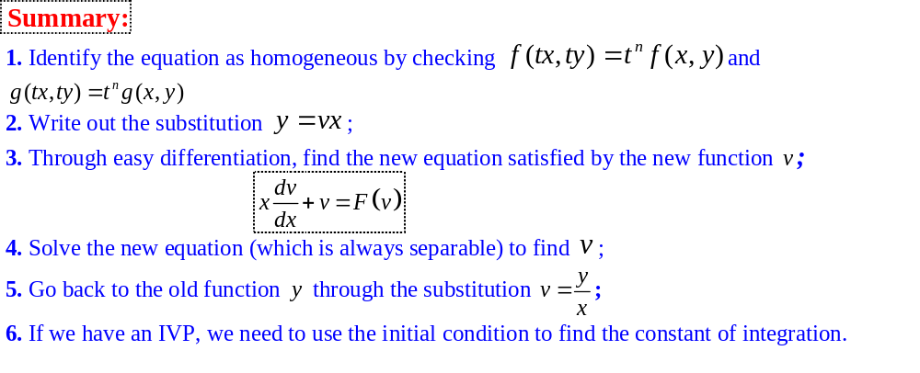
Homogeneous Differential Equations

Slide 8
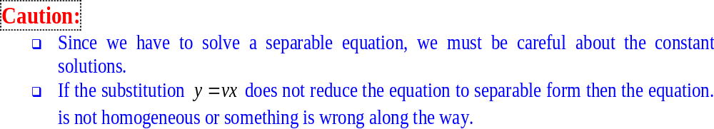
Homogeneous Differential Equations

Slide 9
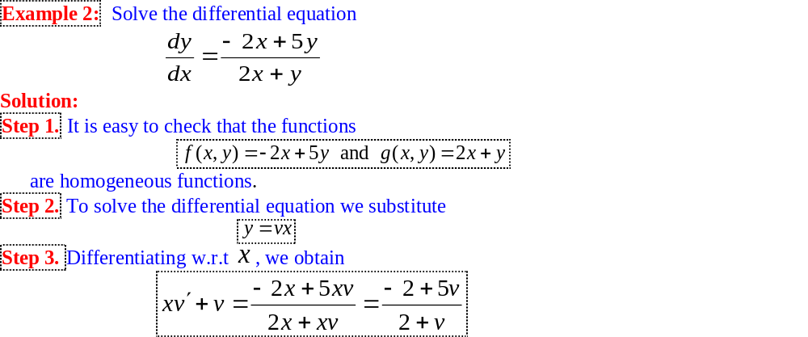
Homogeneous Differential Equations

Slide 10
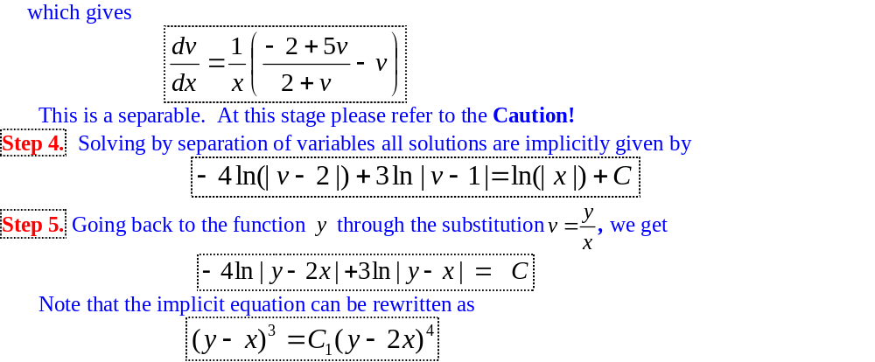
Homogeneous Differential Equations

Slide 11
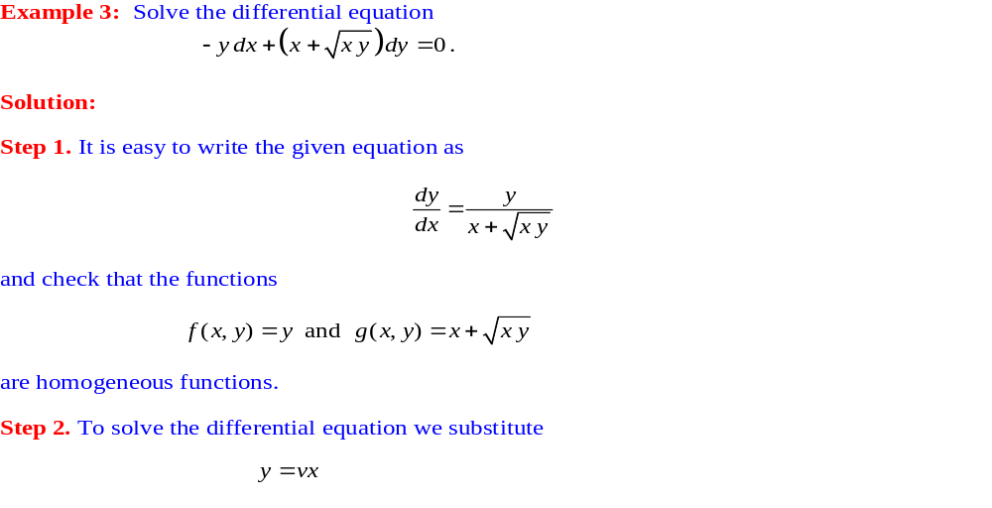
Homogeneous Differential Equations

Slide 12
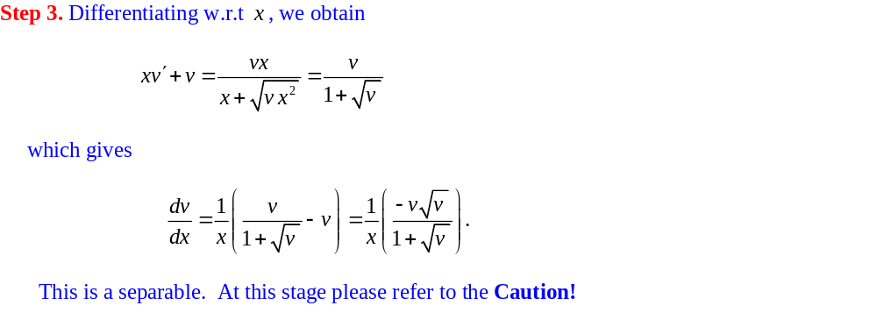
Homogeneous Differential Equations

Slide 13
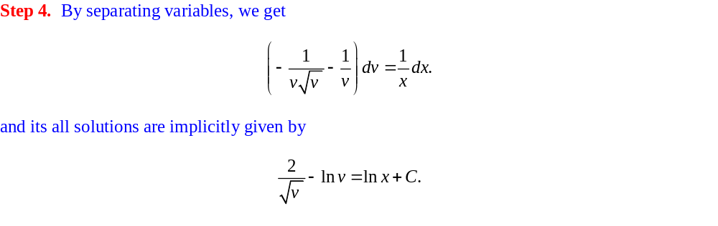
Homogeneous Differential Equations

Slide 14
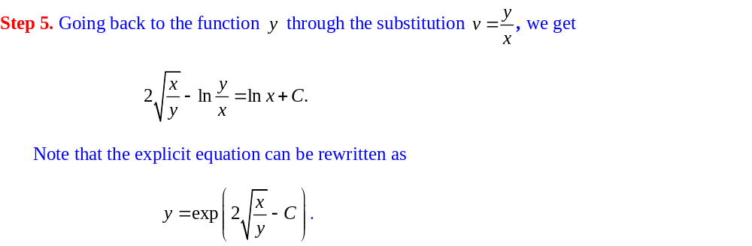
Homogeneous Differential Equations

Slide 15
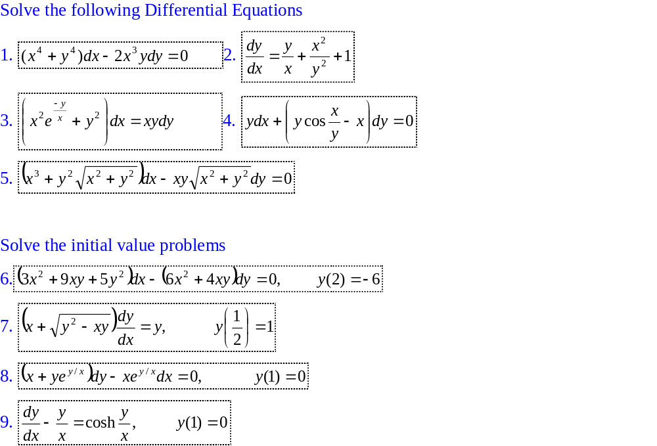
Exercises

