Slide 1

 | National University of Sciences & Technology (NUST) School of Electrical Engineering and Computer Science (SEECS) Department of Basic Sciences
Linear Algebra & Ordinary Differential Equations
MATH-121
Lecture # 26
Course Instructor: Dr Saira Zainab
Ph. # 03325193283
Email: saira.zainab@seecs.edu.pk
Office # 207, Faculty Block, SEECS

Slide 2
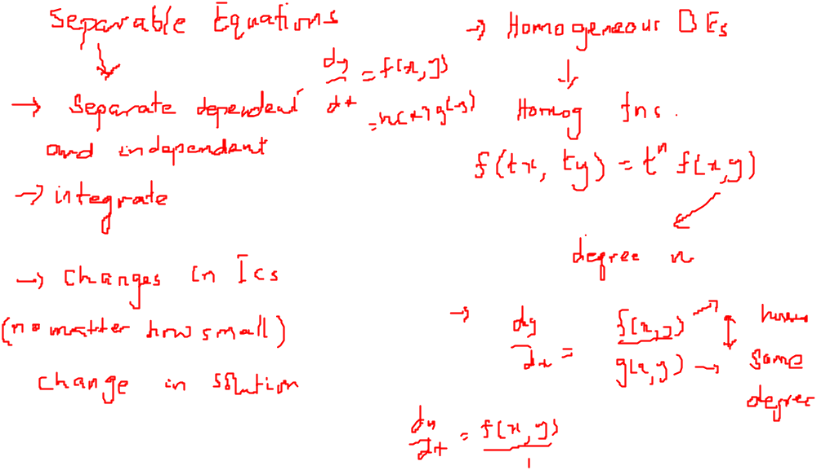
Recalling Previous Lecture

Slide 3
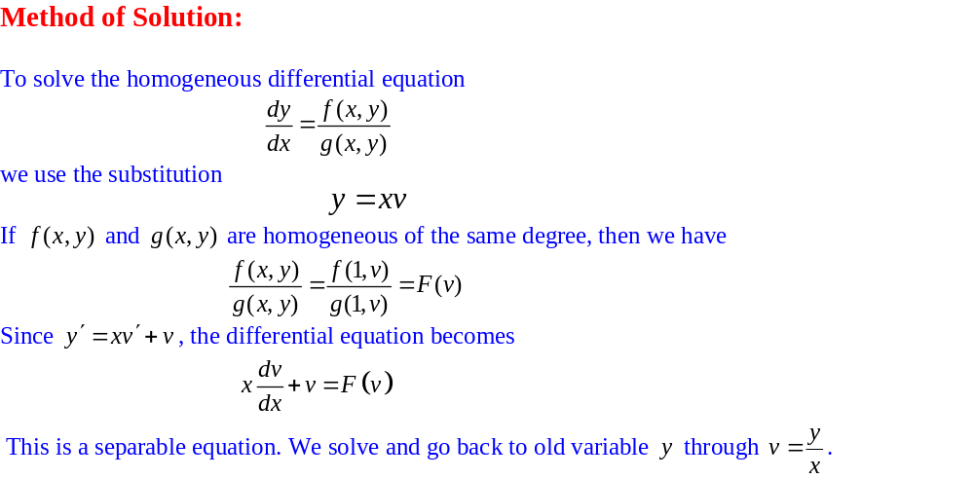
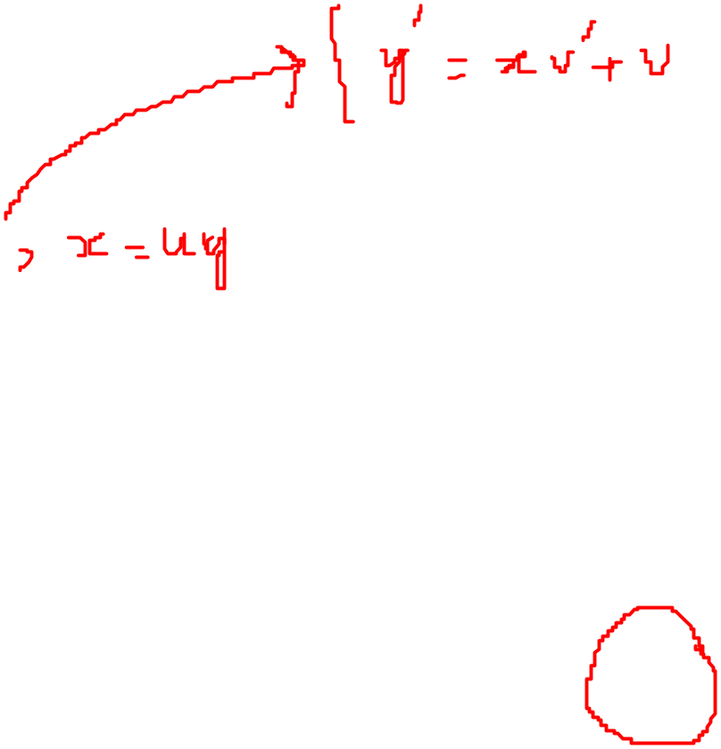
Homogeneous Differential Equations

Slide 4
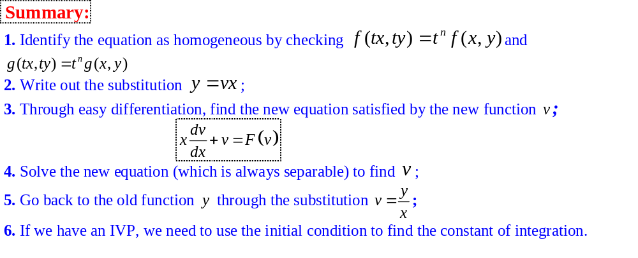
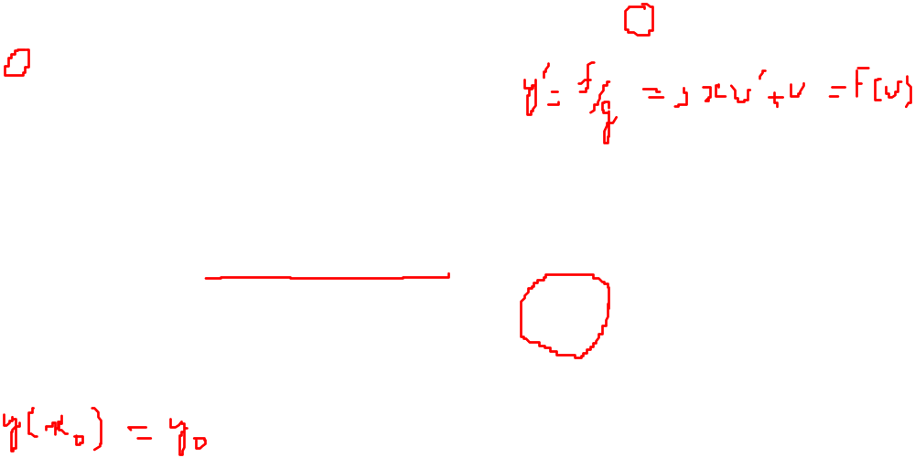
Homogeneous Differential Equations

Slide 5
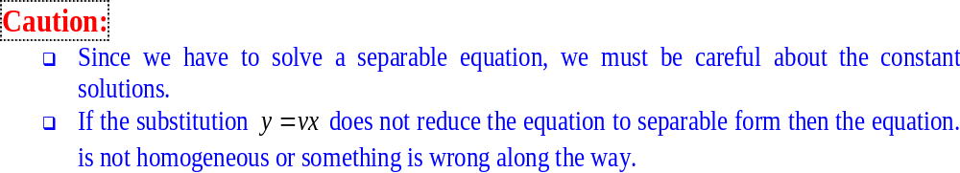
Homogeneous Differential Equations

Slide 6
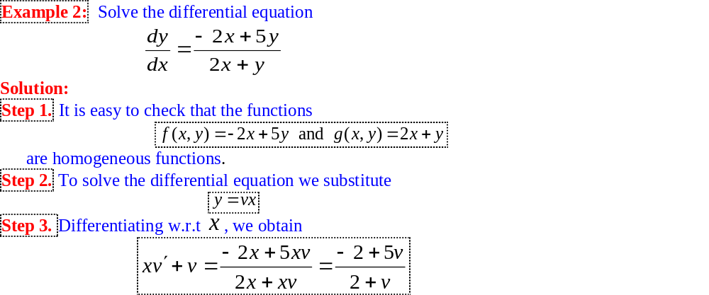
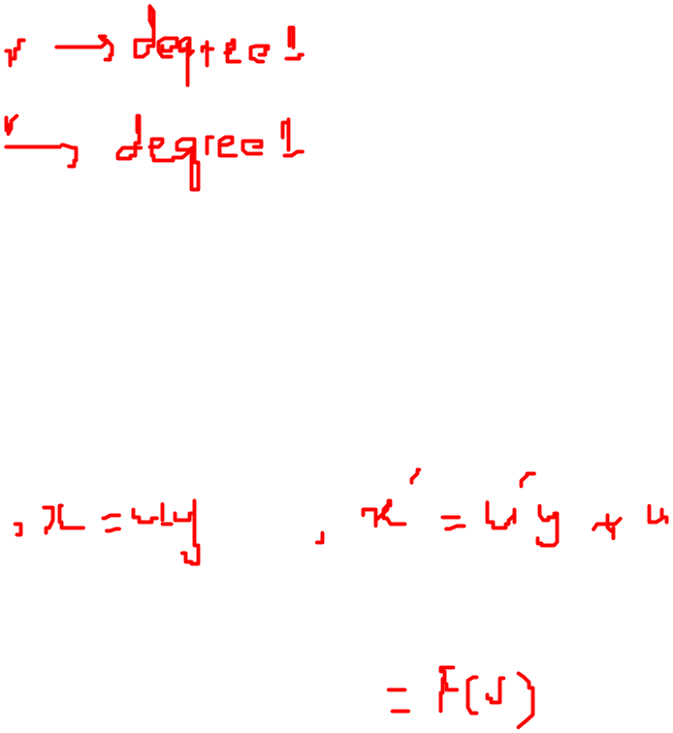
Homogeneous Differential Equations

Slide 7
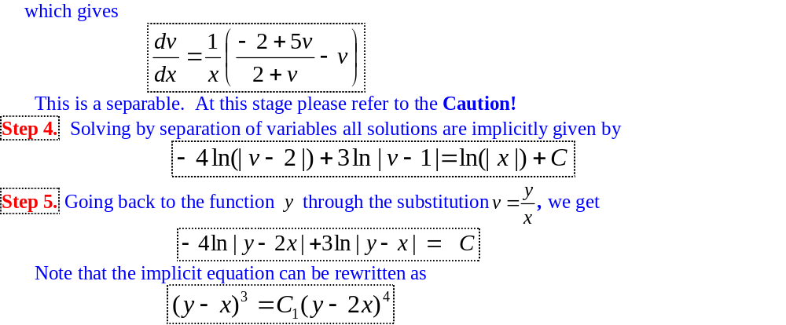
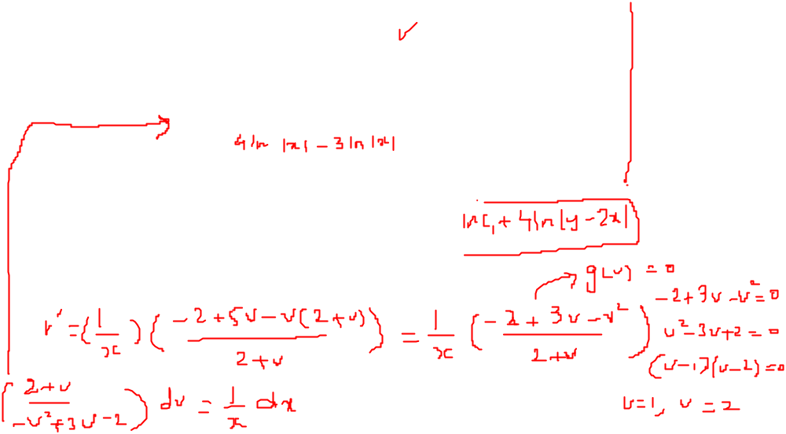
Homogeneous Differential Equations

Slide 8
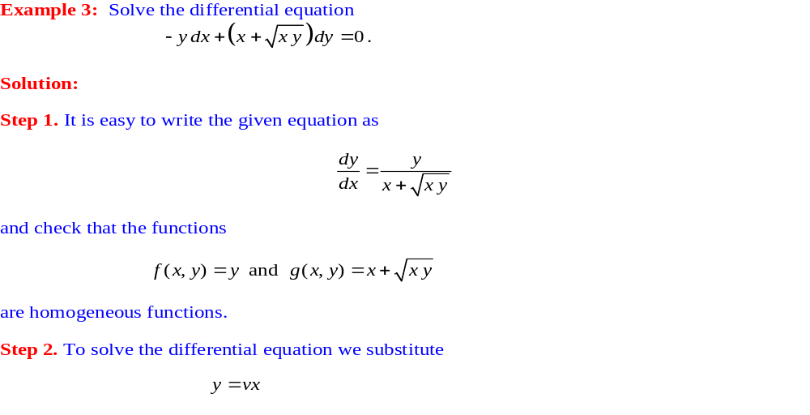
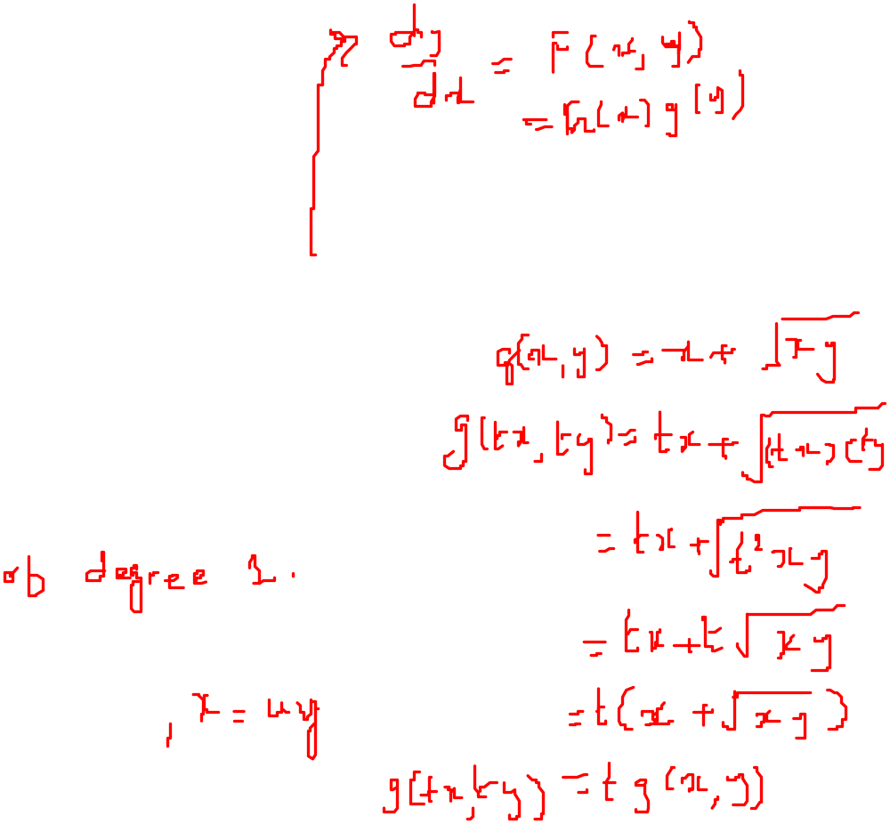
Homogeneous Differential Equations

Slide 9
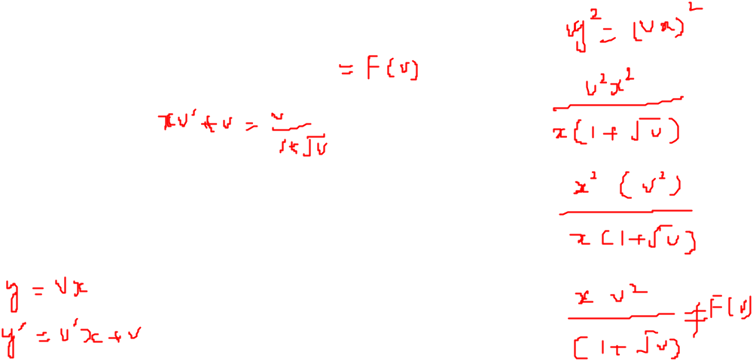
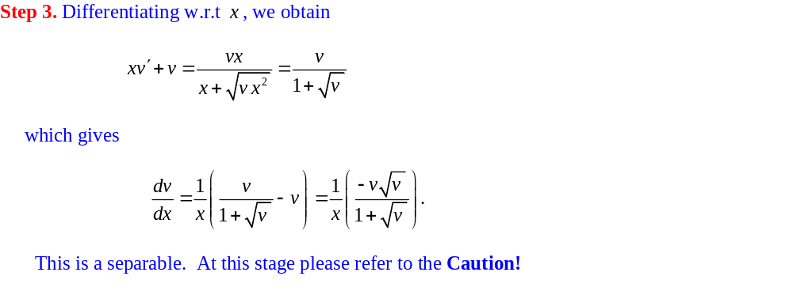
Homogeneous Differential Equations

Slide 10
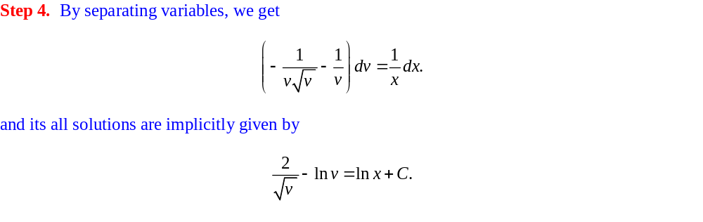
Homogeneous Differential Equations

Slide 11
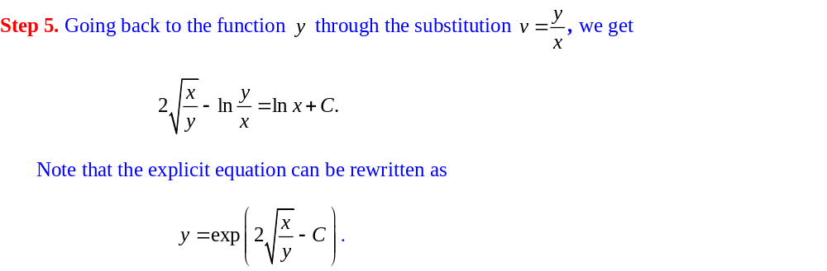
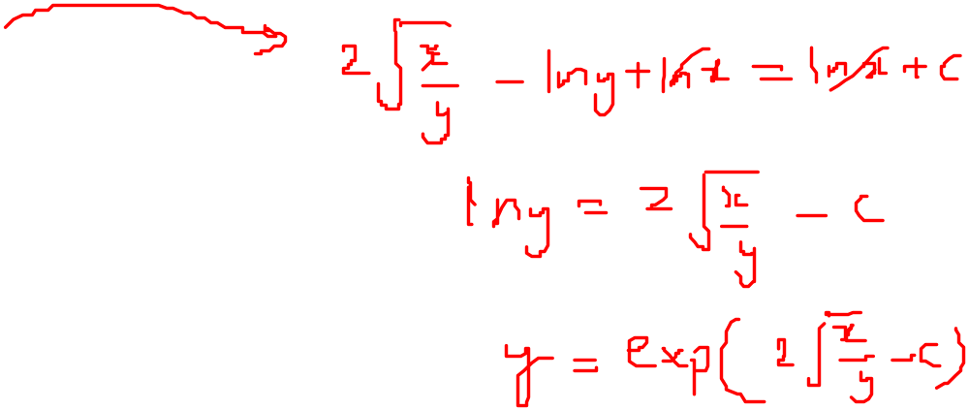
Homogeneous Differential Equations

Slide 12
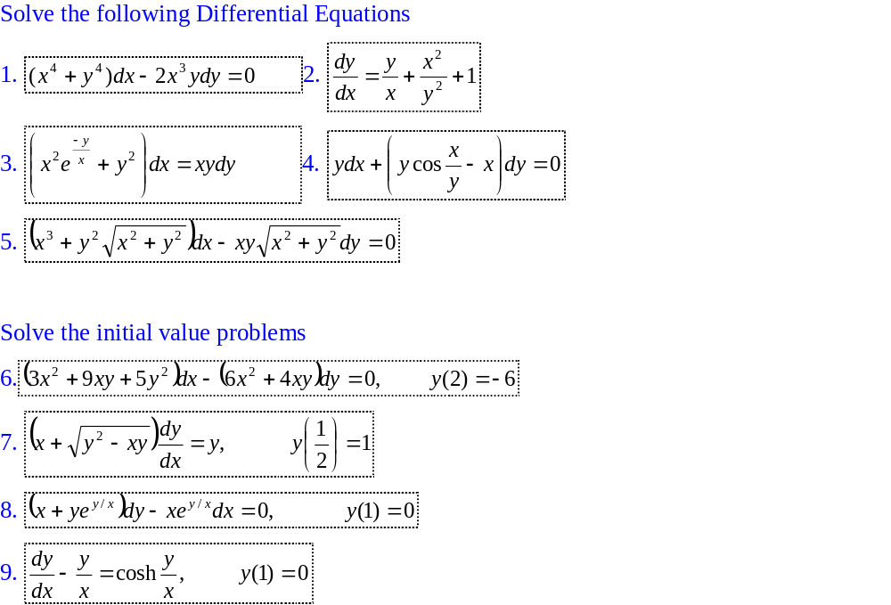
Exercises

