Slide 1

 | National University of Sciences & Technology (NUST) School of Electrical Engineering and Computer Science (SEECS) Department of Basic Sciences
Linear Algebra & Ordinary Differential Equations
MATH-121
Lecture # 27
Course Instructor: Dr Saira Zainab
Ph. # 03325193283
Email: saira.zainab@seecs.edu.pk
Office # 207, Faculty Block, SEECS

Slide 2
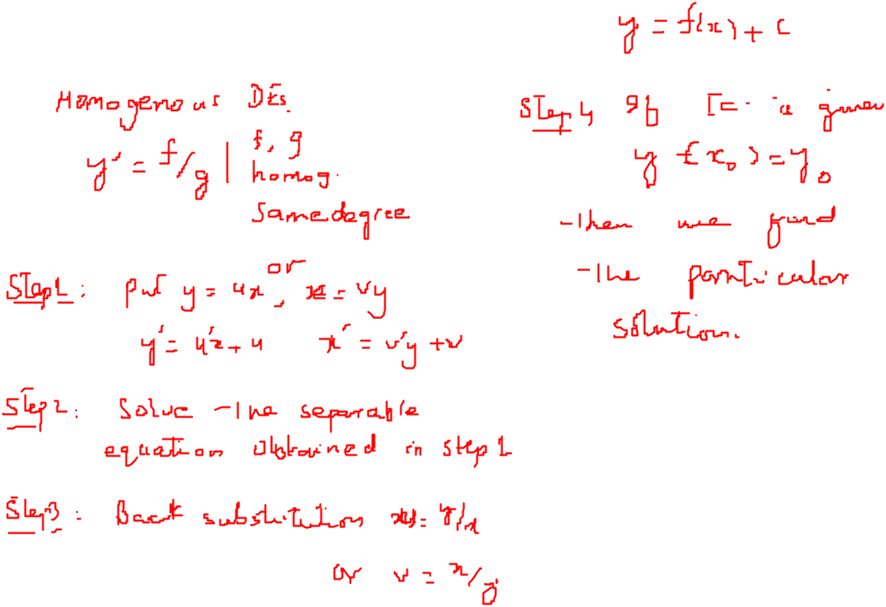
Recalling Previous Lecture

Slide 3
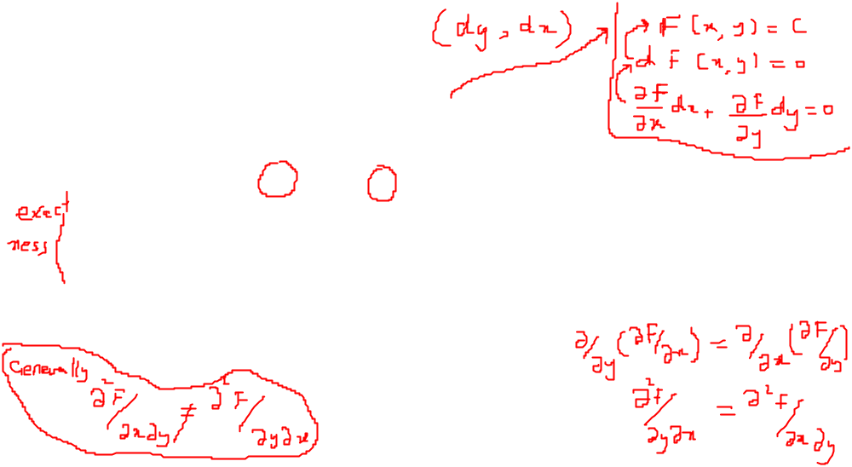
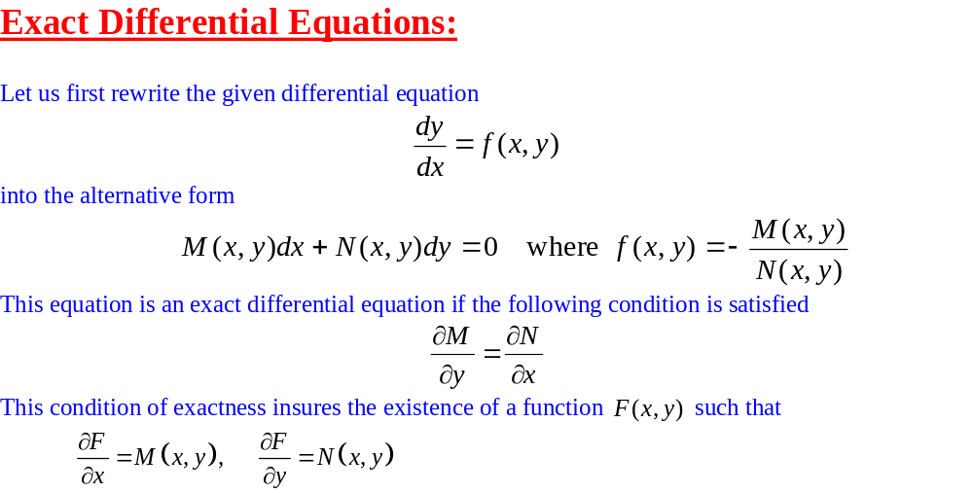
Ordinary Differential Equations of the First Order

Slide 4
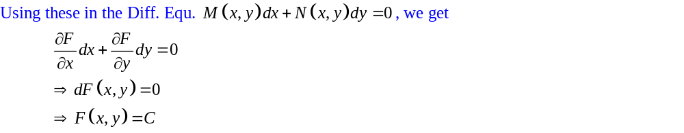
Exact Differential Equations

Slide 5
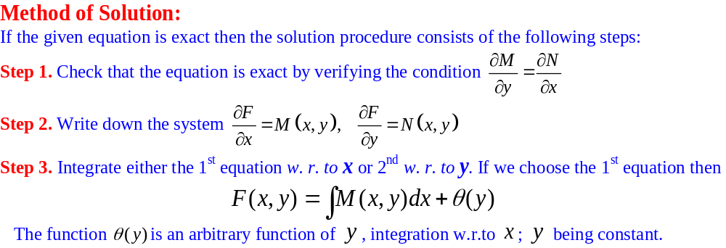
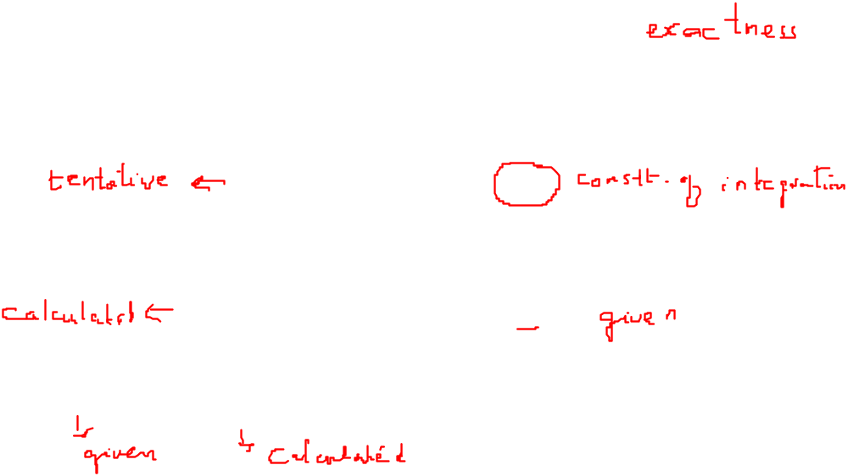
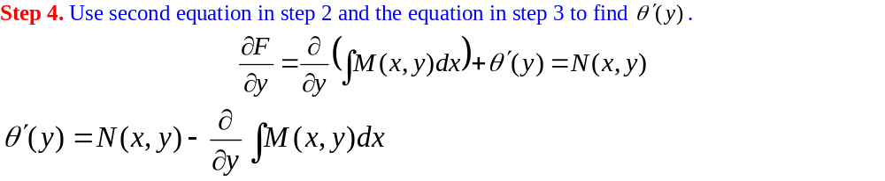
Exact Differential Equations

Slide 6
Exact Differential Equations

Slide 7
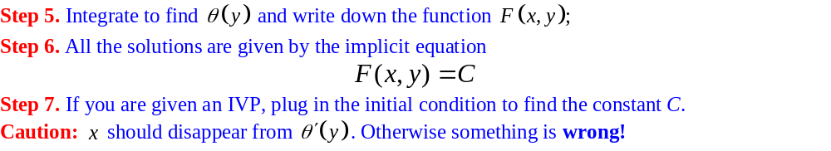
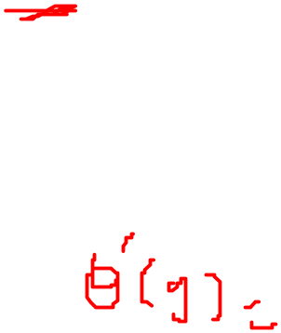
Exact Differential Equations

Slide 8

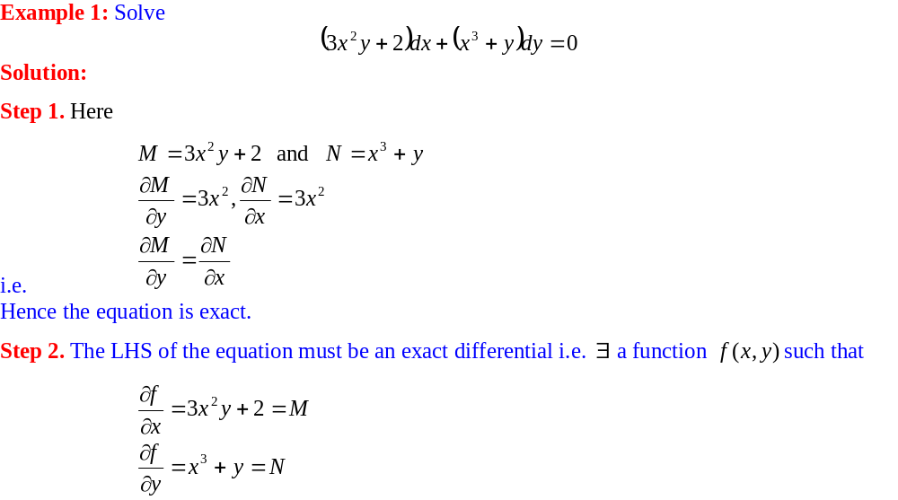
Exact Differential Equations

Slide 9
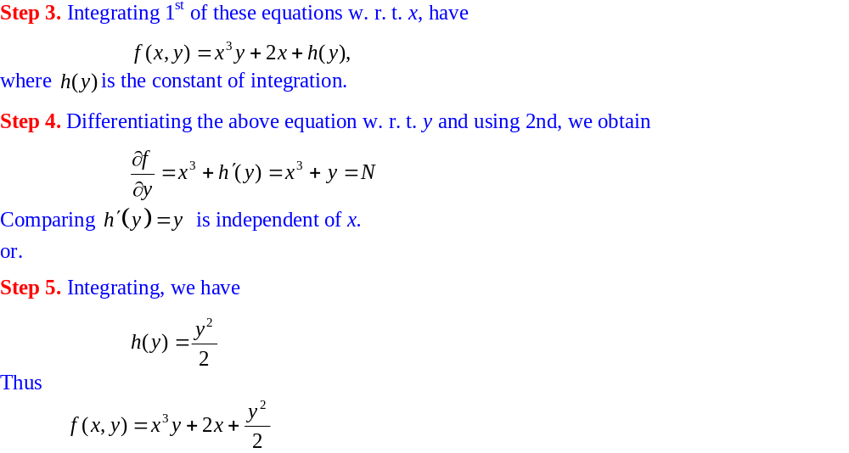
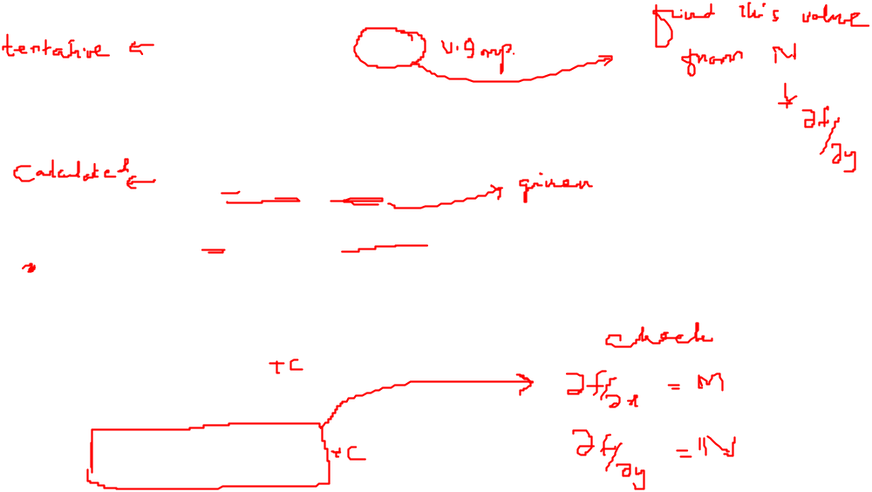
Exact Differential Equations

Slide 10
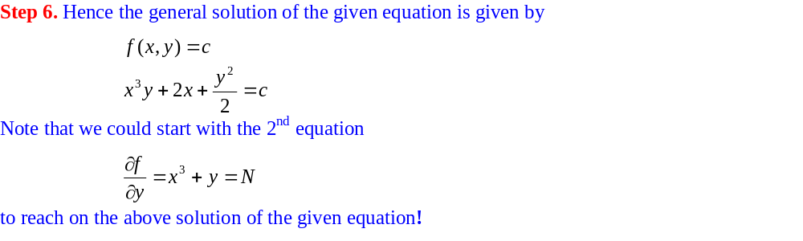

Exact Differential Equations

Slide 11
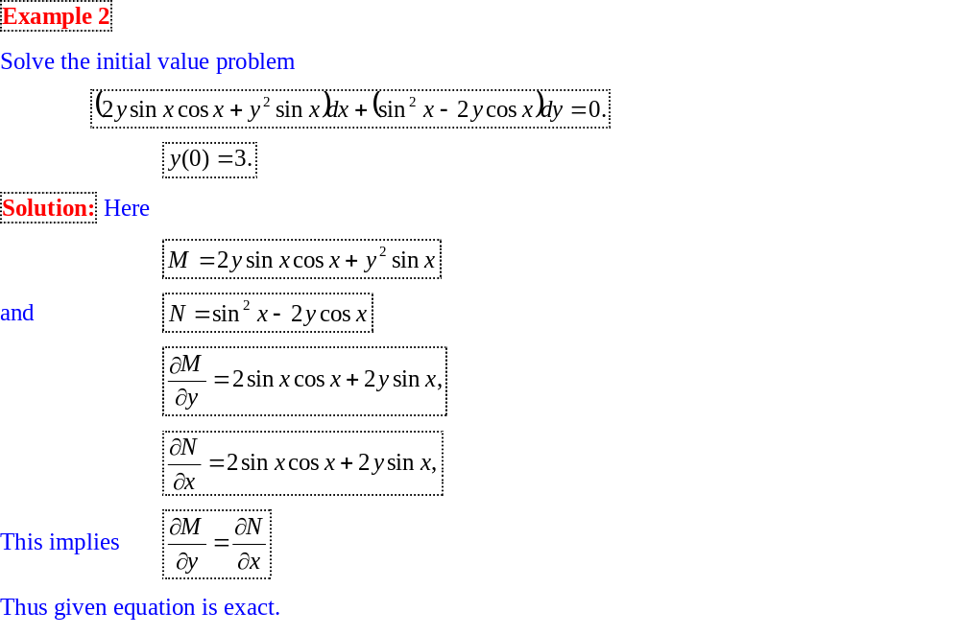
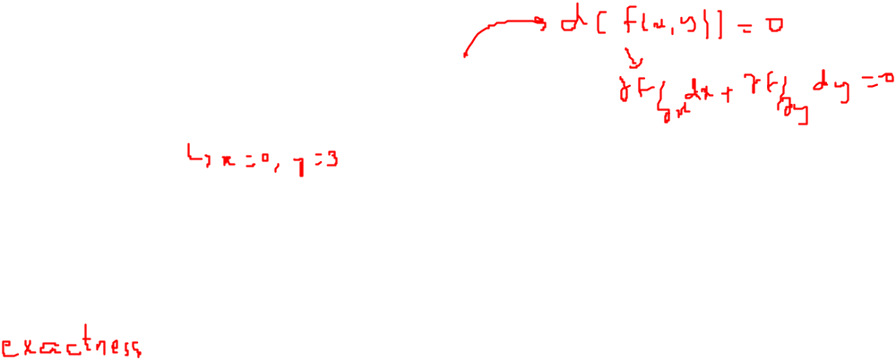
Exact Differential Equations

Slide 12
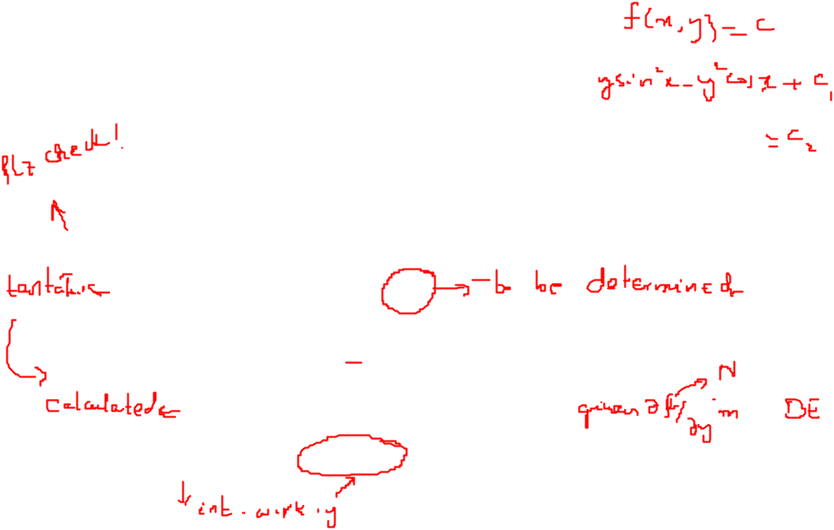
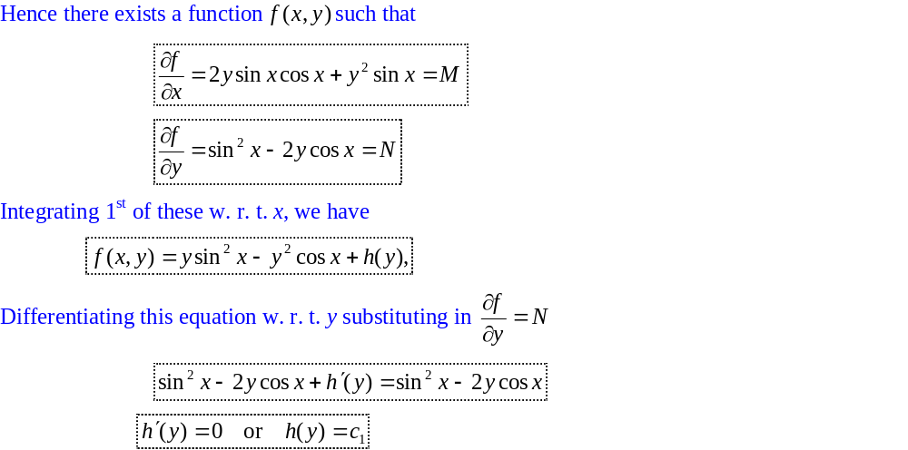
Exact Differential Equations

Slide 13
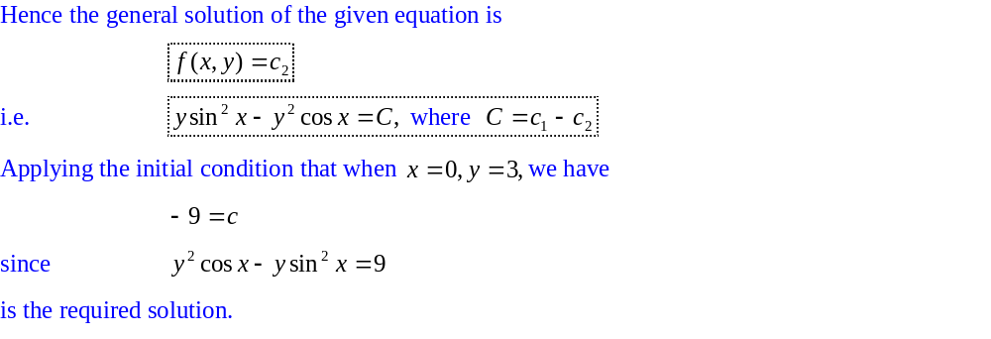
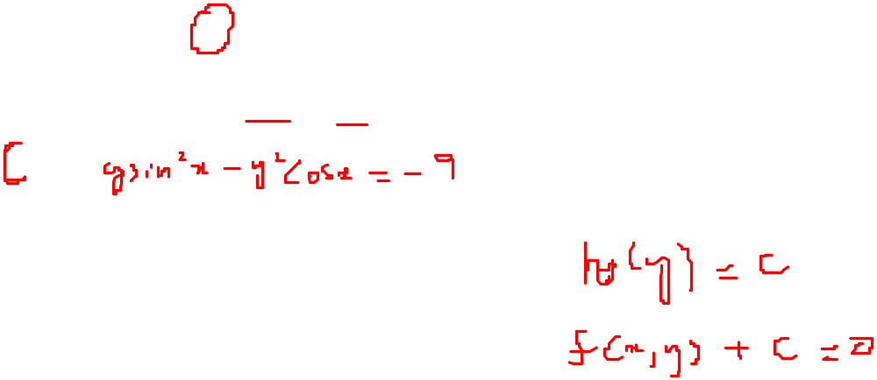
Exact Differential Equations

Slide 14
Exact Differential Equations

Slide 15
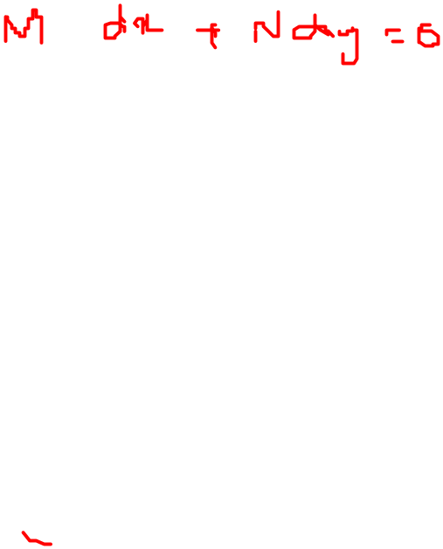
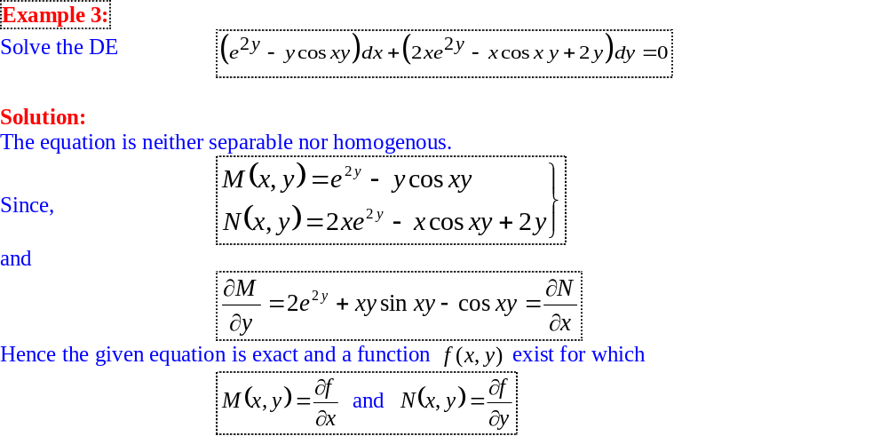
Exact Differential Equations

Slide 16
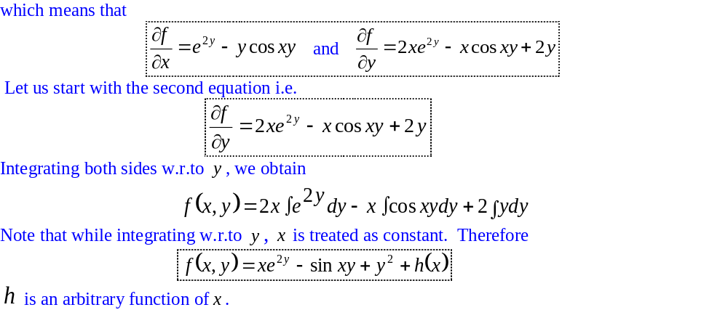
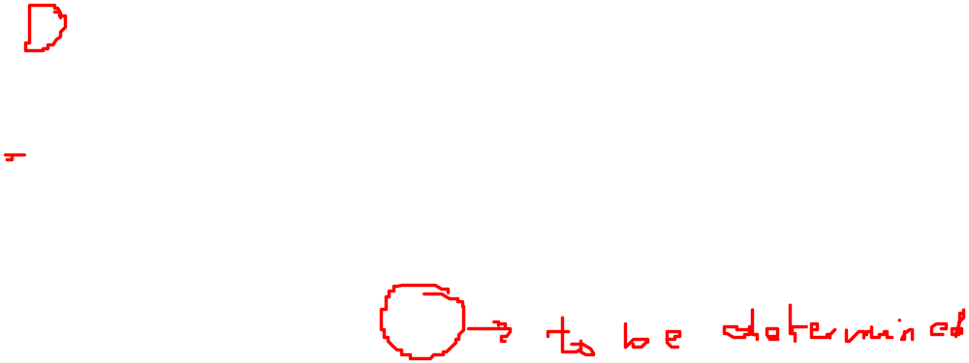
Exact Differential Equations

Slide 17
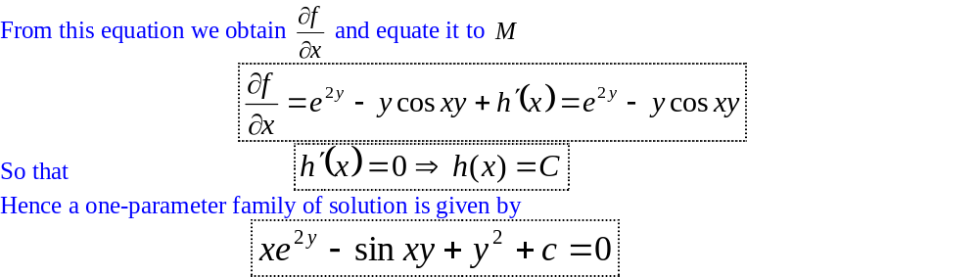
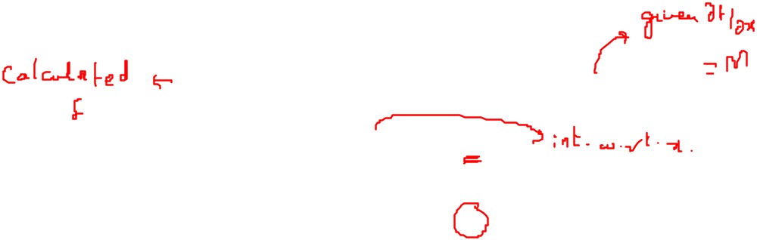
Exact Differential Equations

Slide 18
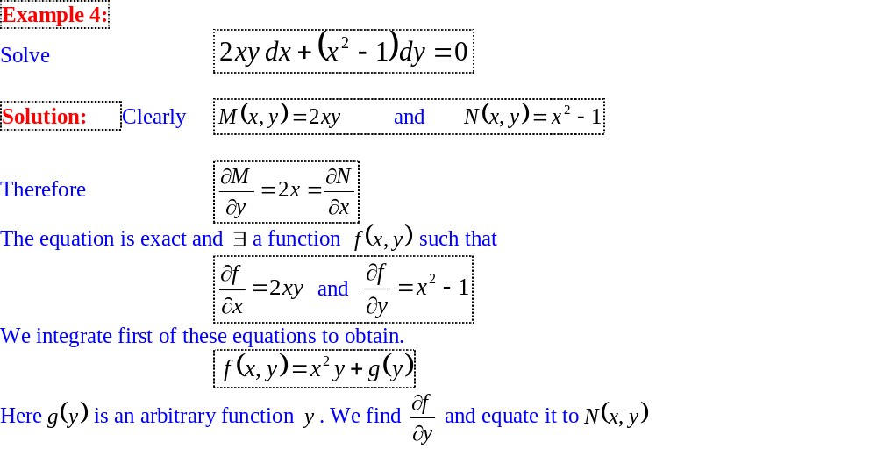
Exact Differential Equations

Slide 19
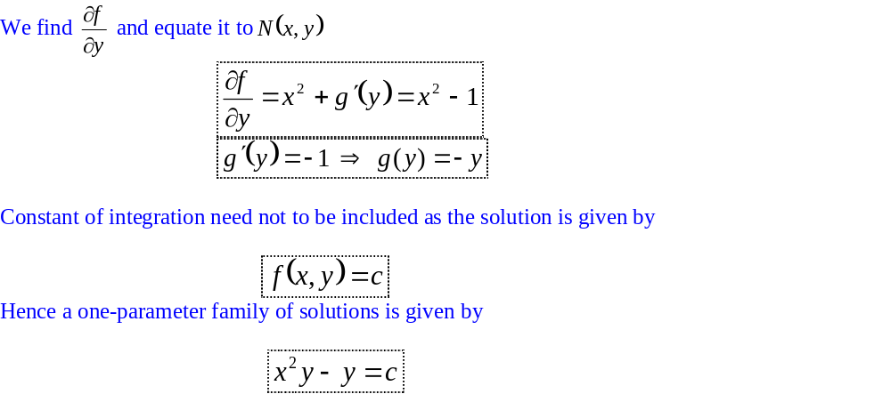
Exact Differential Equations

Slide 20
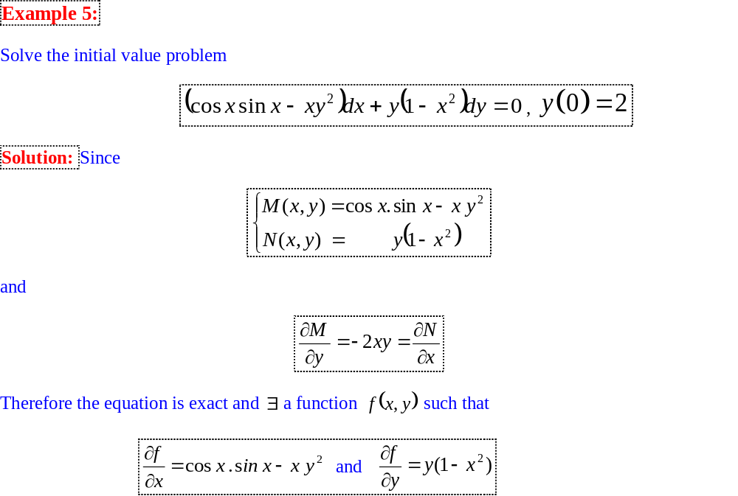
Exact Differential Equations

Slide 21
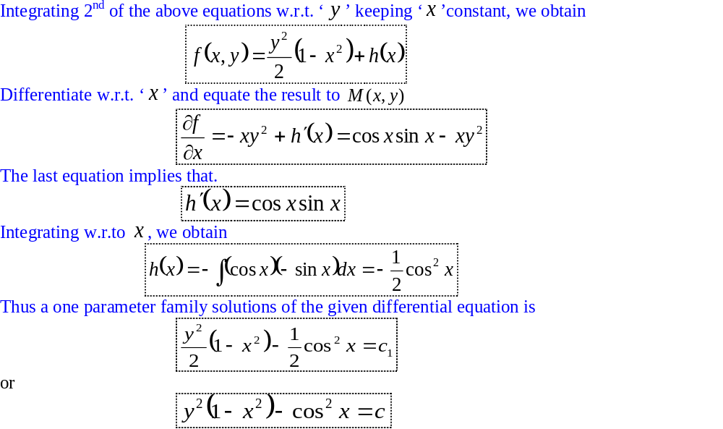
Exact Differential Equations

Slide 22
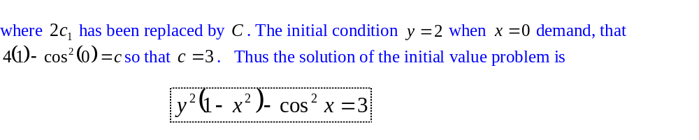
Exact Differential Equations

Slide 23
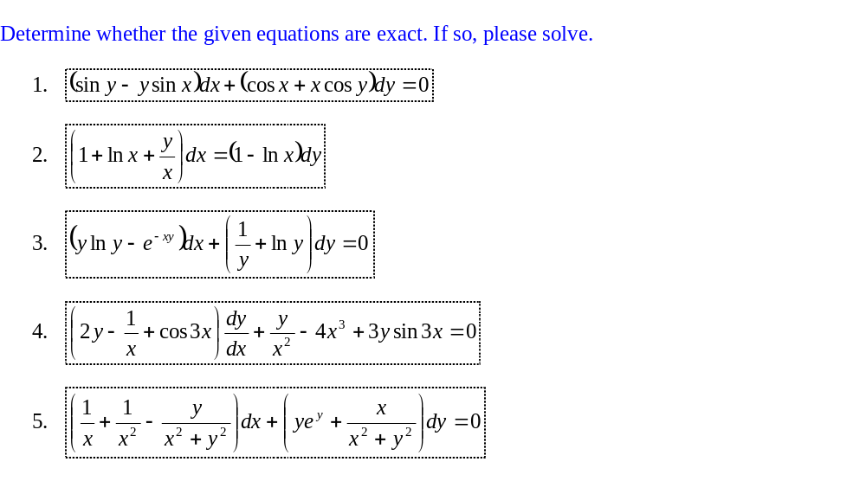
Exercises

Slide 24
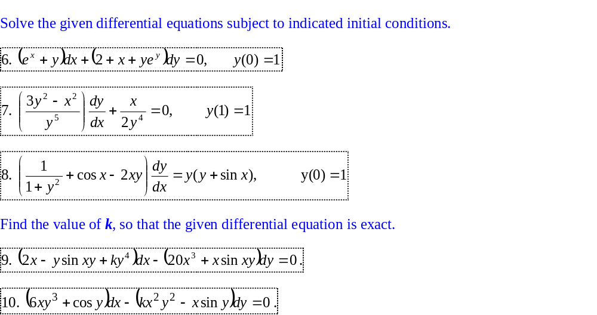
Exercises

