Slide 1

 | National University of Sciences & Technology (NUST) School of Electrical Engineering and Computer Science (SEECS) Department of Basic Sciences
Linear Algebra & Ordinary Differential Equations
MATH-121
Lecture # 32
Course Instructor: Dr Saira Zainab
Ph. # 03325193283
Email: saira.zainab@seecs.edu.pk
Office # 207, Faculty Block, SEECS
1

Slide 2
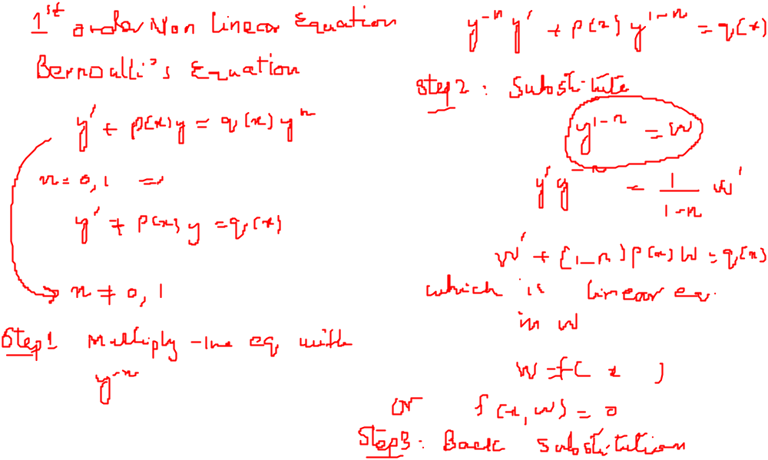
Recalling Previous Lecture

Slide 3
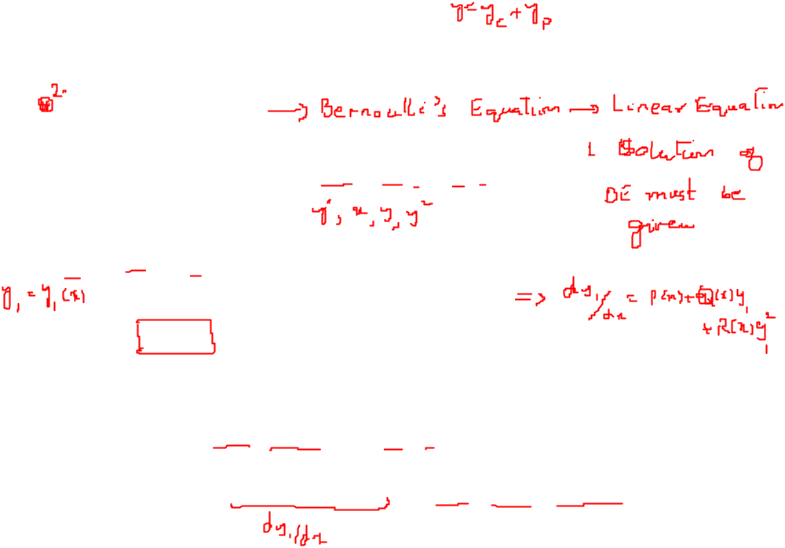
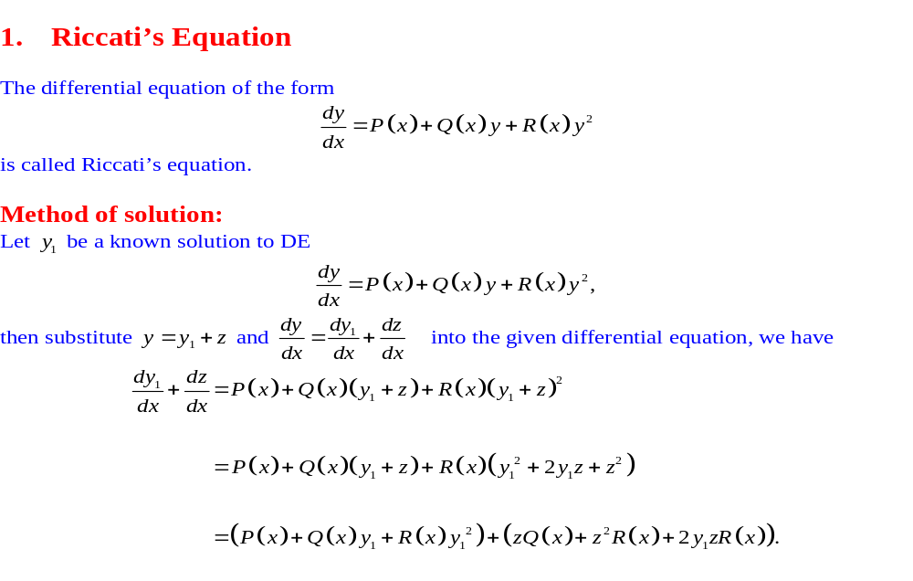
First Order Non-Linear Equations

Slide 4
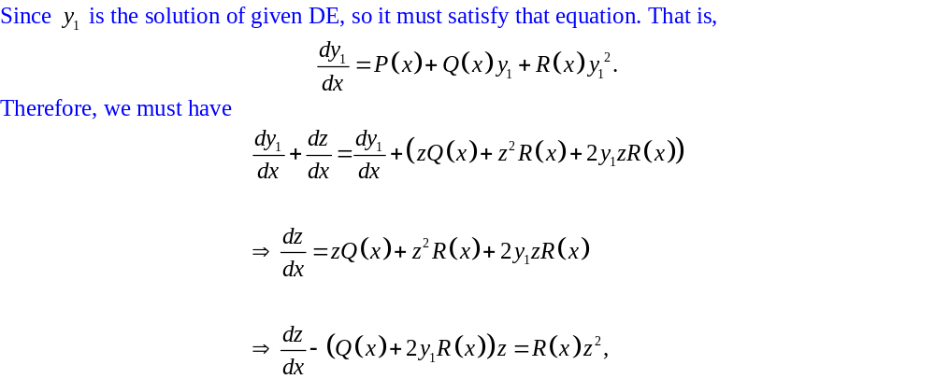
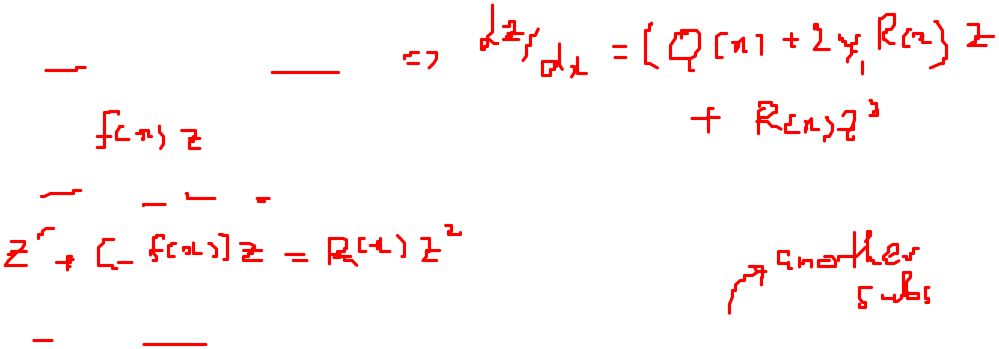
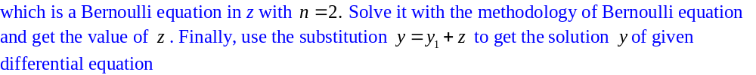
First Order Non-Linear Equations

Slide 5
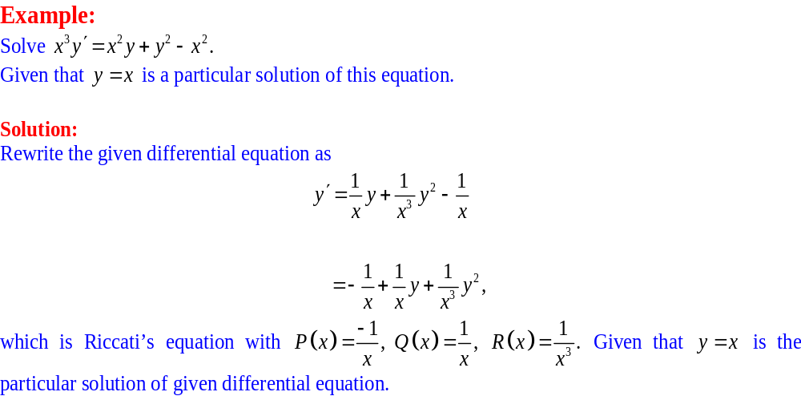
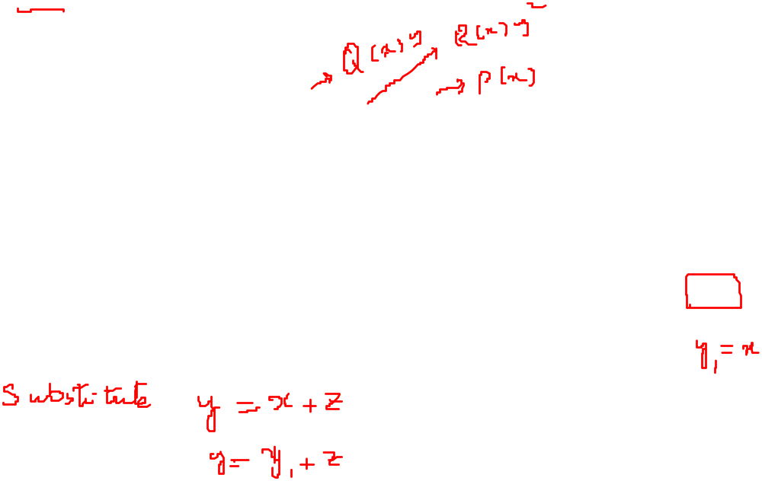
First Order Non-Linear Equations

Slide 6
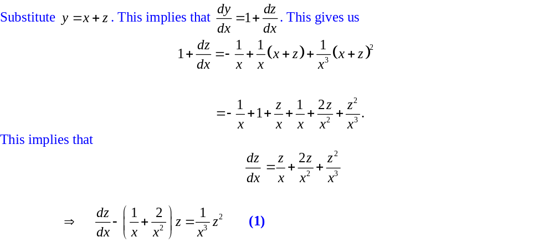
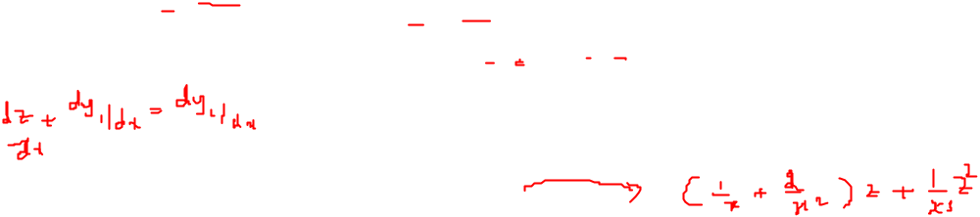
First Order Non-Linear Equations

Slide 7
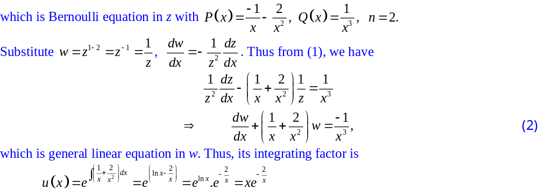

First Order Non-Linear Equations

Slide 8
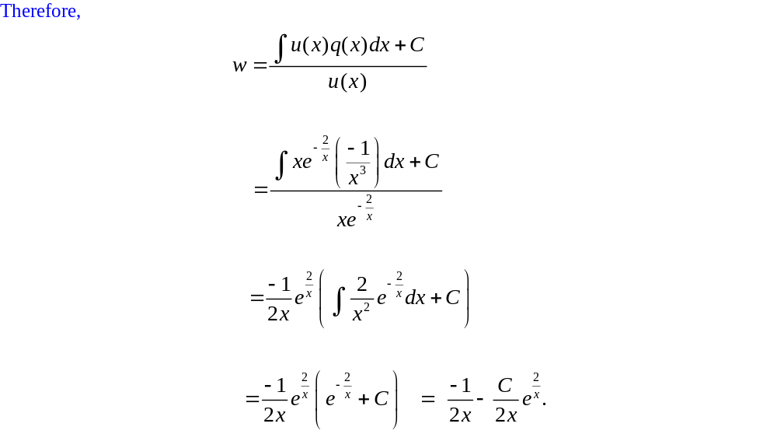
First Order Non-Linear Equations

Slide 9
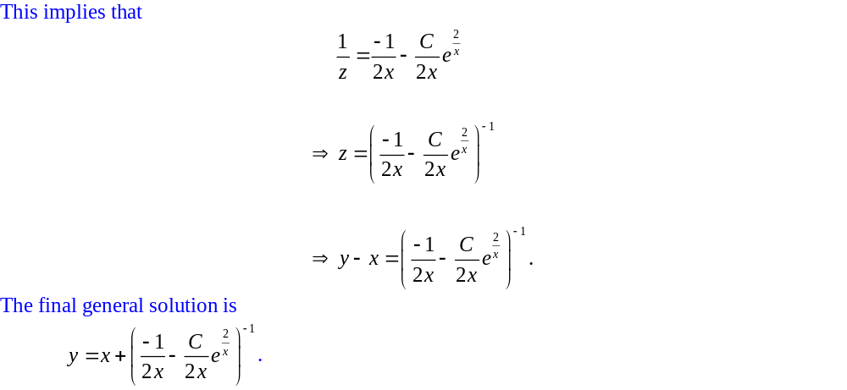
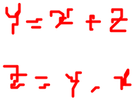
First Order Non-Linear Equations

Slide 10
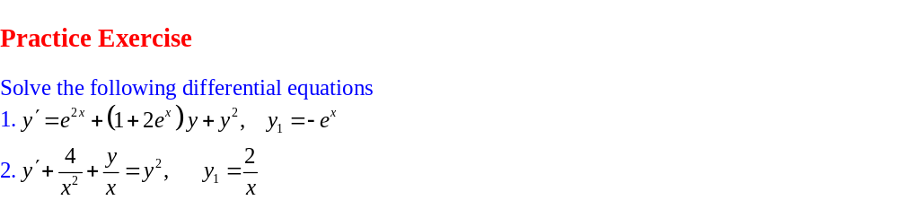
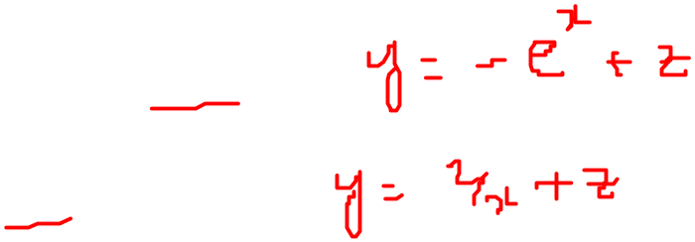
First Order Non-Linear Equations

Slide 11
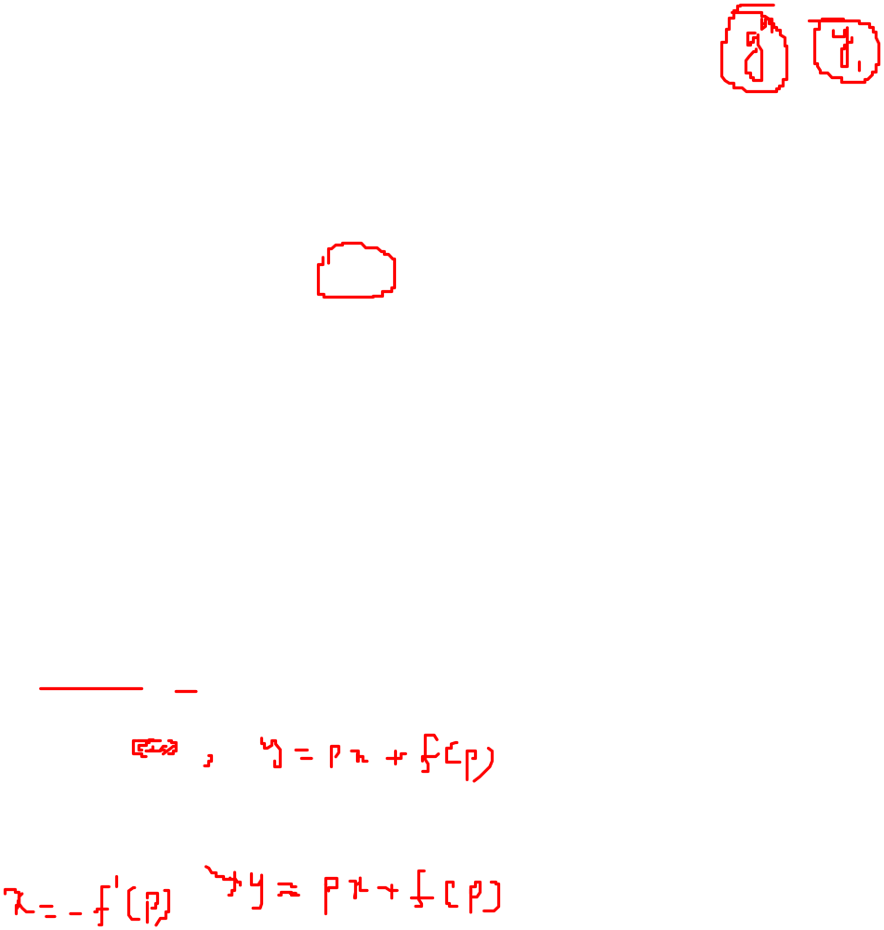
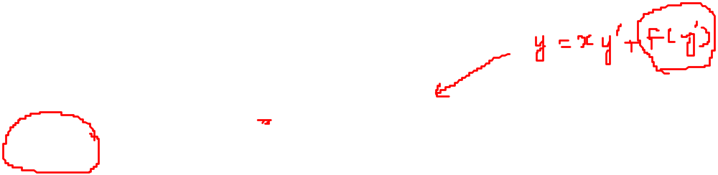
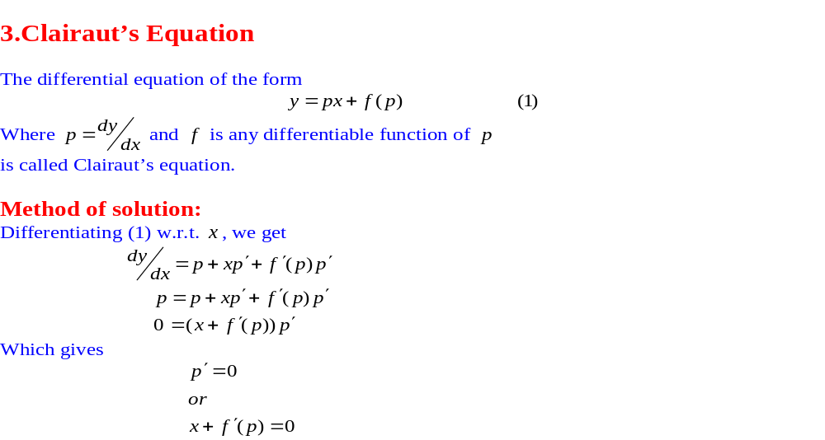
First Order Non-Linear Equations

Slide 12
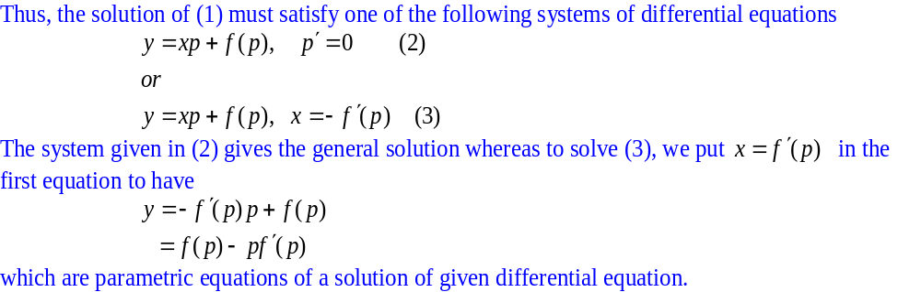
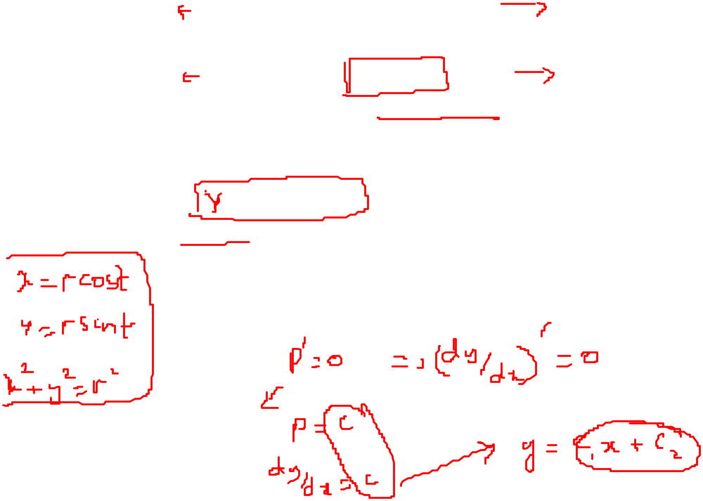
First Order Non-Linear Equations

Slide 13
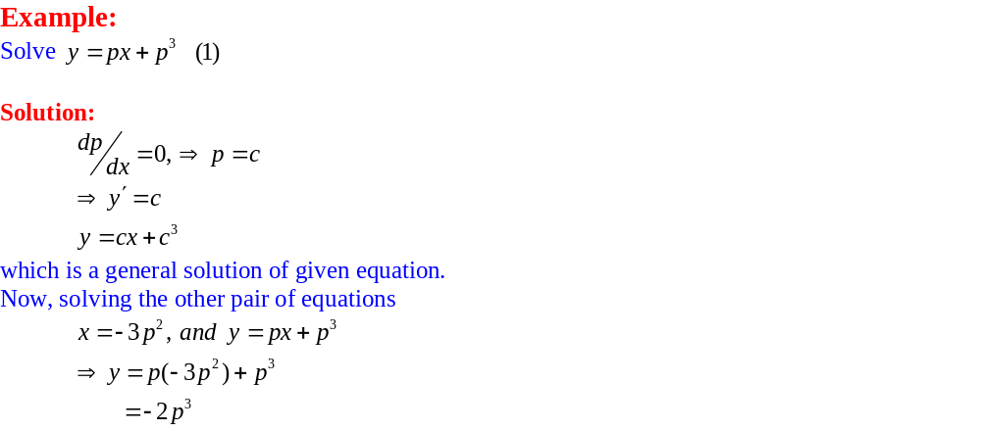
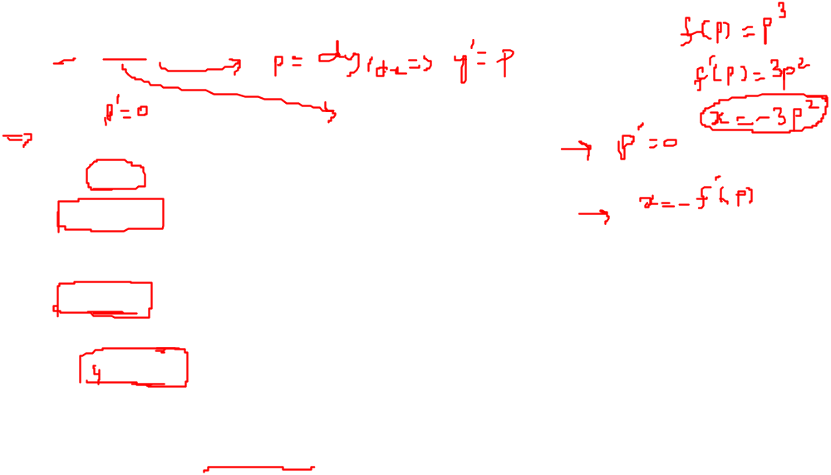
First Order Non-Linear Equations

Slide 14
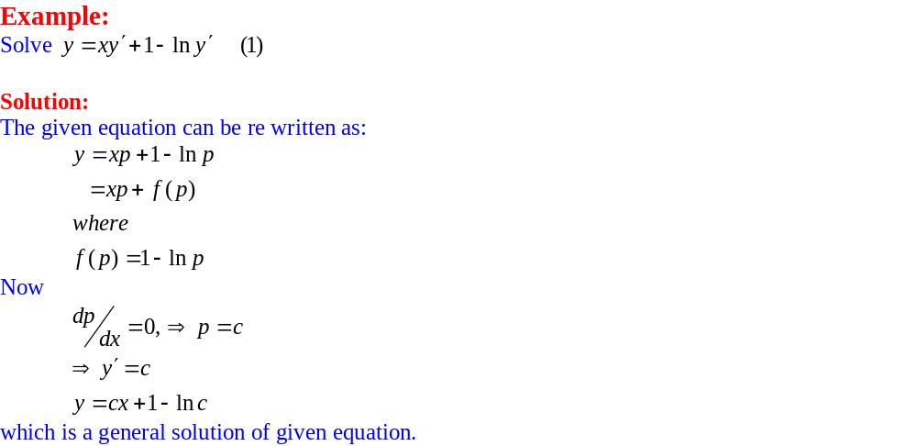
First Order Non-Linear Equations

Slide 15
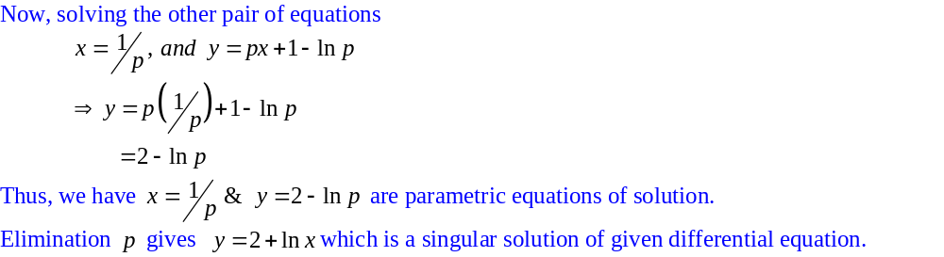
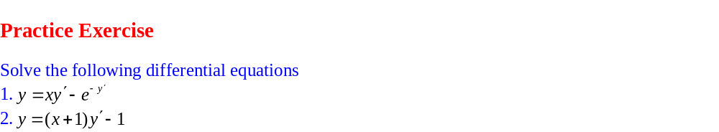
First Order Non-Linear Equations

