Slide 1

 | National University of Sciences & Technology (NUST) School of Electrical Engineering and Computer Science (SEECS) Department of Basic Sciences
Linear Algebra & Ordinary Differential Equations
MATH-121
Lecture # 33
Course Instructor: Dr Saira Zainab
Ph. # 03325193283
Email: saira.zainab@seecs.edu.pk
Office # 207, Faculty Block, SEECS

Slide 2
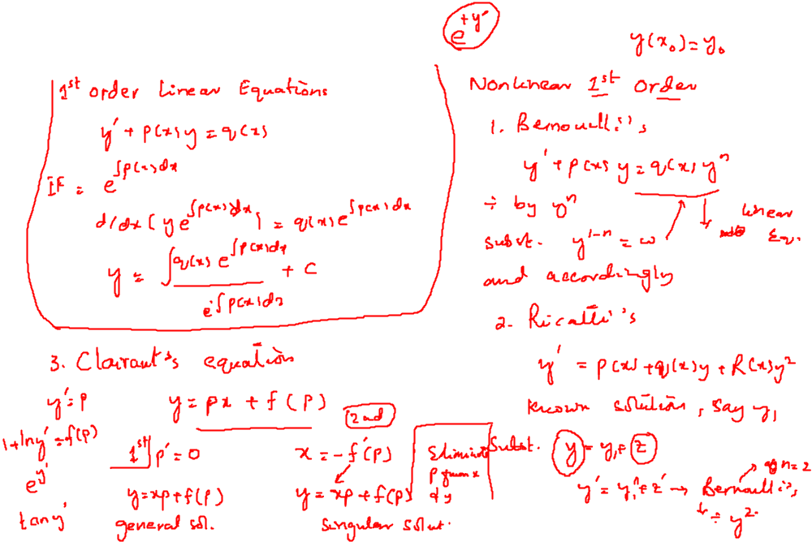
Recalling Previous Lecture

Slide 3
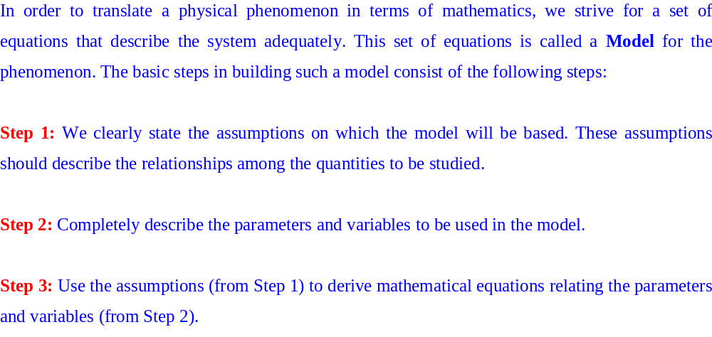
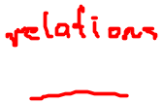
Applications of First Order Differential Equations

Slide 4
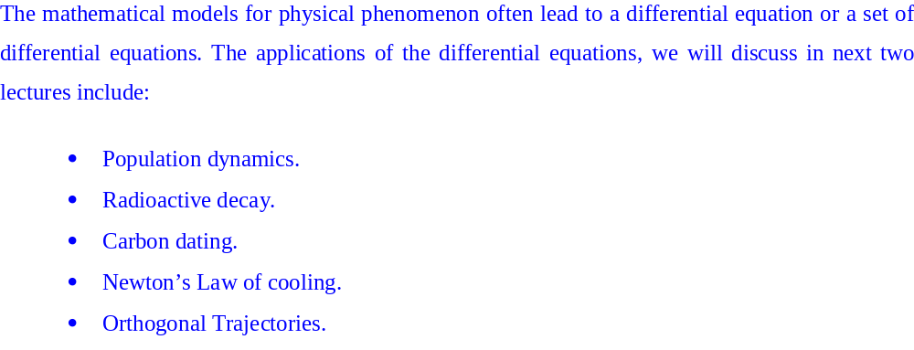
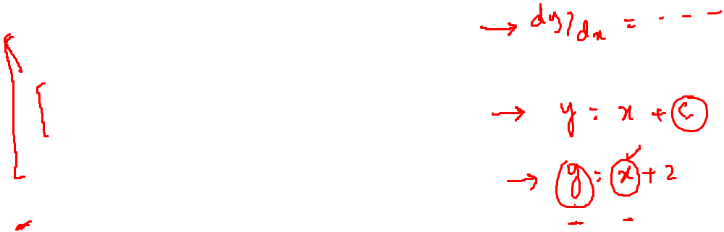
Applications of First Order Differential Equations

Slide 5
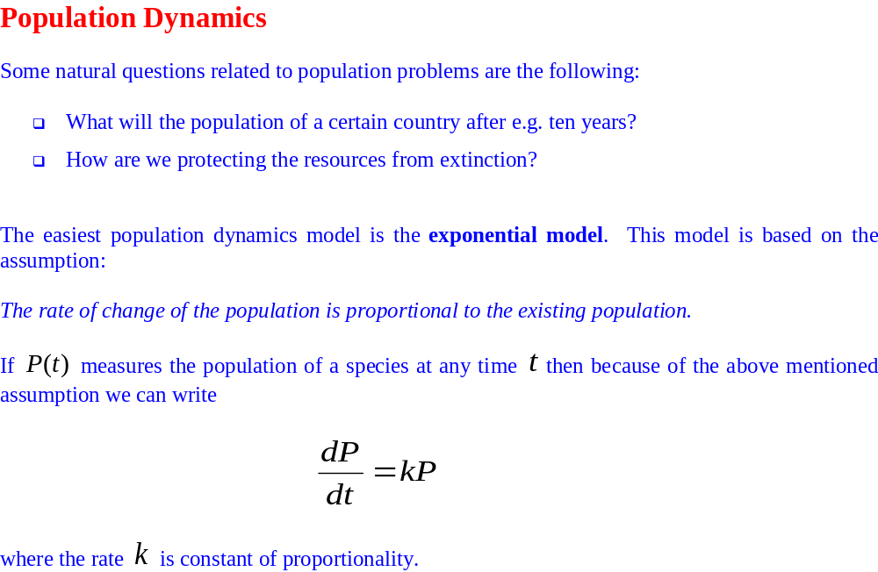
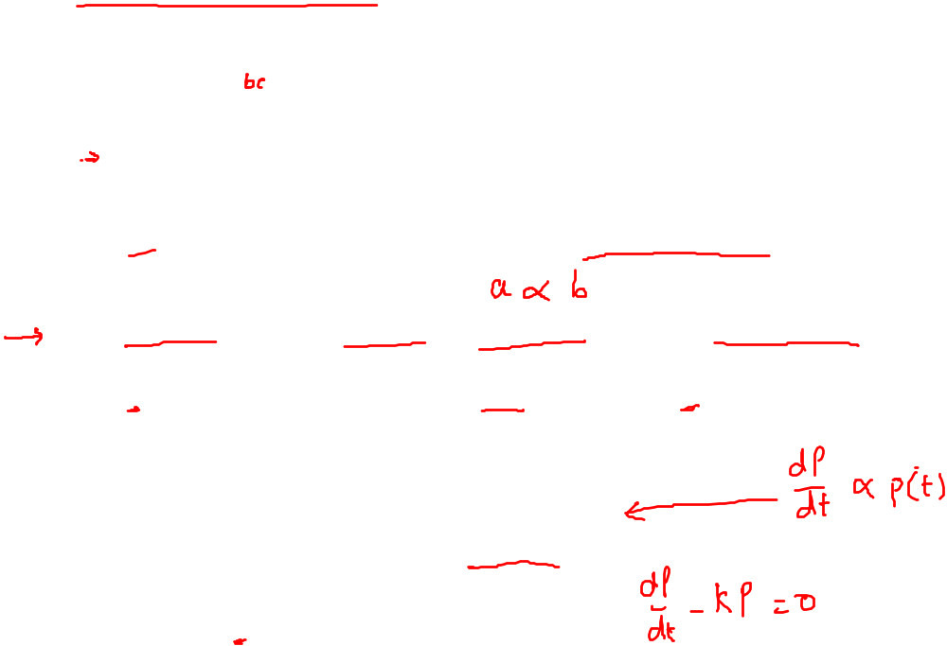
Applications of First Order Differential Equations

Slide 6
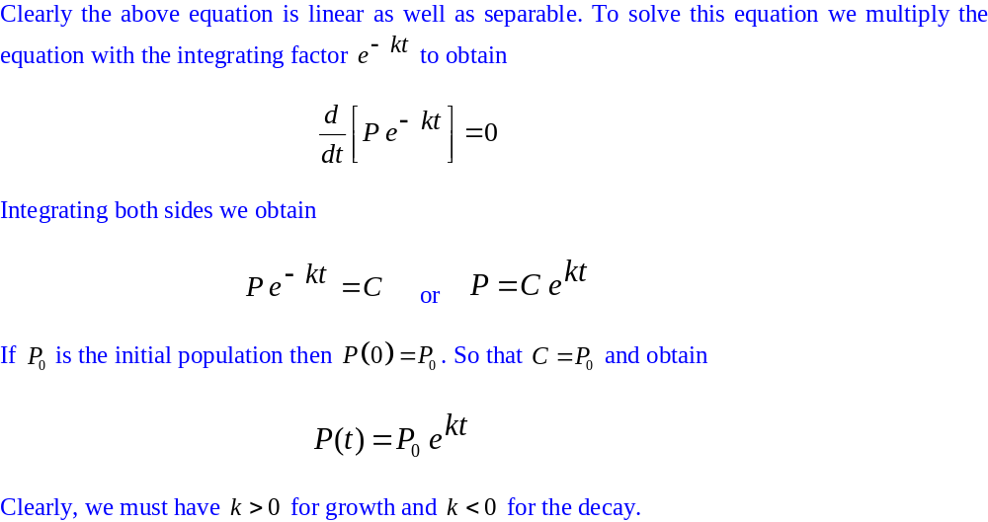
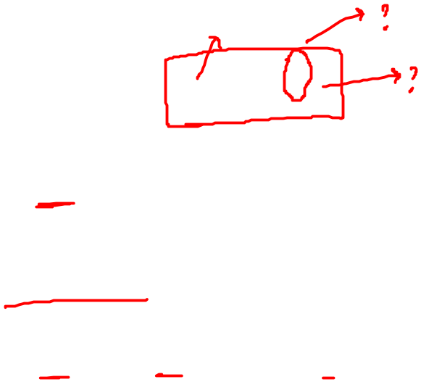
Applications of First Order Differential Equations

Slide 7
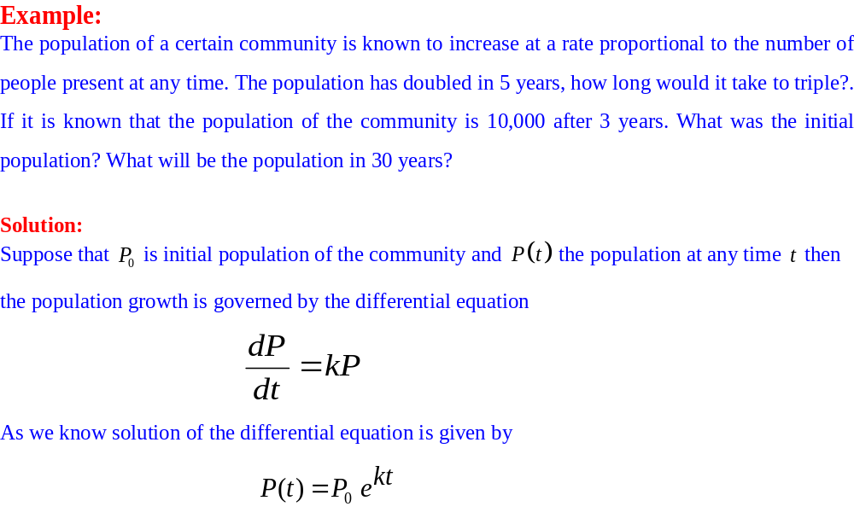

Applications of First Order Differential Equations

Slide 8
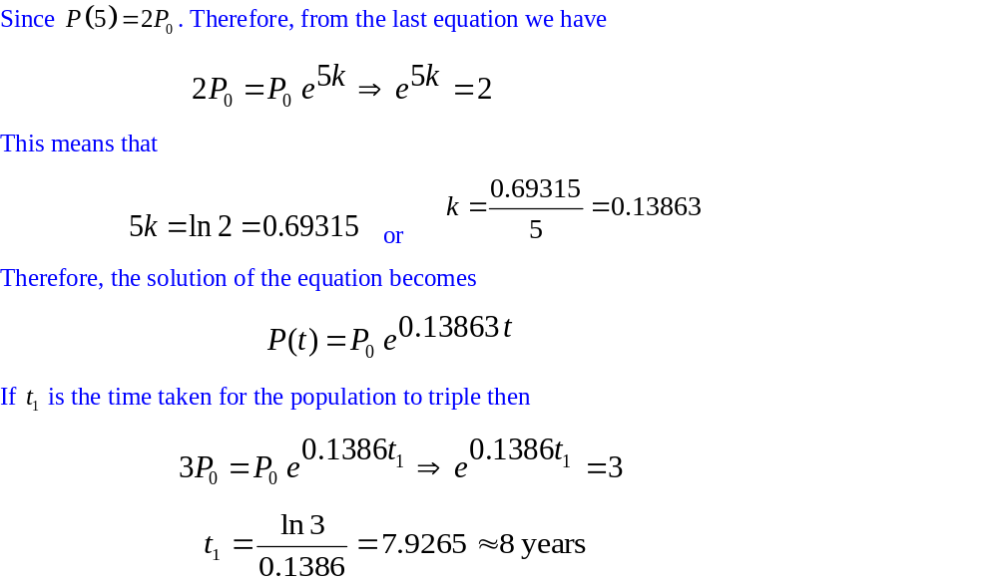
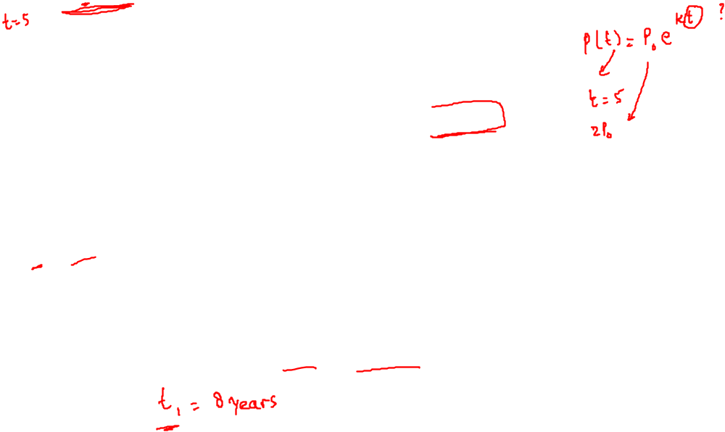
Applications of First Order Differential Equations

Slide 9
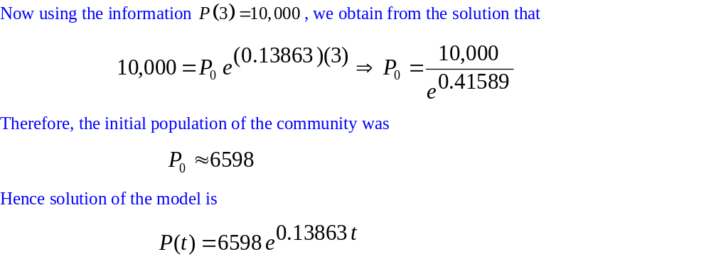

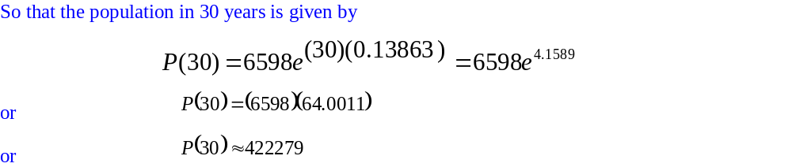
Applications of First Order Differential Equations

Slide 10
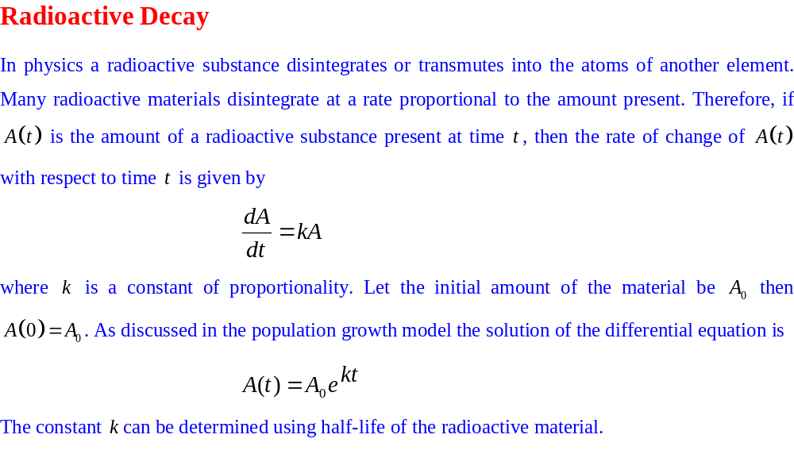
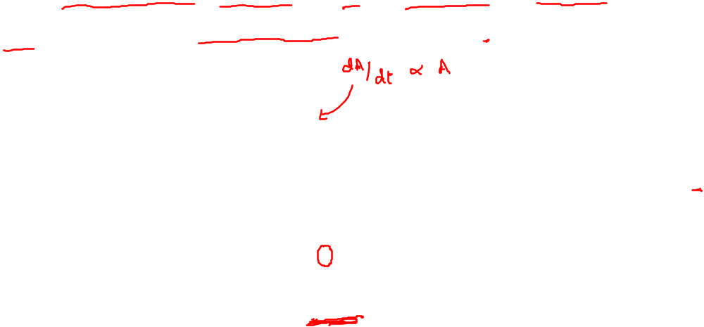
Applications of First Order Differential Equations

Slide 11
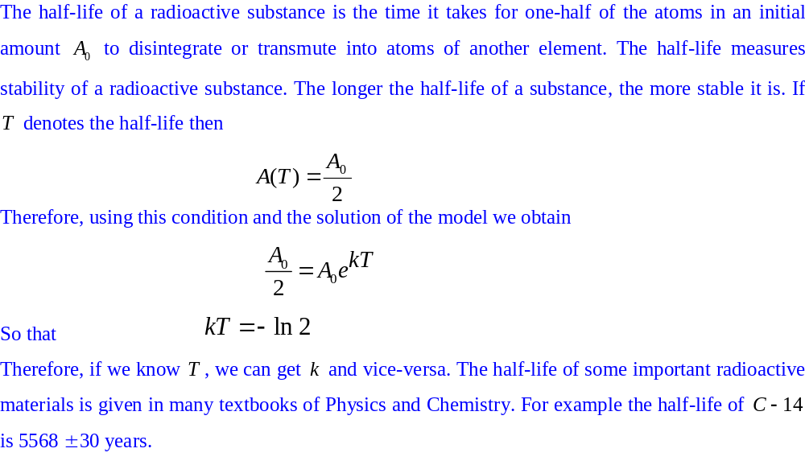

Applications of First Order Differential Equations

Slide 12
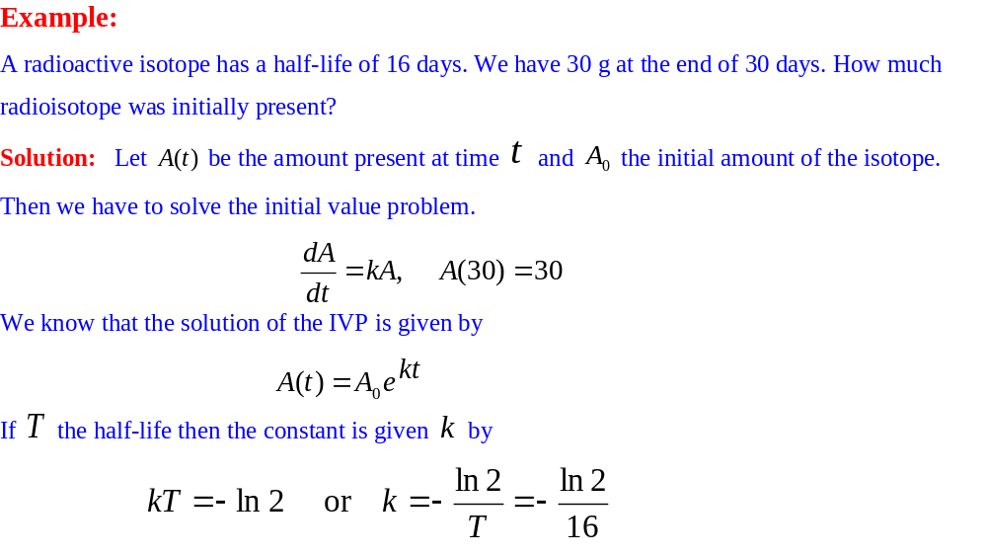
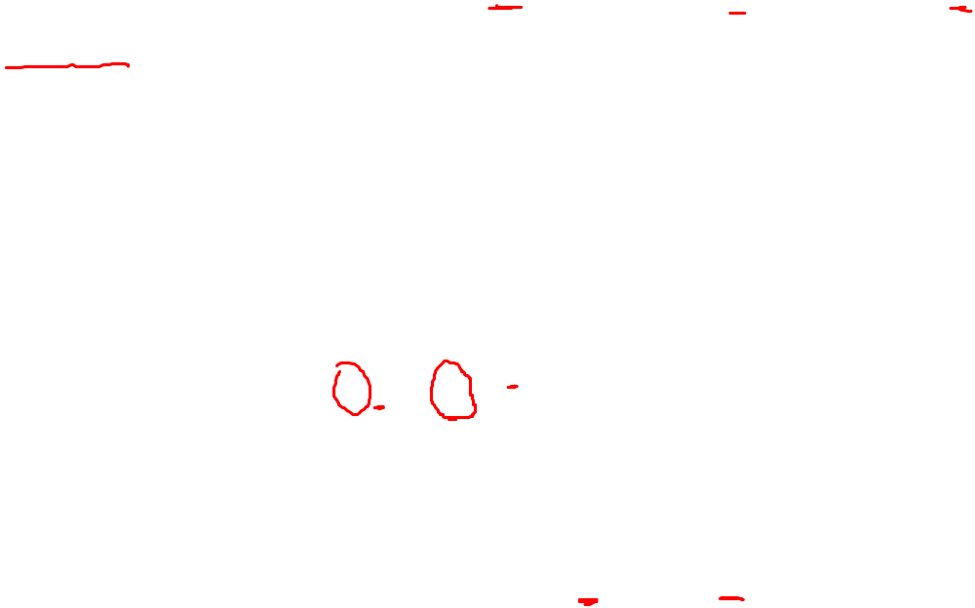
Applications of First Order Differential Equations

Slide 13
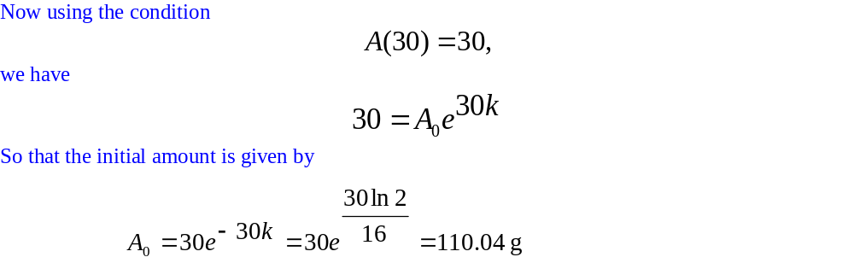
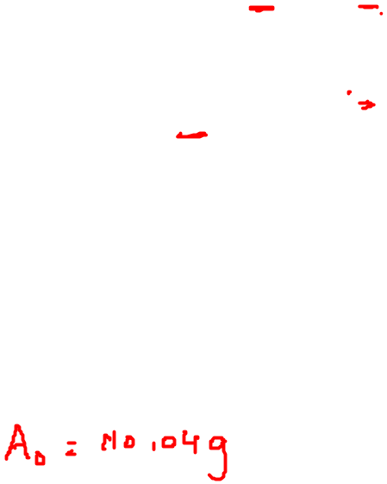
Applications of First Order Differential Equations

Slide 14
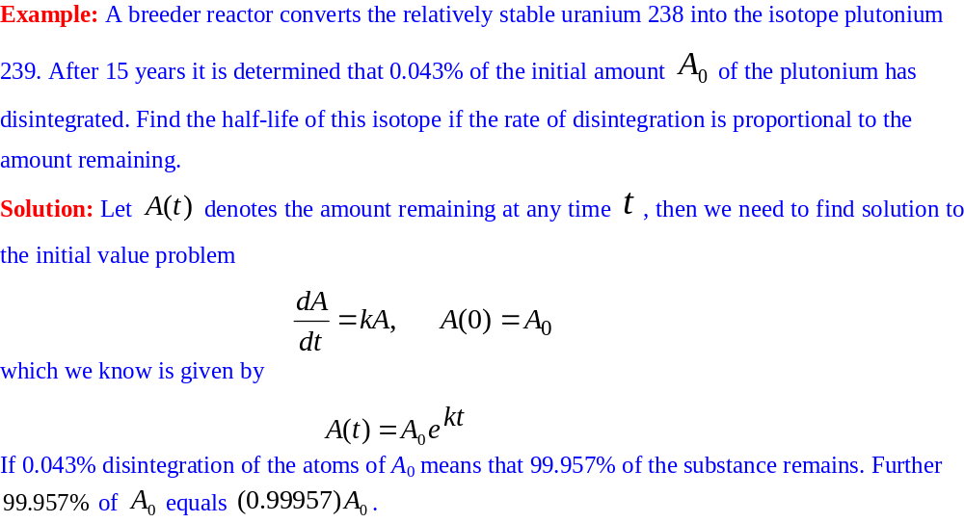
Applications of First Order Differential Equations

Slide 15
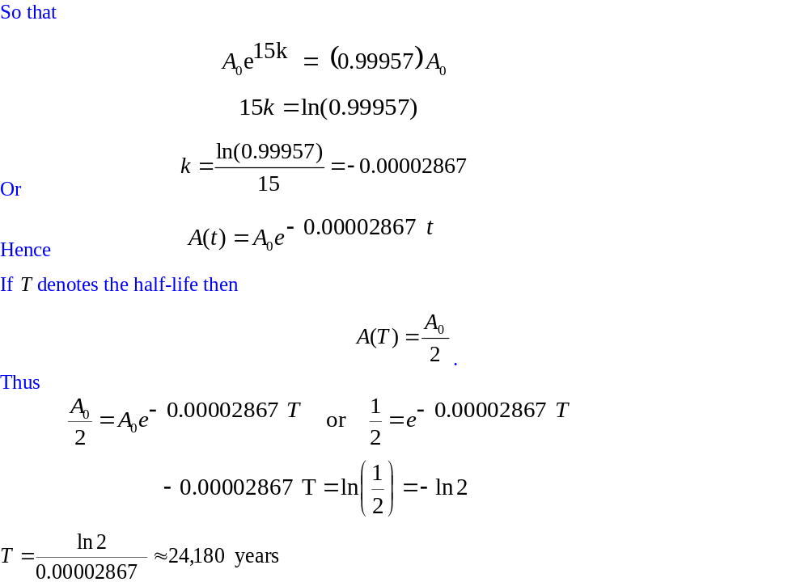
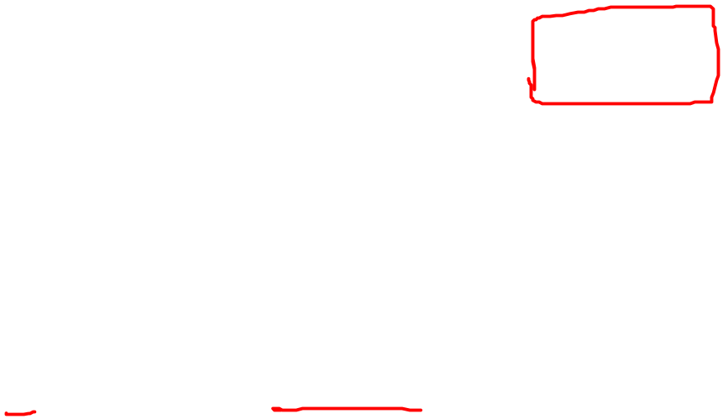
Applications of First Order Differential Equations

Slide 16
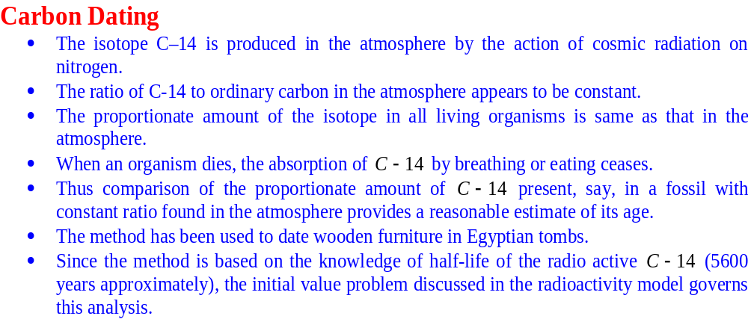
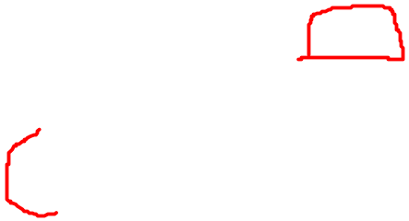
Applications of First Order Differential Equations

Slide 17
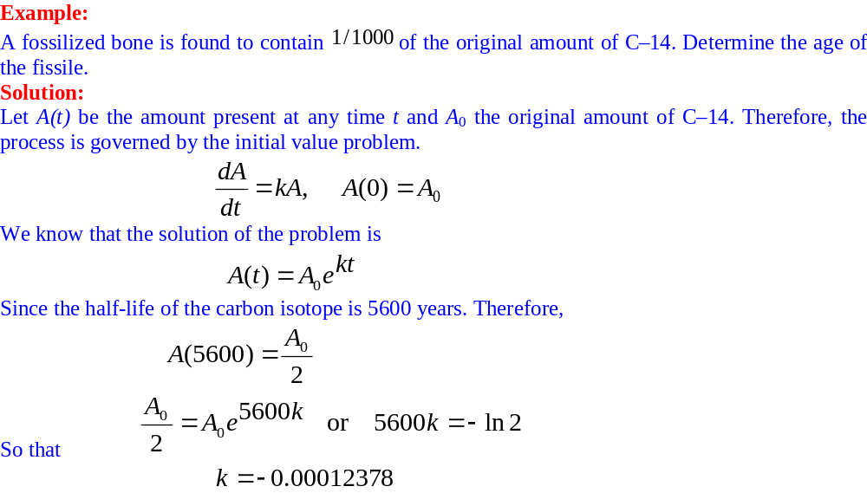
Applications of First Order Differential Equations

Slide 18
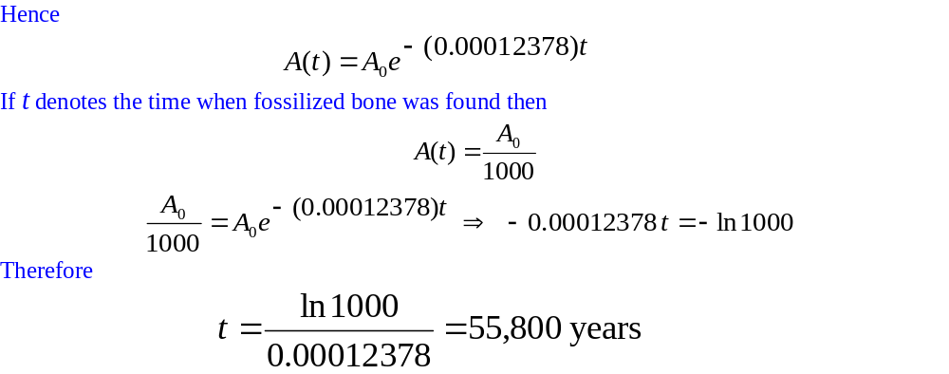
Applications of First Order Differential Equations

Slide 19
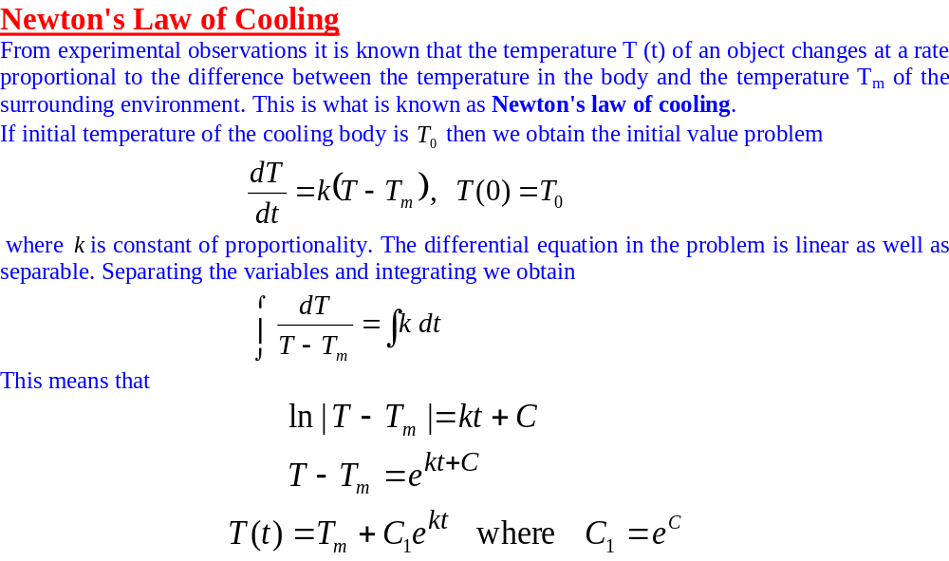
Applications of First Order Differential Equations

Slide 20
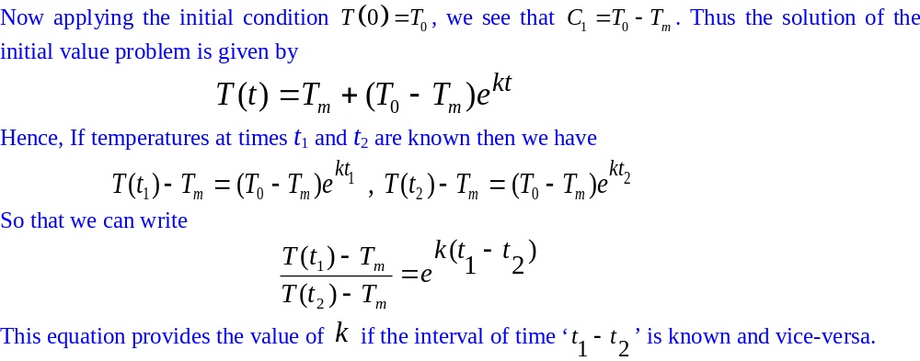
Applications of First Order Differential Equations

Slide 21
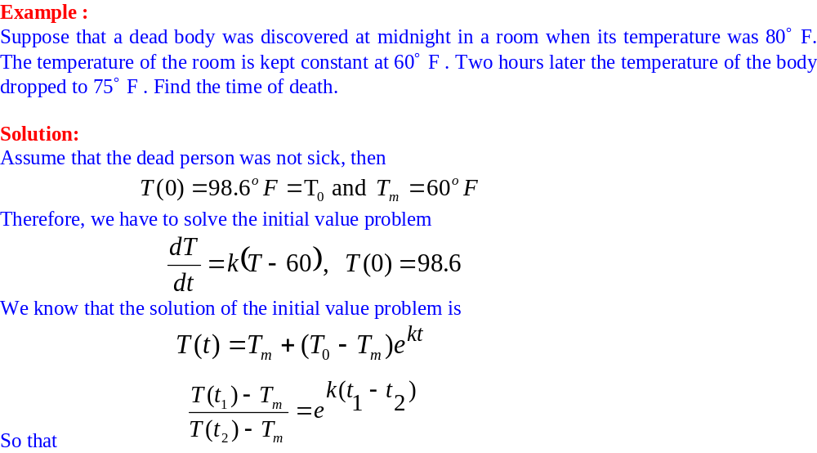
Applications of First Order Differential Equations

Slide 22
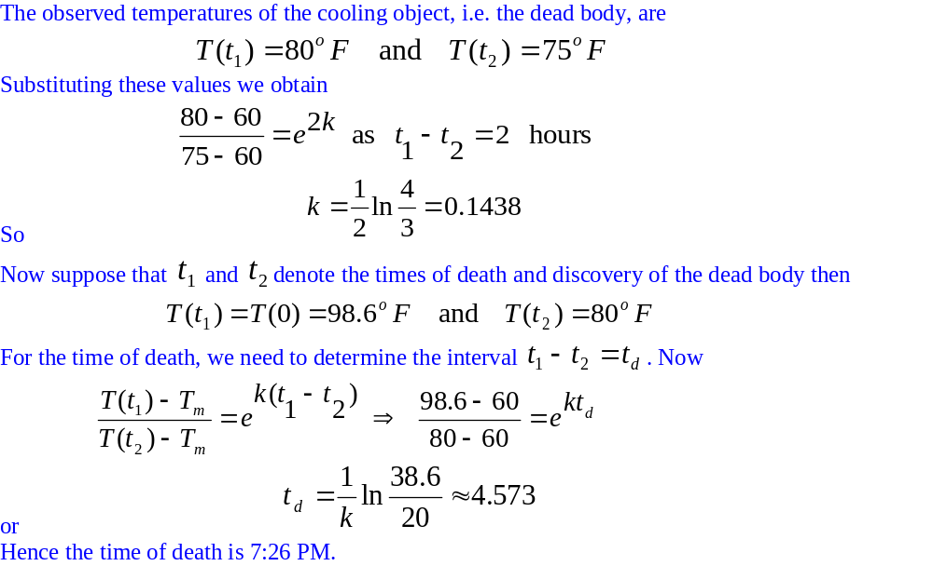
Applications of First Order Differential Equations

Slide 23
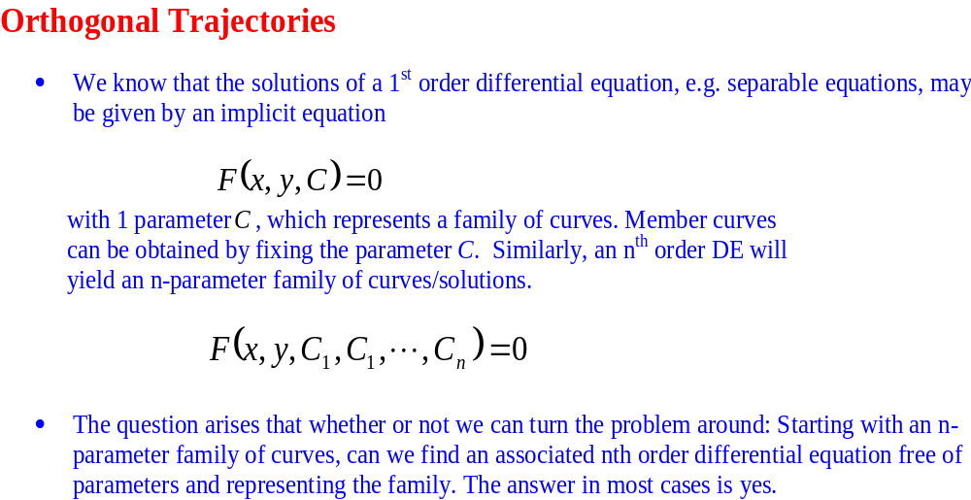
Applications of First Order Differential Equations

Slide 24
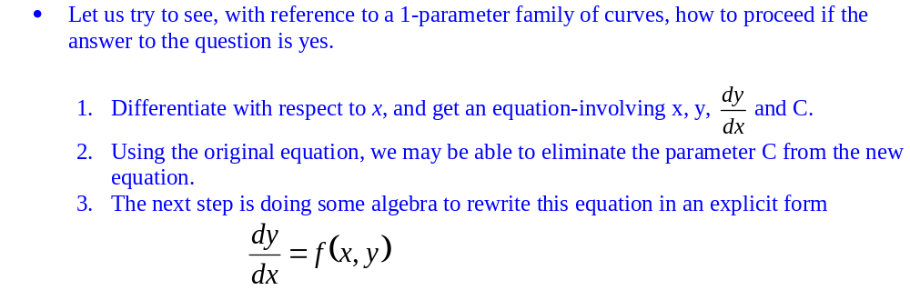
Applications of First Order Differential Equations

Slide 25
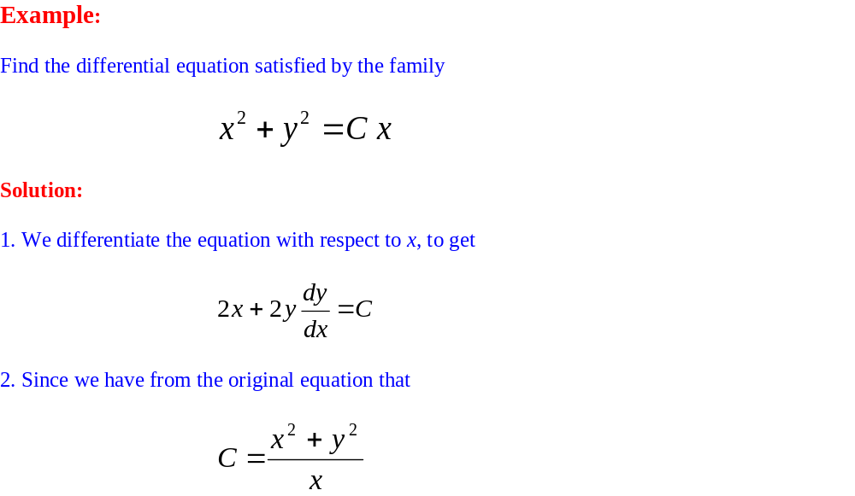
Applications of First Order Differential Equations

Slide 26
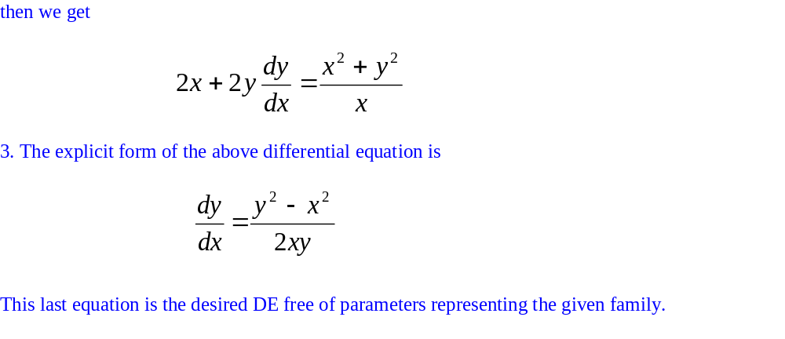
Applications of First Order Differential Equations

Slide 27
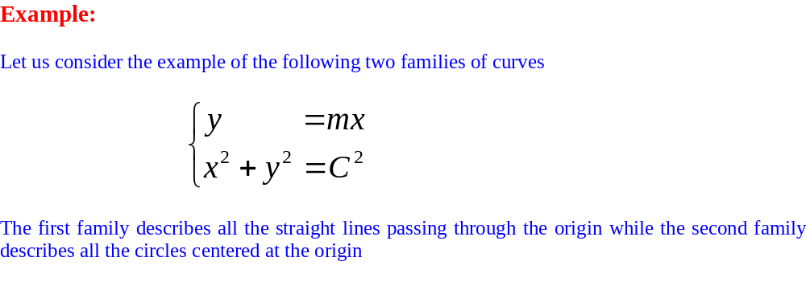
Applications of First Order Differential Equations

Slide 28
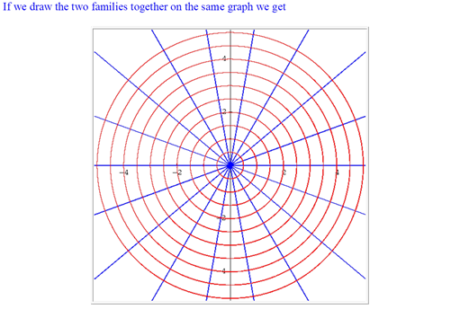
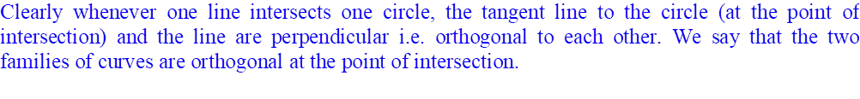
Applications of First Order Differential Equations

Slide 29
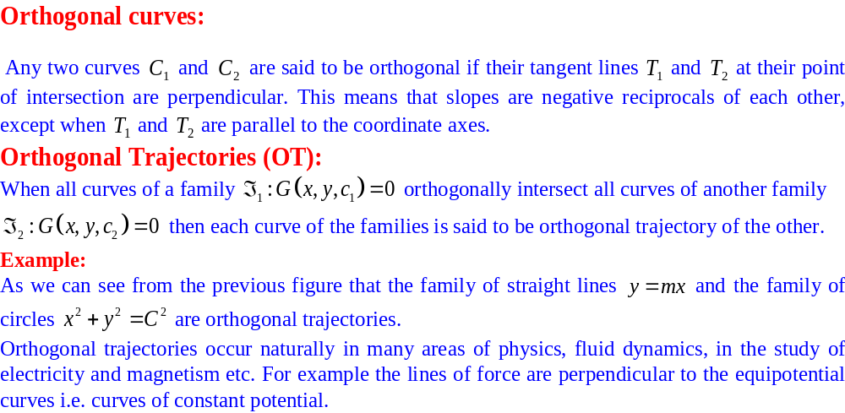
Applications of First Order Differential Equations

Slide 30
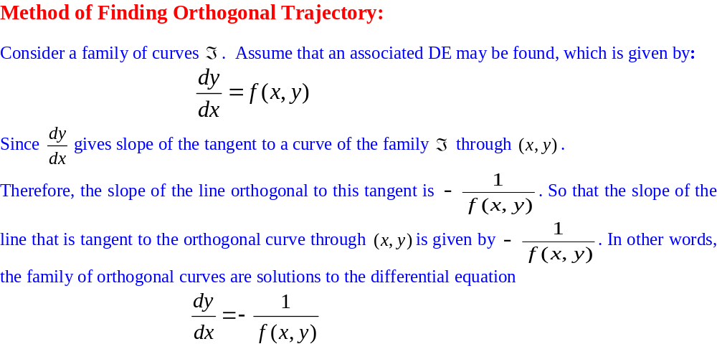
Applications of First Order Differential Equations

Slide 31
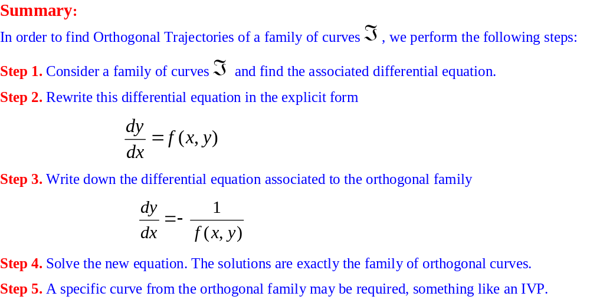
Applications of First Order Differential Equations

Slide 32
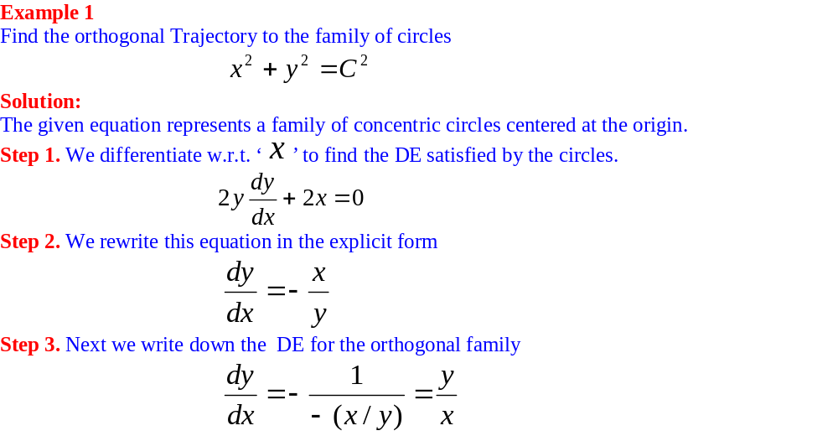
Applications of First Order Differential Equations

Slide 33
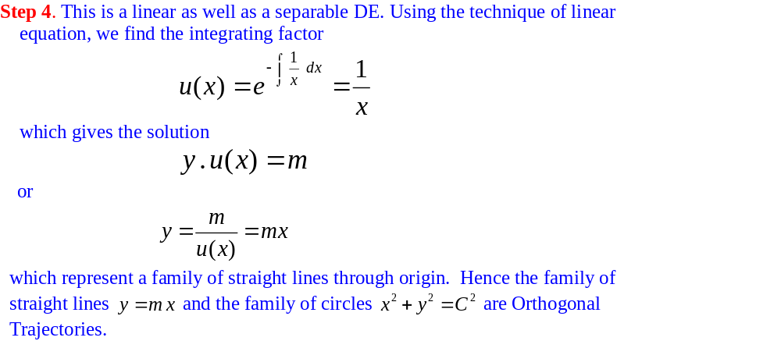
Applications of First Order Differential Equations

Slide 34
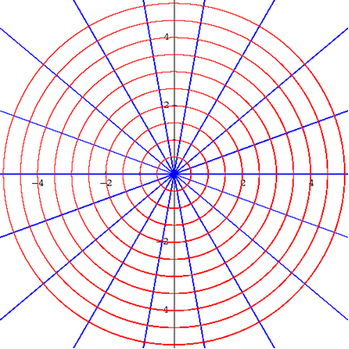
Applications of First Order Differential Equations

Slide 35
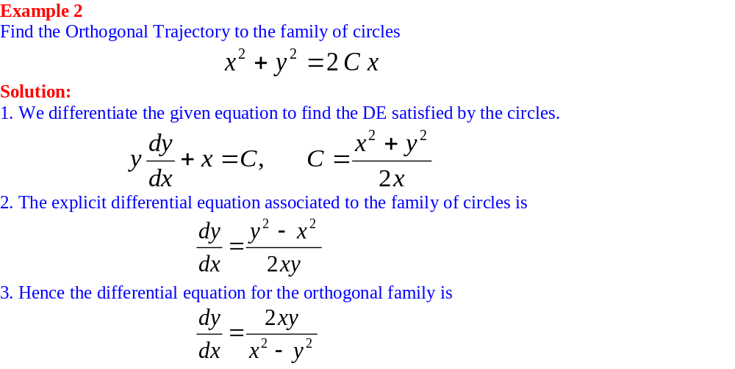
Applications of First Order Differential Equations

Slide 36
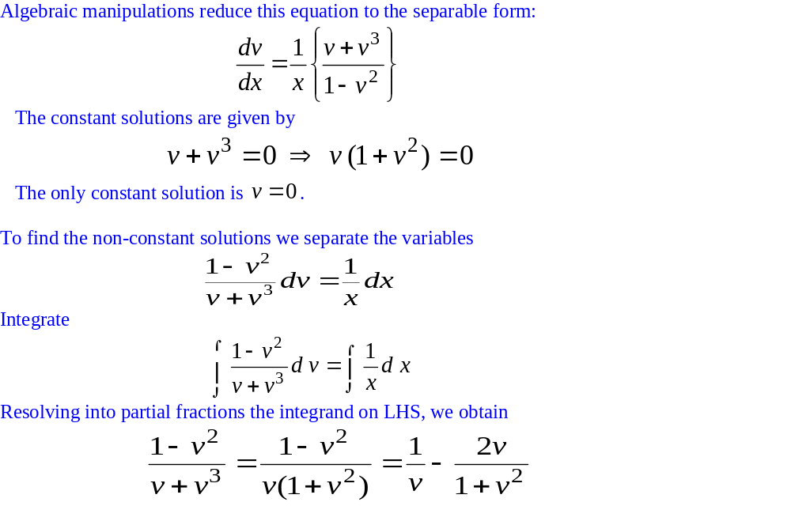
Applications of First Order Differential Equations

Slide 37
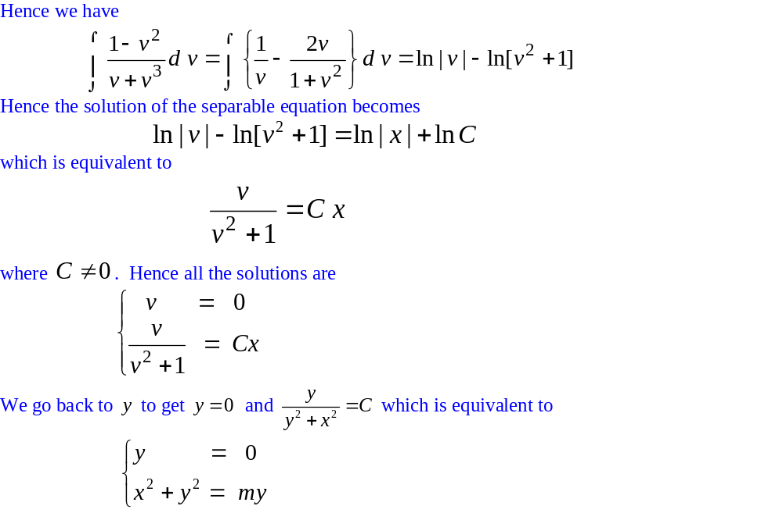
Applications of First Order Differential Equations

Slide 38
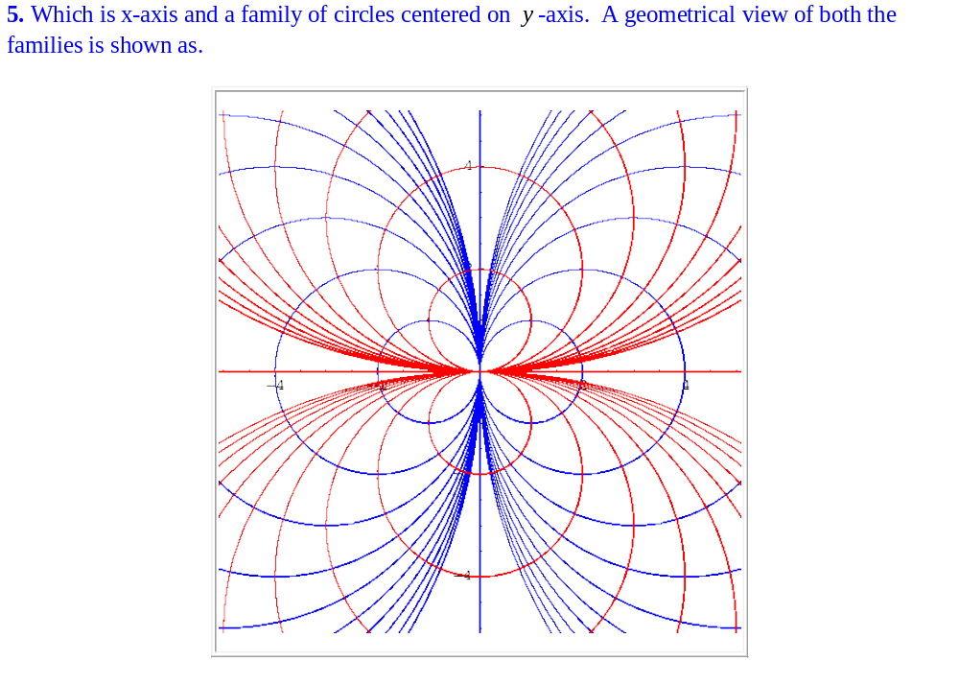
Applications of First Order Differential Equations

