Slide 1

 | National University of Sciences & Technology (NUST) School of Electrical Engineering and Computer Science (SEECS) Department of Basic Sciences
Linear Algebra & Ordinary Differential Equations
MATH-121
Lecture # 35
Course Instructor: Dr Saira Zainab
Ph. # 03325193283
Email: saira.zainab@seecs.edu.pk
Office # 207, Faculty Block, SEECS

Slide 2
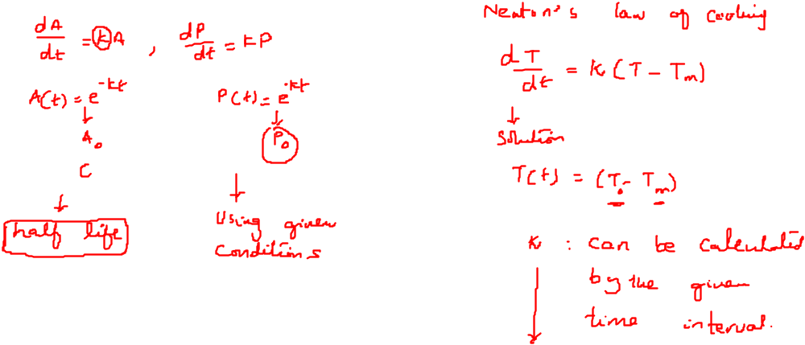
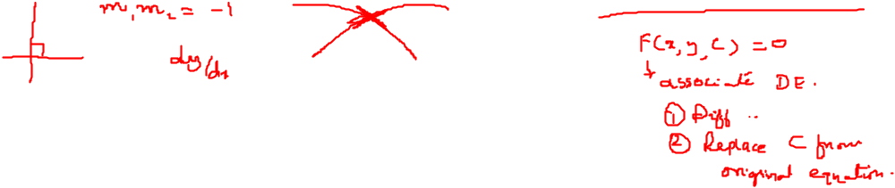
Recalling Previous Lecture

Slide 3
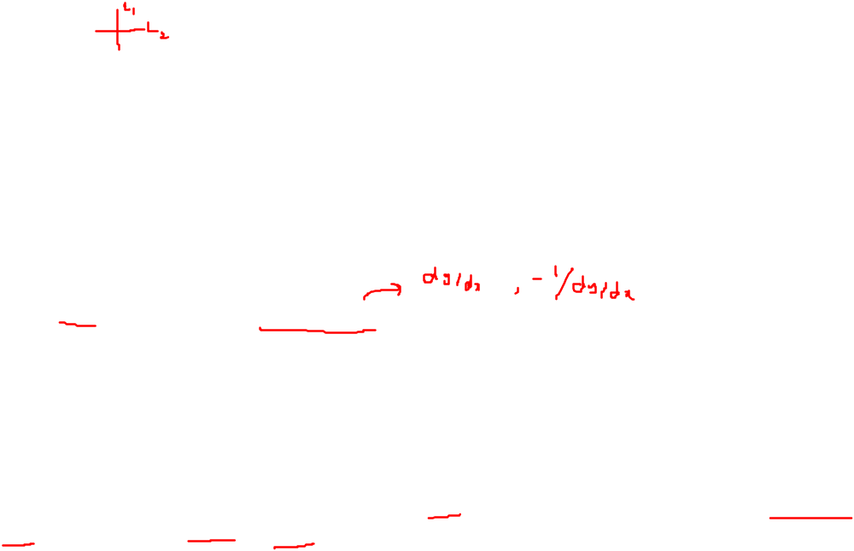
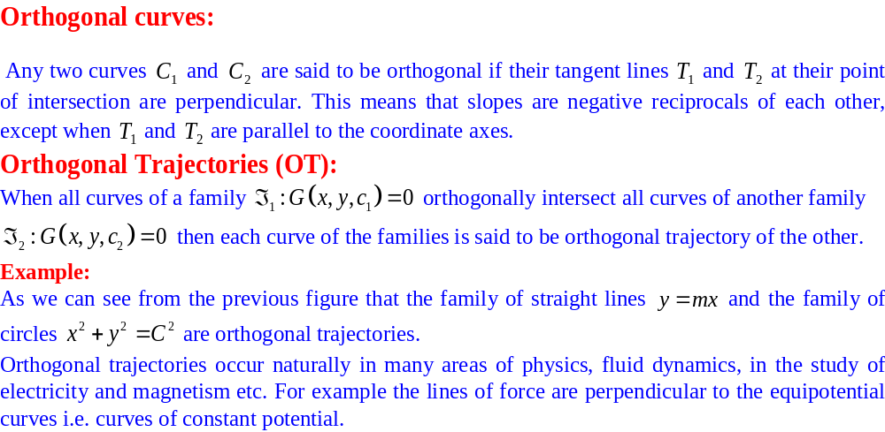
Applications of First Order Differential Equations

Slide 4
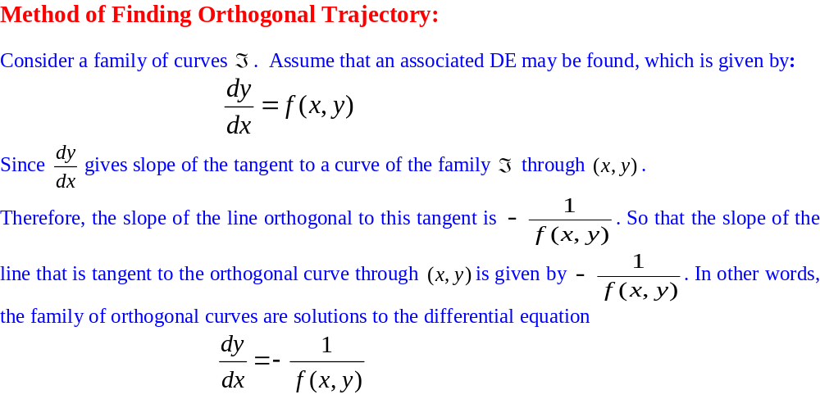
Applications of First Order Differential Equations

Slide 5
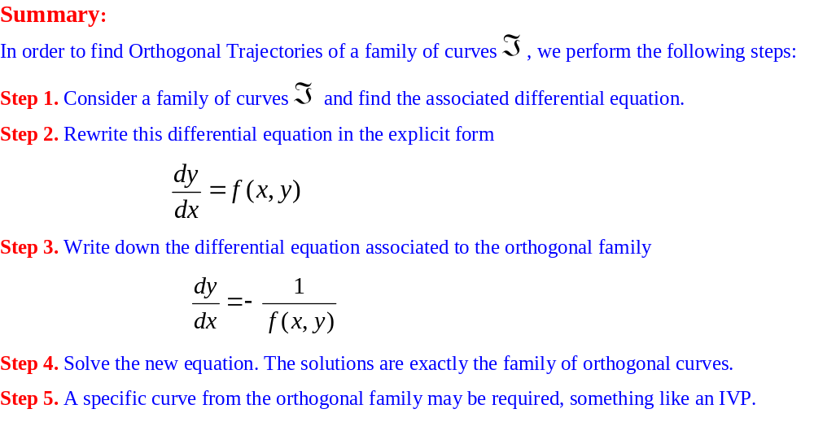
Applications of First Order Differential Equations

Slide 6
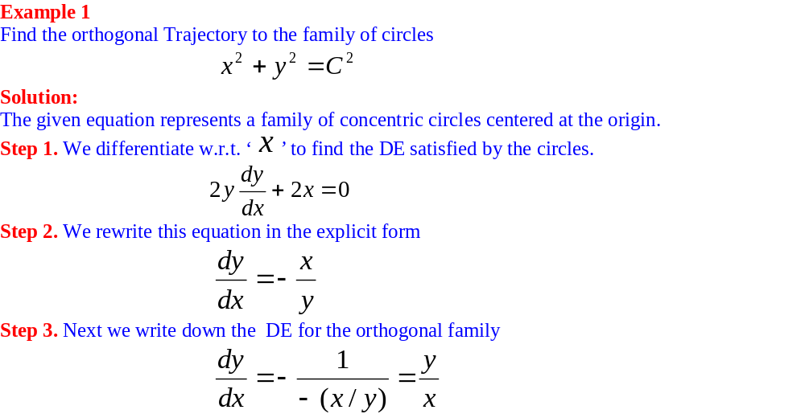
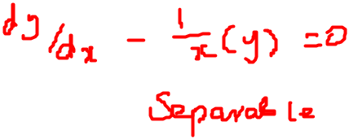
Applications of First Order Differential Equations

Slide 7
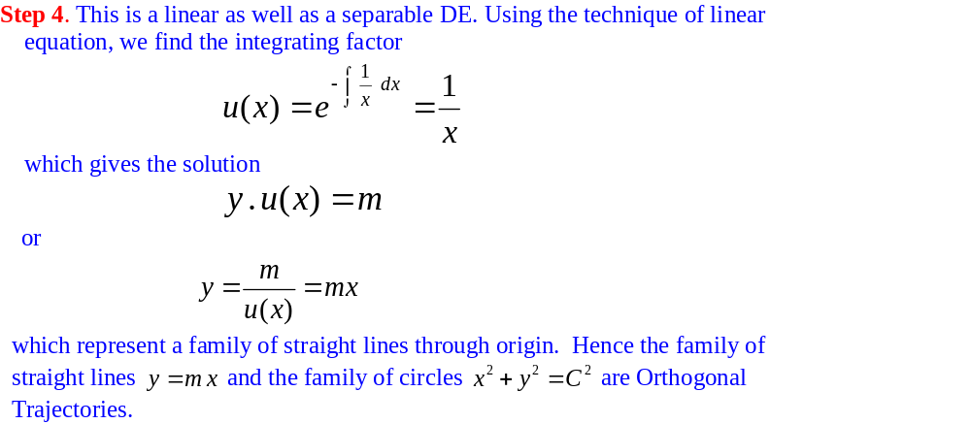
Applications of First Order Differential Equations

Slide 8
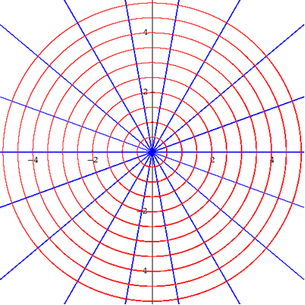
Applications of First Order Differential Equations

Slide 9
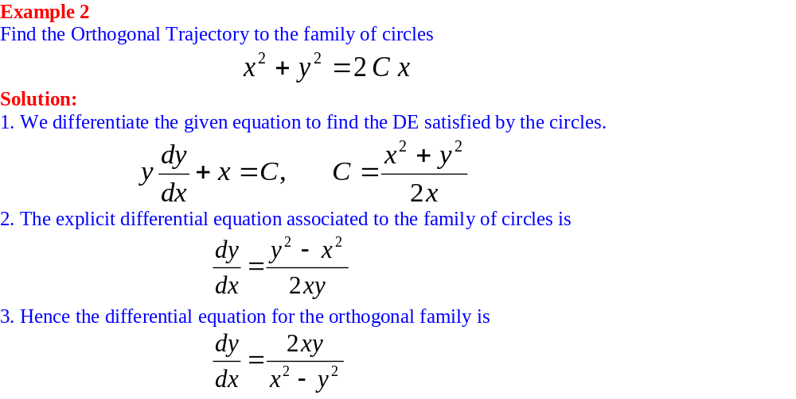
Applications of First Order Differential Equations

Slide 10
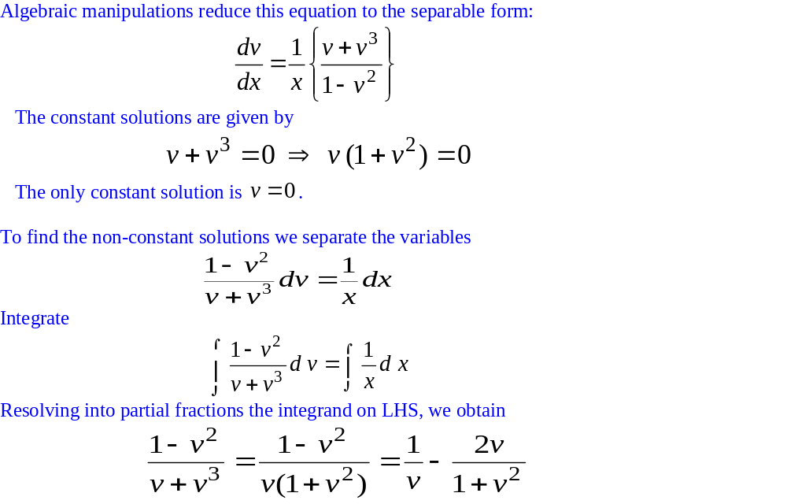
Applications of First Order Differential Equations

Slide 11
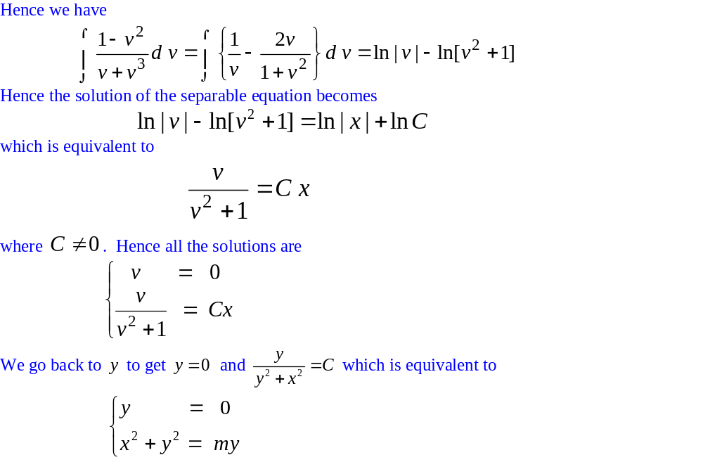
Applications of First Order Differential Equations

Slide 12
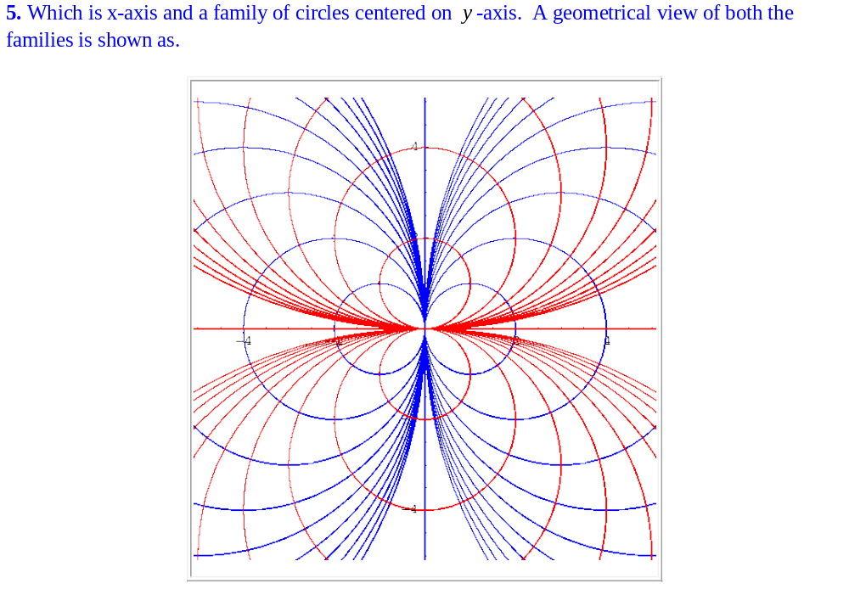
Applications of First Order Differential Equations

Slide 13
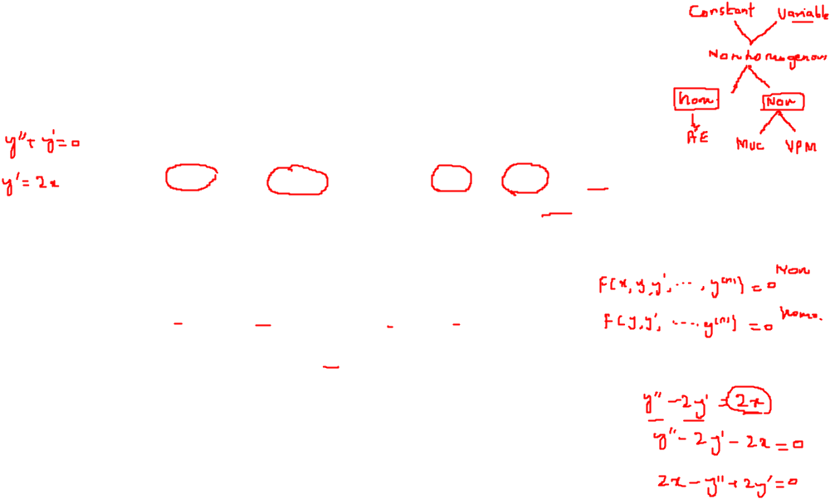
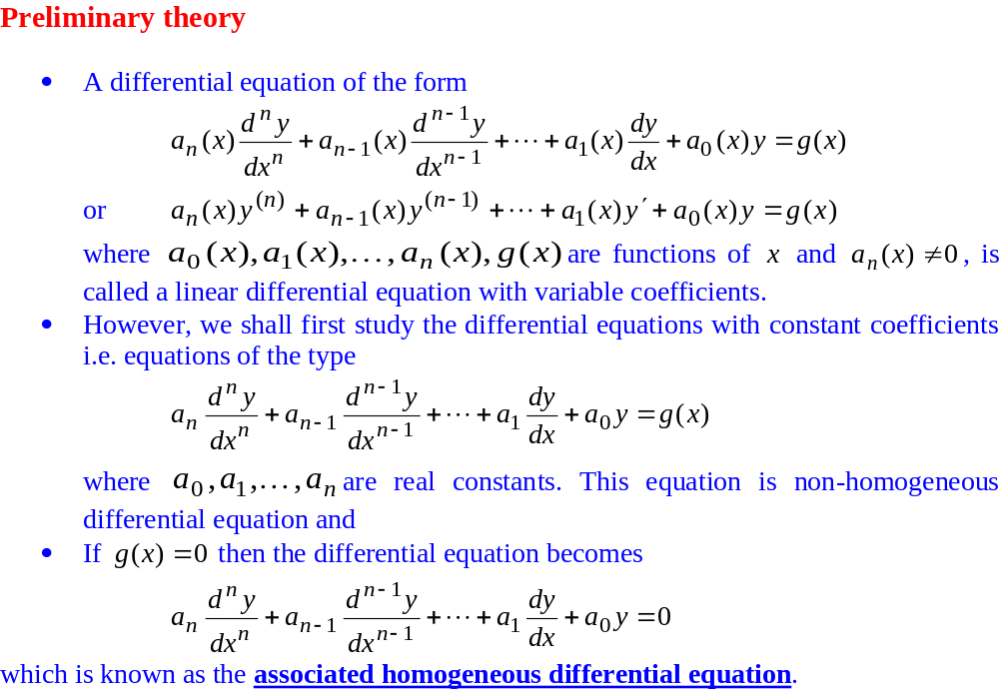
Higher Order Linear Differential Equations

Slide 14
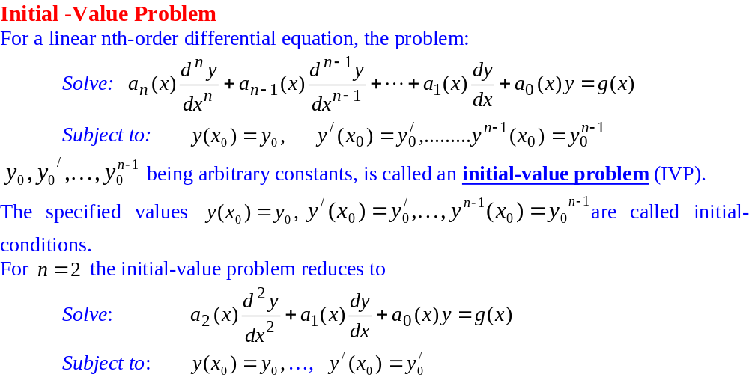
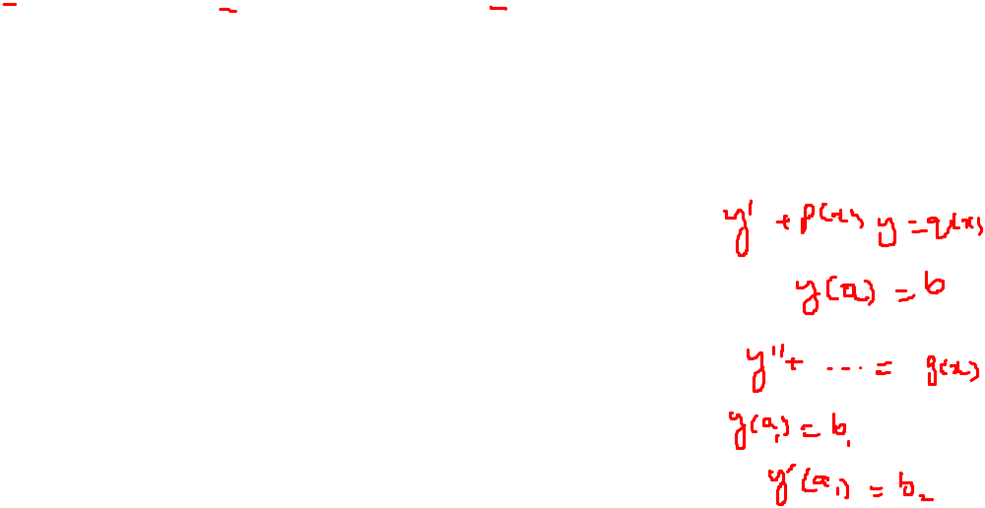
Higher Order Linear Differential Equations

Slide 15
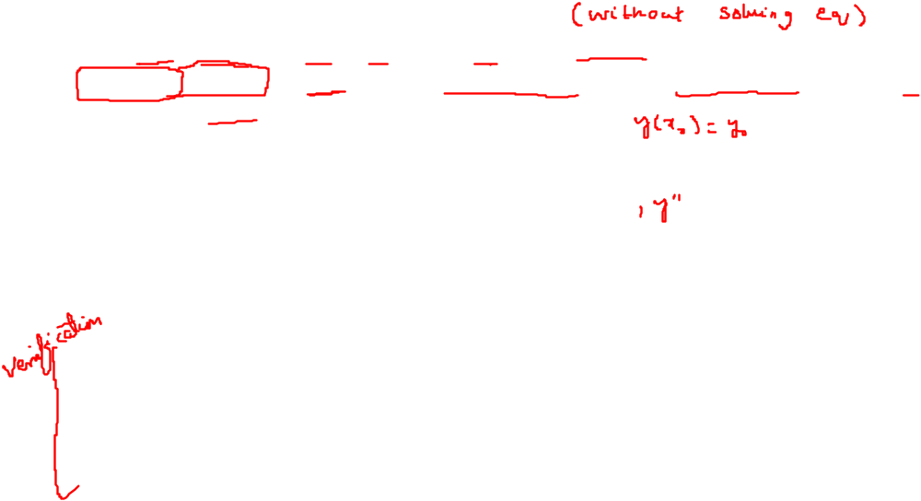
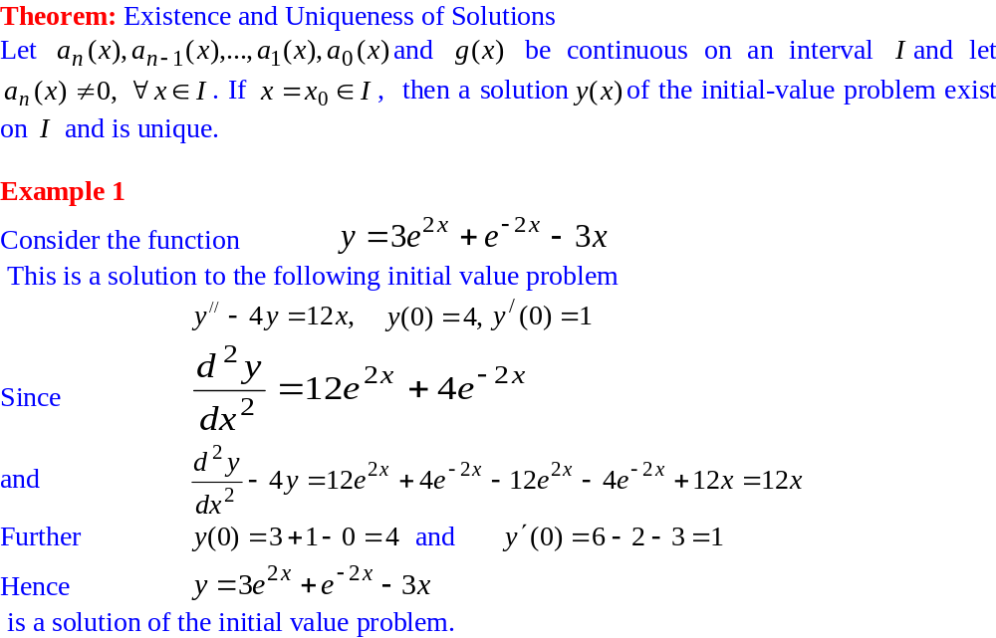
Higher Order Linear Differential Equations

Slide 16
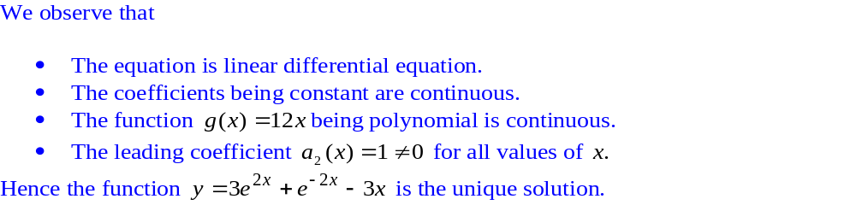
Higher Order Linear Differential Equations

Slide 17
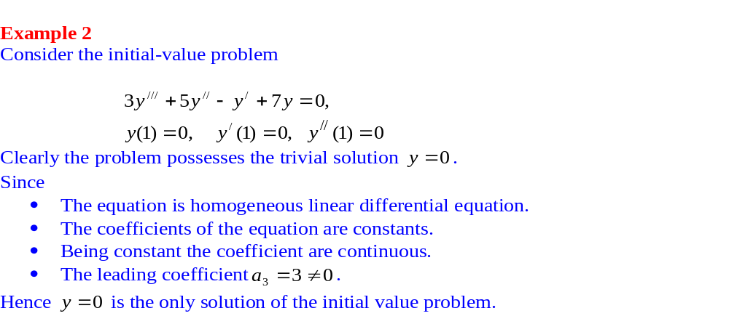
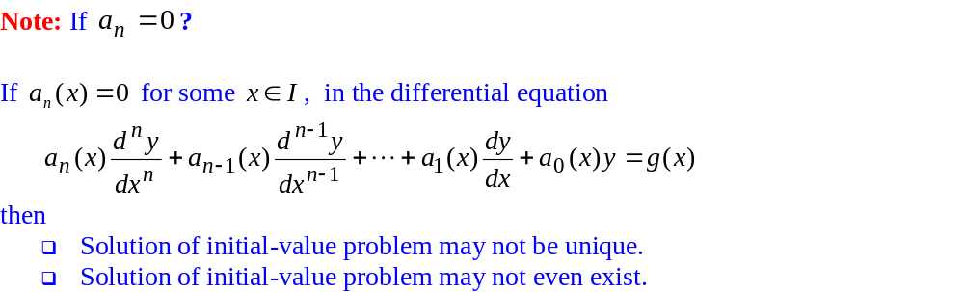
Higher Order Linear Differential Equations

Slide 18
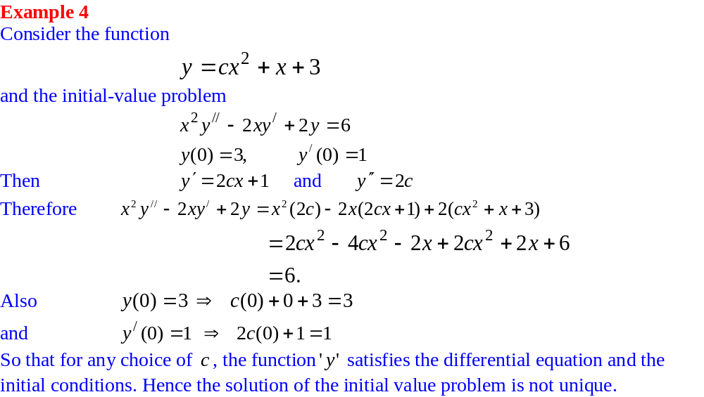
Higher Order Linear Differential Equations

Slide 19
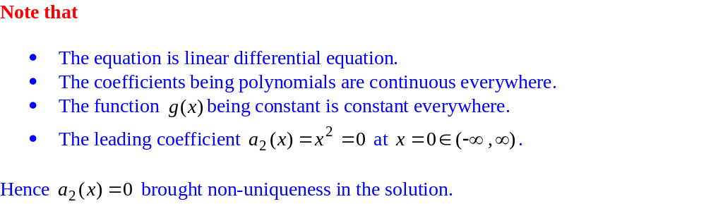
Higher Order Linear Differential Equations

Slide 20
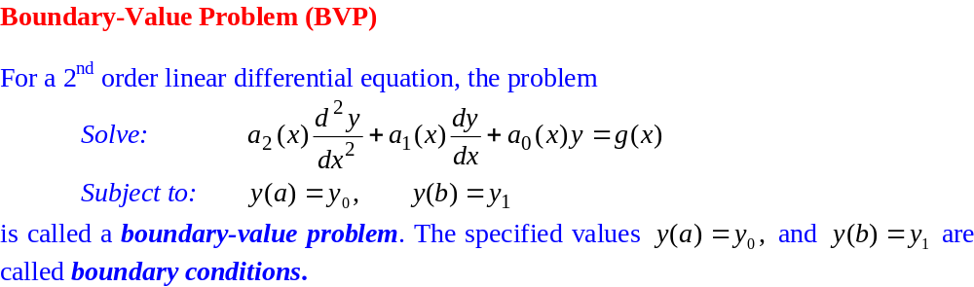
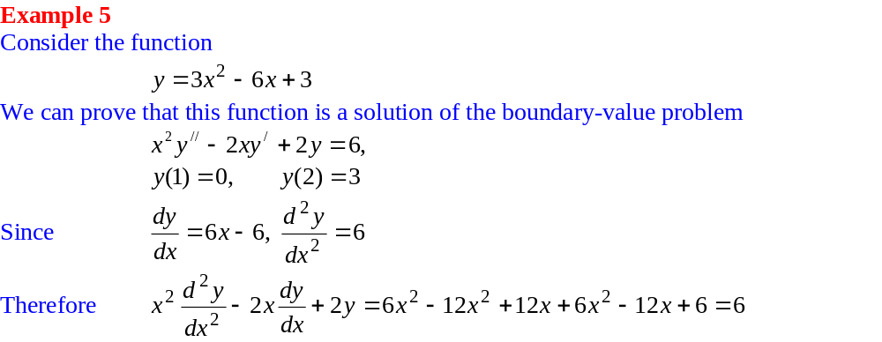
Higher Order Linear Differential Equations

Slide 21
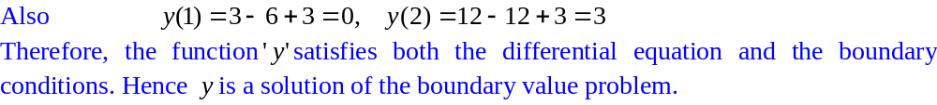
Higher Order Linear Differential Equations

Slide 22
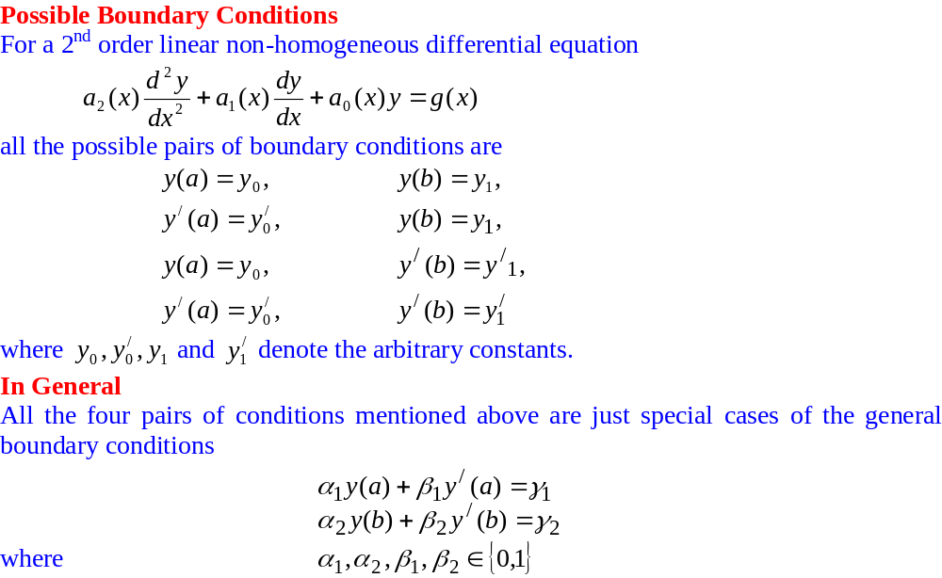
Higher Order Linear Differential Equations

Slide 23
Higher Order Linear Differential Equations

Slide 24
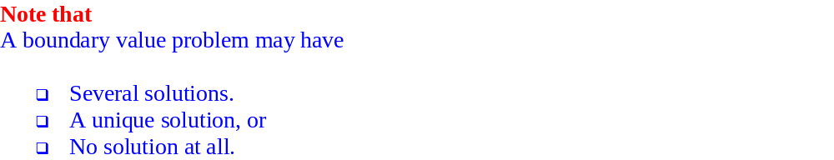
Higher Order Linear Differential Equations

Slide 25
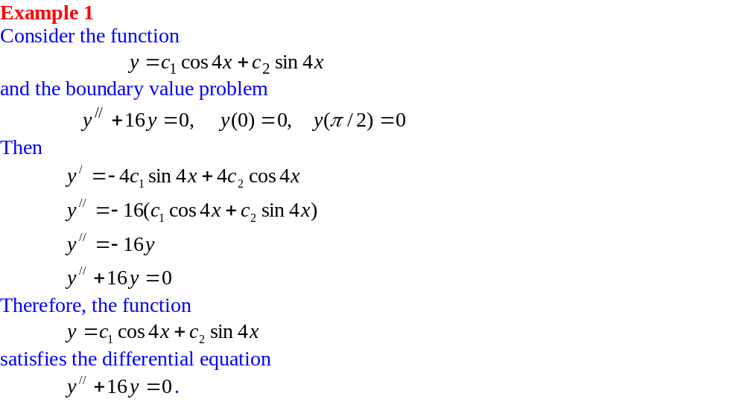
Higher Order Linear Differential Equations

Slide 26
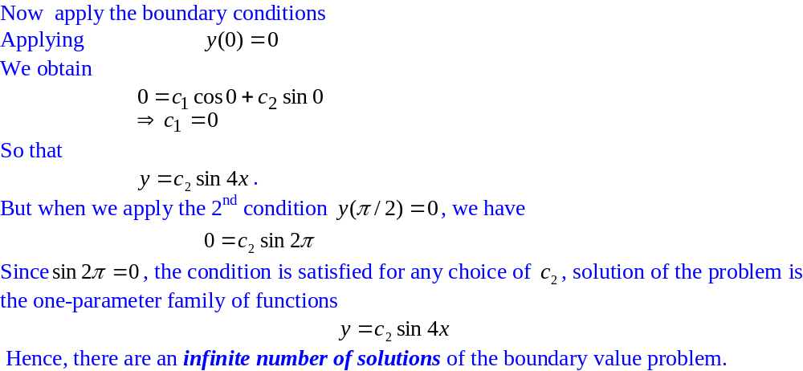
Higher Order Linear Differential Equations

Slide 27
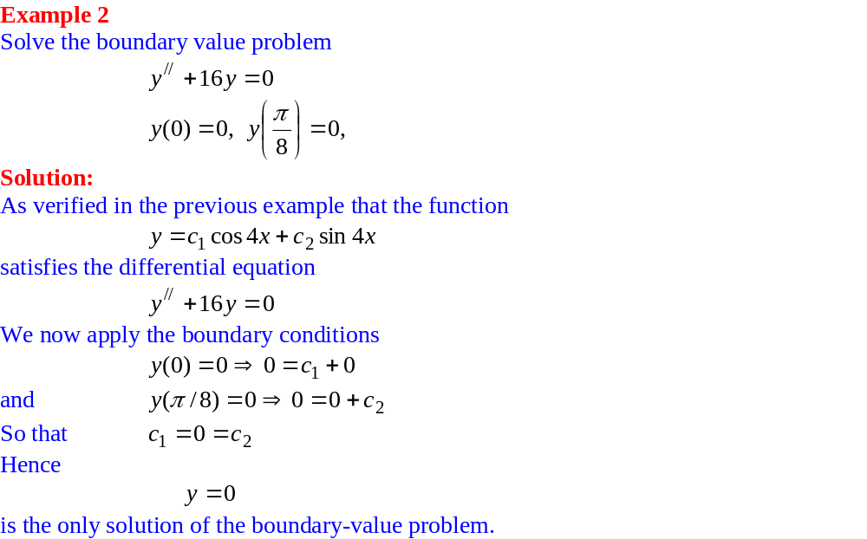
Higher Order Linear Differential Equations

Slide 28
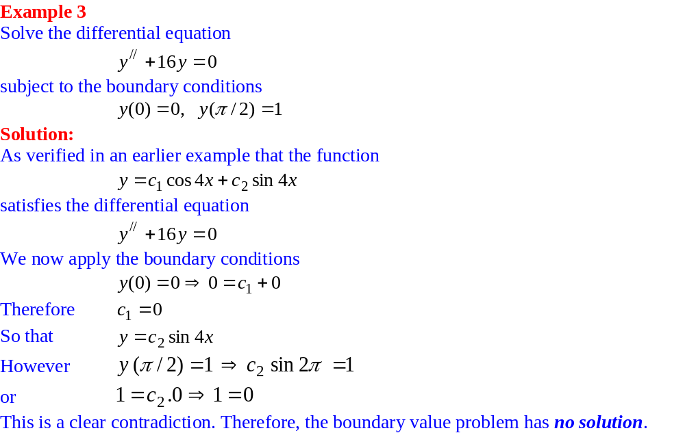
Higher Order Linear Differential Equations

Slide 29
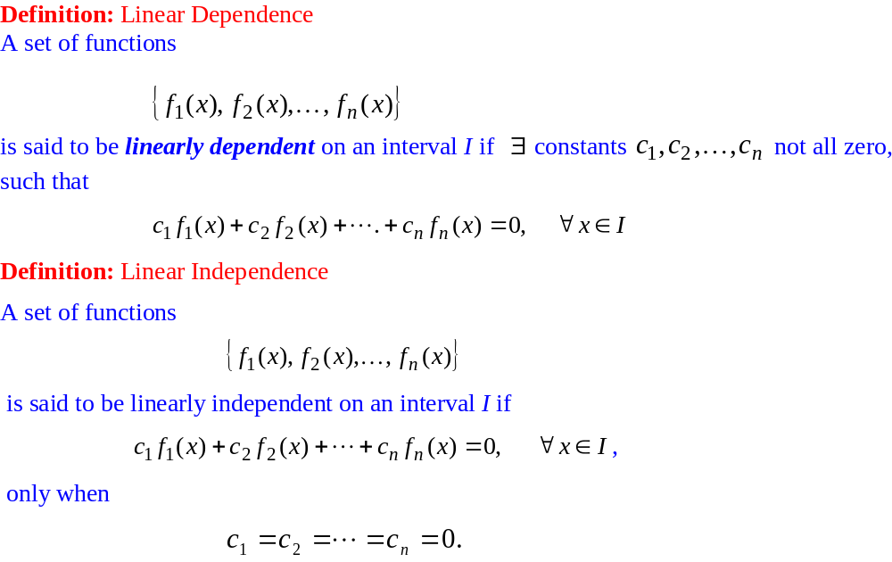
Recalling (Linear Dependence/Independence)

Slide 30
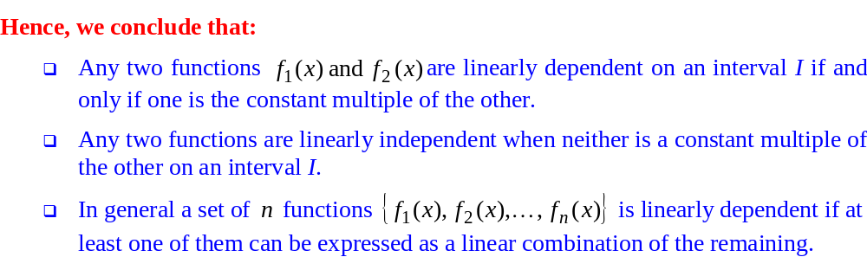
Recalling (Linear Dependence/Independence)

Slide 31
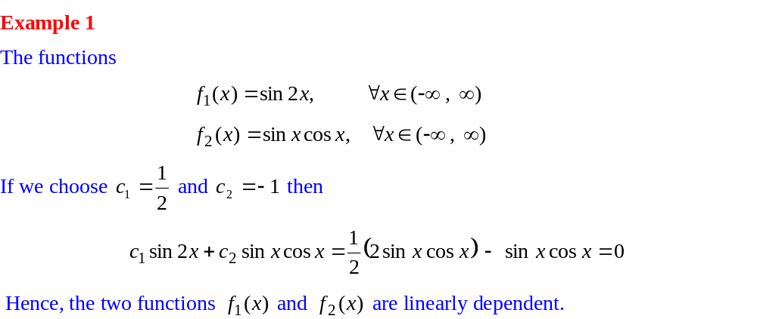
Recalling (Linear Dependence/Independence)

Slide 32
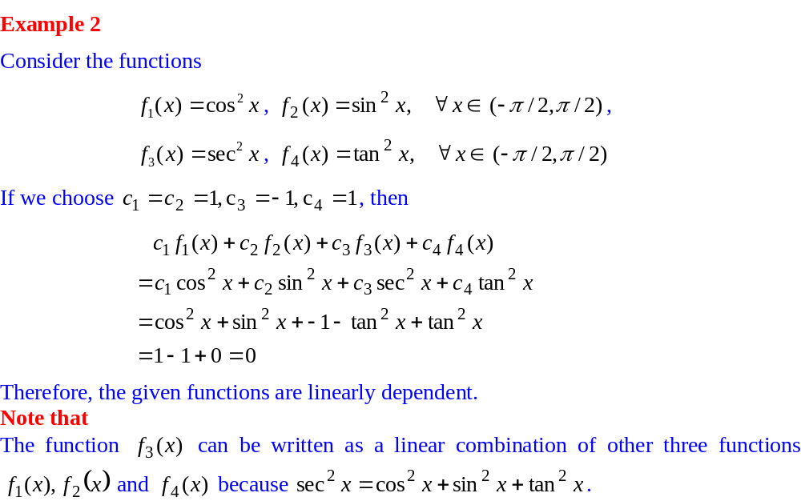
Recalling (Linear Dependence/Independence)

Slide 33
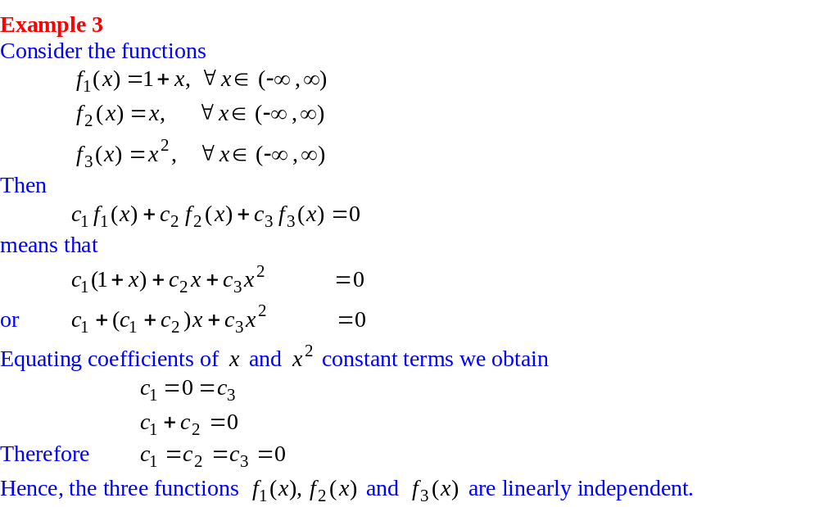
Recalling (Linear Dependence/Independence)

Slide 34
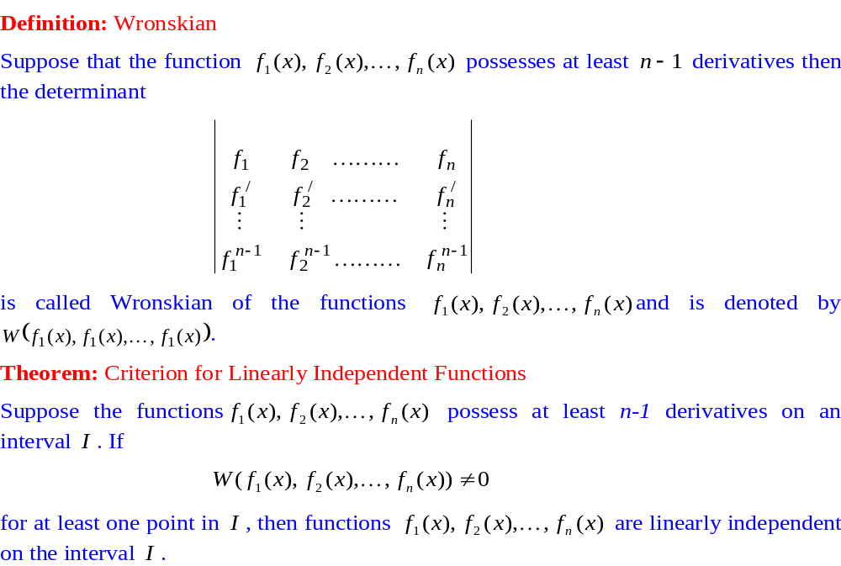
Wronskian

Slide 35
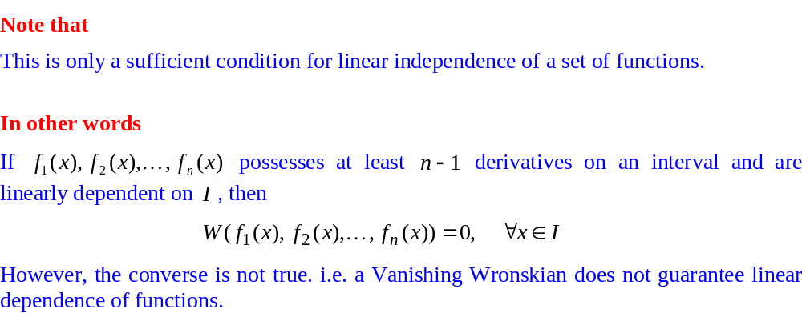
Wronskian

Slide 36
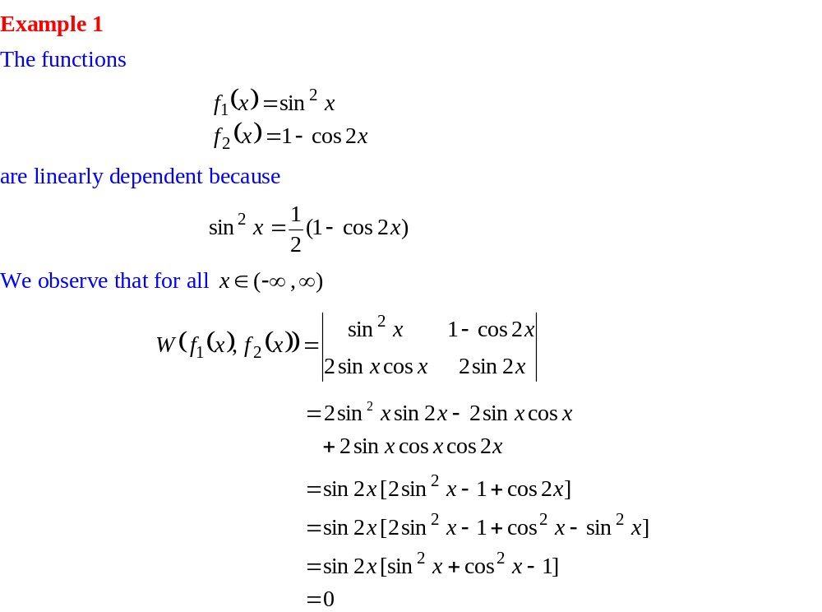
Linear Independence/dependence through Wronskian

Slide 37
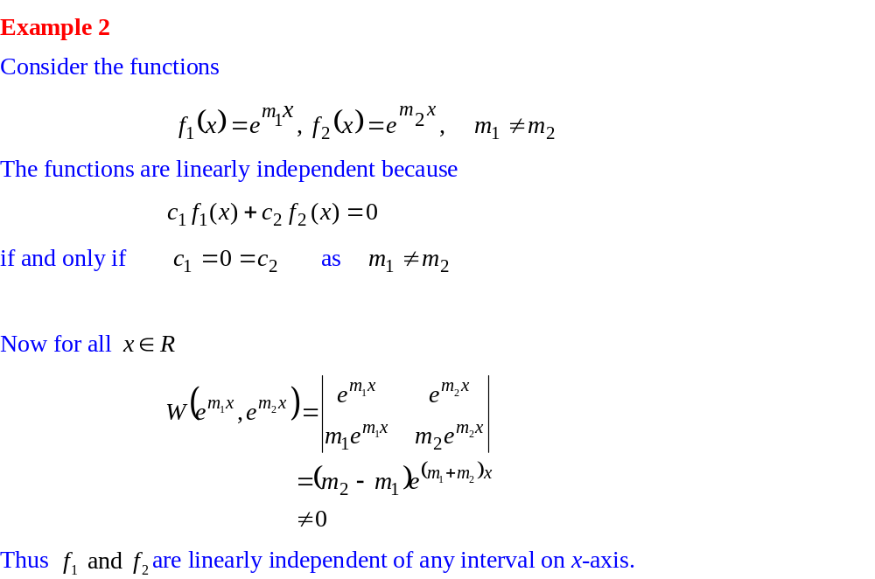
Linear Independence/dependence through Wronskian

Slide 38
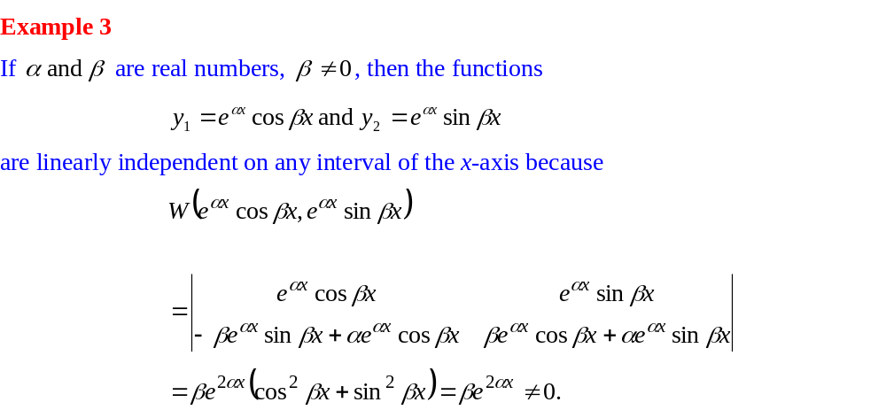
Linear Independence/dependence through Wronskian

Slide 39
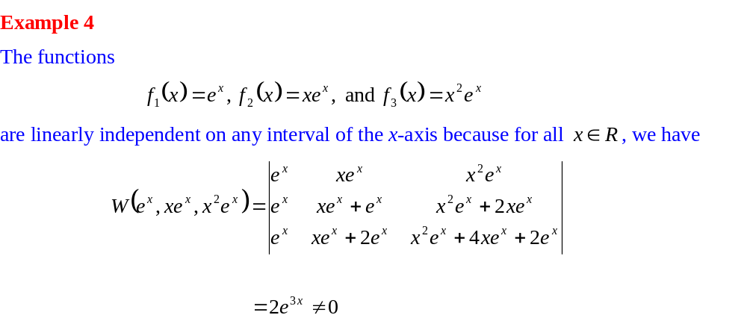
Linear Independence/dependence through Wronskian

Slide 40
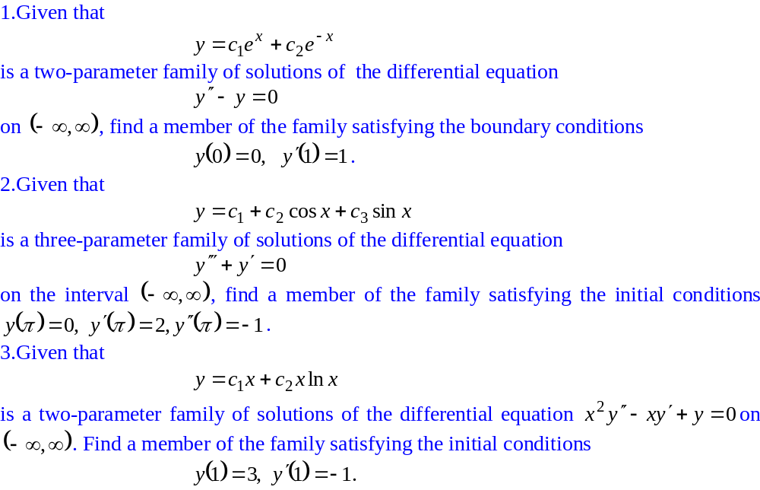
Practice Exercises

Slide 41
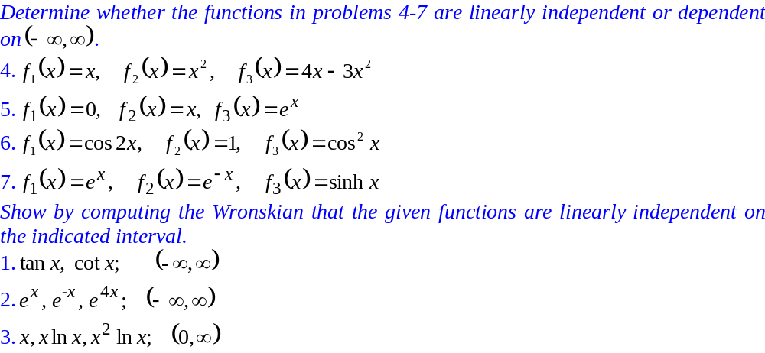
Practice Exercises

