Slide 1

 | National University of Sciences & Technology (NUST) School of Electrical Engineering and Computer Science (SEECS) Department of Basic Sciences
Linear Algebra & Ordinary Differential Equations
MATH-121
Lecture # 36
Course Instructor: Dr Saira Zainab
Ph. # 03325193283
Email: saira.zainab@seecs.edu.pk
Office # 207, Faculty Block, SEECS
1

Slide 2
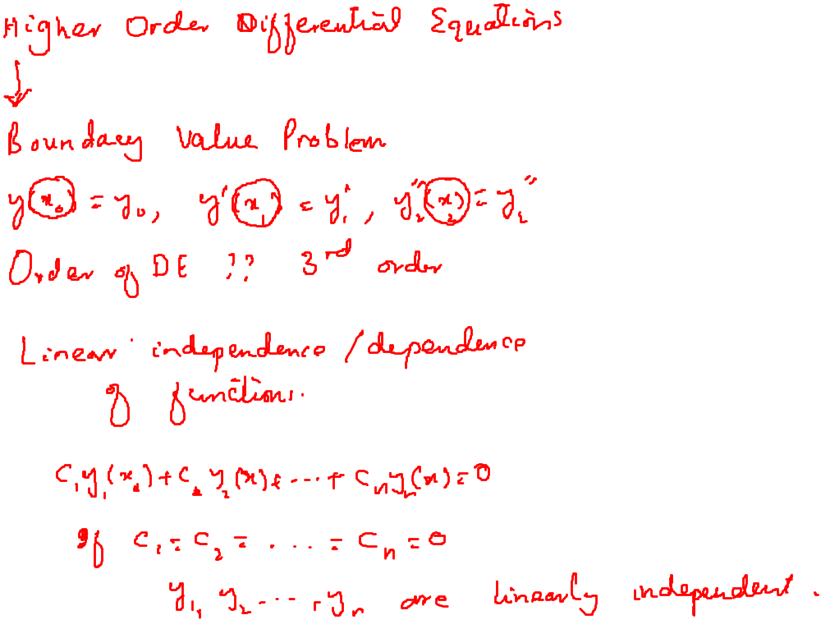
Recalling Previous Lecture

Slide 3
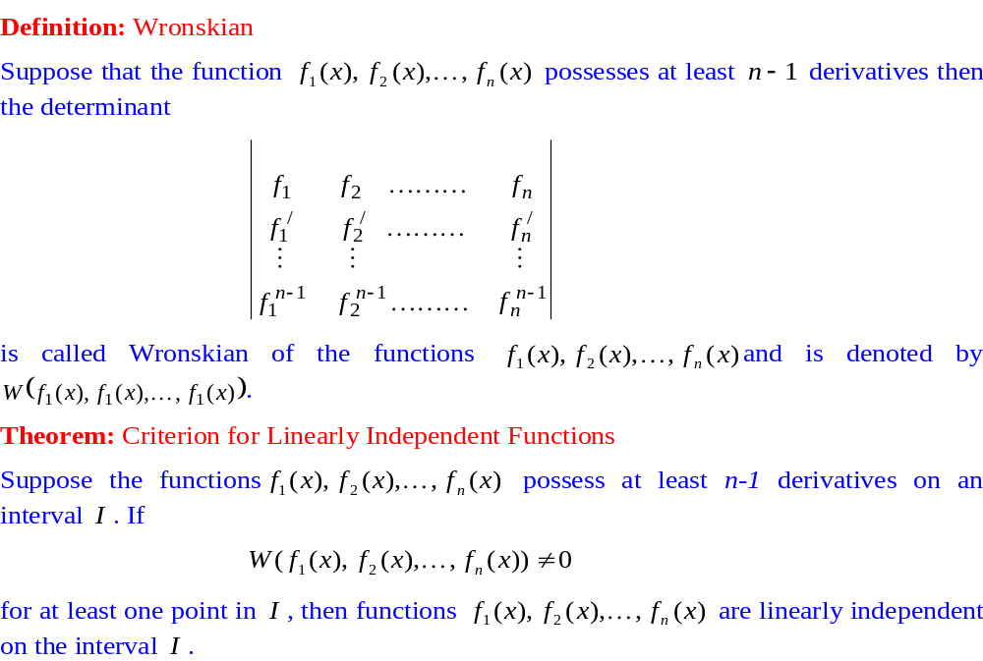
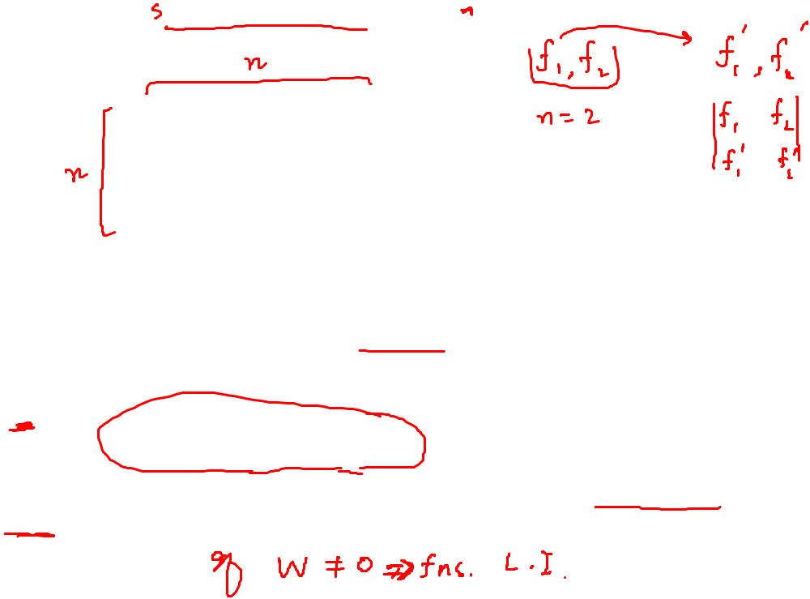
Wronskian

Slide 4
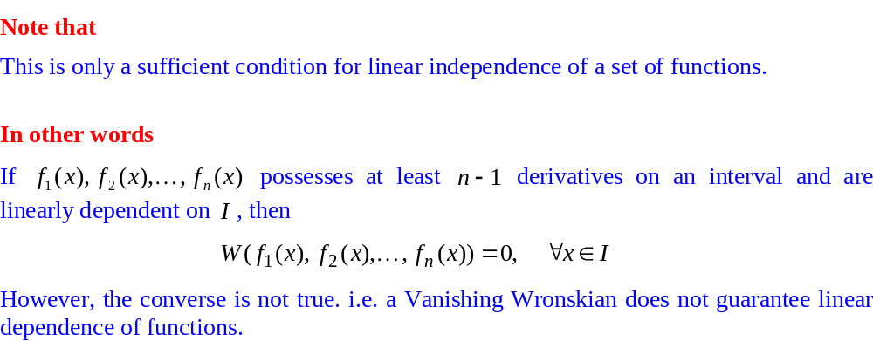
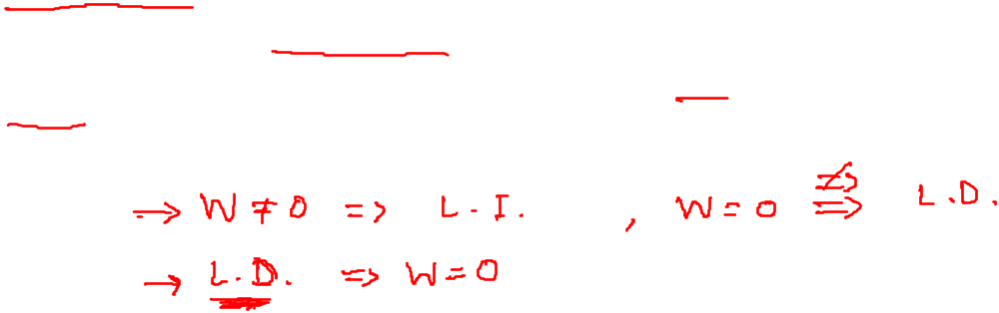
Wronskian

Slide 5
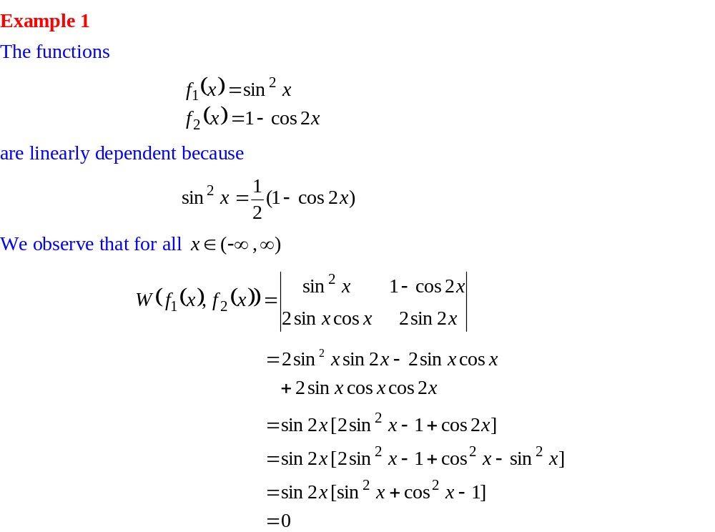
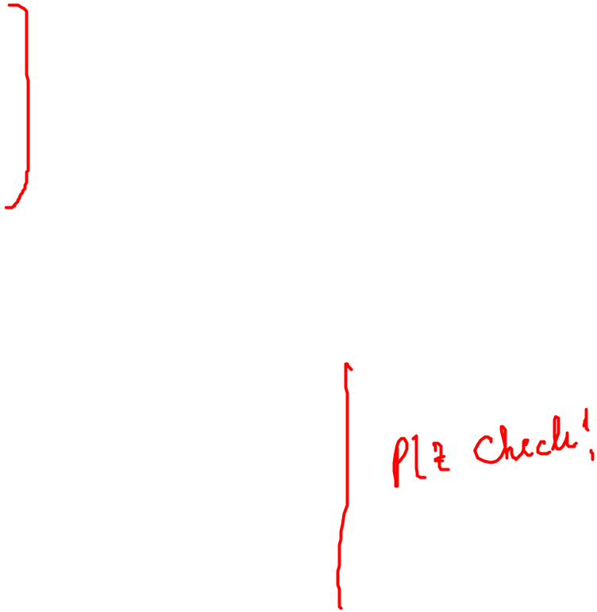
Linear Independence/dependence through Wronskian

Slide 6
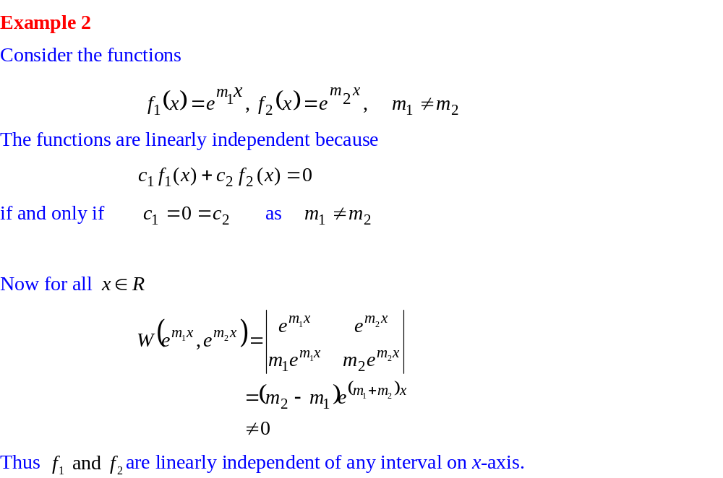
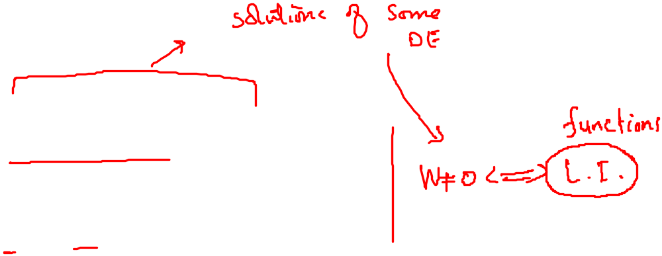
Linear Independence/dependence through Wronskian

Slide 7
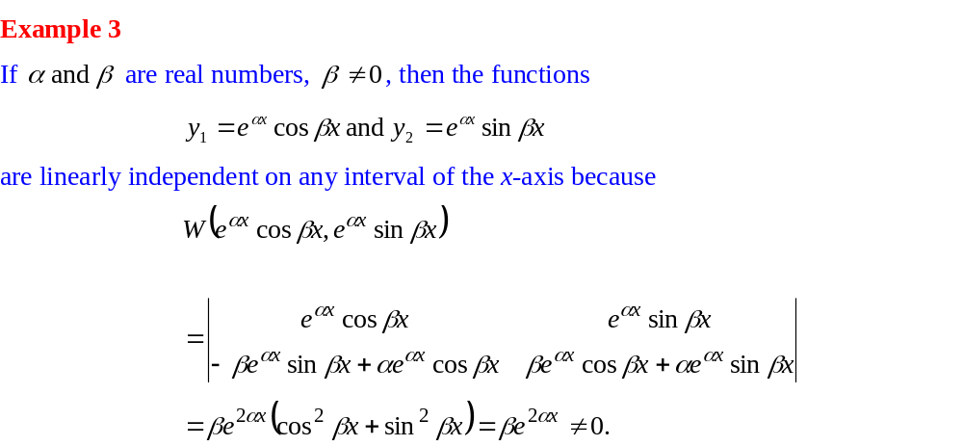

Linear Independence/dependence through Wronskian

Slide 8
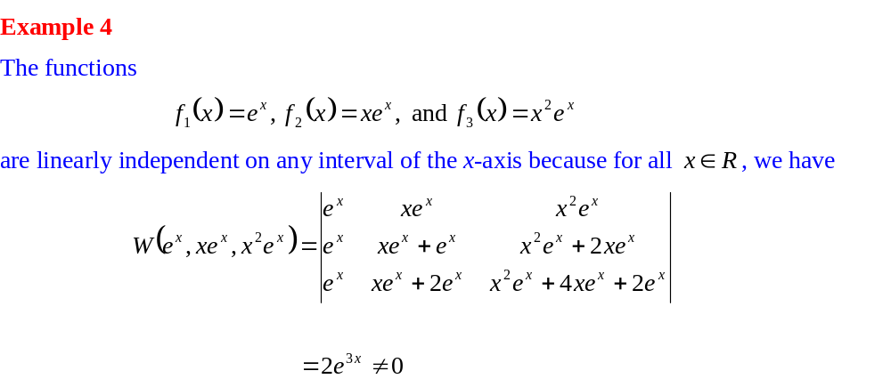

Linear Independence/dependence through Wronskian

Slide 9
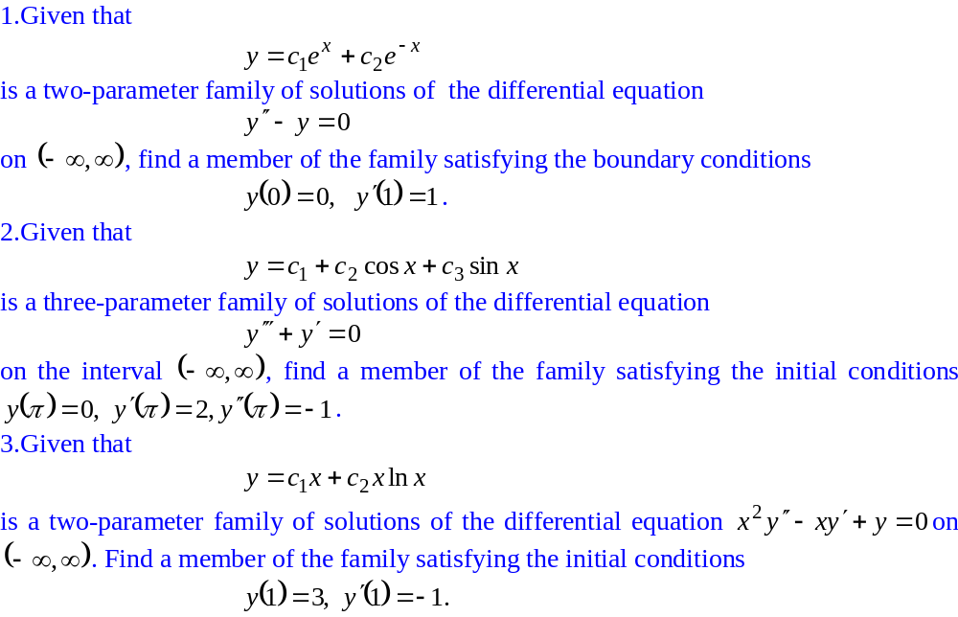

Practice Exercises

Slide 10
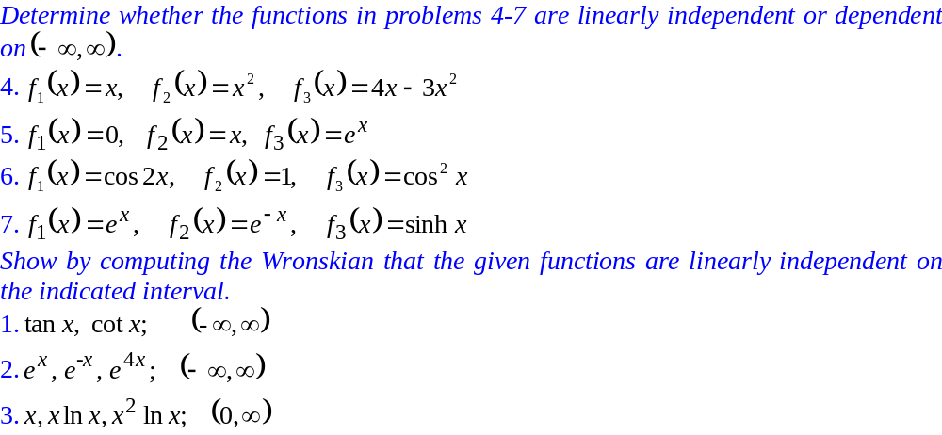
Practice Exercises

Slide 11
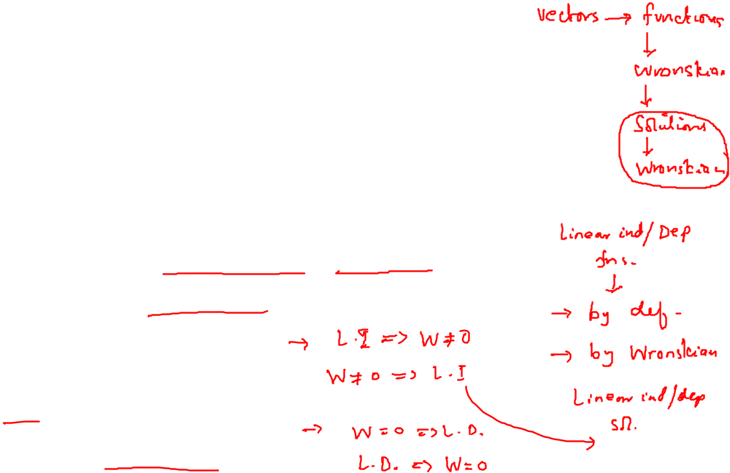
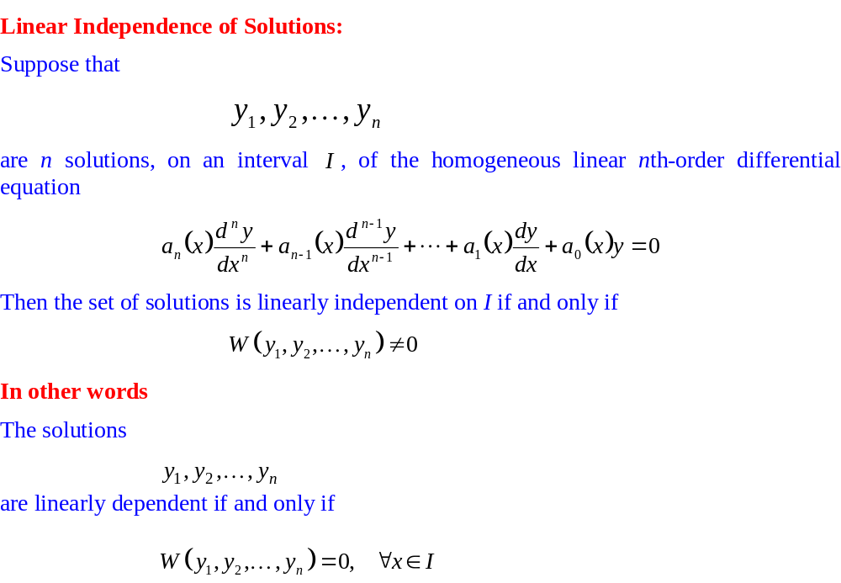
Wronskian

Slide 12
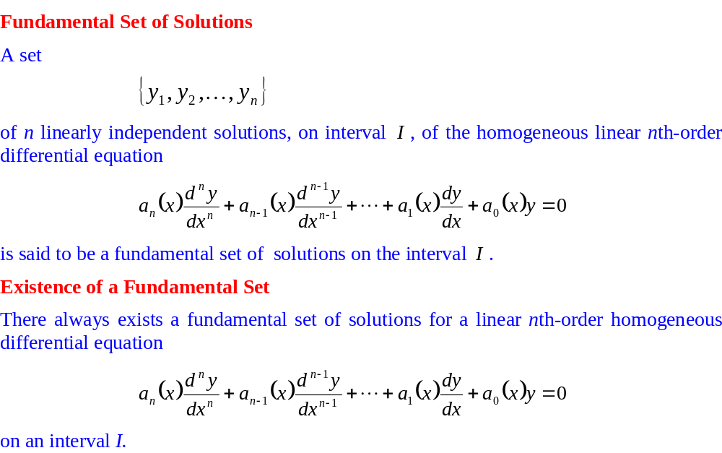
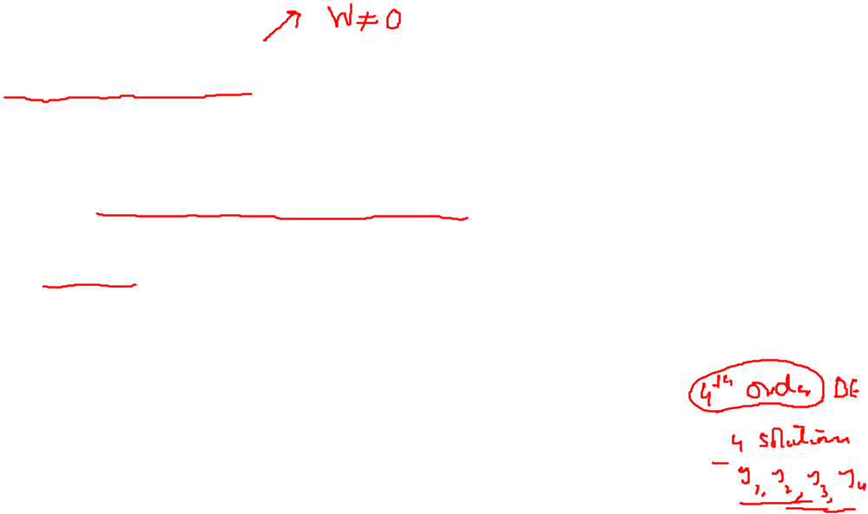
Wronskian

Slide 13
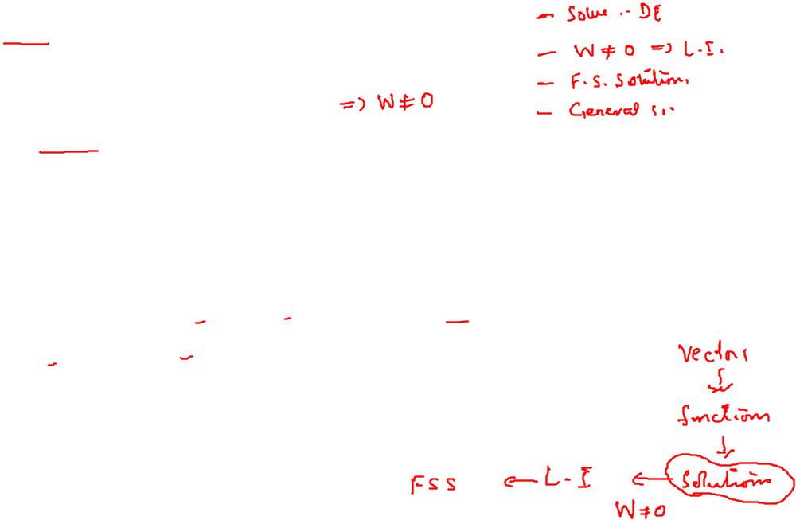
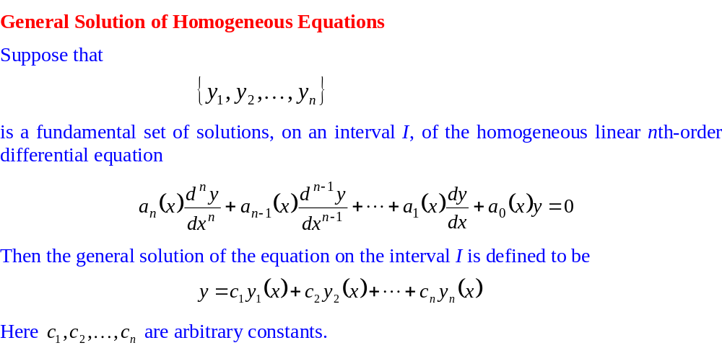
Wronskian

Slide 14
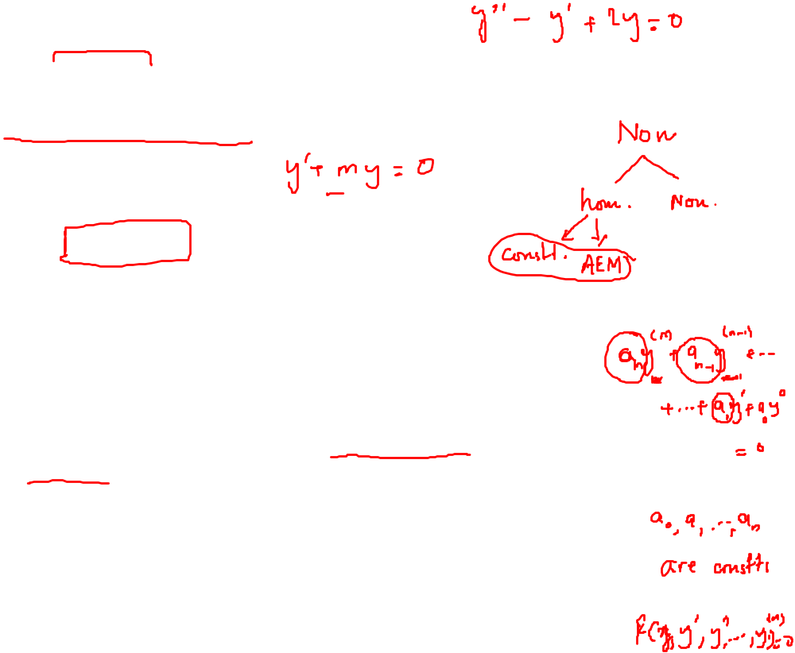
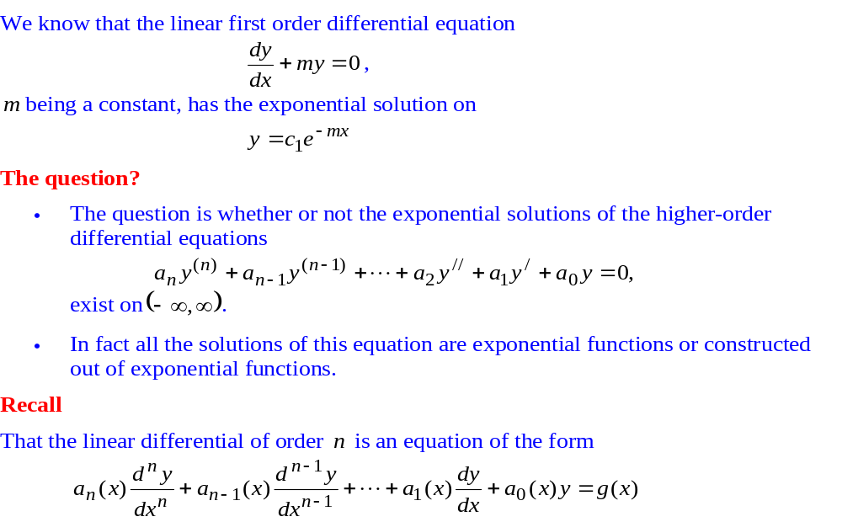
Homogeneous Linear Equations with Constant Coefficients

Slide 15
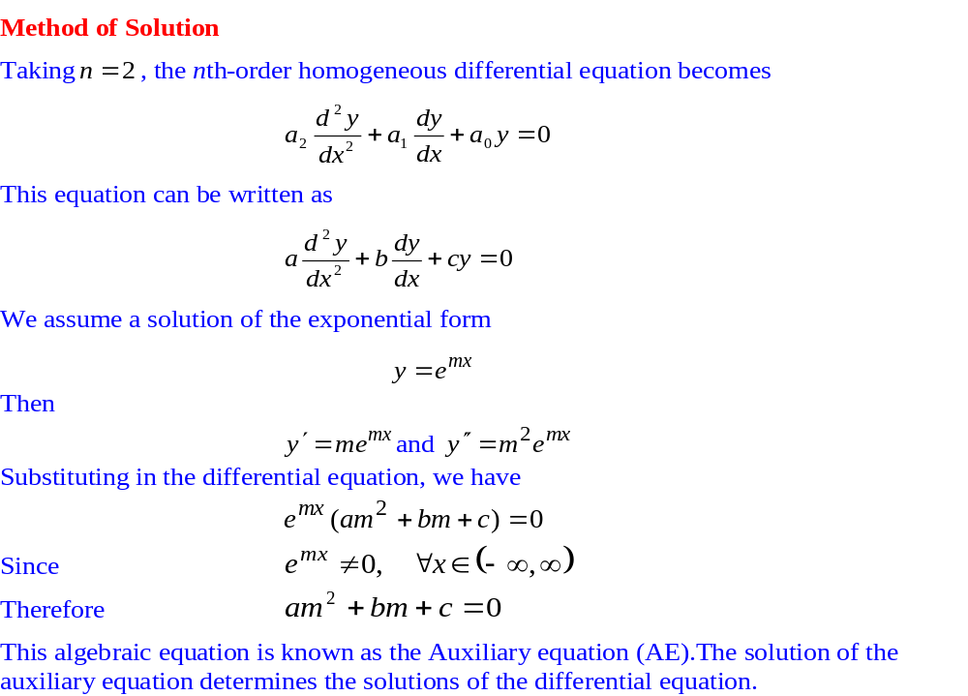
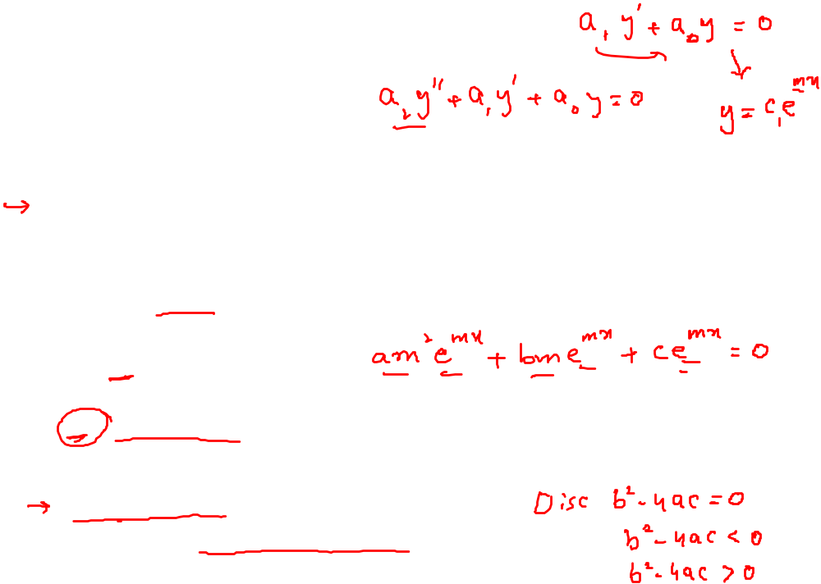
Homogeneous Linear Equations with Constant Coefficients

Slide 16
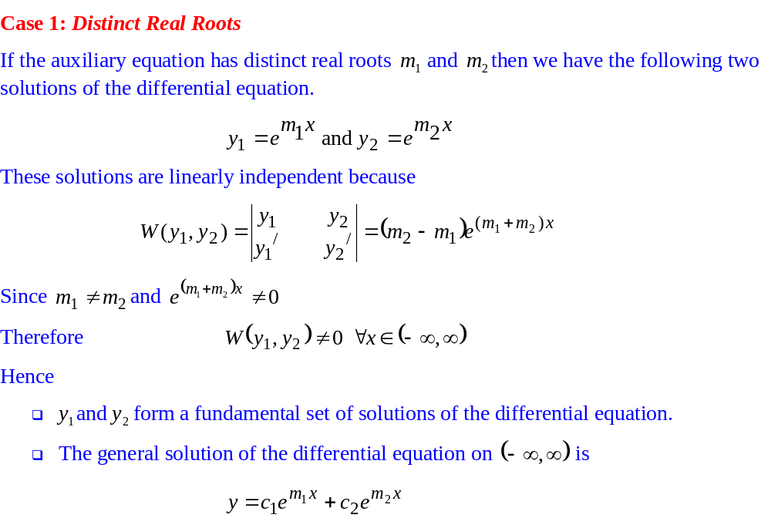
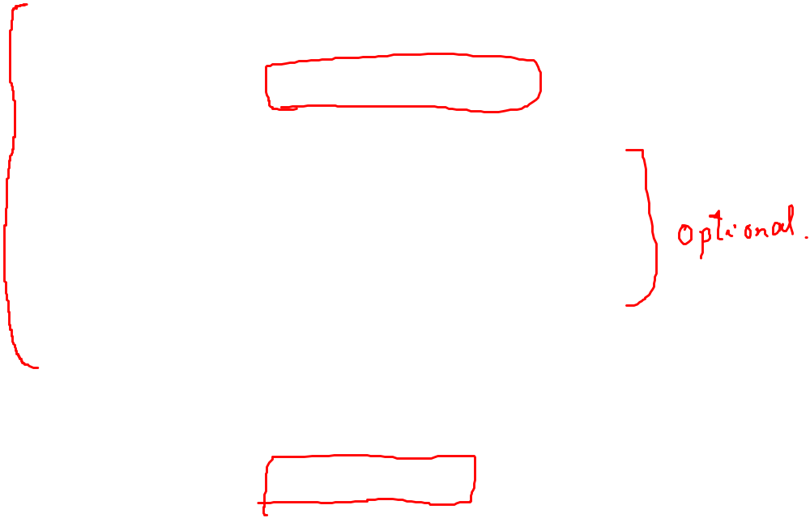
Homogeneous Linear Equations with Constant Coefficients

Slide 17
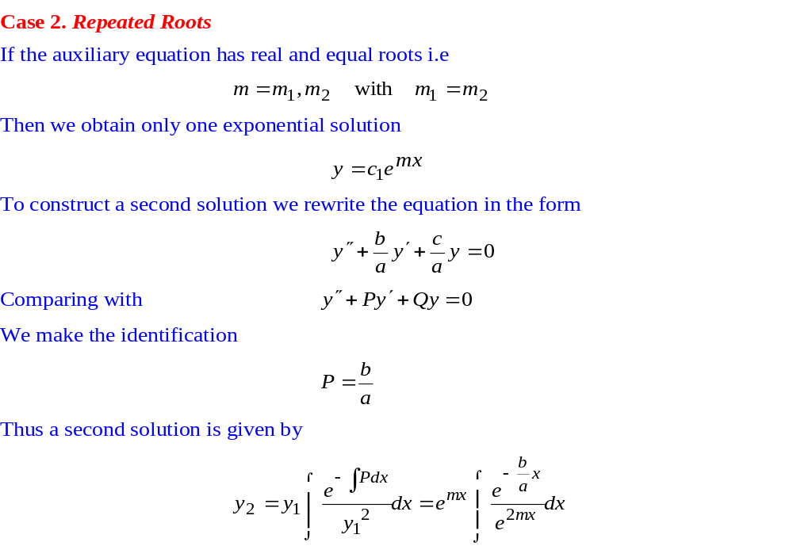
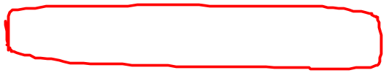
Homogeneous Linear Equations with Constant Coefficients

Slide 18
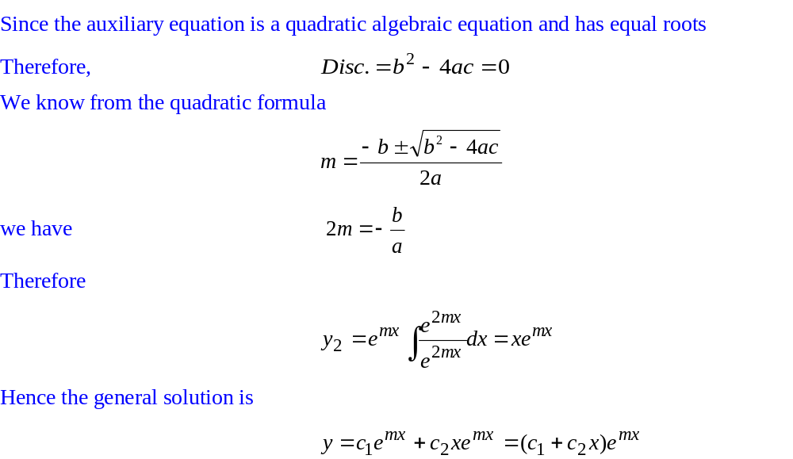
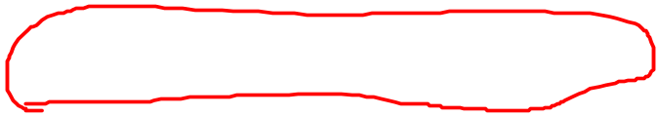
Homogeneous Linear Equations with Constant Coefficients

Slide 19
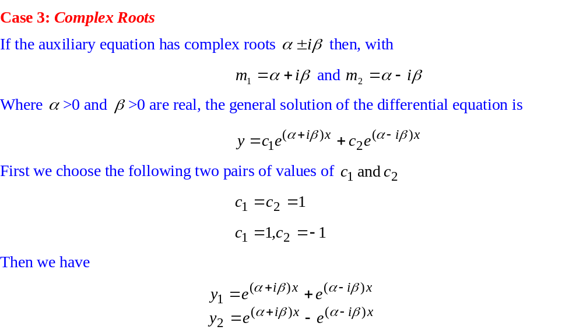

Homogeneous Linear Equations with Constant Coefficients

Slide 20
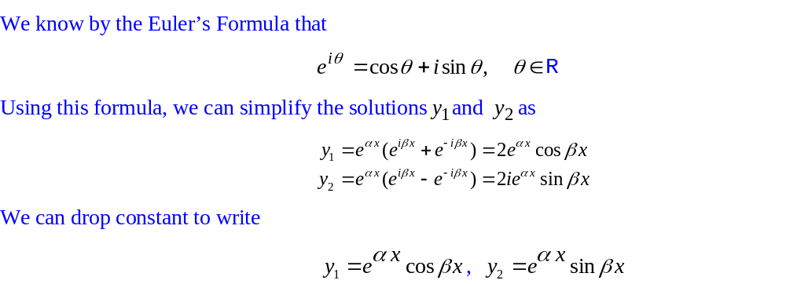
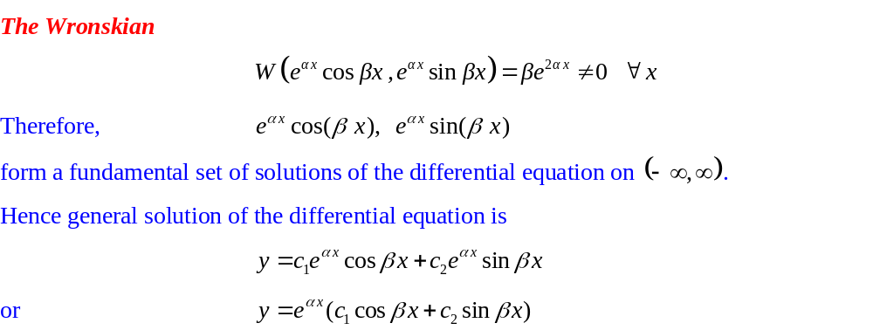
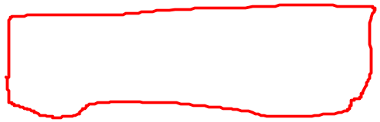
Homogeneous Linear Equations with Constant Coefficients

Slide 21
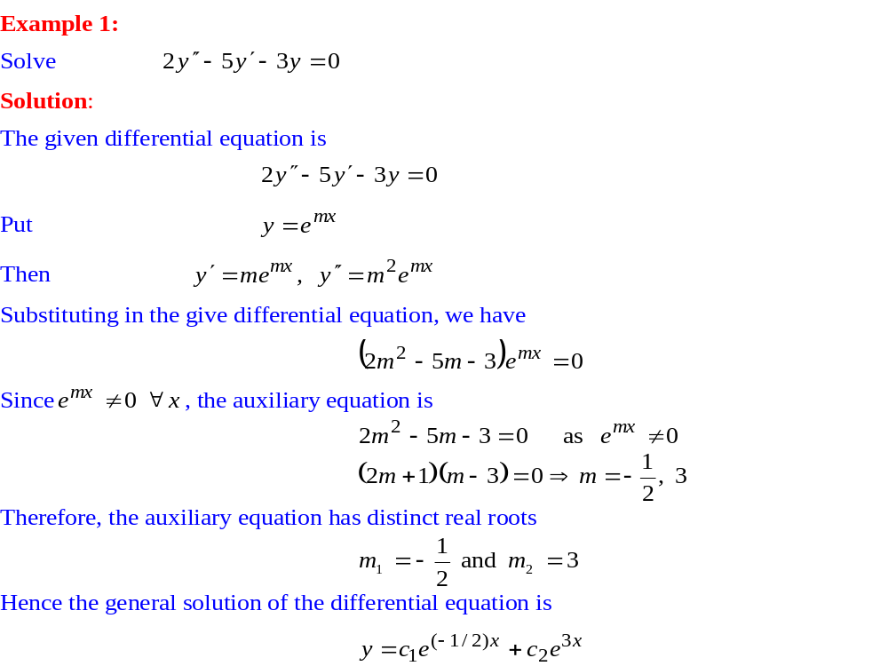
Homogeneous Linear Equations with Constant Coefficients

Slide 22
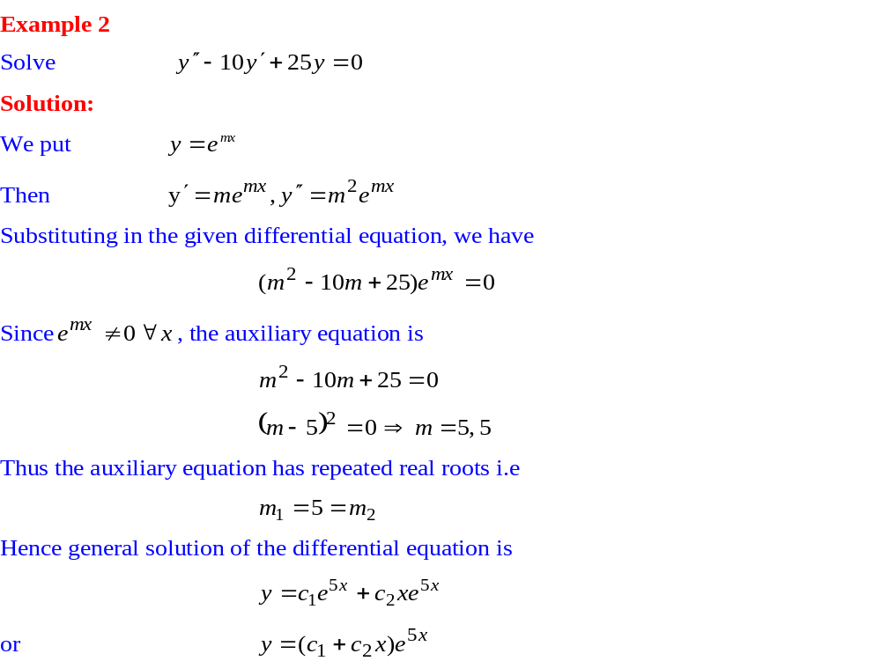
Homogeneous Linear Equations with Constant Coefficients

Slide 23
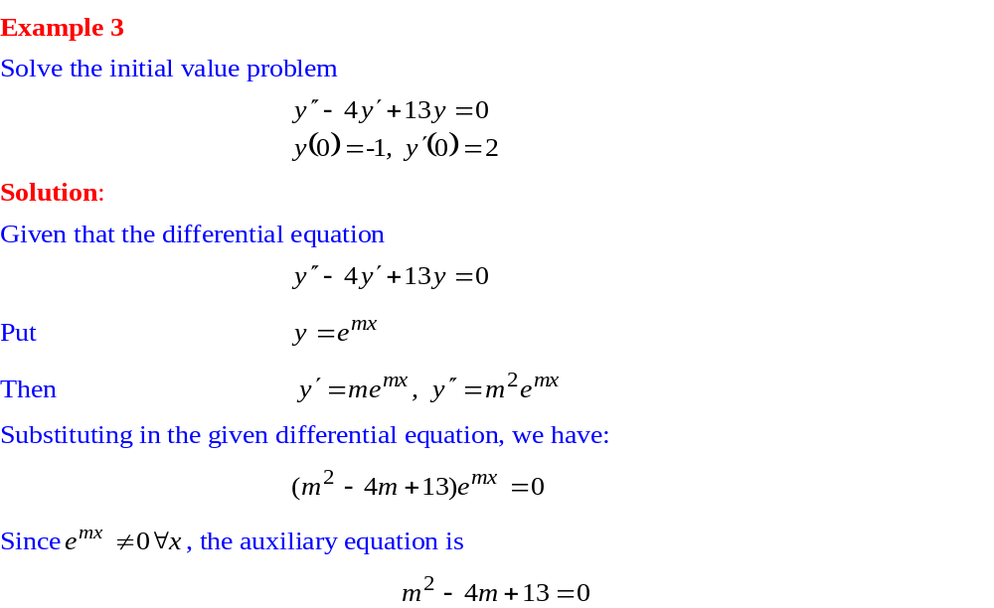
Homogeneous Linear Equations with Constant Coefficients

Slide 24
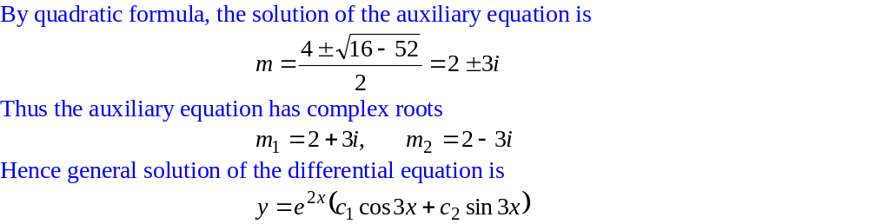
Homogeneous Linear Equations with Constant Coefficients

Slide 25
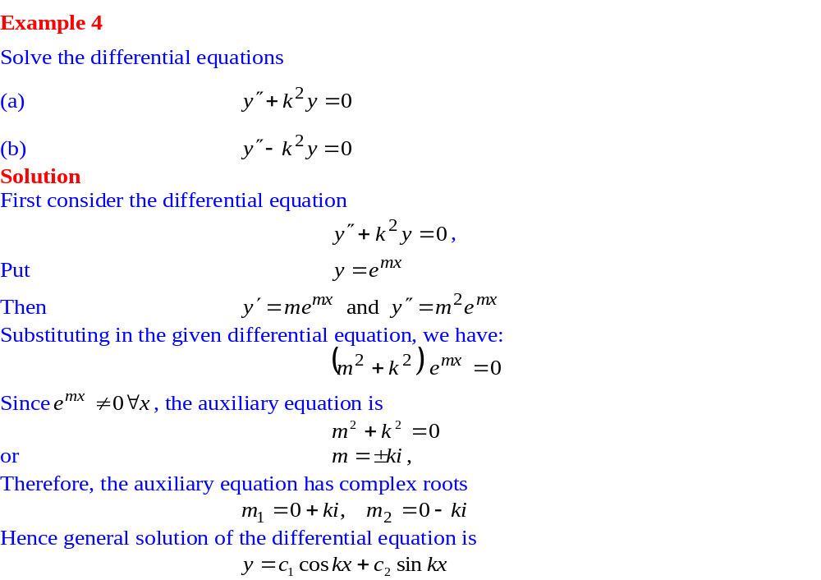
Homogeneous Linear Equations with Constant Coefficients

Slide 26
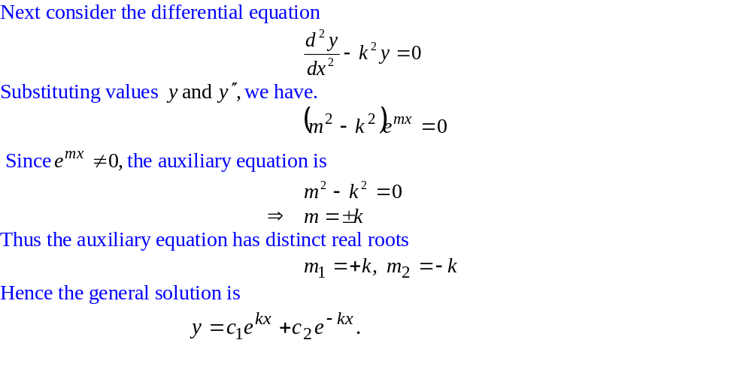
Homogeneous Linear Equations with Constant Coefficients

Slide 27
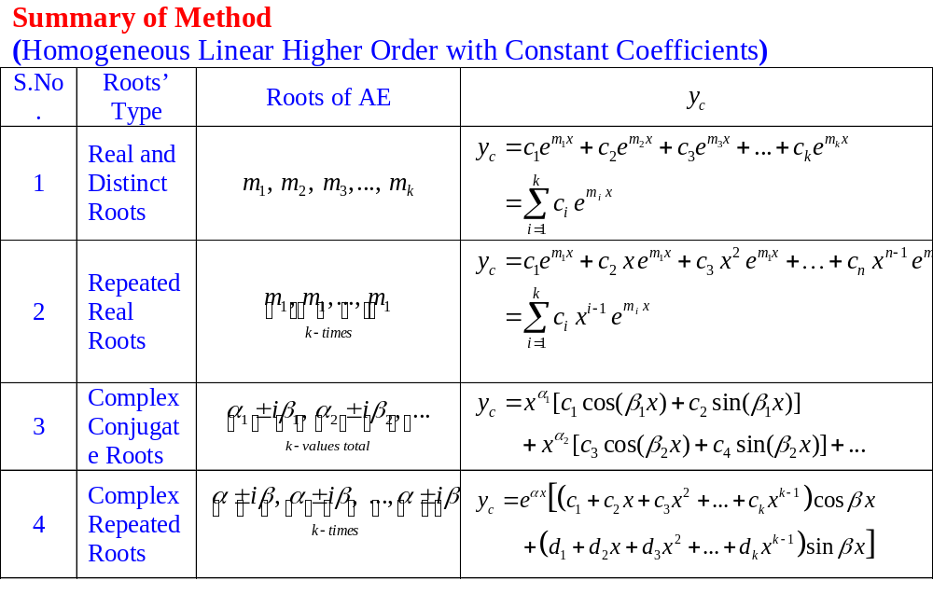
Homogeneous Linear Equations with Constant Coefficients

Slide 28
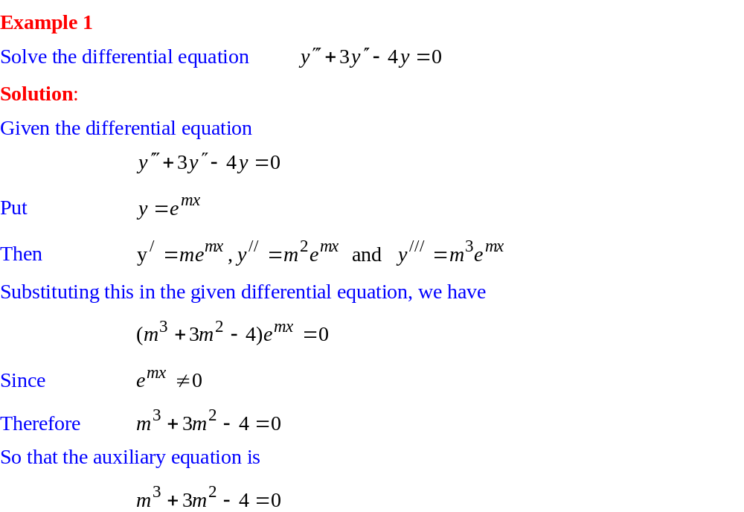
Homogeneous Linear Equations with Constant Coefficients

Slide 29
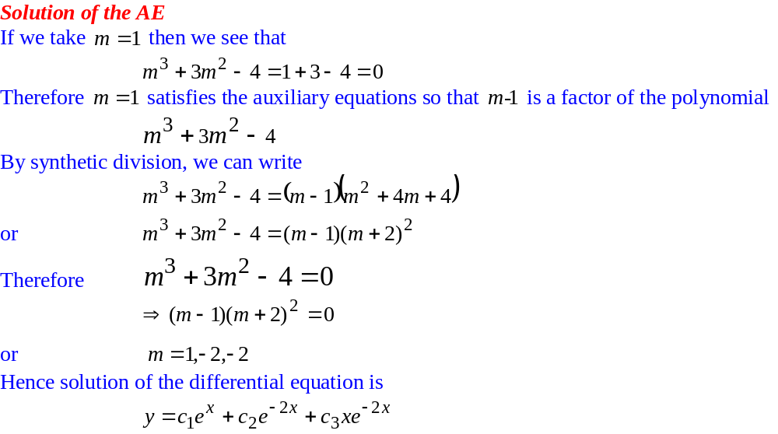
Homogeneous Linear Equations with Constant Coefficients

Slide 30
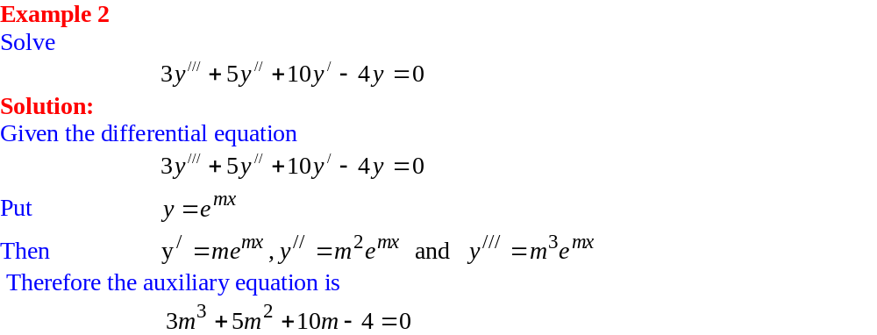
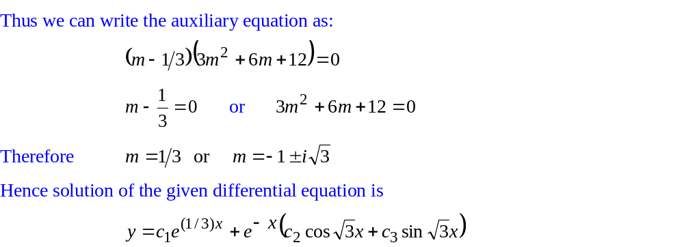
Homogeneous Linear Equations with Constant Coefficients

Slide 31
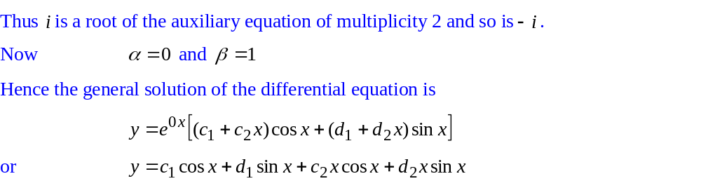
Homogeneous Linear Equations with Constant Coefficients

Slide 32
Homogeneous Linear Equations with Constant Coefficients

Slide 33
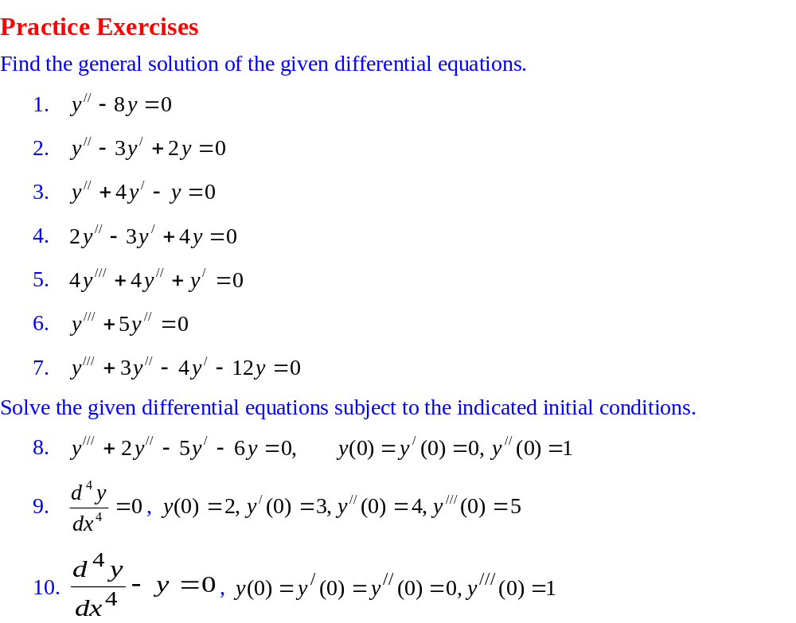
Homogeneous Linear Equations with Constant Coefficients

