Slide 1

 | National University of Sciences & Technology (NUST) School of Electrical Engineering and Computer Science (SEECS) Department of Basic Sciences
Linear Algebra & Ordinary Differential Equations
MATH-121
Lecture # 37
Course Instructor: Dr Saira Zainab
Ph. # 03325193283
Email: saira.zainab@seecs.edu.pk
Office # 207, Faculty Block, SEECS
1

Slide 2
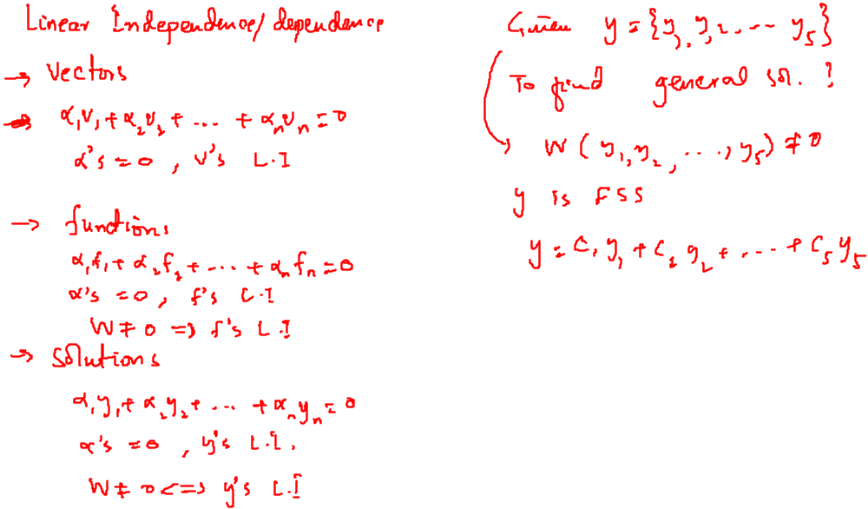
Recalling Previous Lecture

Slide 3

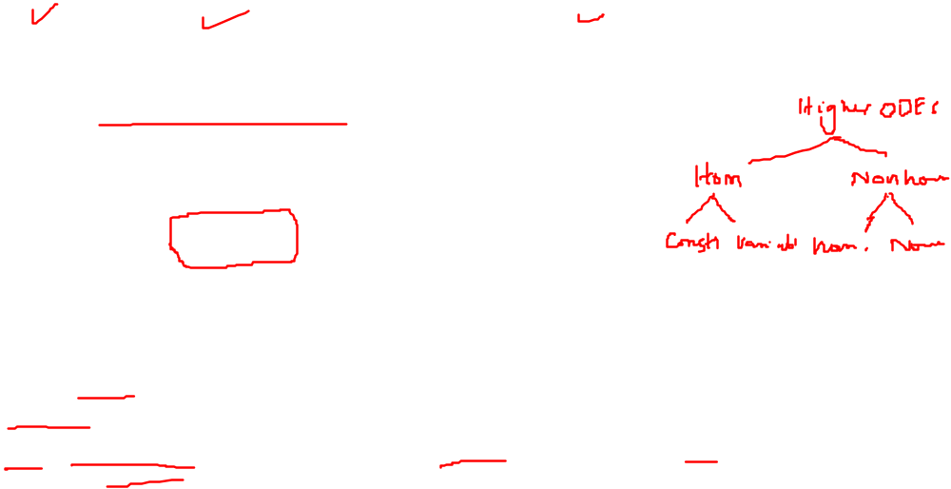
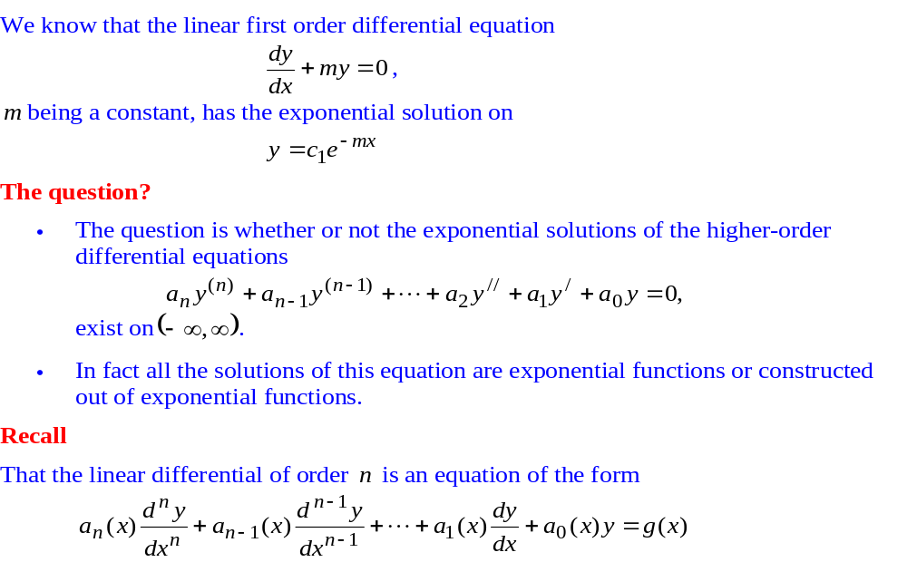
Homogeneous Linear Equations with Constant Coefficients

Slide 4
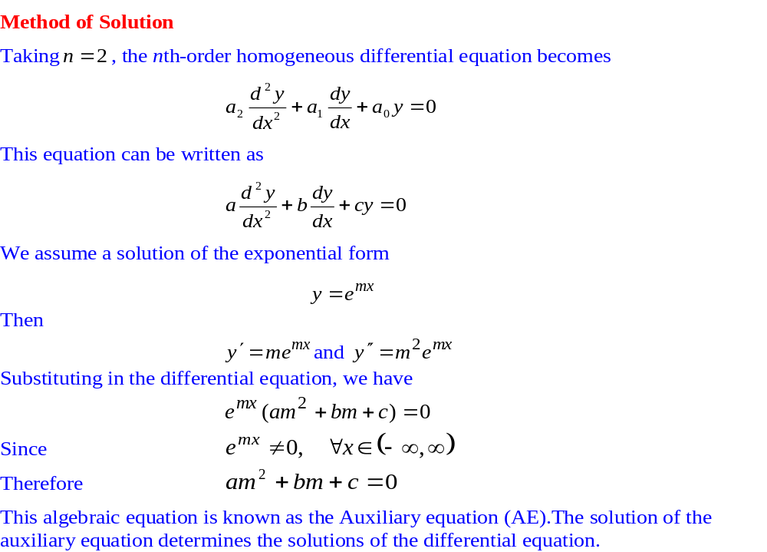
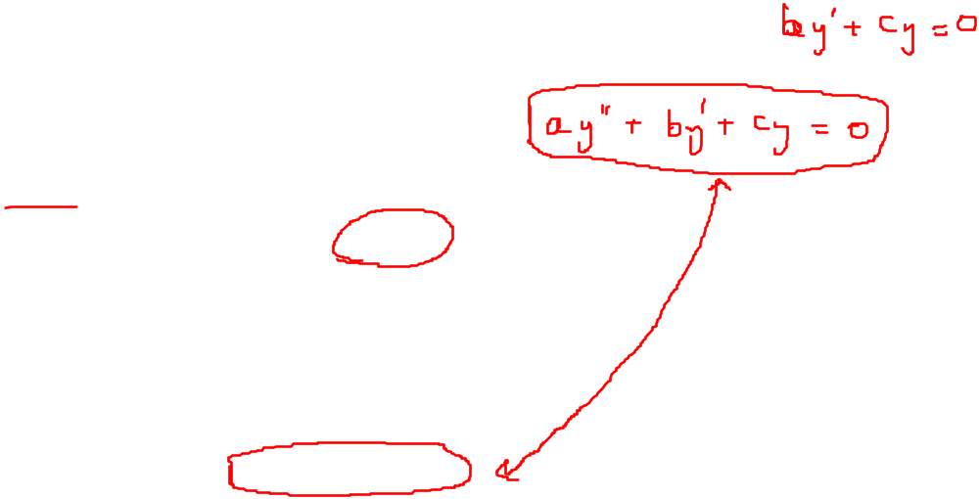
Homogeneous Linear Equations with Constant Coefficients

Slide 5
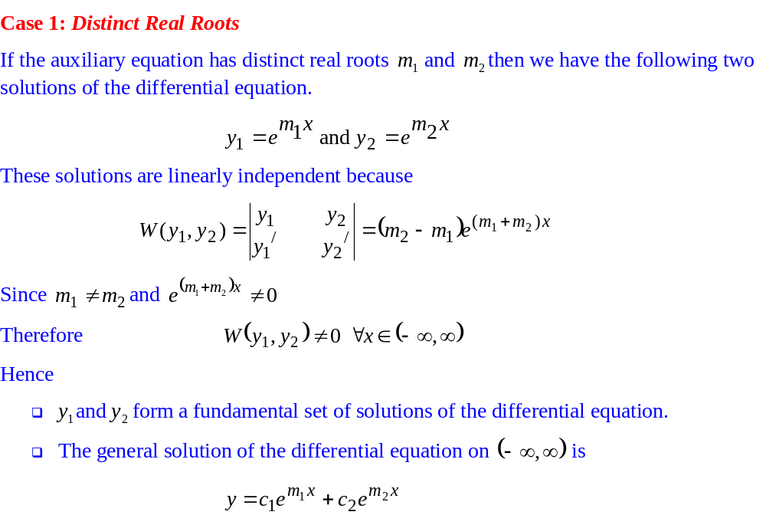
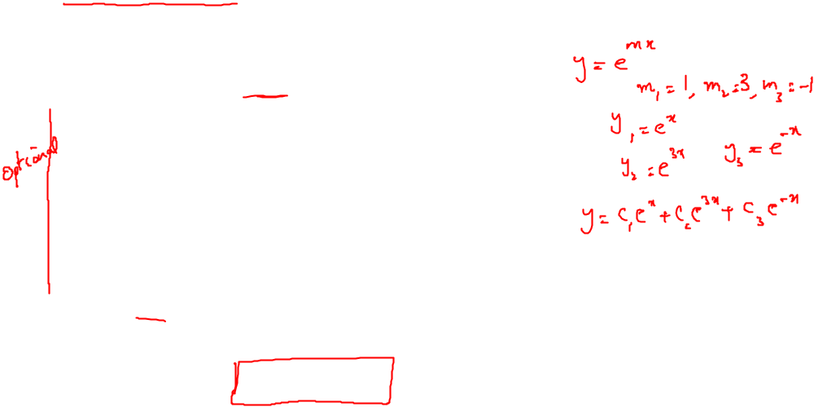
Homogeneous Linear Equations with Constant Coefficients

Slide 6
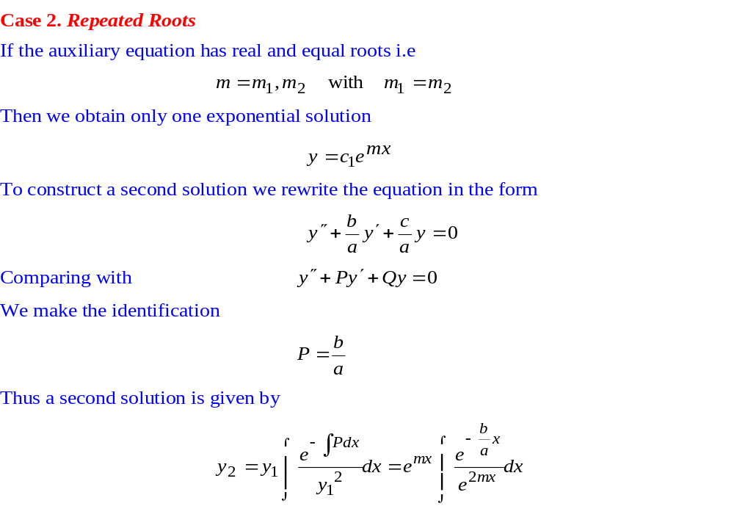
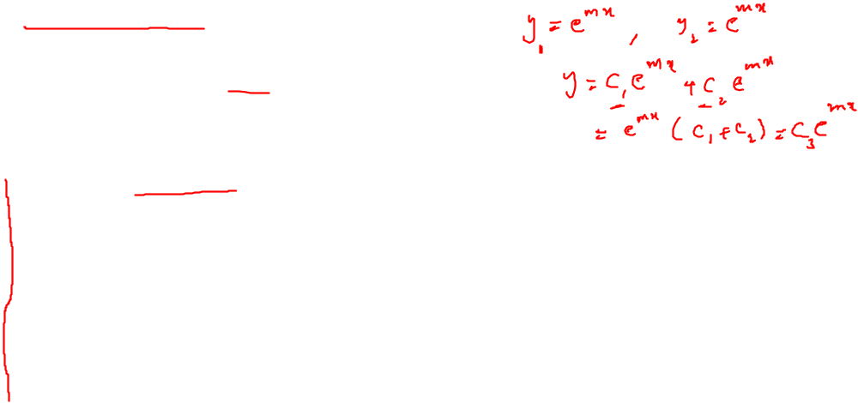
Homogeneous Linear Equations with Constant Coefficients

Slide 7
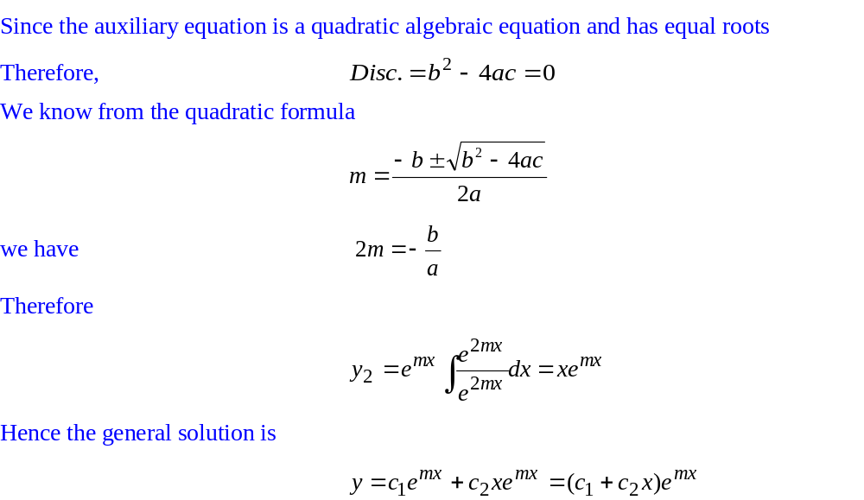
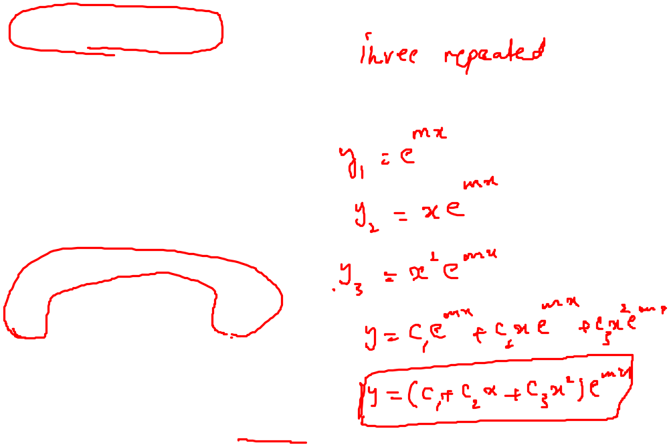
Homogeneous Linear Equations with Constant Coefficients

Slide 8
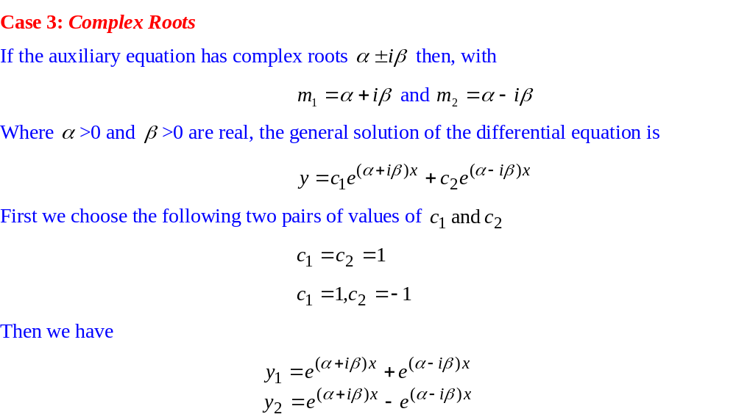
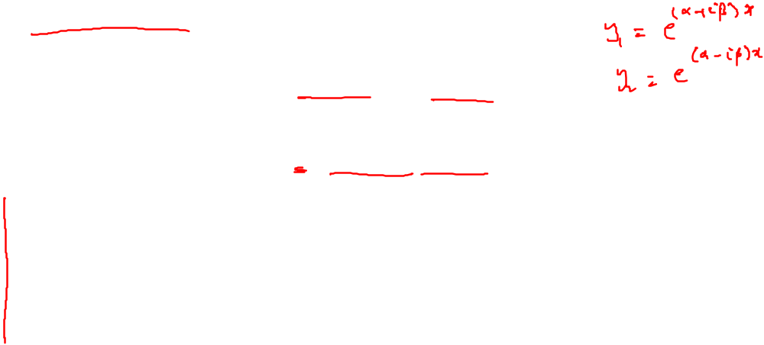
Homogeneous Linear Equations with Constant Coefficients

Slide 9
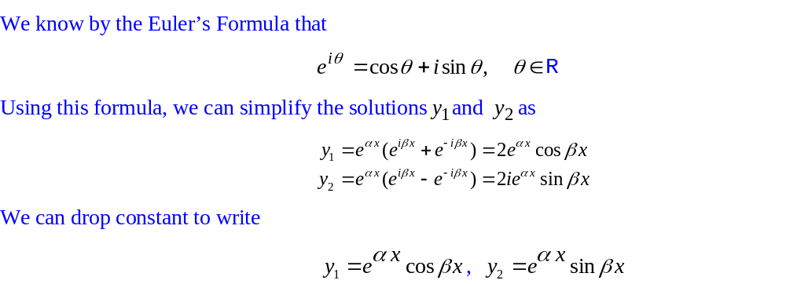
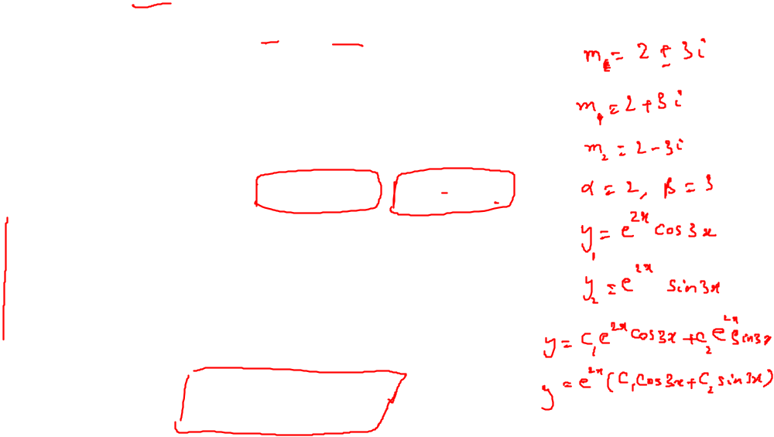
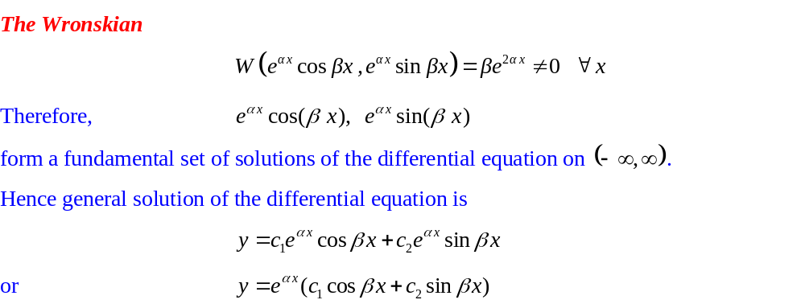
Homogeneous Linear Equations with Constant Coefficients

Slide 10
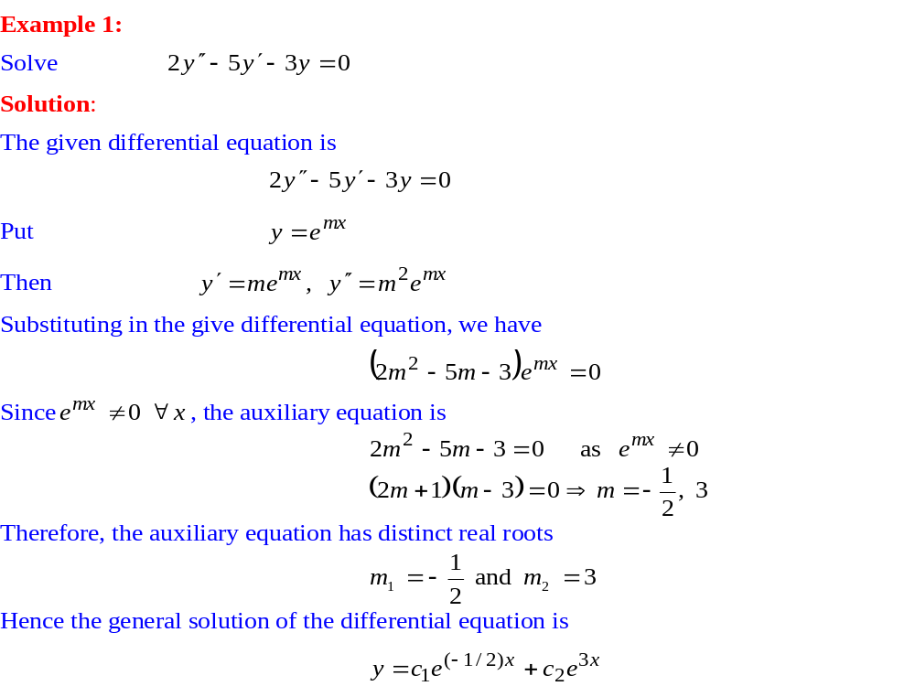
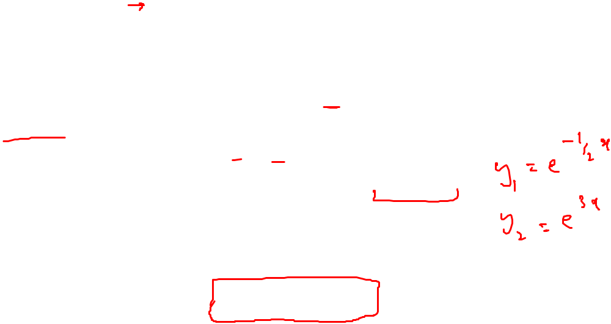
Homogeneous Linear Equations with Constant Coefficients

Slide 11
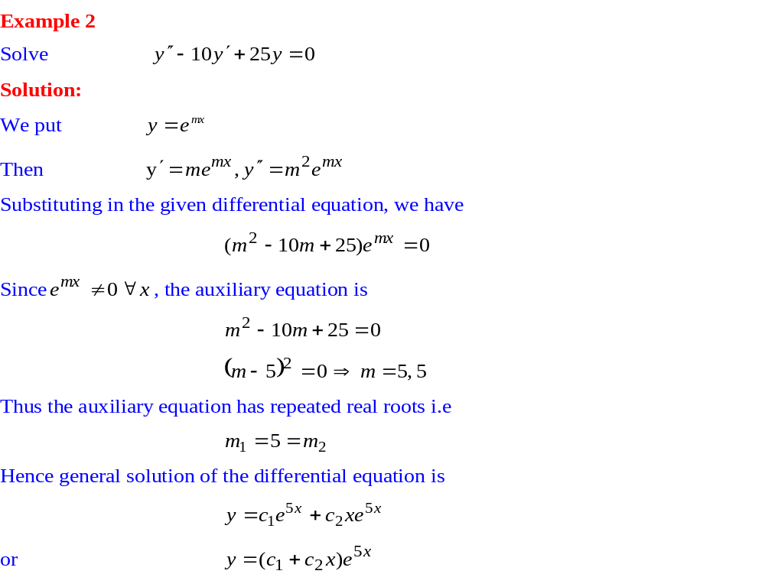
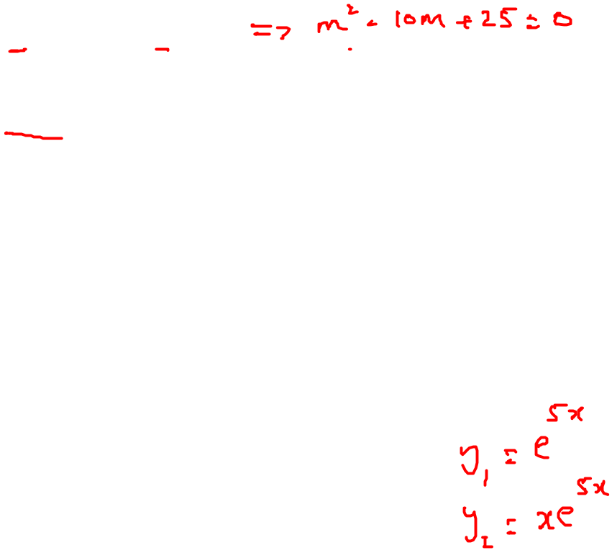
Homogeneous Linear Equations with Constant Coefficients

Slide 12
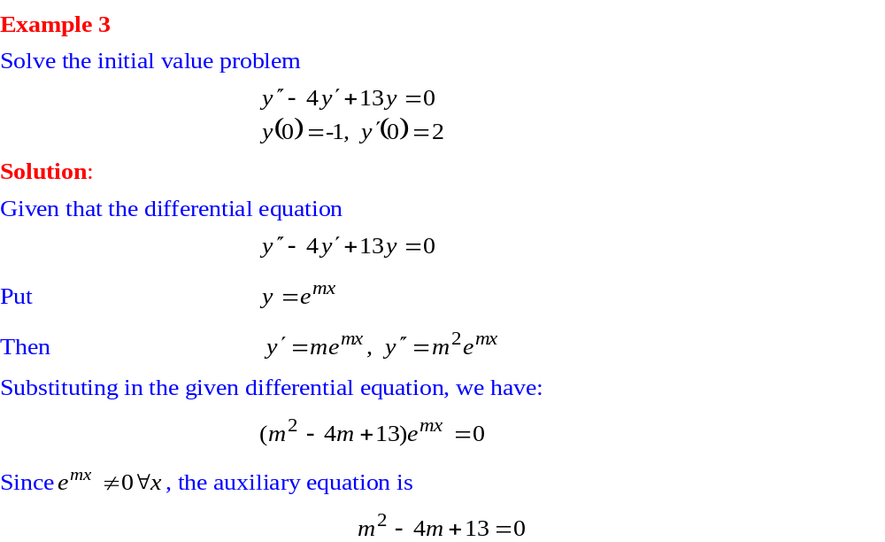
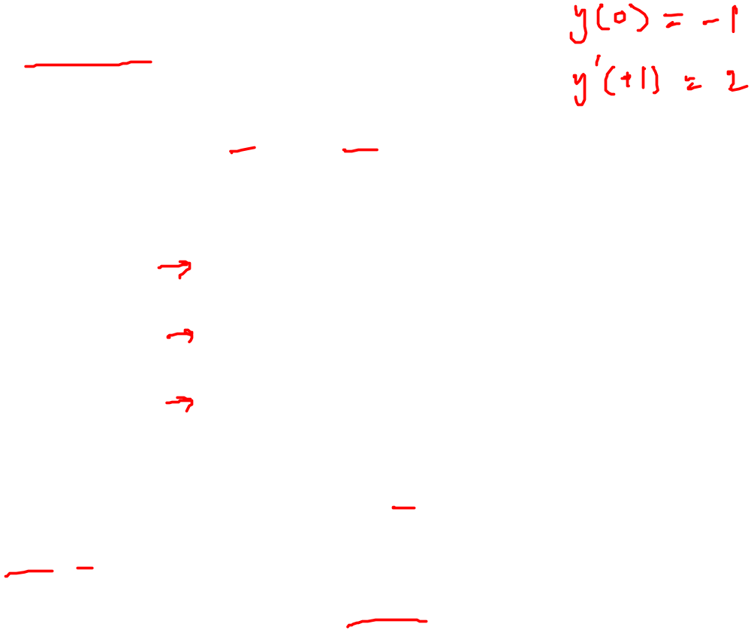
Homogeneous Linear Equations with Constant Coefficients

Slide 13
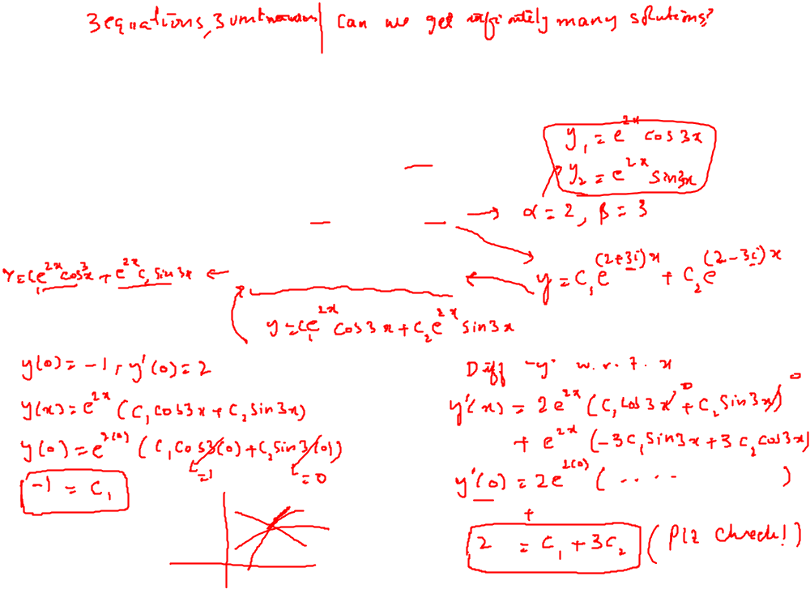
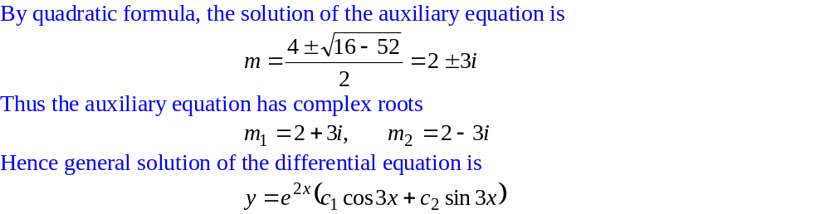
Homogeneous Linear Equations with Constant Coefficients

Slide 14
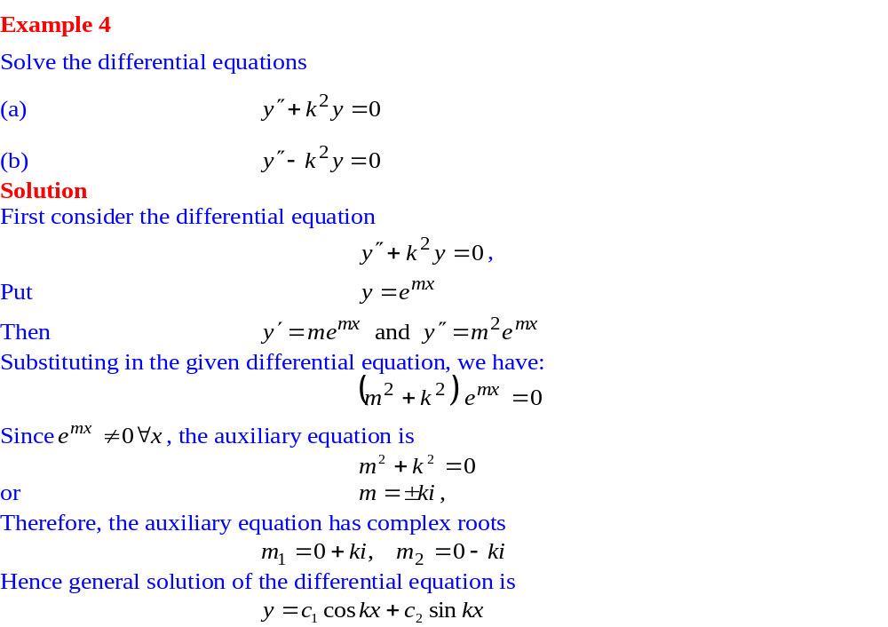
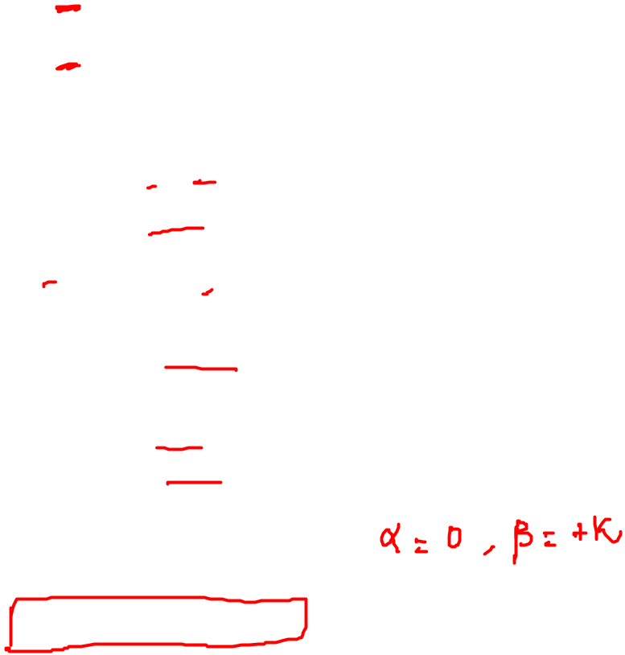
Homogeneous Linear Equations with Constant Coefficients

Slide 15
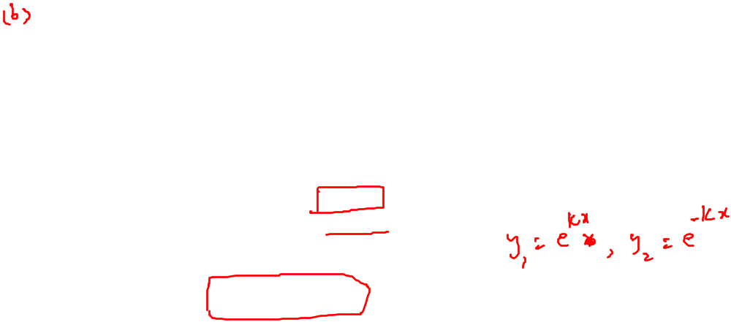
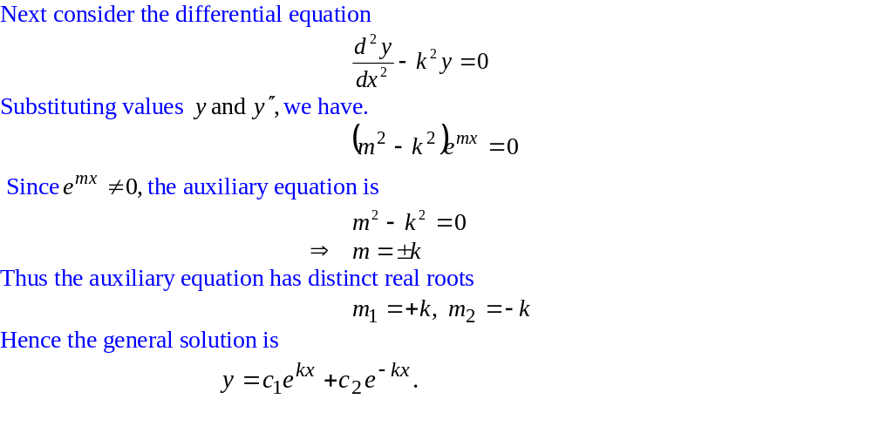
Homogeneous Linear Equations with Constant Coefficients

Slide 16
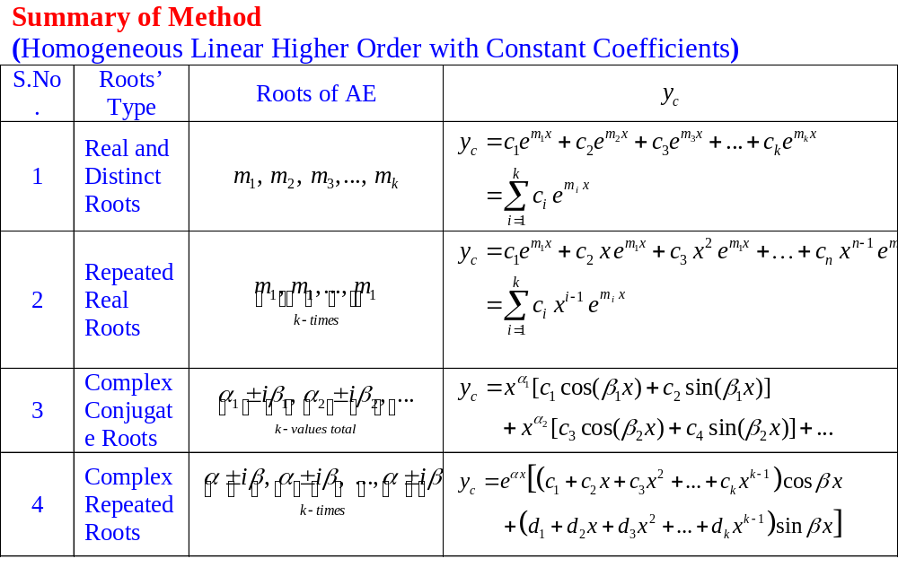
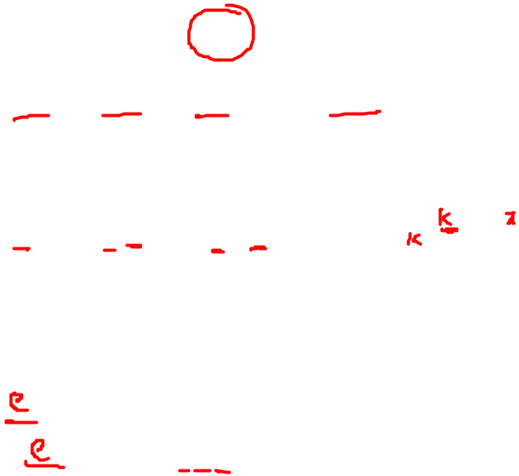
Homogeneous Linear Equations with Constant Coefficients

Slide 17
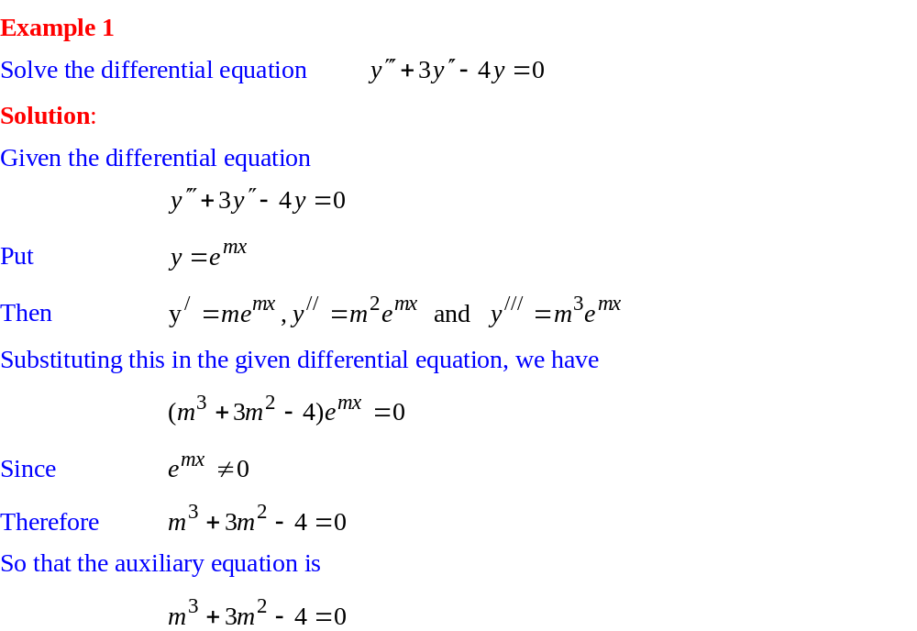

Homogeneous Linear Equations with Constant Coefficients

Slide 18
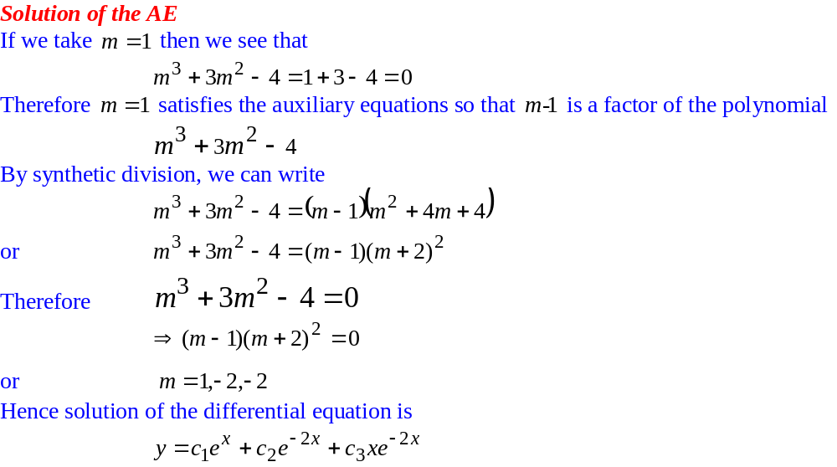
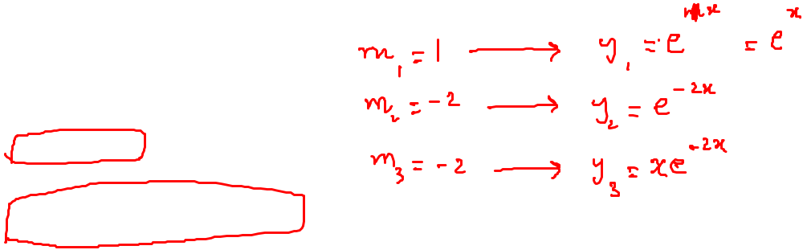
Homogeneous Linear Equations with Constant Coefficients

Slide 19
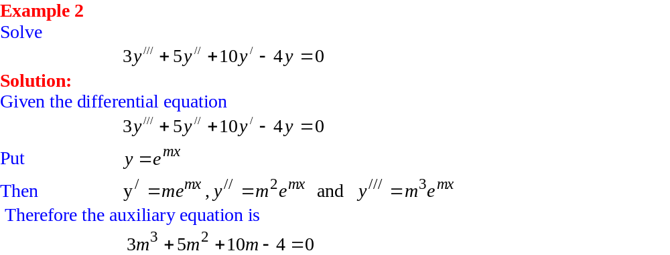
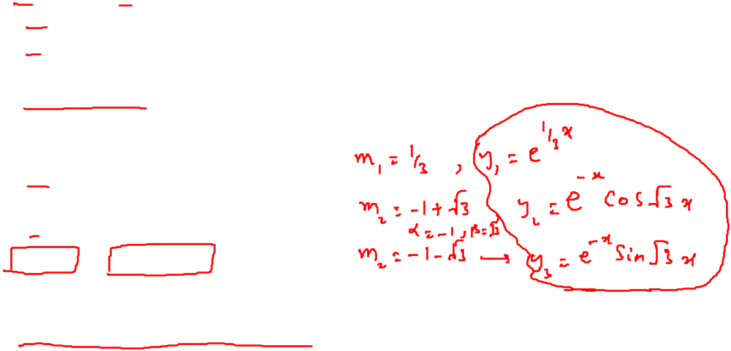
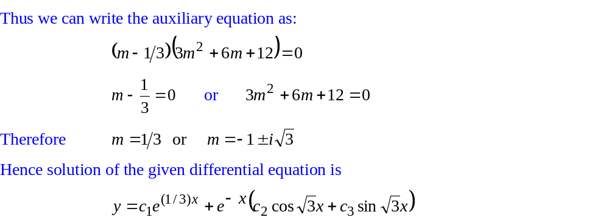
Homogeneous Linear Equations with Constant Coefficients

Slide 20
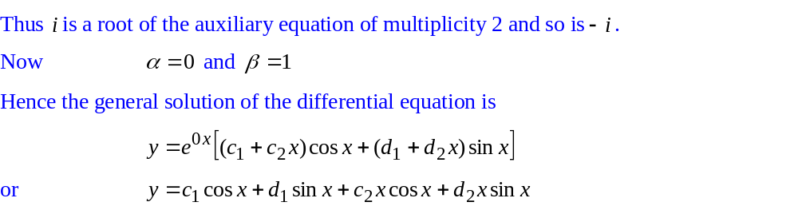
Homogeneous Linear Equations with Constant Coefficients

Slide 21
Homogeneous Linear Equations with Constant Coefficients

Slide 22
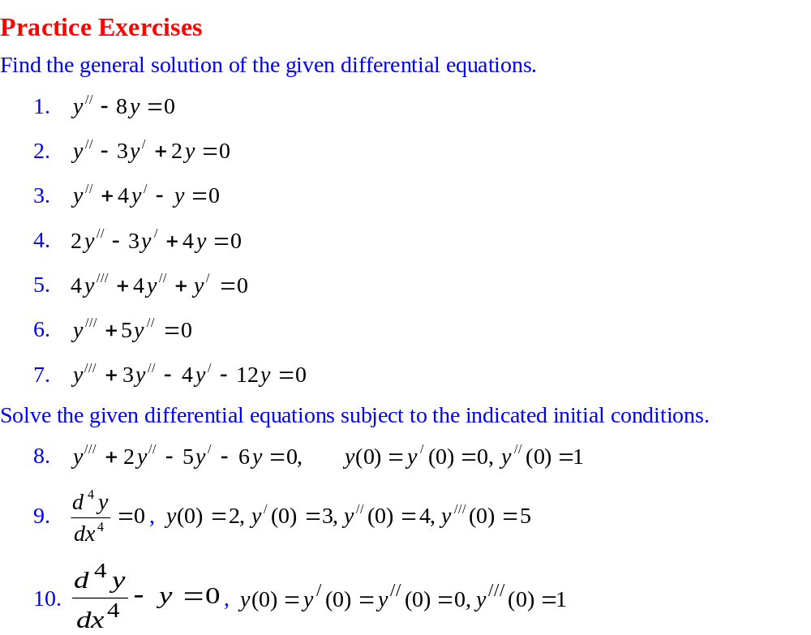
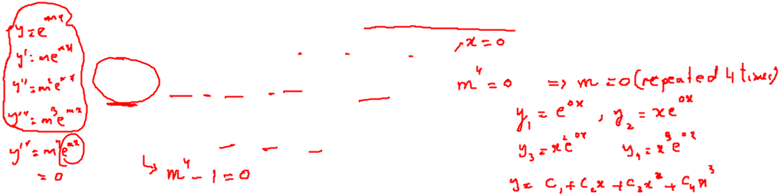
Homogeneous Linear Equations with Constant Coefficients

