Slide 1

 | National University of Sciences & Technology (NUST) School of Electrical Engineering and Computer Science (SEECS) Department of Basic Sciences
Linear Algebra & Ordinary Differential Equations
MATH-121
Lecture # 38
Course Instructor: Dr Saira Zainab
Ph. # 03325193283
Email: saira.zainab@seecs.edu.pk
Office # 207, Faculty Block, SEECS
1

Slide 2
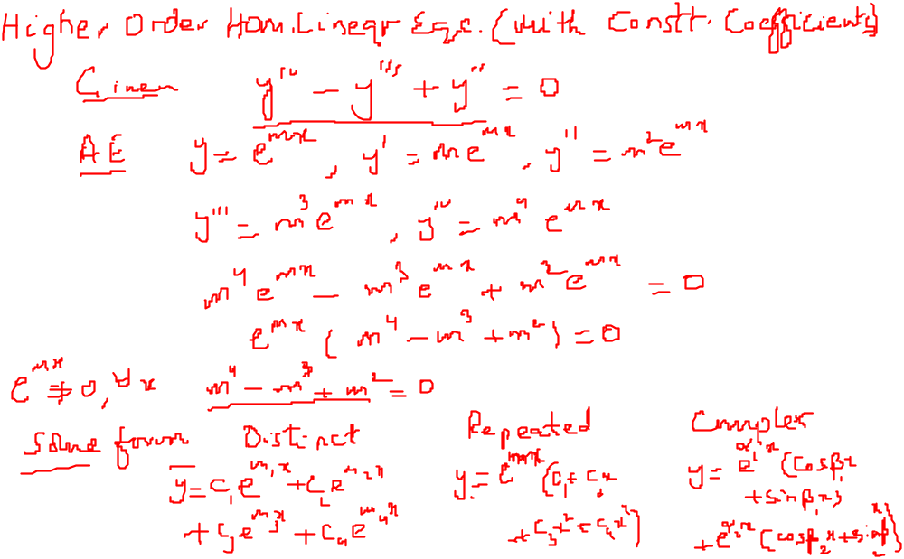
Recalling Previous Lecture

Slide 3
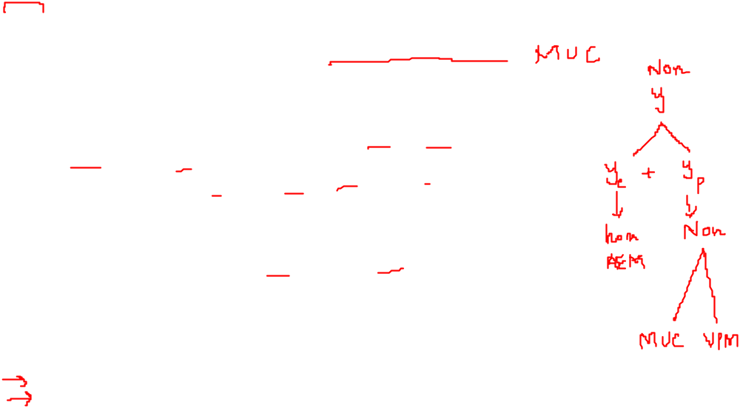
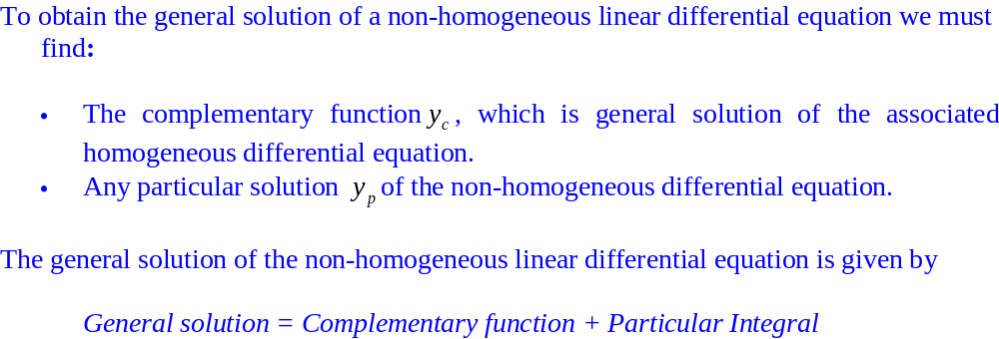
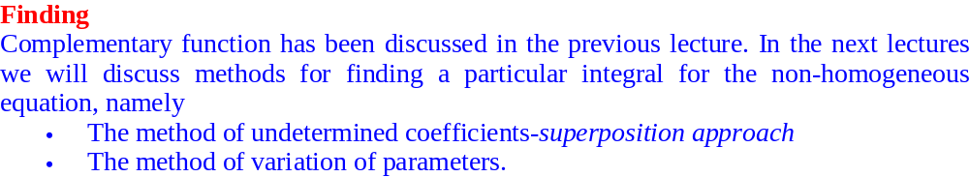
Non Homogeneous Linear Equations with Constant Coefficients

Slide 4
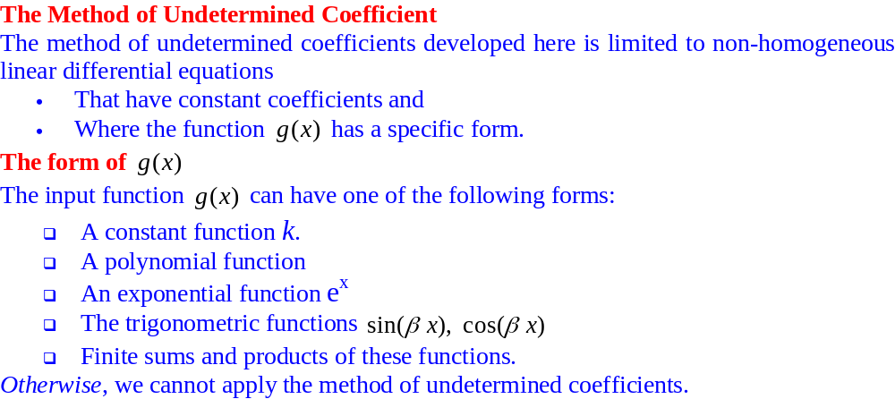
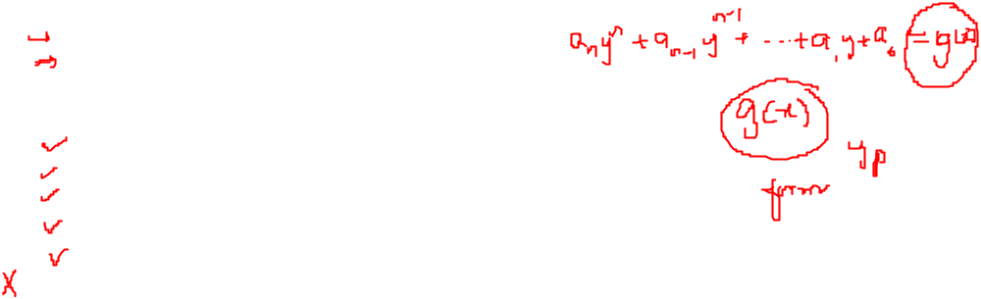
Non Homogeneous Linear Equations with Constant Coefficients

Slide 5
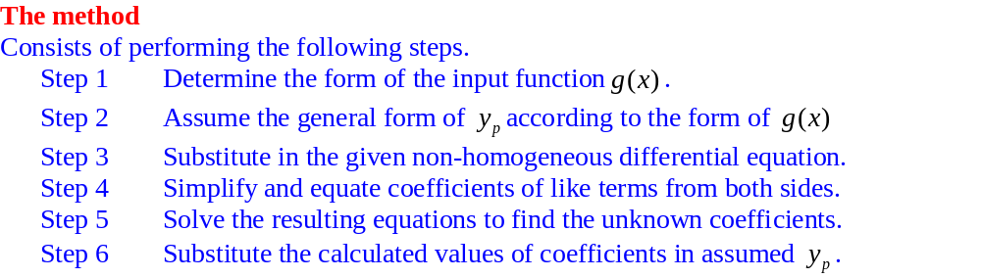
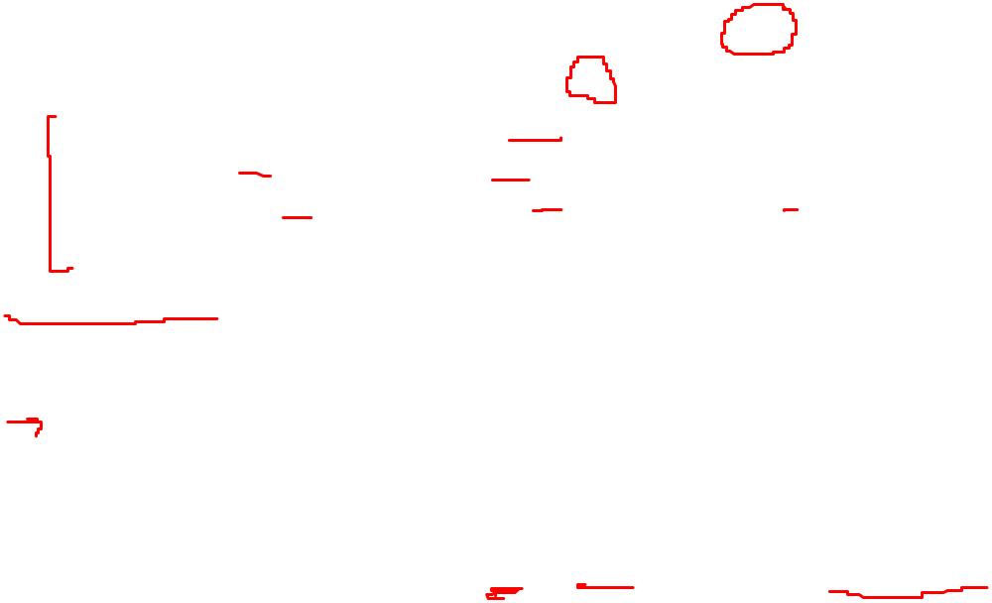
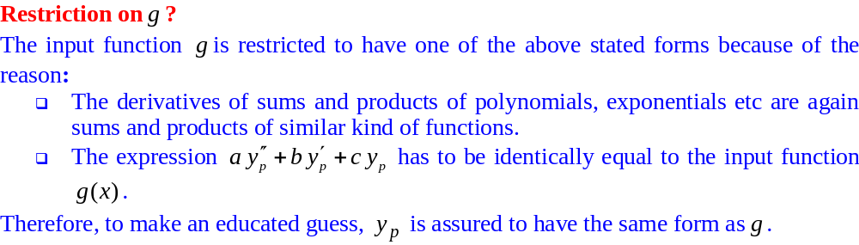
Non Homogeneous Linear Equations with Constant Coefficients

Slide 6
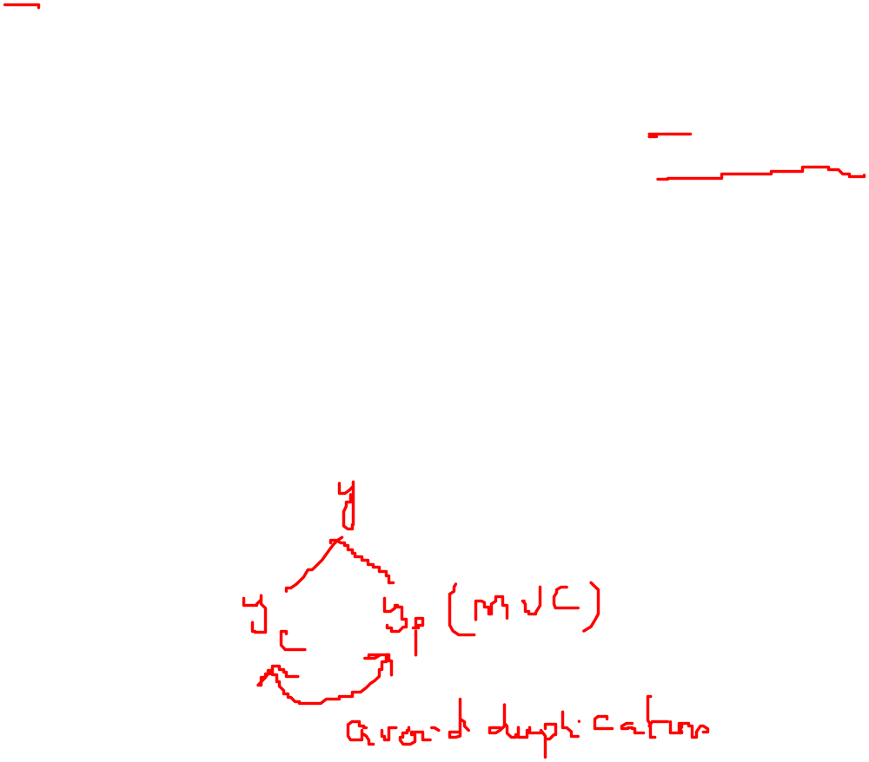
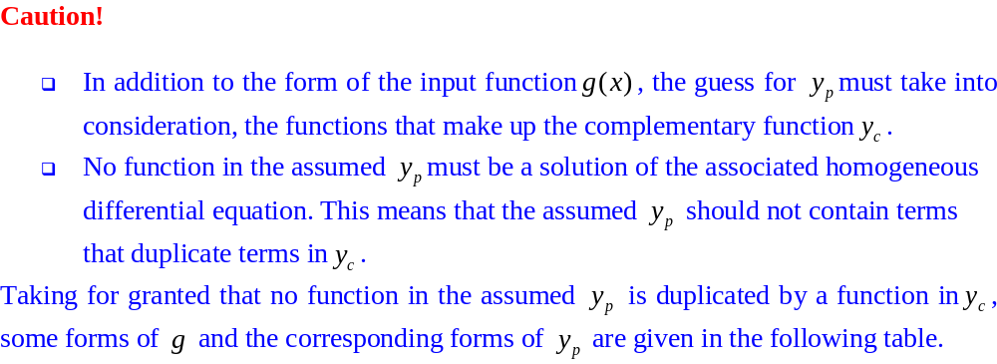
Non Homogeneous Linear Equations with Constant Coefficients

Slide 7
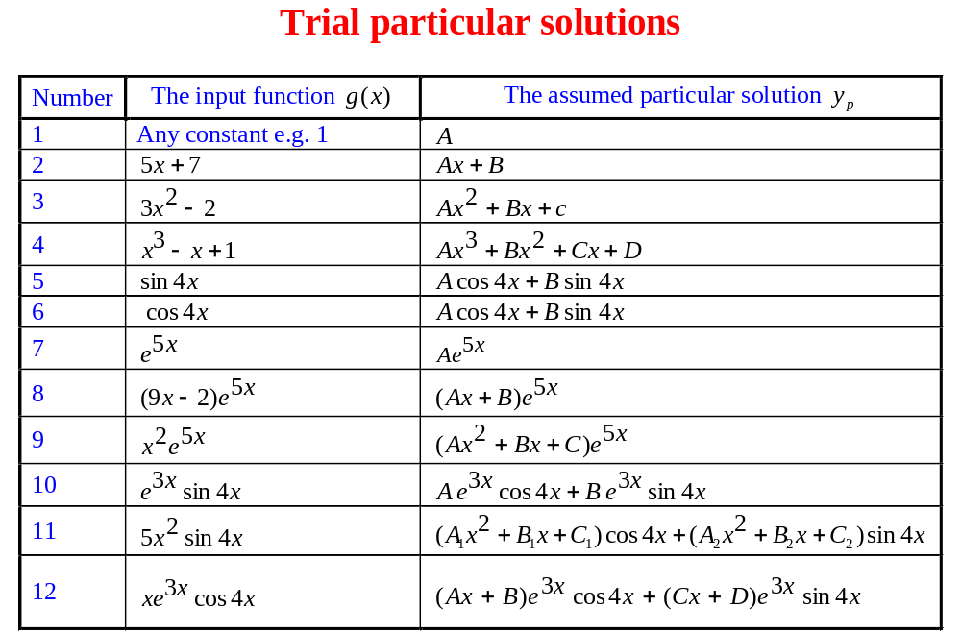
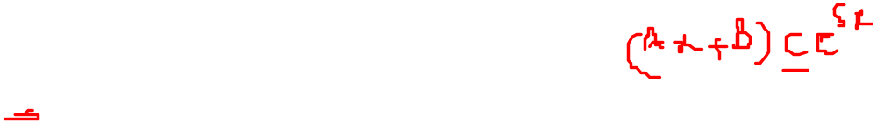
Non Homogeneous Linear Equations with Constant Coefficients

Slide 8
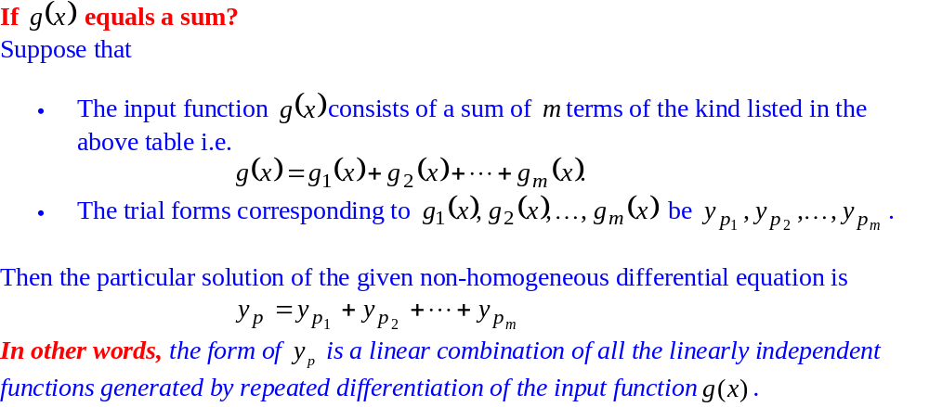
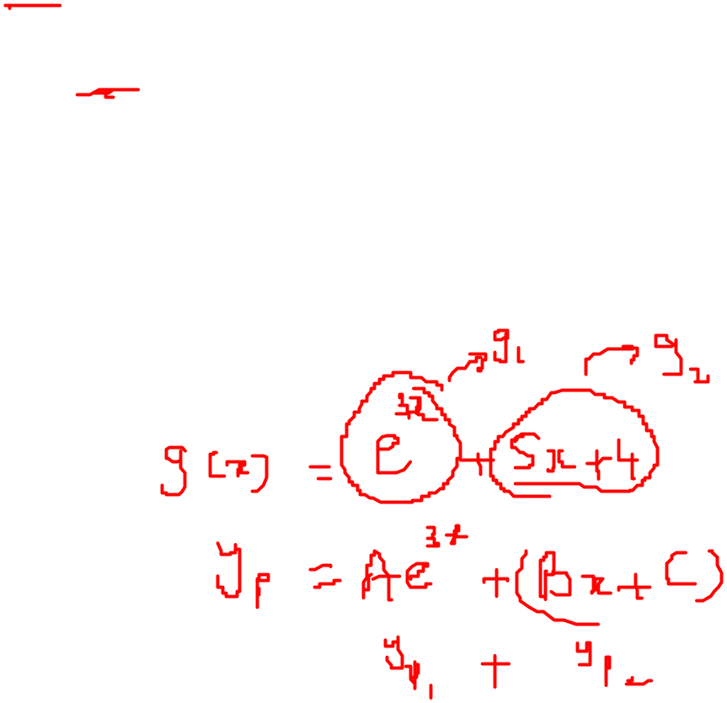
Non Homogeneous Linear Equations with Constant Coefficients

Slide 9
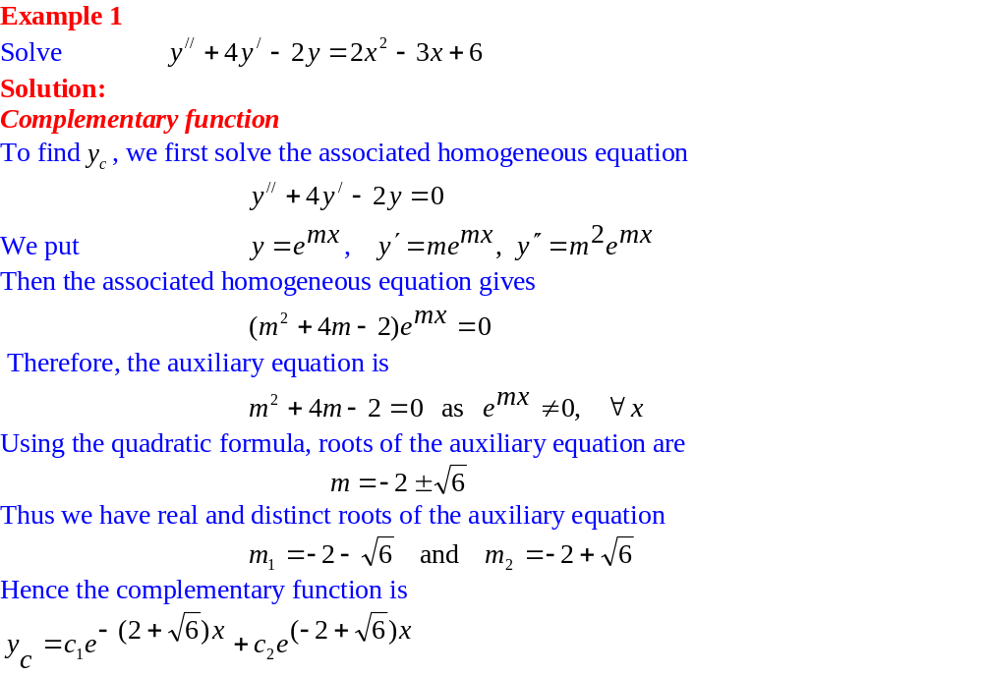
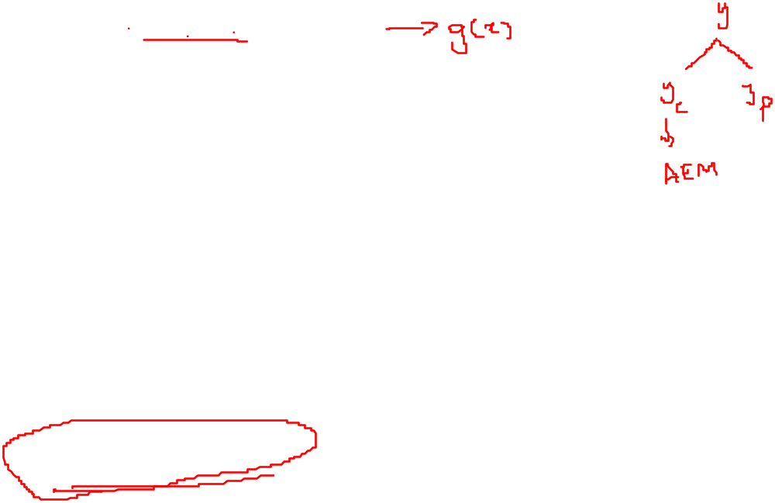
Non Homogeneous Linear Equations with Constant Coefficients

Slide 10
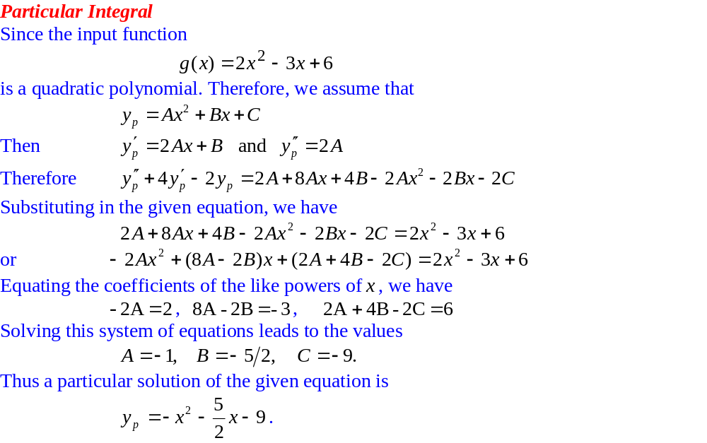
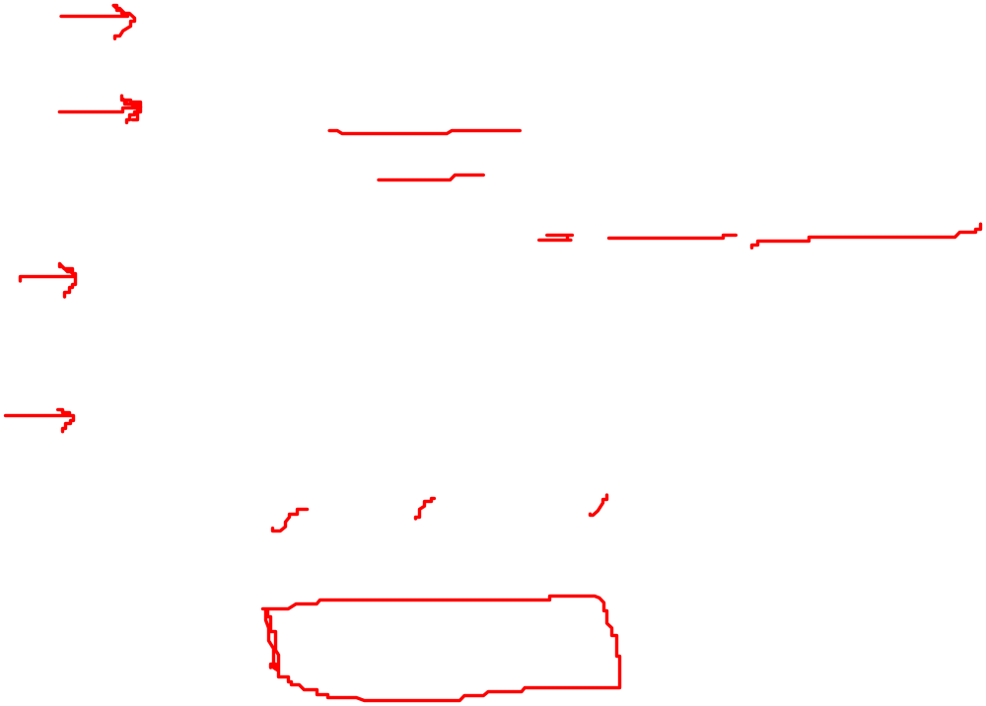
Non Homogeneous Linear Equations with Constant Coefficients

Slide 11
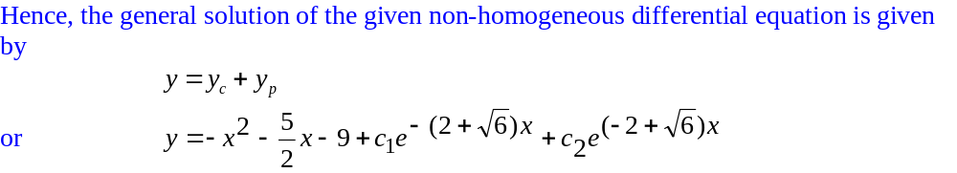
Non Homogeneous Linear Equations with Constant Coefficients

Slide 12
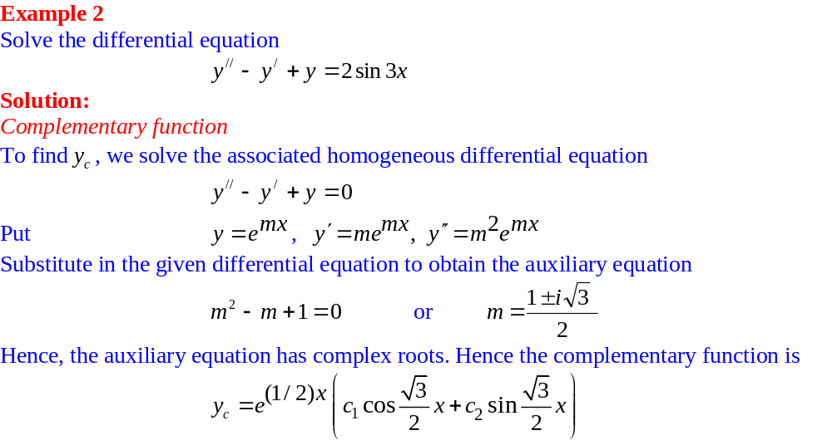
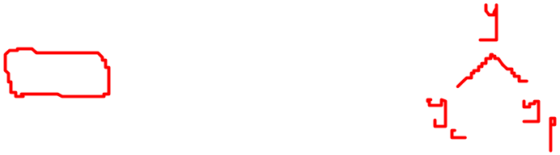
Non Homogeneous Linear Equations with Constant Coefficients

Slide 13
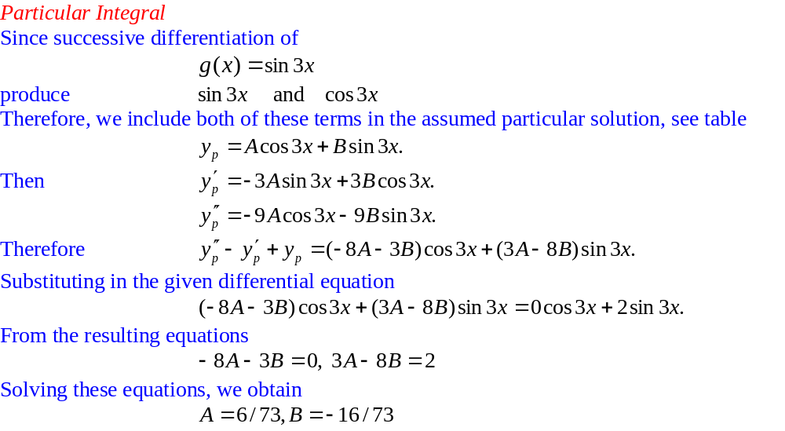
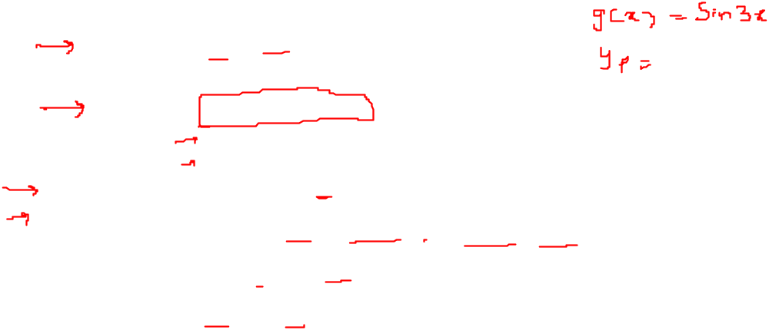
Non Homogeneous Linear Equations with Constant Coefficients

Slide 14
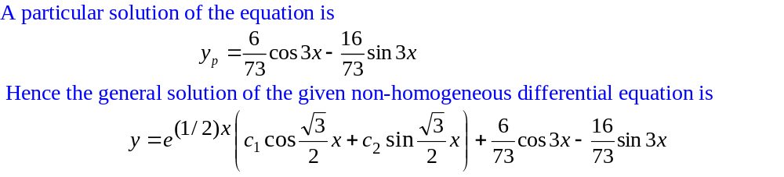

Non Homogeneous Linear Equations with Constant Coefficients

Slide 15
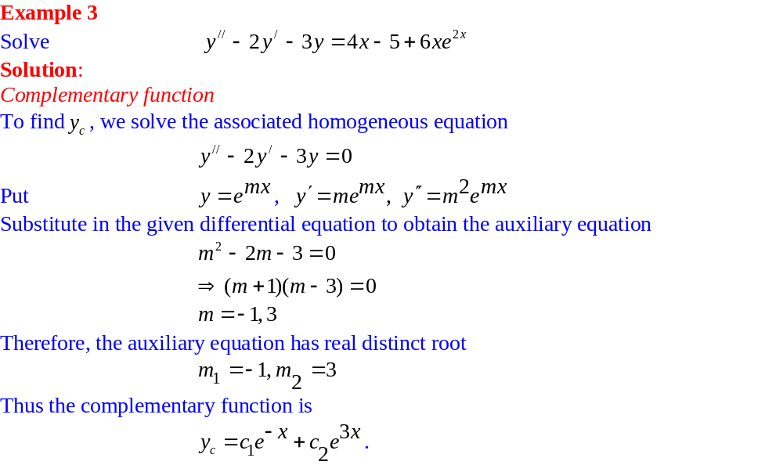
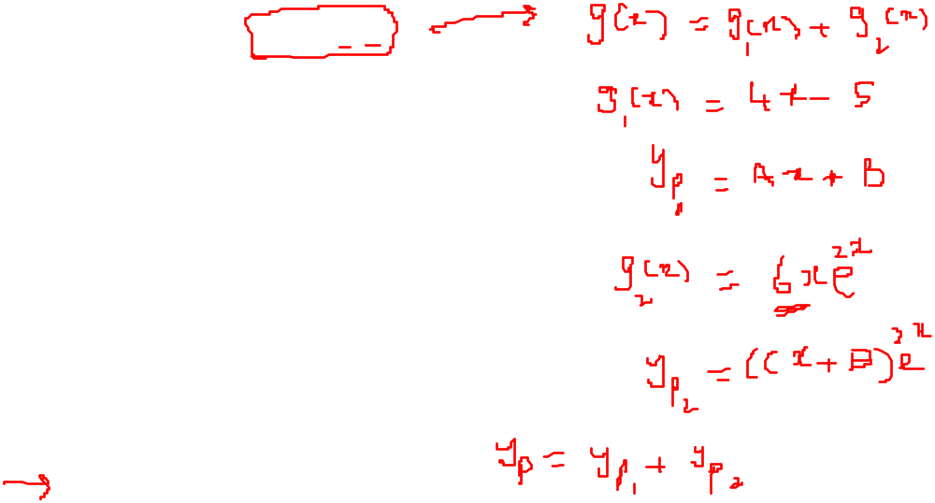
Non Homogeneous Linear Equations with Constant Coefficients

Slide 16
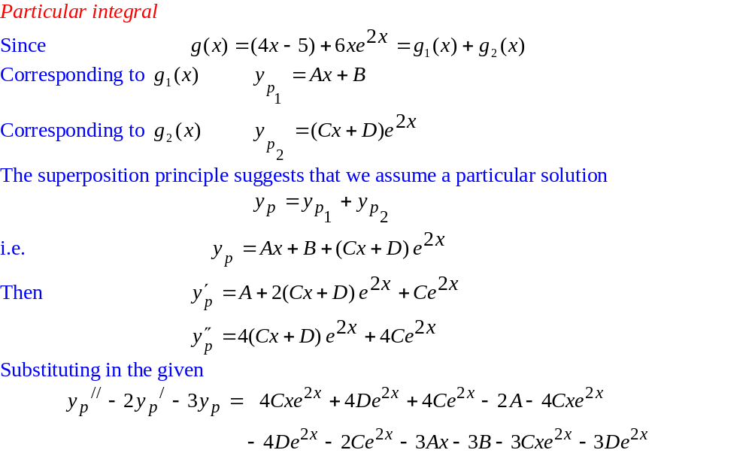
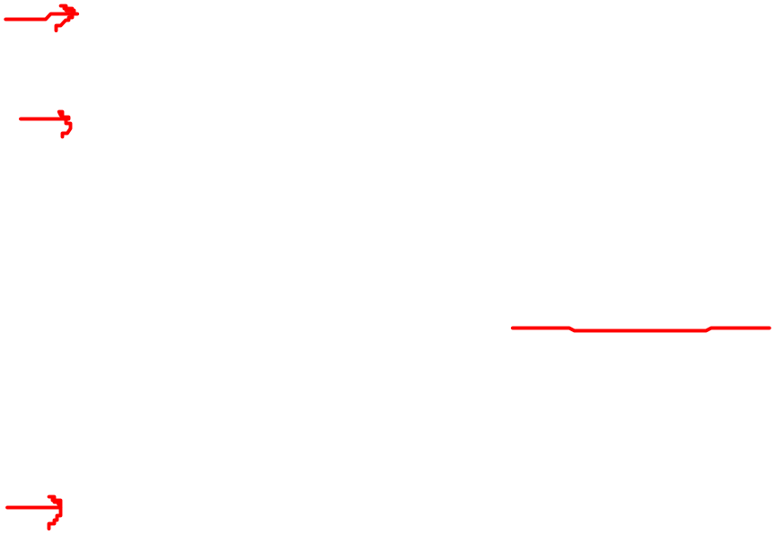
Non Homogeneous Linear Equations with Constant Coefficients

Slide 17
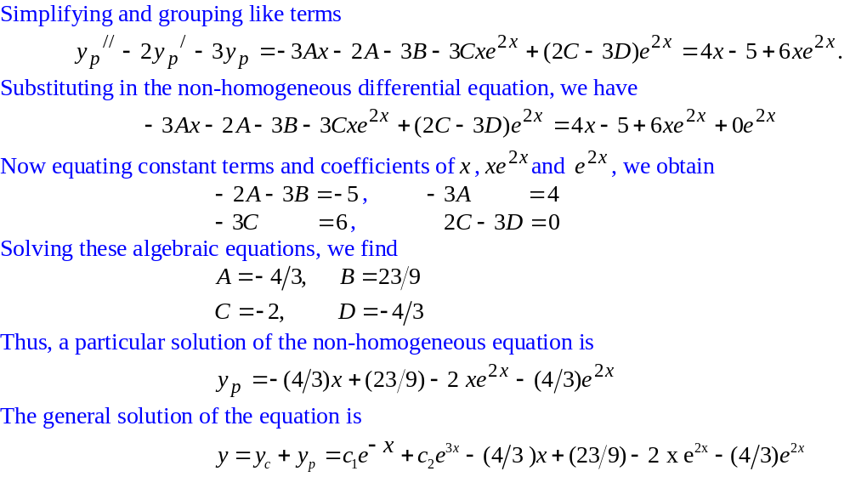
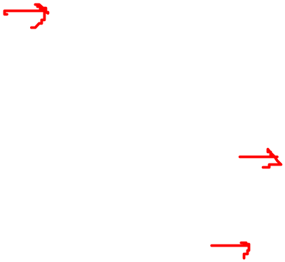
Non Homogeneous Linear Equations with Constant Coefficients

Slide 18
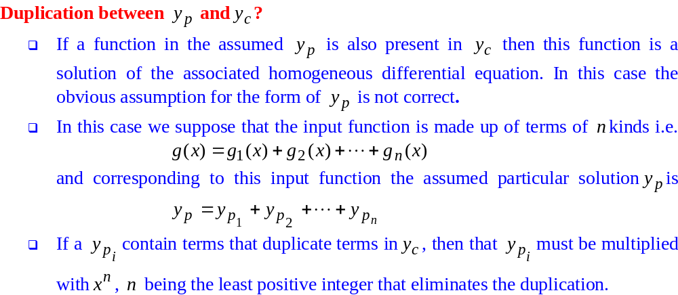
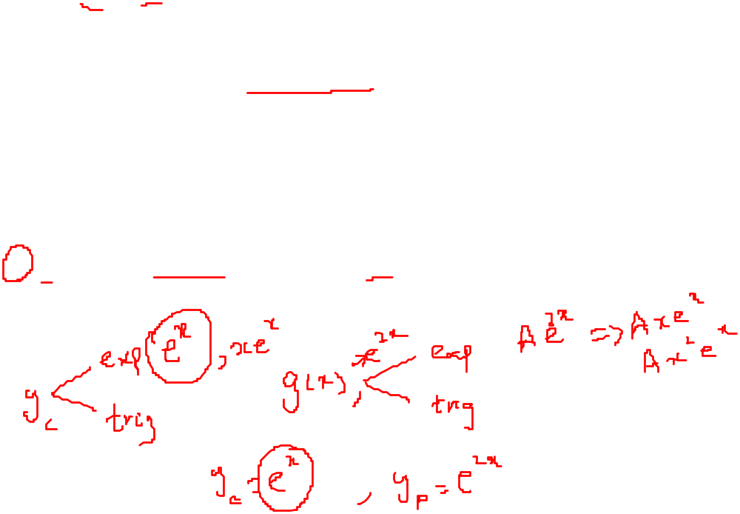
Non Homogeneous Linear Equations with Constant Coefficients

Slide 19
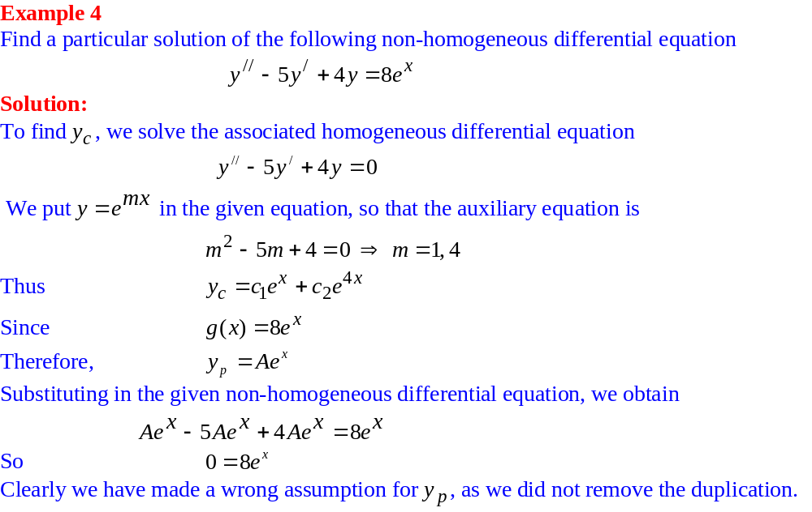
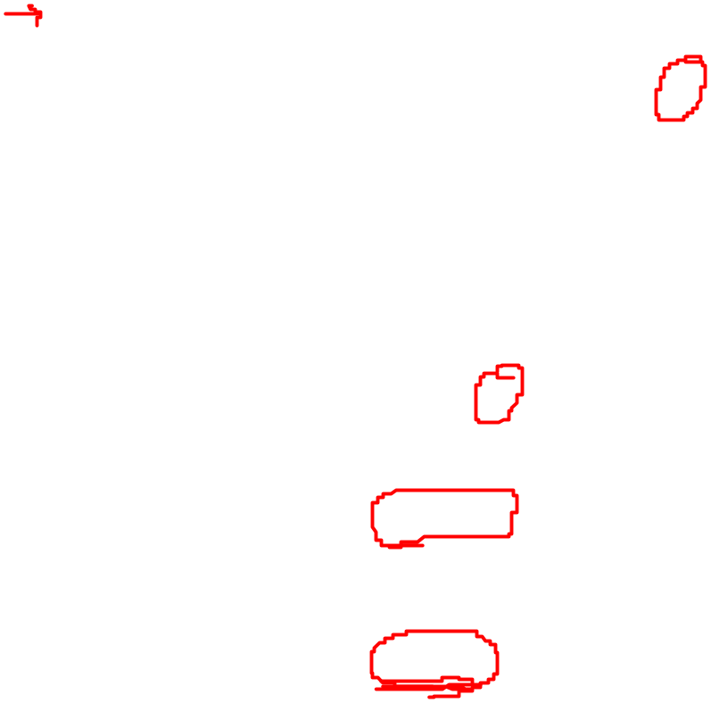
Non Homogeneous Linear Equations with Constant Coefficients

Slide 20
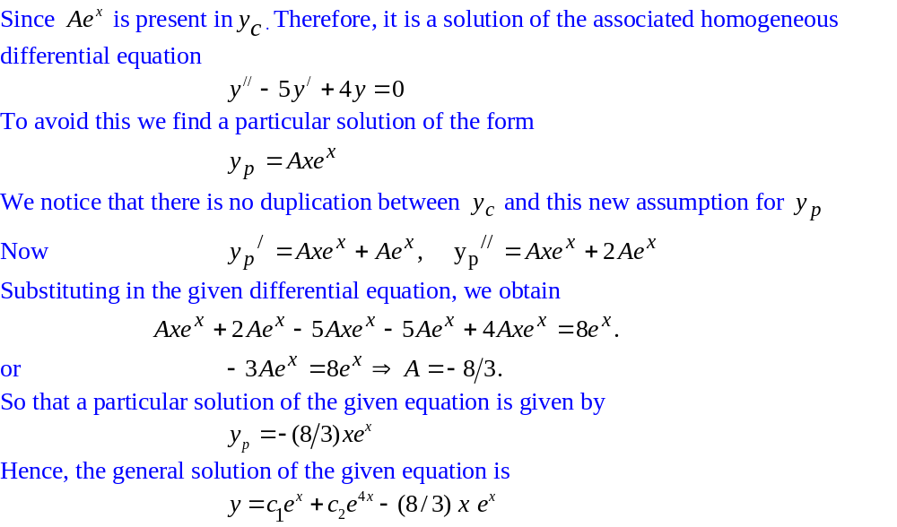
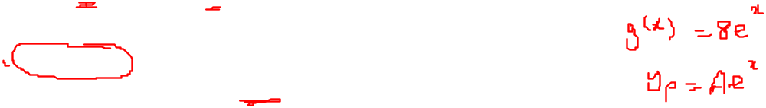
Non Homogeneous Linear Equations with Constant Coefficients

Slide 21
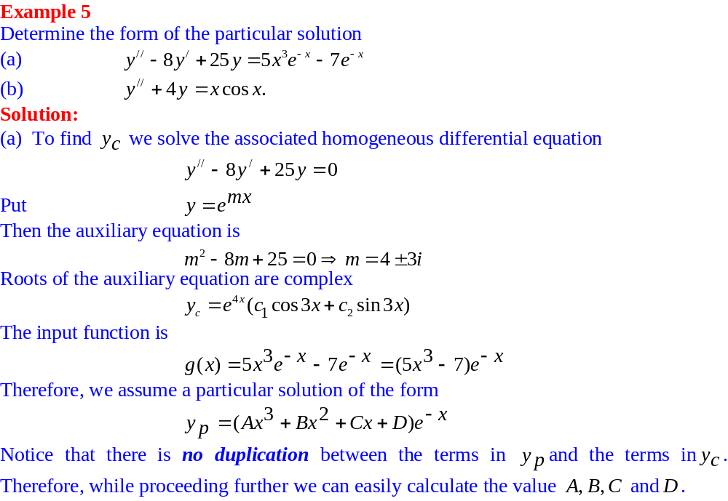

Non Homogeneous Linear Equations with Constant Coefficients

Slide 22
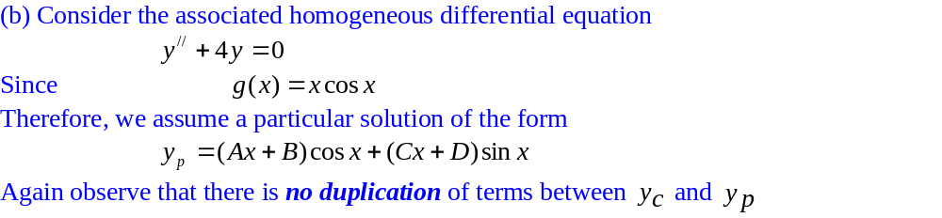
Non Homogeneous Linear Equations with Constant Coefficients

Slide 23
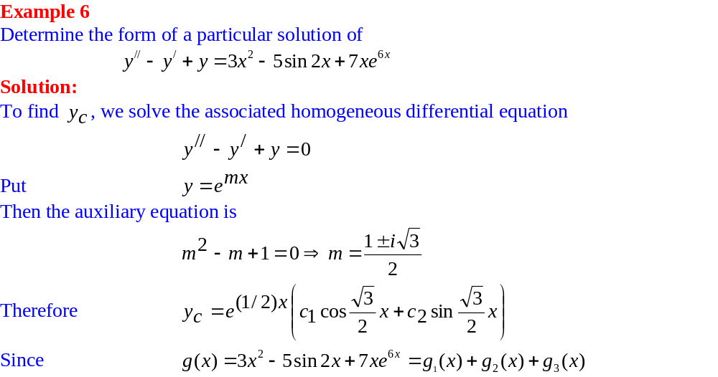
Non Homogeneous Linear Equations with Constant Coefficients

Slide 24
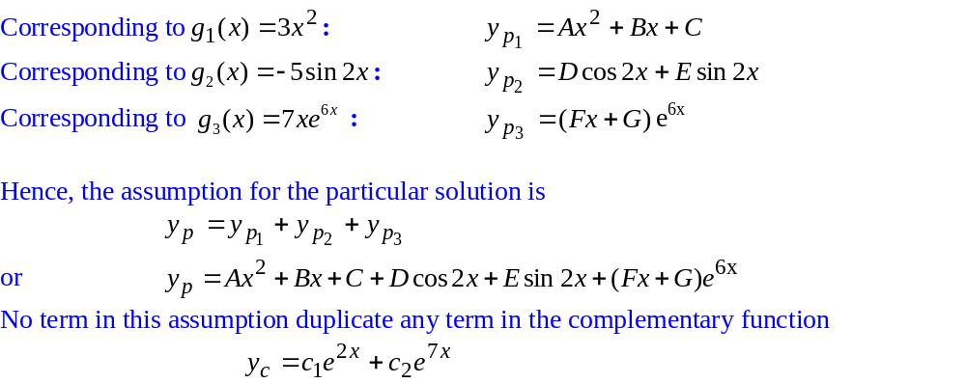
Non Homogeneous Linear Equations with Constant Coefficients

Slide 25
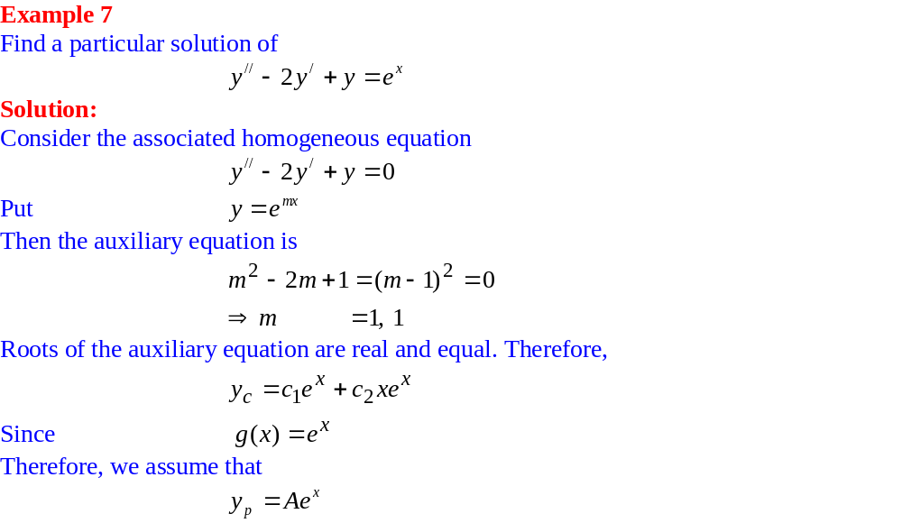
Non Homogeneous Linear Equations with Constant Coefficients

Slide 26
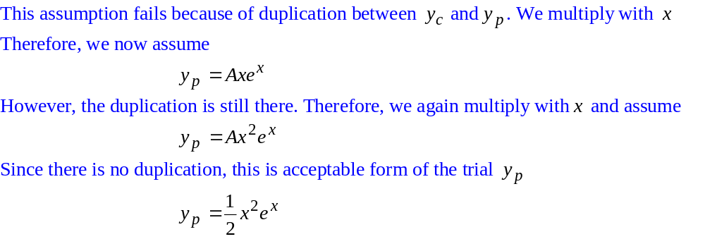
Non Homogeneous Linear Equations with Constant Coefficients

Slide 27
Non Homogeneous Linear Equations with Constant Coefficients

Slide 28
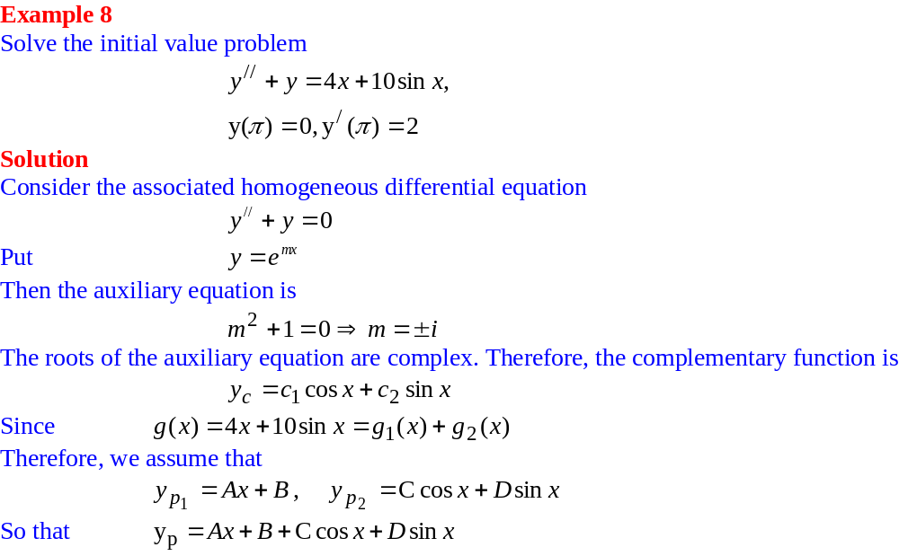
Non Homogeneous Linear Equations with Constant Coefficients

Slide 29
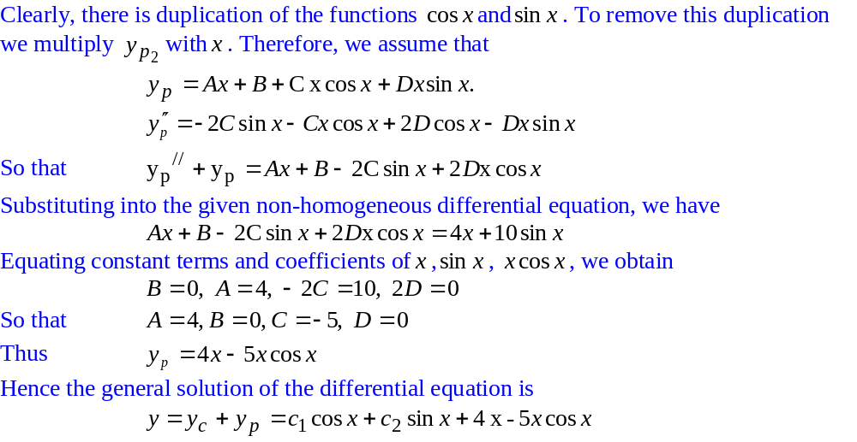
Non Homogeneous Linear Equations with Constant Coefficients

Slide 30
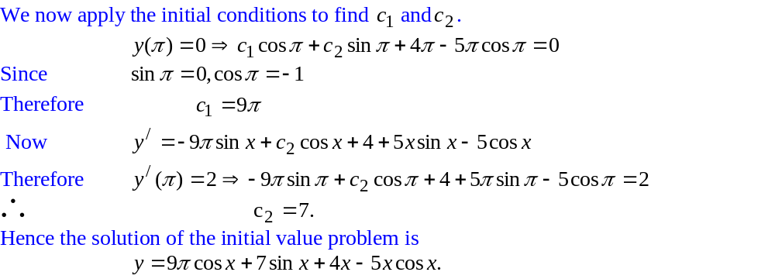
Non Homogeneous Linear Equations with Constant Coefficients

Slide 31
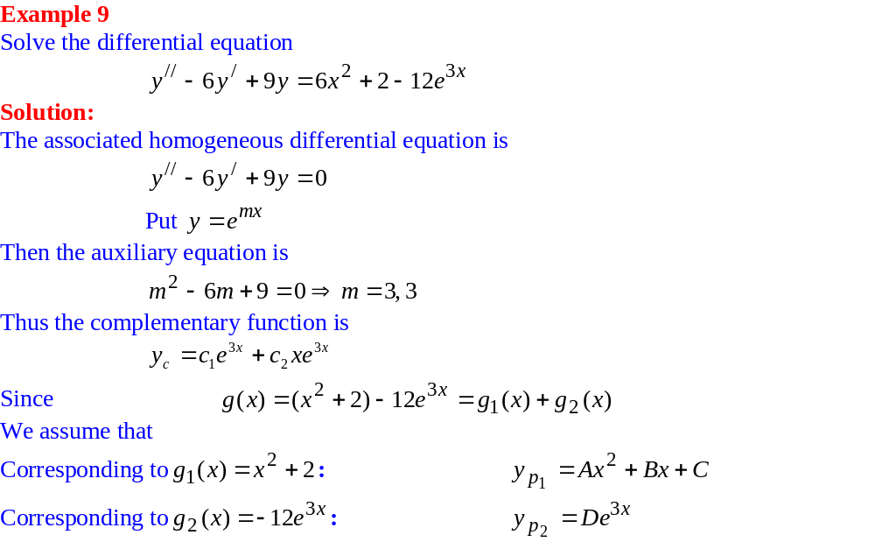
Non Homogeneous Linear Equations with Constant Coefficients

Slide 32
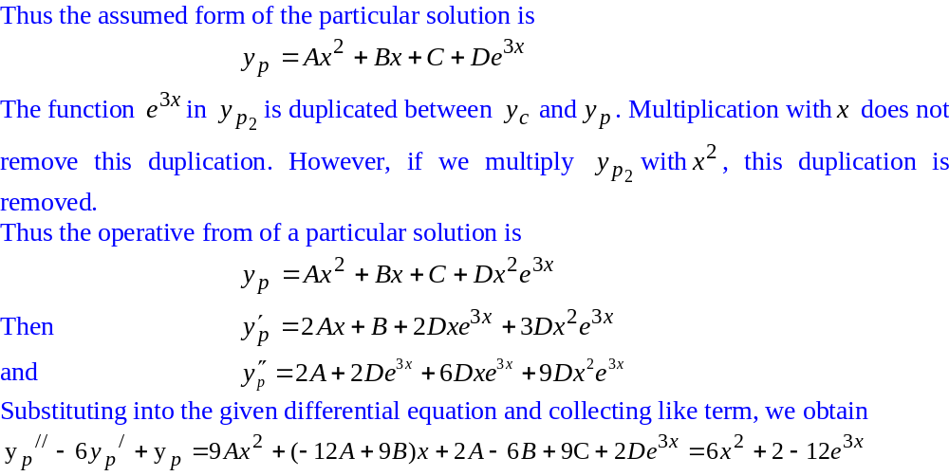
Non Homogeneous Linear Equations with Constant Coefficients

Slide 33
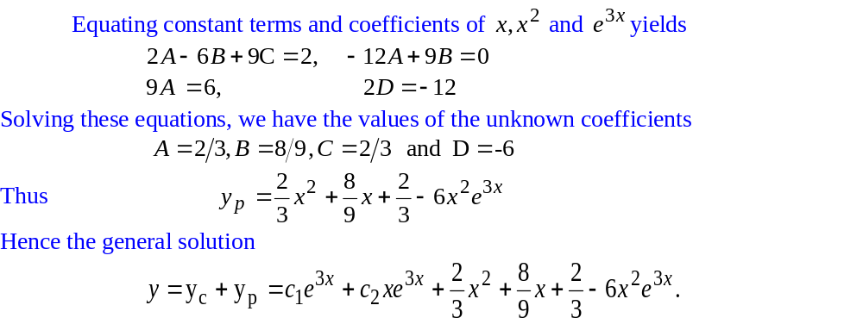
Non Homogeneous Linear Equations with Constant Coefficients

Slide 34
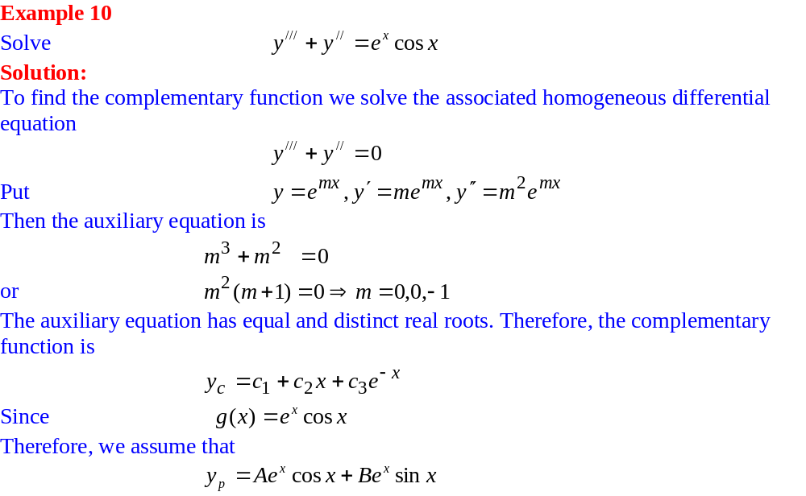
Non Homogeneous Linear Equations with Constant Coefficients

Slide 35

Non Homogeneous Linear Equations with Constant Coefficients

Slide 36

Non Homogeneous Linear Equations with Constant Coefficients

Slide 37

Non Homogeneous Linear Equations with Constant Coefficients

Slide 38

Non Homogeneous Linear Equations with Constant Coefficients

