Slide 1

 | National University of Sciences & Technology (NUST) School of Electrical Engineering and Computer Science (SEECS) Department of Basic Sciences
Linear Algebra & Ordinary Differential Equations
MATH-121
Lecture # 39
Course Instructor: Dr Saira Zainab
Ph. # 03325193283
Email: saira.zainab@seecs.edu.pk
Office # 207, Faculty Block, SEECS
1

Slide 2
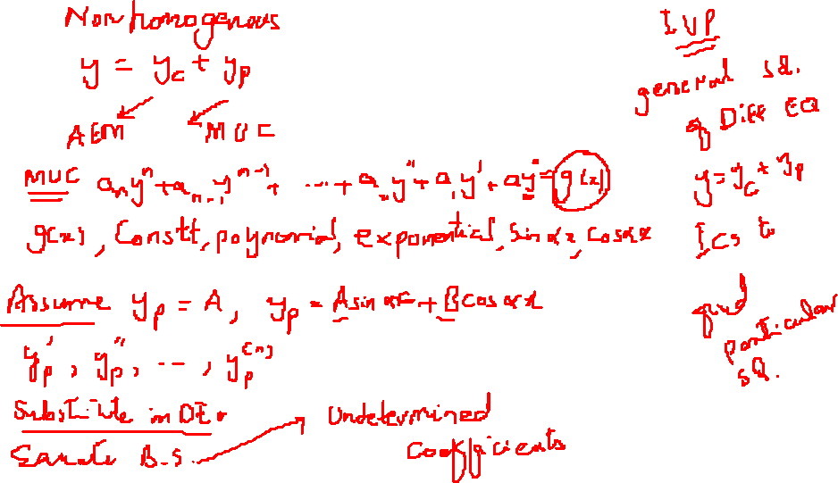
Recalling Previous Lecture

Slide 3
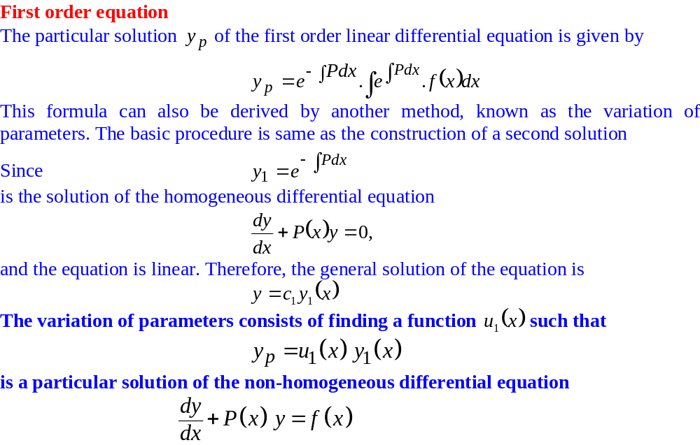
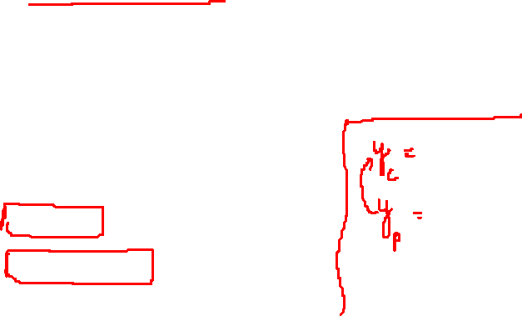
Non Homogeneous Linear Equations with Constant Coefficients
The Variation of Parameters Method

Slide 4
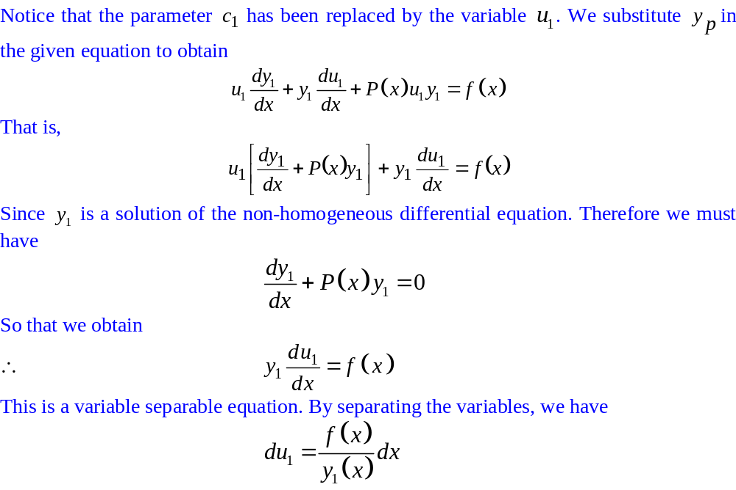
Non Homogeneous Linear Equations with Constant Coefficients
The Variation of Parameters Method

Slide 5
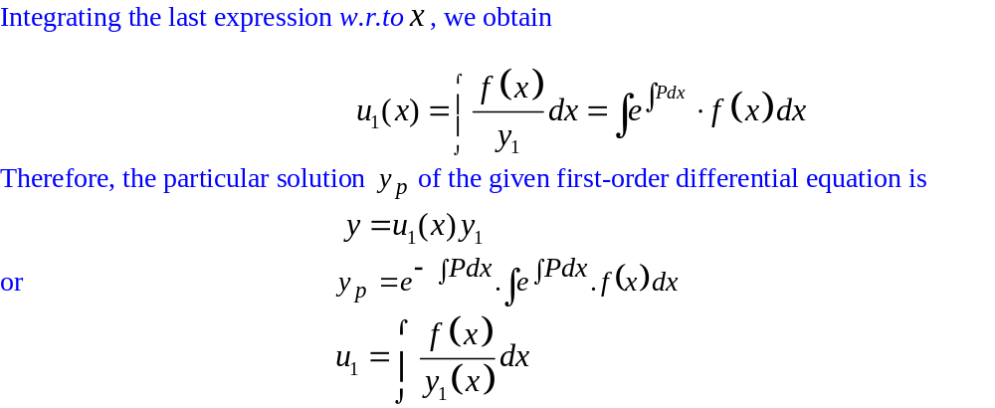

Non Homogeneous Linear Equations with Constant Coefficients
The Variation of Parameters Method

Slide 6
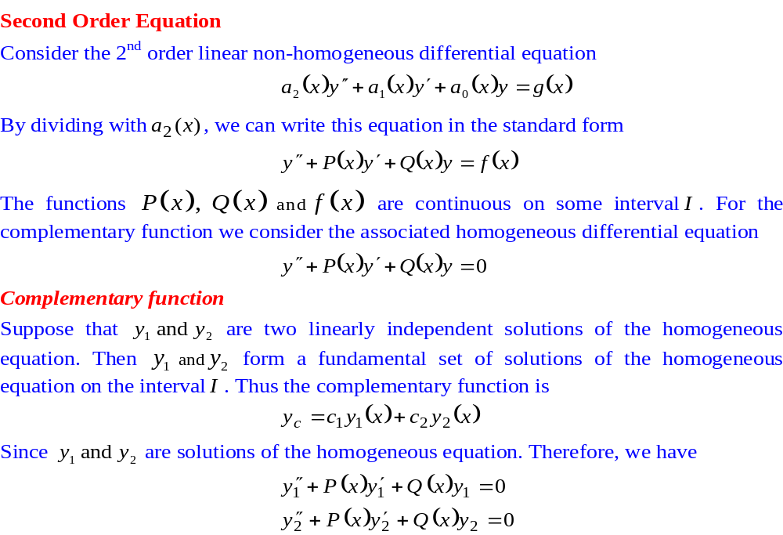
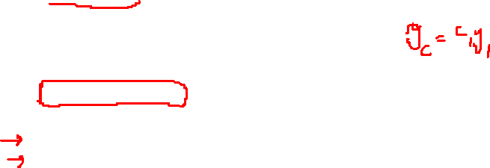
Non Homogeneous Linear Equations with Constant Coefficients
The Variation of Parameters Method

Slide 7
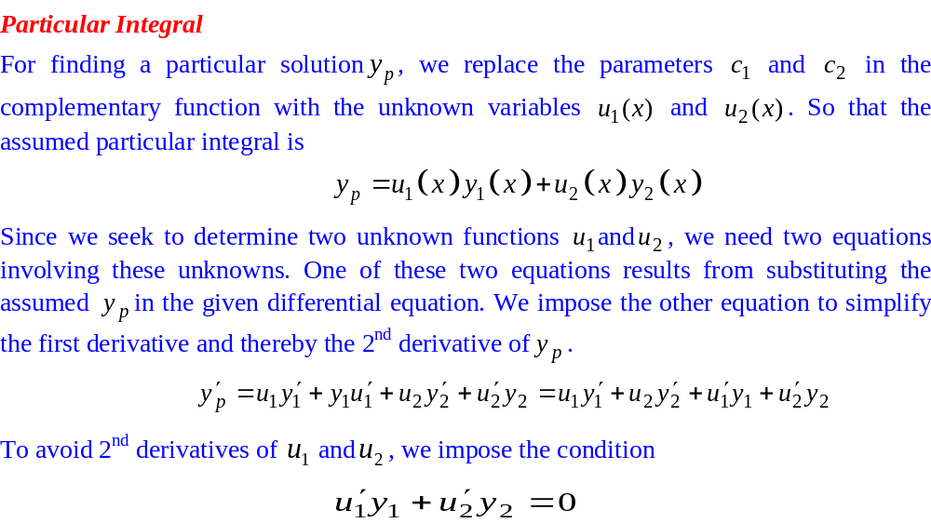
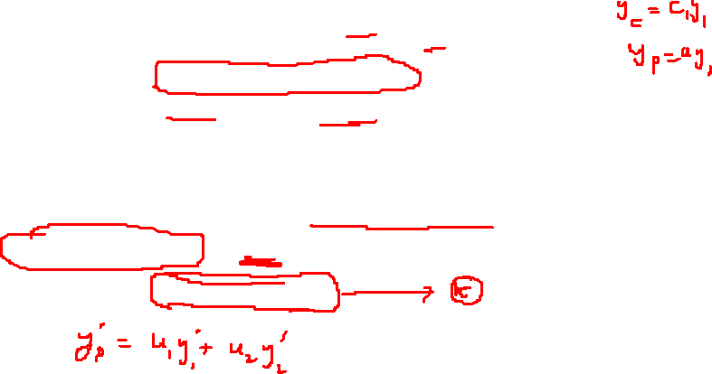
Non Homogeneous Linear Equations with Constant Coefficients
The Variation of Parameters Method

Slide 8
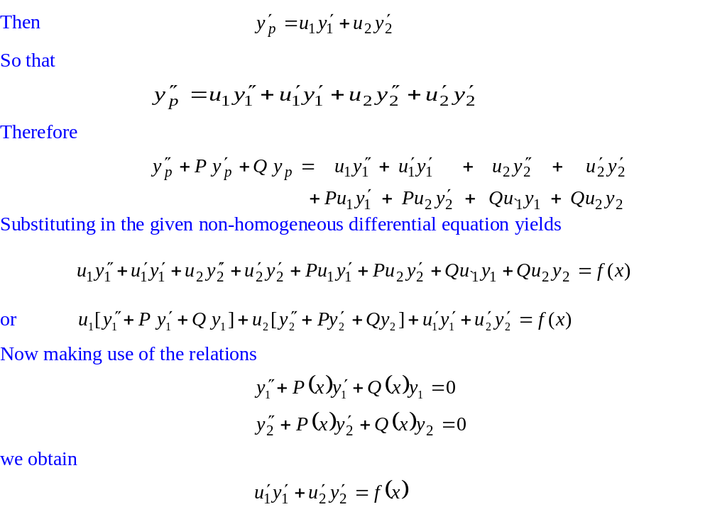
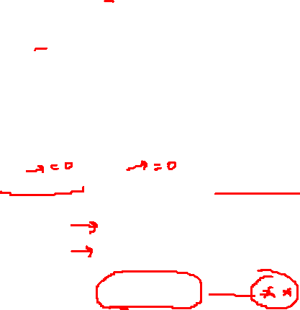
Non Homogeneous Linear Equations with Constant Coefficients
The Variation of Parameters Method

Slide 9
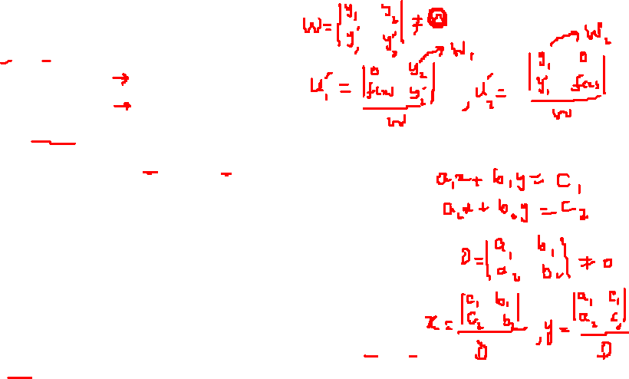
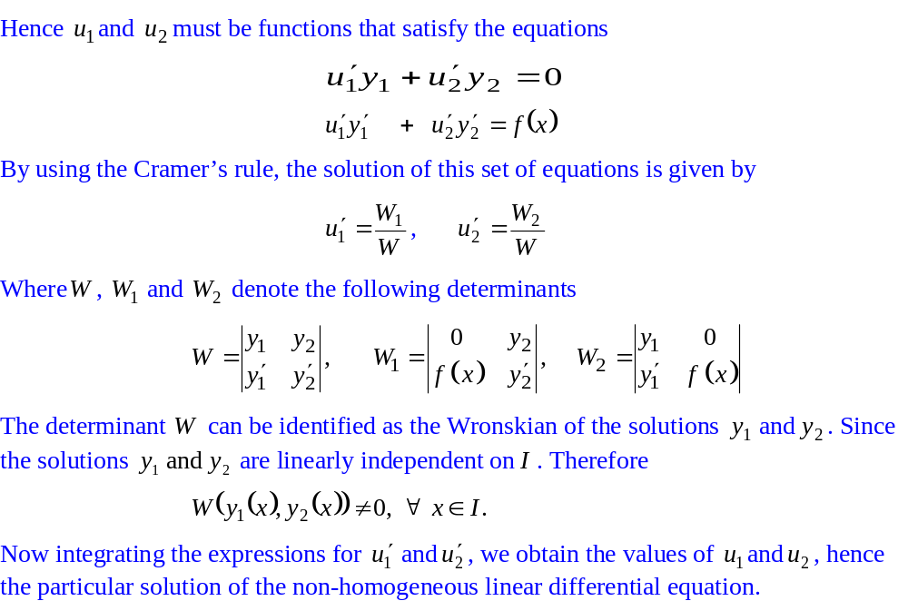
Non Homogeneous Linear Equations with Constant Coefficients
The Variation of Parameters Method

Slide 10
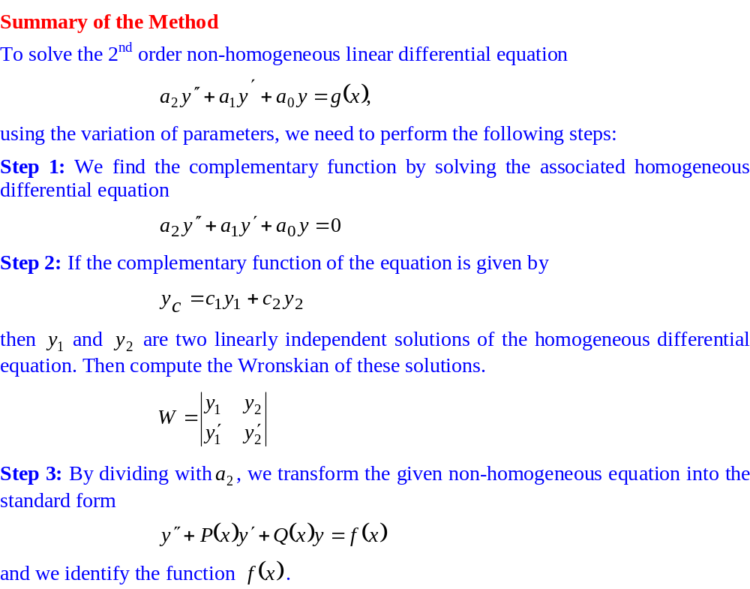
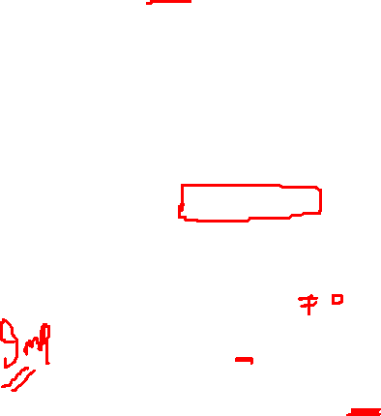
The Variation of Parameters Method

Slide 11
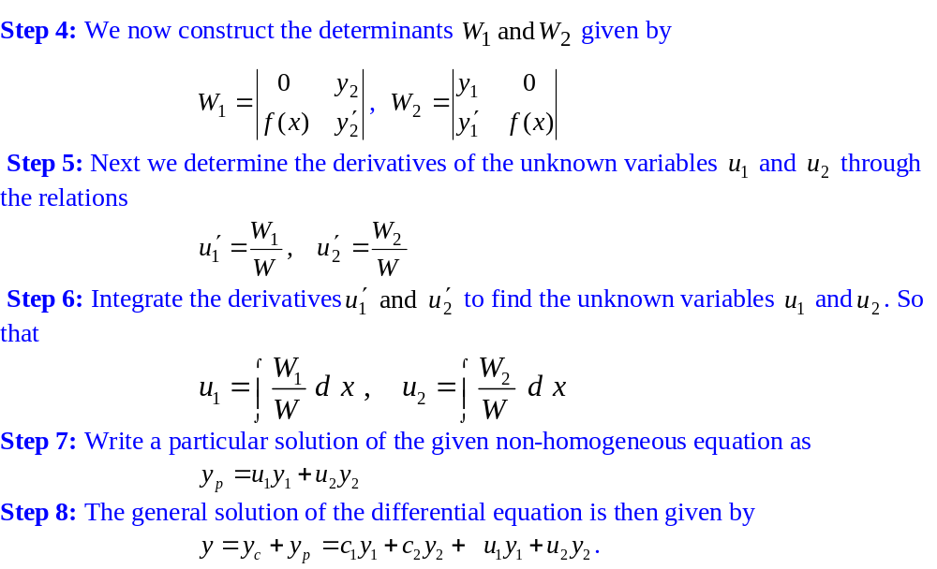
The Variation of Parameters Method

Slide 12
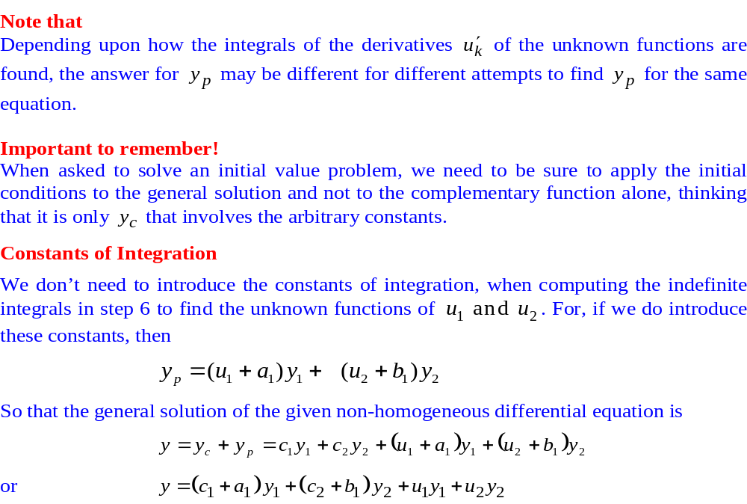
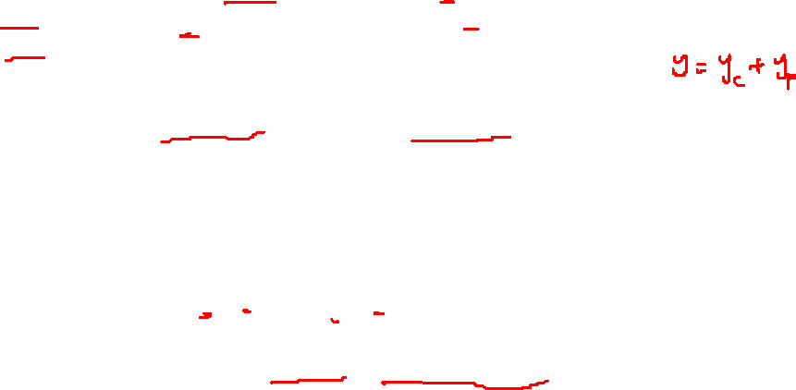
The Variation of Parameters Method

Slide 13
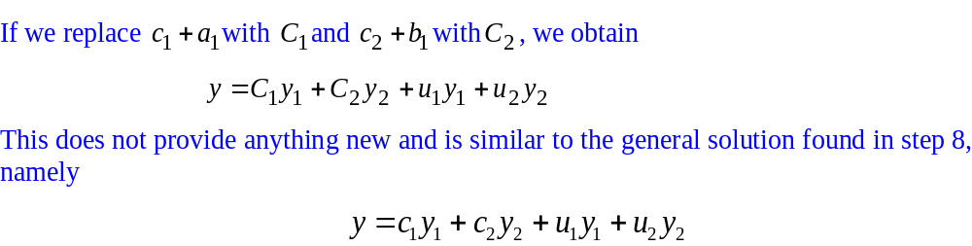
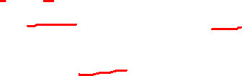
The Variation of Parameters Method

Slide 14
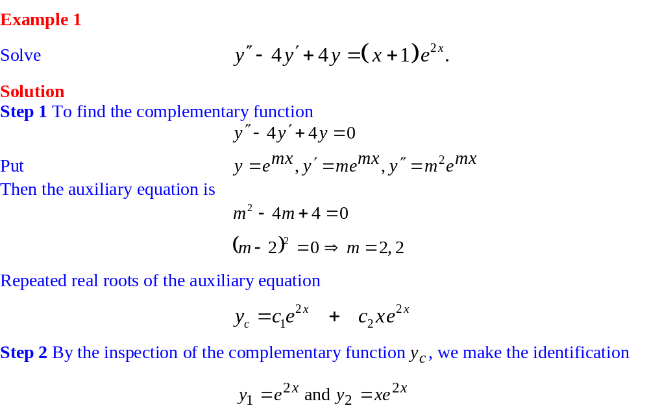
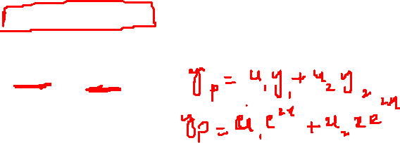
The Variation of Parameters Method

Slide 15
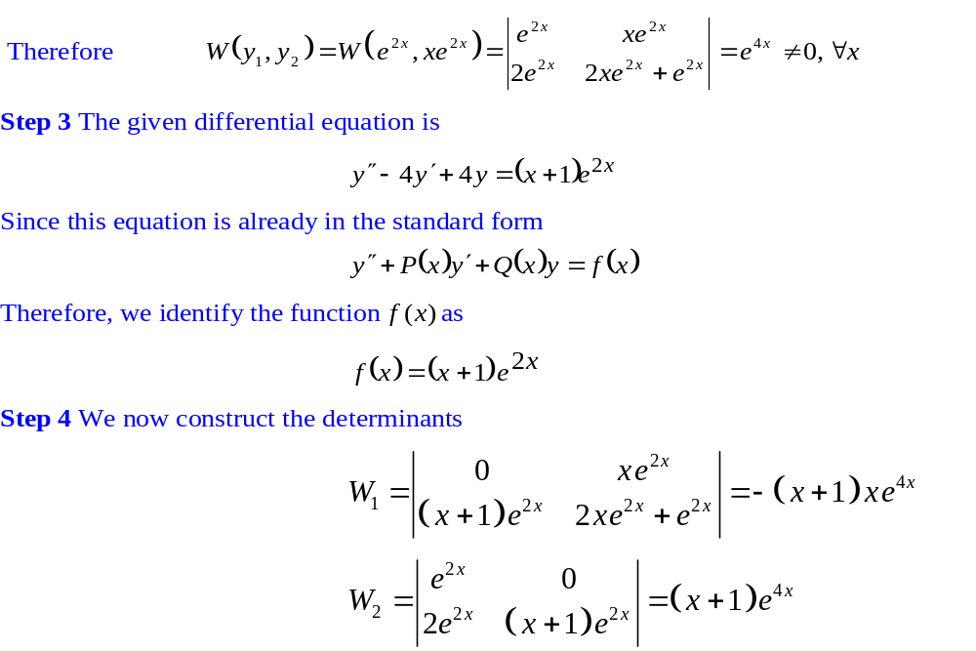

The Variation of Parameters Method

Slide 16
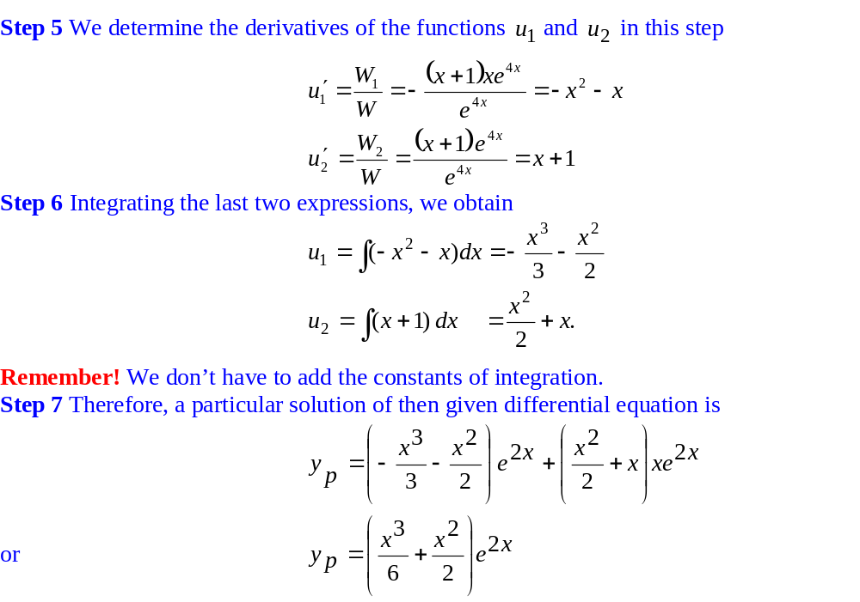
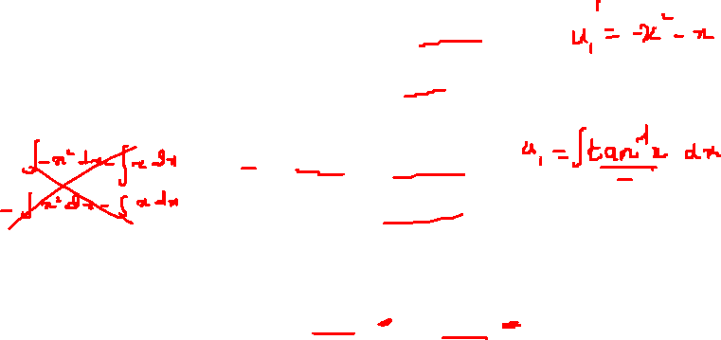
The Variation of Parameters Method

Slide 17
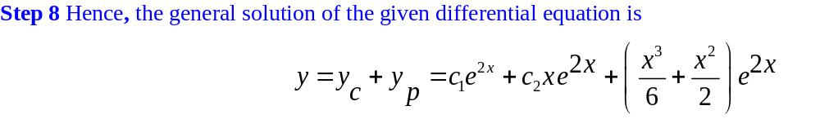

The Variation of Parameters Method

Slide 18
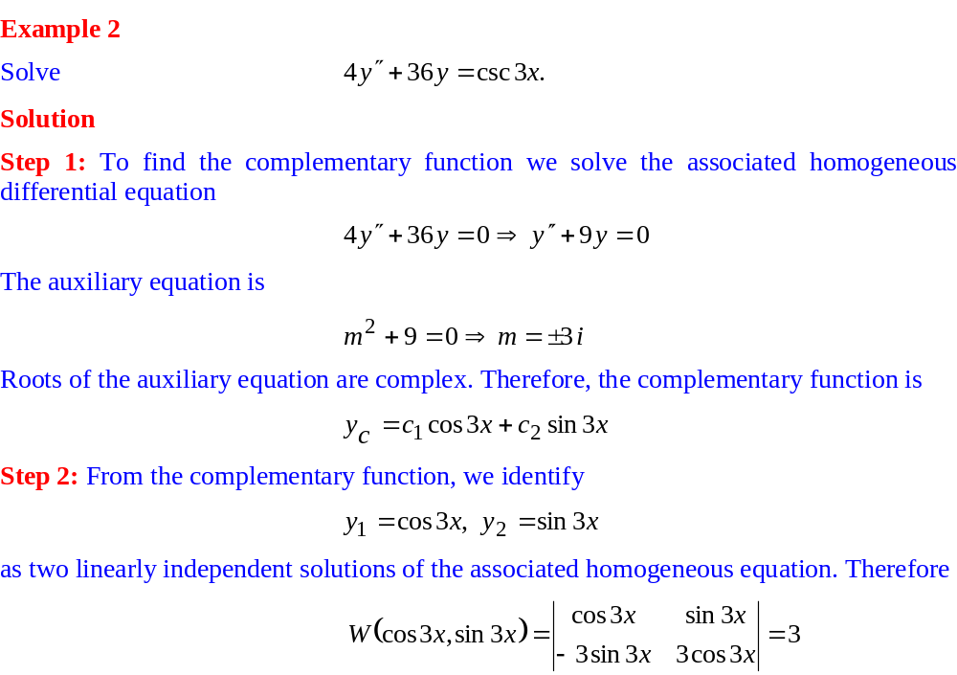

The Variation of Parameters Method

Slide 19
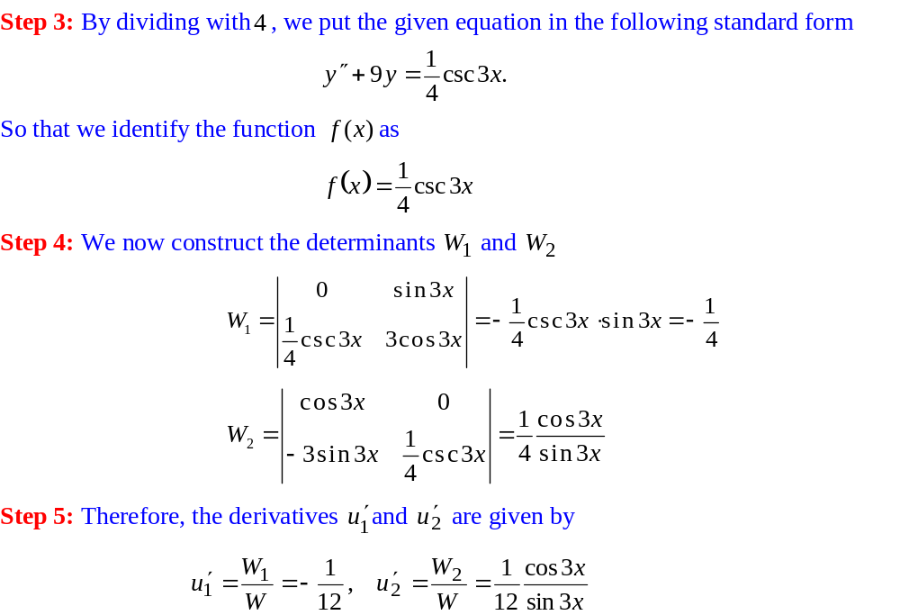
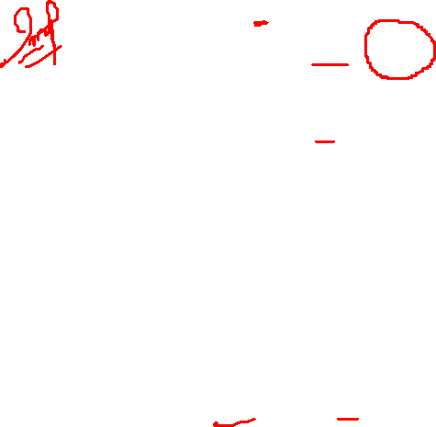
The Variation of Parameters Method

Slide 20
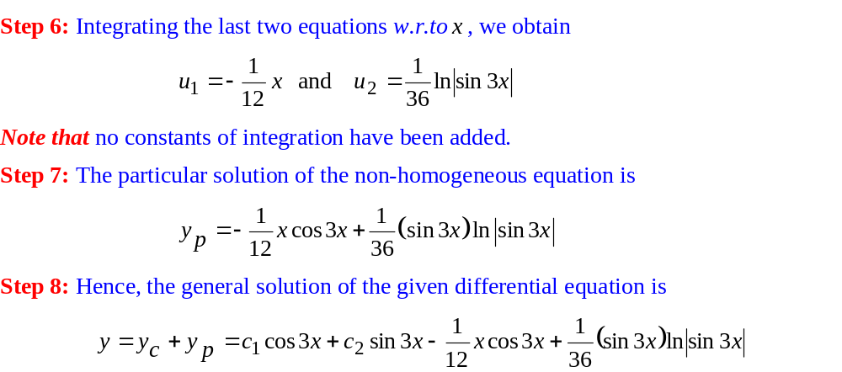

The Variation of Parameters Method

Slide 21
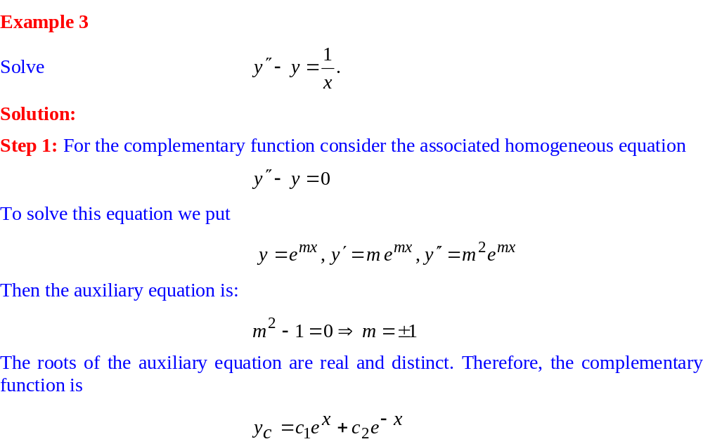
The Variation of Parameters Method

Slide 22
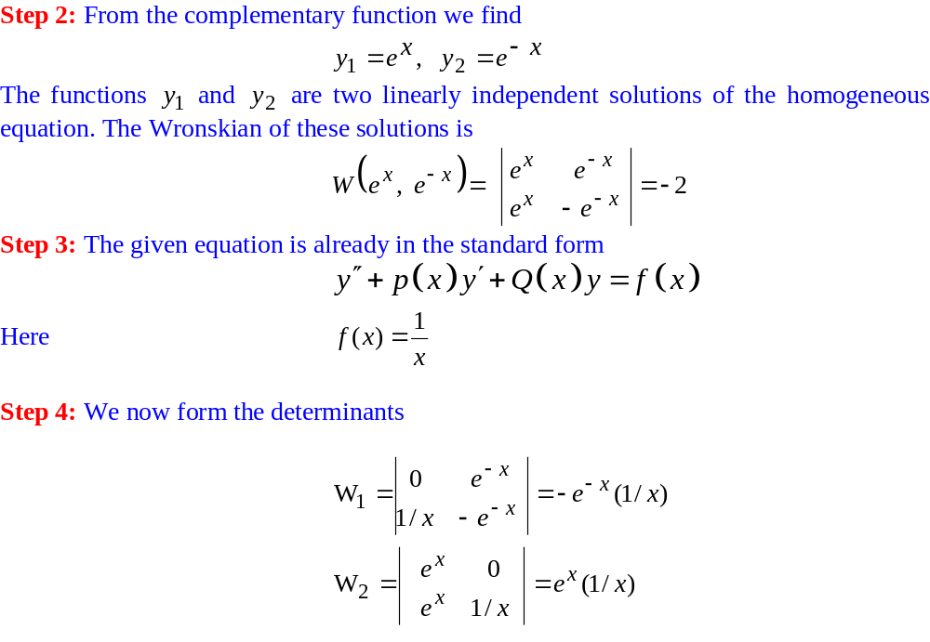
The Variation of Parameters Method

Slide 23
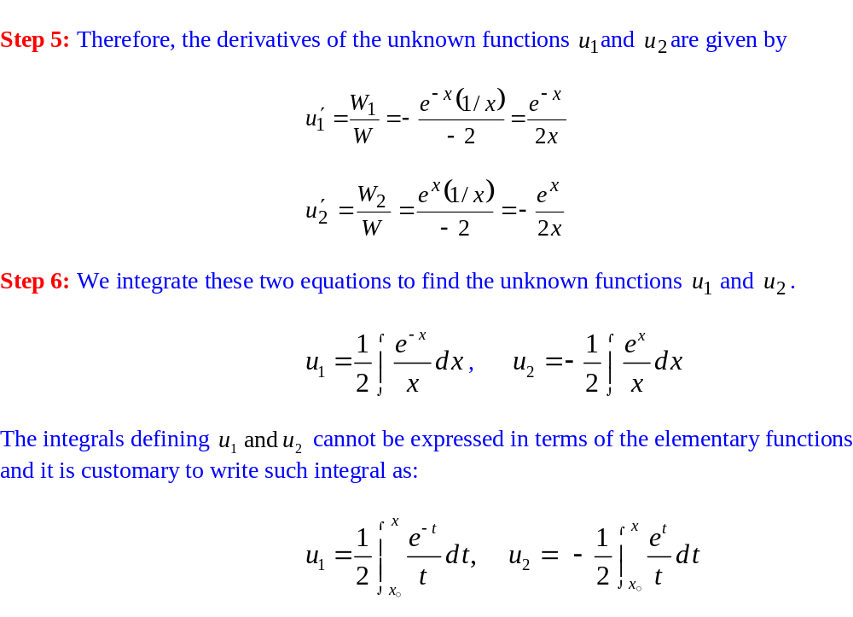
The Variation of Parameters Method

Slide 24
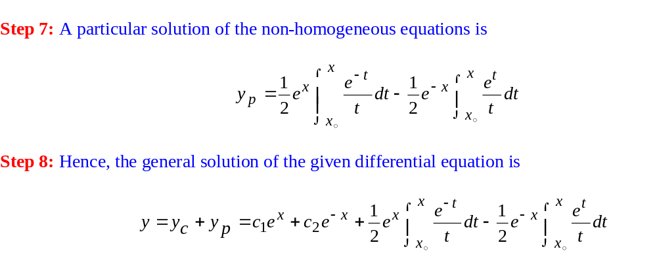
The Variation of Parameters Method

Slide 25
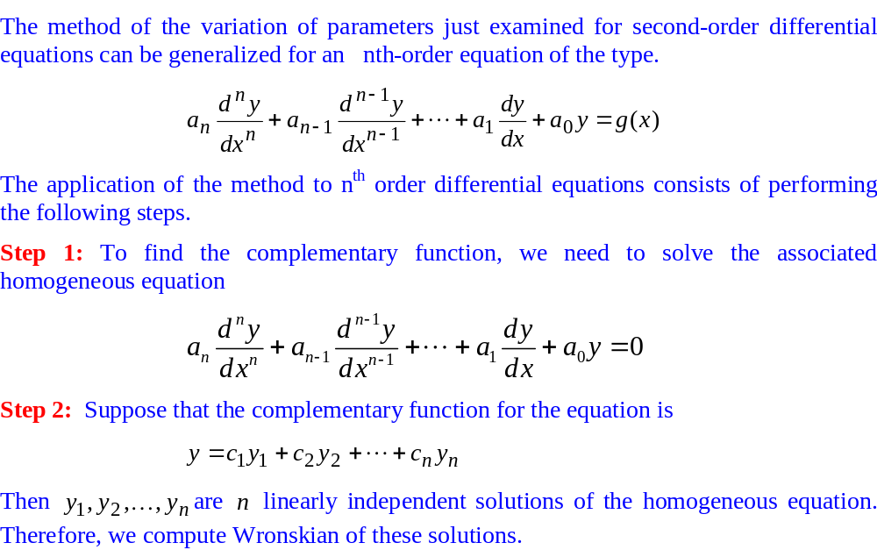
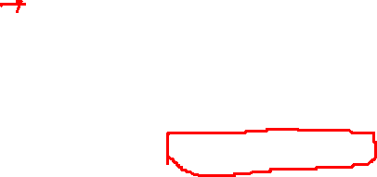
Variation of Parameters Method for Higher-Order Equations

Slide 26
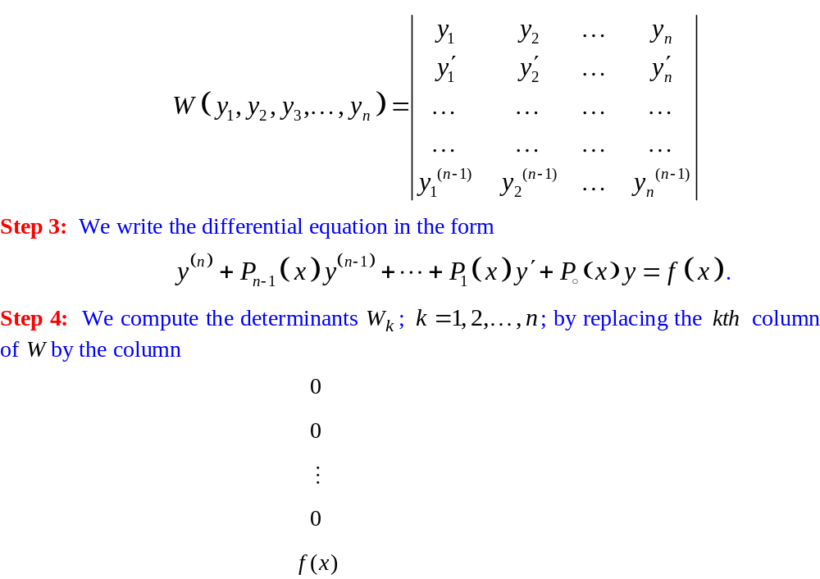
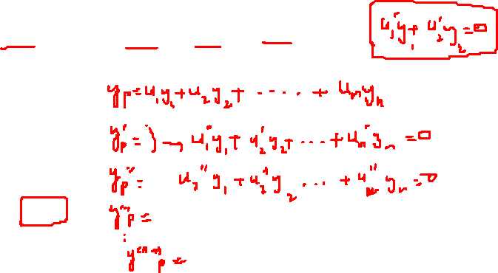
Variation of Parameters Method for Higher-Order Equations

Slide 27
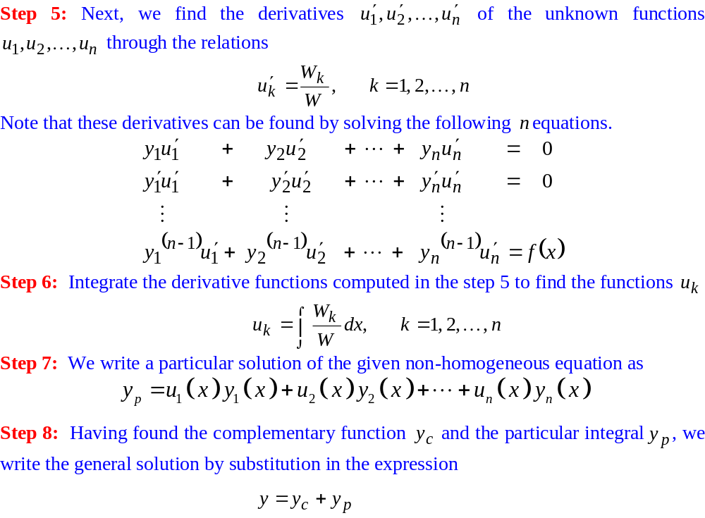
Variation of Parameters Method for Higher-Order Equations

Slide 28
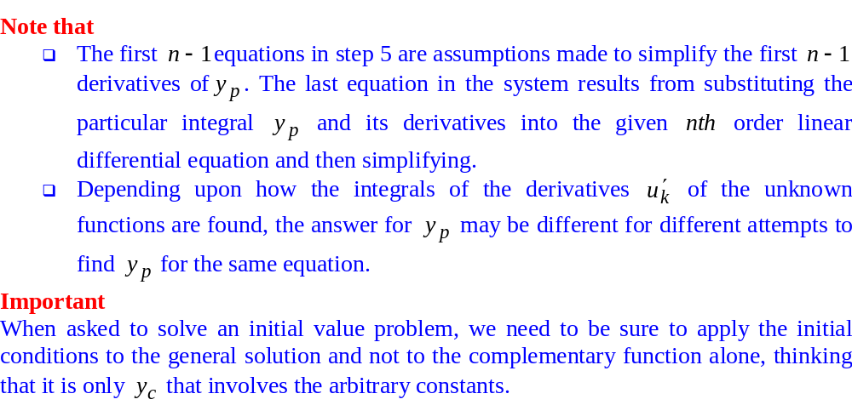
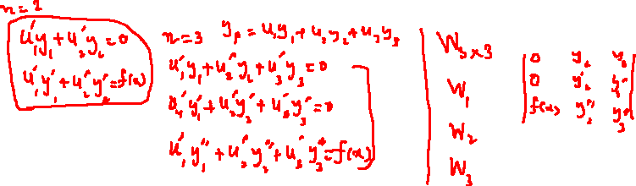
Variation of Parameters Method for Higher-Order Equations

Slide 29
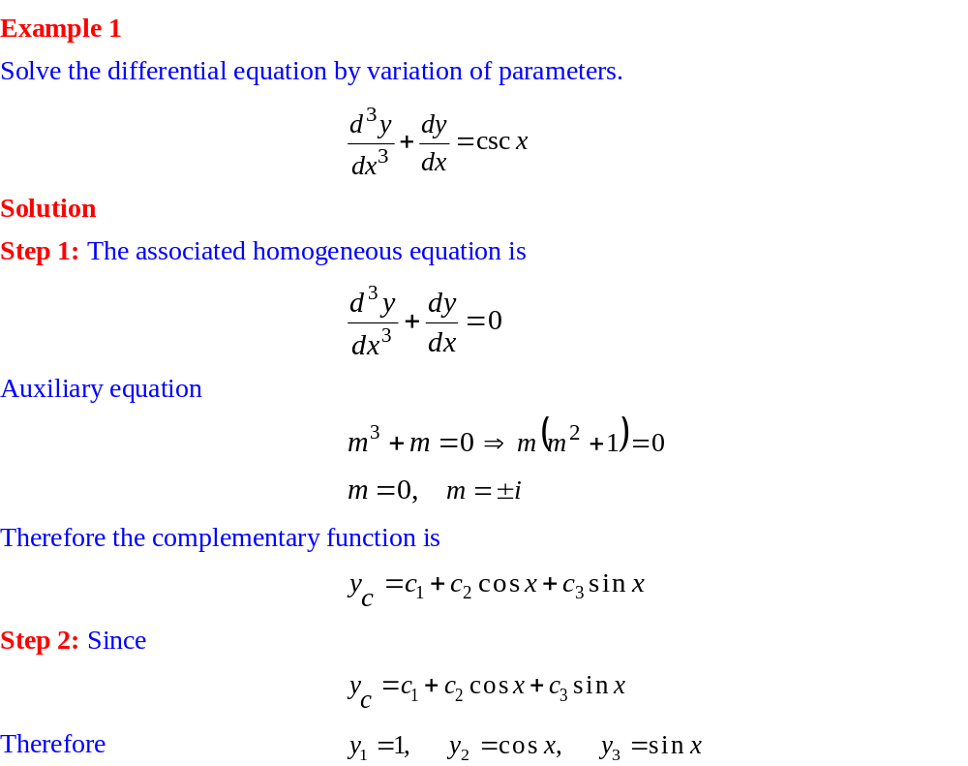
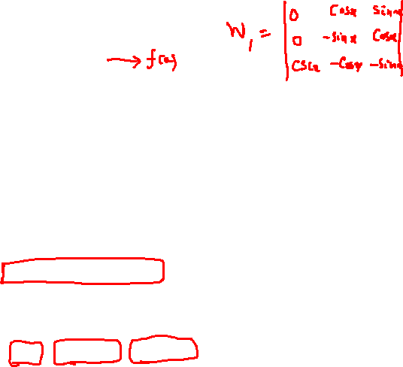
Variation of Parameters Method for Higher-Order Equations

Slide 30
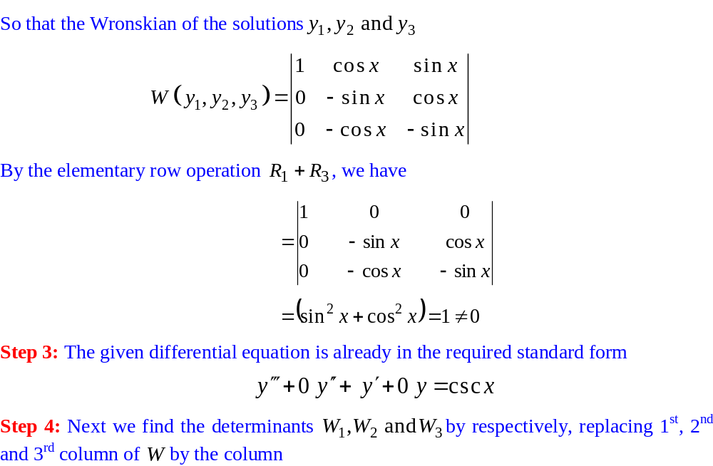
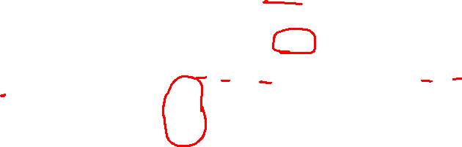

Variation of Parameters Method for Higher-Order Equations

Slide 31
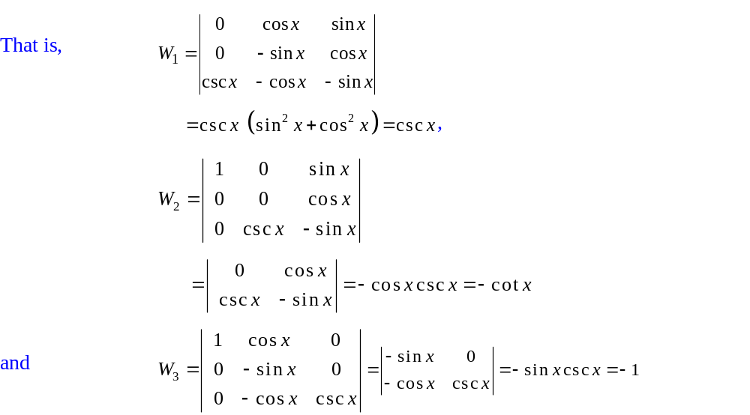
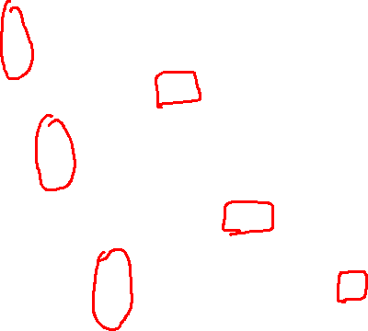
Variation of Parameters Method for Higher-Order Equations

Slide 32
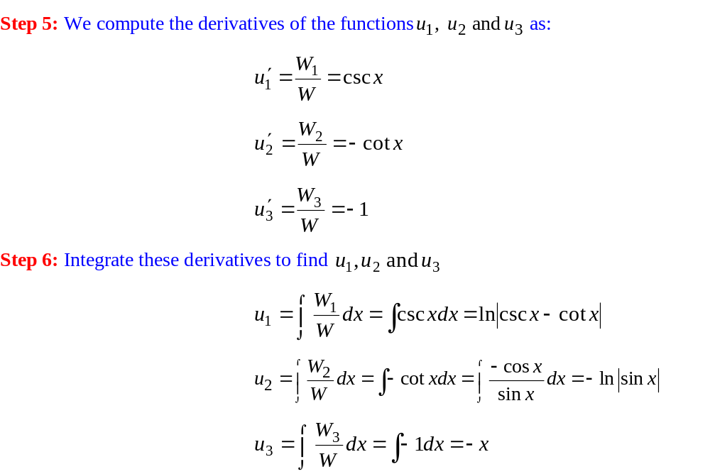

Variation of Parameters Method for Higher-Order Equations

Slide 33
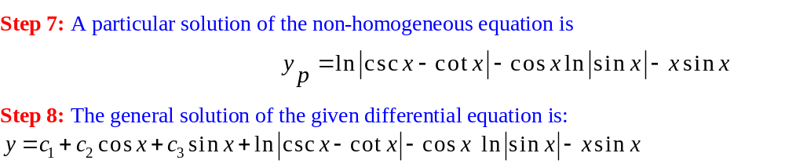
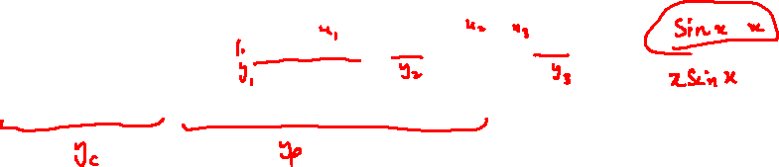
Variation of Parameters Method for Higher-Order Equations

Slide 34


Variation of Parameters Method for Higher-Order Equations

Slide 35



Variation of Parameters Method for Higher-Order Equations

Slide 36


Variation of Parameters Method for Higher-Order Equations

Slide 37


Variation of Parameters Method for Higher-Order Equations

Slide 38


Variation of Parameters Method for Higher-Order Equations

Slide 39


Variation of Parameters Method for Higher-Order Equations

Slide 40


Variation of Parameters Method for Higher-Order Equations

Slide 41


Variation of Parameters Method for Higher-Order Equations

Slide 42

Variation of Parameters Method for Higher-Order Equations

Slide 43


Variation of Parameters Method for Higher-Order Equations

Slide 44


Variation of Parameters Method for Higher-Order Equations

