Slide 1

 | National University of Sciences & Technology (NUST) School of Electrical Engineering and Computer Science (SEECS) Department of Basic Sciences
Linear Algebra & Ordinary Differential Equations
MATH-121
Lecture # 4
Course Instructor: Dr Saira Zainab
Ph. # 03325193283
Email: saira.zainab@seecs.edu.pk
Office # 207, Faculty Block, SEECS
1

Slide 2
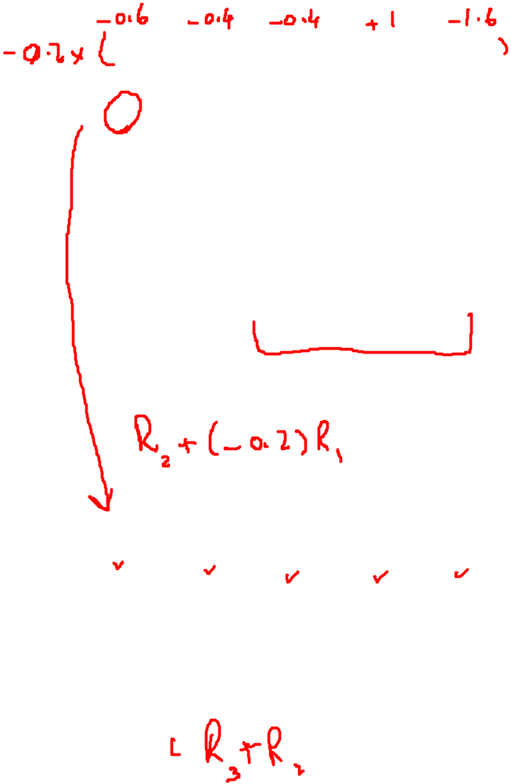


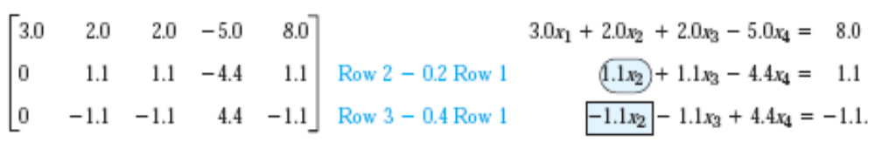
Example (Infinitely Many Solutions)
We are going to eliminate x1 from 2nd and 3rd equations by adding

Slide 3
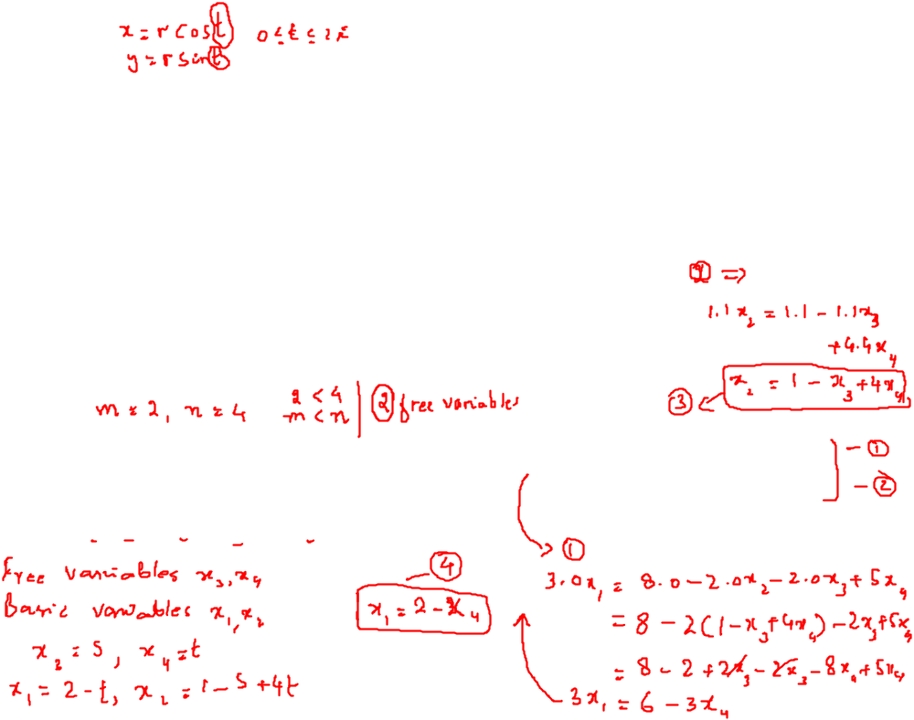


Example (Infinitely Many Solutions)
We are going to eliminate x2 from 3rd equation by adding

Slide 4
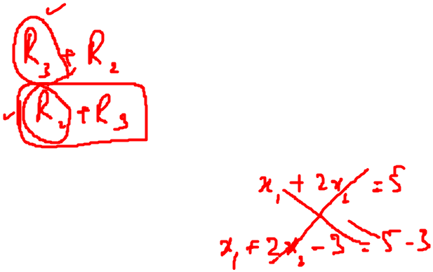



Example (No solution)
We are going to eliminate x1 from 2nd and 3rd equations by adding

Slide 5

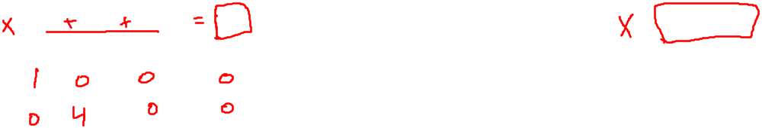
Example (No solution)
We are going to eliminate x2 from 3rd equation by adding

Slide 6
Gaussian Elimination (Electrical Networks)
To obtain the system for the unknown currents in the electrical network, we label the currents as shown, choosing directions arbitrarily; if a current will come out negative, this will simply mean that the current flows against the direction of our arrow. The current entering each battery will be the same as the current leaving it.
The equations for the currents result from Kirchhoff’s laws:
Kirchhoff’s Current Law ( KCL ) . At any point of a circuit, the sum of the inflowing currents equals the sum of the outflowing currents.
Kirchhoff’s Voltage Law ( KV L ) . In any closed loop, the sum of all voltage drops equals the impressed electromotive force.

Slide 7
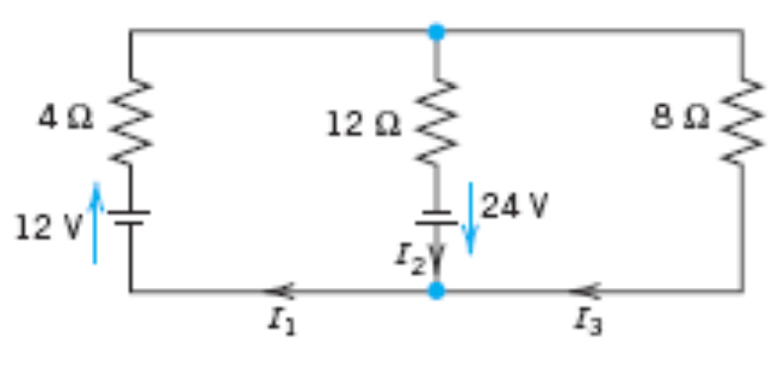
Gaussian Elimination (Electrical Networks)

Slide 8
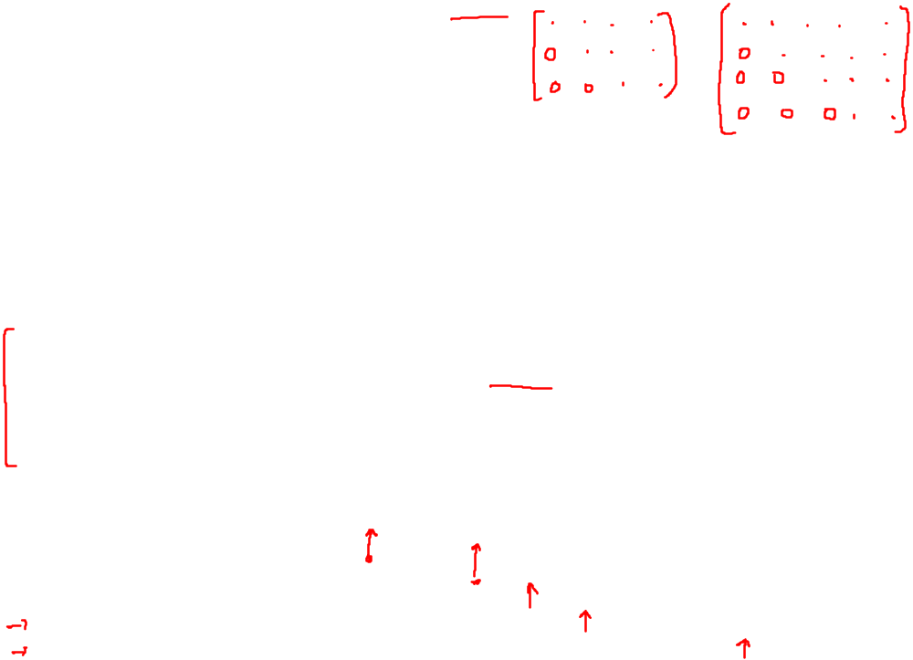
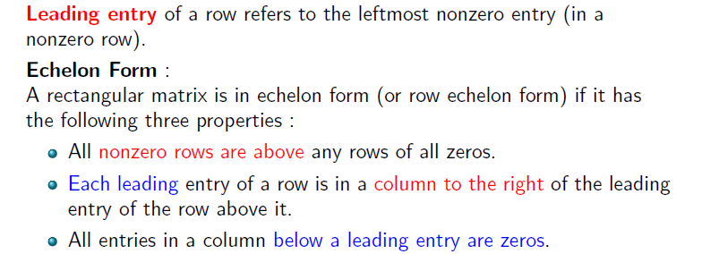
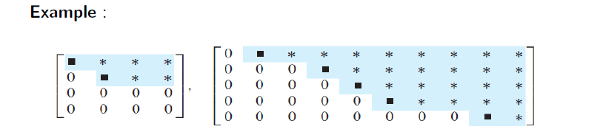
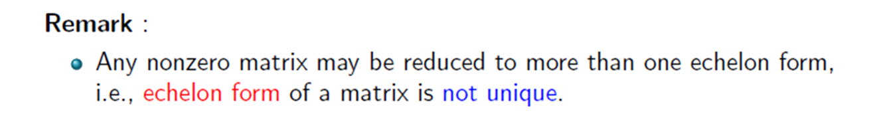
Row Echelon Form

Slide 9
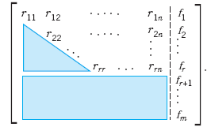
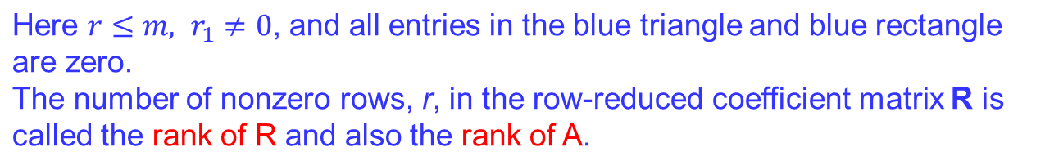
Row Echelon Form
The original system of m equations in n unknowns has augmented matrix
[A b] . This is to be row reduced to matrix [R f] . The two systems are equivalent.
If either one has a solution, so does the other, and the solutions are identical.
At the end of the Gauss elimination (before the back substitution), the row echelon form of the augmented matrix will be

Slide 10
Existence and Uniqueness of Solution
Here is the method for determining whether Ax=b has solutions and what they are:
No solution. If r is less than m (meaning that R actually has at least one row of all 0s) and at least one of the numbers fr+1, fr+2,…, fm is not zero, then the system Rx=f is inconsistent: No solution is possible. Therefore the system is inconsistent as well.
If the system is consistent (either r = m or r < m and all the numbers
fr+1, fr+2,…, fm are zero), then there are solutions.
(b) Unique solution. If the system is consistent and r = n , there is exactly one solution, which can be found by back substitution.
(c) Infinitely many solutions. To obtain any of these solutions, choose values of xr+1, xr+2,…, xn arbitrarily. Then solve the rth equation for xr (in terms of those arbitrary values), then the (r-1)st equation for xr-1, and so on up the line.

Slide 11
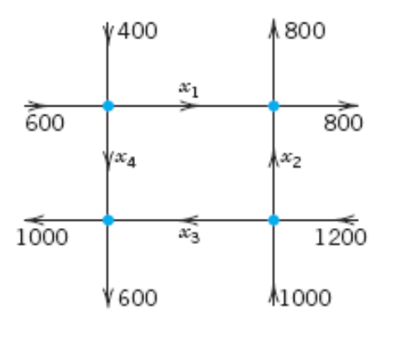
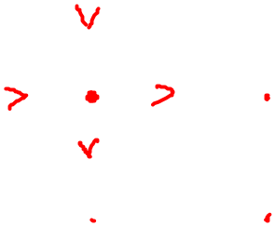
Another Application
Traffic flow: Find the traffic flow (cars per hour) in the net of one-way streets (in the directions indicated by the arrows) shown in the figure. Is the solution unique?

Slide 12
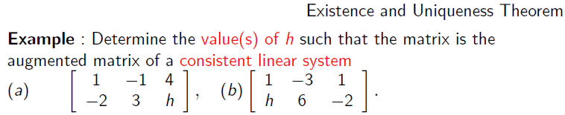
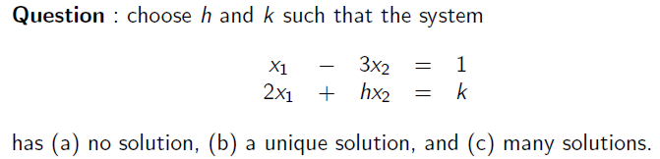
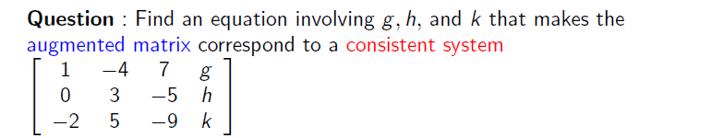
Practice Questions

Slide 13

