Slide 1

 | National University of Sciences & Technology (NUST) School of Electrical Engineering and Computer Science (SEECS) Department of Basic Sciences
Linear Algebra & Ordinary Differential Equations
MATH-121
Lecture # 40
Course Instructor: Dr Saira Zainab
Ph. # 03325193283
Email: saira.zainab@seecs.edu.pk
Office # 207, Faculty Block, SEECS
1

Slide 2
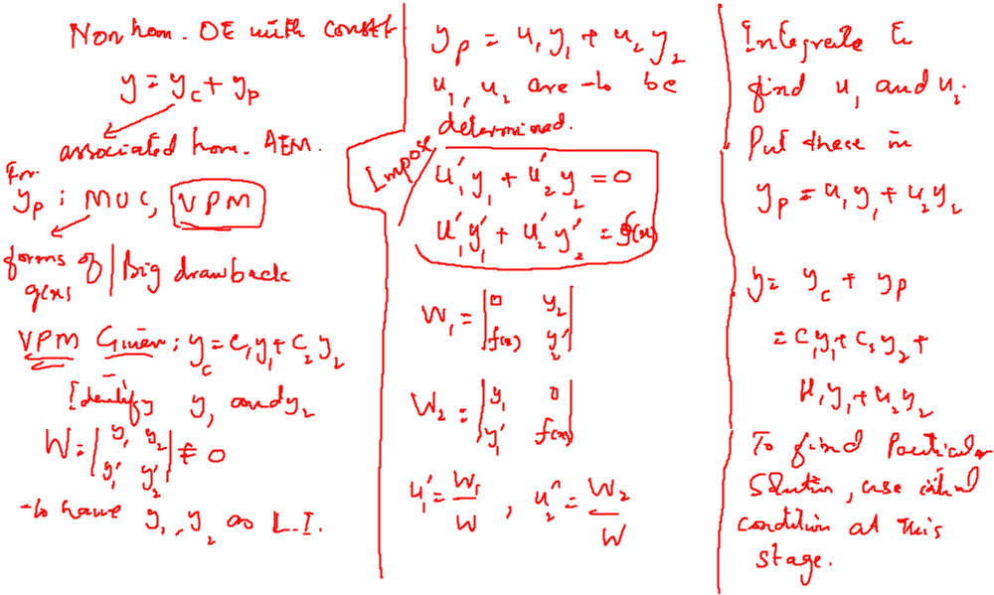
Recalling Previous Lecture

Slide 3
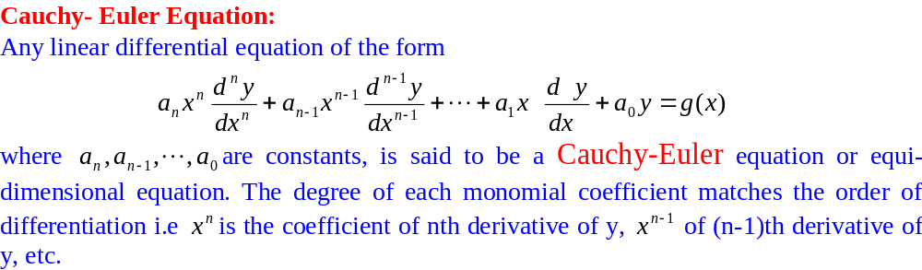
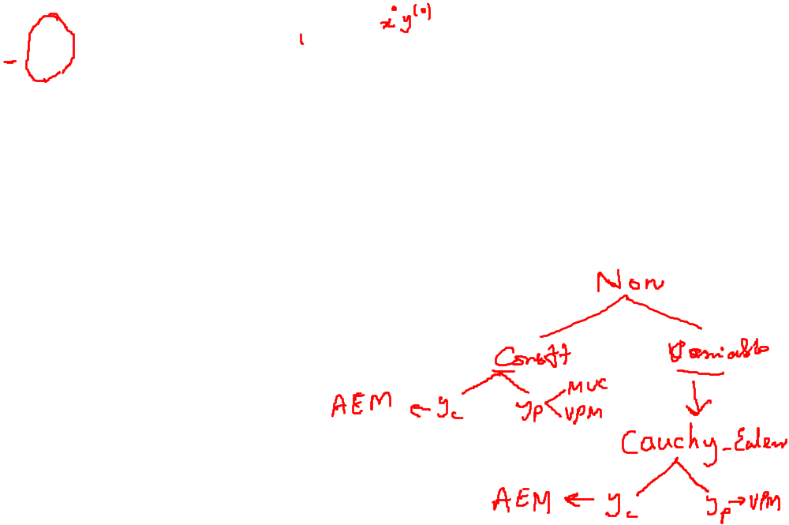
Non Homogeneous Linear Equations with Variable Coefficients
Cauchy Euler Equation

Slide 4
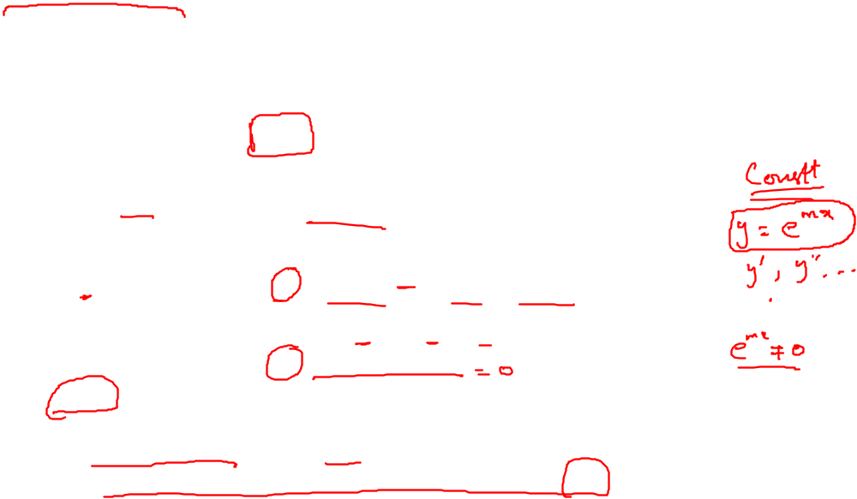
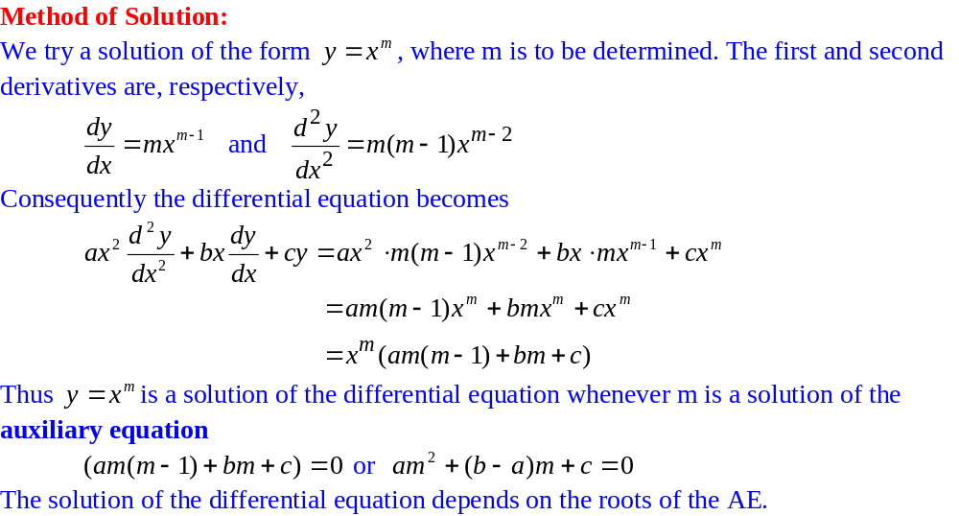
Homogeneous Linear Equations with Variable Coefficients
Cauchy Euler Equation

Slide 5
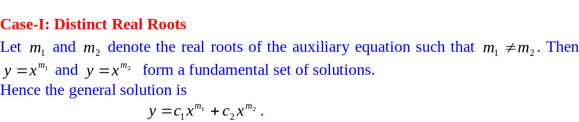
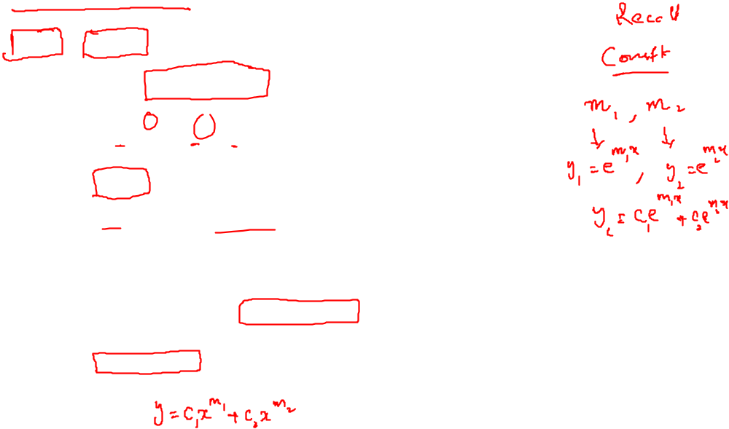
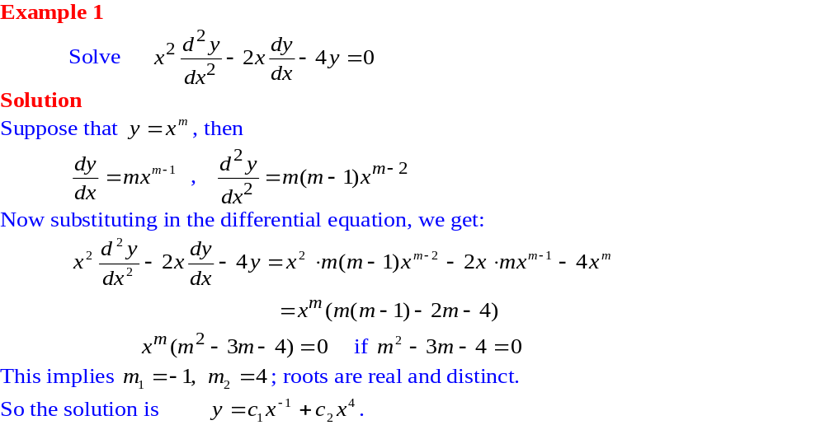
Homogeneous Linear Equations with Variable Coefficients

Slide 6
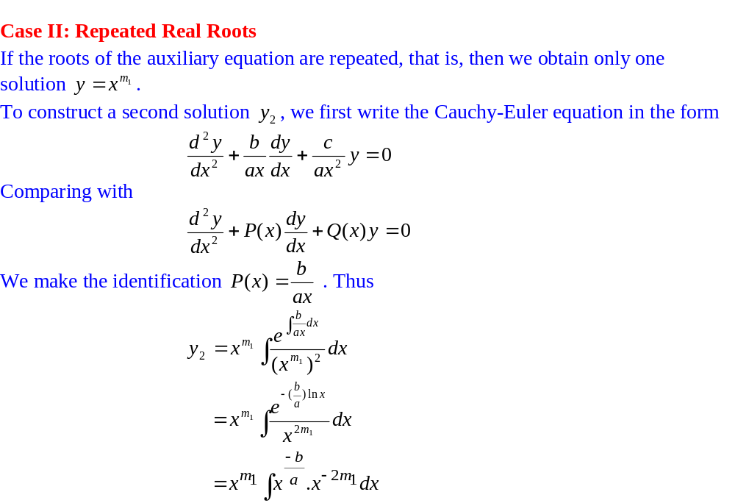
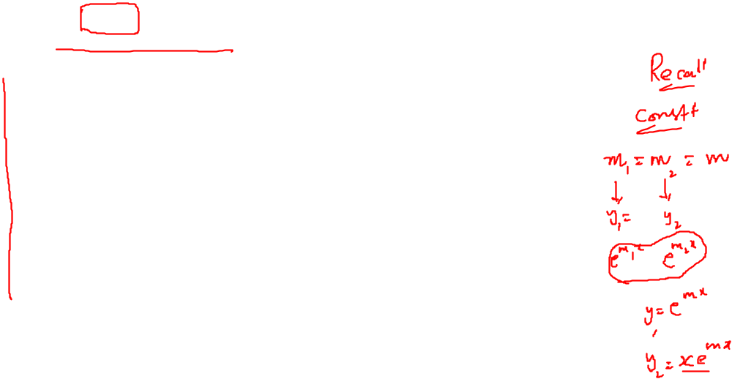
Homogeneous Linear Equations with Variable Coefficients

Slide 7
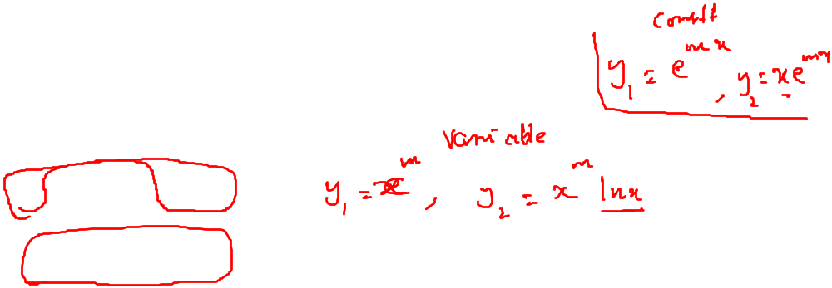
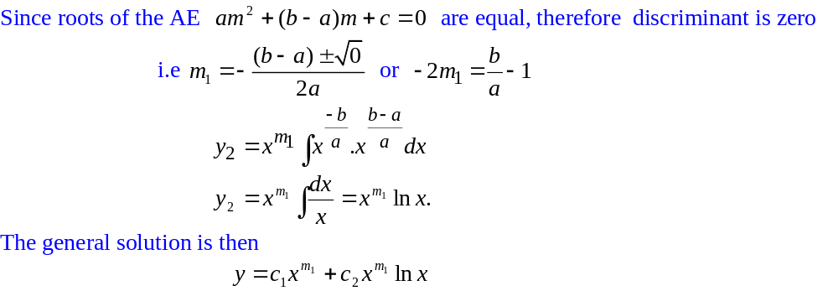
Homogeneous Linear Equations with Variable Coefficients

Slide 8
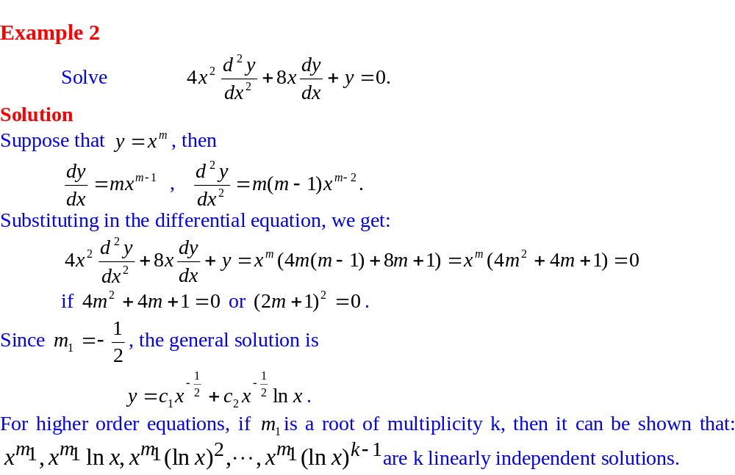
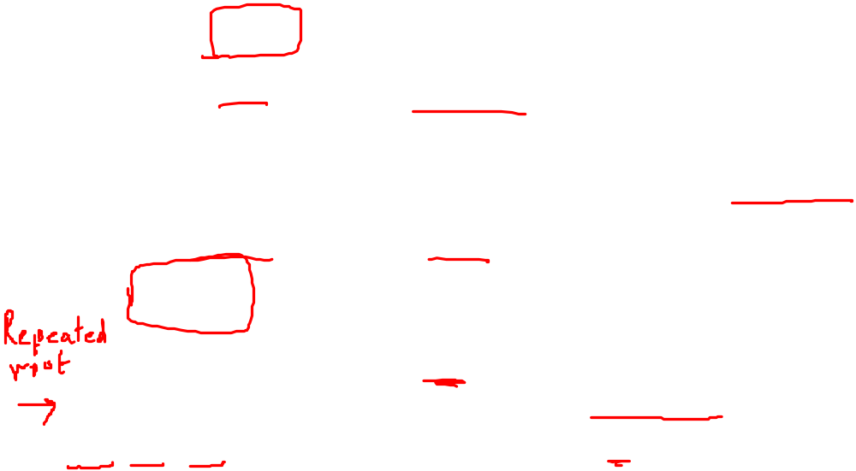
Homogeneous Linear Equations with Variable Coefficients

Slide 9
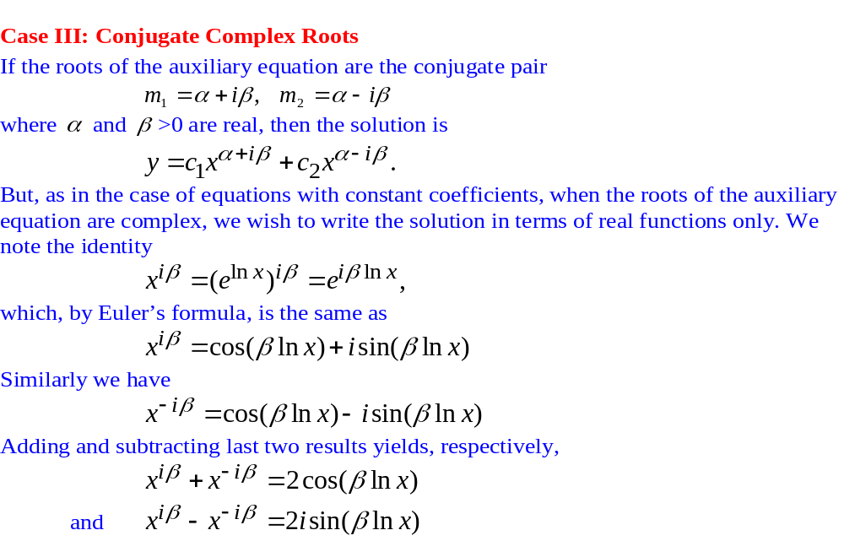
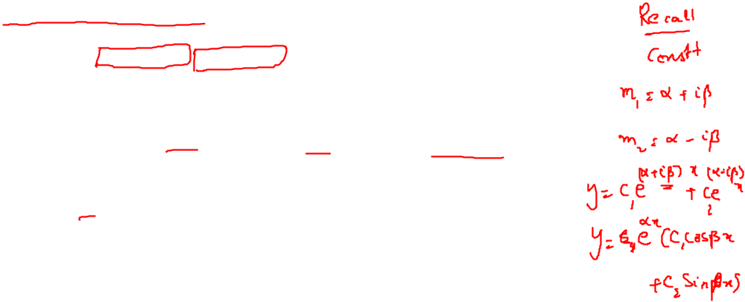
Homogeneous Linear Equations with Variable Coefficients

Slide 10
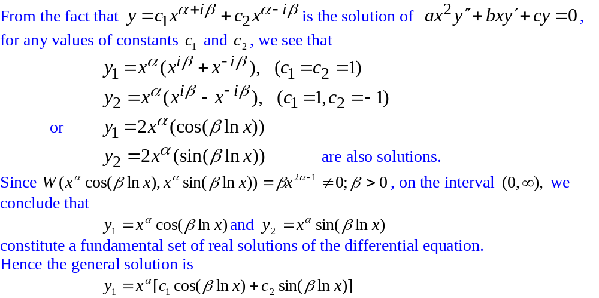
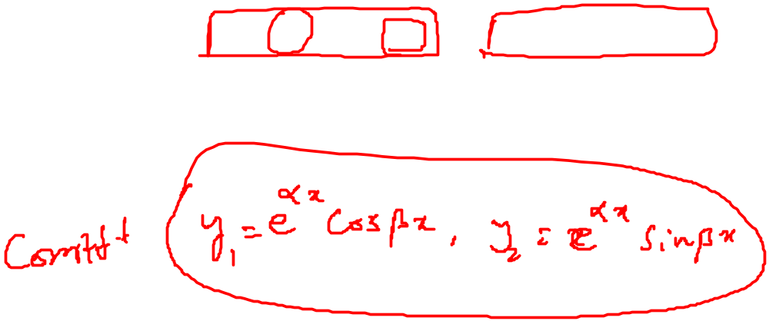
Homogeneous Linear Equations with Variable Coefficients

Slide 11
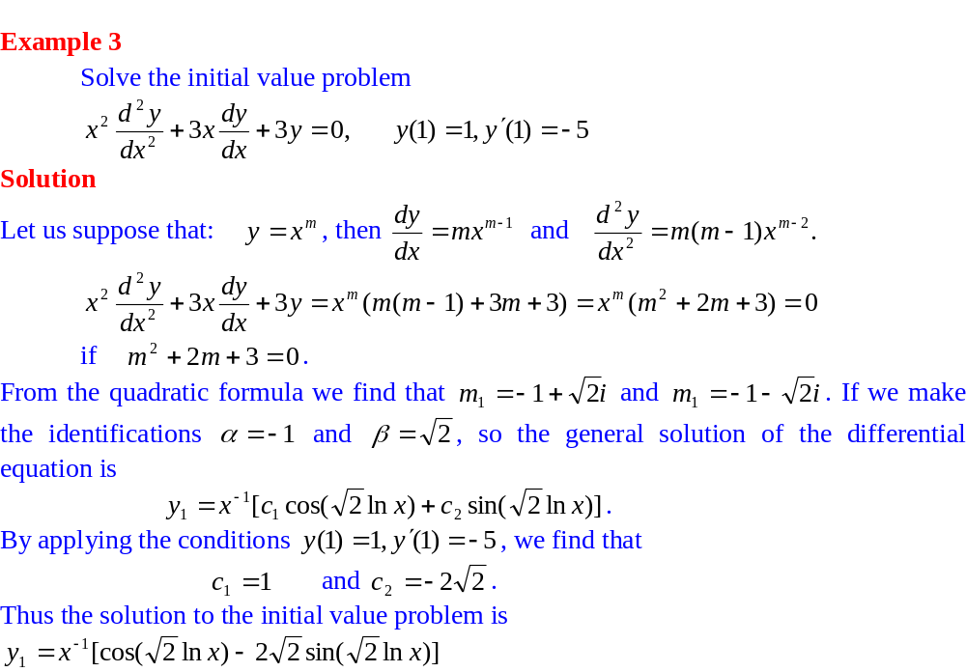
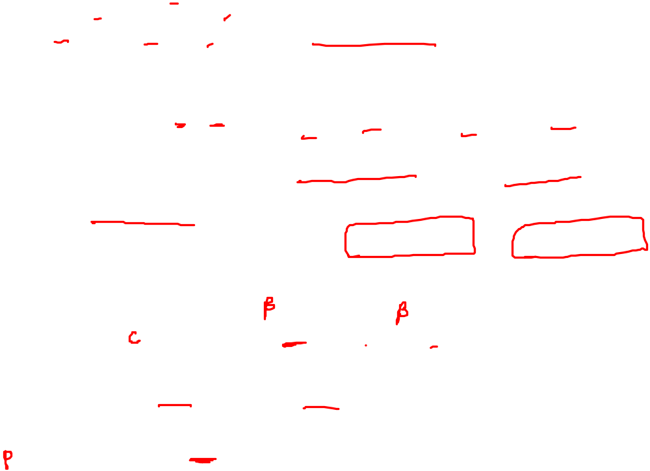
Homogeneous Linear Equations with Variable Coefficients

Slide 12
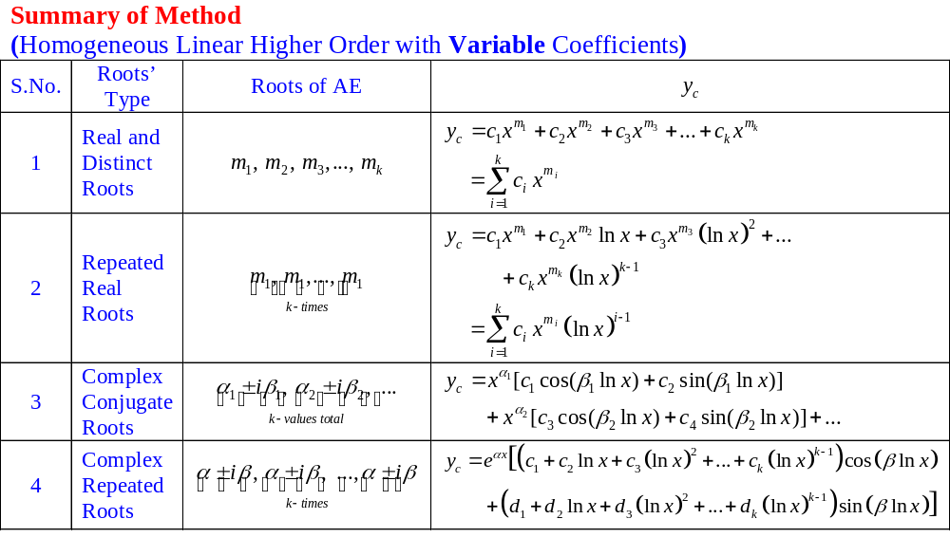

Homogeneous Linear Equations with Variable Coefficients

Slide 13
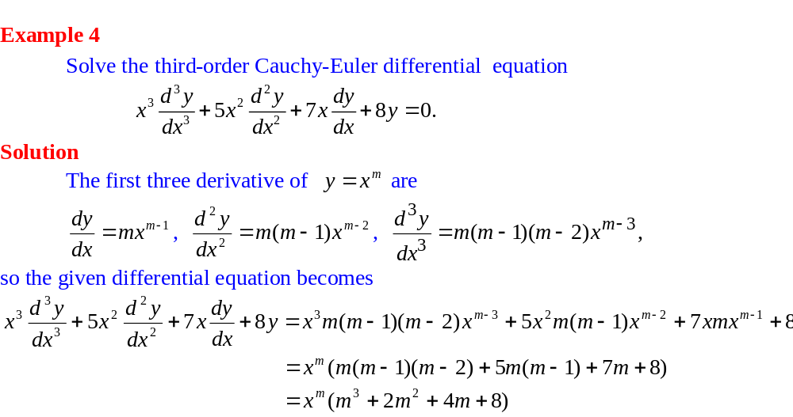

Homogeneous Linear Equations with Variable Coefficients

Slide 14
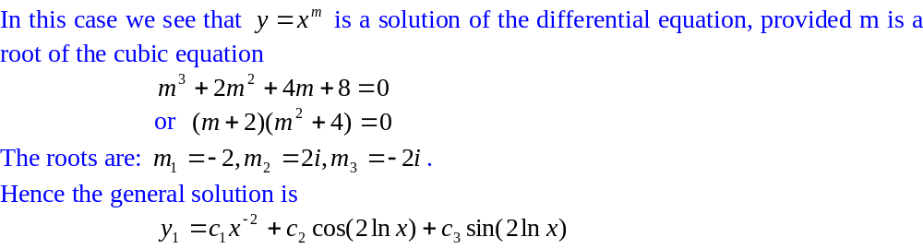
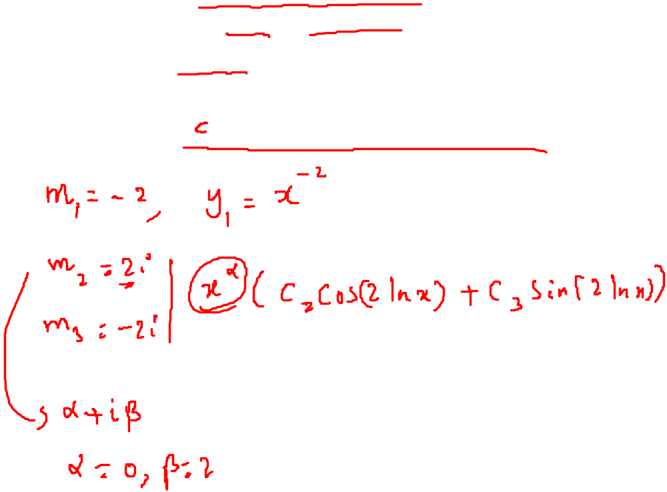
Homogeneous Linear Equations with Variable Coefficients

Slide 15
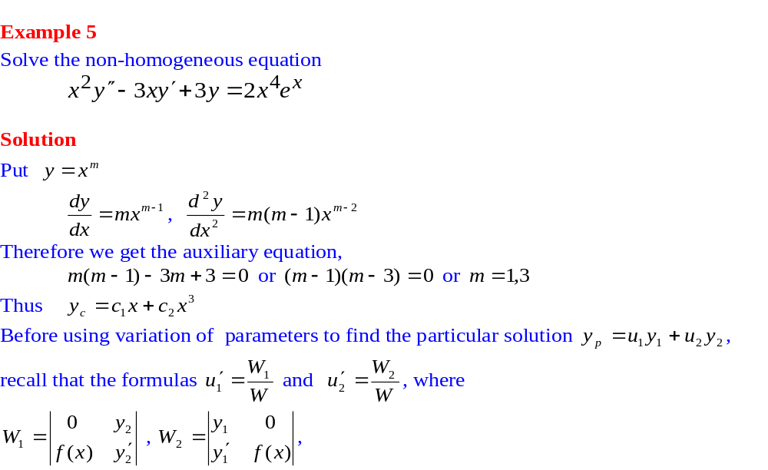
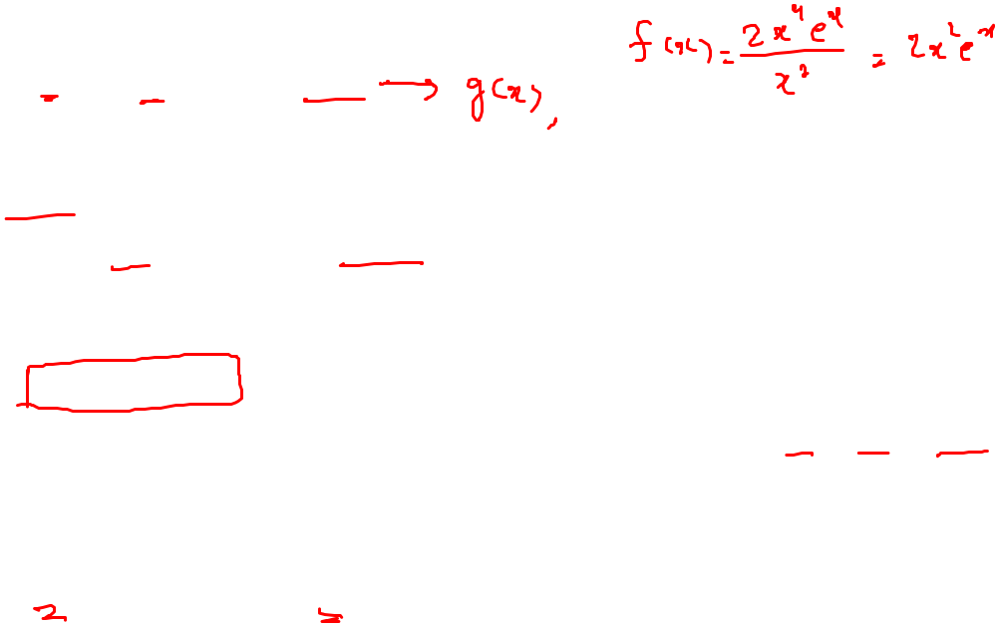
Non Homogeneous Linear Equations with Variable Coefficients

Slide 16
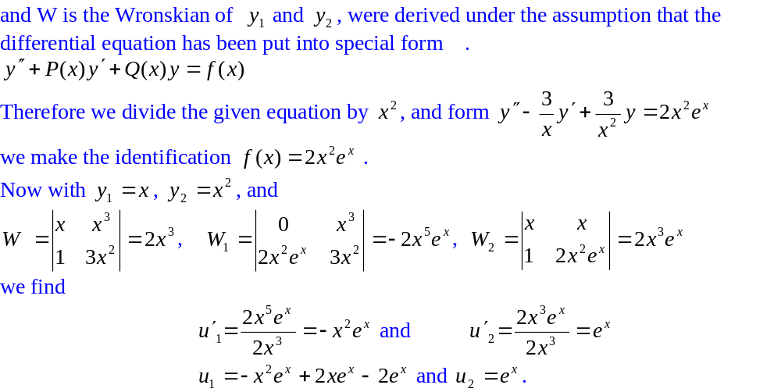

Non Homogeneous Linear Equations with Variable Coefficients

Slide 17
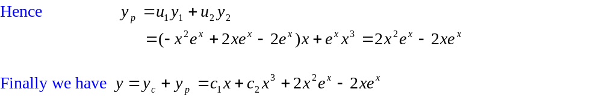
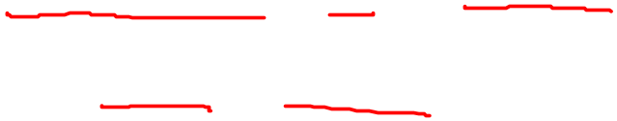
Non Homogeneous Linear Equations with Variable Coefficients

Slide 18
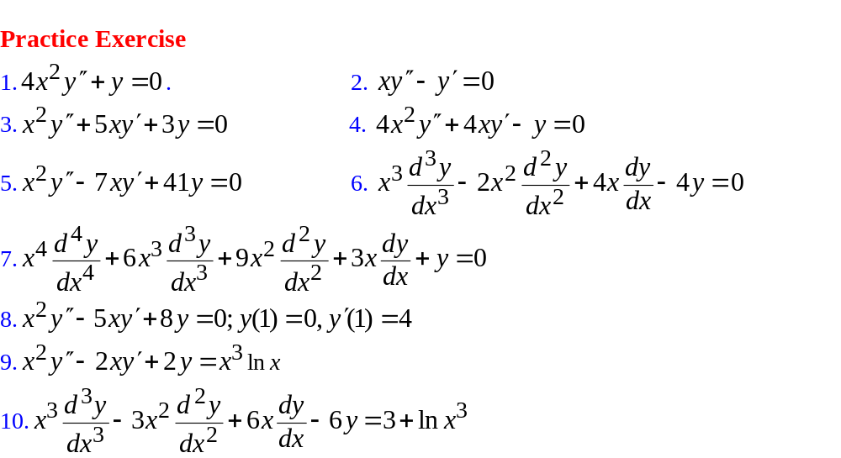
Non Homogeneous Linear Equations with Variable Coefficients

