Slide 1

 | National University of Sciences & Technology (NUST) School of Electrical Engineering and Computer Science (SEECS) Department of Basic Sciences
Linear Algebra & Ordinary Differential Equations
MATH-121
Lecture # 41
Course Instructor: Dr Saira Zainab
Ph. # 03325193283
Email: saira.zainab@seecs.edu.pk
Office # 207, Faculty Block, SEECS
1

Slide 2
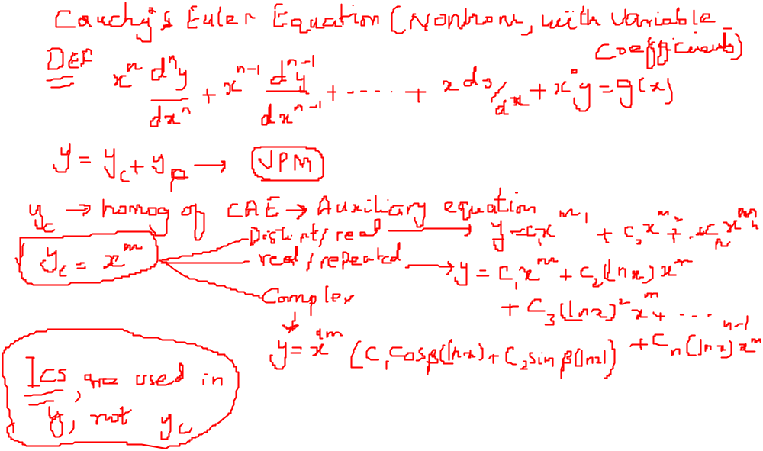
Recalling Previous Lecture

Slide 3
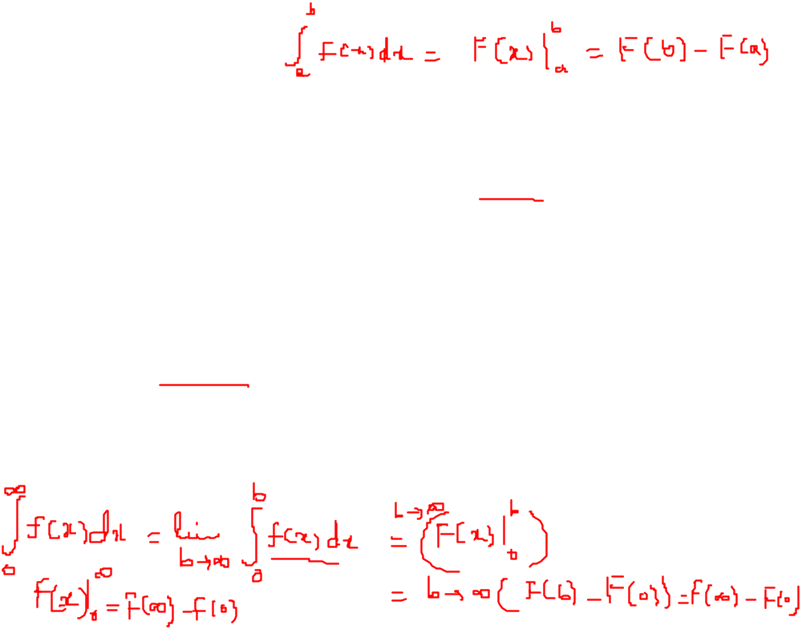
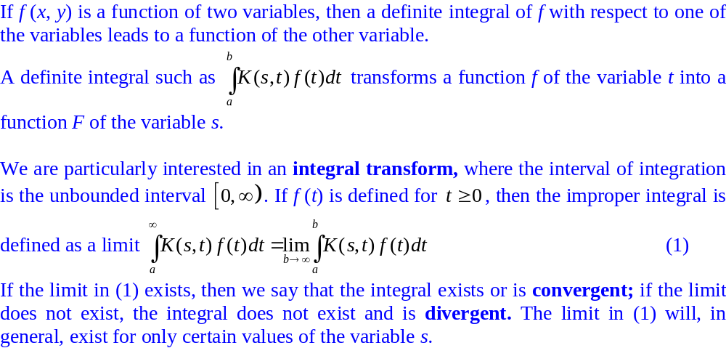
Integral Transform

Slide 4

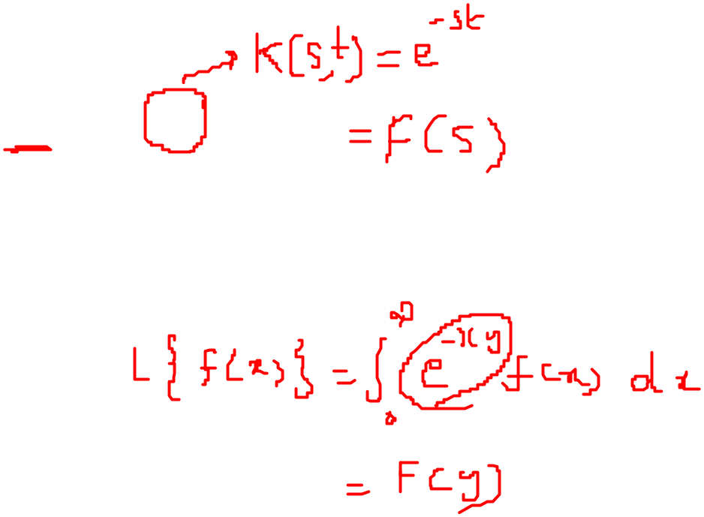
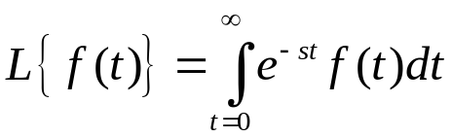
Laplace Transform
Given a function f ( t ) defined for values of the variable t > 0 then the Laplace transform of f ( t ), denoted by:
is defined to be:
where s is a variable whose values are chosen so as to ensure that the semi-infinite integral converges.

Slide 5
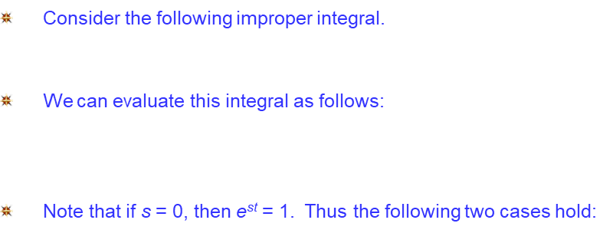
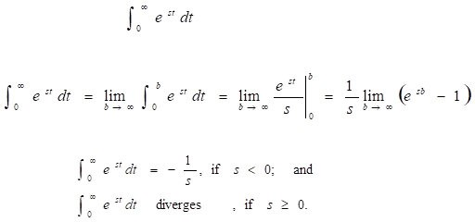
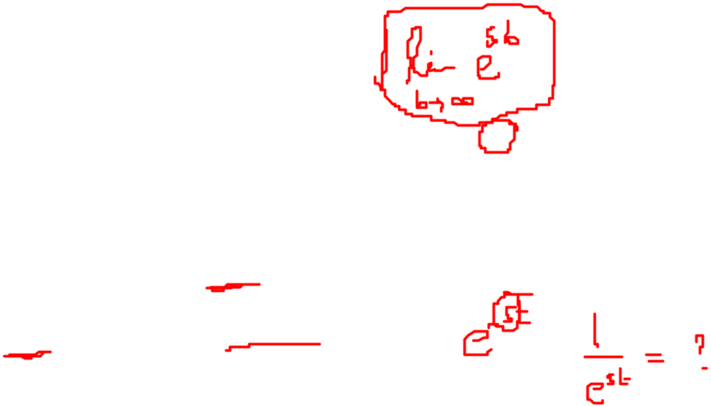
Laplace Transform

Slide 6
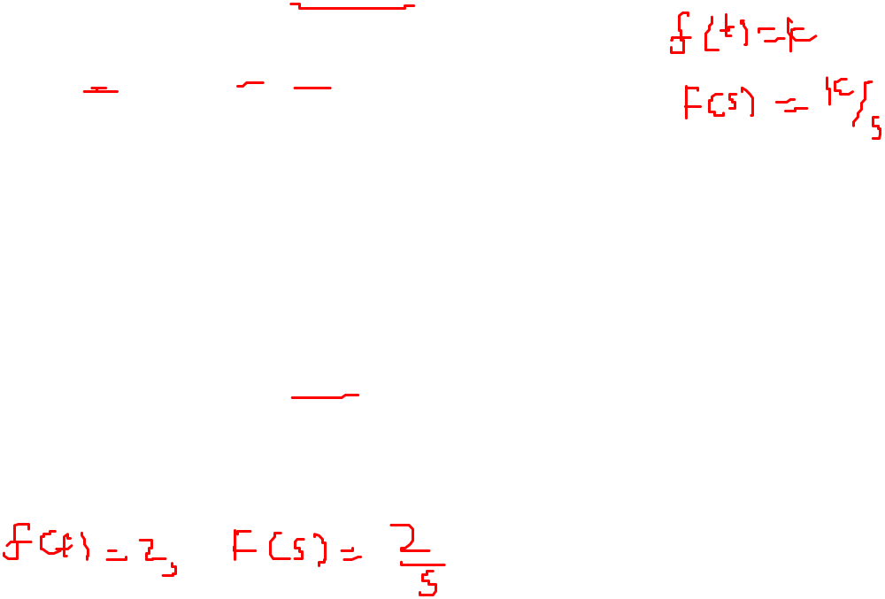
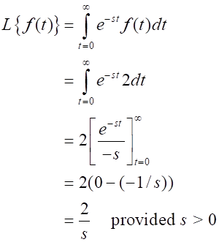
Laplace Transform
Example 1: The Laplace transform of f ( t ) = 2 for t ≥ 0 is:

Slide 7
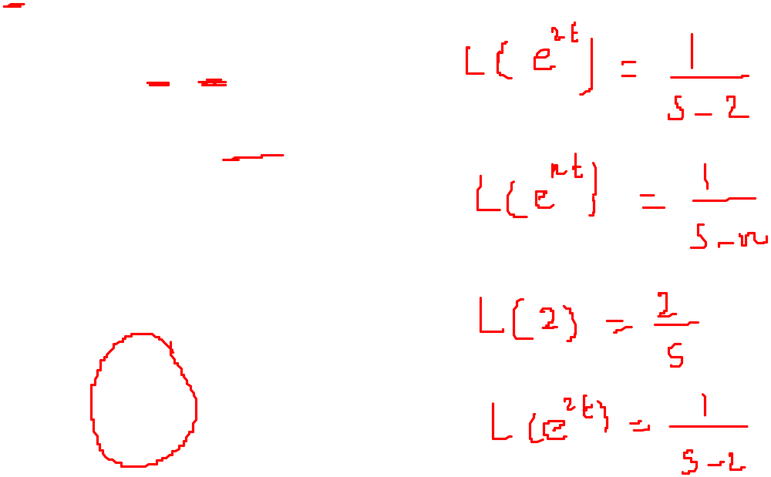
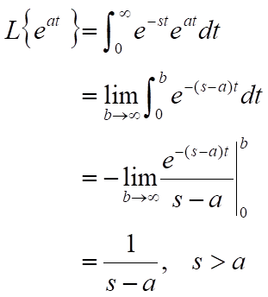
Laplace Transform
Example 2: Let f (t) = e^{at} for t ≥ 0. Then the Laplace transform F(s) of f is

Slide 8
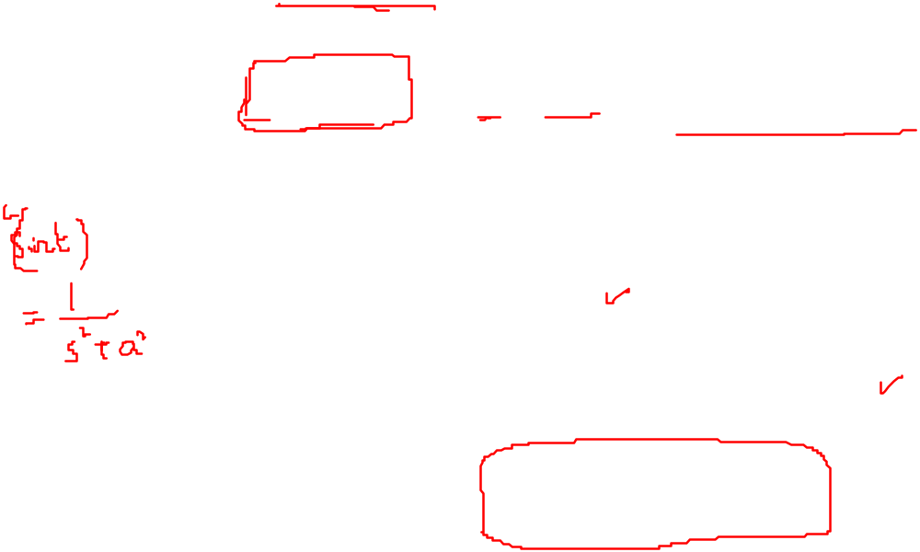
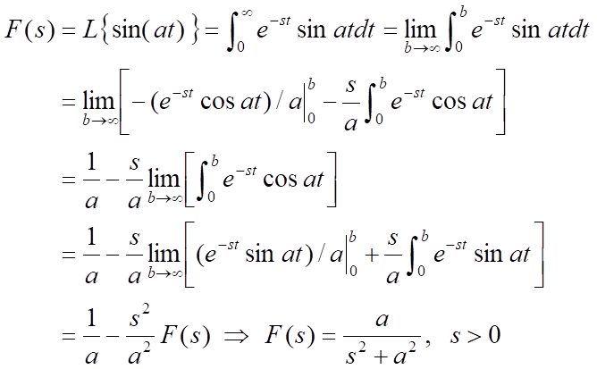
Laplace Transform
Example 3: Let f (t) = sin(at) for t ≥ 0. Using integration by parts twice, the Laplace transform F(s) of f is found as follows:

Slide 9
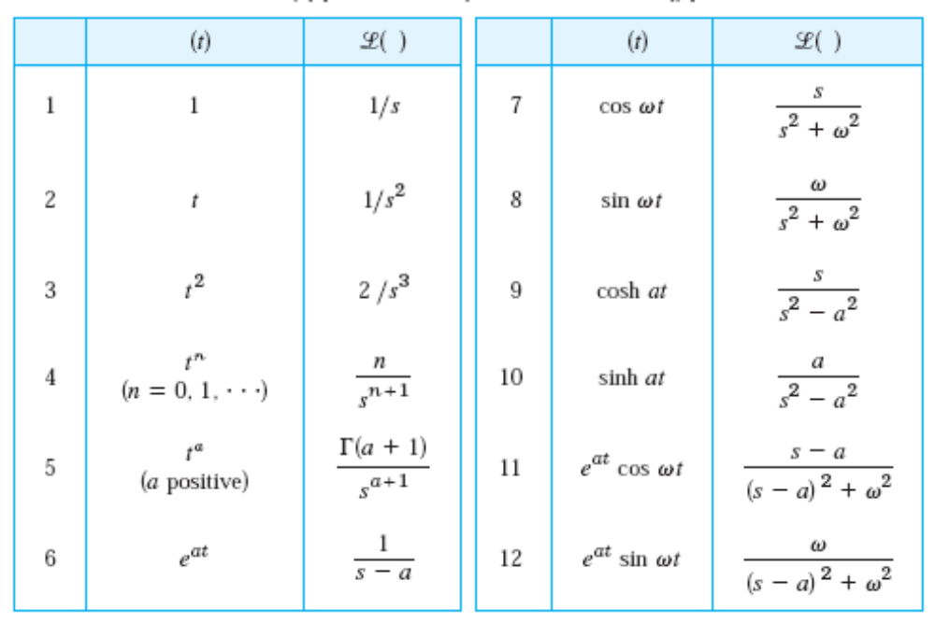
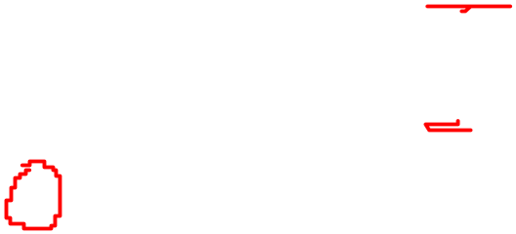
Laplace Transform
Some Basic Functions and their Laplace Transforms

Slide 10
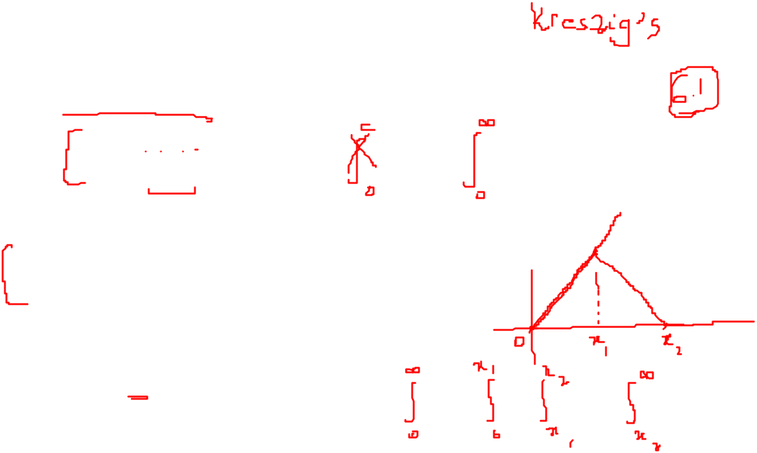
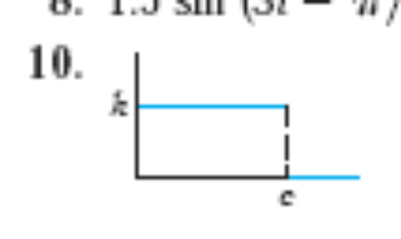
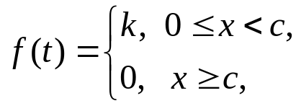
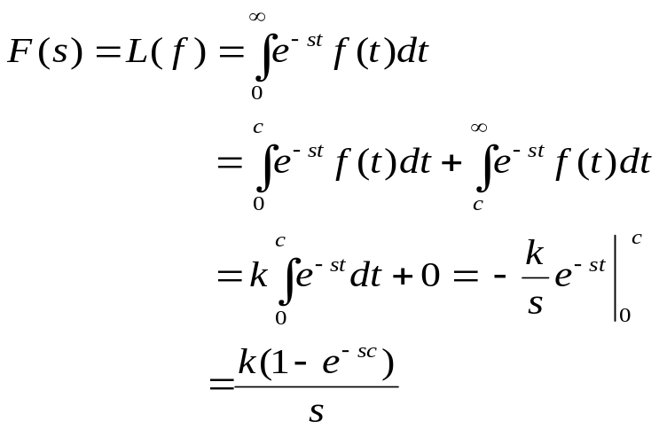
Laplace Transform
Some Basic Functions and their Laplace Transforms
Find the Laplace Transform of the function given in figure.
The function given in figure can be written piecewise as:

Slide 11
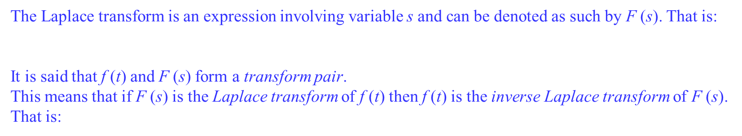


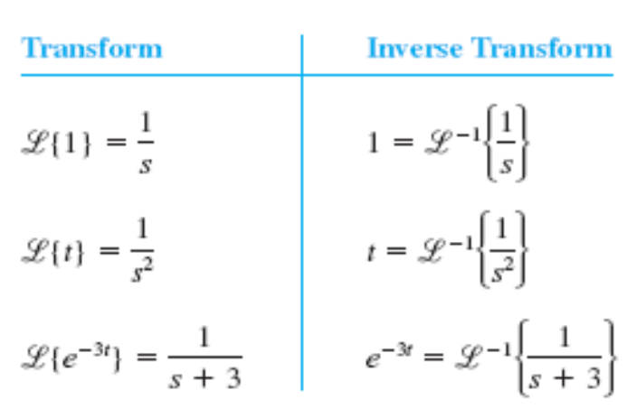
Inverse Laplace Transform

Slide 12
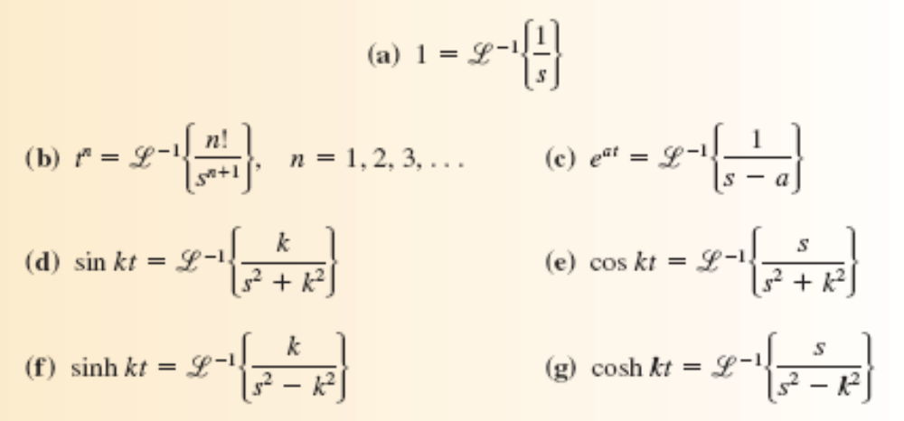
Inverse Laplace Transform
Inverse Laplace Transforms of Some Functions

Slide 13
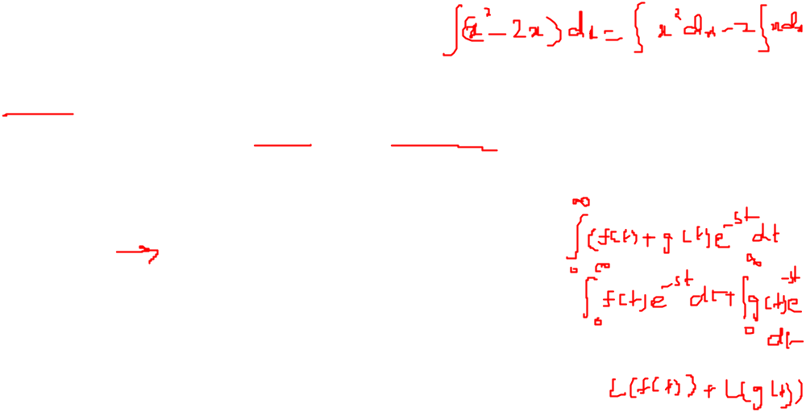
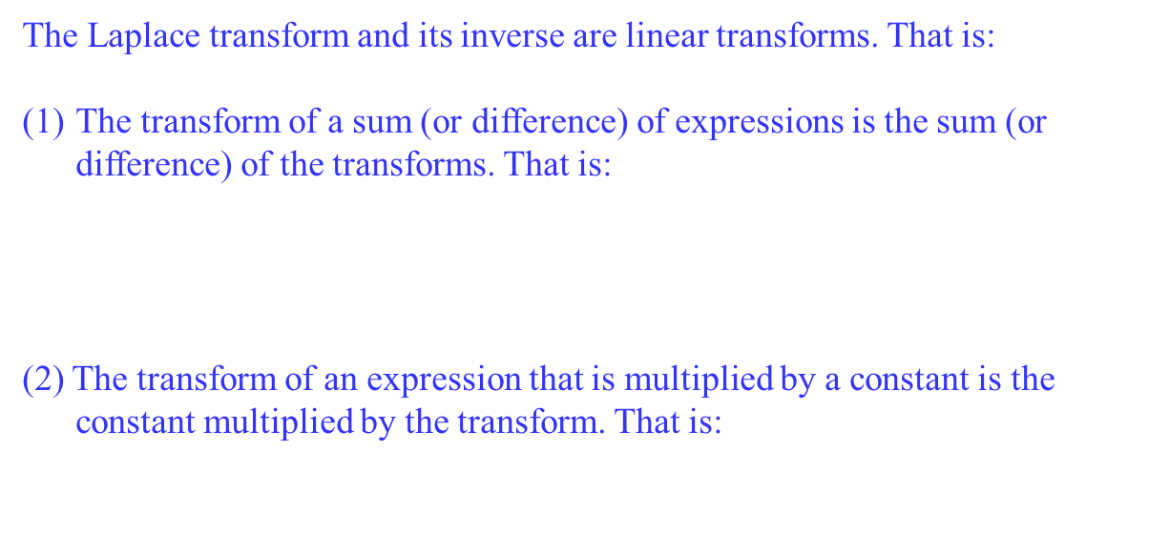
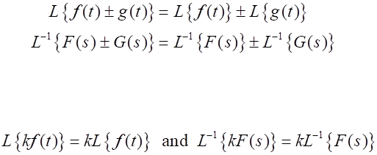
Properties of Laplace Transform
Linearity of Laplace and its Inverse

Slide 14
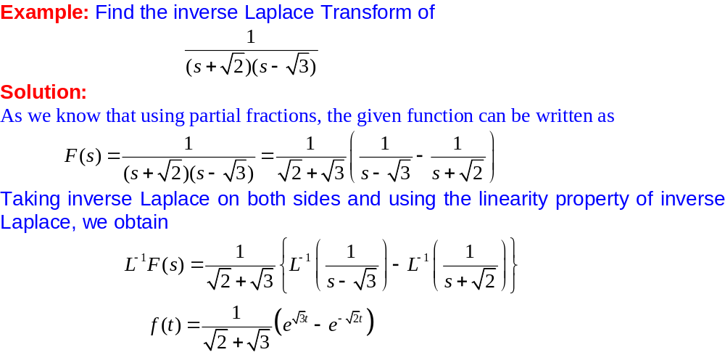
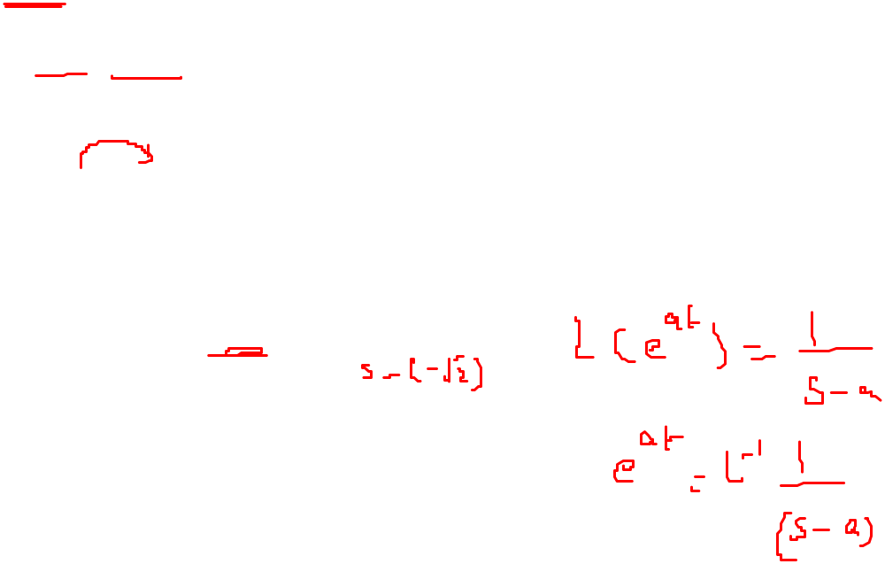
Properties of Laplace Transform

Slide 15
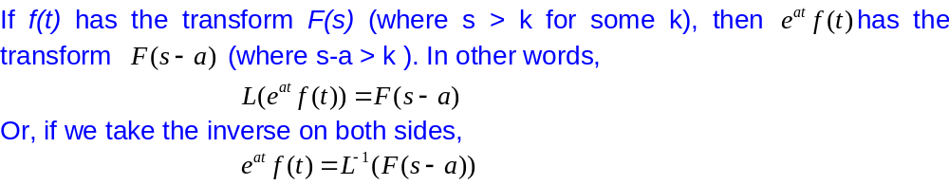
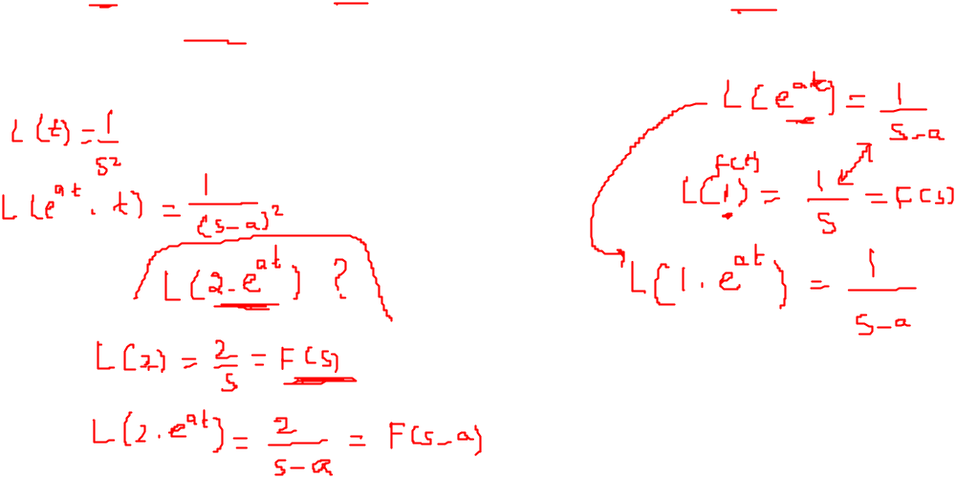
Properties of Laplace Transform
First Shifting Theorem

Slide 16
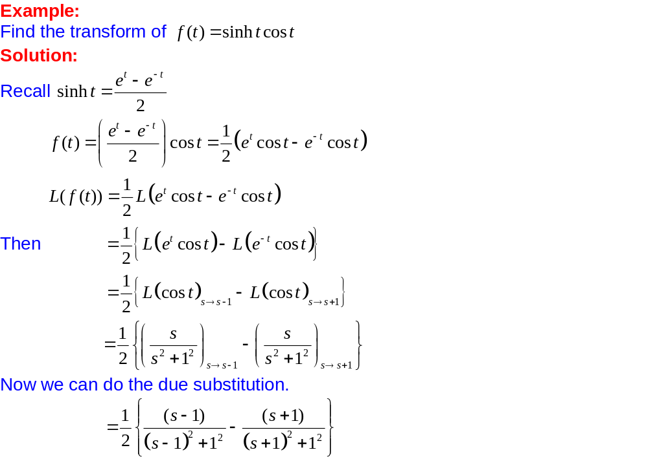
Applications of First Shifting Theorem

Slide 17
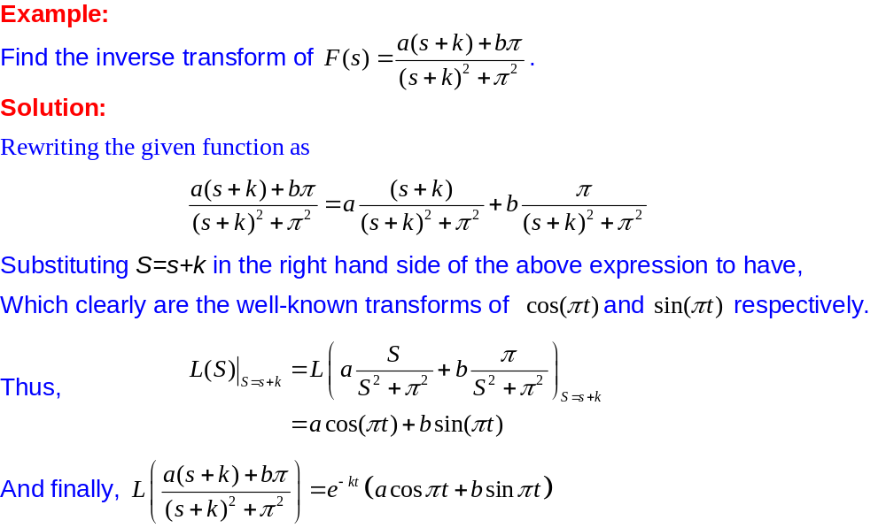
Applications of First Shifting Theorem

Slide 18
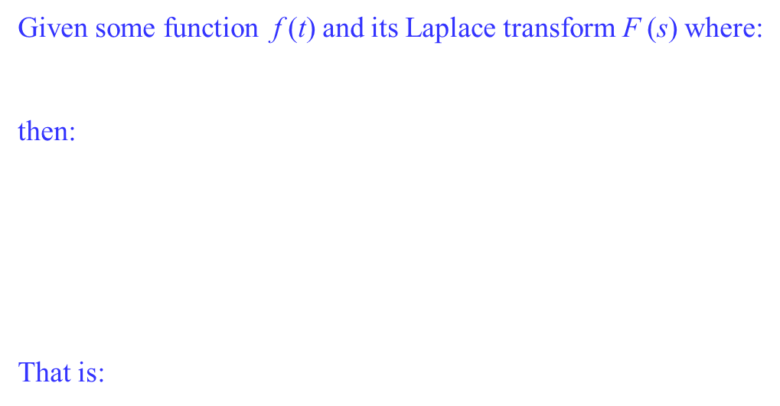
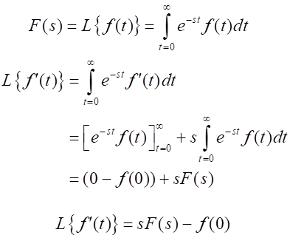
Properties of Laplace Transform
Laplace Transform of a derivative

Slide 19
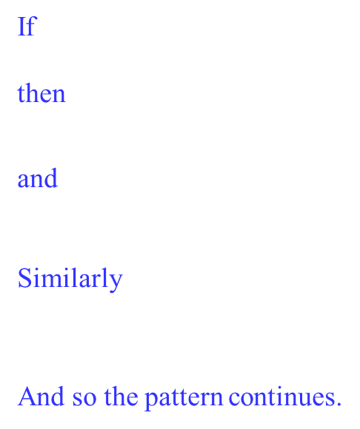
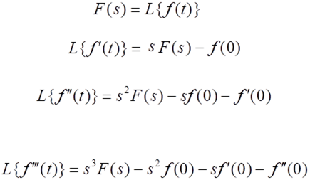
Properties of Laplace Transform
Laplace Transform of higher derivatives

Slide 20
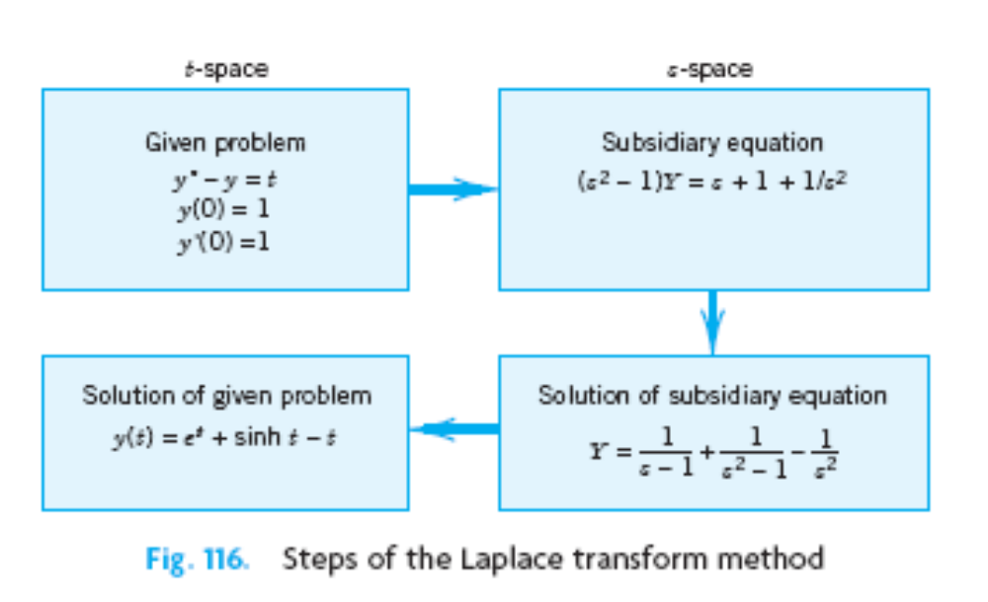
Solution of Initial Value Problems(Using Laplace Transform Method)

Slide 21
Solution of Initial Value Problems(Using Laplace Transform Method)
Advantages of Using Laplace Transform Method
The solution of non homogenous differential equations doesn’t require
the homogenous part to be solved first.
Initial conditions are automatically taken care of.
Complicated input (right hand side of the linear equation) can be handled very efficiently.

Slide 22
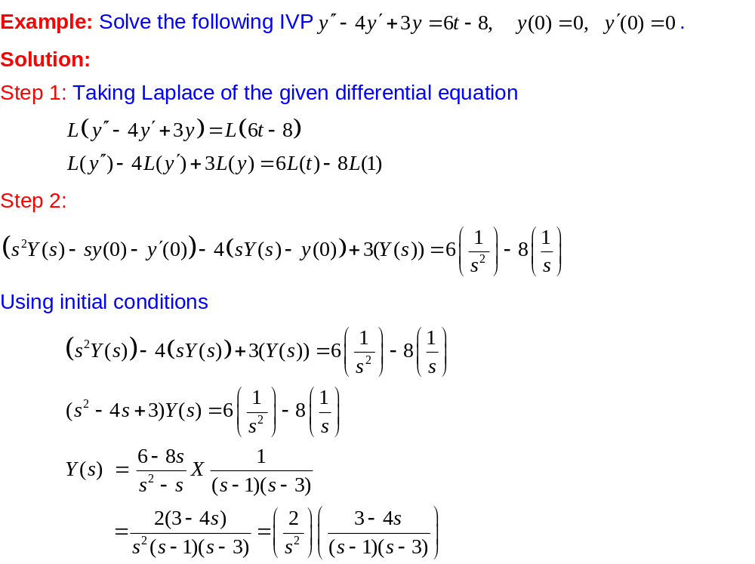
Solution of Initial Value Problems(Using Laplace Transform Method)

Slide 23
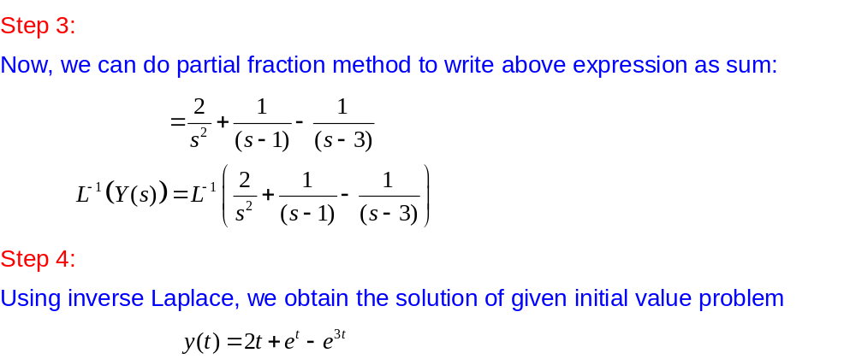
Solution of Initial Value Problems(Using Laplace Transform Method)

