Slide 1

 | National University of Sciences & Technology (NUST) School of Electrical Engineering and Computer Science (SEECS) Department of Basic Sciences
Linear Algebra & Ordinary Differential Equations
MATH-121
Lecture # 42
Course Instructor: Dr Saira Zainab
Ph. # 03325193283
Email: saira.zainab@seecs.edu.pk
Office # 207, Faculty Block, SEECS
1

Slide 2
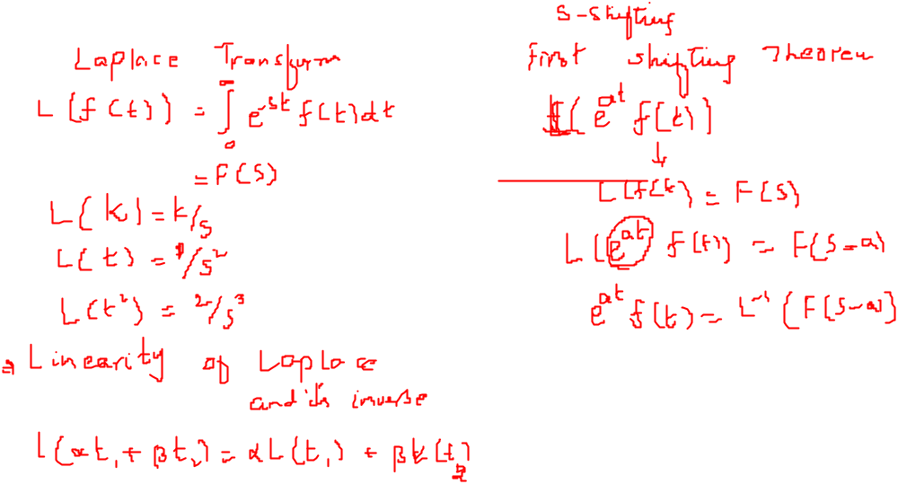
Recalling Previous Lecture

Slide 3
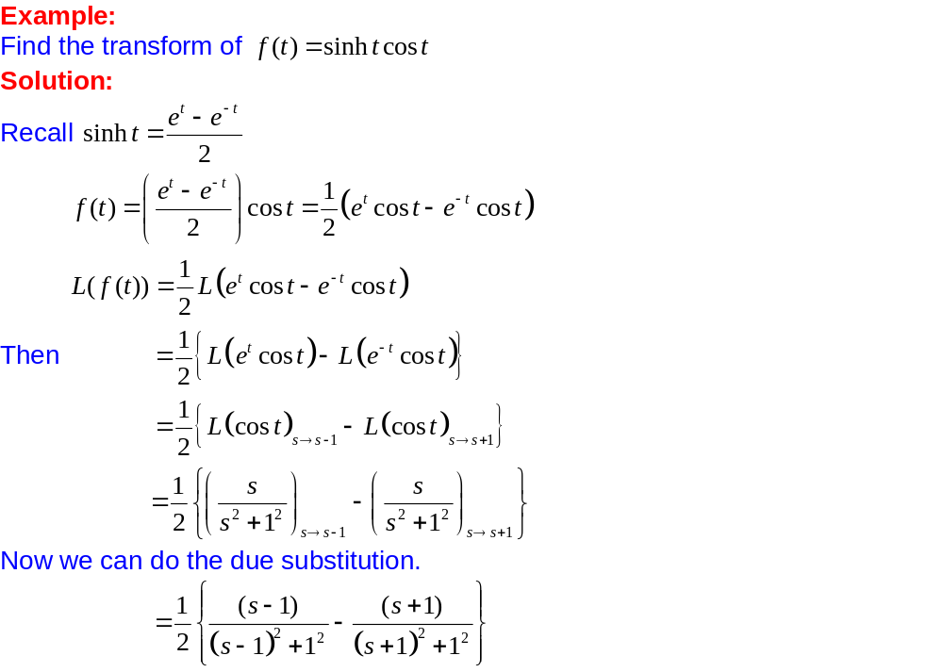
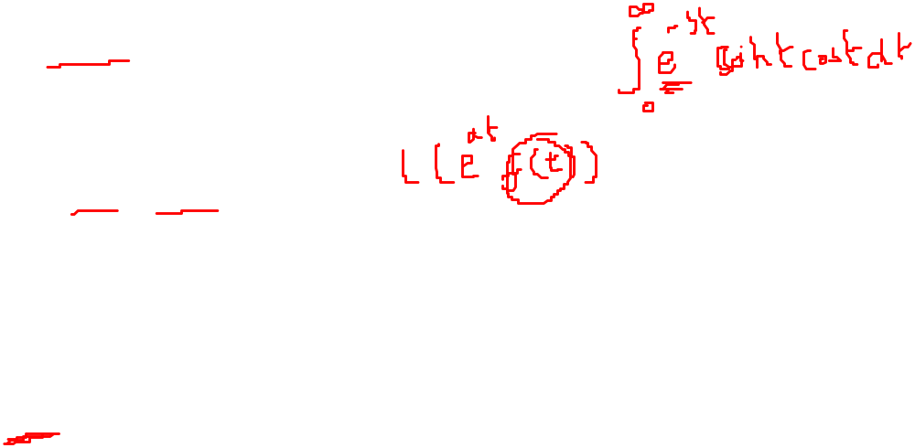
Applications of First Shifting Theorem

Slide 4
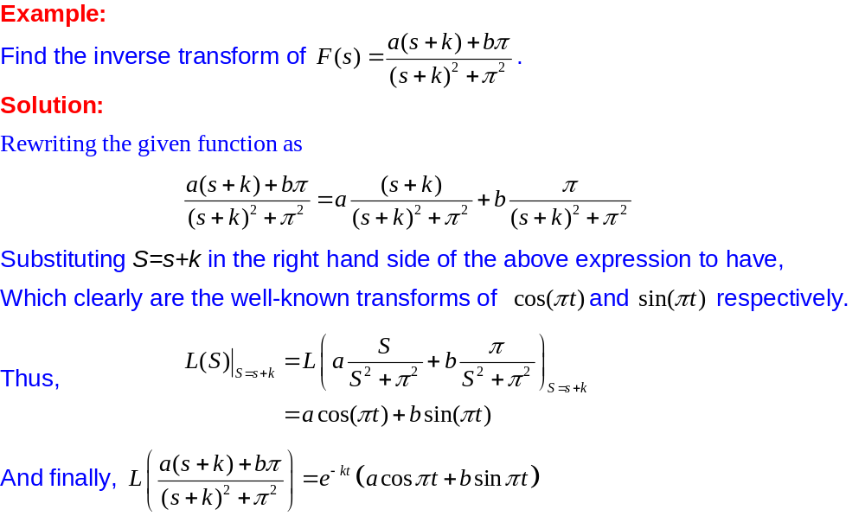
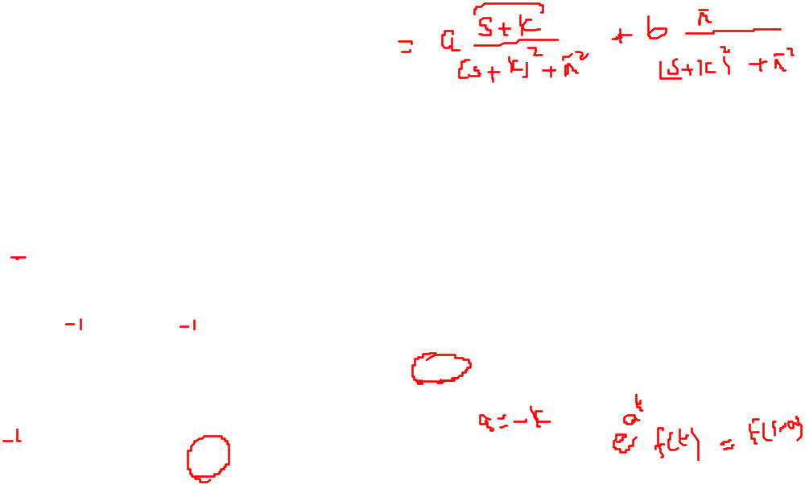
Applications of First Shifting Theorem

Slide 5
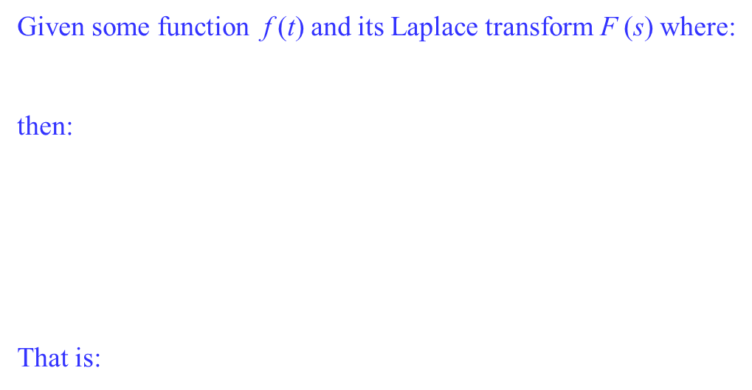
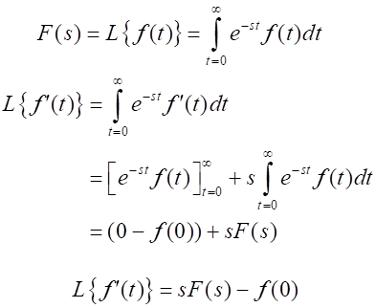
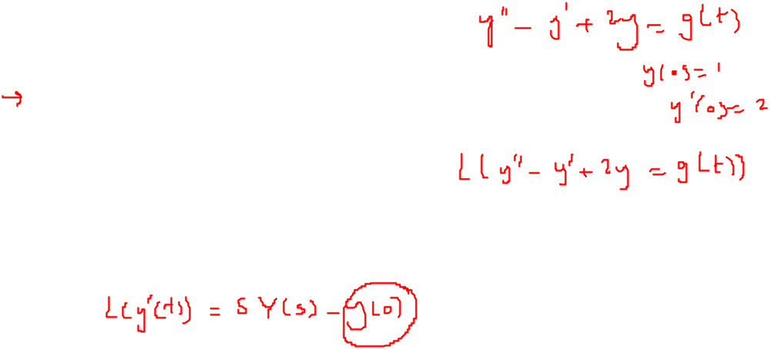
Properties of Laplace Transform
Laplace Transform of a derivative

Slide 6
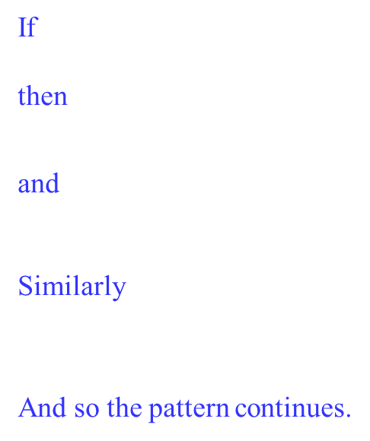
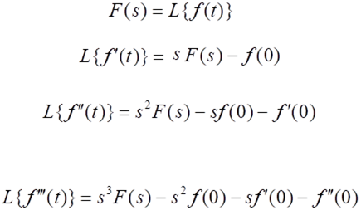
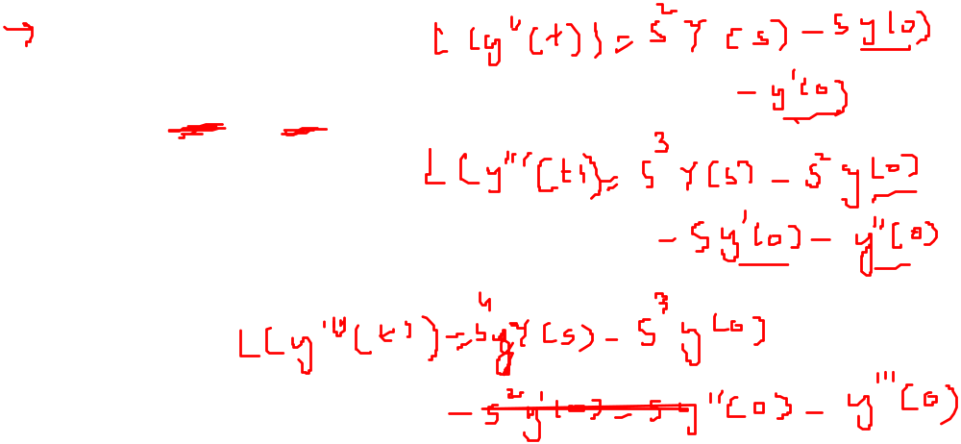
Properties of Laplace Transform
Laplace Transform of higher derivatives

Slide 7
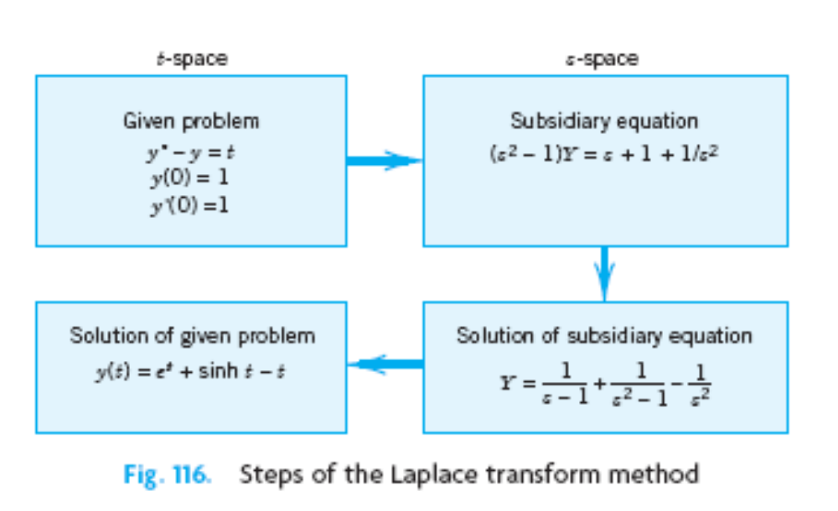
Solution of Initial Value Problems(Using Laplace Transform Method)

Slide 8
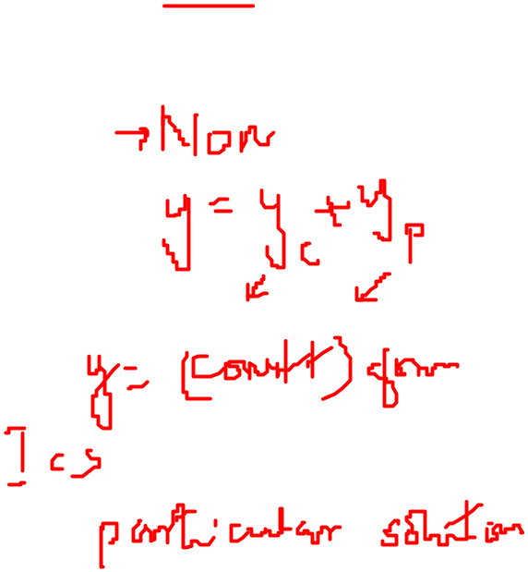
Solution of Initial Value Problems(Using Laplace Transform Method)
Advantages of Using Laplace Transform Method
The solution of non homogenous differential equations doesn’t require
the homogenous part to be solved first.
Initial conditions are automatically taken care of.
Complicated input (right hand side of the linear equation) can be handled very efficiently.

Slide 9
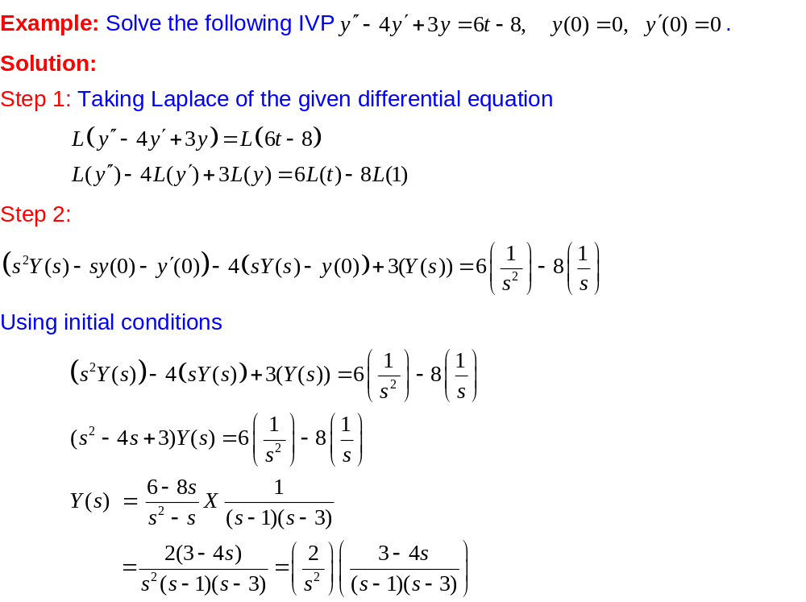
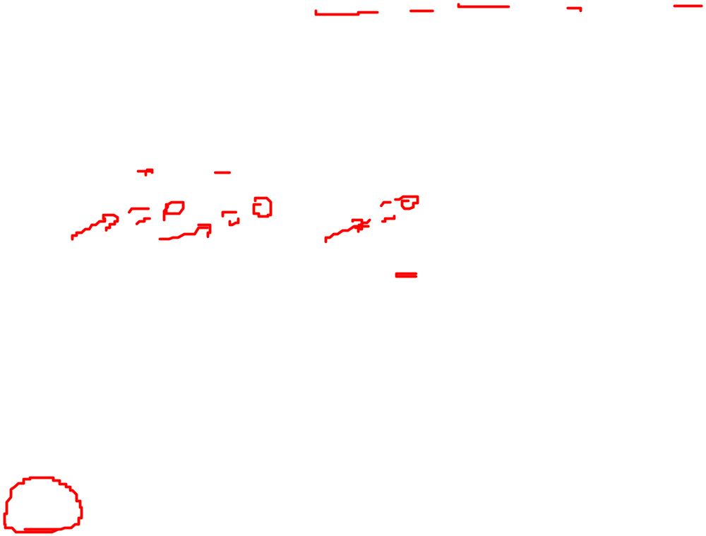
Solution of Initial Value Problems(Using Laplace Transform Method)

Slide 10
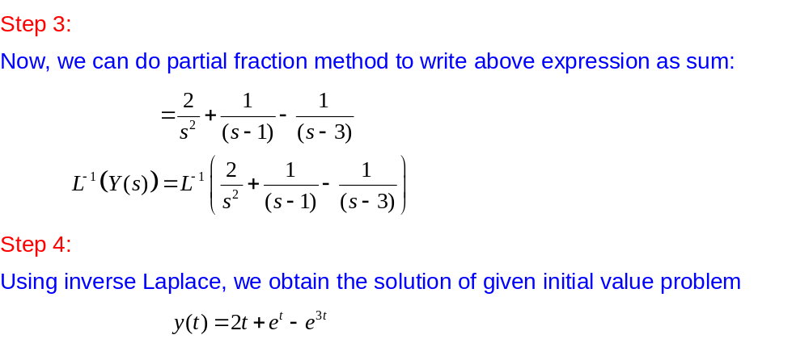

Solution of Initial Value Problems(Using Laplace Transform Method)

Slide 11
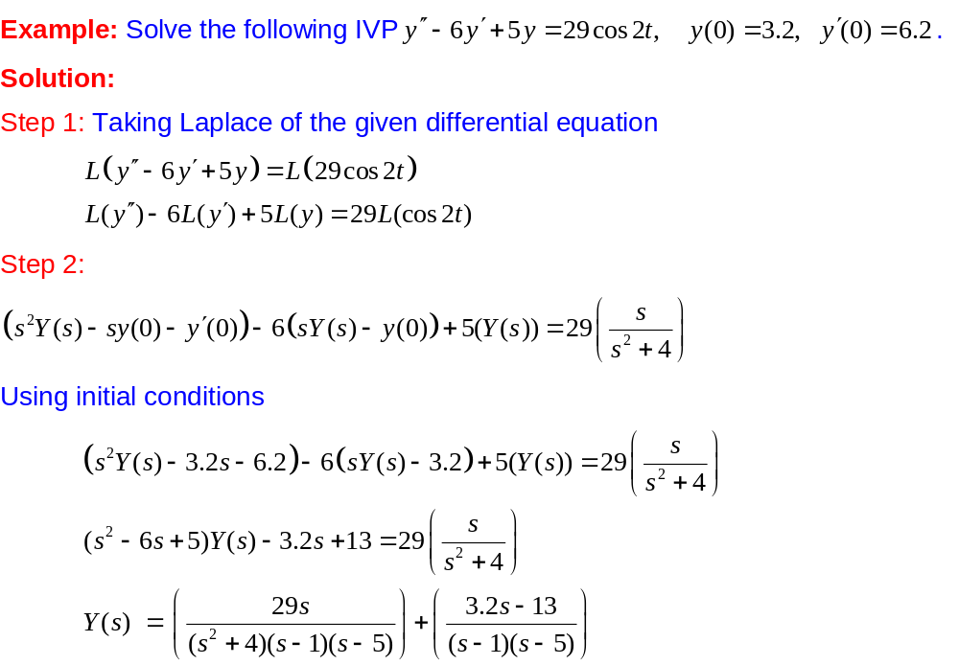

Solution of Initial Value Problems(Using Laplace Transform Method)

Slide 12
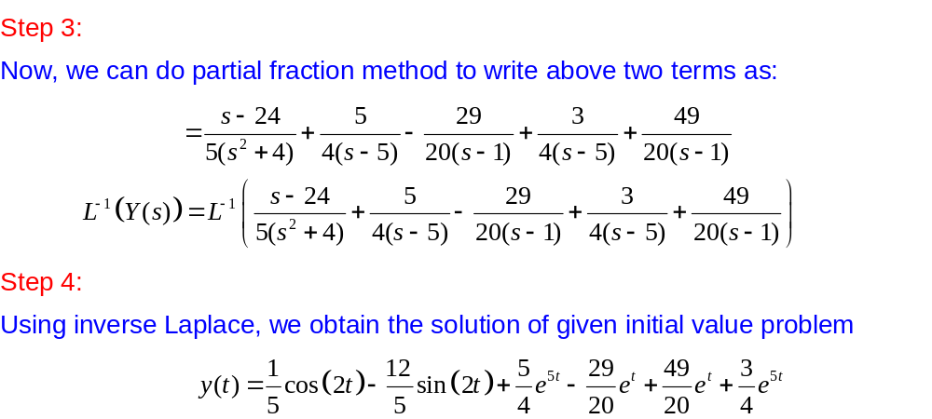
Solution of Initial Value Problems(Using Laplace Transform Method)

Slide 13
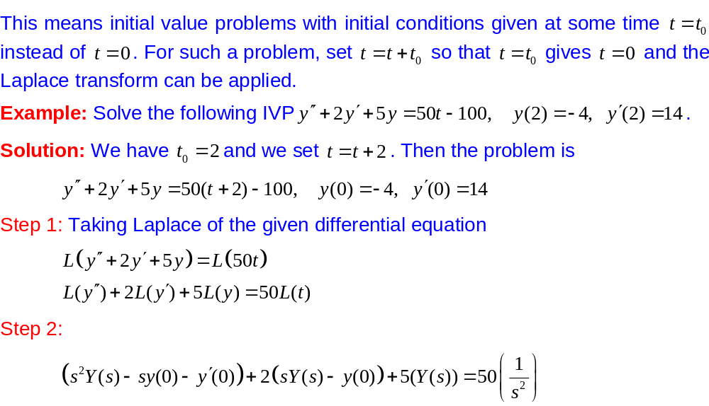

Solution of Shifted Data Problem(Using Laplace Transform Method)

Slide 14
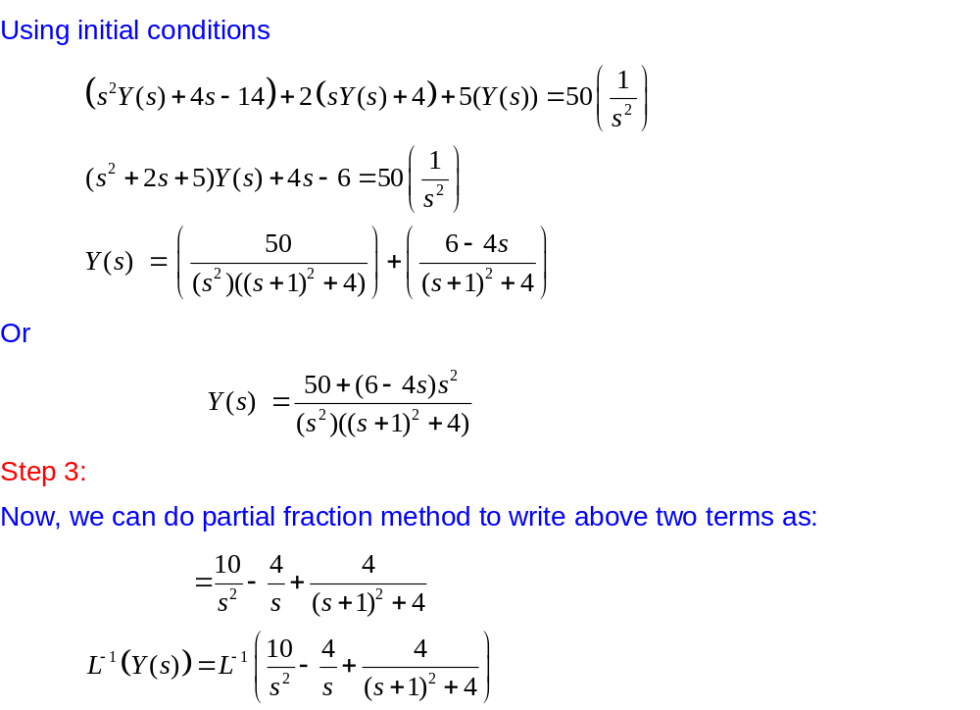
Solution of Shifted Data Problem(Using Laplace Transform Method)

Slide 15
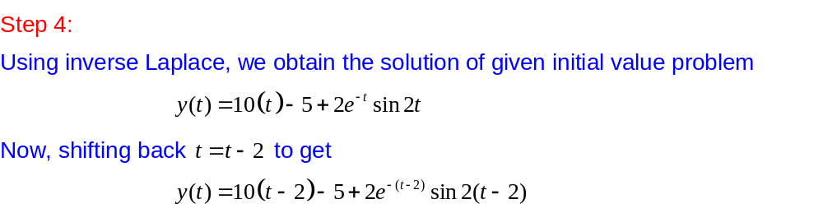
Solution of Shifted Data Problem(Using Laplace Transform Method)

Slide 16
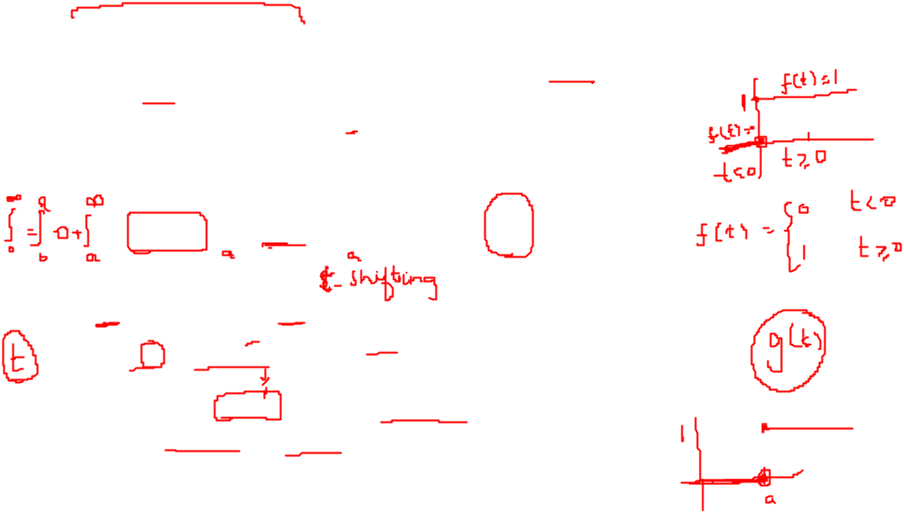
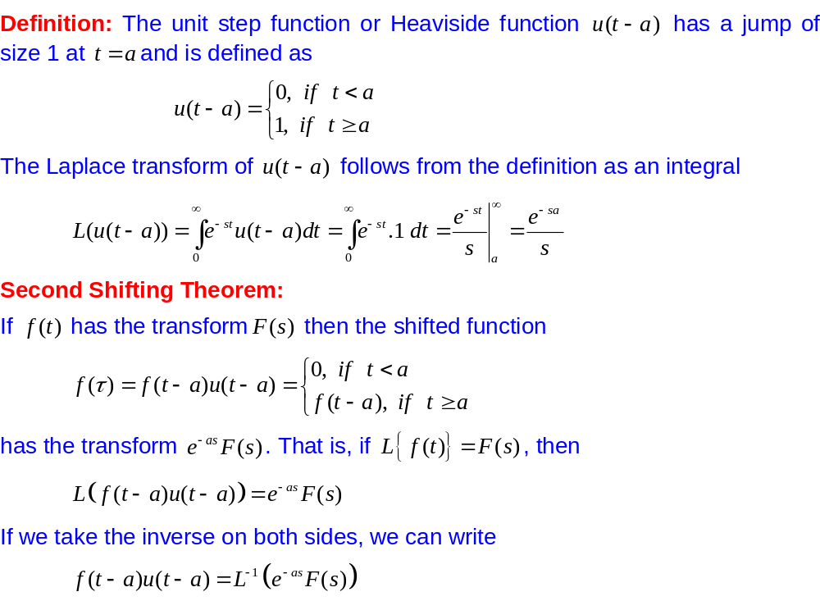
Unit Step Function (Heaviside Function)

Slide 17
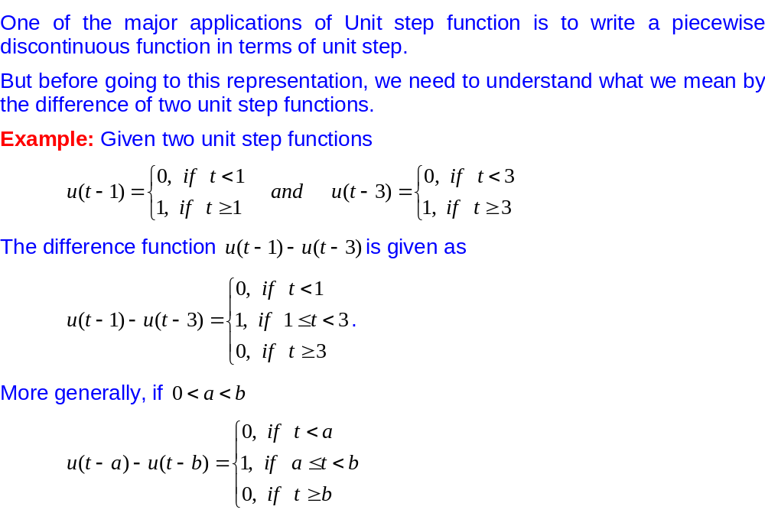
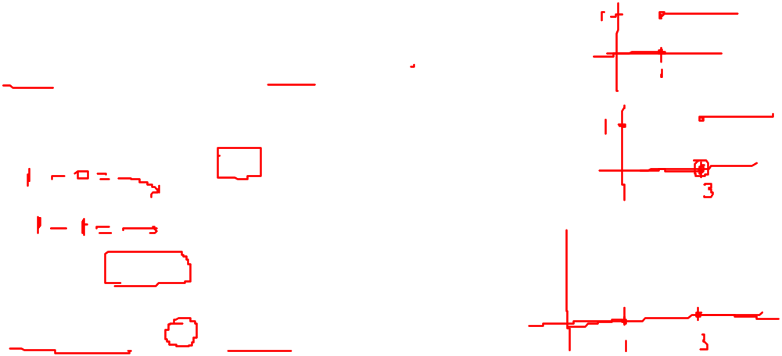
Representation of a function in terms of Unit Step Function

Slide 18
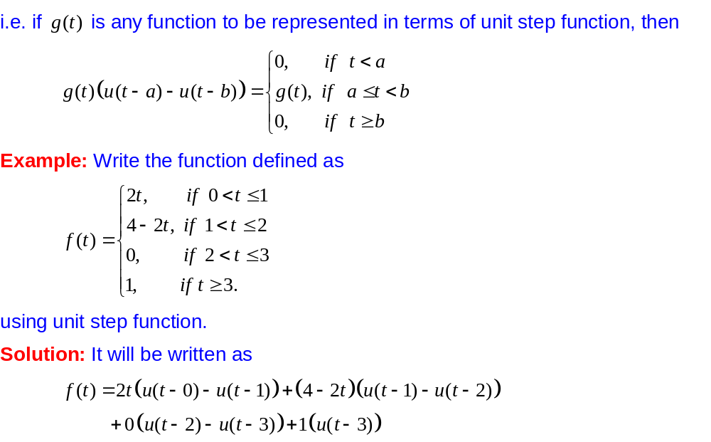
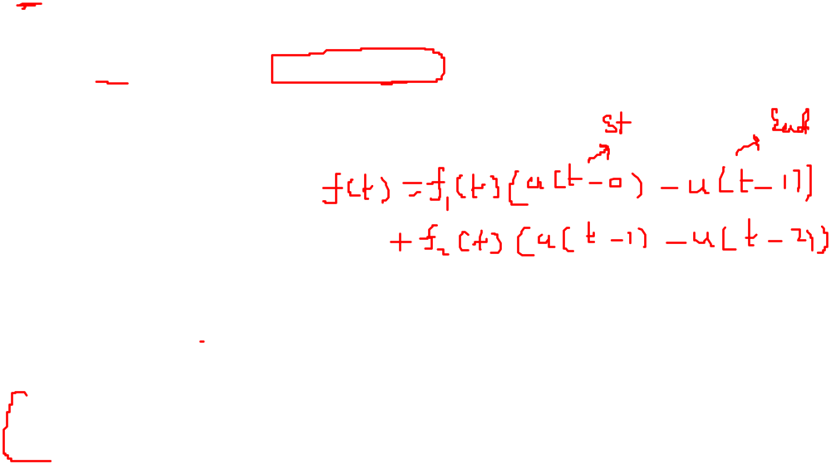
Representation of a function in terms of Unit Step Function

Slide 19
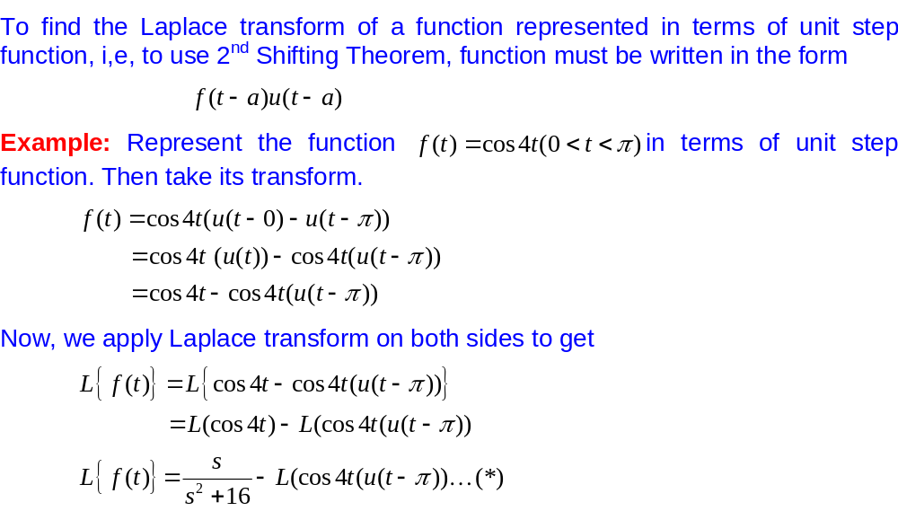
Laplace transform of a function
(represented in terms of Unit Step Function)

Slide 20
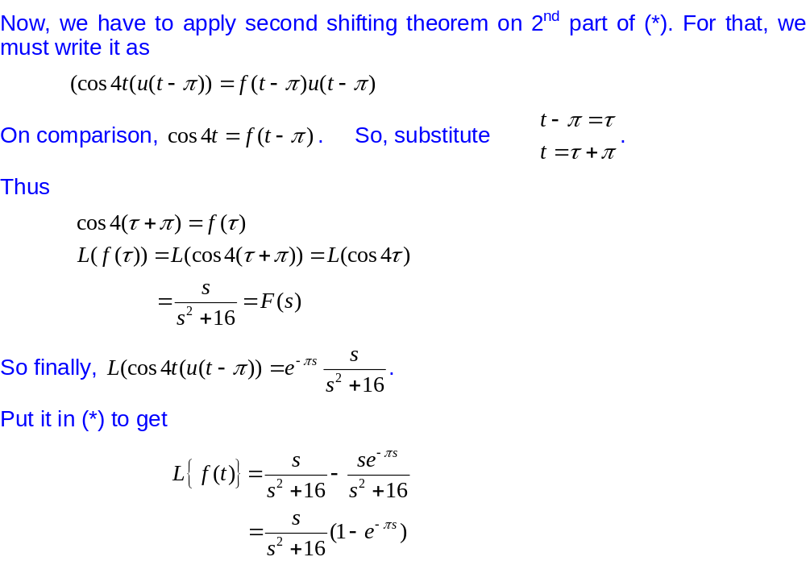
Laplace transform of a function
(represented in terms of Unit Step Function)

Slide 21
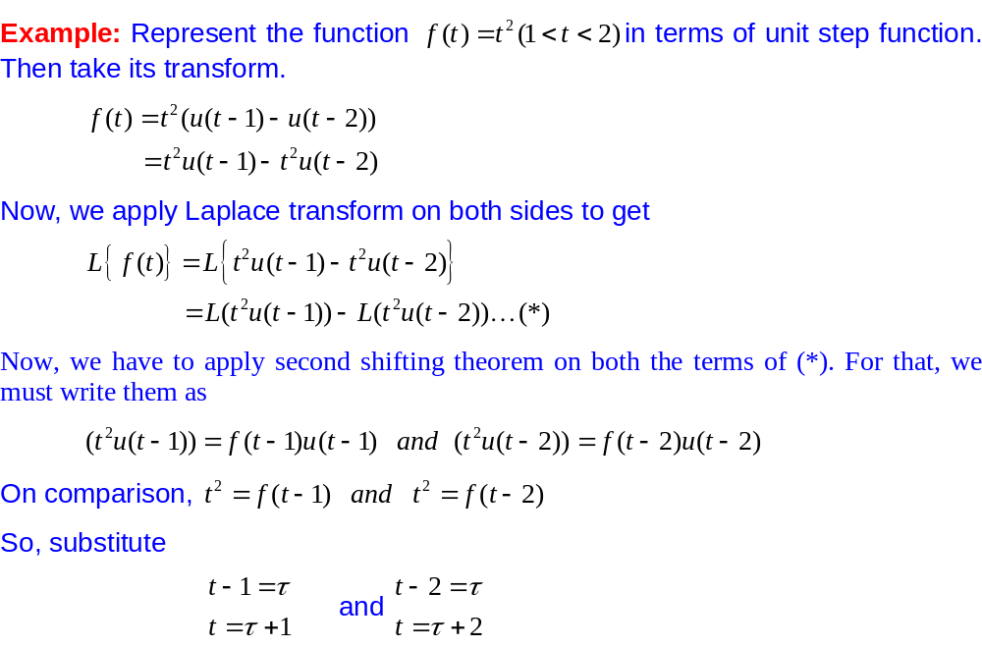
Laplace transform of a function
(represented in terms of Unit Step Function)

Slide 22
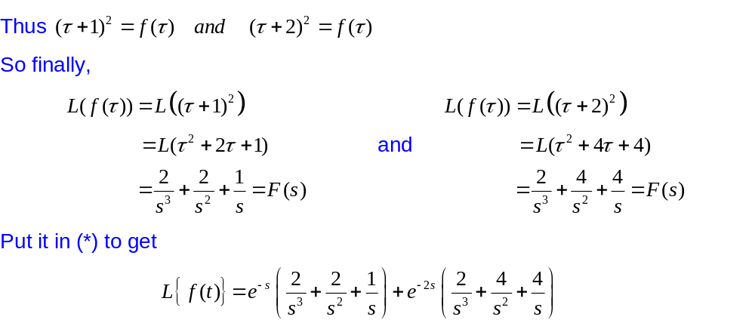
Laplace transform of a function
(represented in terms of Unit Step Function)

Slide 23
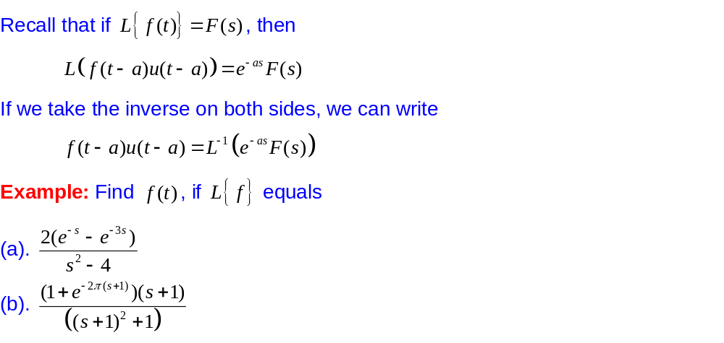
Inverse Laplace transform of a function
(Using 2nd Shifting Theorem)

Slide 24
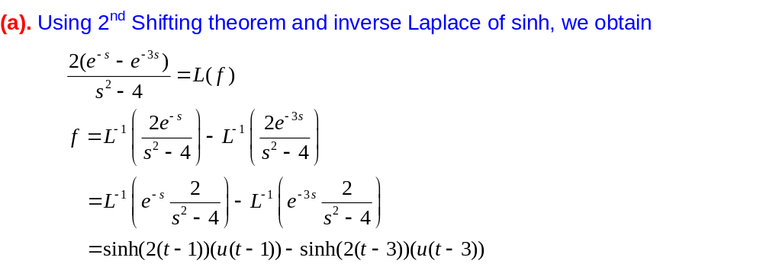
Inverse Laplace transform of a function
(Using 2nd Shifting Theorem)

Slide 25
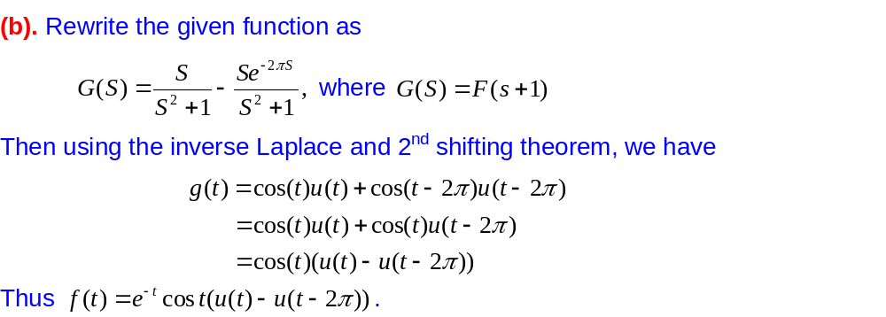
Inverse Laplace transform of a function
(Using 2nd Shifting Theorem)

Slide 26
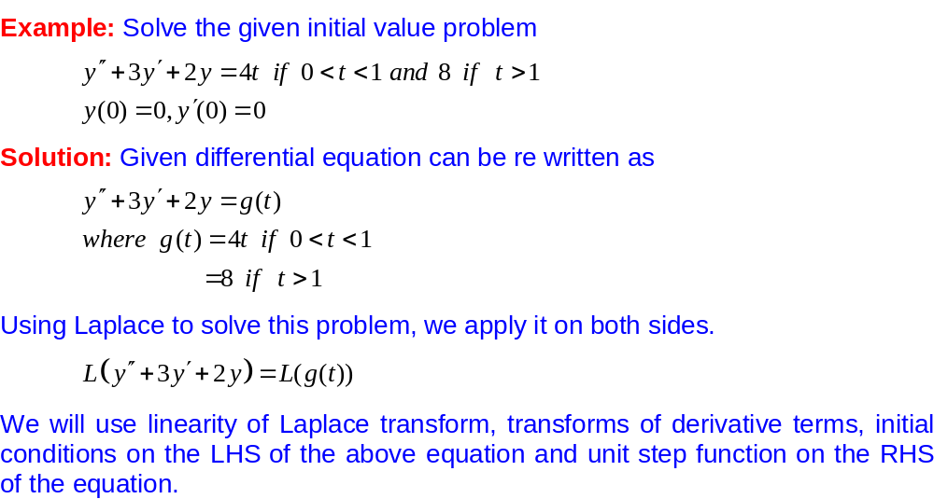
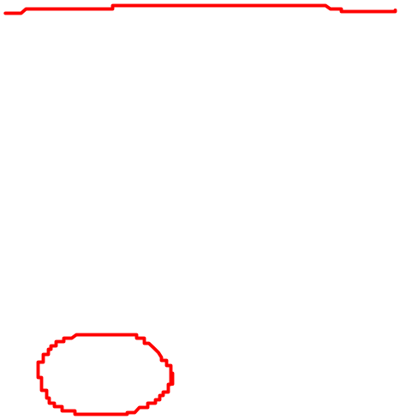
Initial Value Problems (with discontinuous input function)

Slide 27
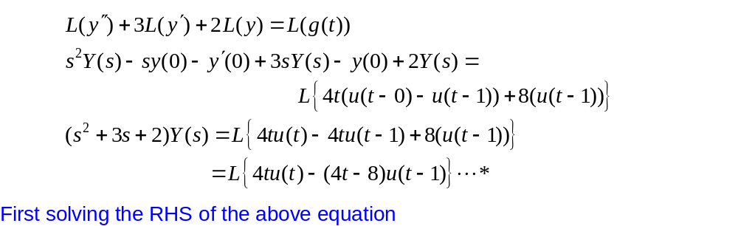
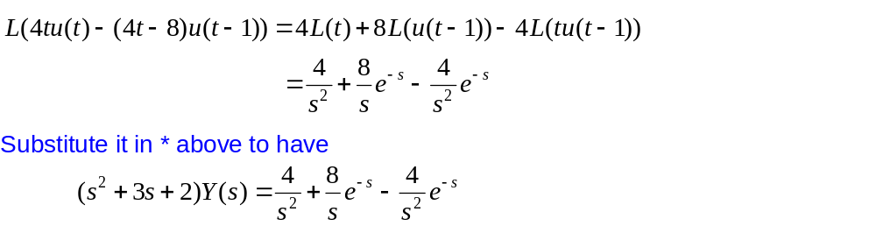
Initial Value Problems (with discontinuous input function)

Slide 28
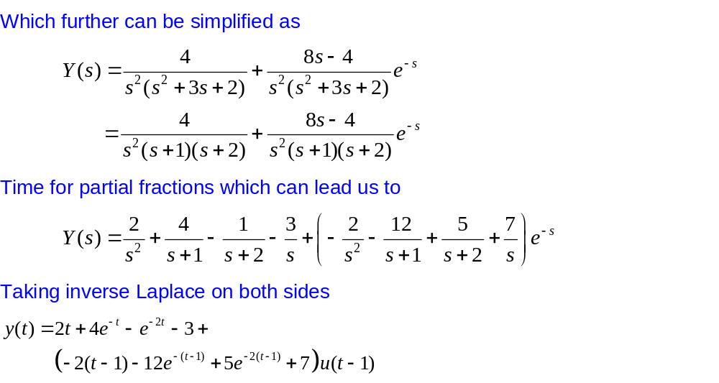
Initial Value Problems (with discontinuous input function)

