Slide 1

 | National University of Sciences & Technology (NUST) School of Electrical Engineering and Computer Science (SEECS) Department of Basic Sciences
Linear Algebra & Ordinary Differential Equations
MATH-121
Lecture # 5
Course Instructor: Dr Saira Zainab
Ph. # 03325193283
Email: saira.zainab@seecs.edu.pk
Office # 207, Faculty Block, SEECS
1

Slide 2
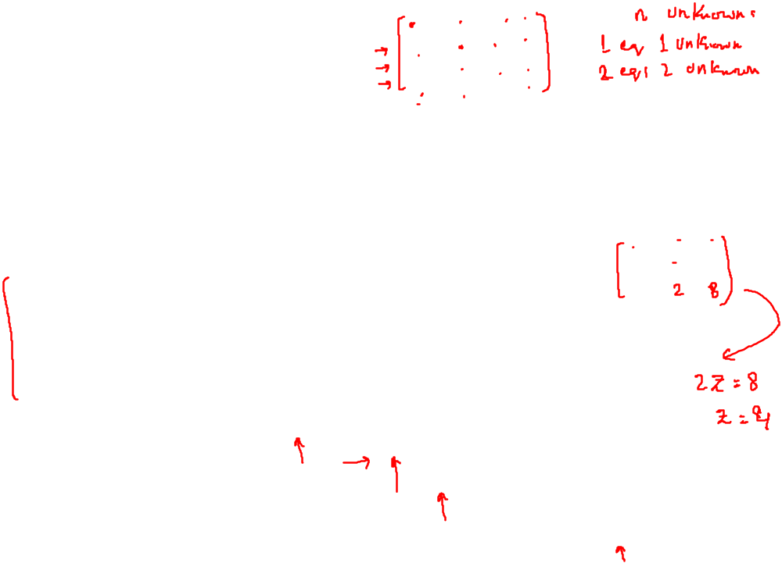
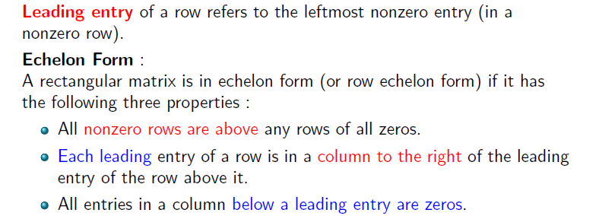
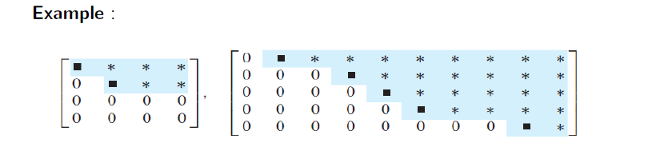
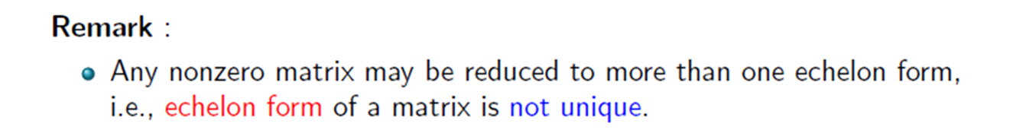
Row Echelon Form

Slide 3
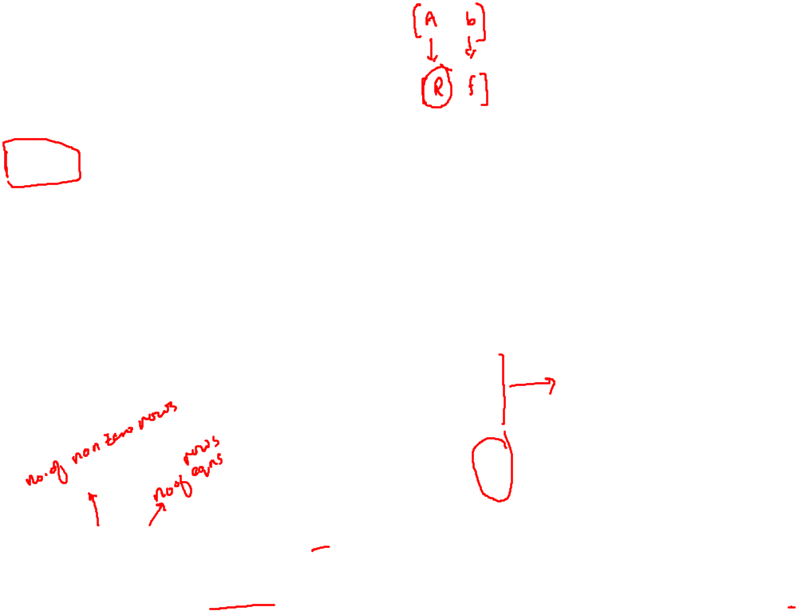
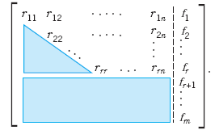
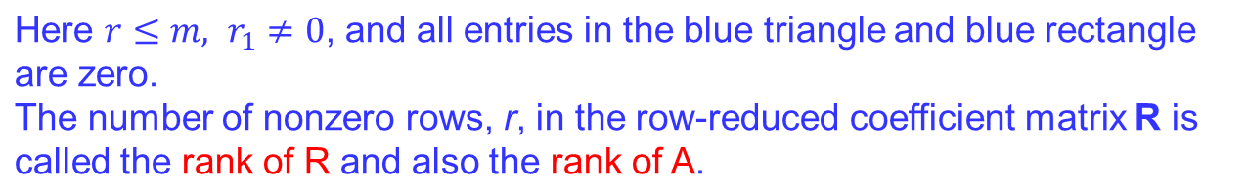
Row Echelon Form
The original system of m equations in n unknowns has augmented matrix
[A b] . This is to be row reduced to matrix [R f] . The two systems are equivalent.
If either one has a solution, so does the other, and the solutions are identical.
At the end of the Gauss elimination (before the back substitution), the row echelon form of the augmented matrix will be

Slide 4
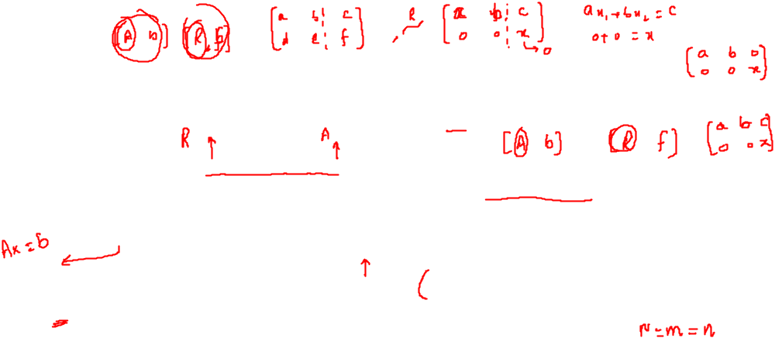
Existence and Uniqueness of Solution
Here is the method for determining whether Ax=b has solutions and what they are:
No solution. If r is less than m (meaning that R actually has at least one row of all 0s) and at least one of the numbers fr+1, fr+2,…, fm is not zero, then the system Rx=f is inconsistent: No solution is possible. Therefore the system is inconsistent as well.
If the system is consistent (either r = m or r < m and all the numbers
fr+1, fr+2,…, fm are zero), then there are solutions.
(b) Unique solution. If the system is consistent and r = n , there is exactly one solution, which can be found by back substitution.
(c) Infinitely many solutions. To obtain any of these solutions, choose values of xr+1, xr+2,…, xn arbitrarily. Then solve the rth equation for xr (in terms of those arbitrary values), then the (r-1)st equation for xr-1, and so on up the line.

Slide 5

Existence and Uniqueness of Solution
More precisely, A linear system of equations in n unknowns has a unique solution if the coefficient matrix and the augmented matrix have the same rank n, and infinitely many solutions if that common rank is less than n. The system has no solution if those two matrices have different ranks.

Slide 6
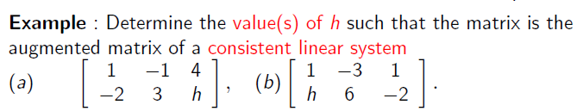
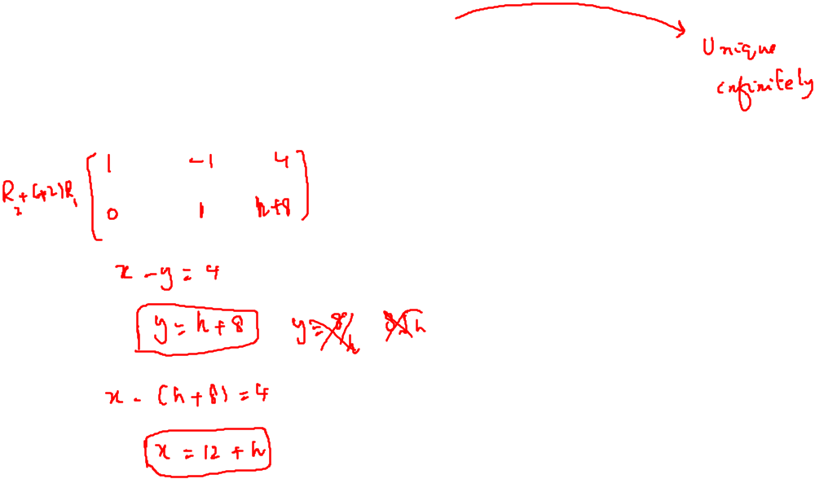
Practice Questions

Slide 7
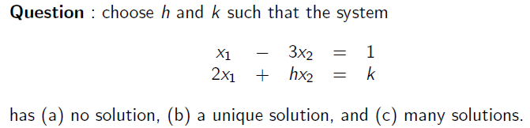
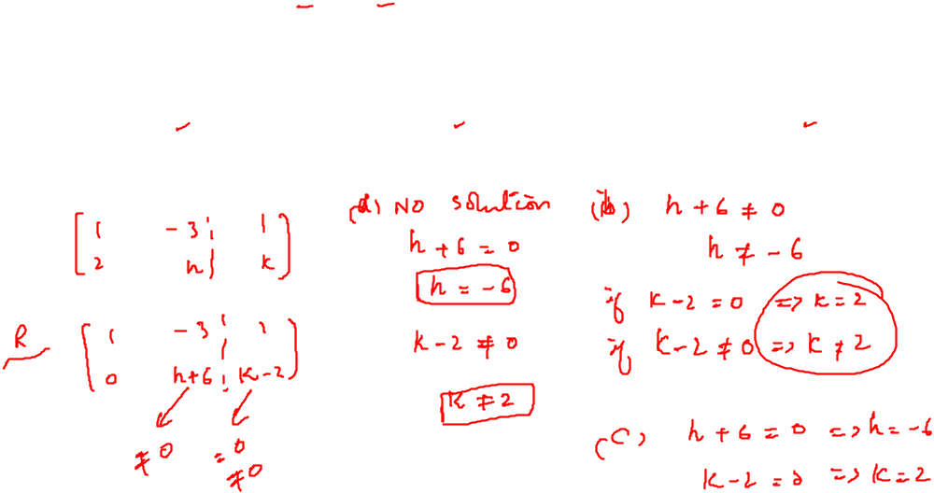
Practice Questions

Slide 8
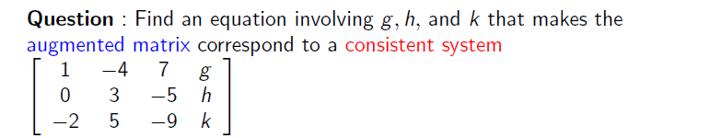
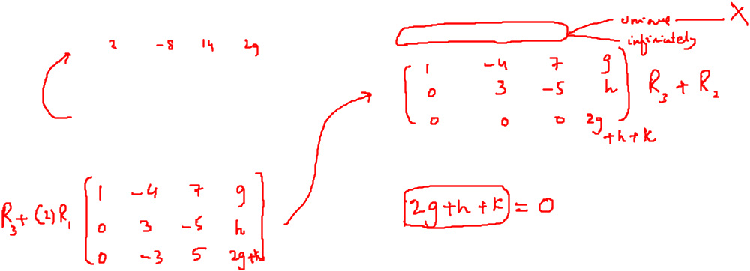
Practice Questions

Slide 9

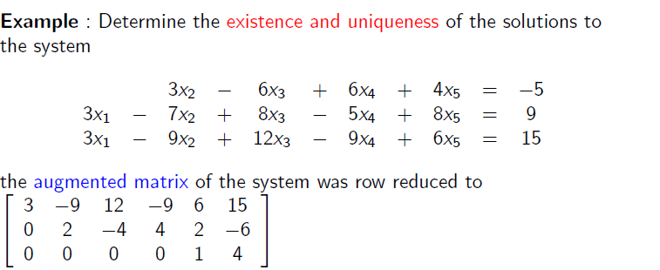
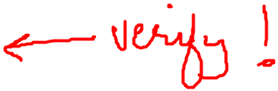

Slide 10
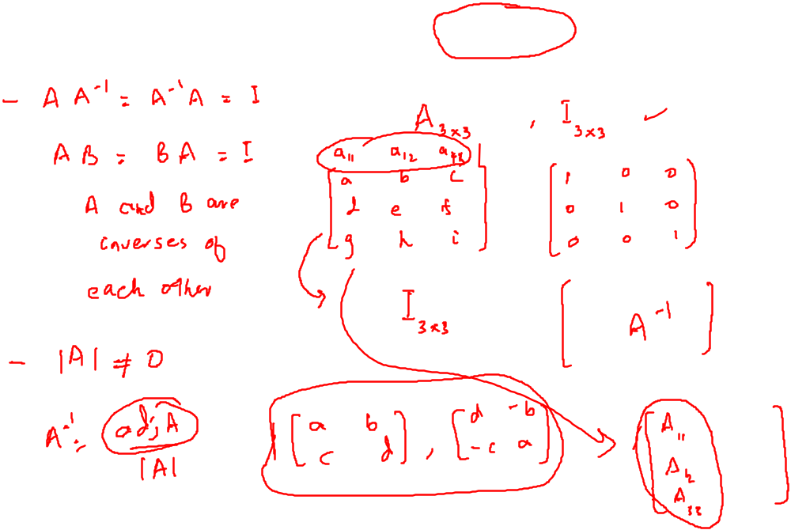
Determinant and Inverse of a Matrix

