Slide 1

 | National University of Sciences & Technology (NUST) School of Electrical Engineering and Computer Science (SEECS) Department of Basic Sciences
Linear Algebra & Ordinary Differential Equations
MATH-121
Lecture # 6
Course Instructor: Dr Saira Zainab
Ph. # 03325193283
Email: saira.zainab@seecs.edu.pk
Office # 207, Faculty Block, SEECS

Slide 2
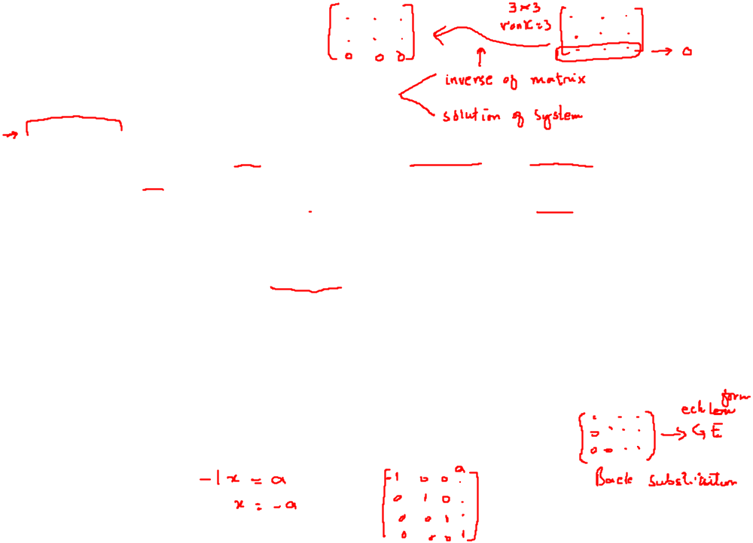


Inverse of a Matrix.
Gauss–Jordan Elimination
Existence of the Inverse
The inverse of an nxn matrix A exists if and only if rank A=n, that is if and only if .
Hence A is nonsingular if rank A=n and is singular if rank A n.
Gauss-Jordan method can be used to compute inverse of any square matrix by row operations additional to Gauss Elimination Method.
(This method is not recommended for solving the system of linear equations since the number of these operations is more than the steps involved in Back substitution used in Gauss Elimination Method.)
The process is illustrated through the following example.

Slide 3
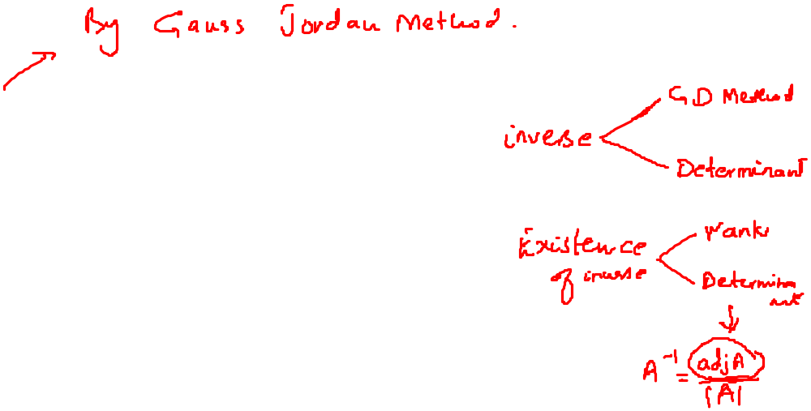

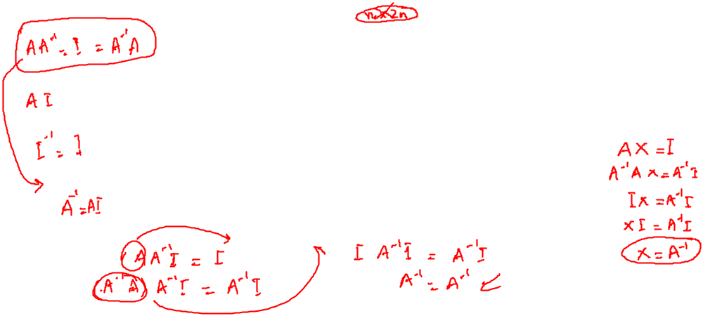
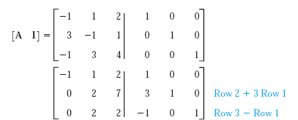
Example
Determine the inverse of
Applying the row operations

Slide 4

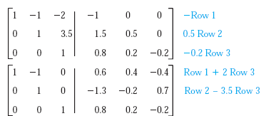
Cont.…

Slide 5

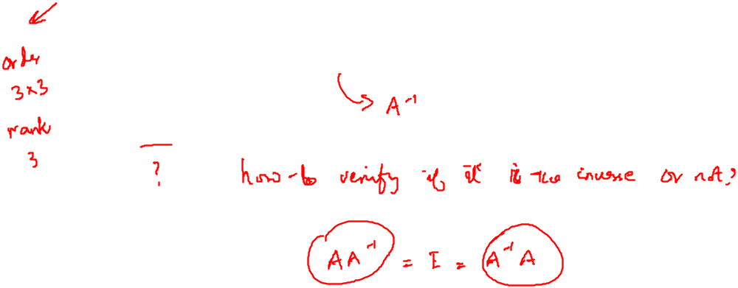
Cont.…
We can verify that the last three columns form the inverse of given matrix.

Slide 6

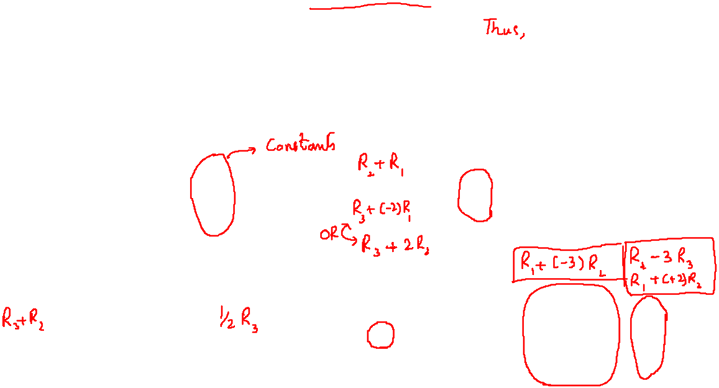
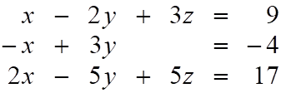
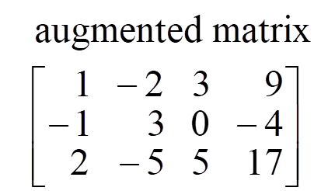
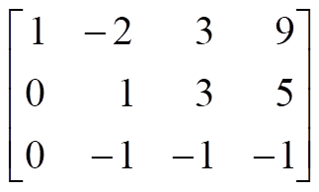
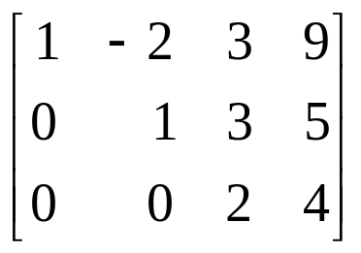
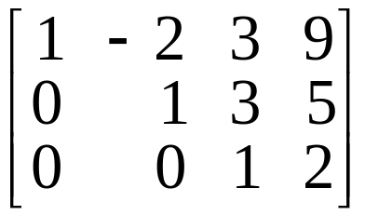
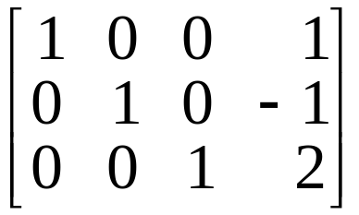
Example
Solve the following system by Gauss Jordan’s Method.

Slide 7
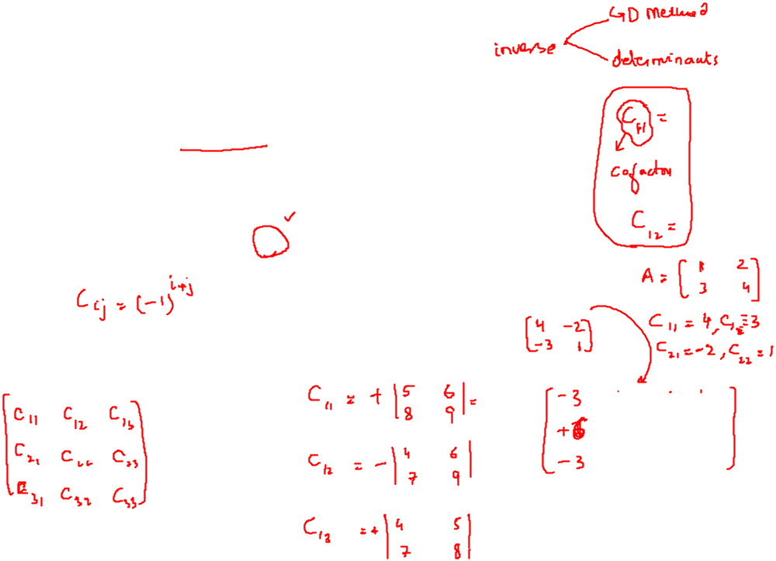
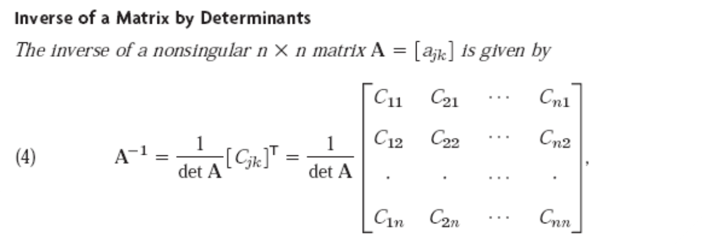

More about inverses
Example: Find the inverse of the following matrix

Slide 8
Example

