Slide 1

 | National University of Sciences & Technology (NUST) School of Electrical Engineering and Computer Science (SEECS) Department of Basic Sciences
Linear Algebra & Ordinary Differential Equations
MATH-121
Lecture # 8
Course Instructor: Dr Saira Zainab
Ph. # 03325193283
Email: saira.zainab@seecs.edu.pk
Office # 207, Faculty Block, SEECS
1

Slide 2
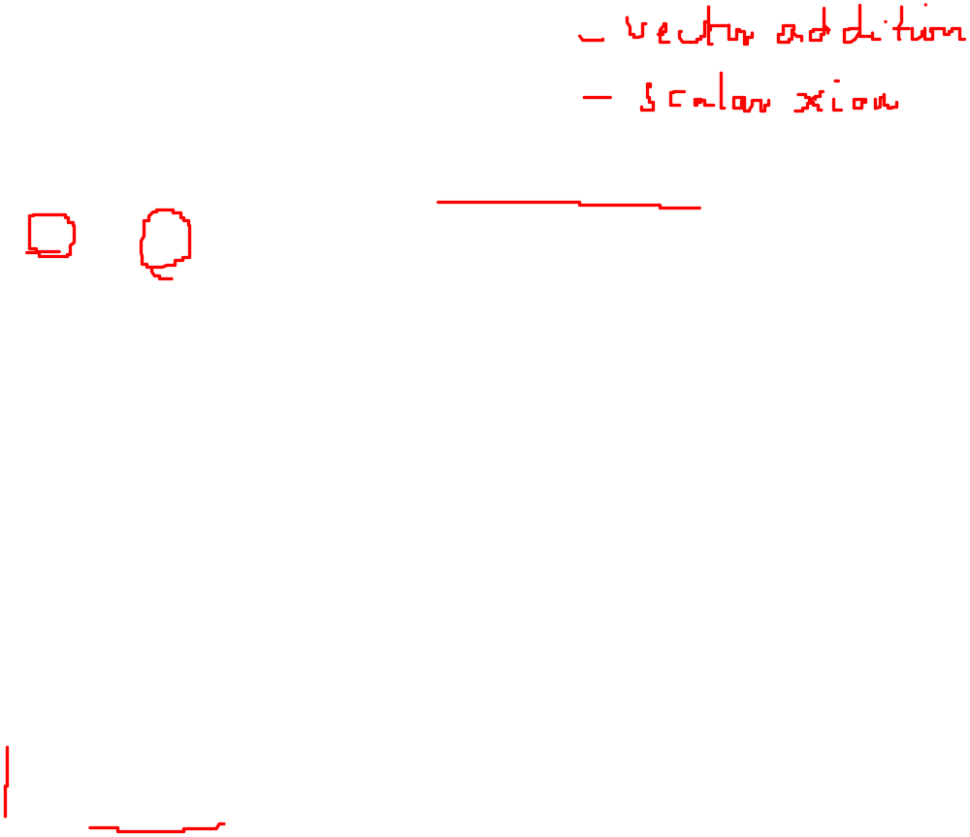


Vector Spaces
A real vector space is a set V of elements on which we have two operations
and defined with the following properties:
(a) If u and v are any elements in V. then u v is in V, (We say that V is closed under the operation )
(I) u v = v u forall u,v in V.
(2) u (v w) = (u v) w for all u, v, w in V.
(3) There exists an element 0 in V such that u 0 = 0 u = u for any u in V
(4) For each u in V there exists an element - u in V such that
u - u = - u u = 0.
(b) If u is any element in V and c is any real number, then c u is in V (i.e., V is closed under the operation ).
(5) C (u v) = c u c v for any u, v in V and any real number c.
(6) (c d) u = c u d u for any u in V and any real numbers f and
d.
(7) C (d u) = (cd) u for any u in V and any real numbers c and d.
(8) 1 u = u for any u in V.

Slide 3
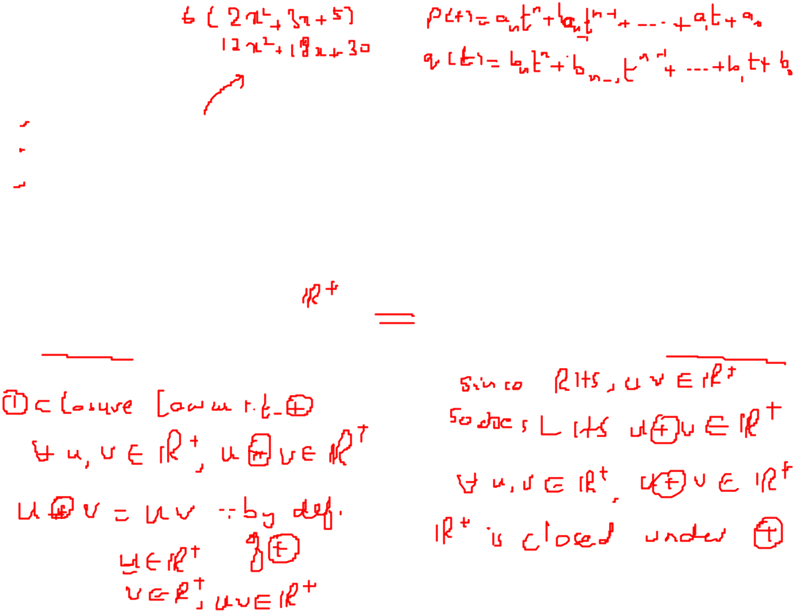


Examples
1.The set of nx1 of column matrices.
2.The set of all real numbers.
3.The set of all polynomials with defined addition and multiplication.
and
4. Let V be the set of all positive reals real numbers with the operations
u v = uv and c u = u^{c}. Is V a vector space? If it is not , which properties does it fail to satisfy?

Slide 4
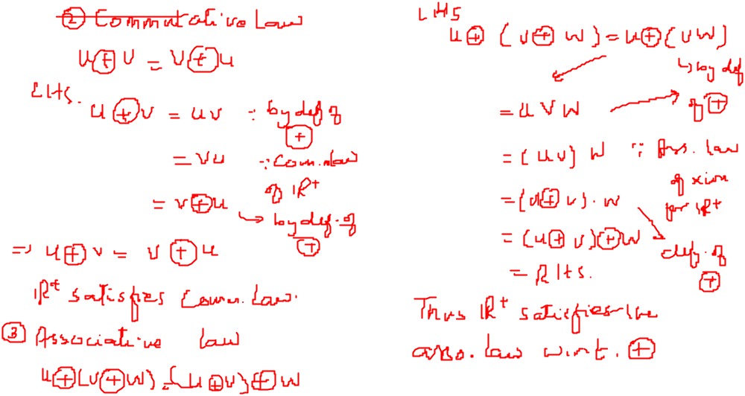
Examples

Slide 5
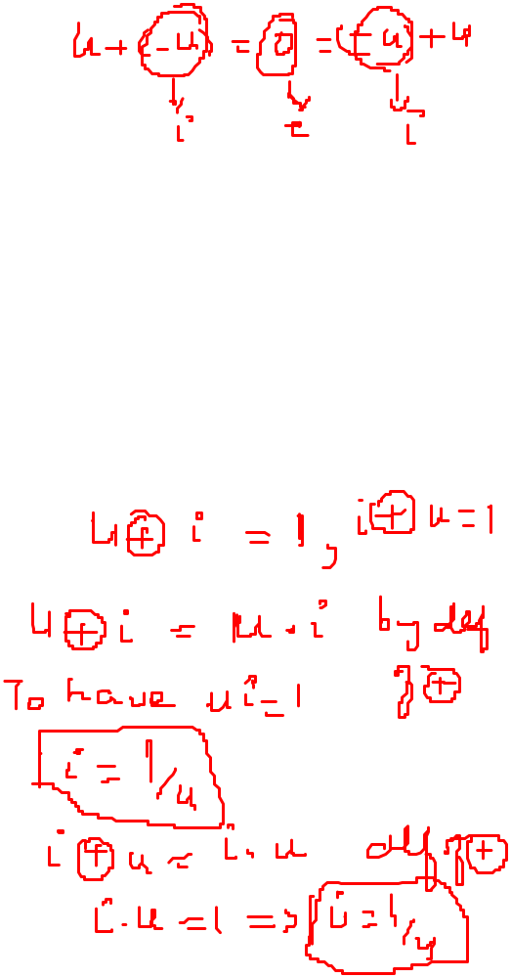
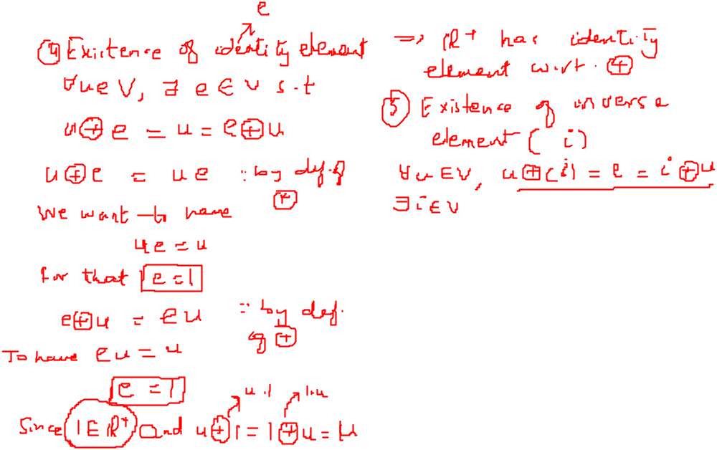
Examples

Slide 6
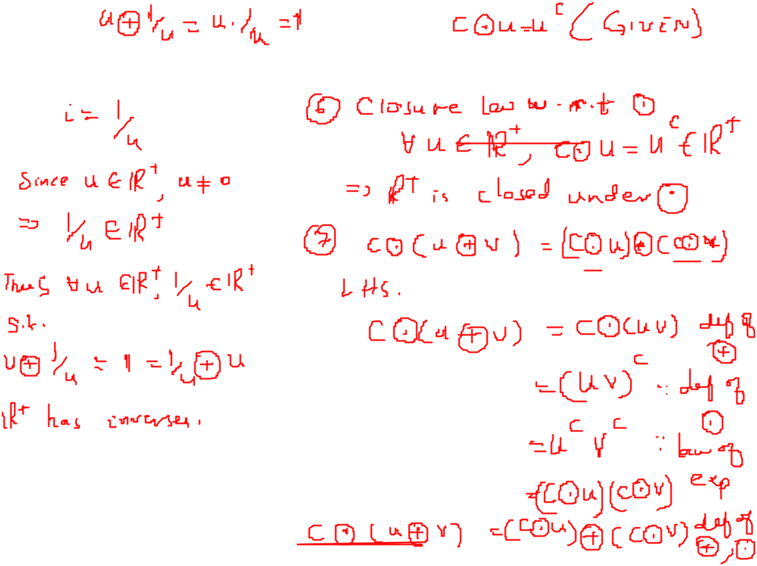
Examples

Slide 7
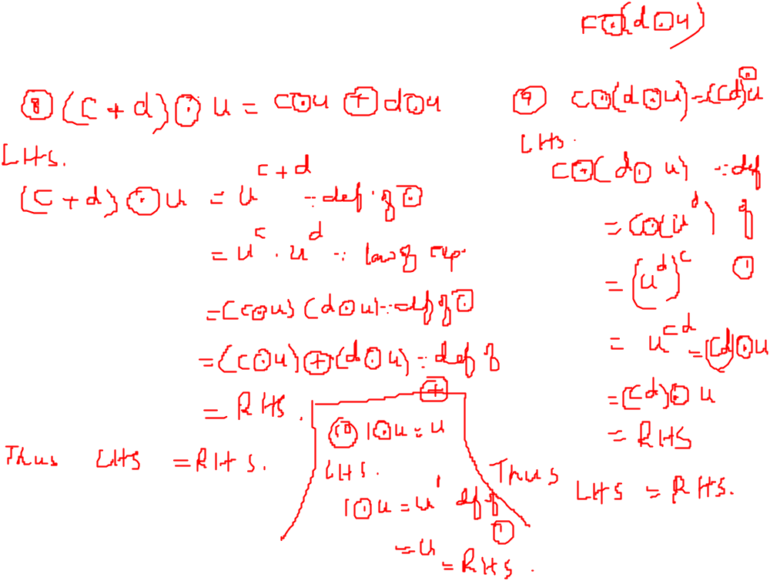
Examples

Slide 8


Examples
5. Let V be the set of all real numbers with the operations u v = u - v ( is
ordinary subtraction) and c u = cu ( is ordinary multiplication). Is V a vector space? If it is not , which properties does it fail to satisfy?

Slide 9

Examples
6. Check if the set of all ordered triples of real numbers with the operations
and
form a vector space or not.

Slide 10


Examples
7. Let V be the set of all positive real numbers.
Define by
u v=uv -1; and c v= v. ls V a vector space?

Slide 11
Important Result
Theorem If V is a vector space, then
(a) 0 u = 0 for any vector u in V.
(b) C 0 = 0 for any scalar c.
(c) If c u = 0, then either c = 0 or u = 0.
(d) (- I) u =-u for any vector u inV.

