Slide 1

 | National University of Sciences & Technology (NUST) School of Electrical Engineering and Computer Science (SEECS) Department of Basic Sciences
Linear Algebra & Ordinary Differential Equations
MATH-121
Lecture # 9
Course Instructor: Dr Saira Zainab
Ph. # 03325193283
Email: saira.zainab@seecs.edu.pk
Office # 207, Faculty Block, SEECS

Slide 2
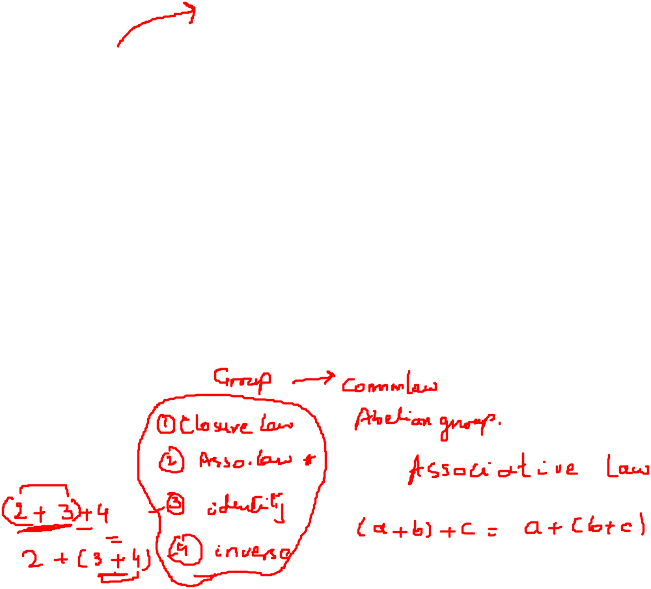


Examples
1.The set of nx1 of column matrices.
2.The set of all real numbers.
3.The set of all polynomials with defined addition and multiplication.
and
4. Let V be the set of all positive reals real numbers with the operations
u v = uv and c u = u^{c}. Is V a vector space? If it is not , which properties does it fail to satisfy?

Slide 3
Examples

Slide 4
Examples

Slide 5
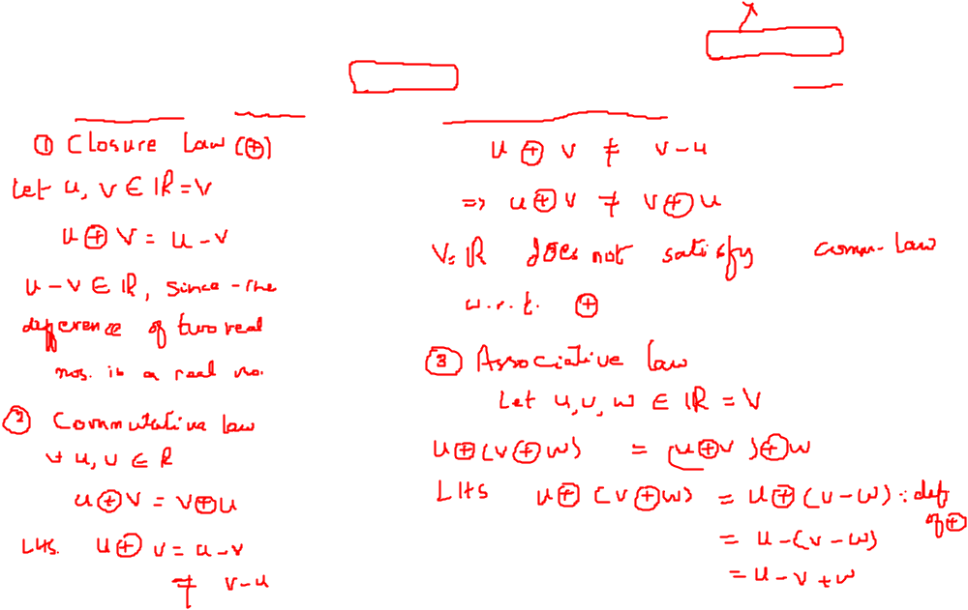


Examples
5. Let V be the set of all real numbers with the operations u v = u - v ( is
ordinary subtraction) and c u = cu ( is ordinary multiplication). Is V a vector space? If it is not , which properties does it fail to satisfy?

Slide 6
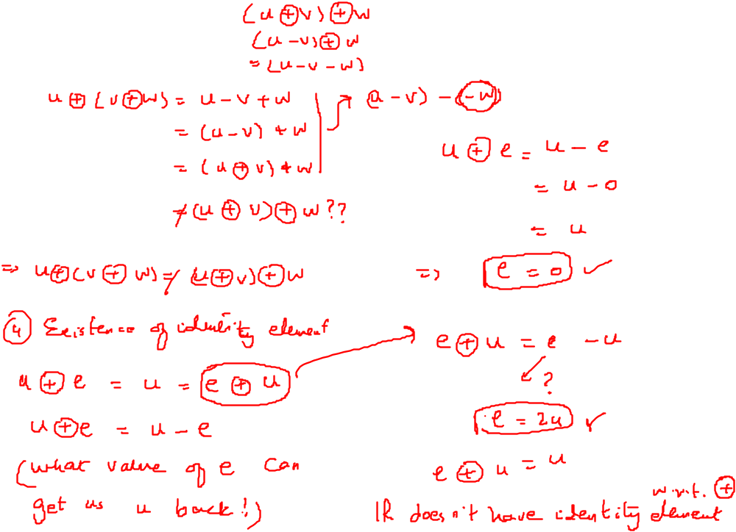
Examples

Slide 7
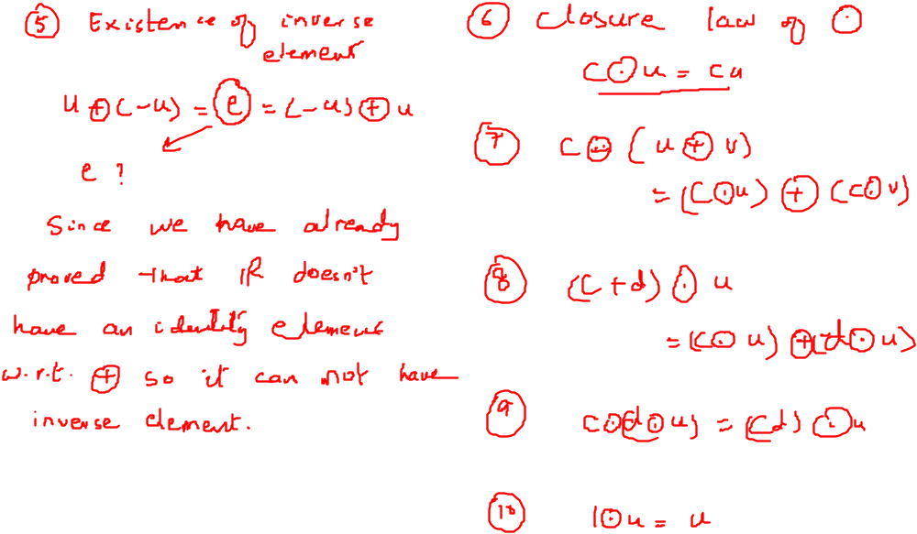
Examples

Slide 8
Examples

Slide 9
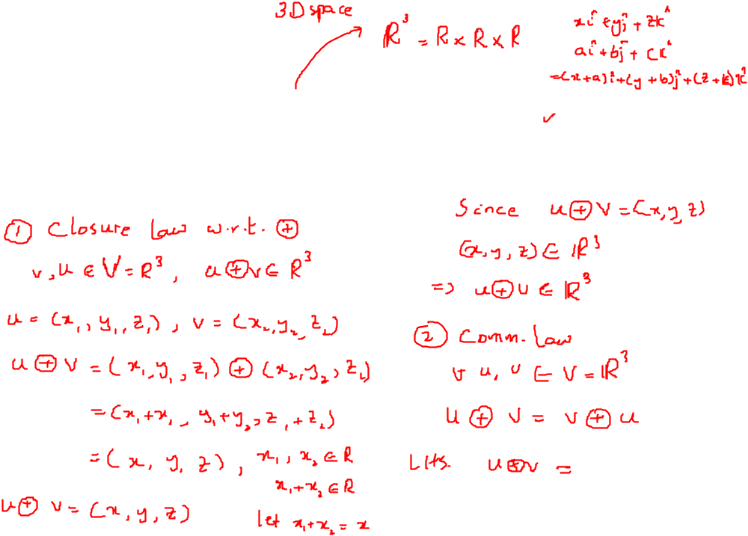

Examples
6. Check if the set of all ordered triples of real numbers with the operations
and
form a vector space or not.

Slide 10
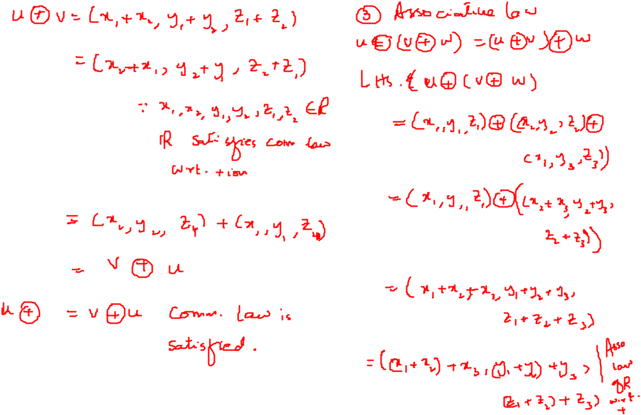
Examples

Slide 11
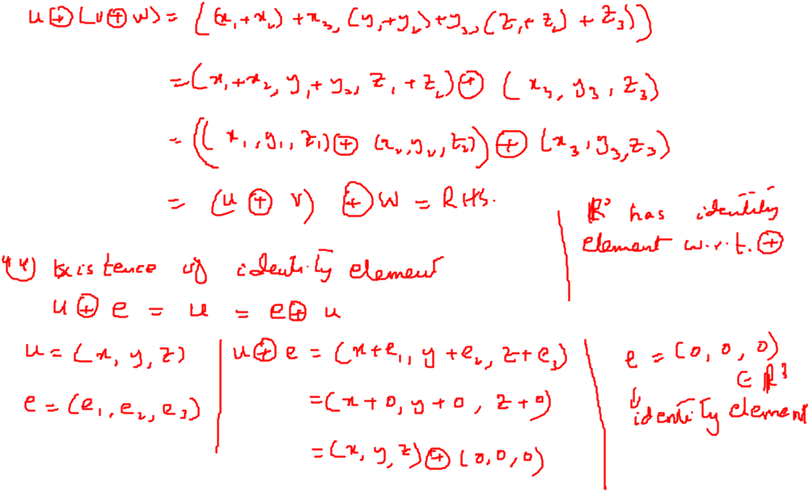
Examples

Slide 12
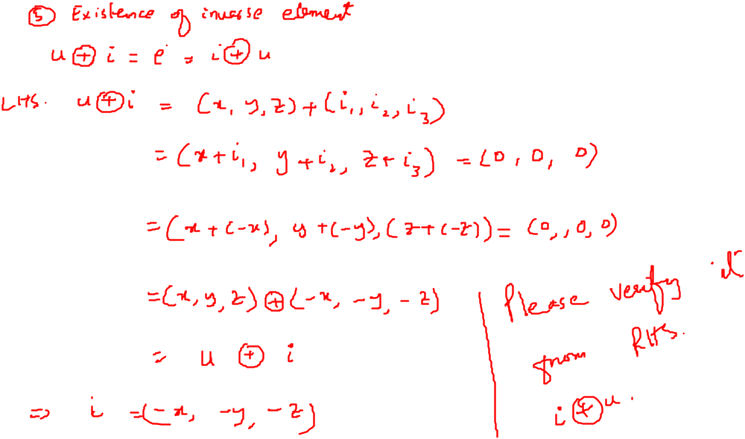
Examples

Slide 13
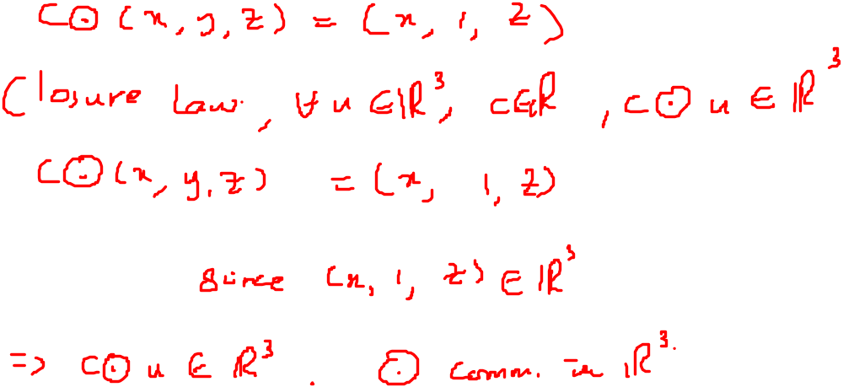
Examples

Slide 14


Examples
7. Let V be the set of all positive real numbers.
Define by
u v=uv -1; and c v= v. ls V a vector space?

Slide 15
Examples

Slide 16
Examples

Slide 17
Examples

Slide 18
Examples

Slide 19
Important Result
Theorem If V is a vector space, then
(a) 0 u = 0 for any vector u in V.
(b) C 0 = 0 for any scalar c.
(c) If c u = 0, then either c = 0 or u = 0.
(d) (- I) u =-u for any vector u inV.

Slide 20
Subspace
Definition
Let V be a vector space and W a nonempty subset of V. If W is a vector space with respect to the operations in V, then W is called a subspace of V.
Theorem
Let V be a vector space with operations and and let W be a nonempty subset of V. Then W is a subspace of V if and only if the following conditions hold:
(a) If u and v are any vectors in W, then u v is in W.
(b) If c is any real number and u is any vector in W. then c u is in W.
Example
Every vector space has at least two subspaces, itself and the subspace {0} consisting only of the zero vector. (Recall that 0 0 = 0 and c 0 = 0 in any vector space.) Thus {0} is closed for both operations and hence is a subspace of V. The subspace {0} is called the zero subspace of V.

