Slide 1
Educational System of Pakistan
A Critical analysis
Presented by
Danial Ahmed
Muhammad Ahmed Mohsin
Muhammad Umer
Saad Bakhtiar
Tariq Umar

Slide 2
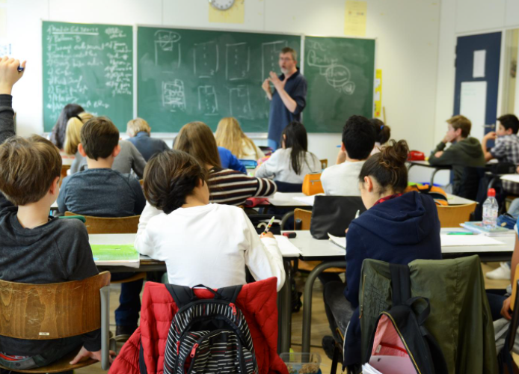
Introduction
Definition
The term “Education”, as defined by John Dewey, is “a form of learning in which knowledge, skills, and habits of a group of people are transferred from one generation to the next through teaching, training, research, or simply through auto didacticism” (Democracy and Education, 1916).
A Powerful Tool
It is the driving force behind the prosperity of any nation. It gives rise to a sense of duty and responsibility among the people.
It is a stretch to say that in the modern times, education is one of the most powerful weapons for a nation to be independent, zealous and sovereign.

Slide 3
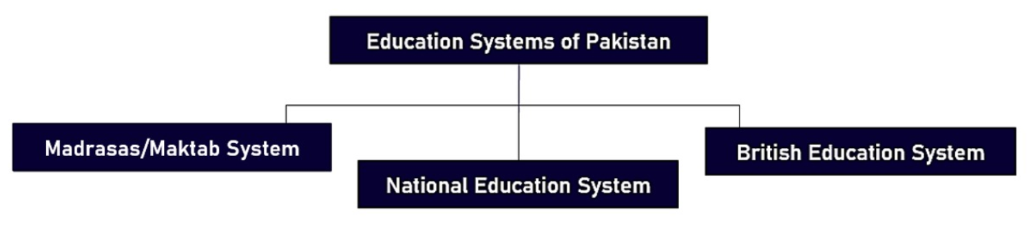
Infrastructure of Pakistan’s Educational System
Three education systems are currently observed in Pakistan:
The curriculum in each of these system is extremely divisive which gives a significant rise to sectarianism and is a major hindrance in the formation of a productive and fraternal society.

Slide 4
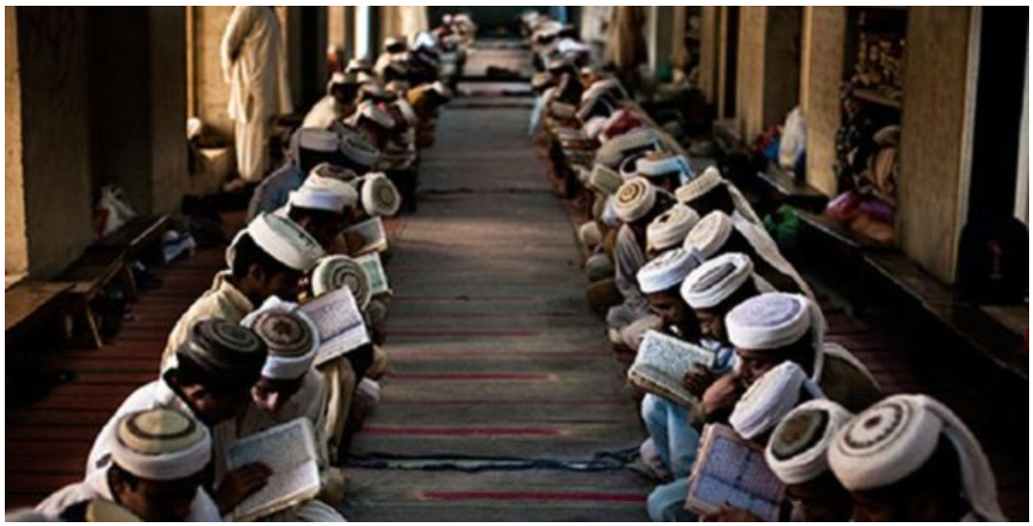
Infrastructure of Pakistan’s Educational System
Madrasa
Madrasas offer higher education along with elementary education. Both religious and secular sciences are taught such as Maths, Medicine, Philosophy, Tafsir, Hadiths, Mantiq, Fiqh and History.
Maktab
These are elementary school of children. In Pakistan, mostly in the rural areas, children from the age of 5 to 14 years are sent to Maktabs to learn Nazra, Tafsir, Hifz, and Tajwid O Qaryat.
Opportunities for Madrasas Students
Narrow career opportunities, mostly in teaching at madrasas or being imam of mosque.
Graduates do not have the knowledge or skills for mainstream job.
Present government trying to restructure curriculum, so madrasas students are well educated.

Slide 5
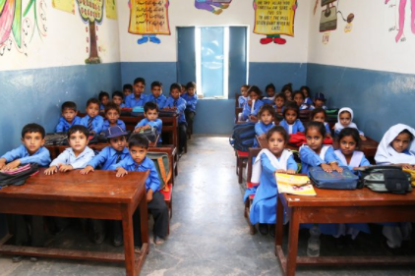
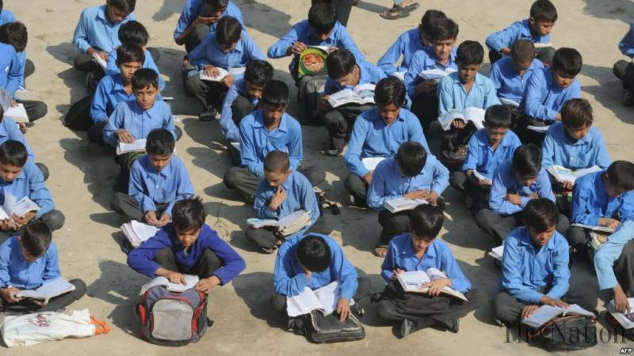
Infrastructure of Pakistan’s Educational System
National Education System
The Constitution of Pakistan compels the state to provide free education to its citizens of age 5 to 16 under Article 25-A.
The education system in Pakistan is divided into six levels:
Kindergarten (for the age of 3 to 5 years)
Primary (1st to 5th)
Middle school (6th to 8th grade)
Matriculation/SSC (9th and 10th grade) (BISE)
Intermediate/HSSC (11th and 12th grade) (BISE)
Disparities
A lot of different boards having differences in their curriculum.
In some boards, courses are thought in English while other areas have Urdu as a medium for teaching.
Difference of Private and Government education system.
Old Curriculum
The overall curriculum is over 20 years old!
Memorizing and rota-based system, with very minimal practicality.
Students are trained, not taught!

Slide 6

Infrastructure of Pakistan’s Educational System
O/A Levels
O-Level (Ordinary Level) & A-Level (Advanced Level) is the British Education system following Cambridge syllabus, introduced in Pakistan in 1959.
In Pakistan 335 such institution are recognized by the British Council.
Advantages over National System
Focuses on developing interests and concepts
Better performance in undergrad studies
Disadvantages
Only elites can afford it due to the extraordinary fees
O/A Level have a higher difficulty level with less national value

Slide 7
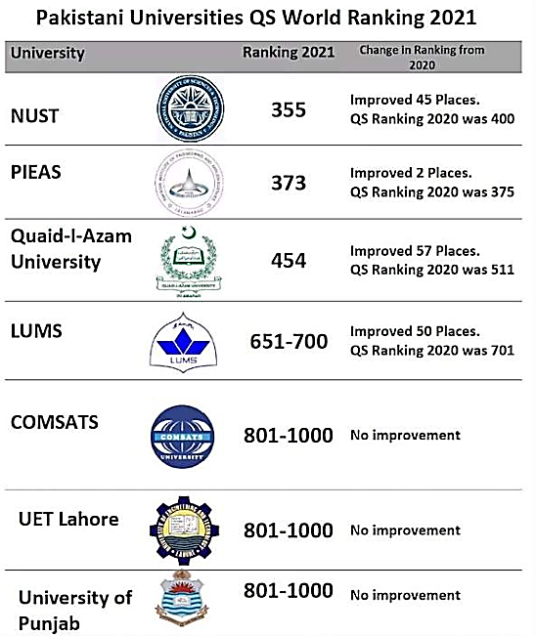
Infrastructure of Pakistan’s Educational System
Higher Education
Higher Education Commission (HEC) manages UG and PG programs in Universities. It provide funds, research projects etc.
174 Universities are registered with HEC.
Global Rankings
10 Pakistani universities ranked in Top 350 in QS Ranking: Asia in 2016.
As for 2021, 7 Universities of Pakistan are ranked in Top 1000 in the QS World University Rankings.
Overall, the conditions of Higher Education are far more satisfactory than the National Education System.

Slide 8
Educational Policies
National Education Policy of 1959
Education compulsory till age of 10
National Education Policy of 1970
Encouraged decentralization of the education administration
National Education Policy of 1972
Encouraging the ideology of Pakistan
National Education Policy of 1979
Curriculum revision, merging the traditional education and religious education (madrassas)
National Education Policy of 1992
Encouragement of Islamic teachings through education
National Education Policy from (1998 – 2010)
Islamic practices and Quranic principles should important part of the education system
National Education Policy from (2010 – Present)
Establishment of fifty new private sector universities; to establish fifteen new public science and technological universities
Moreover, the HEC came into being in 2002 and has implemented multiple projects and overlooked higher education sector of Pakistan

Slide 9
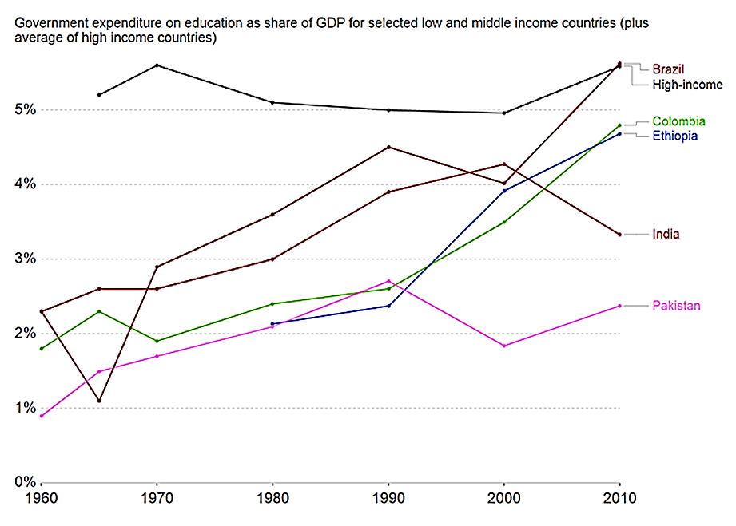
Educational Policies
Hindrances in Implementation of Policies
Economic constraints
Preferring Private Schools
Low political Will
Budget Allocation Problem
The data shows that as education isn’t given as much attention to as other countries do, as Pakistan spends comparatively less on the education department in terms of GDP (2.3%)
In comparison with other countries like Brazil (5.72%), India (3.39%), Colombia (4.79%), Ethiopia (4.56%).
Whereas, the mean expenditure on educational sector by the first world countries is 5.7%.

Slide 10
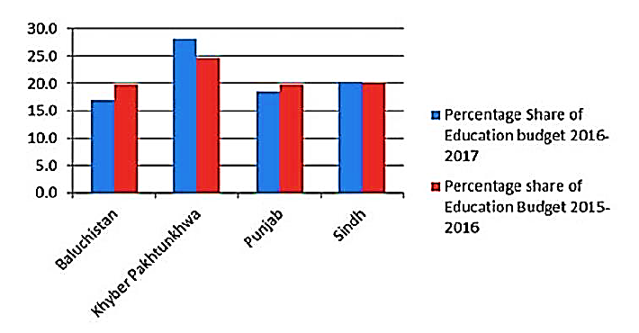
Contemporary Problems
Insufficient Budgetary Allocation
Low Budget Allocation
Successive governments have given less than 2.5 percent budget to the education sector of Pakistan. Although, in the recent years, the allocated budget has shown an imperceptible rise
Less Expenditure
During the 1950s and the 1960s, the actual expenditure on primary education was less than fifty percent for of the amount committed, because of the poor utilization capacity of the State.
The targets of four percent GDP set in 1992, 1998, and 2006 are yet to be achieved because educational ministers often made unrealistic claims to increase their publicity.
UNESCO Report
A report published by UNESCO shows that inadequate financial support has been provided to the education institution of Pakistan. The spending of GDP on public sector is less than 2 percent for the past twenty-years..
Source: ITACEC

Slide 11
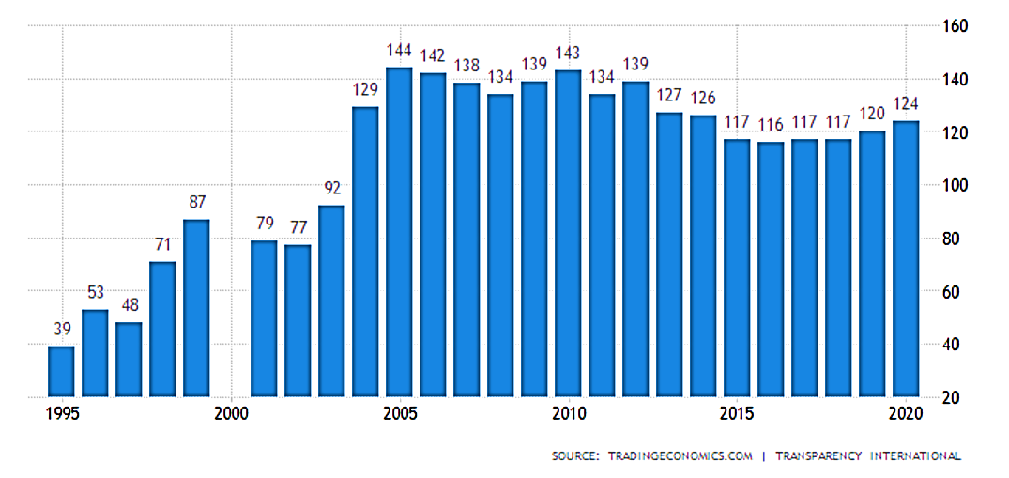
Contemporary Problems
Corruption
Ghost Schools and Faculty
A high number of salaries are being paid to ghost teachers and institutions. On paper, such funds are being supplied to the educational sector but in reality, they do not even exist.
Appointment of Chancellors and Vice Chancellors
The Vice-Chancellors and Chancellors of education institutions are elected on the bases of their affliction towards the ruling party
Internal Influence
Nepotism in matters of promotion, transfer etc. has hollowed the administrative structure of Pakistan.
Corruption Rank of Pakistan from 1995 – 2020
Source: Transparency International

Slide 12
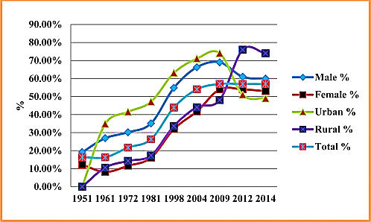
Contemporary Problems
Literacy Rate
Standard
The standard for the being a literate is person is that the person should be able to understand a simple text from a newspaper of any language, be able to write a simple letter and perform basic mathematical calculations.
Population and Illiteracy
Pakistan has the second highest number of children as compared to any other country of the world i.e. (22.8 million). Only a meagre amount of 6 percent of this population schools after 12 years.
Low literacy rate among the youth is due to poverty, child labor and unavailability of schools and colleges in rural areas.
Source: UNESCO

Slide 13
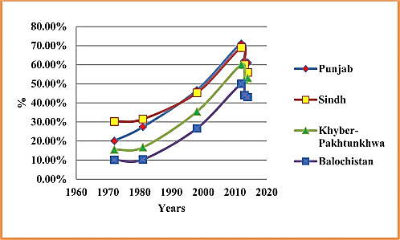
Contemporary Problems
Literacy Rate
Disparity Among Different Regions
Due to poverty and lack of facilities in these areas there are not many schools built in rural areas and thus causing a very low literacy rate in rural areas.
Moreover, coming to the cities and provinces Islamabad and Karachi are close to 75% literacy rate whereas the province of Baluchistan and the so called “tribal regions” are as low as 7% in Pakistan.
Causes
Unavailability Of Schools In Rural Areas
Child Labour
Poverty
Source: UNESCO

Slide 14
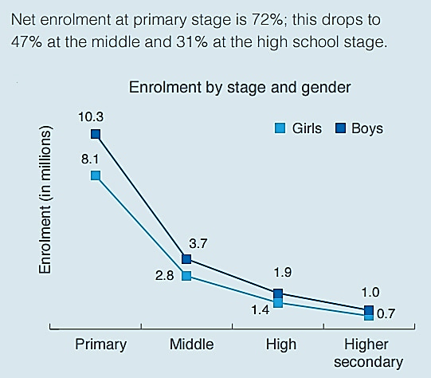
Root Problems
Root problems in Pakistan’s educational system are those which give rise to and influence further long-term problems.
Stressful Studies & Enrolment Rates
East Asian households, in general, are extremely strict on children when it comes to their education.
This tendency gets further worse in Pakistan especially due to appalling environments within schools.
Child Labour
Part of the reason why enrolment rates are so low even at a primary stage is mainly due to child labor and poverty. (Problem of Education in Pakistan, 1990).
High expenses for enrolling into private and prestigious institution also contribute majorly to these factors.
World Bank @ Statista 2021

Slide 15
Root Problems
No Upkeep of Institutions
No long-term plans for the maintenance or the betterment of the environment around educational institutions
The same old modes of teaching, run down precincts and outdated curriculums are being used
Over the years, institutions have become more and more oriented towards being a profitable business rather than actually teaching the students
Non-Uniform Curriculum
Presently, it exists as divided as ever and no protruding measures are being taken to bridge the gap between the public, private and religious sectors.
The exponential increase of sectarianism, hate speech and riots in the recent years can be associated to the disparity of curriculums of different regions throughout Pakistan
Such a polarized system is bound to cause destruction of the finest and well-structured educational systems, even more so of a developing one

Slide 16
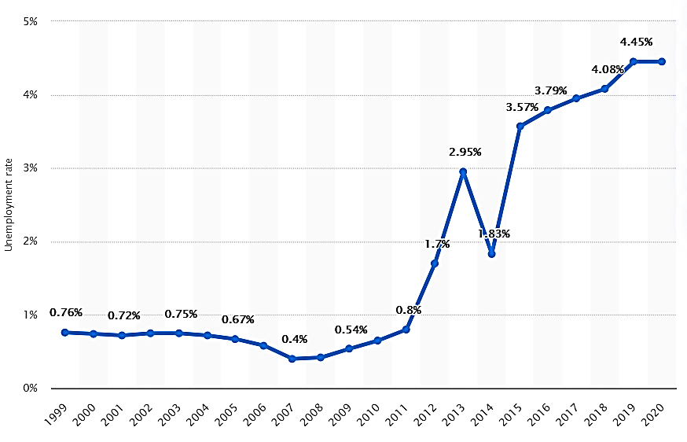
Root Problems
Unemployment
Lack of job opportunities to accommodate the excess of degree holders and graduates
Only a tiny percentage of these graduates possess technical knowledge that meets the potential requirements of employers
“There is lack of cohesion in the system and it is more prone towards general education which does not bring any skilled manpower to the market.” (Critical Analysis of the Problems of Education in Pakistan, 2014).
Due to unemployment, several other critical problems arise. Most notable of such directly affect the crime rates and economy throughout the Nation.
World Bank @ Statista 2020

Slide 17
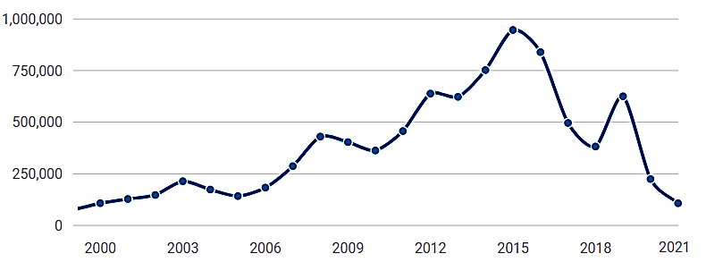
Root Problems
Subpar Teachers in Public Institutions
Current caliber of teachers in Public School of Pakistan is lamentable
Do not experiment with their teaching style and encourage students to cram and learn ‘techniques’ to solely get better grades
It is somewhat justified as there are no appealing salary packages which makes them lose any remaining motivation to teach
Precedence Set by Alumni
Lack of modern technological equipment drives recent Alumni to emigrate to foreign countries
Emerging youth have already made up their minds to emigrate as soon as they graduate
It also induces a shortage in skilled workers that meet the potential requirements of employers
Source: Bureau of Emigration & Overseas Employment

Slide 18
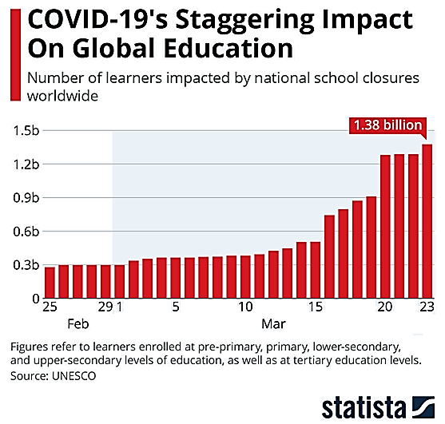
Corona and Education
Defects of Online Classes
Remote locations of students and teachers alike.
Lack of proper training of teachers for online education.
Unavailability of proper syllabus suitable for online learning.
Lack of proper IT professionals and labs in most institutes
Internet issues and poor connectivity issues due to which classes often keeps on dropping.
No discipline as person being at home being more casual loses his discipline and as well as his focus in the class. He quickly gets distracted.
Despite the fact that teachers may give their best but due to the distance learning mode the teacher cannot focus on each and every student of the class.
UNESCO @ Statista 2021

Slide 19
Solutions
& current state of our system

