Slide 1
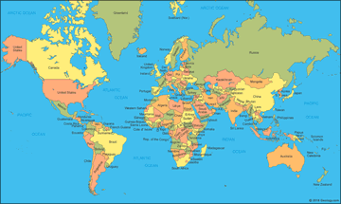
Foreign Policy of Pakistan (Geo strategic Importance)

Slide 2
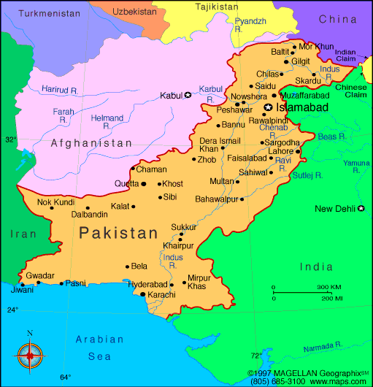
Foreign Policy of Pakistan (Regional Importance)

Slide 3
Introduction
Relation between sovereign states
A state frame its Foreign Policy the light of its domestic policies
According to Crabb:
Pakistan inherited the legacy of foreign Policy from the British India
Pakistan’s Foreign Policy is determined by three Factors:
Security
Development
Ideology

Slide 4
Jinnah’s vision
Our foreign policy is one of friendliness and goodwill toward all the nation of the world. We do not cherish aggressive designs against any state or nation. We believe in policy of honesty and fair play in national and international dealings and are prepared to make our utmost contribution to the promotion of peace and prosperity among the nation of the world. Pakistan will never be found lacking in extending its material and moral support to the suppressed of the UN charter.

Slide 5
Guiding Principles of Pakistan’s Foreign Policy
The sovereign equality of all states
Respect for the sovereignty and territorial integrity of all states
Non aggressive and peaceful settlement of disputes
Cordial Relation with Muslim States
Part of International Organization
Non Interference in the internal affairs of other states
Non Alignment
Nuclear non proliferation and disarmament
Implementation of UN Charter
Promotion of world peace

Slide 6
National Interests and Major Determinations
National Security
Economic Interest
Islamic Solidarity
Peaceful Co-existence
Non Alignment
Bilateralism
United Nations

Slide 7
Determinants of Pakistan’s Foreign Policy
Ideology as Factor
Geographical Factor
Economic Factor
Security Concerns
Special Determinant: The Indian Threat
Kashmir
Public opinion

Slide 8
Phases of Pakistan’s foreign Policy
1947-53: Explorations and friendship with all
1953-62: Alignment with the West
1962-71: Transition
1972-79: Bilateralism and nonalignment
1980-90: Afghanistan and partnership with the US
1990-2001:Post Cold War Era and Pakistan’s Dilemmas
2001 onwards: Pakistan and Counter Terrorism

Slide 9
Challenges to Pakistan Foreign Policy
Security Concerns
Baluchistan Issue
Kashmir Policy
Terrorist Label
Safeguarding Sovereignty
Decline in Foreign Investment
Direct
loan

Slide 10
Recommendations
Weak and concrete Foreign Policy
Address all challenges
Peruse help of China And middle east to stop drone attack
Need to hold negotiation and dialogue
Unity
Attractive incentives

Slide 11
Questions/ Answers

