Slide 1


Slide 2
Questions
What is the geostrategic location?
What is Pakistan’s Geostrategic location?
What is the significance of Pakistan geopolitical location in regional and international setting?

Slide 3
Definition
Saul Bernard Cohen in 2003 defined Geopolitics as;
“Geopolitics is the analysis of the interaction between, on the one hand, geographical settings and perspectives and, on the other hand, political processes. (…) Both geographical settings and political processes are dynamic, and each influences and is influenced by the other. Geopolitics addresses the consequences of this interaction.”
Interaction between geographical settings & perspectives and political processes

Slide 4
Definition
Location of some countries are more important than the others
The geographical environment, ethnic composition and strategy are some important determinants to asses a country’s importance
It is the combination of domestic regional and international factors that determine the strategic location of a country
Modern history shows that the impoverished nations with small territory but important location can have significant impact on regional and global politics

Slide 5
Pakistan’s Geopolitical Setting
Pakistan is located at intersections of three important regions;
South Asia
West Asia/ Middle East
Central Asia
Pakistan location is also significant as it borders with two major emerging powers in the world (India and China)
Pakistani borders with neighbors and its significance.

Slide 6
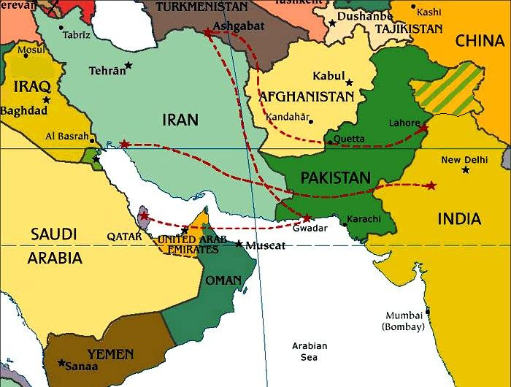

Slide 7
New Emerging Realities
The four major global strategic developments of our time all have direct implications for Pakistan’s security:
Afghanistan situation with the presence of US and NATO;
The spreading turmoil in the Middle East;
The rise of China and the US pivot to Asia, which has opened a new Great Game on this continent;
Renewed tensions between a resurgent Russia and the West seen as a new cold war

Slide 8
Importance of Gwadar Port
Inaugurated by Chinese Prime Minister Wu Bangguo in March 2002 is of utmost significance
1st , located at the strategic strait of Hormuz
2nd it revives the old silk rout from Karakoram to Gwadar port
3rd Provides access to land locked Central Asian States
4th its second naval line of defence for Pakistani Navy
This development has made both US and India wary of Chinese intention, which is keen to develop its foot hold in the Arabian sea and neutralizes Indian navy Influence in the area

Slide 9
A combo of Unconventional and Conventional Challenges
Pakistan has to simultaneously operate in two arenas;
Internal security and;
External challenges
Countering militancy and violent extremism will remain the country’s overriding security goal
Measure to address Internal Security
Dialogue with all stakeholders,
Isolation of terrorists from their support systems,
Enhancing deterrence and capacity of the security apparatus to neutralise the threats to internal security of Pakistan

Slide 10
Pakistan’s External security formation: regional and International
Pakistan has face two external security threats since its independence.
1st form the western border, Afghanistan
2nd from the eastern border, India
India a major conventional adversary
Afghanistan a perpetual security concern since 1947
Pakistan-China a all weather friends
Pakistan-Iran, strategic stability

Slide 11
Pakistan and Middle Eastern security factor
Pakistan’s location and military muscle: A major factor in the Middle Eastern security architecture
Pakistan a buffer between the eastern flank of Middle Eastern States and Indian growing military might and presence in the Arabian Sea
The INDIA-ISREAL nexus is also a great concern for the Middle Eastern states
Pakistan’s economic interests in Middle East;
Pakistani diaspora, a source of remittances
Major workforce in Middle East
Energy resources

Slide 12
Pakistan’s Response
Pakistan’s response to entail COIN strategy
The political, economic and social components of the counter-militancy strategy
Support reconciliation process in Afghanistan
Improved security, economic and political relations with the neighboring countries
Maintaining minimum credible deterrence

