Slide 1
Introduction
Data structures and algorithms

Slide 2
Instructor
Bostan Khan
Email: bostankhan6@gmail.com

Slide 3
Course Information
Pre-requisite
Programming Fundamentals/Object Oriented Programming
Language
C++
Course meeting times
Lectures: 3 sessions/week (3+1)
Labs: 1 session/week (3hr)
Course Resources
Lectures slides, assignments (computer/written), solutions to problems, projects, and announcements will be uploaded on course web page.

Slide 4

Course Aim
To emphasize the importance of data structures and efficient algorithmic design for better management of computing resources while programming.

Slide 5

Course objectives
Equip students with skills to select and design data structures and algorithms that are appropriate for real world problem solving
Developing basic algorithms for manipulating stacks, queues, linked lists, trees, graphs.
Study and design recursive algorithms for applications in trees and graphs
Study and implement searching and sorting algorithms
Study the computational complexities of different algorithms

Slide 6

Expected Student Outcomes
At the completion of this course students are expected to be able to:
Identify and apply appropriate data structures for a particular scenario.
Design and implement Abstract Data Types (ADT) on demand.
Analyze the complexity of algorithms and understand time-space tradeoff.
Provide efficient data management in terms of insertion and retrieval.
Notes:
Abstract Data Types (ADTs) are a concept in computer science that represents a high-level description of a set of operations that can be performed on a data structure, without specifying the underlying implementation details. In other words, an abstract data type defines a logical model for data and operations on that data, but it does not prescribe how these operations are carried out internally.

Slide 7

Course Outline
Before Mid-term
After Mid-term
1 | Introduction to Data Structures and Algorithms
2 | Array, Linked List, Singly Linked List
3 | Doubly Linked List, Circular Linked List
4 | Stacks, Queue, Priority Queue
5 | Introduction to Trees, Binary Search Trees
6 | Binary Search Tree Operations and Traversal
7 | AVL Trees
8 | Binary Heaps
10 | Sorting Algorithms I
11 | Sorting Algorithms II
12 | Introduction to Graphs
13 | Search Operations
14 | Hash Tables
15 | Recursion
16 | Spanning Trees, Shortest Paths
17 | Concept in Running Time Complexity, Function Growth

Slide 8

Semester Project Deadlines
Project Proposal Submission:
Week 8
Project Demo and Viva:
Week 15

Slide 9
Grading policy
Theory | 75%
Labs | 25%

Slide 10

Reference Material
Data Structures & Algorithms Using C++, Fourth or latest Edition, Nell Dale
Adam Drozdek. Data Structures and Algorithms in C++, sixth Edition (2016)

Slide 11



Slide 12
Data Hierarchy
From smallest to largest
Bit: (1s or 0s)
Nibble (4 Bits)
Byte: 8 bits (char)
Field: group of characters with some meaning
Record: group of related fields
Database: group of related files
Sally
Black
Tom
Blue
Judy
Green
File
Iris
Orange
Randy
Red
Judy
Green
Record
Judy
Field
01001010
Byte (ASCII character J)
1
Bit

Slide 13
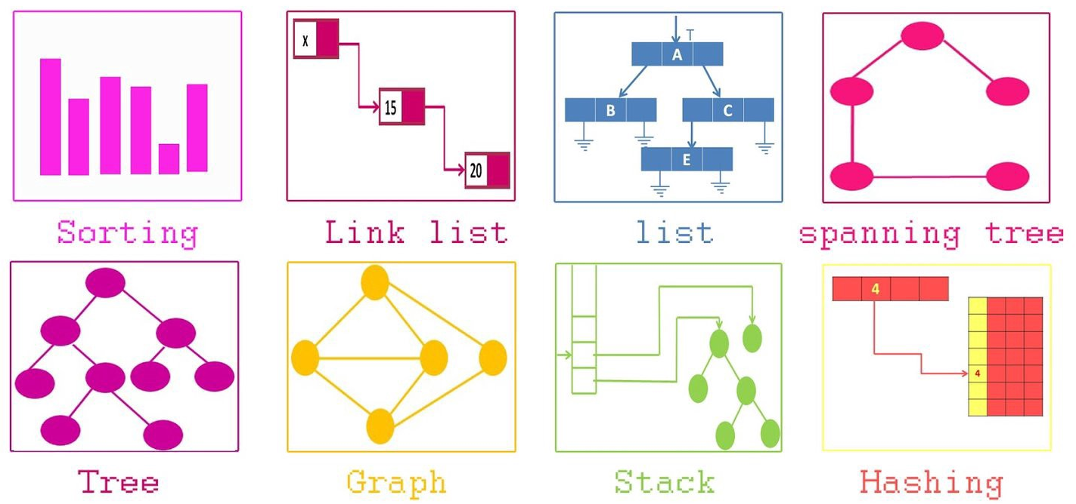
Data structures …..What?
In computer science, a data structure is a data organization, management, and storage format that enables efficient access and modification. More precisely, a data structure is a collection of data values, the relationships among them, and the functions or operations that can be applied to the data.
Notes:
https://www.youtube.com/watch?v=bum_19loj9A

Slide 14
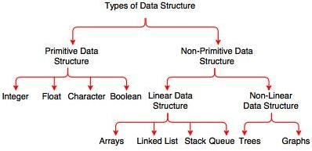
Notes:
Linear and non-linear data structures are two fundamental classifications of data structures based on the organization and arrangement of elements. The main difference between them lies in how elements are connected or related to each other.
Linear Data Structures:
Definition:
Linear data structures organize elements sequentially, where each element has a unique predecessor and successor, except for the first and last elements.
Accessing and traversing elements in a linear structure involves moving through them in a linear or sequential manner.
Examples:
Arrays: Elements are stored in contiguous memory locations, and access is based on indices.
Linked Lists: Elements are connected through pointers, forming a chain-like structure.
Stacks: Follows the Last-In-First-Out (LIFO) principle, where elements are added and removed from one end.
Queues: Follows the First-In-First-Out (FIFO) principle, where elements are added at one end and removed from the other.
Traversal:
Linear structures are traversed in a single, linear pass from the beginning to the end or vice versa.
Memory Allocation:
Linear structures often use contiguous memory allocation for storage.
Non-linear Data Structures:
Definition:
Non-linear data structures organize elements in a hierarchical or interconnected manner, where each element may have multiple predecessors and/or successors.
Accessing and traversing elements in a non-linear structure may involve more complex paths.
Examples:
Trees: Elements are organized hierarchically with a root node and child nodes. Trees can be binary or n-ary.
Graphs: Nodes are connected through edges, and relationships can be more arbitrary and complex.
Traversal:
Non-linear structures may require more sophisticated traversal algorithms, such as depth-first search (DFS) or breadth-first search (BFS).
Memory Allocation:
Non-linear structures often use dynamic memory allocation and pointers to establish relationships between elements.
Summary of Differences:
Connectivity:
Linear: Elements are connected in a linear, sequential manner.
Non-linear: Elements have more complex relationships, with multiple predecessors and/or successors.
Traversal:
Linear: Traversal is straightforward, moving from the first to the last element or vice versa.
Non-linear: Traversal may involve more complex paths, depending on the structure.
Examples:
Linear: Arrays, Linked Lists, Stacks, Queues.
Non-linear: Trees, Graphs.
Memory Allocation:
Linear: Often uses contiguous memory allocation.
Non-linear: Often uses dynamic memory allocation and pointers.
Understanding the differences between linear and non-linear data structures is essential for choosing the right data structure for specific applications and designing algorithms that efficiently manipulate data.

Slide 15

Data structures…..Why?
Market value: Big tech companies like Microsoft etc. focus mainly on data structures.
Computer & Telecom industry
Search engines (Google, Amazon etc.)
Notes:
https://www.youtube.com/watch?v=jc1t0KFsOcs

Slide 16
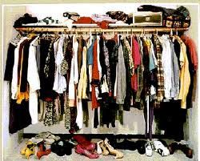

Time it took you to find a shirt …

Slide 17

Find your friend in here……

Slide 18
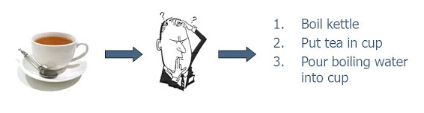
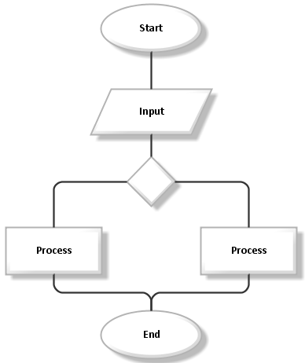
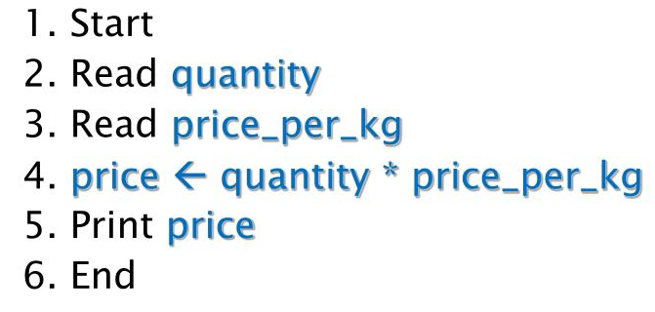
Where do Algorithms fit …???
An algorithm is a set of sequential instructions for solving a problem. Algorithms process (manipulate) data.
Example: How to make a cup of tea?
Can be written in simple English
Can be a flow chart
Can be a pseudocode

Slide 19
Data Structure and Algorithms - Relation
Algorithm: Step by step procedure
Computer Program: Implementation of the algorithm
Data structure: Organization of data that is manipulated by the algorithm or the computer program
Efficient Algorithm
Appropriate Data Structure
Good
Computer Program
Input
Output
Provides the required results
Easy to understand, code and debug
Makes efficient use of resources

Slide 20
Efficient Algorithm…???
Efficiency of an algorithm depends on the amount of resources it uses.
Space (# of variables used)
Time (# of instructions used)
Efficiency as function of input size (n)
Number of data items
Time-Space Trade-off
Ideally, an efficient algorithm is one which uses less memory and requires less time to complete the task at hand.
In reality, this is not always possible!!!
Time-Space trade-off is a situation where memory use can be reduced at the cost of slower program execution (and conversely, the computation time can be reduced at the cost of increased memory use)

Slide 21
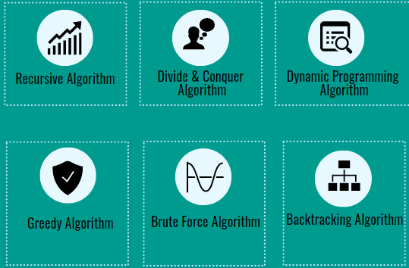

Slide 22
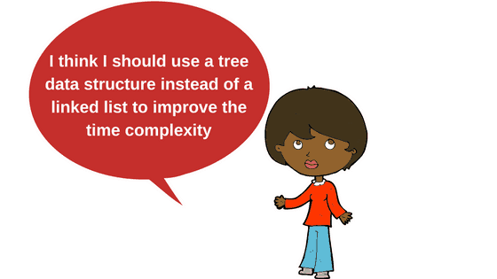
Appropriate Data Structure
No single data structure works well for all purposes, and so it is important to know the strengths and limitations of several of them
Choose the most appropriate data structure for a given data/problem

Slide 23
So As We Discussed Earlier….
A data structure is a way to store and organize data in order to facilitate access and modifications
DS - What?
A method/technique of organizing data.
DS - Why?
To manage huge amount of data efficiently.

Slide 24
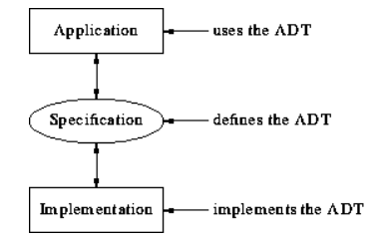
How We Will Approach Data Structures….
We will study data structures from three perspectives:
Specification
ADT (Description of data structures)
Data (Attributes)
Operations (Behaviors)
Implementation in C++
Application in problem solving
Notes:
Abstract Data Types (ADTs) are a concept in computer science that represents a high-level description of a set of operations that can be performed on a data structure, without specifying the underlying implementation details. In other words, an abstract data type defines a logical model for data and operations on that data, but it does not prescribe how these operations are carried out internally.
ADTs are a way of abstracting and encapsulating data structures, providing a clear separation between what an operation does and how it is implemented. This abstraction is crucial for software development because it allows programmers to focus on the functionality of the data without worrying about the implementation details.
Here are some key characteristics of Abstract Data Types:
Encapsulation: ADTs encapsulate the implementation details of a data structure, hiding them from the user. Users only interact with the data and its operations.
Operations: ADTs define a set of operations that can be performed on the data. These operations represent the behavior or functionality of the data structure.
Interface: The interface of an ADT specifies the set of operations that can be performed, their parameters, and their return types. It does not specify how these operations are implemented.
Data Abstraction: ADTs provide a level of abstraction by allowing users to work with data at a conceptual level, without needing to understand the inner workings of the underlying data structure.
Common examples of abstract data types include:
Stacks: A collection of elements with two main operations: push (to add an element) and pop (to remove the top element).
Queues: Similar to stacks but follows the First-In-First-Out (FIFO) principle, with operations like enqueue and dequeue.
Lists: A collection of elements where the order is significant, with operations like insert, delete, and retrieve.
Sets: An unordered collection of unique elements with operations like add, remove, and check for membership.
Maps (or Dictionaries): A collection of key-value pairs with operations like insert, delete, and lookup based on the key.
Trees: A hierarchical structure with nodes, where each node has a value and may have child nodes. Operations include insertion, deletion, and traversal.
It's important to note that while ADTs define what operations can be performed, the choice of a specific data structure to implement an ADT involves considerations of efficiency, space complexity, and other practical concerns. Common programming languages often provide built-in support for some abstract data types, and developers can also implement custom ADTs as needed for specific applications.

Slide 25
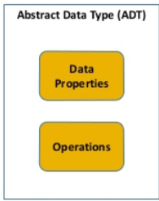
Abstract Data Type (ADT)
An Abstract Data Type (ADT) specifies how a collection of data will be stored and what operations can be performed on the data to access and change it.
Notes:
https://www.youtube.com/watch?v=ZniDyolzrBw

Slide 26
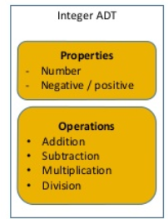
Example: Integer as an ADT
Data:
{-1, -2,…,-∞} U {0, 1, …, ∞}
Operations:
Addition, subtraction, multiplication, division etc.

Slide 27
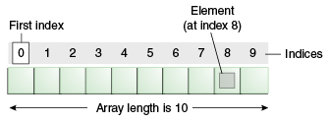
Example: Array as an ADT
Data:
A fixed-size sequence of elements, all of the same type
Operations:
Direct access to each element in the array by specifying its position so that values can be retrieved from or stored in that position.
Implementation of Array: Encapsulated
Application:
Declare an object of array of fixed size and type => int Arr[10];
Store value at a position in an array => Arr[3] = 56;
Retrieve value from a position in an array => cout<<Arr[4];
Notes:
Encapsulation, in the context of Abstract Data Types (ADTs), refers to the bundling of data and the methods that operate on that data into a single unit. It is a fundamental concept in object-oriented programming (OOP) and is closely related to the idea of information hiding.
Here's a breakdown of encapsulation in terms of ADTs:
Data Hiding:
Encapsulation allows the internal details of an ADT (such as the structure of the data and the implementation of methods) to be hidden from the external world.
The ADT's interface, which includes a set of operations or methods, becomes the only means of interacting with the data. The user of the ADT does not need to know how the data is stored or how the methods are implemented.
Protection of Invariants:
Invariants are conditions or properties that are expected to hold true for the data within the ADT. Encapsulation helps in protecting these invariants by controlling access to the data.
By providing a well-defined interface, encapsulation ensures that the data can only be modified in a controlled manner through the specified methods, reducing the risk of unintended changes that could violate invariants.
Implementation Flexibility:
Encapsulation allows for changes to the internal implementation of an ADT without affecting the code that uses the ADT. As long as the interface remains unchanged, modifications to the internal details do not impact external code.
This flexibility is crucial for maintaining and evolving software systems. It enables developers to improve or optimize the internal workings of an ADT without requiring changes to every part of the codebase that uses the ADT.
Enhanced Modularity:
Encapsulation promotes modular design by encapsulating related data and methods into a single unit. This makes it easier to manage and understand complex systems.
Modules or classes that represent ADTs can be independently developed, tested, and maintained, contributing to a modular and scalable software architecture.
Security and Abstraction:
Encapsulation enhances security by limiting access to the internal details of an ADT. It reduces the risk of unintended interference or misuse of the data.
Abstraction, which is another key OOP principle, is closely related to encapsulation. Abstraction involves representing the essential features of an object while hiding unnecessary details. Encapsulation facilitates abstraction by hiding the implementation details.
In summary, encapsulation in the context of ADTs provides a way to organize and structure code by bundling data and methods together while controlling access to the internal details. It contributes to the principles of data hiding, invariants protection, implementation flexibility, modularity, security, and abstraction in software design.

Slide 28
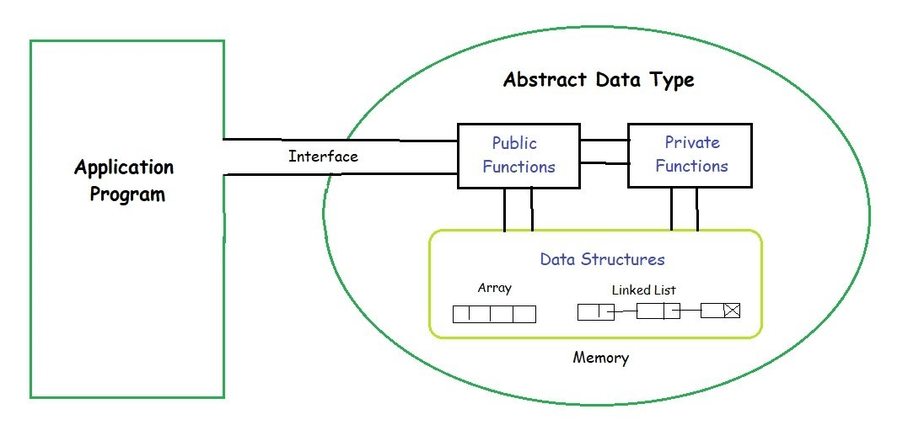
ADT vs. Data Structure
ADT
An ADT is a collection of data and associated operations for manipulating that data
Data Structures
Physical implementation of an ADT
Data structures used in implementations are provided in a language (primitive or built-in) or are built from the language constructs (user-defined)
Notes:
The terms "abstract data type" (ADT) and "data structure" are related concepts in computer science, but they represent different perspectives and levels of abstraction.
### Abstract Data Type (ADT):
1. **Definition:**
- An Abstract Data Type is a high-level description of a set of operations that can be performed on a collection of data, without specifying the implementation details.
- ADTs define a logical model for data and operations on that data, independent of any particular programming language or implementation.
2. **Focus:**
- ADTs focus on the behavior or functionality of the data and the operations that can be performed, rather than on how the data is stored or manipulated internally.
3. **Encapsulation:**
- Encapsulation is a key concept in ADTs, where the implementation details are hidden from the user. The user interacts with the data and its operations through a well-defined interface.
4. **Examples:**
- Examples of ADTs include stacks, queues, sets, maps, and lists. Each ADT has a set of operations (methods) associated with it, defining how elements can be added, removed, or accessed.
### Data Structure:
1. **Definition:**
- A data structure refers to the actual implementation of a particular way of organizing and storing data in a computer's memory.
- Data structures specify how data is arranged, accessed, and manipulated in terms of algorithms and storage representation.
2. **Focus:**
- Data structures focus on the physical organization and layout of data in memory, the relationships between elements, and the algorithms used for performing operations on the data.
3. **Implementation Details:**
- Data structures provide the concrete details of how data is stored, retrieved, and manipulated. This includes considerations such as memory allocation, pointers, and algorithms for common operations.
4. **Examples:**
- Examples of data structures include arrays, linked lists, trees, graphs, hash tables, and more. Each data structure has specific rules and algorithms governing how data is organized and accessed.
### Relationship:
- ADTs and data structures are closely related, and the implementation of an ADT often involves using one or more data structures. The ADT provides the interface and abstract behavior, while the data structure defines the concrete representation and manipulation of data.
- For example, a stack ADT can be implemented using an array or a linked list as the underlying data structure. The stack operations (push, pop) are part of the ADT's definition, while the choice of a specific data structure influences the efficiency and characteristics of those operations.
In summary, ADTs are high-level specifications of data and operations, while data structures are the actual implementations that realize those specifications in terms of memory layout and algorithms. The combination of ADTs and data structures allows for a clear separation of concerns, promoting modularity and flexibility in software design.

Slide 29
Operations on Arrays
Sorting items in an array
Ascending order
Descending order
Lexicographical order
Searching for a key value in an array
Linear Search (Unsorted Arrays)
Binary Search (Sorted Arrays)

Slide 30
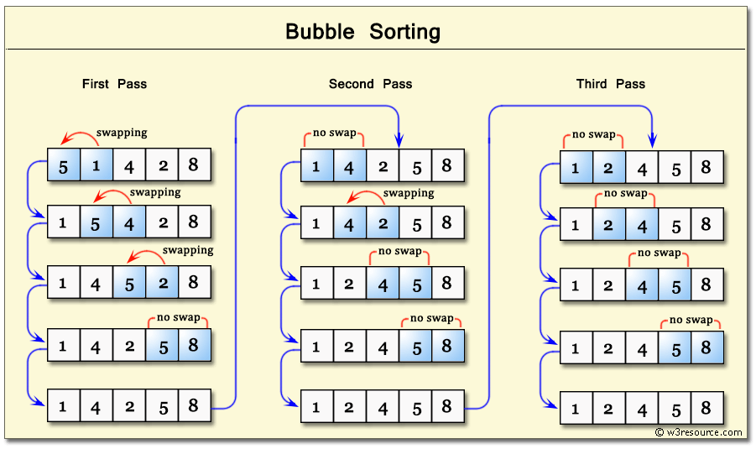
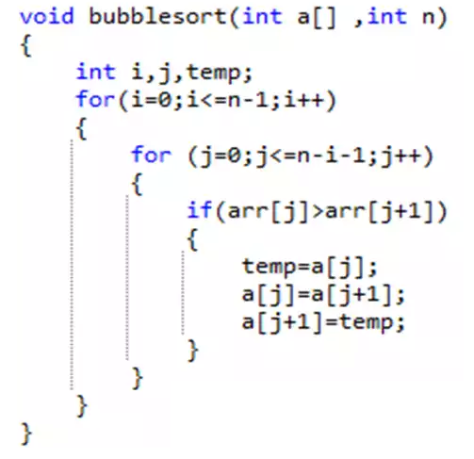
Sorting an Array
Bubble Sort:

Slide 31
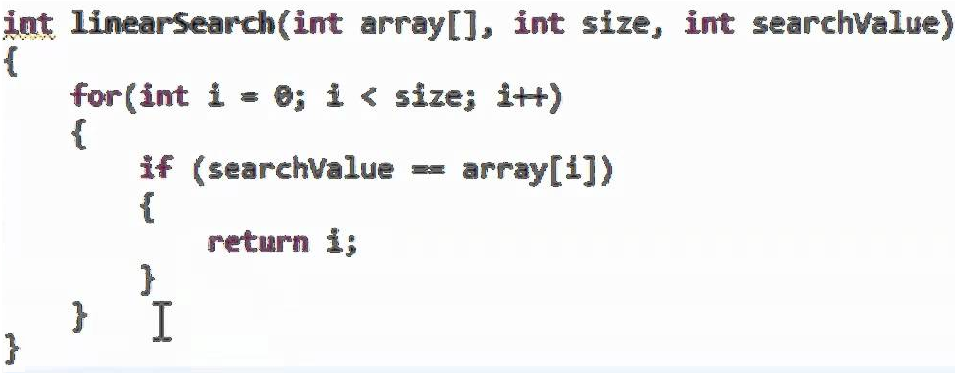
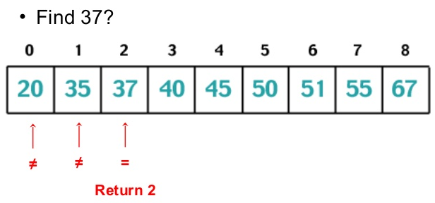
Searching an Array
Linear Search:

Slide 32
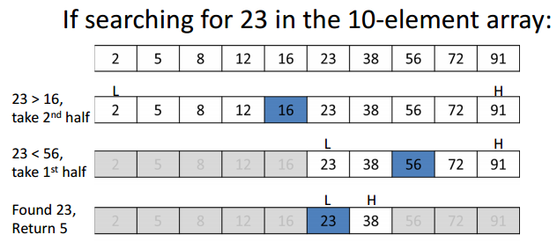
Searching an Array
Binary Search:

Slide 33
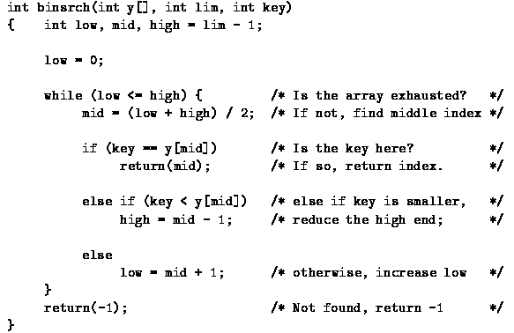
Searching an Array
Binary Search:

Slide 34

Refresh earlier programming concepts
C++ Programming Concepts
Pointers
Arrays
Parameters
File handling
OOP Concepts
Classes
Structures
Dynamic memory
Return values & constructors
Templates

Slide 35


What will it be like…….
Extreme hard work as not an easy subject

Slide 36


Take home message….
Must be familiar with the concept of data abstraction and abstract data types (Revise Concepts)
Must be able to describe what a data structure is

