Slide 1
Selection Sort

Slide 2
Selection Sort
A sorting algorithm that selects the smallest element from an unsorted list in each iteration and places that element at the beginning of the unsorted list.
The algorithm repeatedly selects the smallest (or largest) element from the unsorted portion of the list and swaps it with the first element of the unsorted part.

Slide 3
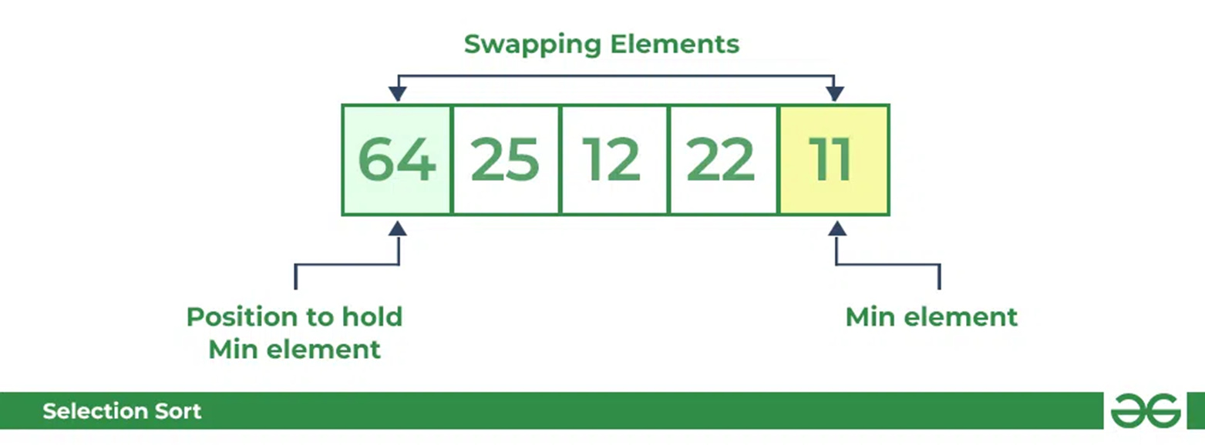
Selection Sort: Example
Source: Selection Sort – Data Structure and Algorithm Tutorials - GeeksforGeeks

Slide 4
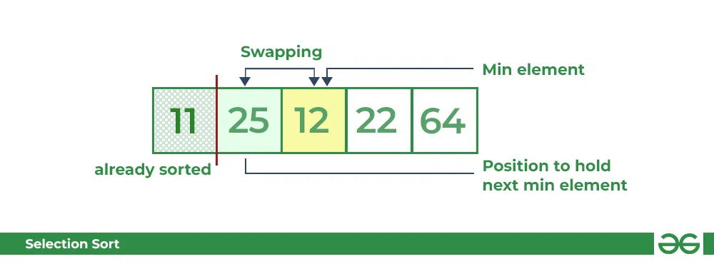
Selection Sort: Example
Source: Selection Sort – Data Structure and Algorithm Tutorials - GeeksforGeeks

Slide 5
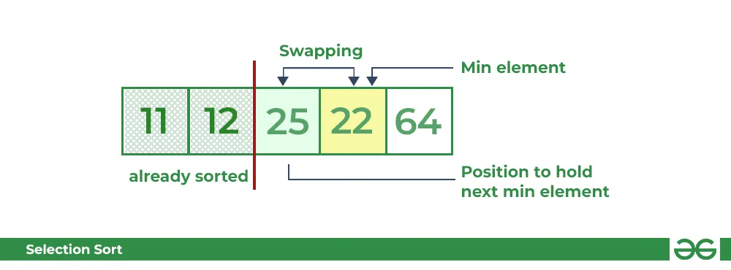
Selection Sort: Example
Source: Selection Sort – Data Structure and Algorithm Tutorials - GeeksforGeeks

Slide 6
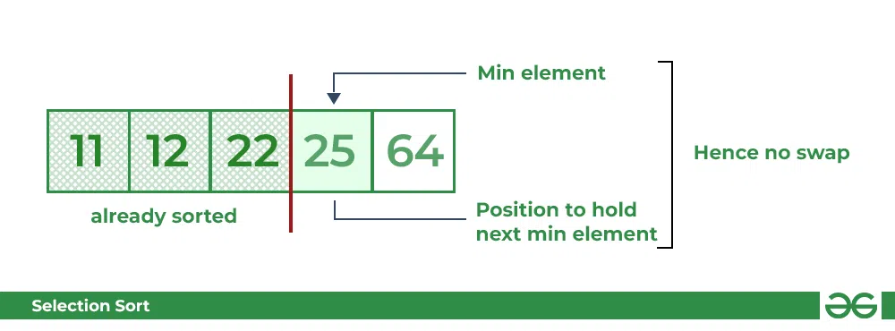
Selection Sort: Example
Source: Selection Sort – Data Structure and Algorithm Tutorials - GeeksforGeeks

Slide 7
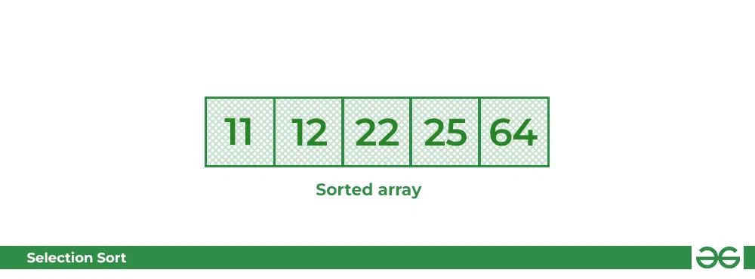
Selection Sort: Example
Source: Selection Sort – Data Structure and Algorithm Tutorials - GeeksforGeeks

Slide 8
Selection Sort: C++ Code
void selectionSort(int arr[], int n)
{
int i, j, min_idx; // One by one move boundary of
// unsorted subarray
//n=size of array
for (i = 0; i < n - 1; i++) { // Find the minimum element in
// unsorted array
min_idx = i;
for (j = i + 1; j < n; j++) {
if (arr[j] < arr[min_idx])
min_idx = j;
}
// Swap the found minimum element
// with the first element
if (min_idx != i)
swap(arr[min_idx], arr[i]);}}
Source: Selection Sort – Data Structure and Algorithm Tutorials - GeeksforGeeks

Slide 9
Selection Sort: Time Complexity
The time complexity of Selection Sort is O(N²) as there are two nested loops:
One loop to select an element of Array one by one = O(N)
Another loop to compare that element with every other Array element = O(N)
Therefore overall complexity = O(N) * O(N) = O(N*N) = O(N²)
Source: Selection Sort (With Code in Python/C++/Java/C) (programiz.com)

Slide 10
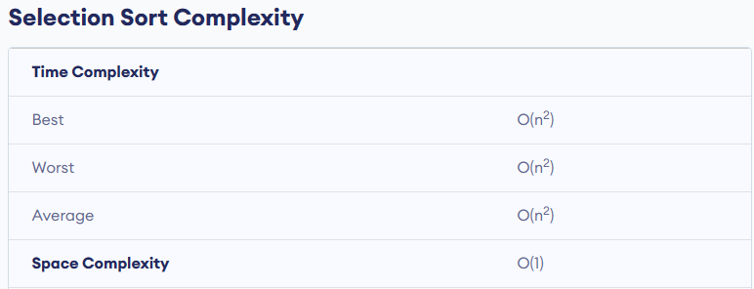
Selection Sort: Time Complexity
Source: Selection Sort (With Code in Python/C++/Java/C) (programiz.com)

Slide 11
Selection Sort: Advantages and disadvantages
Advantages:
Simple and easy to understand.
Works well with small datasets.
Disadvantages:
Selection sort has a time complexity of O(n^2) in the worst and average case.
Does not work well on large datasets.
Does not preserve the relative order of items with equal keys which means it is not stable.
Source: Selection Sort (With Code in Python/C++/Java/C) (programiz.com)

Slide 12
Selection Sort: Video
Selection sort in 3 minutes (youtube.com)

