Slide 1
Graphs and Applications
Data structures and algorithms

Slide 2
What is a Graph?
A graph consists of a number of data items, each of which is called a vertex. Any vertex may be connected to any other, these connections are called edges.
A graph G = (V,E) is composed of:
V: set of vertices
E: set of edges connecting the vertices in V
An edge e = (u,v) is a pair of vertices
Example:
a
b
V= {a,b,c,d,e}
E= {(a,b),(a,c),(a,d),
(b,e),(c,d),(c,e),
(d,e)}
c
d
e

Slide 3
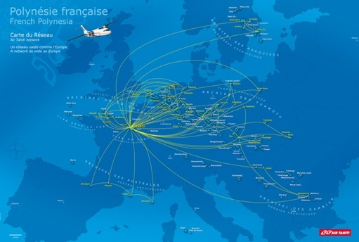
Applications
Networks (Roads, flights, communications)

Slide 4
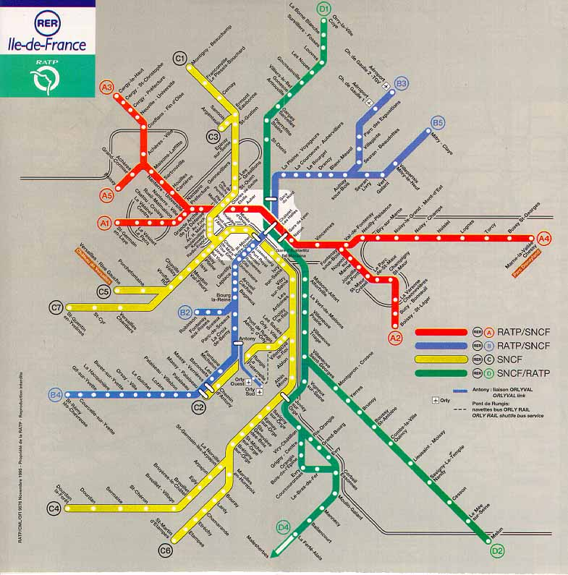
Train/metro maps

Slide 5
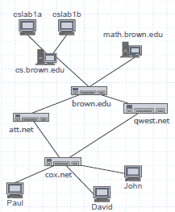
Applications
Electronic circuits
Printed circuit board
Integrated circuit
Transportation networks
Highway network
Flight network
Computer networks
Local area network
Wide area network
Internet
Databases
Entity-relationship diagram

Slide 6
DIRECTED AND UNDIRECTED GRAPH
Undirected graph
When the edges in a graph have no direction, the graph is called undirected
B
A
D
E
G
C
H
F
Set of nodes : {A,B,C,D,E,F,G,H}
Set of arcs: {(A,B),(A,C),(A,D),(C,D),(C,F),(E,G),(A,A)}

Slide 7
DIRECTED AND UNDIRECTED GRAPH
Directed Graph
When the edges in a graph have a direction, the graph is called directed graph .
Also known as digraph.
This kind of graph contains ordered pair of vertices i.e. if the graph is directed, the order of the vertices in each edge is important
A
B
E
V = {A, B, C, D, E}
E = {(A,B), (B,C), (C,B), (A,C), (A,E), (C,D)}
C
D

Slide 8
DIRECTED AND UNDIRECTED GRAPH
B
Directed Graphs
E
G
A
D
C
H
F
A digraph
The set of arcs for the digraph would be:
{<A,B>, <A,C>, <A,D>, <C,D>, <F,C>, <E,G>, <A,A>}
In some cases, authors use parentheses to indicate unordered pairs and angled brackets to indicate an ordered pair.

Slide 9
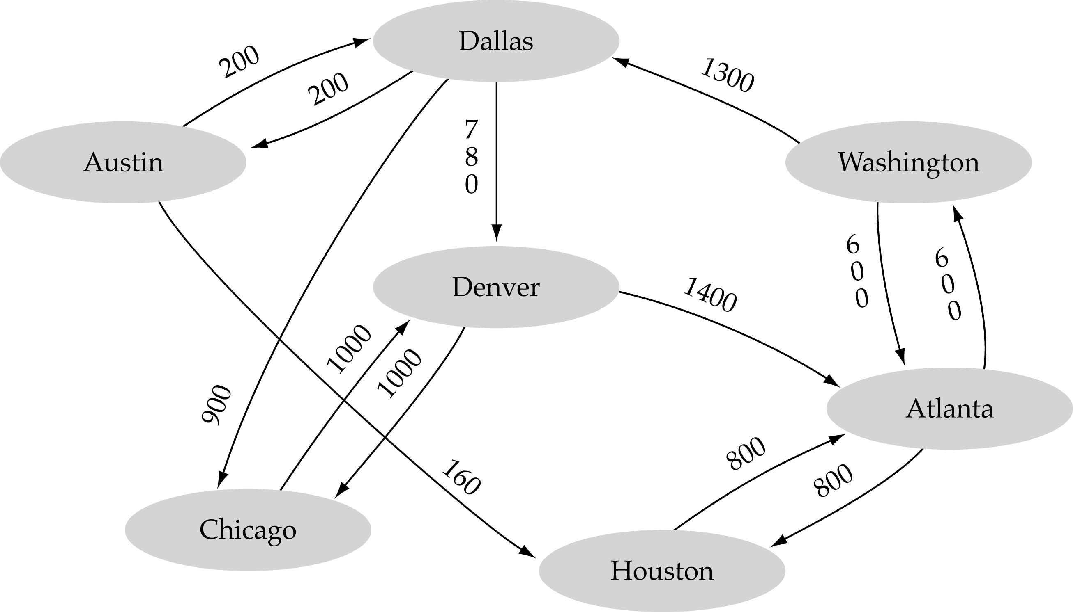
GRAPH TERMINOLOGIES
Weighted Graph
A graph is suppose to be weighted if its every edge is assigned some value which is greater than or equal to zero.

Slide 10
GRAPH TERMINOLOGIES

Slide 11
GRAPH TERMINOLOGIES
Adjacent Nodes
When there is an edge from one node to another then these nodes are called adjacent nodes.
Path
A sequence of vertices v₁,v₂,. . .v_{k} such that consecutive vertices v_{i} and v_{i+1} are adjacent.
a
b
a
b
c
c
d
e
d
e
a b e d c
b e d c

Slide 12
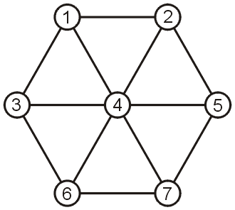
GRAPH TERMINOLOGIES
Examples of paths:
(1, 2, 4, 3, 6, 7, 5)
(1, 2, 5, 7, 6, 3)
(2, 4, 1, 2)

Slide 13
GRAPH TERMINOLOGIES
Length of a Path
Length of a path is the total number of edges included in the path from source to destination node
Simple Path
Path such that all its vertices and edges are distinct.
a
b
b e c
c
d
e

Slide 14
GRAPH TERMINOLOGIES
Cycle
Simple path, except that the last vertex is the same as the first vertex
Acyclic Graph
A graph without cycle is called acyclic Graph
A tree is an example of an acyclic graph.
a
b
c
d
e
a b e c a

Slide 15
GRAPH TERMINOLOGIES
v1
v2
v4
v5
v3
v6
v7
The sequence v1, v2, v5, v4, v3, v6 is a path. The length is 5.
It is a simple path.

Slide 16
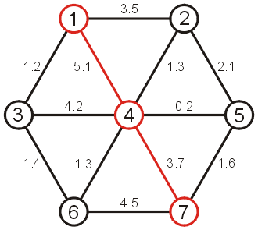
GRAPH TERMINOLOGIES
The length of a path – a weighted graph
The length of the path (1, 4, 7) = 5.1 + 3.7 = 8.8

Slide 17
GRAPH TERMINOLOGIES
Connected Graph
A graph is connected if, for any pair of vertices, there is a path between them.
Connected
Not Connected

Slide 18
GRAPH TERMINOLOGIES
Complete Graph
A graph in which all pairs of vertices are adjacent OR
A graph in which every vertex is directly connected to every other vertex
Let n = Number of vertices, and m = Number of edges
For a complete graph with n vertices, the number of edges is n(n – 1)/2. A graph with 6 vertices needs 15 edges to be complete

Slide 19
GRAPH TERMINOLOGIES
Degree of a node
In an Undirected graph, the total number of edges linked to a node is called a degree of that node.
For directed graph there are two degree for every node
Indegree
The indegree of a node is the total number of edges coming to that node.
Outdegree
The outdegree of a node is the total number of edges going out from that node

Slide 20
GRAPH TERMINOLOGIES
3
0
0
2
1
2
3
1
2
3
3
3
3
4
5
6
G
3
3
1
1
1
1
0
in:1, out: 1
Directed graph
in-degree
out-degree
1
in: 1, out: 2
2
in: 1, out: 0

Slide 21
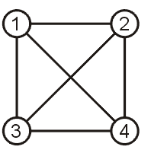
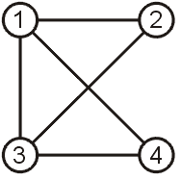
GRAPH TERMINOLOGIES
A subgraph of G is a graph G' such that V(G') ⊆ V(G) and E(G') ⊆ E(G).
G G'

Slide 22
Graph Representation
Adjacency Matrix
Table (2-dim Array)
Adjacency List
Linked List

Slide 23
Adjacency matrix
Let G=(V,E) be a graph with n vertices.
The adjacency matrix of G is a two-dimensional n by n array, say adj_mat
If the edge (vi, vj) is in E(G), adj_mat[i][j]=1
If there is no such edge in E(G), adj_mat[i][j]=0
The adjacency matrix for an undirected graph is symmetric; since adj_mat[i][j]=adj_mat[j][i]
The adjacency matrix for a digraph may not be symmetric

Slide 24
Adjacency Matrix Representation
For each edge (u,v) we set G[u][v] to true (1);
else it is false (0). If there are weights associated
with the edges, insert those instead.

Slide 25
Adjacency Matrix Representation
0
4
2
1
5
3
6
0
7
0
1
2
3
1
2
G2
G1
G3

Slide 26
Adjacency Matrix Representation
2
B
1 1 1
adj =
0 0 1
A
C
0 0 0
1
3
For a weighted digraph in which some cost or weight is associated with each arc, the cost of the arc from vertex i to vertex j is used instead of 1 in the adjacency matrix.

Slide 27
Graphs representation
The matrix representation of a directed graph is useful in a variety of graph problems
Its’ straightforward to determine the in-degree and the out degree of any vertex:
The sum of entries in row i of the adjacency matrix is the out-degree of the ith vertex, and the sum of the entries in the ith column is its in-degree

Slide 28
Graphs representation
Deficiencies in matrix representation:
It does not store the data items in the vertices of the digraph, the letters A,B,C,D and E in the previous example.
This problem can be remedied by creating an auxiliary array data and store the data item for the ith vertex in data[i].
0 1 1 0 1
0 0 1 0 0
0 1 0 1 0
0 0 0 1 0
0 0 0 0 0
A
B
C
D
E
adj =
data =

Slide 29
Adjacency List Representation
Using Table (a 2-dim array)
For each vertex we keep a list of adjacent vertices.

Slide 30
0
0
4
2
1
5
1
2
3
6
3
7
0
1
2
3
1
2
3
0
1
2
3
4
5
6
7
1
2
0
2
3
0
3
0
1
3
0
3
0
1
2
1
2
G1
0
5
4
6
0
1
2
1
5
7
0
2
1
6
G2
G3
2

Slide 31
Adjacency List Representation
v[1]
A
2
3
5
1
v[2]
B
3
A
v[3]
C
E
5
2
4
2
B
v[4]
D
4
C
D
v[5]
E
3
4

Slide 32
Adjacency List Representation
Using a Linked List
If there are weights associated with the edges, that information must be stored as well.

Slide 33
Adjacency Matrix Representation
v1
v2
v4
v5
v1 v2 v3 v4 v5 v6 v7
v3
v1
0 1 1 1 0 0 0
v2
0 0 0 1 1 0 0
v3
0 0 0 0 0 1 0
v6
v7
v4
0 0 1 0 0 1 1
v5
0 0 0 1 0 0 1
v6
0 0 0 0 0 0 0
v7
0 0 0 0 0 1 0

Slide 34
Adjacency List Representation
v1
v2
v4
v5
v1 → v2 → v4 → v3
v3
v2 → v4 → v5
v3 → v6
v4 → v6 → v7 → v3
v6
v7
v5 → v4 → v7
v6
v7 → v6

