Slide 1
Applications of Graph 1. Shortest Paths 2. Minimum Spanning Trees

Slide 2
Problem: Laying Telephone Wire
Central office

Slide 3
Wiring: First Approach
Central office
Simple but Expensive!

Slide 4
Wiring: Better Approach
Central office
Minimize the total length of wire connecting the customers

Slide 5
Minimum Spanning Tree
A minimum spanning tree (MST) is a subset of the edges of a connected, edge-weighted graph that connects all the vertices together without any cycles and with the minimum possible total edge weight.
How Many Edges Does a Minimum Spanning Tree Have?
A minimum spanning tree has precisely n-1 edges, where n is the number of vertices in the graph.

Slide 6
Minimum Spanning Tree (MST)
A minimum spanning tree is a subgraph of an undirected weighted graph G, such that
it is a tree (i.e., it is acyclic)
it covers all the vertices V
contains |V| - 1 edges
the total cost associated with tree edges is the minimum among all possible spanning trees
not necessarily unique

Slide 7
Minimum Spanning Tree (MST)
9
b
9
b
a
2
6
a
2
6
d
d
4
5
4
5
5
4
5
4
5
e
5
e
c
c

Slide 8
Applications of MST
Any time you want to visit all vertices in a graph at minimum cost (e.g., wire routing on printed circuit boards, sewer pipe layout, road planning…)
Design of Communication Networks

Slide 9
Finding Minimum Spanning Trees: Prim’s Algorithm
Prim's algorithm is a minimum spanning tree algorithm that takes a graph as input and finds the subset of the edges of that graph which
Form a tree that includes every vertex
Has the minimum sum of weights among all the trees that can be formed from the graph
It falls under a class of algorithms called greedy algorithms that find the local optimum in the hopes of finding a global optimum.
9
b
a
2
6
d
4
5
5
4
5
e
c

Slide 10
Finding Minimum Spanning Trees: Prim’s Algorithm
We start from one vertex and keep adding edges with the lowest weight until we reach our goal.
The steps for implementing Prim's algorithm are as follows:
Initialize the minimum spanning tree with a vertex chosen at random.
Find all the edges that connect the tree to new vertices, find the minimum and add it to the tree
Keep repeating step 2 until we get a minimum spanning tree
9
b
a
2
6
d
4
5
5
4
5
e
c
Prim's Algorithm (programiz.com)

Slide 11
Prim’s Algorithm
Prim's algorithm begins with a tree T that contains a single vertex.
Then we add a least-cost edge (u, v) to T such that T ∪ {(u, v)} is also a tree.
This edge-addition step is repeated until T contains n-1 edges.
9
b
a
2
6
d
4
5
5
4
5
e
c

Slide 12
Prim’s Algorithm
TV = {a}; // start with vertex a and no edge
for (T = ∅; T contains fewer than n-1 edges; add (u, v) to T)
{
Let (u, v) be a least-cost edge such that u ∈ TV and v ∉ TV
if (there is no such edge)
break;
Add v to TV;
}
if (T contains fewer than n-1 edges)
write: "no spanning tree";
9
b
a
2
6
d
4
5
5
4
5
e
c

Slide 13
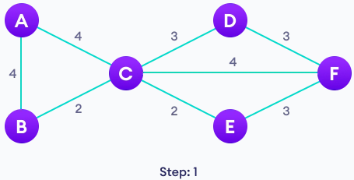
Prim’s Algorithm: Example
Step 1: Start with a weighted Graph

Slide 14

Prim’s Algorithm: Example
Step 2: Choose a vertex from the graph

Slide 15
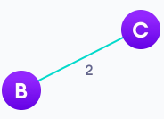
Prim’s Algorithm: Example
Step 3: Choose the shortest edge from this vertex and add it

Slide 16
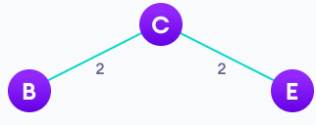
Prim’s Algorithm: Example
Step 3: Repeat Step 2 until all vertices are added

Slide 17
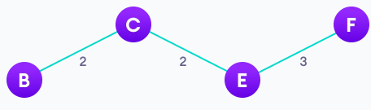
Prim’s Algorithm: Example
Step 3: Repeat Step 2 until all vertices are added

Slide 18
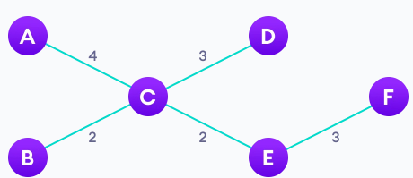
Prim’s Algorithm: Example
Step 3: Repeat Step 2 until all vertices are added
Minimum Spanning Tree

Slide 19
Kruskal’s Algorithm
Another minimum spanning tree algorithm that takes a graph as input and finds the subset of the edges of that graph which:
Forms a tree that includes every vertex
Has the minimum sum of weights among all the trees that can be formed from the graph
It also falls under a class of algorithms called greedy algorithms that find the local optimum in the hopes of finding a global optimum.

Slide 20
Kruskal’s Algorithm
We start from the edges with the lowest weight and keep adding edges until we reach our goal.
The steps for implementing Kruskal's algorithm are as follows:
Sort all the edges from low weight to high
Take the edge with the lowest weight and add it to the spanning tree. If adding the edge created a cycle, then reject this edge.
Keep adding edges until we reach all vertices.

Slide 21
Kruskal’s Algorithm
Initialization
a. Create a ‘forest’ of vertices F
b. Initialize the set of “safe edges” T comprising the MST to the empty set
c. Sort edges by increasing weight
9
b
a
2
6
F = {a}, {b}, {c}, {d}, {e}
T = ∅
E = {(a,d), (c,d), (d,e), (a,c),
(b,e), (c,e), (b,d), (a,b)}
d
4
5
5
4
5
e
c

Slide 22
Kruskal’s Algorithm
9
b
a
2
6
E = {(a,d), (c,d), (d,e), (a,c),
(b,e), (c,e), (b,d), (a,b)}
d
4
5
5
4
5
e
c
Forest
{a}, {b}, {c}, {d}, {e}
{a,d}, {b}, {c}, {e}
{a,d,c}, {b}, {e}
{a,d,c,e}, {b}
{a,d,c,e,b}
T
∅
{(a,d)}
{(a,d), (c,d)}
{(a,d), (c,d), (d,e)}
{(a,d), (c,d), (d,e), (b,e)}

Slide 23
Kruskal’s Algorithm
T = ∅
while ((T contains less than n-1 edges) && (E not empty))
{
choose an edge (v, w) from E of lowest cost;
delete (v, w) from E;
if ((v, w) does not create a cycle in T)
add (v, w) to T;
else
discard (v, w);
}
if (T contains fewer than n-1 edges)
write: "no spanning tree";

Slide 24
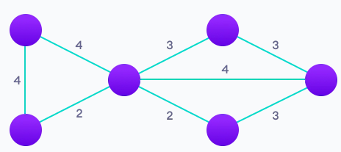
Kruskal’s Algorithm: Example
Step 1: Start with a weighted graph

Slide 25
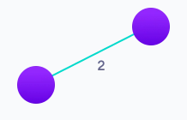
Kruskal’s Algorithm: Example
Step 2: Choose the edge with the least weight, if there are more than 1, choose anyone

Slide 26
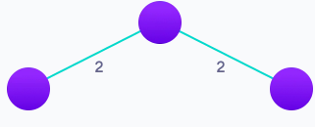
Kruskal’s Algorithm: Example
Step 3: Choose the next shortest edge and add it

Slide 27
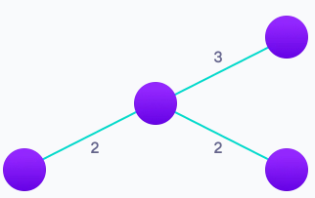
Kruskal’s Algorithm: Example
Step 4: Choose the next shortest edge that doesn't create a cycle and add it

Slide 28
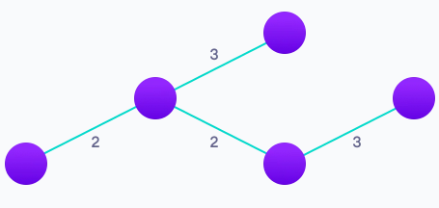
Kruskal’s Algorithm: Example
Step 5: Repeat step 4 until you have a spanning tree.

Slide 29
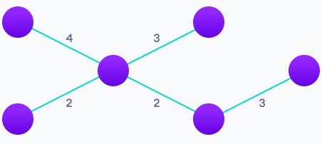
Kruskal’s Algorithm: Example
Step 5: Repeat step 4 until you have a spanning tree.

