Slide 1
Binary Trees & Applications
Data structures and algorithms

Slide 2

Real world
Data structure

Slide 3
Introduction
Data structure such as Arrays, Stacks, Linked List and Queues are linear data structure. Elements are arranged in linear manner i.e. one after another.
Tree is a non-linear data structure.
Tree imposes a Hierarchical structure, on a collection of items.

Slide 4
A Tree

Slide 5
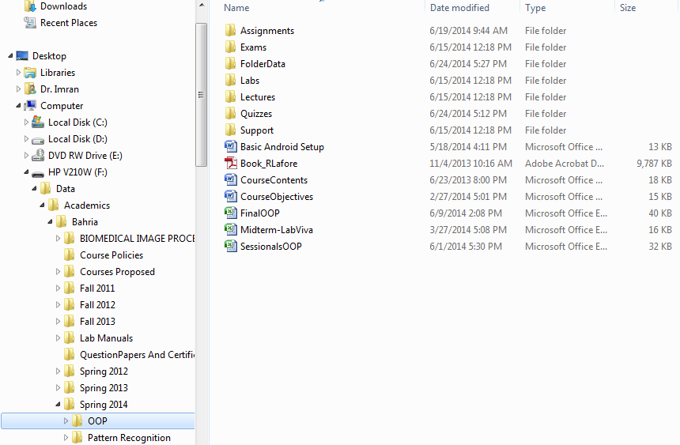
Examples: directory structure

Slide 6
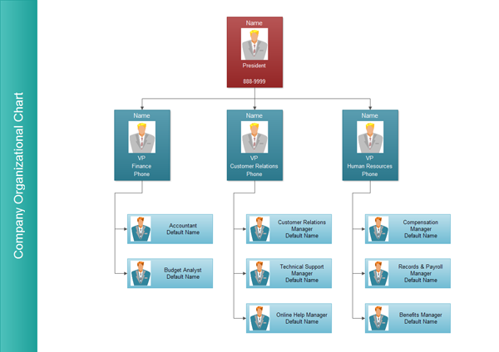
Organizational organograms

Slide 7
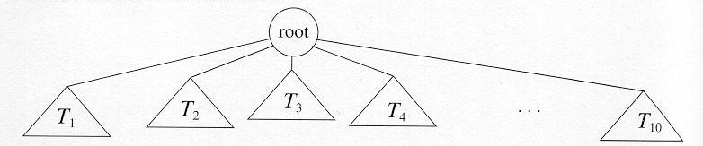
Definition
A tree is a finite set of nodes, such that:
There is a special node called the root.
The remaining nodes are partitioned into n ≥ 0 disjoint sets T₁, T₂, ......., T_{n}.
Each of the sets T₁, T₂, ......., T_{n} is itself a tree (subtrees of root).

Slide 8
Trees - Definition and Terminology
Tree: A finite set of elements called nodes (or vertices) and a finite set of directed arcs that connect pairs of nodes. If the tree is not empty, one of the nodes, called the root, has no incoming arcs.
Leaf: Node with no outgoing arcs.
Nodes directly accessible (using one arc) from a node are called the children of that node, which is called the parent of these children; these nodes are siblings of each other.

Slide 9
1
root
2
3
4
5
6
7
children of this parent
siblings of each other
8
9
leaves

Slide 10
Tree Terminologies
A
B
C
Root
It is the key node of a tree structure that does not have parent. It is the first node in hierarchical arrangement.
Node
The node of a tree stores the data and its role is the same as in the linked list. Nodes are connected by the means of links with other nodes.
Parent
It is the immediate predecessor of a node. In the figure A is the parent of B and C.

Slide 11
Tree Terminologies
A
B
C
Child
All successor nodes are called child nodes. In the figure B and C are the child nodes of A
Sibling
The child node of same parent are called sibling.
Link / Edge
An edge connects the two nodes. The line drawn from one node to other node is called edge / link. Link is nothing but a pointer to node in a tree structure.
Leaf / Terminal Node
This node is located at the end of the tree. It does not have any child hence it is called leaf node.

Slide 12
Tree Terminologies
Level
Level is the rank of tree hierarchy. The whole tree structure is leveled. The level of the root node is always at 0. the immediate children of root are at level 1 and their children are at level 2 and so on.
Depth
The depth of a node n is the length of the path from the root to a leaf node.
The depth (or height) of a tree is the length of the path from the root to the deepest node in the tree.
Root node
Interior nodes
Height
Leaf nodes

Slide 13
Levels and depth
Root
Level 0
Node
Level 1
Edge/Link
Level 2
Level 3
Leaf

Slide 14
Binary Trees
A binary tree is a tree in which each node has at most 2 children.
root
O
M
T
left subtree
of node O
right subtree
of node O
C
E
•
P
U
•
•
left subtree
of node M
right subtree
of node M

Slide 15
Binary Tree Examples

Slide 16
Binary Trees
If A is the root of a binary tree and B is the root of its left or right subtree, then A is said to be parent of B, and B is said to be the left or right child of A.
A
left child of A
B
C
right child of A
D
E
•
F
G
•
•
left child of B
right child of B

Slide 17
Binary Trees
A node having no children is called a leaf of the binary tree.
A
B
C
D
E
F
G
leaves

Slide 18
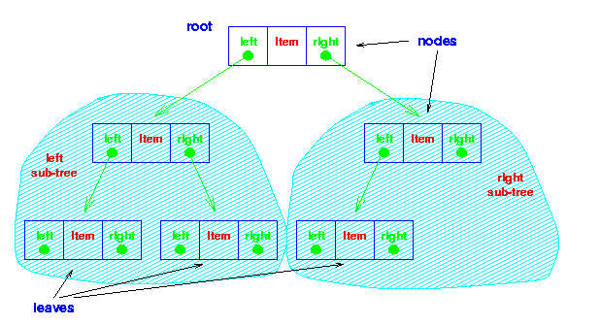
Binary Tree

Slide 19
Binary Trees
Node n1 is an ancestor of node n2 (and n2 is descendent of n1) if n1 is either the parent of n2 or the parent of some ancestor of n2.
A
A is ancestor of D
B
C
H is descendent of B
G is ancestor of J
D
E
F
G
F is ___ of H ???
H
I
J

Slide 20
Binary Trees
A node n2 is left descendent of node n1 if n2 is either the left child of n1 or a descendent of the left child of n1.
Similar definition for right descendent.
Two nodes are siblings if they are left and right children of the same parent.

Slide 21
Binary Trees
A
G is descendent of A.
right
E is descendent of A.
left
B
C
H is descendent of B.
right
D
E
F
G
I is descendent of C.
right
H
I
J
H is descendent of E.
left

Slide 22
Examples – familiarization with notation
Root
A
B
C
D
E
F
Left Subtree of A
G
H
I
Right Subtree of A

Slide 23
Examples – familiarization with notation
A
An Edge
B
C
D
E
F
G
H
I

Slide 24
Examples – familiarization with notation
A
Child nodes of C?
B
C
Child nodes of A?
D
E
F
G
H
I

Slide 25
Examples – familiarization with notation
Descendants of Node C?
A
Descendants of A?
B
C
D
E
F
G
H
I

Slide 26
Examples – familiarization with notation
Parent of Node E?
A
Parent of Node H?
B
C
D
E
F
G
H
I

Slide 27
Examples – familiarization with notation
Ancestors of Node D?
A
Ancestors of Node H?
B
C
D
E
F
G
H
I

Slide 28
Examples – familiarization with notation
A path from J to A
A
Path:
If n₁, n₂,…n_{k} is a sequence of nodes such that n_{i} is the parent of n_{i+1}, then that sequence is a path.
B
C
D
E
F
G
H
I
J

Slide 29
Examples – familiarization with notation
Leaf node:
Any node that has empty children
A
B
C
D
E
F
G
H
I

Slide 30
Examples – familiarization with notation
A
B
C
D
E
F
Internal node:
Any node that has at least one
non-emptyChild
G
H
I

Slide 31
Example Binary Trees
One node
Two nodes
Three nodes

Slide 32
Types of Binary Trees
Strictly Binary Trees
Complete Binary Trees
Perfect Binary Tree
Almost Complete Binary Tree

Slide 33
Strictly Binary Tree
If every non-leaf node in a binary tree has nonempty left and right subtrees, the tree is known as Strictly Binary Tree.
A
A
B
C
B
C
D
E
F
G
D
E
F
G
H
I
J
I
J
Strictly Binary Tree??
Strictly Binary Tree

Slide 34
Binary Trees (recall)
Level:
The root of the tree has level 0, and the level of any other node in the tree is one more than the level of its parent.
Level 0
A
Level 1
B
C
Level 2
D
E
F
G
I
J

Slide 35
Binary Trees (recall)
Depth:
The depth of a binary tree is the maximum level of any
leaf in the tree.
A
B
C
D
E
F
G
Depth:
3
I
J

Slide 36
Perfect Binary Tree
A perfect binary tree of depth d is a strictly binary tree all of whose leaves are at level d.
A
B
C
D
E
F
G
A perfect (complete) binary tree of depth 2

Slide 37
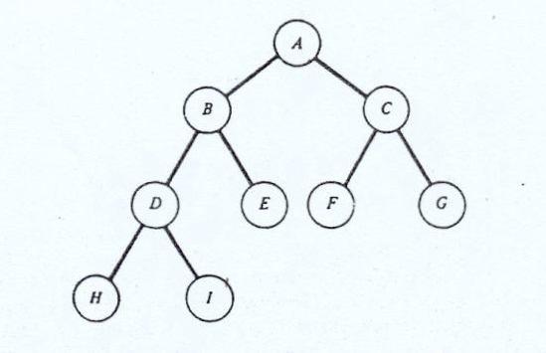
Almost Complete Binary Tree
A binary tree (of depth d) is an almost complete
binary tree if:
1. Each leaf in the tree at level d or at level d-1.
2. All nodes at level d (last level) are left aligned.

Slide 38
Binary Trees
If a binary tree contains m nodes at level l, it can contain
at the most nodes at level l+1.
2m
Since a binary tree can have at the most one node at level 0, It can have at the most 2^{l} nodes at level l.
A perfect binary tree of depth d is a binary tree that contains exactly 2^{l} nodes at each level between 0 and d.
A perfect binary tree contains exactly 2^{d} nodes at level d, that is; 2^{d} leaves.

Slide 39
Binary Trees
A
B
C
D
E
F
G
A perfect Binary Tree…
Dept d = 2
No of nodes at level i = 2^{i}
No of leaves = 2^{d} = 2² = 4

Slide 40
Binary Trees
A
B
C
D
E
F
G
.
.
.
.
.
.
.
.
.
.
.
.
Total Number of nodes in a perfect binary tree:
N = 2⁰+2¹+2²+ ……+2^{d} = _{j=0} Σ^{d} 2^{j}
= 2 ^{d+1}- 1

Slide 41
Binary Trees
Number of nodes in a perfect binary tree:
N = 2 ^{d+1}- 1
Given the number of nodes of a perfect binary tree,
its depth d would be:
d = log₂(N + 1) -1

Slide 42
BINARY TREE ADT
Create
Create an empty binary tree
Empty
Return true when binary tree is empty else return false.
Tree Traversal
Inorder Traversal
Preorder Traversal
Postorder Traversal
Insert
To insert a node
Deletion
To delete a node
Search
To search a given node
Copy
Copy one tree into another

Slide 43
Tree Traversal
Moving through a tree, visiting each node exactly once
Preorder Traversal
Inorder Traversal
Postorder Traversal

Slide 44
Traversal of a Binary Tree
Used to display/access the data in a tree in a certain order.
In traversing always right sub-tree is traversed after left sub-tree.
Three methods of traversing
Preorder Traversing
Root – Left –Right
Inorder Traversing
Left – Root – Right
Postorder Traversing
Left – Right - Root

Slide 45
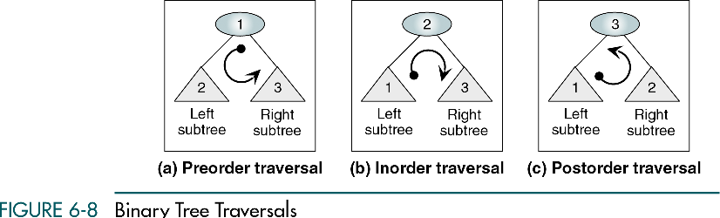
Traversal of a Binary Tree

Slide 46
Tree Traversal
Preorder:
Visit the root
Traverse the left subtree in preorder
Traverse the right subtree in preorder
Also known as depth-first traversal.

Slide 47
Preorder Traversal
Visit the root
Traverse the left subtree in preorder
Traverse the right subtree in preorder
32
left subtree
79
42
right subtree
13
95
16
Output:
32
Problem now reduced to traversal of two smaller binary trees.

Slide 48
Preorder Traversal
79
Visit root
Traverse left subtree
Traverse right subtree
13
Output: 32
79
Left subtree is empty
Now, traverse the right subtree

Slide 49
Preorder Traversal
Visit root
Traverse left subtree
Traverse right subtree
13
Output: 32 79
13

Slide 50
Preorder Traversal
32
79
42
13
95
16
Output: 32 79 13

Slide 51
Preorder Traversal
42
Output: 32 79 13
42
Output: 32 79 13 42
95
Output: 32 79 13 42 95
16
95
16
95
16

Slide 52
Preorder Traversal
32
79
42
13
95
16
Output: 32 79 13 42 95 16

Slide 53
Preorder Traversal
32
79
42
13
95
16
32
79
13
42
95
16

Slide 54
Tree Traversal
Inorder:
Traverse the left subtree in inorder
Visit the root
Traverse the right subtree in inorder
Also known as Symmetric order.

Slide 55
Inorder Traversal
32
Traverse the left subtree
Visit the root
Traverse the right subtree
79
42
13
95
16
79 13 32 95 42 16

Slide 56
Tree Traversal
Postorder:
Traverse the left subtree in postorder
Traverse the right subtree in postorder
Visit the root

Slide 57
Postorder Traversal
32
Traverse the left subtree
Traverse the right subtree
Visit the root
79
42
13
95
16
13 79 95 16 42 32

Slide 58
Tree Traversal
Preorder:
root – left – right
Postorder:
left – right – root
Inorder:
left – root – right

Slide 59
Tree Traversal
A
Preorder: A B D G C E F H
Inorder: D G B A E C H F
B
C
Postorder: G D B E H F C A
D
E
F
G
H

Slide 60
Tree Traversal
15
16
5
3
20
12
23
10
13
18
6
7
Pre-order: 15, 5, 3, 12, 10, 6, 7, 13, 16, 20, 18, 23
Post-order: 3, 7, 6, 10, 13, 12, 5, 18, 23, 20, 16, 15
In-order: 3, 5, 6, 7, 10, 12, 13, 15, 16, 18, 20, 23

Slide 61
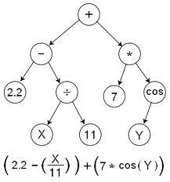
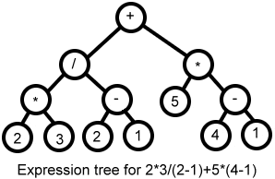
Binary Tree Applications
Expression trees

Slide 62
Binary Expression Tree
A special kind of binary tree in which:
Each leaf node contains a single operand
Each nonleaf node contains a single binary operator
The root contains the operator that is to be applied to the results of evaluating the expressions in the left and right subtrees

Slide 63
A binary expression tree
treePtr
‘-’
‘8’
‘5’
INORDER TRAVERSAL: 8 - 5
PREORDER TRAVERSAL: - 8 5
POSTORDER TRAVERSAL: 8 5 -

Slide 64
A Binary Expression Tree
‘*’
‘+’
‘3’
‘4’
‘2’
Evaluate the expression?
( 4 + 2 ) * 3 = 18

Slide 65
A Binary Expression Tree
‘*’
‘+’
‘3’
‘4’
‘2’
What infix, prefix, postfix expressions does it represent?

Slide 66
A Binary Expression Tree
‘*’
‘+’
‘3’
‘4’
‘2’
Infix: ( ( 4 + 2 ) * 3 )
Prefix: * + 4 2 3
Postfix: 4 2 + 3 *

Slide 67
Representing Expressions
A * B + C
A * (B + C)
((A + B) * C) / (D - E)
+
*
/
*
A
*
-
C
+
A
B
+
C
D
E
B
C
A
B
x Δ y
Δ
x
y

Slide 68
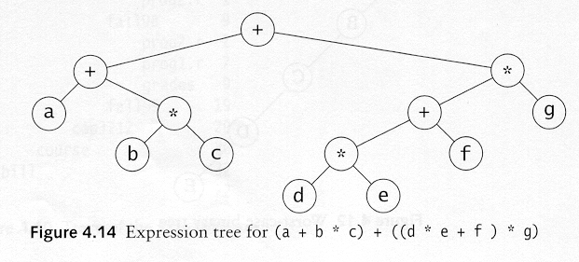
A Binary Expression Tree
Draw an expression tree for the following:
(a+b*c)+((d*e+f)*g)

Slide 69
Traverse the tree in Left-Right-Root order (postorder) to get postfix:
/
*
-
A
B
+
C
*
D
E
-
/
+
C
D
E
Traverse tree in Root-Left-Right order (preorder) to get prefix:
/
A
B
*
-
/ * + A B
C
- D E
+
C
D
E
Traverse tree in Left-Root-Right order (inorder) to get infix — must insert ()'s
/
A
B
*
-
( )
/
( * C)
(A + B)
(D - E)
+
E
C
D
A
B

Slide 70
Binary expression tree
‘*’
‘-’
‘/’
‘8’
‘5’
‘+’
‘4’
‘4’
‘2’
What infix, prefix, postfix expressions does it represent?

Slide 71
Binary Expression Tree
‘*’
‘-’
‘/’
‘8’
‘5’
‘+’
‘4’
‘4’
‘2’
Infix: ( ( 8 - 5 ) * ( ( 4 + 2 ) / 4 ) )
Prefix: * - 8 5 / + 4 2 4
Postfix: 8 5 - 4 2 + 4 / *

Slide 72
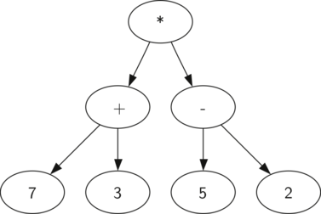
((7+3)*(5-2))

Slide 73
Conversion of a postfix expression to tree
Scan the postfix expression from left to right.
Create a node Curr
Get the next symbol from the expression.
If the symbol is an operand
Set this operand as data member of the node Curr
Push the node on the stack
If the symbol is an operator
T2 = Pop()
T1 = Pop()
Attach T1 to the left and T2 to the right of Curr
Set the operator as data member of the node Curr
Push Curr (with child nodes attached) onto the stack
Repeat Steps I-V till end of expression
Pop the (only remaining) node from the stack which is a pointer to the root of the expression tree.

Slide 74
Expression: a b + c d e + * *
‘a’ is an operand, a one-node tree is created and pushed on the stack
‘b’ is again an operand, and is pushed on the stack
a
b
Next, a ‘+’ is read, so two pointers to trees are popped, a new tree is formed, and a pointer to it is pushed onto the stack.
+
a
b

Slide 75
Conversion of Postfix Expression to tree
Expression: a b + c d e + * *
Next, c, d, and e are read, and for each a one-node tree is created and a pointer to the corresponding tree is pushed onto the stack.
+
c
d
e
a
b
Now a ‘+’ is read, so two trees are merged.
+
c
+
a
b
d
e

Slide 76
Expression: a b + c d e + * *
Continuing, a ‘*’ is read, so we pop two tree pointers and form a new tree with a ‘*’ as root.
+
c
+
+
*
a
b
d
e
a
b
c
+
d
e

Slide 77
Expression: a b + c d e + * *
Finally, the last symbol is read, two trees are merged, and a pointer to the final tree is left on the stack.
+
*
*
a
b
c
+
+
*
d
e
a
b
c
+
d
e

Slide 78
Linked Nodes Implementation: Use nodes of the form
data
left
right
Left child
Right child
And maintain a pointer to the root.

Slide 79
C++ Implementation:
class Node { public: int data; Node *left, *right; };
class BinaryTree {
public:
Node *root; // pointer to root node BinaryTree();
Node* insert(int);
//Node* search(int); //tree type dependent
//void delete_node(int); //tree type dependent
void traverse(); //pre, in, post order
};

Slide 80

Implementing Tree Traversals

Slide 81
Tree Traversal
Preorder:
root – left – right
Postorder:
left – right – root
Inorder:
left – root – right

Slide 82
Implementing Tree Traversals
void Preorder(Node* ptr)
{
if(ptr!=NULL)
{
cout << ptr->data << “ “;
Preorder(ptr->left);
Preorder(ptr->right);
}
}

Slide 83
Implementing Tree Traversals
void Postorder(Node* ptr)
{
if(ptr!=NULL)
{
Postorder(ptr->left);
Postorder(ptr->right);
cout << ptr->data << “ “;
}
}

Slide 84
Implementing Tree Traversals
void Inorder(Node* ptr)
{
if(ptr!=NULL)
{
Inorder(ptr->left);
cout << ptr->data << “ “;
Inorder(ptr->right);
}
}

Slide 85
Traversal exercises: finding output
14
15
4
3
18
9
14
20
7
9
16
5
17
4
5
14 4 3 3 9 7 5 4 4 5 5 5 7 9 9 9 4 15 14 14 18 16 17 17 16 20 20 18 15 14
void Traversal(Node* temp)
{
if(temp!=NULL)
{
cout<<temp->data;
Traversal(temp->left);
Traversal(temp->right);
cout<<temp->data;
}
}
Practice Tracing The Tree Using
The Given Traversal Function

Slide 86
Utility functions
Counting the number of leaf nodes:
Int countleafnodes(Node *ptr)
{
if(ptr==NULL)
return 0;
if(ptr->left==NULL&&ptr->right==NULL)
return 1;
else
return countleafnodes(ptr->left)+coutnleafnodes(ptr->right);
}

