Slide 1


Pitch Deck merafuture.pk
Dr. Zunaira Saqib

Slide 2


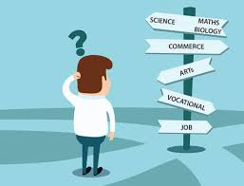
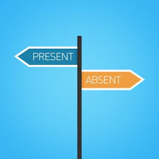

The Problem
Absence of Career Counselling for Youngsters (FA, FSc, A Levels)
Students choosing degrees based on social pressure, job security, and, popular options
Absence and Access of career counselling / counsellors
Bigger Problem: Students in Wrong Degrees
Bigger Problem: Wrong Careers
Demotivated Workforce

Slide 3

The Solution? Aptitude Testing
Matching Students with the Right Degrees according to their personality, Interest and knowledge.

Slide 4


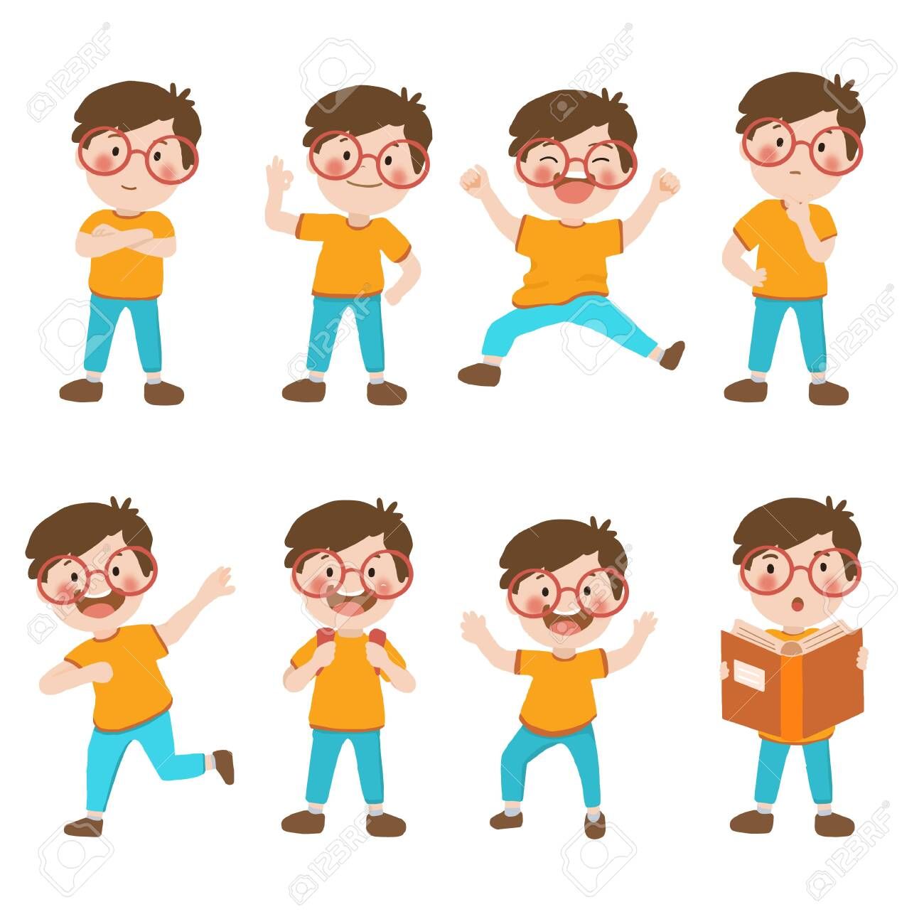

The Solution: www.merafuture.pk Pakistan’s First AI based Career Counseling Website
Technical / Subject Based Tests
Personality Tests
Interest Tests
Numerical
Mechanical
Verbal
Inductive
Deductive
Error Checking
Holland’s Personality Test
6 Personality Types
10 Interest Fields

Slide 5




30 Pages Career Assessment Report
The Product/Service
Multidimensional Career Counselling Test (MCCT)
1st and 2nd Dominant Personality
Suggested Careers
1st and 2nd Dominant Interests
Suggested Careers
Subject Based Tests Results
Suggested Careers
Matching with Education Fields and Degrees
Based on All Dimensions

Slide 6
Industry Analysis
3.5 Million High School Students in Pakistan
40% in Private Schools
Over 40,000 Private Schools
Capture 1% of Market (35,000) in First 3 Years at 1000 PKR per test
Revenue of 35 Million PKR
We are going to be focused on Differentiation

Slide 7



USP
AI
Affordable
Accessible
Based on Validated Tests and AI Model
Localized Tests and Results
One time fee and Priced reasonably
Accessible to anyone and everyone throughout Pakistan

Slide 8
Thank you! Questions Please

