Slide 1

Justice and Fairness Part 1

Slide 2
Disputes among individuals in business often refer to justice or fairness.
Resolving disputes like these requires that we compare and weigh the conflicting claims of each of the parties and strike a balance between them.
Justice and fairness are essentially comparative.
Although the terms justice and fairness are used almost interchangeably, we tend to reserve the word justice for matters that are especially serious, although some authors have held that the concept of fairness is more fundamental.

Slide 3
Standards of justice are generally taken to have more weight than utilitarian considerations.
If a society is unjust to many of its members, then we normally condemn that society, even if the injustices secure more utilitarian benefits for everyone.
If we think that slavery is unjust, for example, then we condemn a society that uses slavery even if slavery makes that society more productive.

Slide 4
Standards of justice do not generally override/overrule/ignore the moral rights of individuals.
Part of the reason for this is that, to some extent, justice is based on individual moral rights.
The moral right to be treated as a free and equal person, for example, is part of what lies behind the idea that benefits and burdens should be distributed equally.

Slide 5
However, correcting extreme injustices may justify restricting the rights of some individuals.
Property rights, for example, might be legitimately redistributed for the sake of justice.
Issues involving questions of justice and fairness are usually divided into three categories.
1
2
3
Distributive Justice
Retributive justice
Compensatory justice

Slide 6
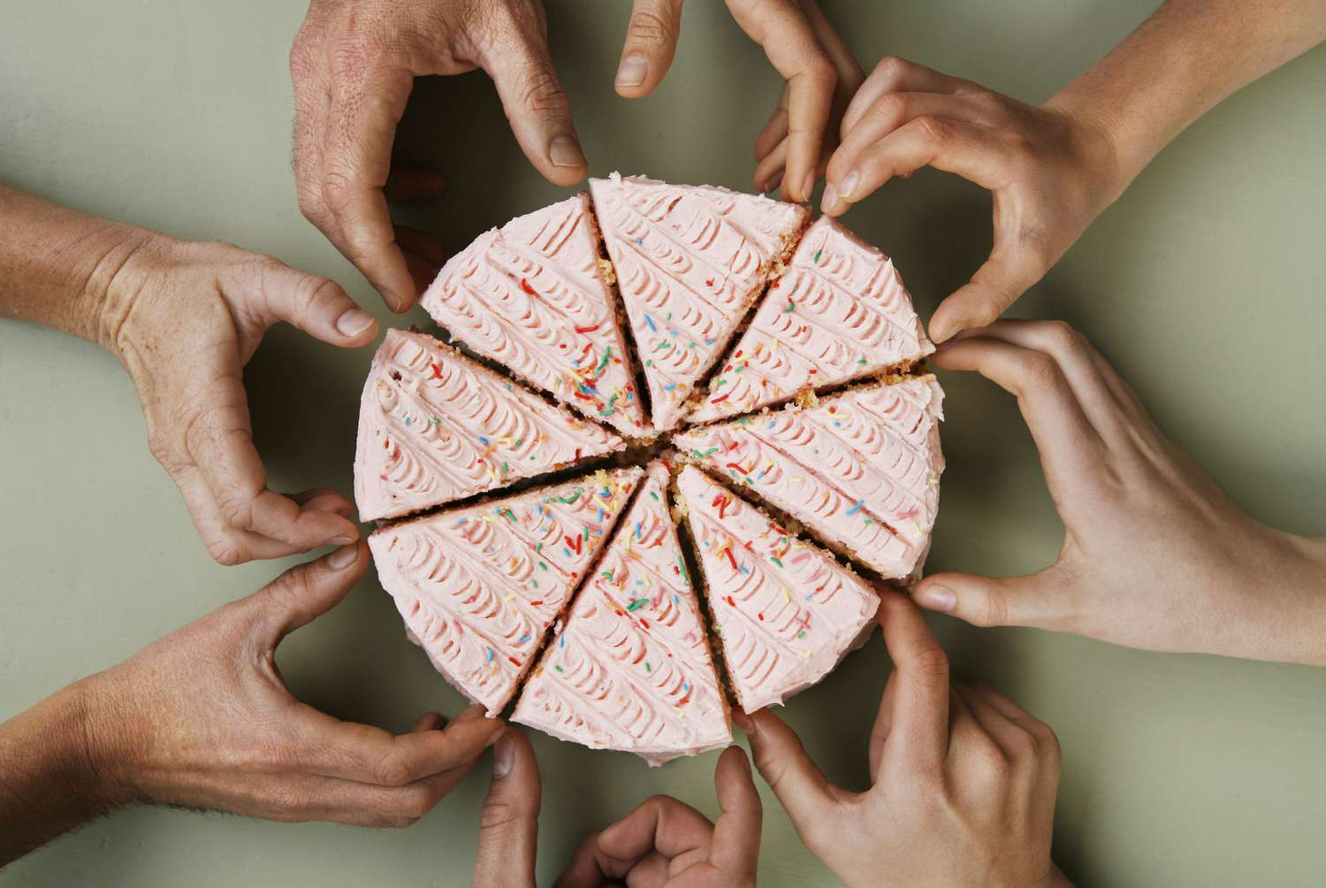
Distributive Justice
The first and basic category, is concerned with the fair distribution of society’s benefits and burdens.
Questions of distributive justice arise when different people make claims on society’s benefits and burdens and all the claims cannot be satisfied.

Slide 7
The central cases are those where there is a scarcity of benefits—such as jobs, food, housing, medical care, income, and wealth—as compared with the numbers and desires of the people who want these goods.
The other side of the coin is that there may be too many burdens— unpleasant work, drudgery(hard word/donkey work), substandard housing, health injuries of various sorts—and not enough people willing to shoulder them.
When people’s desires and aversions exceed the adequacy of their resources, they are forced to develop principles for allocating scarce benefits and undesirable burdens in ways that are just and that resolve the conflicts in a fair way. The development of such principles is the concern of distributive justice

Slide 8
For example, if Susan and Bill are both doing the same work for me and there are no relevant differences between them or the work they are doing, then, in justice, I should pay them equal wages. However, if Susan is working twice as long as Bill and if length of working time is the relevant basis for determining wages on the sort of work they are doing, then, to be just, I should pay Susan twice as much as Bill.

Slide 9
This fundamental principle of distributive justice, however, is purely formal.
The principle is considered purely formal because it does not prescribe a specific way in which the distribution of goods and benefits should occur.
Instead, distributive justice as a formal principle recognizes that there are many different ways in which goods and benefits can be distributed, depending on the context and the specific needs of society, such as need, merit, or equality, but it does not specify which of these criteria should be used or how they should be applied.

Slide 10
For example, in a healthcare system, the formal principle of distributive justice would require that healthcare be distributed fairly to all individuals in society. However, the specific criteria for determining how healthcare is distributed might vary depending on the particular society and its values. Some societies might prioritize healthcare distribution based on need, while others might prioritize it based on merit or equality.
For example, one simple principle that people often use to decide who should receive a limited or scarce good is the “first-come, first-served” principle that operates when waiting in line to receive something, as well as in the seniority systems used by businesses.

Slide 11
Justice as Equality: Egalitarianism
Egalitarians hold that there are no relevant differences among people that can justify unequal treatment.
According to the egalitarian, all benefits and burdens should be distributed according to the following formula:
Every person should be given exactly equal shares of a society’s or a group’s benefits and burdens.
According to the egalitarian, this implies that goods should be allocated to people in equal portions.

Slide 12

Equality has been proposed as a principle of justice not only for entire societies, but also within smaller groups or organizations.
Within a family, for example, often children receive equal shares of the goods parents make available to them.
At work place…feeling of solidarity…workers feel that all should receive equal compensation

Slide 13

Equality has appeared to many to be as an attractive social ideal, and inequality as a defect.
“All men are created equal,” states the U.S. Declaration of Independence, and the ideal of equality has been the driving force behind the emancipation of slaves; the prohibition of indentured servitude; the elimination of racial, sexual, and property requirements on voting and holding public office; and the institution of free public education.

Slide 14

Despite their popularity, however, egalitarian views have been subjected to heavy criticisms.
One line of attack has focused on the
egalitarian claim that all human beings
are equal in some fundamental respect.
Critics claim that there is no quality that
all human beings possess in precisely
the same degree: Human beings differ
in their abilities, intelligence, virtues,
needs, desires, and all other physical
and mental characteristics.
If this is so, then human beings are
unequal in all respects.

Slide 15
A second set of criticisms argues that the egalitarian ignores some characteristics that should be taken into account in distributing goods both in society and in smaller groups: need, ability, and effort.
If everyone is given exactly the same things, critics point out, then the lazy person will get as much as the industrious one, although the lazy one does not deserve as much.
If everyone is given exactly the same, then the sick person will get only as much as a healthy one, although the sick person needs more.
If everyone is given exactly the same, the handicapped person will have to do as much as a more able person, although the handicapped person has less ability.

Slide 16
If everyone is given exactly the same, then individuals will have no incentives to exert greater efforts in their work.
As a result, society’s productivity and efficiency may decline.
Critics allege that egalitarianism must be mistaken because the egalitarian formula ignores all these facts, and because it is clear that they should be taken into account.

Slide 17
Political equality
Some egalitarians have tried to strengthen their position by distinguishing two different kinds of equality:
Economic equality

Slide 18
Political equality
refers to an equal participation in, and treatment by, the means of controlling and directing the political system. This includes equal rights to participate in the legislative process, equal civil liberties, and equal rights to due process.
Economic equality
refers to equality of income and wealth and equality of opportunity.

Slide 19
The criticisms leveled against equality, according to some egalitarians, only apply to economic equality and not to political equality.
Other egalitarians have claimed that even economic equality is defensible if it is suitably limited. Thus, they have argued that every person has a right to a minimum standard of living and that income and wealth should be distributed equally until this standard is achieved for everyone.

Slide 20
Justice Based on Contribution: Capitalist Justice
Some writers have argued that a society’s benefits should be distributed in proportion to what each individual contributes to a society and/or to a group.
According to this capitalist view of justice, when people engage in economic exchanges with each other, what a person gets out of the exchange should be at least equal in value to what the person contributed.

Slide 21
The principle of contribution is perhaps the principle of fairness most widely used to establish salaries and wages in U.S. companies.
Interestingly, when workers are paid in accordance with the principle of contribution, this tends to promote among them an uncooperative and even competitive atmosphere in which resources and information are less willingly shared and in which status differences emerge

Slide 22
The main question raised by the contributive principle of distributive justice is how the “value of the contribution” of each individual is to be measured.
One long lived tradition has held that contributions should be measured in terms of work effort.
The harder one works, the more one deserves.

Slide 23
This is the assumption behind the Puritan ethic, which held that individuals had a religious obligation to work hard at their calling (the vocation to which God summons each individual) and that God justly rewards hard work with wealth and success, while He justly punishes laziness with poverty and failure.
In the United States, this Puritan ethic has evolved into a secularized work ethic, which places a high value on individual effort and which assumes that, whereas hard work does and should lead to success, loafing is and should be punished.

Slide 24
However, there are many problems with using effort as the basis of distribution.
First, to reward a person’s efforts without any reference to whether the person produces anything worthwhile through these efforts is to reward incompetence and inefficiency.
Second, if we reward people solely for their efforts and ignore their abilities and relative productivity, then talented and highly productive people will be given little incentive to invest their talent and productivity in producing goods for society. As a result, the welfare of society will decline.

Slide 25
A second important tradition has held that contributions should be measured in terms of productivity.
The greater the quantity of a person’s contributed product, the more that person should receive. ( Product here should be interpreted broadly to include services rendered, capital invested, commodities manufactured, and any type of literary, scientific, or aesthetic works produced.)

Slide 26
A major problem with this second proposal is that it ignores people’s needs. Handicapped, ill, untrained, and immature persons may be unable to produce anything worthwhile; if people are rewarded on the basis of their productivity, the needs of these disadvantaged groups will not be met.
The main problem with this second proposal is that it is difficult to place any objective measure on the value of a person’s product, especially in fields such as science, the arts, entertainment, athletics, education, theology, and health care. Who would want to have their products priced on the basis of someone else’s subjective estimates?
Third version of principle of contribution pdf pg 122

Slide 27
Justice Based on Needs and Abilities: Socialism
The socialist principle, can be paraphrased as follows:
Work burdens should be distributed according to people’s abilities, and benefits should be distributed according to people’s needs.
This socialist principle is based first on the idea that people realize their human potential by exercising their abilities in productive work.
Work should be distributed in such a way that a person can be as productive as possible, and this implies distributing work according to ability.

Slide 28
Second, the benefits produced through work should be used to promote human happiness and well-being.
Perhaps, most fundamental to the socialist view is the notion that societies should be communities in which benefits and burdens are distributed on the model of a family.
Just as able family members willingly support the family, and just as needy family members are willingly supported by the family, so also the able members of a society should contribute their abilities to society by taking up its burdens while the needy should be allowed to share in its benefits.

Slide 29
Nevertheless, there is something to be said for the socialist principle: Needs and abilities certainly should be taken into account when determining how benefits and burdens should be distributed among the members of a group or society.
However, the socialist principle has also had its critics.

Slide 30
First, opponents have pointed out that, under the socialist principle, there would be no relation between the amount of effort a worker puts forth and the amount of remuneration the worker receives (because remuneration would depend on need, not on effort).
Consequently, opponents conclude, workers would have no incentive to put forth any work efforts at all knowing that they will receive the same regardless of whether they work hard.
Underlying this criticism is a deeper objection— namely, that it is unrealistic to think that entire societies could be modeled on familial relationships.

Slide 31
Human nature is essentially self-interested and competitive, the critics of socialism hold, and so outside the family people cannot be motivated by the fraternal willingness to share and help that is characteristic of families.
Socialists have usually replied to this charge by arguing that human beings are trained to acquire the vices of selfishness and competitiveness by modern social and economic institutions that inculcate and encourage competitive, self-interested behavior, but that people do not have these vices by nature.

Slide 32
A second objection that opponents of the socialist principle have argued is that, if the socialist principle were enforced, it would obliterate individual freedom.
Under the socialist principle, the occupation each person entered would be determined by the person’s abilities and not by free choice.
If a person has the ability to be a university teacher but wants to be an actor, the person will have to become a teacher.

Slide 33
Similarly, under the socialist principle, the goods a person gets will be determined by the person’s needs and not by free choice.
If a person needs a loaf of bread but wants a chocolate, the person will have to take the loaf of bread.
The sacrifice of freedom is even greater.
Critics say that, some central government agency has to decide what tasks should be matched to each person’s abilities and what goods should be allotted to each person’s needs. The decisions of this central agency will then have to be imposed on other persons at the expense of their freedom to choose for themselves. Hence substitutes paternalism/ authoritarianism for freedom.

Slide 34
Justice as Freedom: Libertarianism
The libertarian holds that no particular way of distributing goods can be said to be just or unjust apart from the free choices individuals make.
Any distribution of benefits and burdens is just if it is the result of individuals freely choosing to exchange with each other the goods each person already owns.

Slide 35
Robert Nozick, a leading libertarian, suggested this principle as the basic principle of distributive justice.
For example, if I choose to write a novel or carve a statue out of a piece of driftwood, then I should be allowed to keep the novel or statue if I choose to keep it. If I choose, I should be allowed to give it away to someone else or exchange it for another object with whomever I choose. In general, people should be allowed to keep everything they make and everything they are freely given. Obviously, this means it would be wrong to tax one person (i.e., take the person’s money) to provide welfare benefits for the needs of someone else.

Slide 36
The only distribution that is just, according to Nozick, is one that results from free individual choices. Any distribution that results from an attempt to impose a certain pattern on society (e.g., imposing equality on everyone or taking from the “haves” and giving to the “have-nots”) will therefore be unjust.
Criticism pg 125 pdf
Freedom from ignorance and freedom from hunger.
What if person is unable to do anything for himself and others also deny to help him. Should he be left alone?

Slide 37
Justice as Fairness: John Rawls
These discussions have suggested several different considerations that should be taken into account in the distribution of society’s benefits and burdens: political and economic equality, a minimum standard of living, needs, ability, effort, and freedom.
What is needed, however, is a comprehensive theory capable of drawing these considerations together and fitting them into a logical whole.
John Rawls provides one approach to distributive justice that at least approximates this ideal of a comprehensive theory.

Slide 38
Rawls’s theory is based on the assumption that conflicts involving justice should be settled by first devising a fair method for choosing the principles by which the conflicts are resolved.
Once a fair method of choosing principles is devised, the principles we choose by using that method should serve us as our own principles of distributive justice.
The principles of distributive justice that Rawls proposes can be paraphrased by saying that the distribution of benefits and burdens in a society is just, if and only if,:

Slide 39
Principal of equal liberty:
Principle 1 is called the principle of equal liberty. Essentially it says that each citizen’s liberties must be protected from invasion by others and must be equal to those of others. These basic liberties include the right to vote, freedom of speech and conscience and the other civil liberties, freedom to hold personal property, and freedom from arbitrary arrest.
If the principle of equal liberty is correct, then it implies that it is unjust for business institutions to invade the privacy of employees, pressure managers to vote in certain ways, exert undue influence on political processes by the use of bribes, or otherwise violate the equal political liberties of society’s members.

Slide 40
2. (a) The difference principle.
Principle 2a is called the difference principle. It assumes that
a productive society will incorporate inequalities, but takes steps to
improve the position of the neediest members of society. Rawls claims that the more productive a society is, the more benefits it will be able to provide for its least-advantaged members.
For example, consider a society where some individuals possess significant talents or skills that allow them to earn higher incomes or accumulate more wealth. According to the difference principle, it would be acceptable for these individuals to enjoy the fruits of their labor in the form of higher incomes or greater wealth. However, the principle also requires that measures be taken to ensure that the less fortunate members of society, such as those with disabilities or those born into disadvantaged circumstances, are not left behind.

Slide 41
2. (b) Principle of fair equality of opportunity.
Principle 2b is called the principle of fair equality of opportunity.
It says that everyone should be given an equal opportunity to qualify for the more privileged positions in society’s institutions.
This means that not only job qualifications should be related to the requirements of the job (thereby prohibiting racial and sexual discrimination), but that each person must have access to the training and education needed to qualify for the desirable jobs. A person’s efforts, abilities, and contribution would then determine remuneration.

Slide 42
Rawls tells us that Principle 1 is supposed to take priority over Principle 2 if the two of them ever come into conflict, and within Principle 2, Part b is supposed to take priority over Part a.

Slide 43
The principles that Rawls proposes are quite comprehensive and bring together the main considerations stressed by the other approaches to justice that we have examined.
However, Rawls not only provides us with a set of principles of justice, he also proposes a general method for evaluating the adequacy of any moral principles in a fair way.

Slide 44
John Rawls developed theory of justice that could guide modern societies. In his influential book "A Theory of Justice," Rawls used the thought experiment of an "original position" to explore how rational individuals would construct a just society.
The original position is an imaginary scenario in which a group of individuals come together to determine the principles of justice that will govern their society. Rawls assumes that these individuals are rational and self-interested, but that they are also ignorant of any particulars about themselves, such as their social status, wealth, talents, or even their gender or race. This state of ignorance is called the "veil of ignorance."

Slide 45
Rawls argues that this veil of ignorance is necessary for the individuals to make fair and impartial decisions about the principles of justice that will govern their society. By not knowing anything about themselves or others, they will be forced to adopt a "neutral" perspective that does not favor any particular group or individual.
In this original position, Rawls asks individuals to choose principles of justice that would be acceptable to everyone, regardless of their particular interests or circumstances. Rawls argues that these principles would include basic liberties, equality of opportunity, and a fair distribution of resources and benefits across society.

Slide 46
According to Rawls, the principles that the imaginary parties to the original position accept will therefore turn out to be morally justified.
The original position incorporates three moral ideas of Kant that we saw earlier:
(1) reversibility(the parties choose principles that they will apply to themselves),
(2) universalizability(the principles must apply equally to everyone), and
(3) treating people as ends (each party has an equal say in the choice of principles).

Slide 47
Criticism to Rawls’s theory
1. The original position is not an adequate method for choosing moral principles. According to these critics, the mere fact that a set of principles is chosen by the hypothetical parties to the original position tells us nothing about whether the principles are morally justified.
In the context of Rawls' theory of justice, hypothetical parties refer to the individuals that are imagined to be behind a "veil of ignorance" in the original position. A hypothetical situation where individuals are asked to decide on principles of justice without knowing their own position in society, such as their social class, race, gender, or abilities.

Slide 48
2. Other critics have argued that the parties to the original position would not choose Rawls’s principles at all. Utilitarian, for example, have argued that the hypothetical parties to the original position would choose utilitarianism and not Rawls’s principles.

Slide 49
Defenders still claim that the advantages of Rawls theory.
The theory preserves the basic values that have become embedded in our moral beliefs: freedom, equality of opportunity, and concern for the disadvantaged.
Second, the theory fits easily into the basic economic institutions. By requiring that inequalities work for the benefit of the least-advantaged and by requiring equality of opportunity, the theory shows how the inequalities that attend the division of labor and free markets can be compensated for and thereby, made just.

Slide 50
3. The difference principle encourages the more talented to use their skills in ways that will rebound to the benefit of fellow citizens who are less well off, thereby encouraging a type of communitarian or fraternal concern.
4. Fourth, Rawls’s theory takes into account the criteria of need, ability, effort, and contribution. The difference principle distributes benefits in accordance with need, whereas the principle of fair equality of opportunity in effect distributes benefits and burdens according to ability and contribution.

Slide 51
5. Fifth, the defenders of Rawls argue that there is the moral justification that the original position provides. The original position is defined so that its parties choose impartial principles that take into account the equal interests of everyone, and this, they claim, is the essence of morality.

