Slide 1

Ethics of
Care

Slide 2

An Ethic of Care
Claims ethics need not be impartial, unlike traditional ethical theories which assume ethics has to be impartial
Emphasizes
preserving and nurturing
concrete valuable relationships.
Says we should care for those dependent on and related to us.

Slide 3
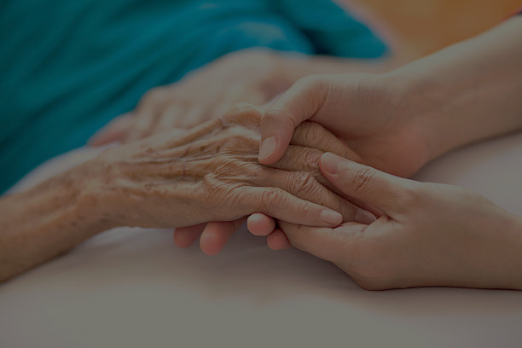
This view—that we have an obligation to exercise special care toward those particular persons with whom we have valuable close relationships, particularly relations of dependency—is a key concept in an “ethic of care,”.
According to this “care” view of ethics, the moral task is not to follow universal and impartial moral principles, but instead to attend and respond to the good of particular concrete persons with whom we are in a valuable and close relationship.
Compassion, concern, love, friendship, and kindness are all sentiments or virtues that normally manifest this dimension of morality.

Slide 4

Thus, an ethic of care emphasizes two moral demands:
1. We each exist in a web of relationships and should preserve and nurture
those concrete and valuable relationships we have with specific persons.

Slide 5
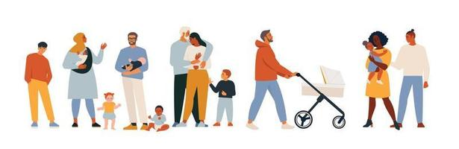
2. We each should exercise special care for those to whom we are concretely related by attending to their particular needs, values, desires, and concrete well-being as seen from their own personal perspective, and by responding positively to these needs, values, desires, and concrete well-being, particularly of those who are vulnerable and dependent on our care.

Slide 6

It is important not to restrict the notion of a concrete relationship to relationships between two individuals or to relationships between an individual and a specific group.
Many advocates of an ethic of care have argued that it should also encompass the larger systems of relationships that make up concrete communities.

Slide 7

A communitarian ethic is an ethic that sees concrete communities and communal relationships as having a fundamental value that should be preserved and maintained.

Slide 8


What is important in a communitarian ethic is not the isolated individual, but the community within which individuals discover who they are by seeing themselves as integral parts of a larger community with its traditions, culture, practices, and history.
The broad web of concrete relationships that make up a particular community, then, should be preserved and nurtured just as much as the more limited interpersonal relationships that spring up between individual people.

Slide 9
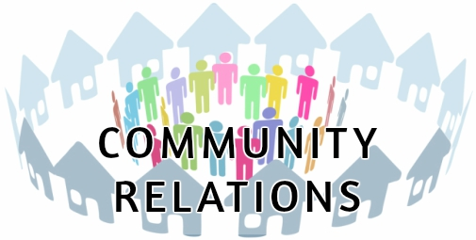
An ethic of care can be based on the claim that the identity of the self—who I am—is based on the relationships the self has with other selves: The individual cannot exist, cannot even be who he or she is, in isolation from caring relationships with others.

Slide 10
I need others to feed and care for me when I am born; I need others to educate me and care for me as I grow; I need others as friends and lovers to care for me when I mature; and I must always live in a community on whose language, traditions, culture, and other benefits I depend and that come to define me. It is in these concrete relationships with others that I form my understanding of who and what I am.

Slide 11
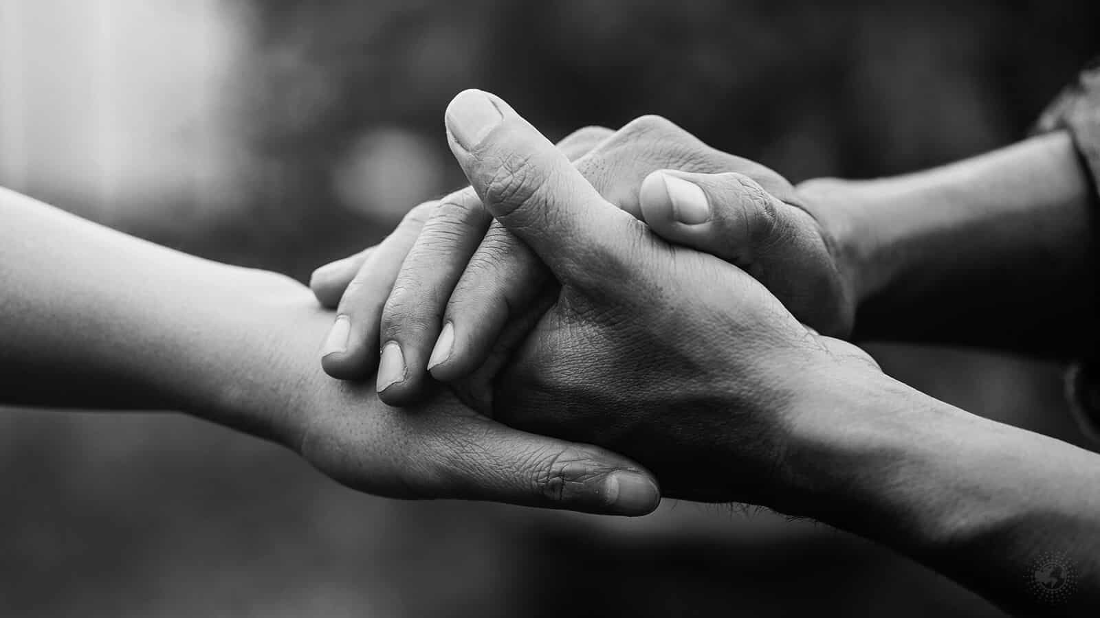
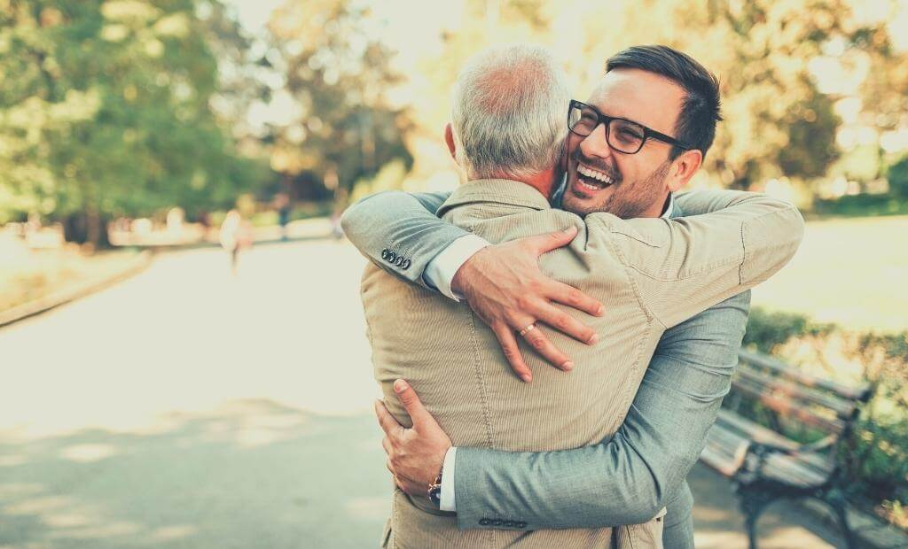
It is also important in this context to distinguish three different forms of caring:
caring about something,
caring after someone, and
caring for someone.
Caring for someone
The paradigm example of caring for someone is the kind of caring that a mother extends toward her child. Such caring is focused on persons and their wellbeing, not on things; it does not seek to foster dependence, but nurtures the person’s development so that he or she becomes capable of making his or her own choices and living his or her own life.

Slide 12


Caring about something
In contrast, caring about something is the kind of concern and interest that one can have for things or ideas. E.g you feel that it is important and are concerned about it. ...a company that cares about the environment.
Such caring for objects or ideas is not the kind of caring demanded by an ethics of care.

Slide 13


Caring after someone
One can also become busy taking care of people in a manner that looks after their needs but remains objective and distant from them as, for example, often happens in bureaucratic service institutions such as the post office or a social welfare office. Caring after people in this way, although often necessary, is not the kind of caring demanded by an ethic of care.
pdf page 133 read

Slide 14
Objections to ethics of care Page 135 pdf for detail reading
The care approach to ethics has been criticized on several grounds.
First, it has been claimed that an ethic of care can degenerate into unjust favoritism.
A second important criticism of an ethic of care is that its demands can lead to “burnout.”

Slide 15

Discrimination and respect for diversity
Discrimination and respect for diversity are two interconnected concepts that are important in creating a just and equitable society.
Discrimination refers to the unfair treatment of individuals or groups based on characteristics such as race, gender, religion, sex, or age. Discrimination can take many forms, including outright exclusion, unequal treatment, or the denial of opportunities.

Slide 16
Respect for diversity, on the other hand, refers to the recognition and valuing of differences among individuals and groups. This includes differences in culture, language, ethnicity, religion, gender, sex, and ability. Respect for diversity means acknowledging the value of diversity and promoting a culture of inclusion and acceptance.
The two concepts are interconnected because discrimination often arises from a lack of respect for diversity. When individuals or groups are seen as different or inferior, it can lead to prejudice and discrimination. Conversely, promoting respect for diversity can help to reduce discrimination and promote a more inclusive and equitable society.

Slide 17
Respect for diversity can be promoted through education, training, and awareness-raising initiatives. It is important to create a culture that values and celebrates diversity, and to actively work to challenge discrimination and prejudice.
This can involve promoting equal opportunities, providing support for marginalized groups, and actively seeking out diverse perspectives and experiences.
Ultimately, creating a society that values diversity and promotes respect for all individuals is essential for creating a just and equitable world. Discrimination and intolerance can have profound negative impacts on individuals and communities, and it is important that we work together to promote inclusion, respect, and acceptance for all.

Slide 18
Forms of Discrimination
Intentional discrimination is conscious and deliberate discrimination.
Unintentional discrimination is discrimination that is not consciously or deliberately sought, but is brought about by stereotypes or as an unintended outcome.
Individual discrimination is the discrimination of one or a few individuals acting on their own. (isolated act of a single (or a few) individual(s) who unintentionally discriminates against women or minorities because the individual has unconscious stereotypes about the abilities of women or minorities, perhaps absorbed from surrounding society.)

Slide 19
Institutional discrimination is discrimination that is the result of the actions of all or many of the people in an institution and of their routine processes and policies. (for example, organizations in which the best-paying jobs are routinely assigned to men and the worst-paying jobs are routinely assigned to women—on the stereotypical assumption that women are fit for some jobs and not for others.
Pdf pg.393 - 397 read

Slide 20
Sexual Harassment
Sexual harassment includes but is not limited to:
Making unwelcome sexual advances
Verbal harassment or abuse, verbal or written communication (it includes narration of sexual incidents, emailing or messaging or showing explicit sexual content in print or electronic form (SMS, Email, Screensavers, Posters, CDs etc)
Request for sexual favors (invitations for sex, requests for going out on dates)
Physical conduct (like touching, kissing, patting, pinching, physical assault like rape etc)
Sexually demeaning attitude (leering or staring at a person’s body
pdf pag 404-406 read

