Slide 1
Leadership and Organizational skills/culture

Slide 2
Culture as a concept has had a long and checkered/inconsistent history. It has been used by the layman as a word to indicate sophistication, as when we say that someone is very “cultured.”
It has been used by anthropologists to refer to the customs and rituals that societies develop over the course of their history.
In the last several decades it has been used by some organizational researchers and managers to refer to the climate and practices that organizations develop around their handling of people, or to the espoused values and credo of an organization

Slide 3
The culture of an organisation is its personality and character.
Organisational culture is made up of shared values, beliefs and assumptions about how people should behave and interact, how decisions should be made and how work activities should be carried out.
Key factors in an organisation’s culture include its history and environment as well as the people who lead and work for it.

Slide 4
The culture of an organization affects the way in which people behave and has to be taken into account as a contingency factor in any programme for developing organizations and HR policies and practices.
This is why it is important for HR specialists to understand the concept of organizational culture, how it affects organizations and how it can be managed, as discussed in this chapter.

Slide 5
Organizational culture defined
Organizational or corporate culture is the pattern of values, norms, beliefs, attitudes and assumptions that may not have been articulated but shape the ways in which people in organizations behave and things get done. ‘Values’ refer to what is believed to be important about how people and organizations behave. ‘Norms’ are the unwritten rules of behaviour.

Slide 6
The definition emphasizes that organizational culture is concerned with the subjective aspect of what goes on in organizations.
It refers to abstractions such as values and norms that pervade the whole or part of a business, which may not be defined, discussed or even noticed.
Nevertheless, culture can have a significant influence on people’s behaviour. The following are some other definitions of organizational culture:

Slide 7
The culture of an organization refers to the unique configuration of norms, values, beliefs and ways of behaving that characterize the manner in which groups
and individuals combine to get things done. Eldridge and Crombie (1974)

Slide 8
Culture is a system of informal rules that spells out how people are to behave most of the time. Deal and Kennedy (1982)

Slide 9
Culture is the commonly held beliefs, attitudes and values that exist in an organization. Put more simply, culture is ‘the way we do things around here’. Furnham and Gunter (1993)

Slide 10
Characteristics of culture, Furnham and Gunter (1993)
It is difficult to define (often a pointless exercise).
It is multi-dimensional, with many different components at different levels.
It is not particularly dynamic and ever-changing (being relatively stable over short periods of time).
It takes time to establish and therefore time to change a corporate culture.

Slide 11
Significance of culture, Furnham and Gunter (1993)
Culture represents the ‘social glue’ and generates a ‘we-feeling’, thus counteracting processes of differentiations that are an unavoidable part of organizational life.
Organizational culture offers a shared system of meanings which is the basis for communications and mutual understanding.
If these functions are not fulfilled in a satisfactory way, culture may significantly reduce the efficiency of an organization.

Slide 12
How organizational culture develops
The values and norms that are the basis of culture are formed in four ways;
first, by the leaders in the organization, especially those who have shaped it in the past. Schein (1990) indicates that people associate with visionary leaders – how they behave and what they expect. They note what such leaders pay attention to and treat them as role models.
Second, as Schein also points out, culture is formed around critical incidents – important events from which lessons are learnt about desirable or undesirable behaviour.

Slide 13
Third, as suggested by Furnham and Gunter (1993), culture develops from the need to maintain effective working relationships among organization members, and this establishes values and expectations.
Finally, culture is influenced by the organization’s environment. The external environment may be relatively dynamic or unchanging.

Slide 14
The components of culture
Organizational culture can be described in terms of values, norms, artefacts and management style.
VALUES
Values are beliefs in what is best or good for the organization and what should or ought to happen. The stronger the values the more they will influence behaviour. Implicit values that are deeply embedded in the culture of an organization and are reinforced by the behaviour of management can be highly influential, while espoused/adopted values that are idealistic and are not reflected in managerial behaviour may have little or no effect. When values are acted on they are called ‘values in use’.

Slide 15
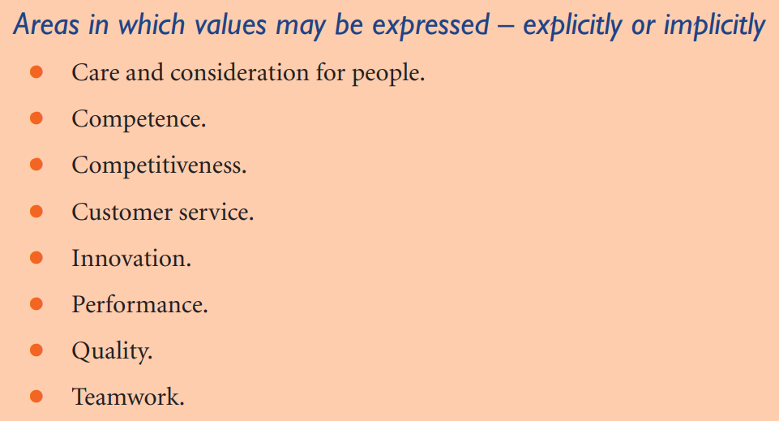

Slide 16
Norms
Norms are the unwritten rules of behaviour, the ‘rules of the game’ that provide informal guidelines on how to behave.
Norms tell people what they are supposed to be doing, saying, believing, even wearing.
They are never expressed in writing – if they were, they would be policies or procedures. They are passed on by word of mouth or behaviour and can be enforced by the reactions of people if they are violated. They can exert very powerful pressure on behaviour because of these reactions – we control others by the way we react to them.

Slide 17
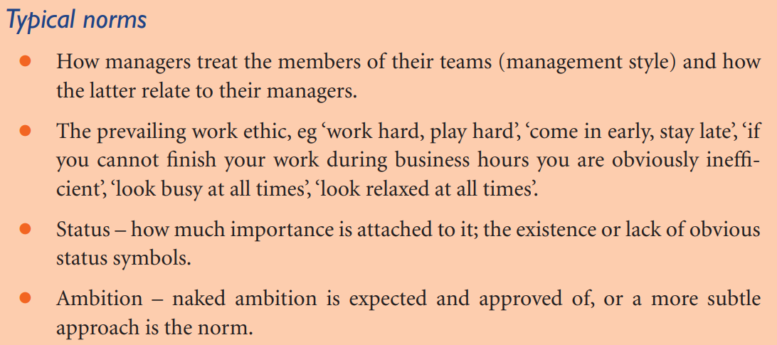

Slide 18
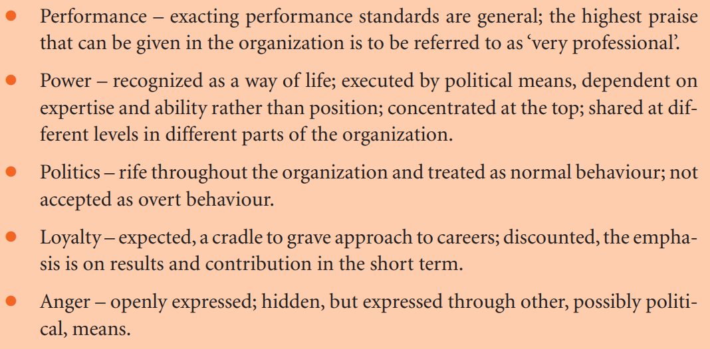

Slide 19
Artefacts
Artefacts are the visible and tangible aspects of an organization that people hear, see or feel and which contribute to their understanding of the organization’s culture.
Artefacts can include such things as the working environment, the tone and language used in e-mails, letters or memoranda, the manner in which people address each other at meetings, in e-mails or over the telephone, the welcome (or lack of welcome) given to visitors and the way in which telephonists deal with outside calls. Artefacts can be very revealing.

Slide 20
Management style
Management style is the approach managers use to deal with people. It is also called ‘leadership style’. It consists of the following extremes:
• Charismatic/non-charismatic.
• Autocratic/democratic.
• Enabler/controller.
• Transactional/transformational.

Slide 21
Organization ideologies, Harrison (1972)
Power-oriented – competitive, responsive to personality rather than expertise.
People-oriented – consensual, management control rejected.
Task-oriented – focus on competency, dynamic.
Role-oriented – focus on legality, legitimacy and bureaucracy

Slide 22
The power culture is one with a central power source that exercises control. There are few rules or procedures and the atmosphere is competitive, power-oriented and political.
The role culture in which work is controlled by procedures and rules and the role, or job description, is more important than the person who fills it. Power is associated with positions not people.

Slide 23
3. The task culture in which the aim is to bring together the right people and let them get on with it. Influence is based more on expert power than in position or personal power. The culture is adaptable and teamwork is important.
4. The person culture in which the individual is the central point. The organization exists only to serve and assist the individuals in it.

Slide 24
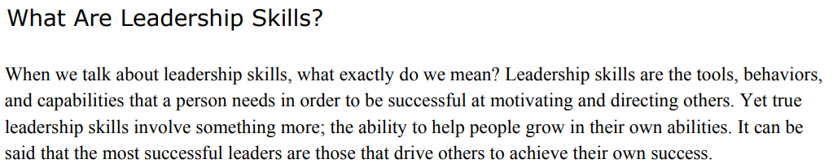
Leadership Skills

Slide 25
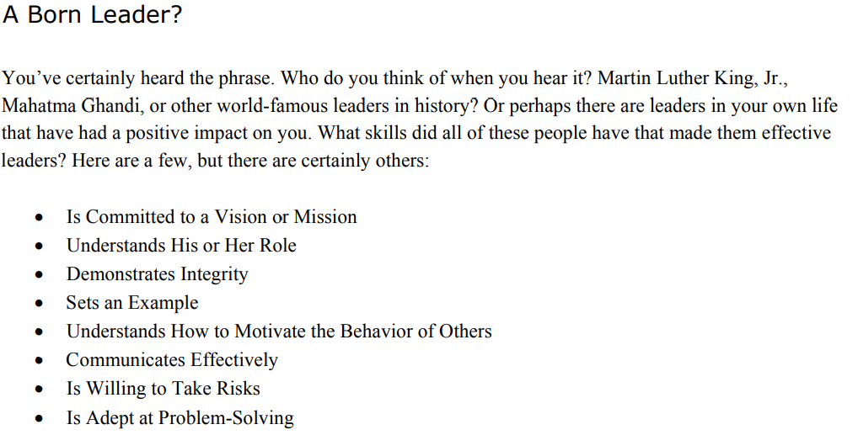

Slide 26
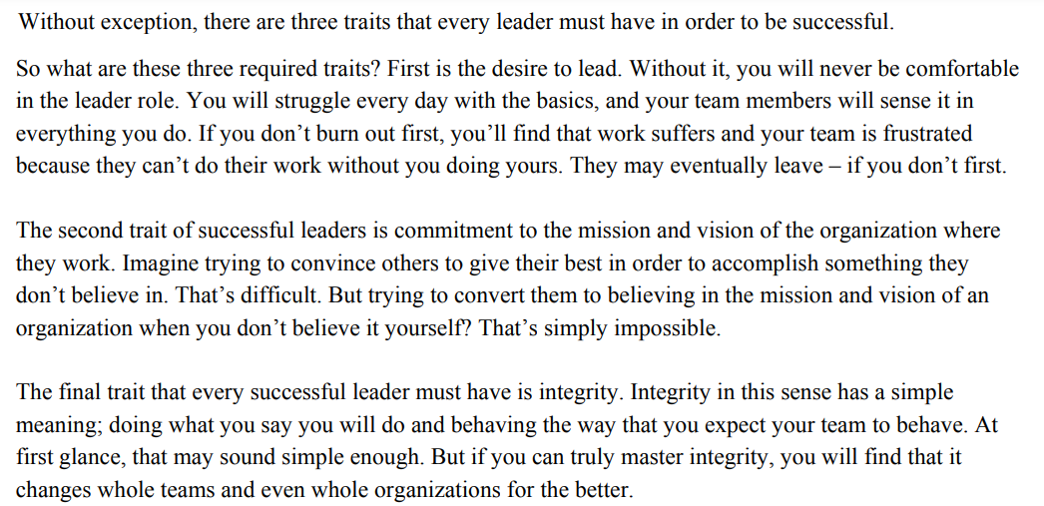
Reading Leadership skills – page 12 pdf

Slide 27
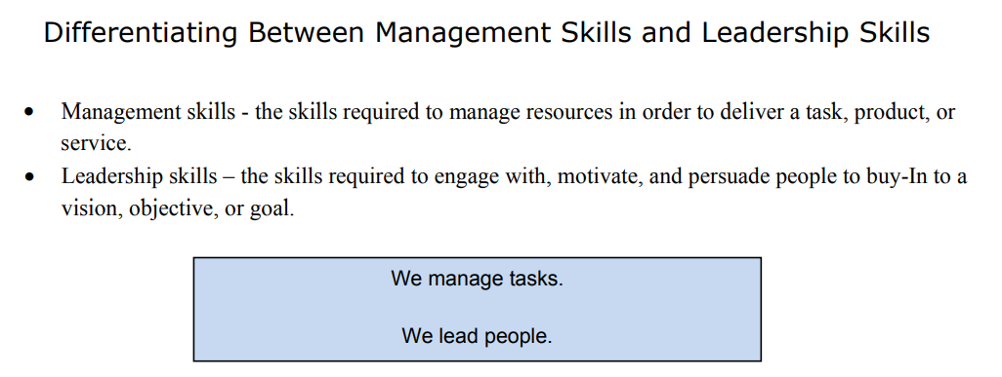

Slide 28
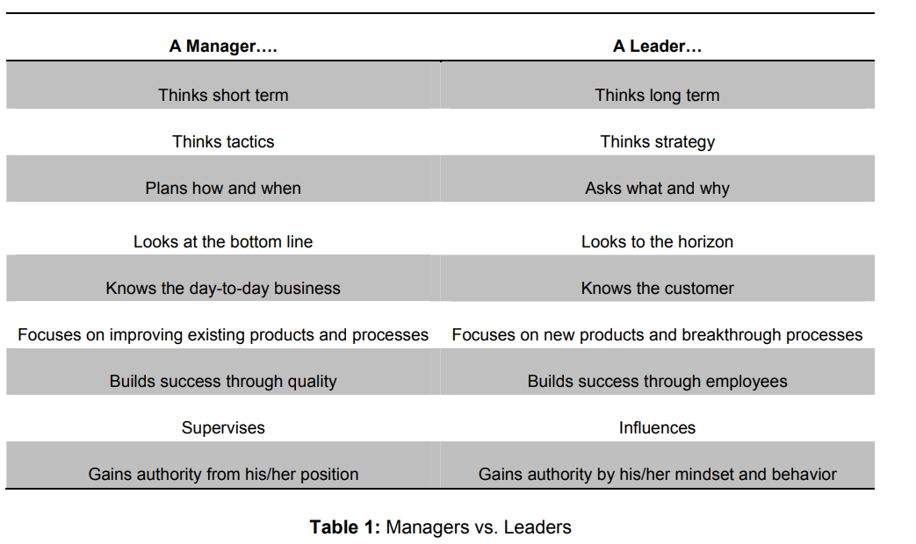

Slide 29
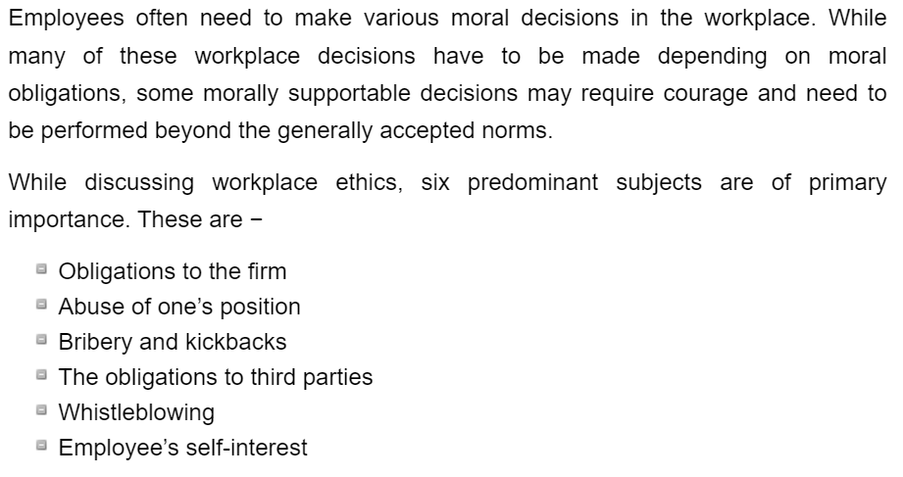
EMPLOYEE'S OBLIGATION TO FIRM

Slide 30
1.Obligations to the Firm
Employees are hired for the company’s tasks. The employees may obligate themselves to do the work of the particular company for financial gains. The employers often have numerous conditions to employment which the employee has to follow. These may include dress codes and respectful behavior.

Slide 31
a.Loyalty to the Company
Most people have a viewpoint that employees must have some moral obligations to stay loyal to their organizations. It is true that employees are obligated to do the tasks offered to them, but is it acceptable to have an obligation to work for the company in a manner that is beyond the assigned jobs?
Many employers may think so, but is not mentioned anywhere. The employees are not bound or obligated to have any kind of loyalty to the employers. But on a moral ground, loyalty to the company is often considered to be a good thing and it is plausible that the loyalty is rewarded through pay-raises, promotions, and good recommendations etc.

Slide 32
b.Conflicts of Interest
Employees can have a conflict of interest with the company. Some of these conflicts of interest are minor and include general workplace conditions or situations. However, some other conflicts may be serious and can let the employees to show disloyalty.
Generally, employees must avoid significant conflicts of interest by not involving themselves in disloyal activities. However, it is difficult enough to decide when a conflict is significant and it may not always clear what employees should do besides resisting the temptation to be disloyal.

Slide 33
2.Abuse of Official Position
Using the official position for private or personal gains is often considered as an abuse of power. Such abuse can result from disloyalty.
a. Insider Trading
Insider trading occurs when an employee has access to company information that’s usually unavailable to the public and can have an impact on the stock prices. For example, some employees may come to know that their company is going to be bankrupt before general public and they can sell all their stock. People who tend to buy the stocks will be deceived. It is also a kind of insider trading to encourage near ones to sell their stock having such “insider information.”

Slide 34
b. Proprietary Data
Companies can often have “trade secrets” which they don’t want to share with other organizations.
Three major arguments why trade secrets should be protected by the law are −
These are intellectual property.
Trade secrets theft is wrong.
Stealing trade secrets is a violation of the confidentiality terms.
Sharing trade secrets and obeying confidentiality information is a difficult moral issue. People have the right to seek and advance employment and it is not easy to separate proprietary information from a worker’s own skills and technical knowledge

Slide 35
3.Bribes and Kickbacks
Bribery is aimed to letting someone to act against their duties. Bribes can be very serious when it can injure people. Kickbacks are also a form of bribery that involves a person to uses his/her position to benefit a party or someone.
Bribing foreign officials for favors could harm people. However, instances of bribing are numerous and they include both large and small organizations.

Slide 36
a.Gifts and Entertainment
Gifts and entertainment may be used to reward and encourage certain behavior from employees.
The following considerations may be considered while judging the ethics of gifting −
The Price of the Gift − Gifts of huge prices are more likely a bribe.
The Purpose of the Gift − Gift can be used to encourage, for advertising, or as a bribe.
The Circumstances − A gift given at a special occasion is different than a gift on non-special occasions, and a gift given openly is more ethical.

Slide 37
The Position of the Person Receiving the Gift − A person in a position to reciprocate is more likely to be taking a bribe.
The Accepted Practices − Gifts as “tips” for a waiter or waitress is norm, but to a CEO; it is clearly unethical.
The Company’s Policy − Some companies may have stricter rules about gifts than others.

Slide 38
4.Obligations to Third Parties
A person is morally obligated to let others know about dangerous and deceptive business practice. However, employees should compare and judge the importance of their job duties and personal interests with the importance of the interests of others. It can be morally preferable to let the third parties know about immoral and illegal business practices, even when it is not a moral obligation to do so.

Slide 39
5.Whistleblowing
Whistleblowing is the act of going public with significantly immoral or illegal acts of an organization one is part of. However, someone is not a whistle blower for discussing the embarrassing or rude behavior with public, and a whistle blower doesn’t need to involve in damage or violence.
The reasoning given to judge a whistle-blowing activity may include the following −
The motive must be ethical. The employee must act against the organization that committed a significant immoral or illegal act.

Slide 40
The whistleblower should look for less harmful ways to resolve the issue first. Employees should tell the management and executives of wrong-doing before making the information public.
The whistleblower should have enough evidence. It is unethical to accuse a company when there’s a possibility of company being innocent.
The company’s fault must be specific and significant. The wrong-doing must have specific and significant reasons.

Slide 41
6.Self-Interest
Are the people obligated to save the interests of others by making misconducts known to the management or by alerting the public by making significant immoral acts committed by companies publicly?
It is always preferable to think rationally and impartially regarding morality. It is important to think about our life and ask the following questions −
Are we following authorities blindly?
Are we suffering from a moral tunnel vision? Tunnel vision is defined as one's tendency to focus on a single goal or point of view.
Are we mindlessly doing what is asked from us, without considering the impact on outside parties?

Slide 42
Are we having a proper view of our interests against those of others?
Is there any substantial evidence for acting against the norms?
Morality often wants us to consider the interests of everyone who can be affected by our decisions and also about the situations we are in. We can have serious social and personal obligations and depends on all these important and unique factors.

