Slide 1
Towards Collaborative and Fuel-Efficient Maneuvers for Autonomous Vehicles (AVs)
By
Muhammad Umer | 345834
Muhammad Abdullah Sohail | 343642
Muhammad Ahmed Mohsin | 333060
Hassan Rizwan | 335753

Slide 2
Introduction
Autonomous vehicles (AVs) hold immense potential to revolutionize transportation but require sophisticated decision-making algorithms for safe and efficient navigation.
Lane changing is a critical maneuver impacting traffic flow and safety, requiring careful consideration of surrounding vehicles and dynamic environments
Existing approaches often struggle to adapt to real-world traffic variability and optimize multiple objectives like fuel efficiency, passenger comfort, etc.

Slide 3
Related Work
Traditional lane-changing methods rely on rule-based systems, trajectory generation, or optimization techniques. RL has emerged as a promising alternative, particularly for single-agent scenarios
Limitations
Rule-based methods lack flexibility to adapt to dynamic environments
Trajectory generation methods often disregard the complexities of real-world traffic
Single-agent approaches struggle to handle coordination of multiple AVs
Many existing studies neglect fuel efficiency and passenger comfort as important objectives

Slide 4
Motivation
“Autonomous driving has captivated researchers for the past two decades, providing numerous societal and economic benefits”
Significant challenges in high-level lane-changing decision-making
Majority of traditional strategies consider a single agent without a fuel efficiency indicator in a restricted traffic environment
Addressing the Limitations
Collaborative reinforcement learning algorithm for multi-AV lane changing
Consider multiple objectives simultaneously: fuel efficiency, safety, and passenger comfort
Leverage hybrid action space and parameter-sharing scheme for efficient and cooperative decision-making

Slide 5
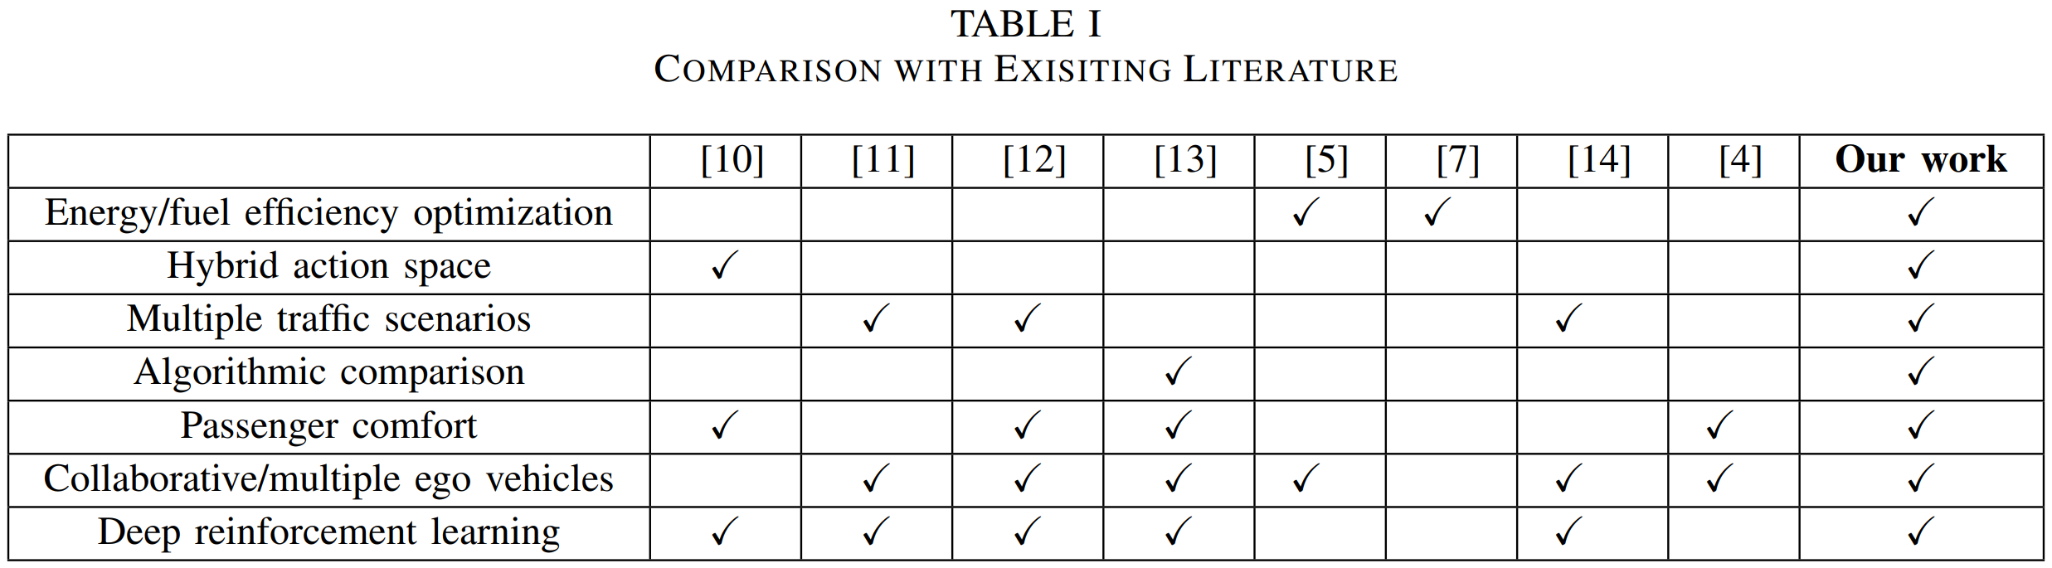
Our Contributions
Custom reward design incorporating fuel efficiency, safety, and passenger comfort
Multi-agent simulation environment for evaluating collaborative lane changing behaviors
Comprehensive analysis comparing different traffic scenarios and DRL algorithms, demonstrating robust performance and scalability

Slide 6
Environment & DRL Framework

Slide 7
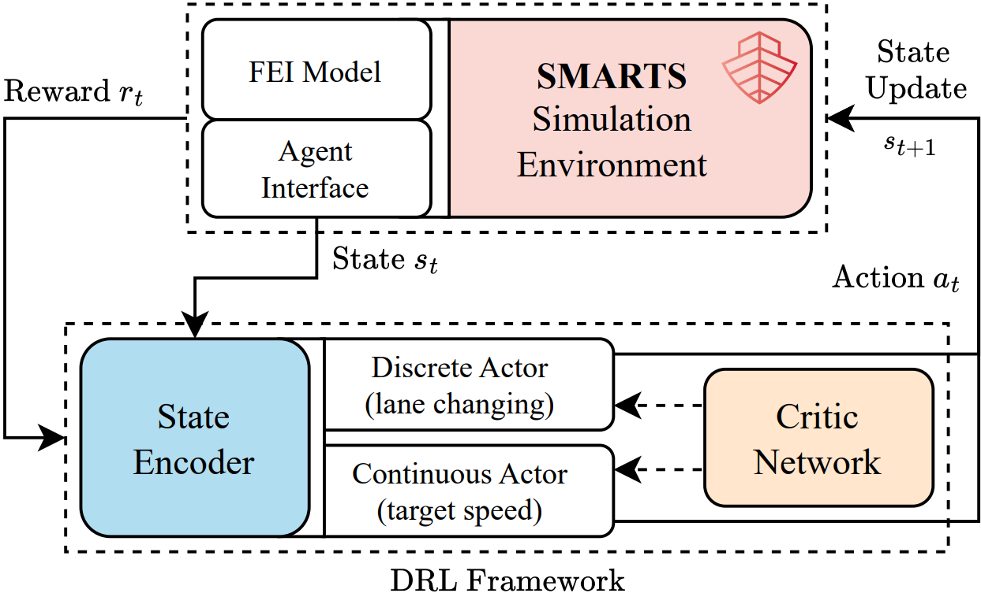
Environment Model

Slide 8
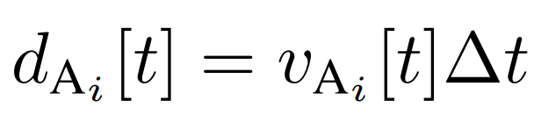
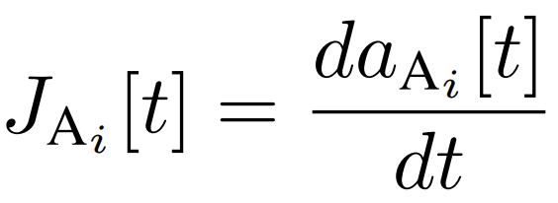
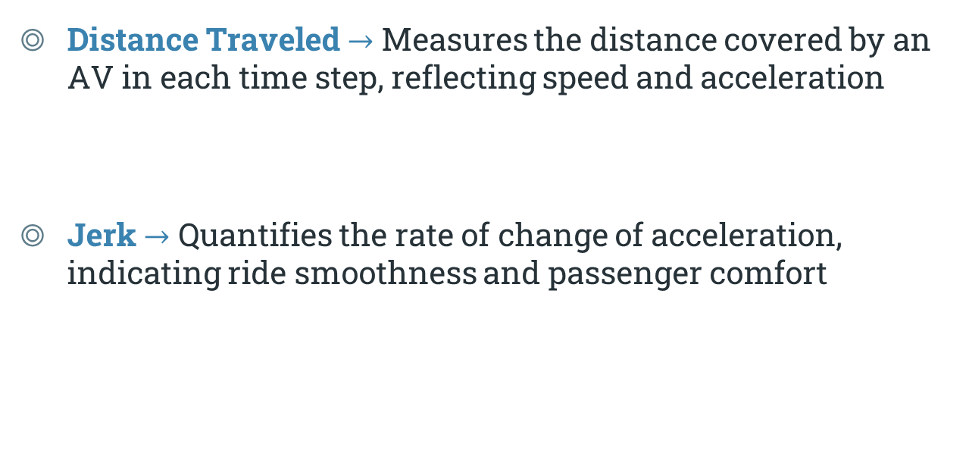
Performance Metrics
Distance Traveled $→$ Measures the distance covered by an AV in each time step, reflecting speed and acceleration
Jerk $→$ Quantifies the rate of change of acceleration, indicating ride smoothness and passenger comfort

Slide 9
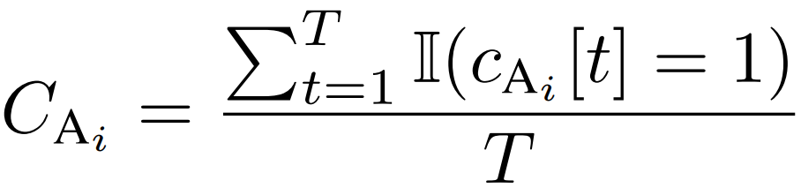
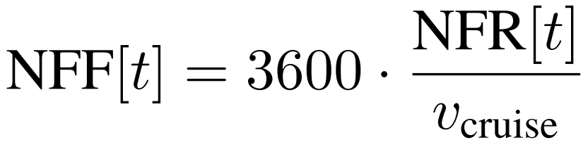
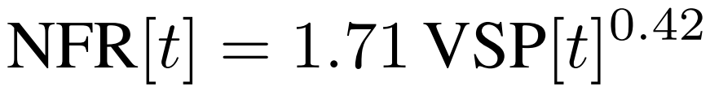

Performance Metrics
Collision Rate $→$ Represents the likelihood of an AV being involved in a collision, assessing safety
Fuel Efficiency Indicator (FEI) $→$ Measures the normalized fuel consumption rate, evaluating fuel efficiency

Slide 10
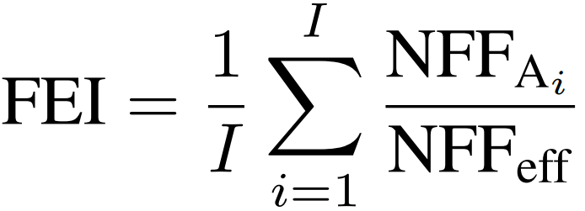

Performance Metrics
Fuel Efficiency Indicator (FEI) $→$ Measures the normalized fuel consumption rate, evaluating fuel efficiency

Slide 11
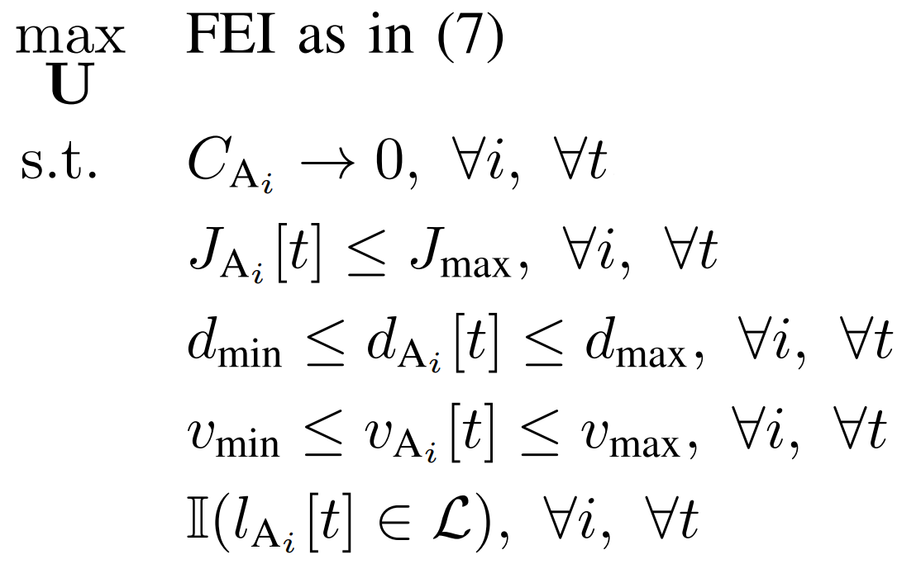
Problem Formulation
“Maximize fuel efficiency while ensuring passenger comfort and safety”
Maximize the FEI subject to constraints
Collision rate being minimum
Limited jerk / comfort factor
Safe distance and speed constraints
Valid lane changes

Slide 12
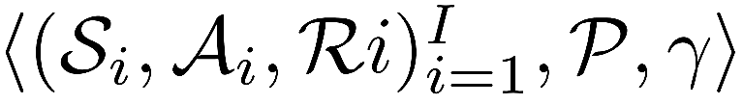
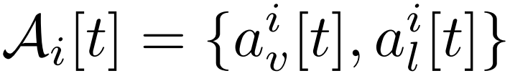
Dec-POMDP
Problem is formulated as a decentralized partially observable Markov decision process
(Dec-POMDP)
State Space: Includes information about vehicle distance, angle error, speed, steering angle, time-to-collision, and distance to nearby vehicles
Action Space: Consists of acceleration (continuous) and lane selection (discrete) actions

Slide 13

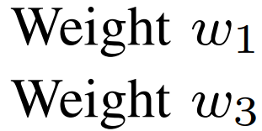
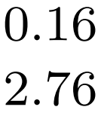
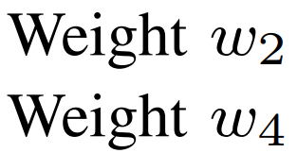
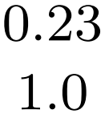
Dec-POMDP
Problem is formulated as a decentralized partially observable Markov decision process
(Dec-POMDP)
Reward: Designed to promote fuel efficiency, safety, and passenger comfort.

Slide 14

Challenges and Proposed Solution
“Hybrid action space (continuous and discrete actions) poses a challenge for traditional RL algorithms”
Solution: Hybrid Proximal Policy Optimization (H-PPO)
Two parallel actor networks for discrete and continuous actions
Parameter sharing for efficient feature extraction
Single critic network for value function estimation

Slide 15
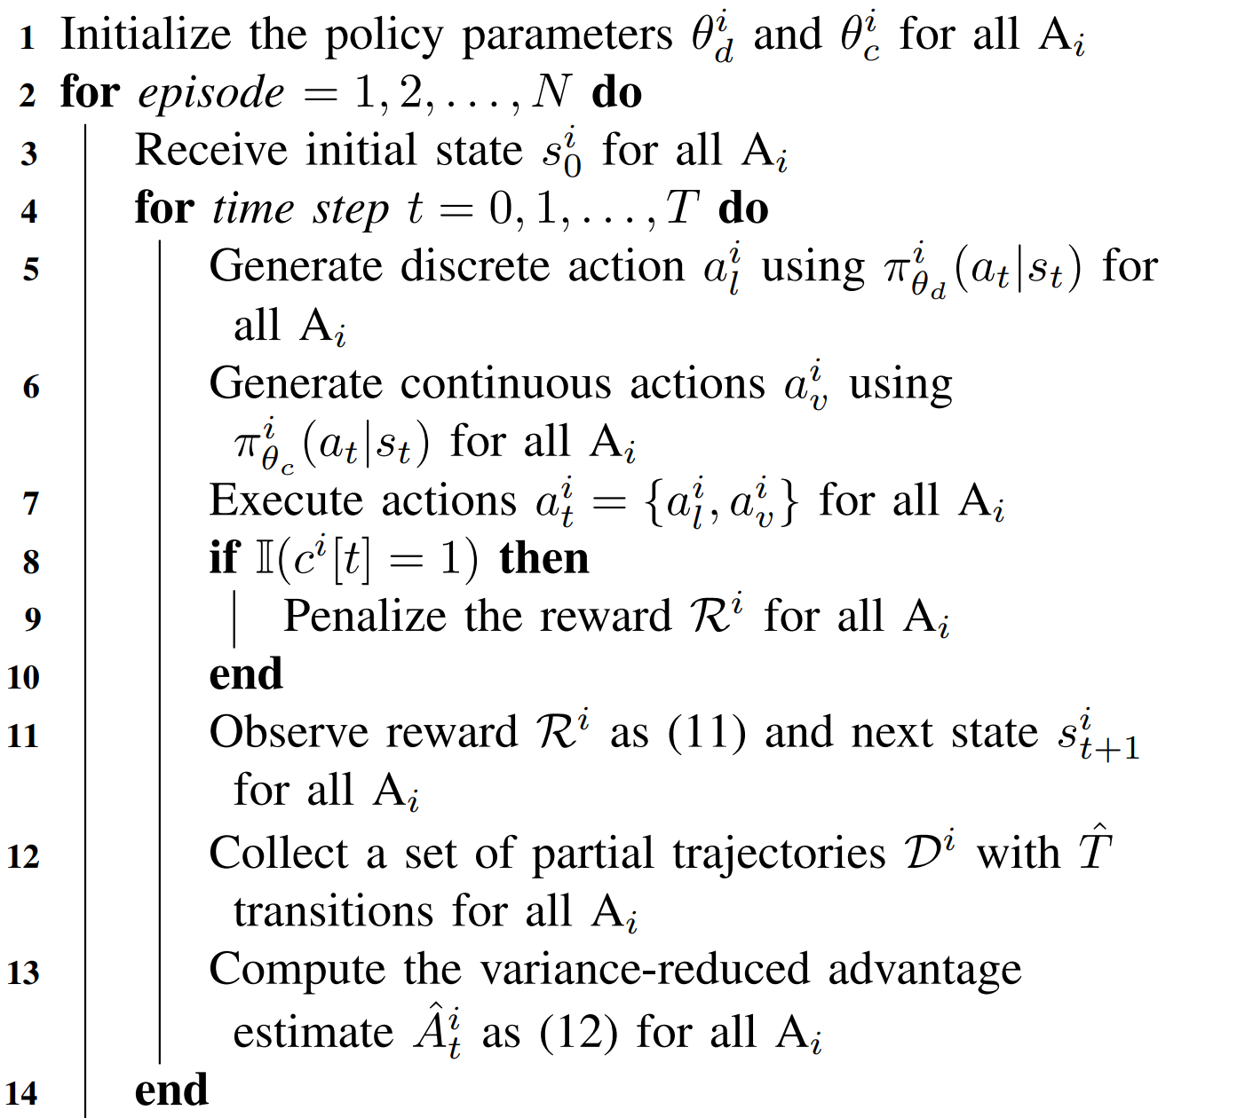
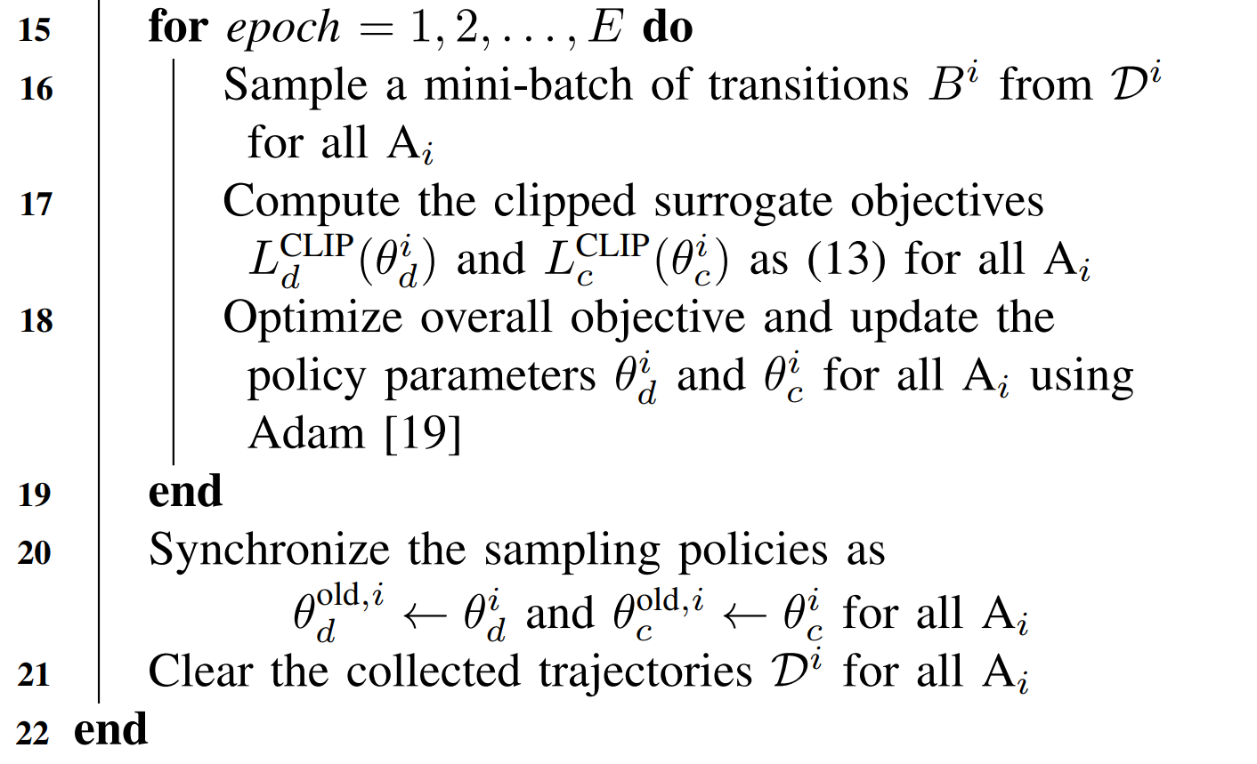
Multi-agent H-PPO

Slide 16
Simulation & Results

Slide 17
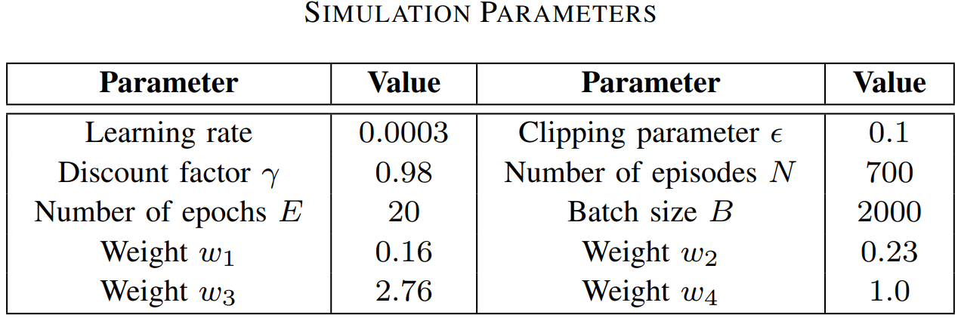

Simulation Parameters
“SMARTS with three lanes and three Avs”
Traffic Flow Scenarios
Free flow $→$ No additional vehicles
Normal flow $→$ $60×normal(0, 5)$additional vehicles per hour
Congested flow $→$ $60×normal(5, 10)$additional vehicles per hour

Slide 18
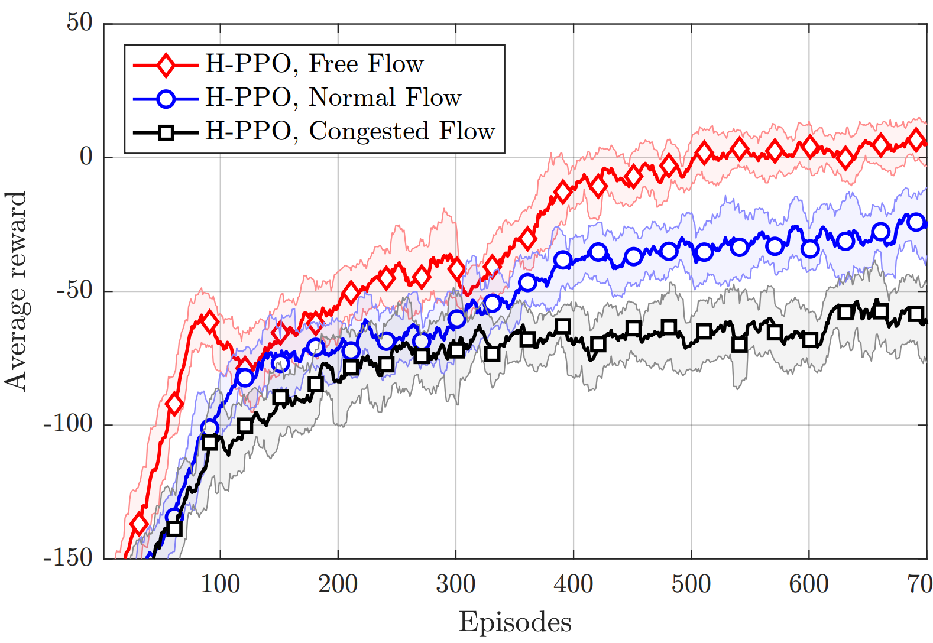
Episodic Rewards

Slide 19
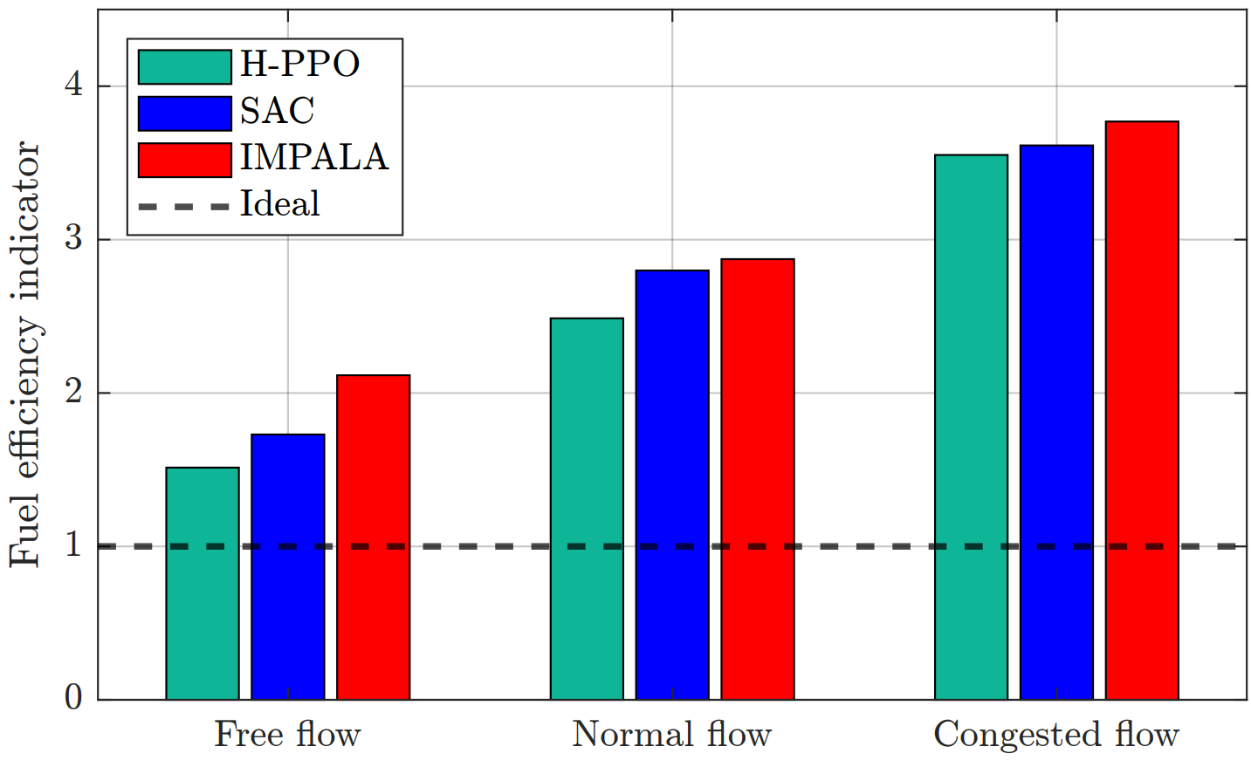
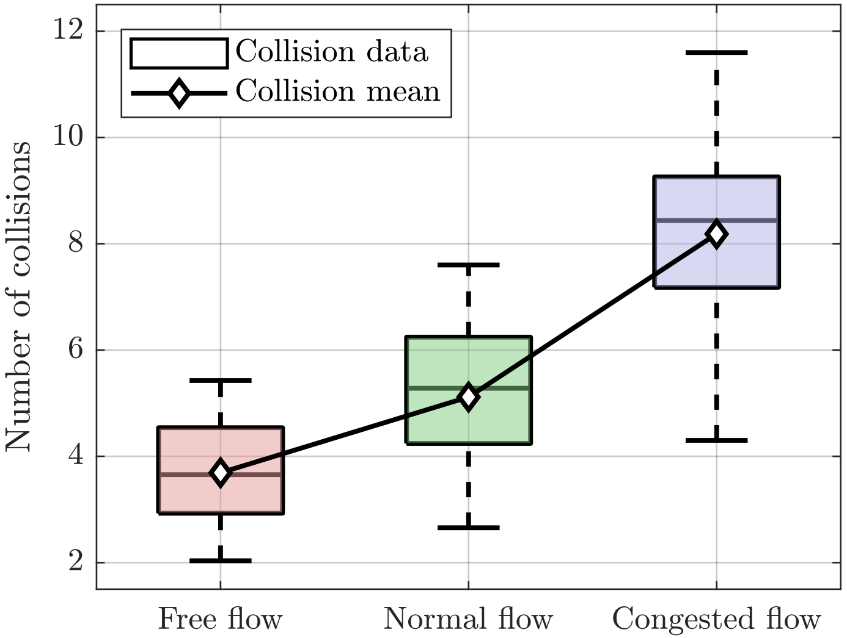
Collision Analysis
Fuel Efficiency

Slide 20
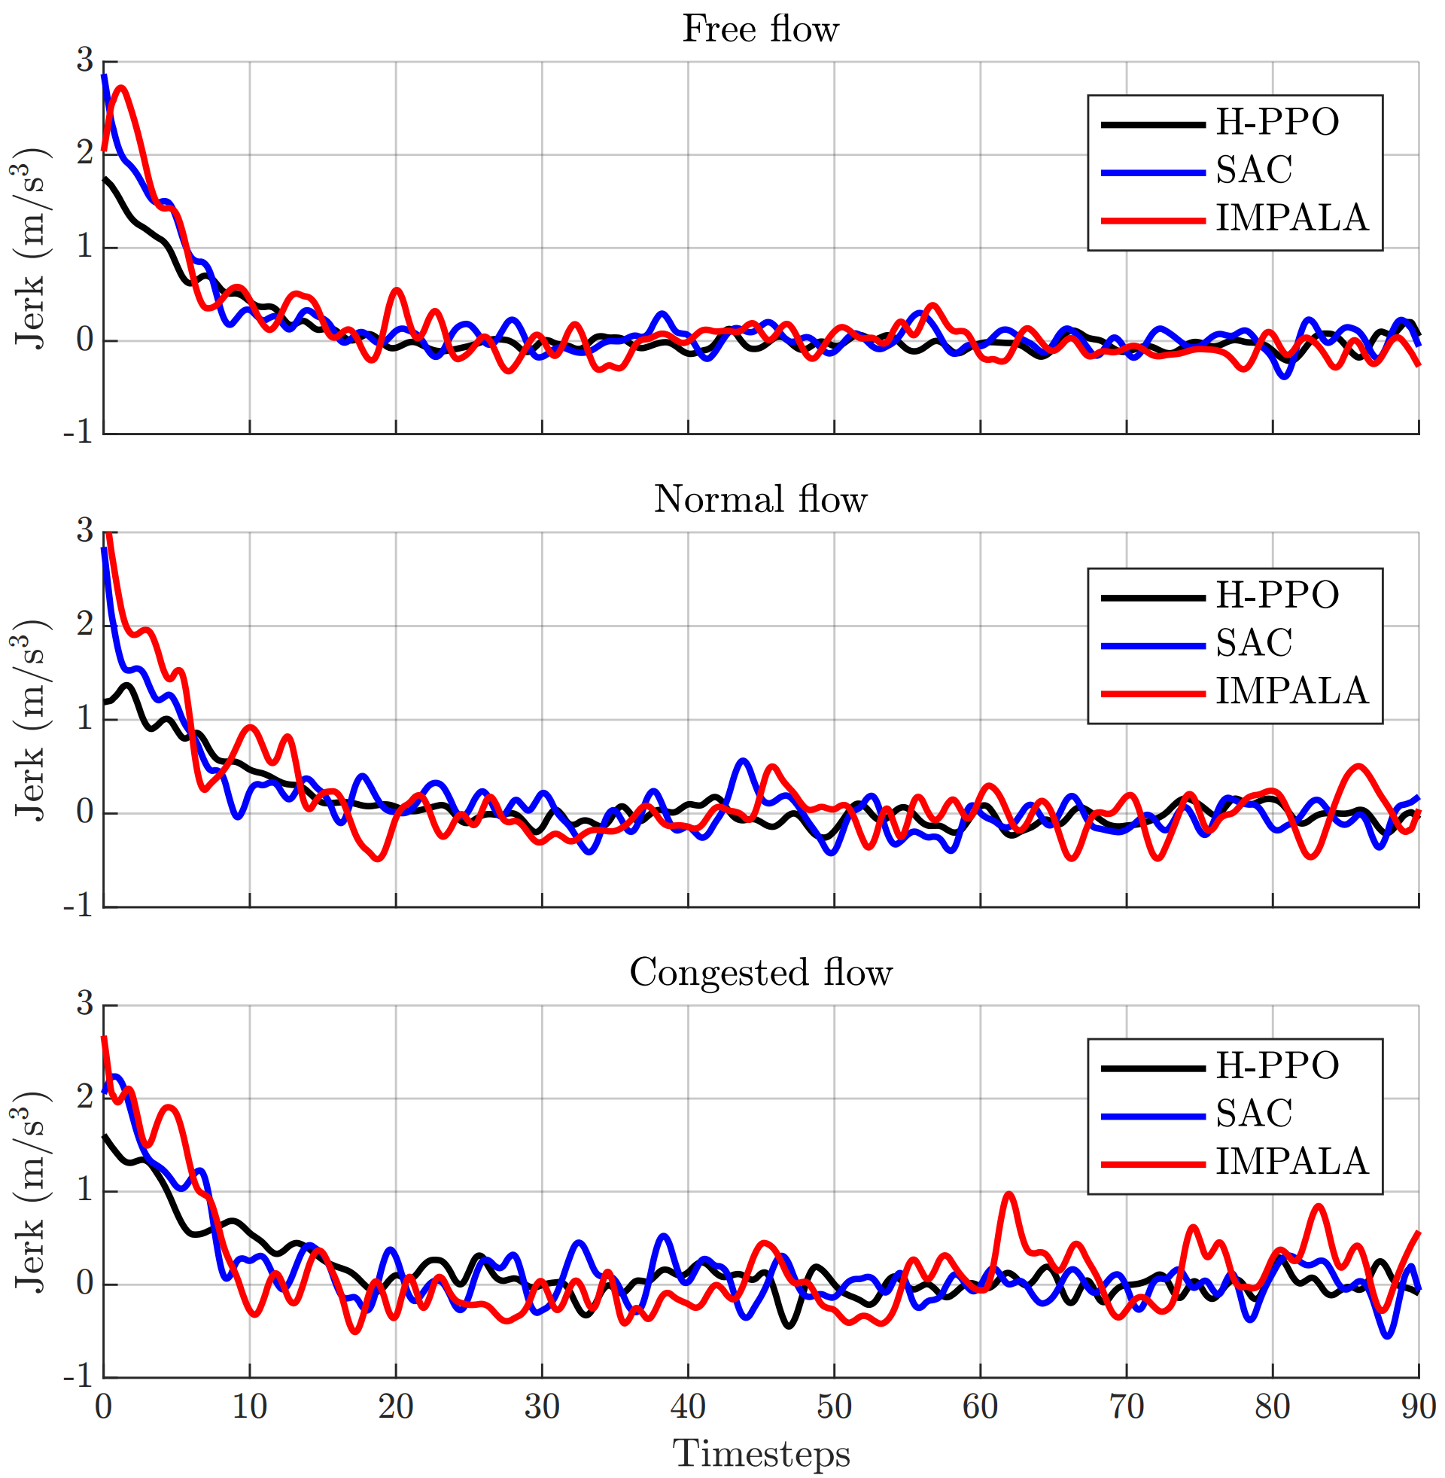
Results: Jerk
Comparison of jerk values experienced by passengers for the three algorithms across different traffic flows
H-PPO consistently exhibits lower jerk values, indicating smoother rides
Higher jerk in congested traffic is due to frequent speed and direction changes

Slide 21
Thanks!
Any questions?
;-;

