Slide 1


Limit of a Sequence
Calculus & Analytical Geometry MATH- 101
Instructor: Dr. Naila Amir (SEECS, NUST)

Slide 2
Book: Thomas Calculus (11th Edition) by George B. Thomas, Maurice D. Weir, Joel R. Hass, Frank R. Giordano
Chapter: 11
Sections: 11.1

Slide 3
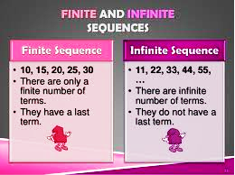
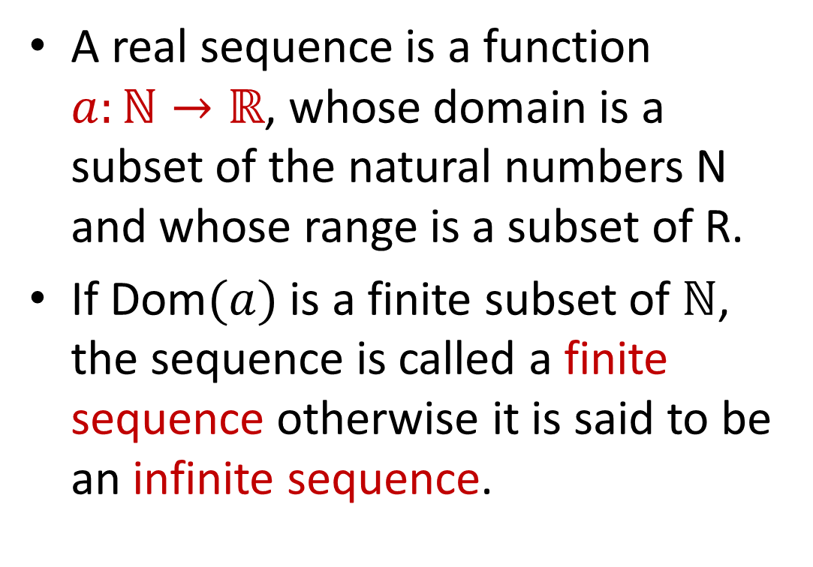
Sequence as a function
A real sequence is a function $a:ℕ→ℝ$, whose domain is a subset of the natural numbers N and whose range is a subset of R.
If Dom$(a)$ is a finite subset of $ℕ$, the sequence is called a finite sequence otherwise it is said to be an infinite sequence.

Slide 4
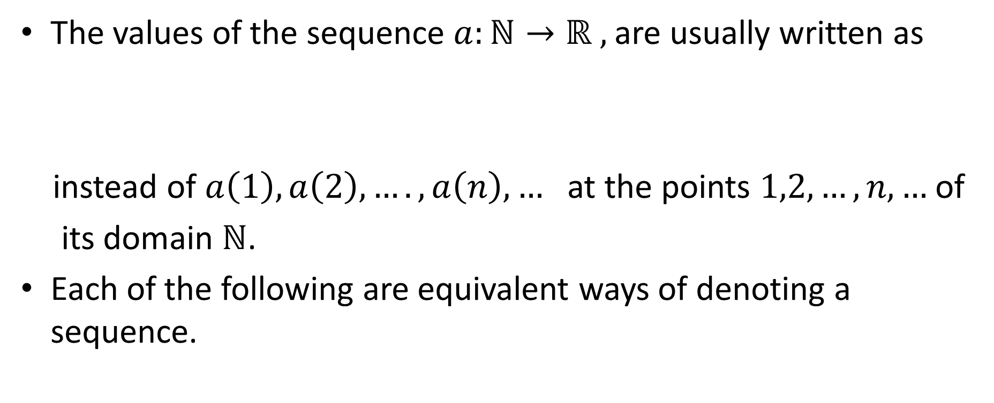
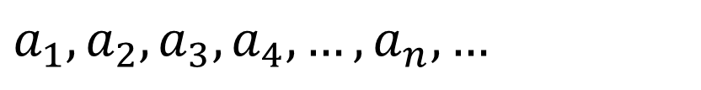
The values of the sequence $a:ℕ→ℝ ,$are usually written as
instead of $a\left(1\right),a\left(2\right),….,a\left(n\right),…$ at the points $1,2,…,n,…$of
its domain $ℕ$.
Each of the following are equivalent ways of denoting a sequence.
$$a_{1},a_{2},a_{3},a_{4},…,a_{n},…$$
$$\left\{a_{1},a_{2},a_{3},...,a_{n},...\right\}, \left\{a_{n}\right\}, {\left\{a_{n}\right\}}_{n=1}^{∞}$$

Slide 5

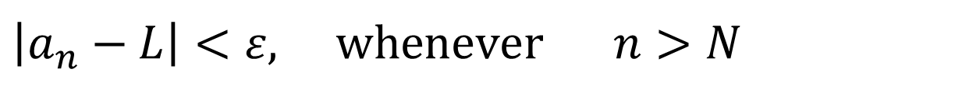
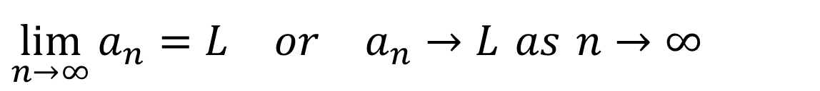
Limit of a sequence
A sequence $\left\{a_{n}\right\}$ has the limit $L$ if for every $ε>0$
there is a corresponding integer $N$ such that
We write
$$\left|a_{n}−L\right|<ε, whenever n>N$$
$$\lim_{n→∞}{a_{n}}=L or a_{n}→L as n→∞$$

Slide 6
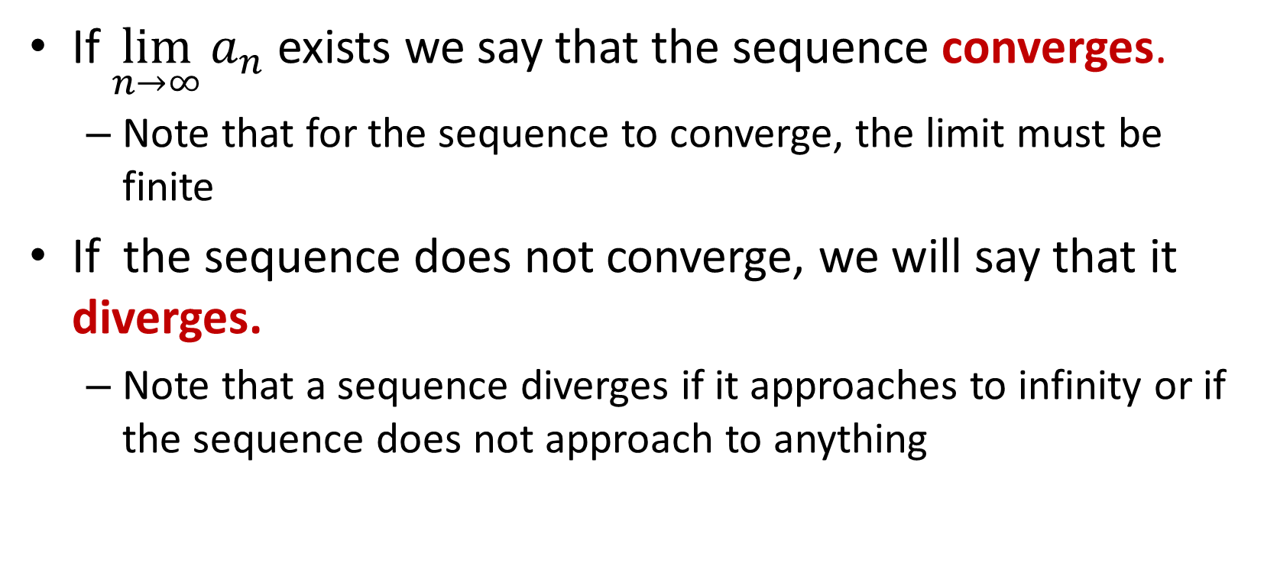
Convergence/Divergence
If $\lim_{n→∞}{a_{n}}$ exists we say that the sequence converges.
Note that for the sequence to converge, the limit must be finite
If the sequence does not converge, we will say that it diverges.
Note that a sequence diverges if it approaches to infinity or if the sequence does not approach to anything

Slide 7
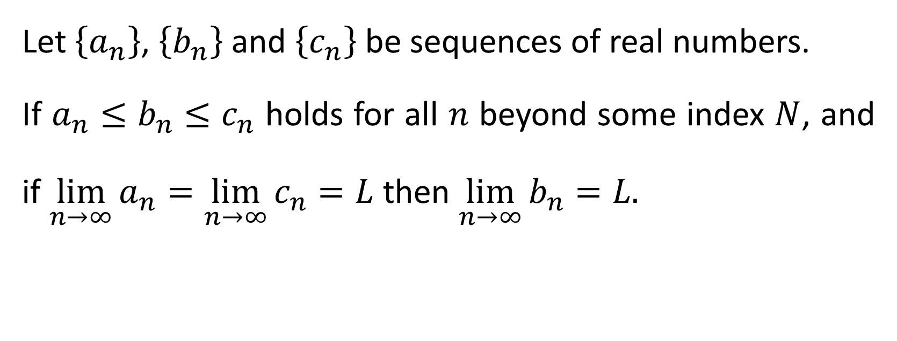
The Sandwich Theorem for Sequences
Let $\left\{a_{n}\right\}$, $\left\{b_{n}\right\}$ and $\left\{c_{n}\right\}$ be sequences of real numbers.
If $a_{n}≤b_{n}≤c_{n}$ holds for all $n$ beyond some index $N$, and if $\lim_{n→∞}{a_{n}}=\lim_{n→∞}{c_{n}}=L$ then $\lim_{n→∞}{b_{n}}=L.$

Slide 8

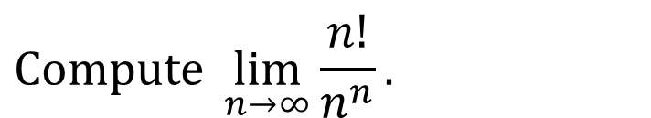
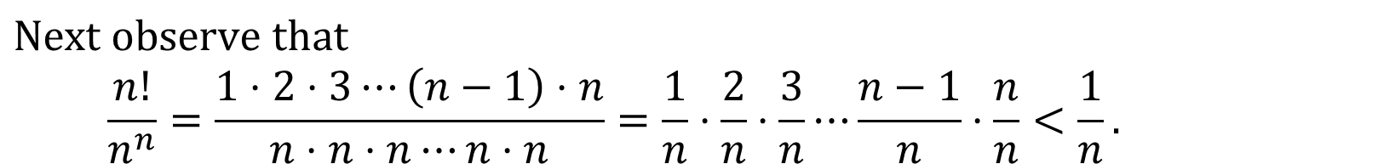

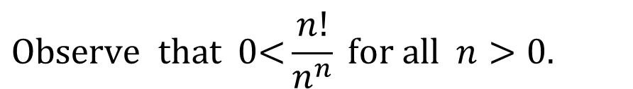
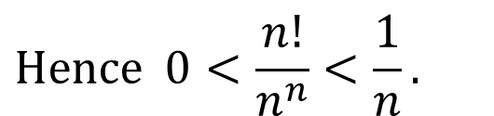
Using the Sandwich Theorem
$$\text{Compute} \lim_{n→∞}{\frac{n!}{n^{n}}}.$$
Example:
Solution: This is difficult to compute using the standard methods because $n!$is defined only if $n$ is a natural number.
$$\text{Observe} \text{that}\text{ 0<}\frac{n!}{n^{n}} \text{for} \text{all} n>0.$$
Here each term $k/n < 1.$
$$\text{Next} \text{observe} \text{that} \\ \frac{n!}{n^{n}}=\frac{1⋅2⋅3⋯\left(n−1\right)⋅n}{n⋅n⋅n⋯n⋅n}=\frac{1}{n}⋅\frac{2}{n}⋅\frac{3}{n}⋯\frac{n−1}{n}⋅\frac{n}{n}<\frac{1}{n}.$$
$$\text{Hence} 0<\frac{n!}{n^{n}}<\frac{1}{n}.$$
$$\text{Since} \lim_{n→∞}{\frac{1}{n}}=0, \text{so} \text{by} \text{Sandwich} \text{Theorem} \lim_{n→∞}{\frac{n!}{n^{n}}}=0.$$

Slide 9
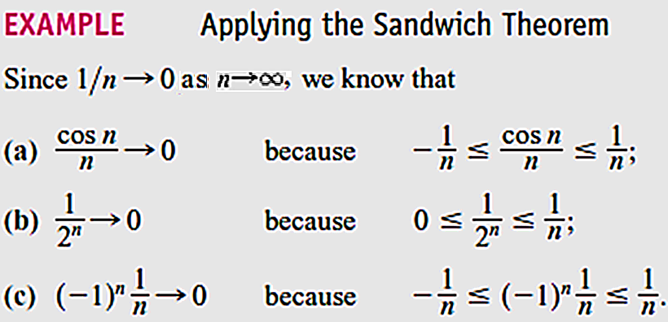

Slide 10
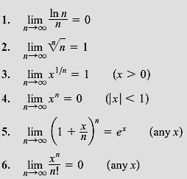
Commonly occurring limits in sequences
Note: In Formulas (3) through (6), $x$ remains fixed as $n →∞$.

Slide 11

Commonly occurring limits in sequences
$\lim_{n→∞}{{\left(1+\frac{1}{n}\right)}^{n}=e.}$
$\lim_{n→∞}{{\left(1−\frac{1}{n}\right)}^{n}=\frac{1}{e}.}$
$\lim_{n→0}{{\left(1+n\right)}^{1/n}=e}$.

Slide 24
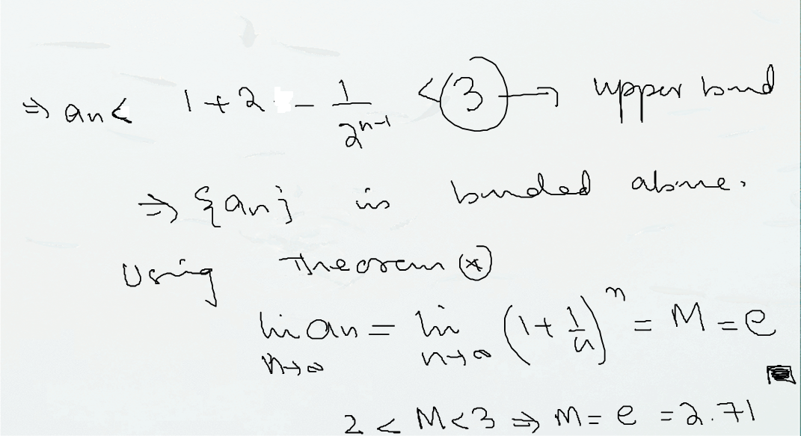

Slide 25
Practice Questions
Book: Thomas Calculus (11th Edition) by George B. Thomas, Maurice D. Weir, Joel R. Hass, Frank R. Giordano
Chapter: 11
Exercise: 11.1
Q # 1 – 12, 23 – 69

