Slide 1

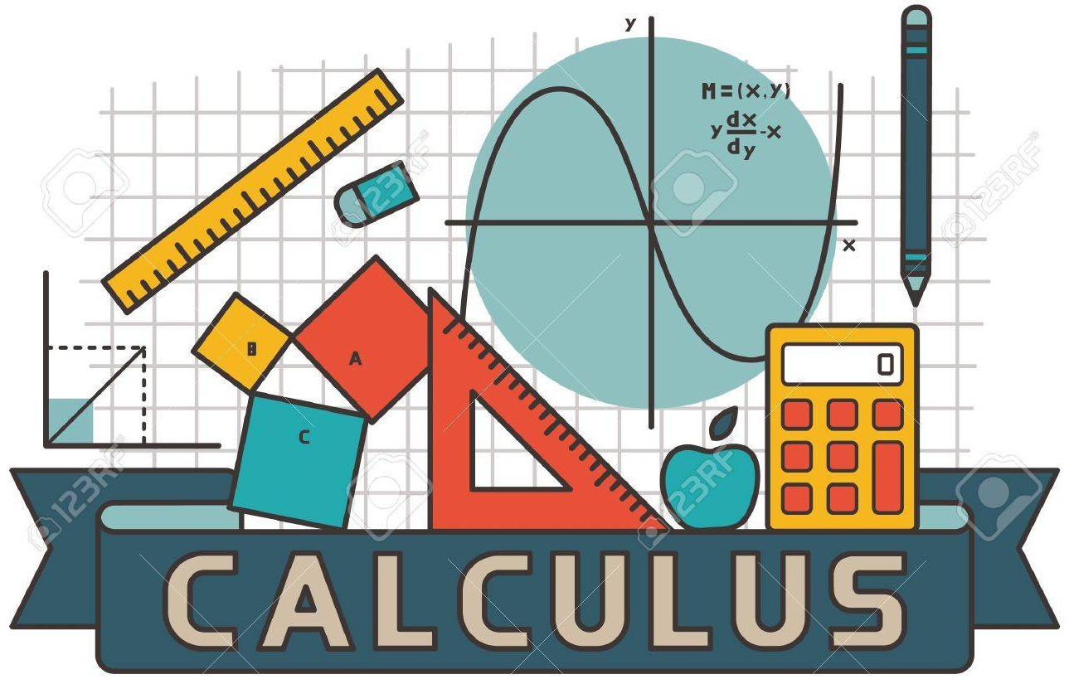
Calculus & Analytical Geometry MATH- 101
Instructor: Dr. Naila Amir (SEECS, NUST)

Slide 2
Course Learning Outcomes (CLOs)
At the end of the course the students will be able to:
CLO1: Understand the concept of limit, continuity and derivative with its application to find extrema.
CLO2: Understand integration and use it to compute areas, volumes and arc length.
CLO3: Comprehend sequence, series and their convergence using miscellaneous tests.

Slide 3
Functions
Domain and Range

Slide 4

Functions vs. Relations
A "relation" is just a relationship between sets of information.
A “function” is a well-behaved relation, that is, given a starting point we know exactly where to go.

Slide 5
Example
Students and their heights, i.e. the pairing of students and heights.
We can think of this relation as ordered pair:
(height, student)
Or
(student, height)

Slide 6
Name | Height (in feet)
Ali=1 | 6’=6
Usman=2 | 5’9”=5.75
Hina=3 | 5’=5
Alia=4 | 5’=5
Salar=5 | 6’6”=6.5

Slide 7
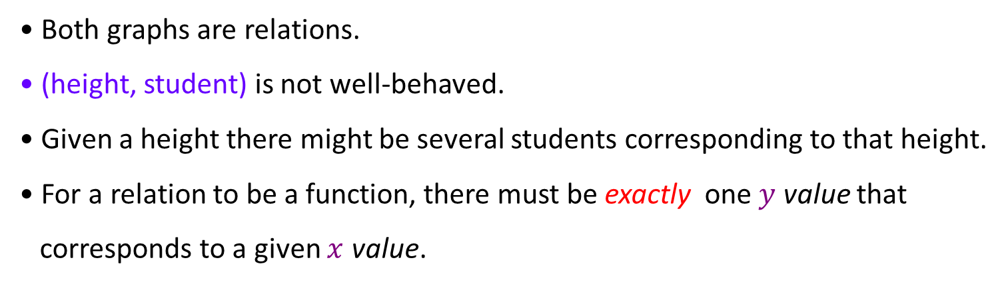
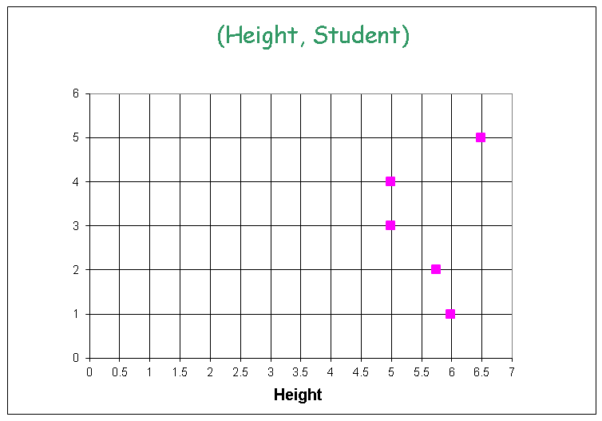
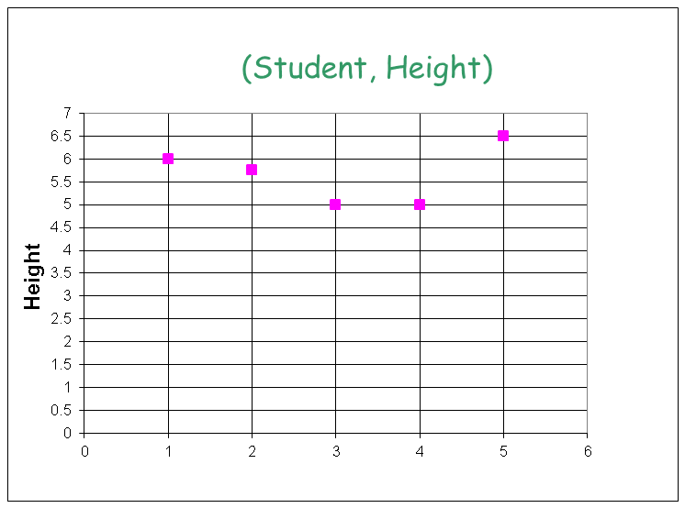
Salar
Alia
Hina
Usman
Ali
Ali
Usman
Hina
Alia
Salar
Both graphs are relations.
(height, student) is not well-behaved.
Given a height there might be several students corresponding to that height.
For a relation to be a function, there must be exactly one$y$value that
corresponds to a given $x$ value.

Slide 8
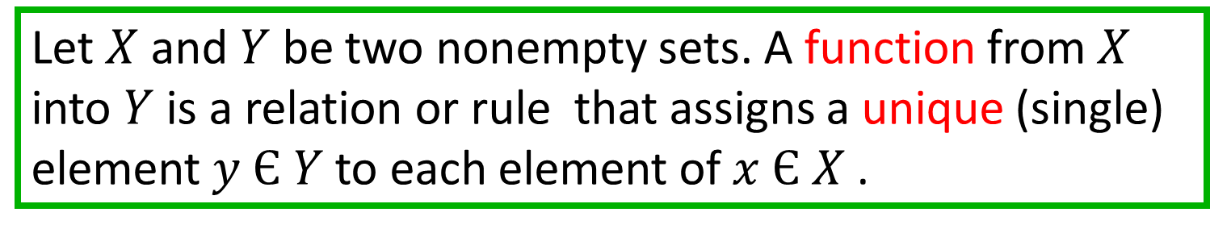
Conclusion and Definition
Not every relation is a function.
Every function is a relation.
Definition:
Let $X$ and $Y$ be two nonempty sets. A function from $X$ into $Y$ is a relation or rule that assigns a unique (single) element $y Є Y$to each element of $x Є X$.

Slide 9
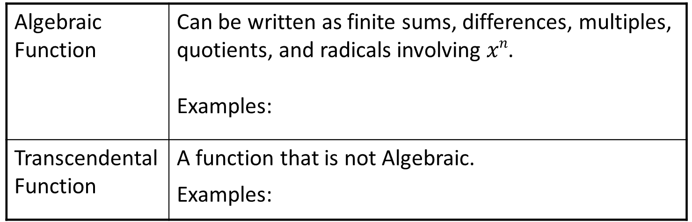
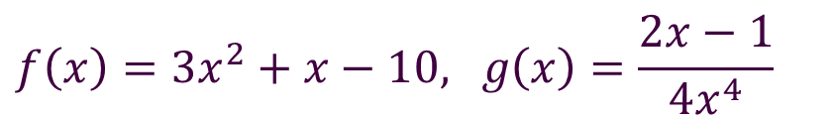
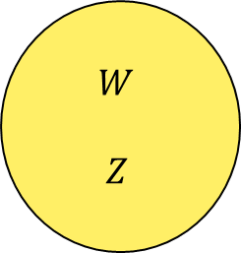
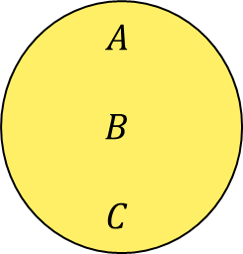
Function
A relation such that there is no more than one output for each input
$$A$$
$$B$$
$$C$$
$$W$$
$$Z$$
Algebraic Function | Can be written as finite sums, differences, multiples, quotients, and radicals involving $xn$. Examples:
Transcendental Function | A function that is not Algebraic. Examples:
$$f\left(x\right)=3x^{2}+x−10\text{, }g\left(x\right)=\frac{2x−1}{4x^{4}}$$
$$h\left(x\right)=\sin\left(x\right), g\left(x\right)=\ln\left(x\right)$$
Notes:
9

Slide 10
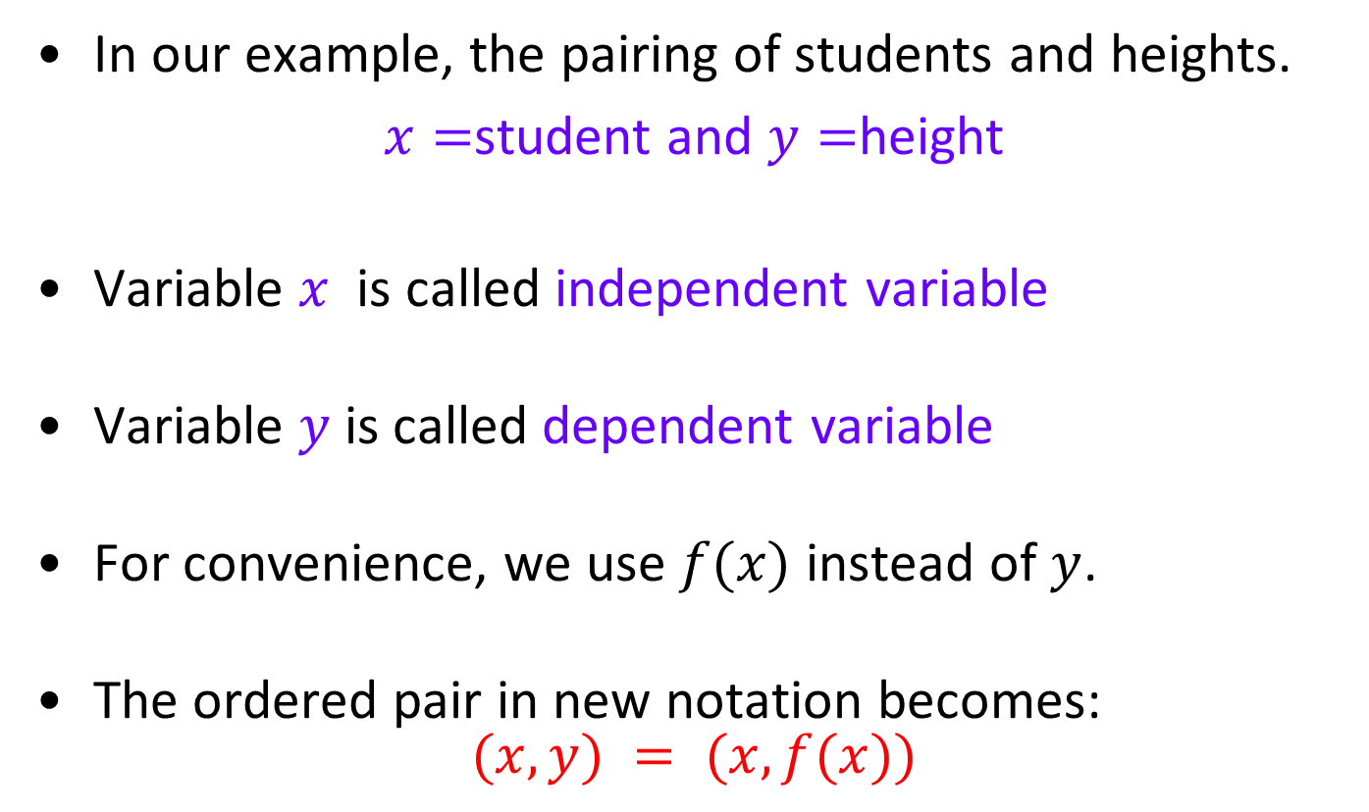
In our example, the pairing of students and heights.
$x=$student and $y=$height
Variable $x$ is called independent variable
Variable $y$ is called dependent variable
For convenience, we use $f(x)$ instead of $y$.
The ordered pair in new notation becomes:
$$(x, y) = (x, f(x))$$

Slide 11
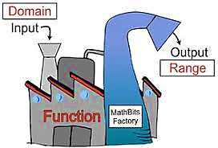
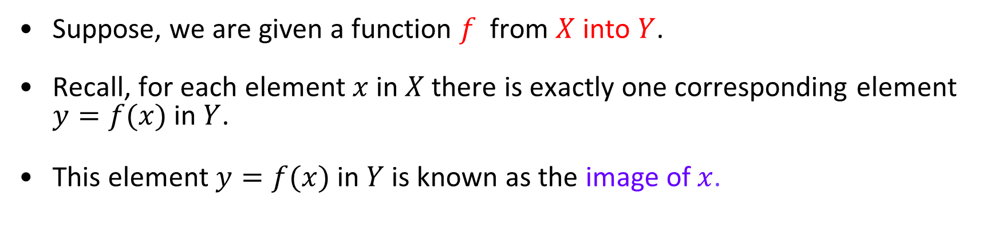
Domain and Range
Suppose, we are given a function $f$ from $X$ into $Y$.
Recall, for each element $x$ in $X$ there is exactly one corresponding element $y=f(x)$ in $Y$.
This element $y=f(x)$ in $Y$ is known as the image of $x$.

Slide 12
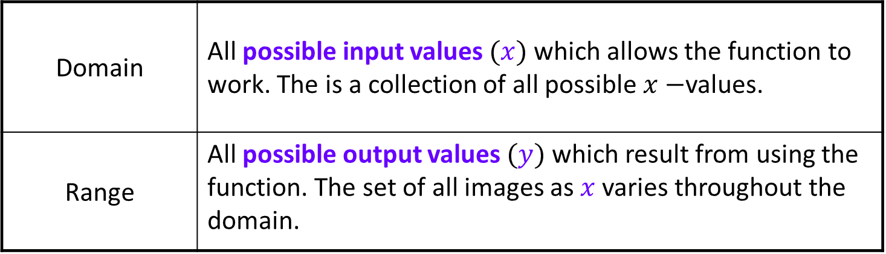
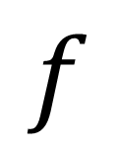
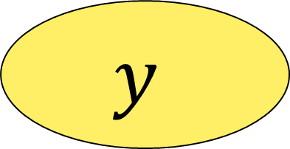
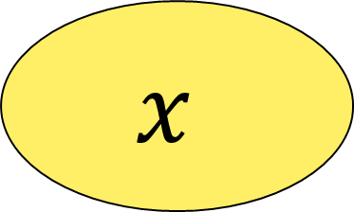
Domain | All possible input values $(x)$ which allows the function to work. The is a collection of all possible $x−$values.
Range | All possible output values $(y)$ which result from using the function. The set of all images as $x$ varies throughout the domain.
$$f$$
$$x$$
$$y$$
Note: The domain and range help us to determine the window of a graph.
Notes:
12

Slide 13
Our Example
Domain = {Ali, Usman, Hina, Alia, Salar}
Range = {6, 5.75, 5, 6.5}

Slide 14
Representations of Functions
Verbally
Numerically, i.e. by a table
Visually, i.e. by a graph
Algebraically, i.e. by an explicit formula

Slide 15
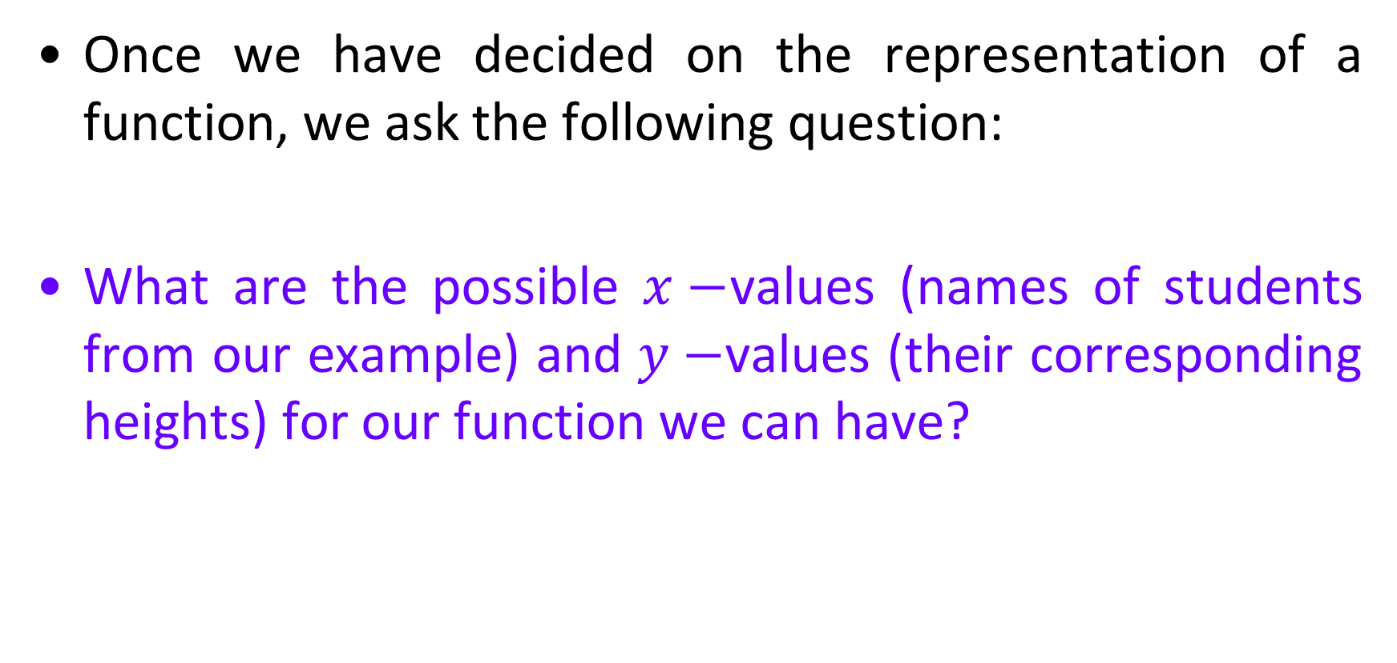
Once we have decided on the representation of a function, we ask the following question:
What are the possible $x−$values (names of students from our example) and $y−$values (their corresponding heights) for our function we can have?

Slide 16
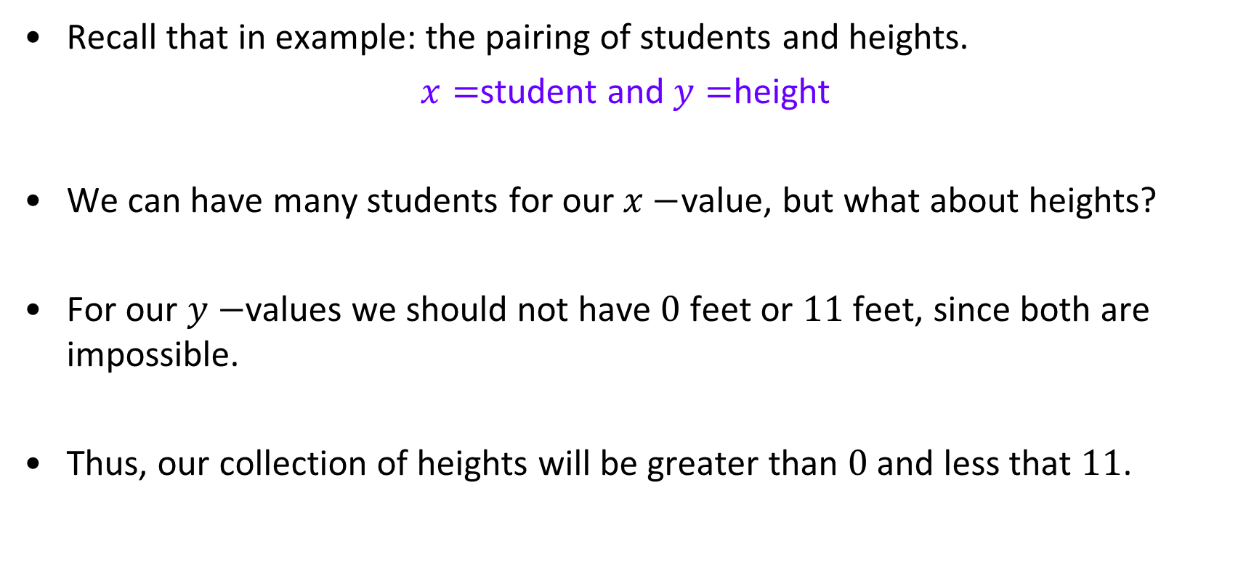
Recall that in example: the pairing of students and heights.
$x=$student and $y=$height
We can have many students for our $x−$value, but what about heights?
For our $y−$values we should not have $0$ feet or $11$ feet, since both are impossible.
Thus, our collection of heights will be greater than $0$ and less that $11$.

Slide 17



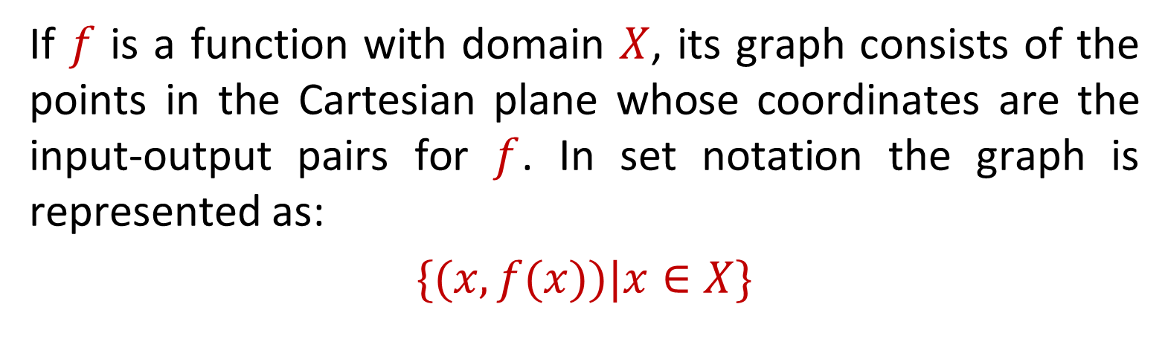
Graph Of a Function
If $f$ is a function with domain $X$, its graph consists of the points in the Cartesian plane whose coordinates are the input-output pairs for $f$. In set notation the graph is represented as:
$\{(x,f(x))|x∈X\}$

Slide 18


Interval Notation
The interval does NOT include the endpoint(s)
Interval Notation | Inequality Notation | Graph
Parentheses ( ) | < Less than > Greater than | Open Dot
The interval does include the endpoint(s)
Interval Notation | Inequality Notation | Graph
Square Bracket [ ] | ≤ Less than ≥ Greater than | Closed Dot

Slide 19
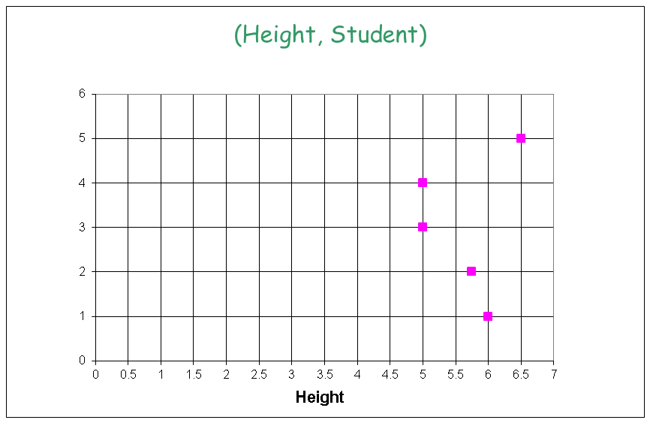
Recall, the graph of (height, student name):
Salar
Alia
Hina
Usman
Ali

Slide 20

Vertical-Line Test
A set of points in the $xy−$plane is the graph of a function if and only if every vertical line intersects the graph in at most one point.

Slide 21
Identifying Functions, their Domain and Range

Slide 22

Algebraic representation of a function
Consider the following relation:
Is this a function?
If yes, then what is domain and range?

Slide 23
Visualizing domain of

Slide 24

Visualizing range of

Slide 25
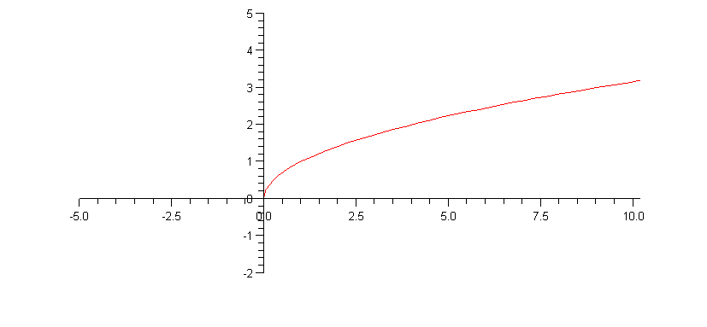
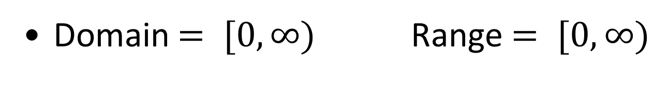
Domain $= [0, ∞)$ Range $= [0, ∞)$

Slide 26
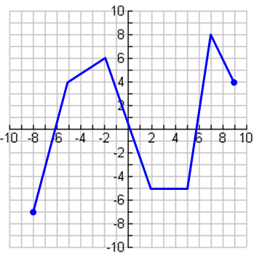


Example: Describe the domain and range of the following function:
Domain:
Range:

Slide 27

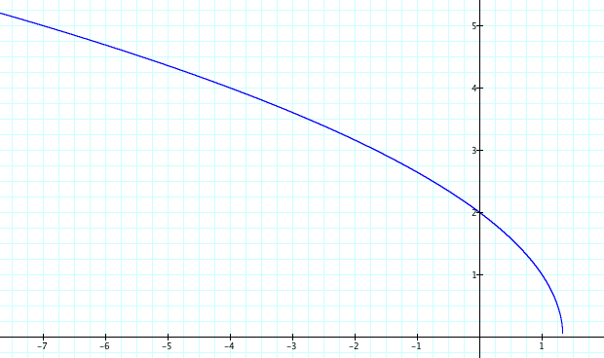
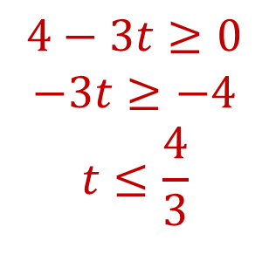

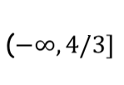


Example: Find the domain and range of
The input to a square root function must be greater than or equal to 0
t | -32 | -20 | -15 | 5 | -4 | 0 | 1 | 2 | 3
h | 10 | 8 | 7 | -7 | 4 | 2 | 1 | ER | ER
Dividing by a negative switches the sign
Domain:
The range is clear from the graph and table.
Range:

Slide 28
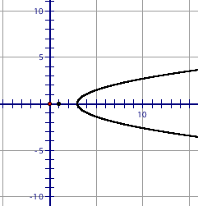

Examples: Identifying Domain and Range
$\left\{\left(3,7\right),\left(−3,7\right),\left(7,−2\right),\left(−8,−5\right)\right\}$
$y=f\left(x\right)=3x^{2}−4$
$y=f\left(x\right)=\frac{2}{x}$

Slide 29
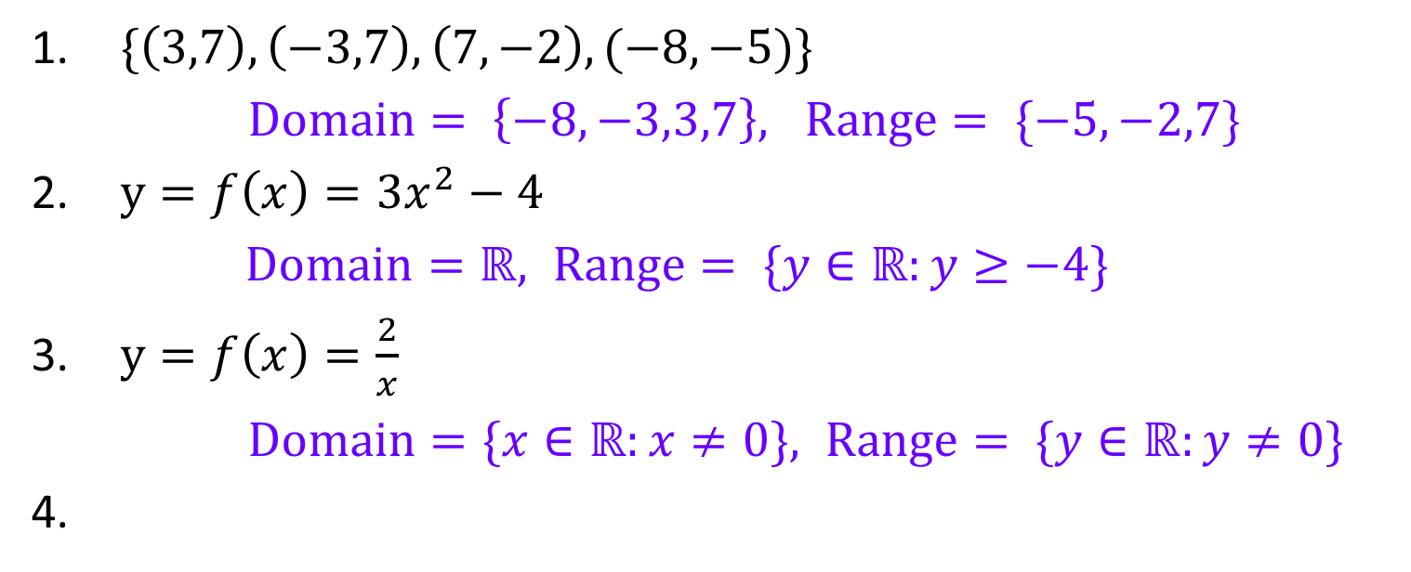
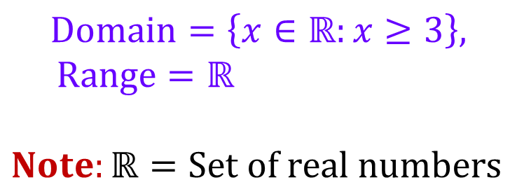
Examples: Identifying Domain and Range
$\{\left(3,7\right),\left(−3,7\right),\left(7,−2\right),(−8,−5)\}$
$Domain= \left\{−8,−3,3,7\right\}, Range= \{−5,−2,7\}$
$y=f\left(x\right)=3x^{2}−4$
$Domain=ℝ, Range= \{y∈ℝ:y≥−4\}$
$y=f\left(x\right)=\frac{2}{x}$
$Domain=\{x∈ℝ:x≠0\}, Range= \{y∈ℝ:y≠0\}$
$$Domain=\left\{x∈ℝ:x≥3\right\},$$
$Range=ℝ$
$Note:ℝ=Set of real numbers$

