Slide 1

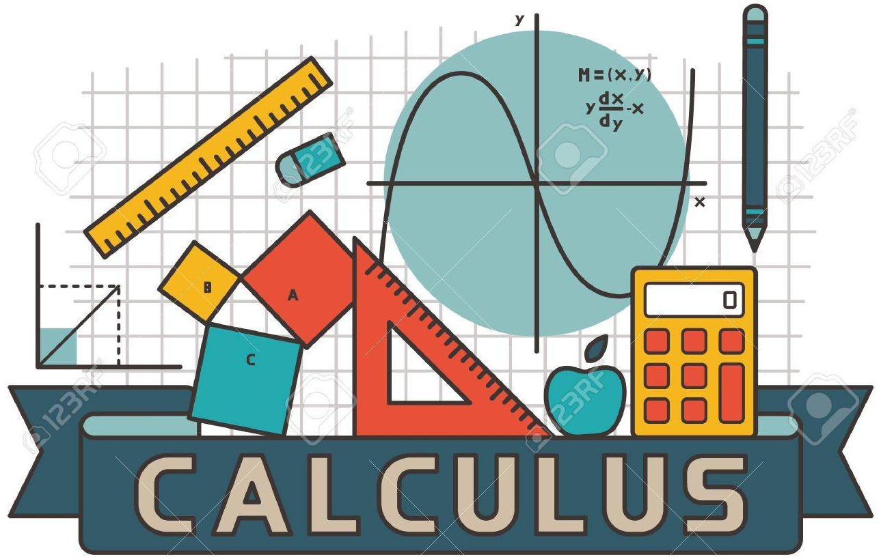
Calculus & Analytical Geometry MATH- 101
Instructor: Dr. Naila Amir (SEECS, NUST)

Slide 2
Identifying Functions, their Domain and Range

Slide 3

Algebraic representation of a function
Consider the following relation:
Is this a function?
Yes it is a function.
If yes, then what is domain and range?

Slide 4
Visualizing domain of

Slide 5

Visualizing range of

Slide 6
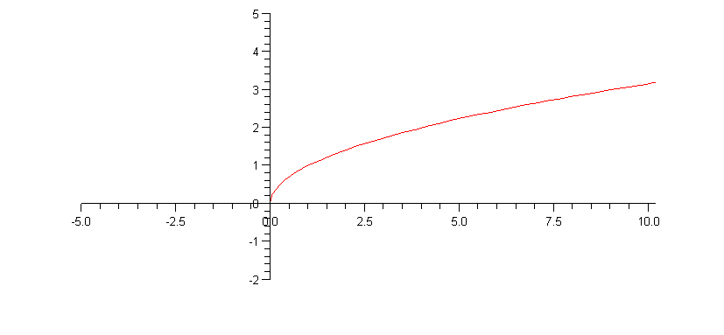
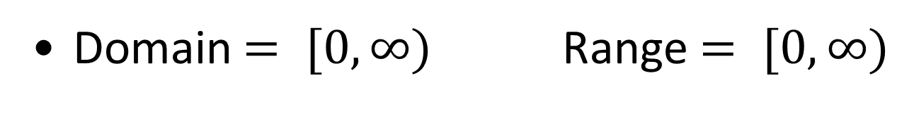
Domain $= [0, ∞)$ Range $= [0, ∞)$

Slide 7
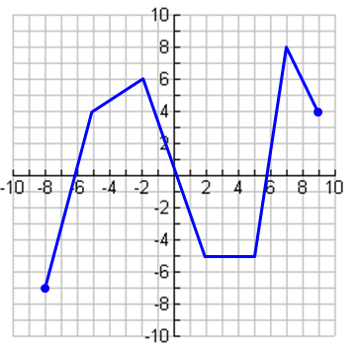


Example: Describe the domain and range of the following function:
Domain:
Range:

Slide 8

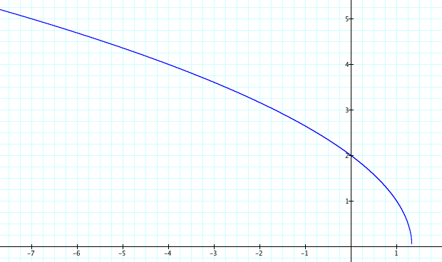
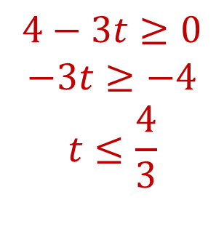

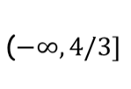


Example: Find the domain and range of
The input to a square root function must be greater than or equal to 0
t | -32 | -20 | -15 | -7 | -4 | 0 | 1 | 2 | 3
h | 10 | 8 | 7 | 5 | 4 | 2 | 1 | ER | ER
Dividing by a negative switches the sign
Domain:
The range is clear from the graph and table.
Range:

Slide 9
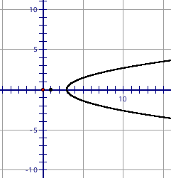

Examples: Identifying Domain and Range
$\left\{\left(3,7\right),\left(−3,7\right),\left(7,−2\right),\left(−8,−5\right)\right\}$
$y=f\left(x\right)=3x^{2}−4$
$y=f\left(x\right)=\frac{2}{x}$

Slide 10
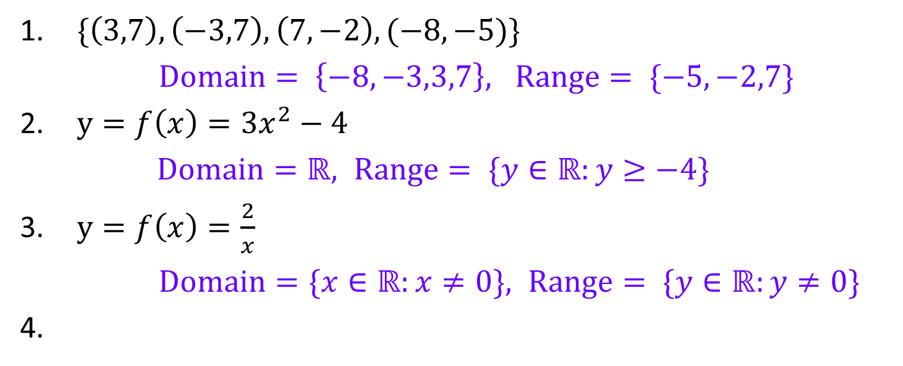
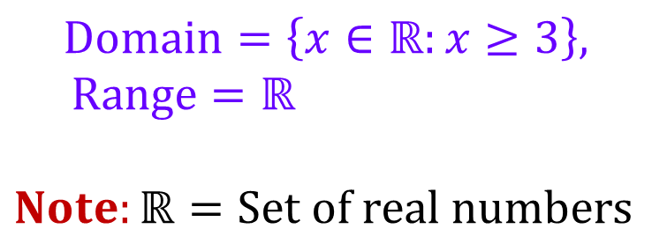
Examples: Identifying Domain and Range
$\{\left(3,7\right),\left(−3,7\right),\left(7,−2\right),(−8,−5)\}$
$Domain= \left\{−8,−3,3,7\right\}, Range= \{−5,−2,7\}$
$y=f\left(x\right)=3x^{2}−4$
$Domain=ℝ, Range= \{y∈ℝ:y≥−4\}$
$y=f\left(x\right)=\frac{2}{x}$
$Domain=\{x∈ℝ:x≠0\}, Range= \{y∈ℝ:y≠0\}$
$$Domain=\left\{x∈ℝ:x≥3\right\},$$
$Range=ℝ$
$Note:ℝ=Set of real numbers$

Slide 11
Identifying Functions and their graphs

Slide 12
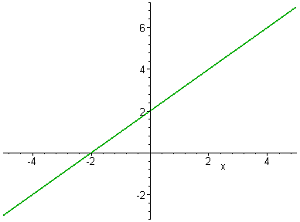
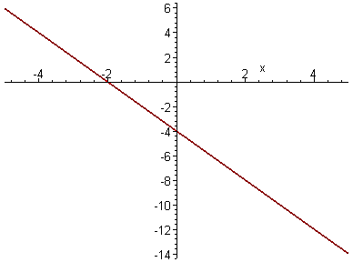
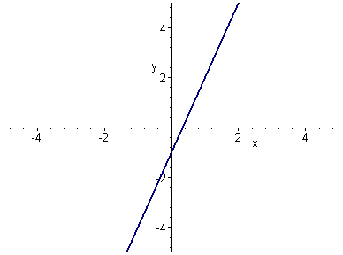
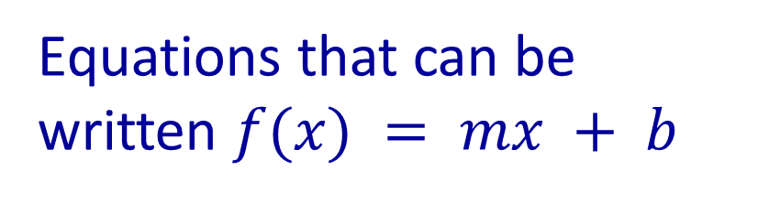
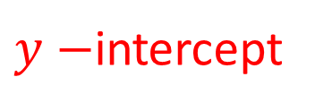
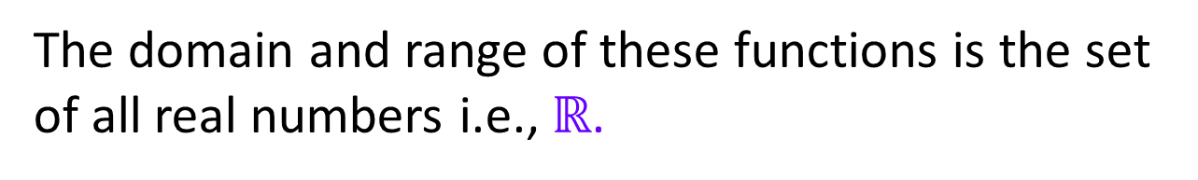
Linear Functions
Equations that can be written $f(x) = mx + b$
slope
$y−$intercept
The domain and range of these functions is the set of all real numbers i.e., $ℝ$.

Slide 13
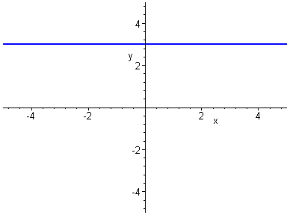
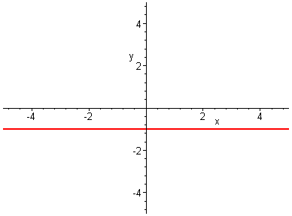
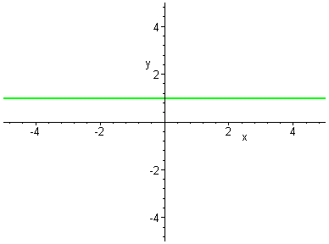

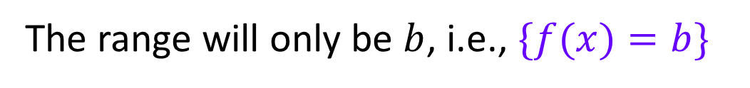


$$f(x)=3$$
$$f(x)=−1$$
$$f(x)=1$$
Constant Functions
$f(x)=b,$where $b$ is a real number
The domain of these functions is all real numbers, i.e., $ℝ$
The range will only be $b$, i.e., $\{f(x)=b\}$

Slide 14
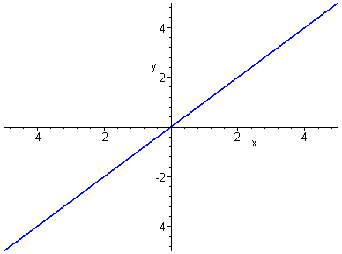


Identity Function
If we put any real number in this function, we get the same real number “back”.
$$f(x) = x$$
$f(x)=x$, slope 1, $y−$intercept = 0
The domain of this function is all real numbers, i.e., $ℝ$.
The range is also all real numbers , i.e., $ℝ$.

Slide 15
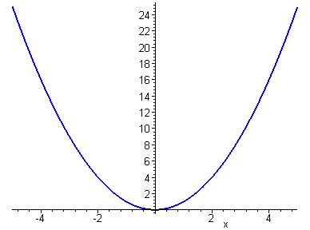


Square Function (Parabolic Function)
$$f(x) = x2$$
The domain of this function is all real numbers, i.e., $ℝ$.
The range of this function is: $\left\{y∈ℝ:y≥0\right\}.$

Slide 16
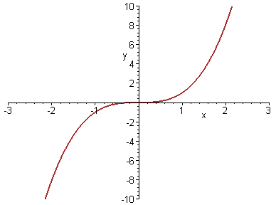


Cubic Function
$$f(x) = x3$$
The domain of this function is all real numbers, i.e., $ℝ$.
The range is also all real numbers , i.e., $ℝ$.

Slide 17
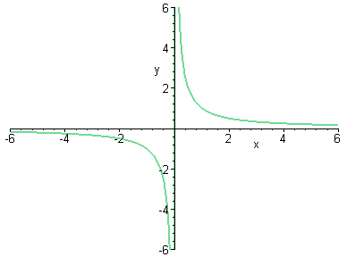

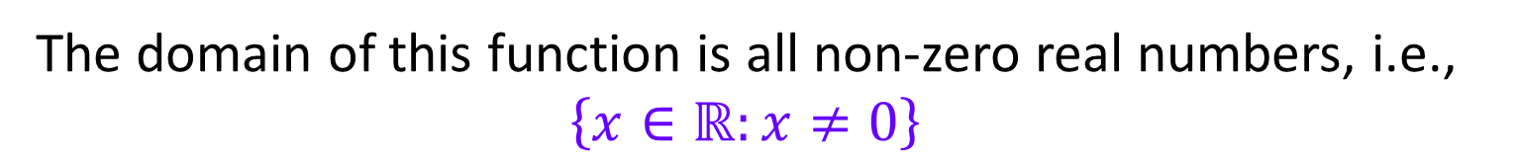
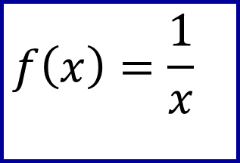
Reciprocal Function
$$f\left(x\right)=\frac{1}{x}$$
The domain of this function is all non-zero real numbers, i.e., $\left\{x∈ℝ:x≠0\right\}$
The range is: $\left\{f(x)∈ℝ:f(x)≠0\right\}$

Slide 18
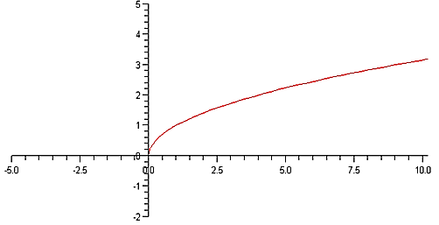

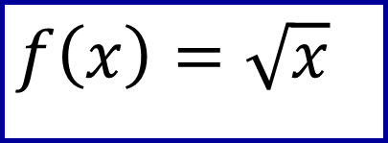
Square Root Function
$$f\left(x\right)=\sqrt{x}$$
The domain of this function is: $\left\{x∈ℝ:x≥0\right\}$
The range is: $\left\{f(x)∈ℝ:f(x)≥0\right\}$

Slide 19
These are the functions that are defined differently on different parts of the domain.
WISE
FUNCTIONS

Slide 20
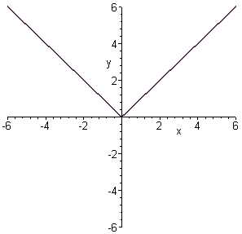
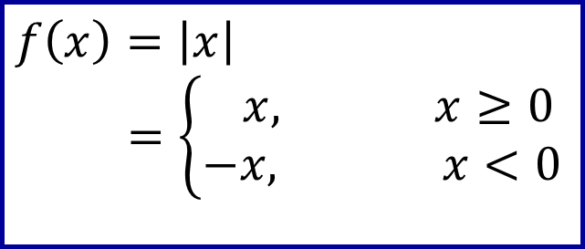
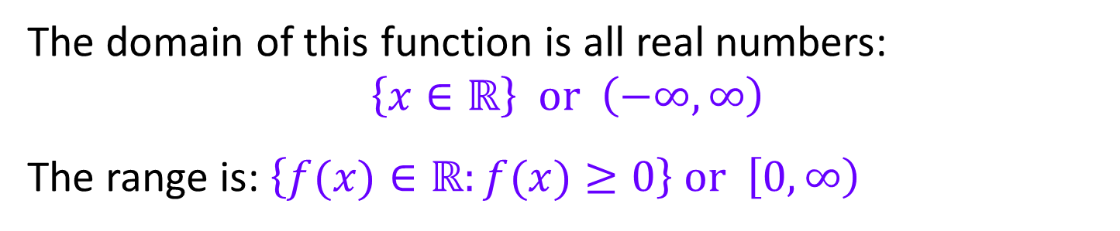
Absolute Value Function
$$f\left(x\right)=\left|x\right| \\ =\left\{\begin{matrix} x, x≥0 \\ −x, x<0\end{matrix}\right.$$
The domain of this function is all real numbers:
$$\left\{x∈ℝ\right\} \text{or} \left(−∞,∞\right)$$
The range is: $\left\{f(x)∈ℝ:f(x)≥0\right\} \text{or} \left[0,∞\right)$

Slide 21

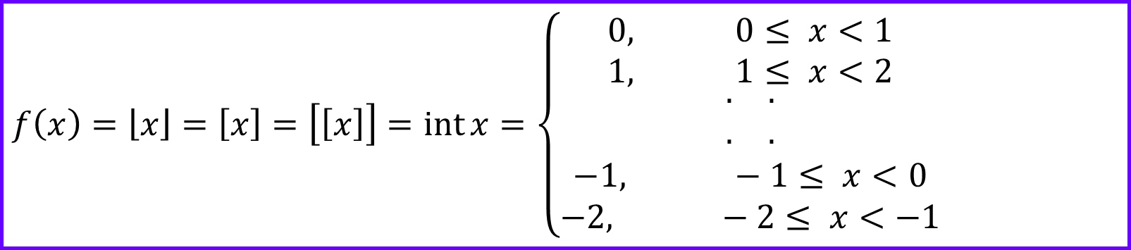
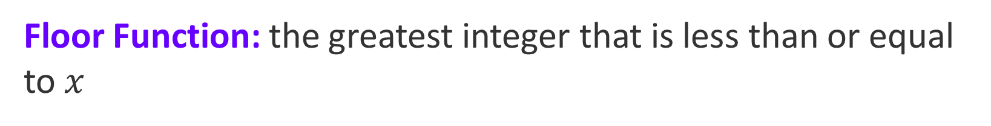
The Greatest Integer Function (floor function)
Floor Function: the greatest integer that is less than or equal to $x$
$$f\left(x\right)=\left\lfloor x\right\rfloor =\left[x\right]=\left[\left[x\right]\right]=\operatorname{int}{x}=\left\{\begin{matrix}0, 0≤ x<1 \\ 1, 1≤ x<2 \\ \begin{matrix}\begin{matrix}. & .\end{matrix} \\ \begin{matrix}. & .\end{matrix}\end{matrix} \\ −1, −1≤ x<0 \\ −2, −2≤ x<−1\end{matrix}\right.$$
Practice: Define the least integer function (ceiling function).

Slide 22
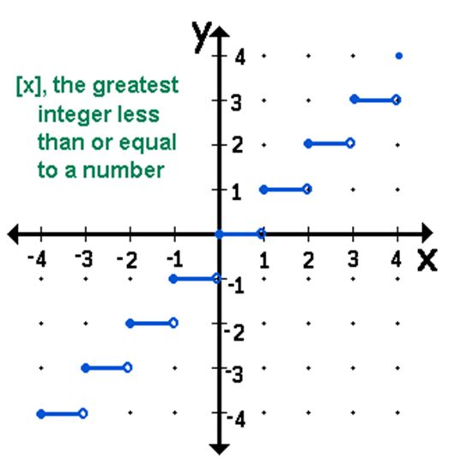


Slide 23
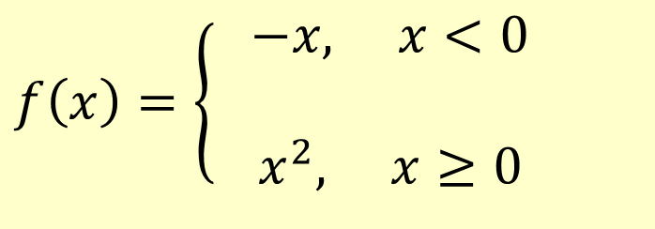
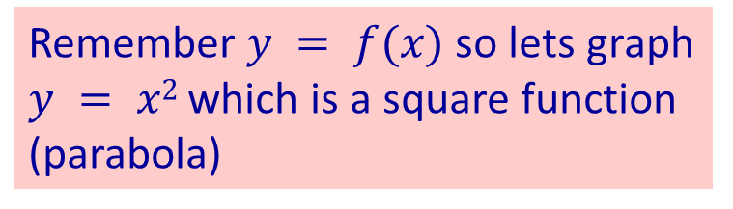
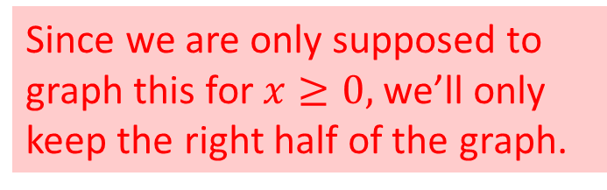
$$f\left(x\right)=\left\{ \begin{aligned}−x, x<0 \\ \\ &x^{2}, x≥0\end{aligned}\right.$$
Remember $y = f(x)$so lets graph $y = x2$which is a square function (parabola)
Since we are only supposed to graph this for $x≥0,$we’ll only keep the right half of the graph.
This then is the graph for the piecewise function given above.

Slide 24

$$f\left(x\right)=\left\{\begin{aligned}& 2x+5, −3≤x<0 \\ \\ & −3, x=0 \\ \\ & −5x, x>0\end{aligned}\right.$$
open dot since not "or equal to"
solid dot for "or equal to"

Slide 25
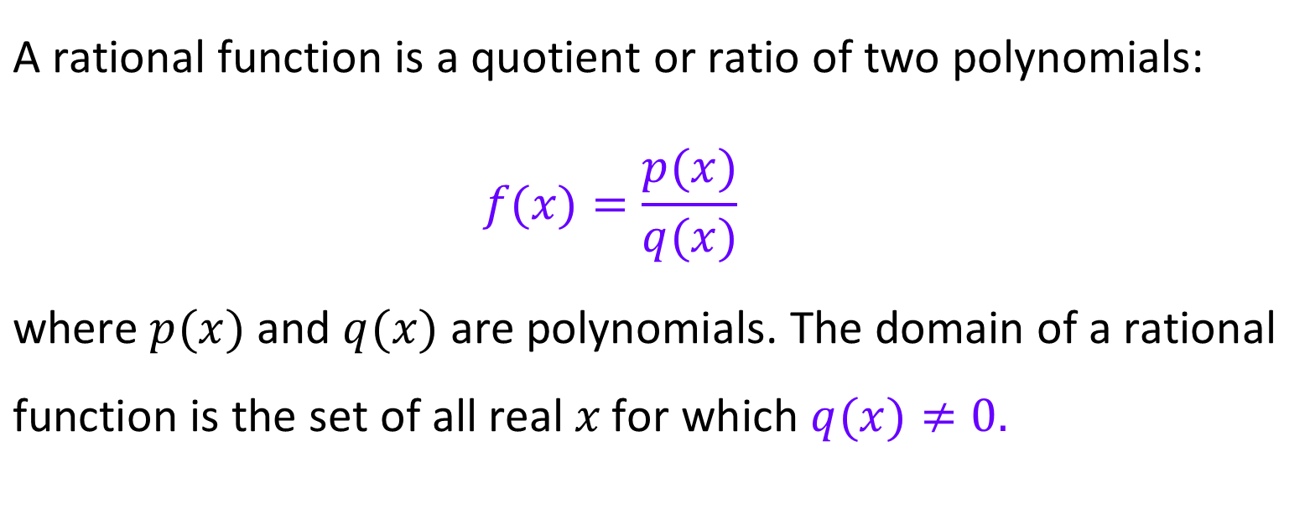
Rational Functions
$$\text{A} \text{rational} \text{function} \text{is} \text{a} \text{quotient} \text{or} \text{ratio} \text{of} \text{two} \text{polynomials}\text{:} \\ f(x)=\frac{p(x)}{q(x)}$$ $\text{where} p(x) \text{and} q(x) \text{are} \text{polynomials}\text{. }\text{The} \text{domain}$ $\text{of} \text{a} \text{rational} \text{function} \text{is} \text{the} \text{set} \text{of} \text{all} \text{real} x \text{for}$ $\text{which} q(x)≠0.$

Slide 26
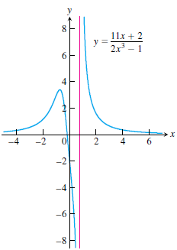
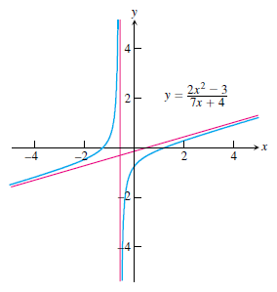
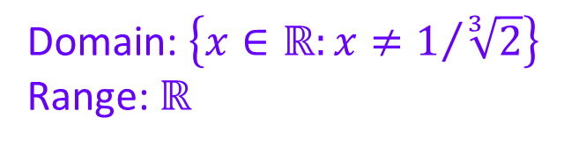
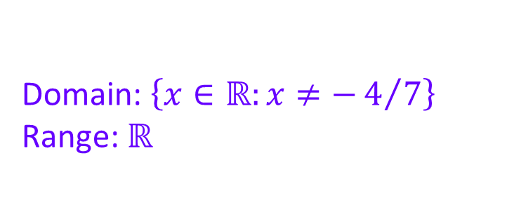
Graphs of rational functions:
Domain: $\left\{x∈ℝ:x≠−4/7\right\}$
Range: $ℝ$
Domain: $\left\{x∈ℝ:x≠1/{\sqrt[3]{2}}\right\}$
Range: $ℝ$

