Slide 1

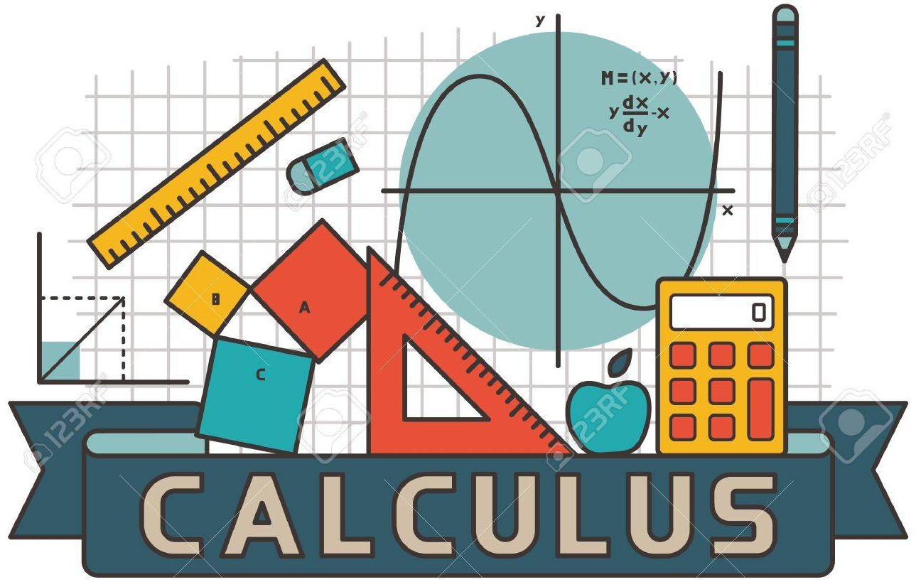
Calculus & Analytical Geometry MATH- 101
Instructor: Dr. Naila Amir (SEECS, NUST)

Slide 2
Identifying Functions and their graphs

Slide 3
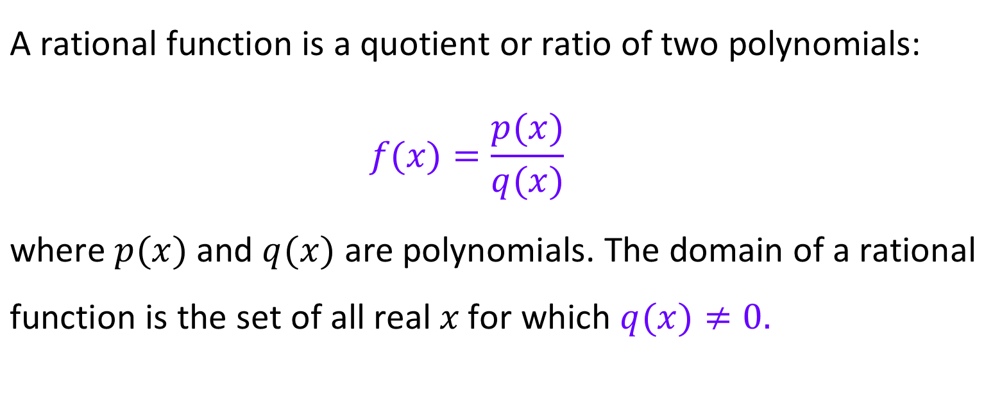
Rational Functions
$$\text{A} \text{rational} \text{function} \text{is} \text{a} \text{quotient} \text{or} \text{ratio} \text{of} \text{two} \text{polynomials}\text{:} \\ f(x)=\frac{p(x)}{q(x)}$$ $\text{where} p(x) \text{and} q(x) \text{are} \text{polynomials}\text{. }\text{The} \text{domain}$ $\text{of} \text{a} \text{rational} \text{function} \text{is} \text{the} \text{set} \text{of} \text{all} \text{real} x \text{for}$ $\text{which} q(x)≠0.$

Slide 4
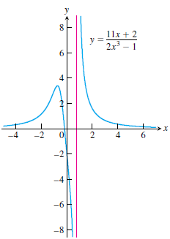
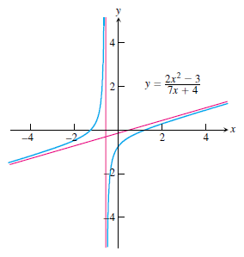
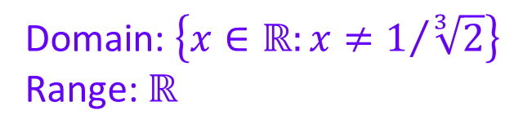
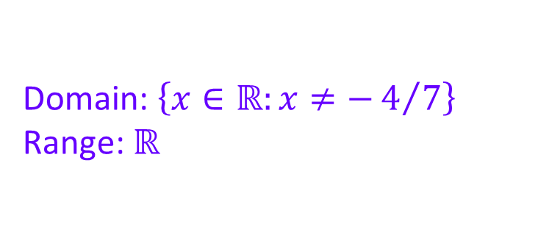
Graphs of rational functions:
Domain: $\left\{x∈ℝ:x≠−4/7\right\}$
Range: $ℝ$
Domain: $\left\{x∈ℝ:x≠1/{\sqrt[3]{2}}\right\}$
Range: $ℝ$

Slide 5
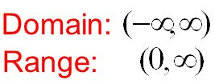
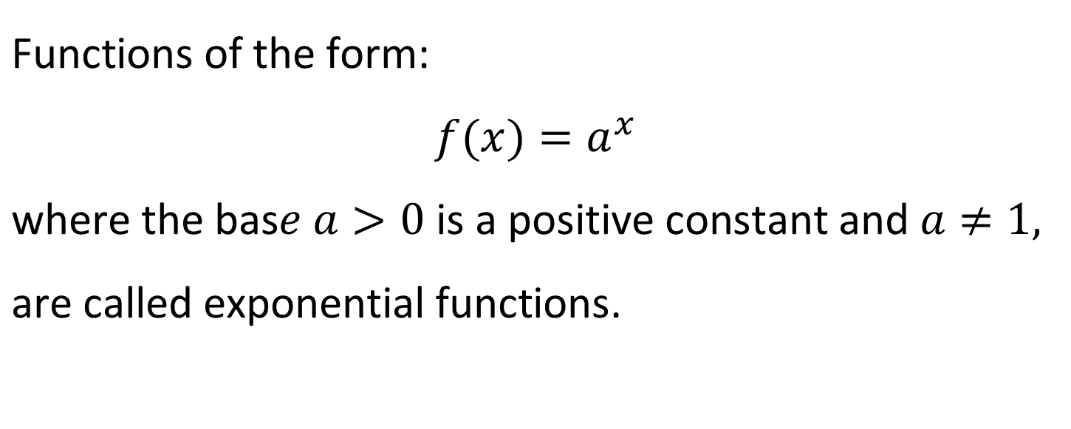
Exponential Functions
$$\text{Functions} \text{of} \text{the} \text{form}\text{:}$$
$$f(x)=a^{x}$$
$\text{where} \text{the} \text{bas}e a>0 \text{is} \text{a} \text{positive} \text{constant} \text{and} a≠1,$ $\text{are} \text{called} \text{exponential} \text{functions}\text{.}$

Slide 6
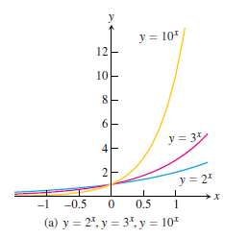
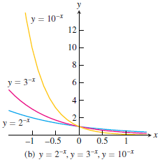
Graphs of exponential functions:

Slide 7
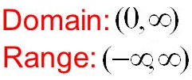
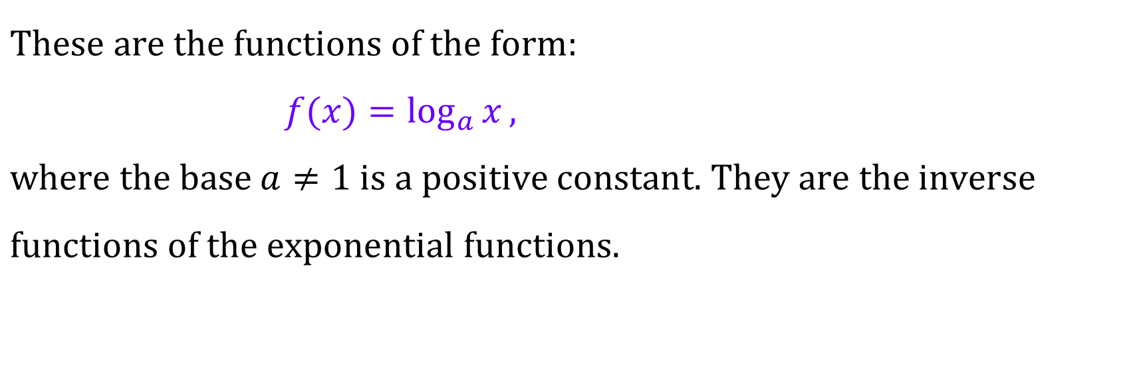
Logarithmic Functions
$$\text{These} \text{are} \text{the} \text{functions} \text{of} \text{the} \text{form}\text{:} \\ f(x)=\log_{a}{x}, \\ \text{where} \text{the} \text{base} a≠1 \text{is} \text{a} \text{positive} \text{constant}\text{. }\text{They} \text{are} \text{the} \text{inverse} \\ \text{functions} \text{of} \text{the} \text{exponential} \text{functions}\text{.}$$

Slide 8
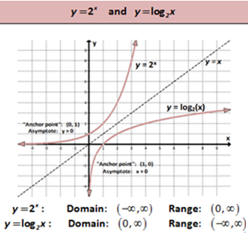
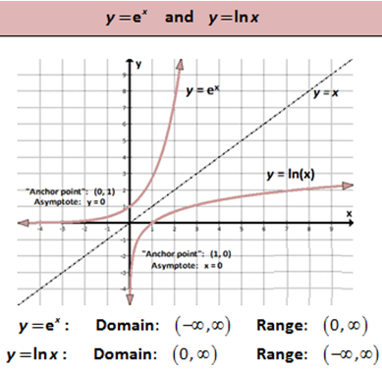
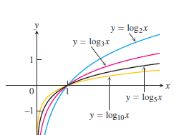
Graphs of Logarithmic functions

Slide 9
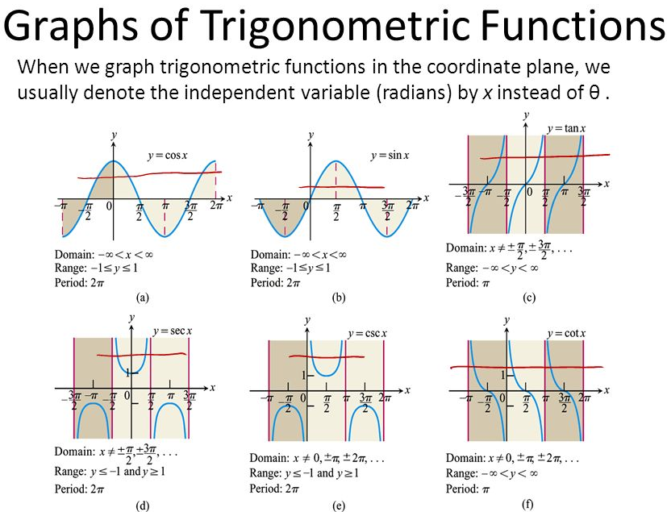

Slide 10
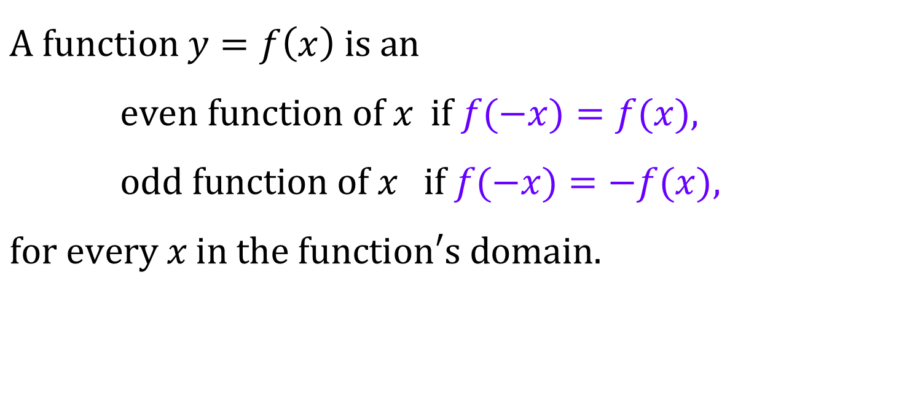
Even and Odd Functions
$$\text{A} \text{function} y=f\left(x\right) \text{is} \text{an} \\ \text{even} \text{function} \text{of} x \text{if} f(−x)=f(x), \\ \text{odd} \text{function} \text{of} x \text{if} f(−x)=−f(x), \\ \text{for} \text{every} x \text{in} \text{the} \text{function}\text{′}\text{s} \text{domain}\text{.}$$

Slide 11






Examples:
$$1. f\left(x\right)=5x^{4}−2x^{2}+1$$
Even function
$$2. f\left(x\right)=5x^{5}−2x^{3}+x$$
Odd function
$$3. f\left(x\right)=\sin{x}$$
$$4. f\left(x\right)=\sec{x}$$
???
$$5. f\left(x\right)=\tan{x}$$
$$6.f\left(x\right)=5x^{3}−2x^{2}+x$$

Slide 12
Symmetric Graphs

Slide 13
Symmetric about the y axis
FUNCTIONS
Symmetric about the origin

Slide 14
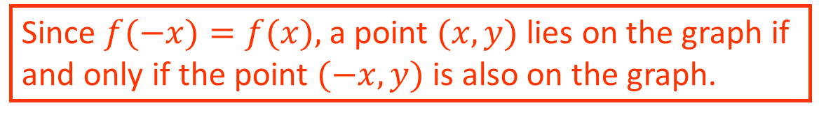
Even functions have y-axis Symmetry
8
7
6
5
4
3
2
1
-7
-6
-5
-4
-3
-2
-1
0
1
2
3
4
5
6
7
8
-2
-3
-4
-5
-6
-7
Since $f(−x)=f(x),$a point $(x, y)$lies on the graph if and only if the point $(−x, y)$is also on the graph.

Slide 15
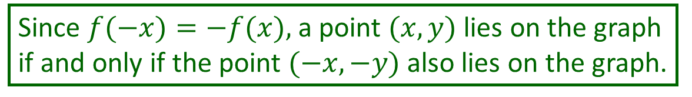
Odd functions have origin Symmetry
8
7
6
5
4
3
2
1
-7
-6
-5
-4
-3
-2
-1
0
1
2
3
4
5
6
7
8
-2
-3
-4
-5
-6
-7
Since $f(−x)=−f(x),$a point $(x, y)$lies on the graph if and only if the point $(−x, −y)$also lies on the graph.

Slide 16
x-axis Symmetry
We won’t talk about a function with x-axis symmetry because it wouldn’t be a function.
8
7
6
5
4
3
2
1
-7
-6
-5
-4
-3
-2
-1
0
1
2
3
4
5
6
7
8
-2
-3
-4
-5
-6
-7

Slide 17
Shifting Graphs

Slide 18
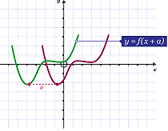
Shifting a graph of a function
A shift is a rigid translation, means it does not change the shape or size of the graph of the function. All that a shift will do is change the location of the graph.
A vertical shift adds/subtracts a constant to/from every y-coordinate while leaving the x-coordinate unchanged.
A horizontal shift adds/subtracts a constant to/from every x-coordinate while leaving the y-coordinate unchanged.
Vertical and horizontal shifts can be combined into one expression.

Slide 19



$$f\left(x\right)=x^{2}$$
$$f\left(x\right)+1=x^{2}+1$$
$$f\left(x\right)−3=x^{2}−3$$
Vertical shift

Slide 20



$$f\left(x\right)=\left|x\right|$$
$$f\left(x\right)+2=\left|x\right|+2$$
$$f\left(x\right)−4=\left|x\right|−4$$
Vertical shift

Slide 21


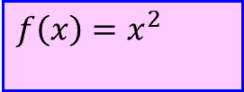
$$f\left(x+2\right)={\left(x+2\right)}^{2}$$
$$f\left(x\right)=x^{2}$$
$$f\left(x−1\right)={\left(x−1\right)}^{2}$$
Horizontal shift

Slide 22
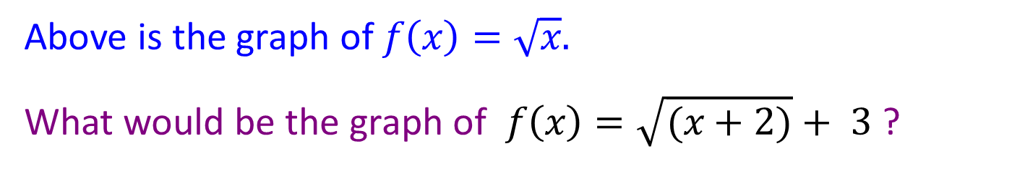
We can have a function that is shifted both vertically & horizontally.
up 3
left 2
Above is the graph of $f\left(x\right)=\sqrt{x}.$
What would be the graph of $f\left(x\right)=\sqrt{(x+2)}+ 3$?

Slide 23
Scaling Graphs

Slide 24
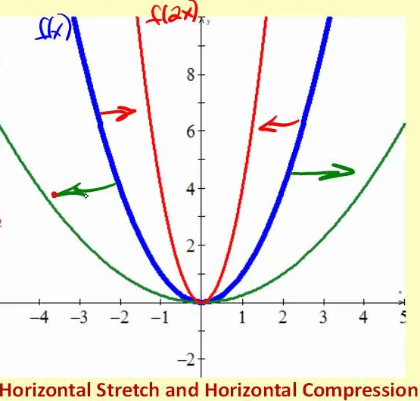
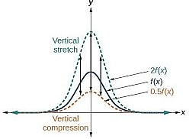
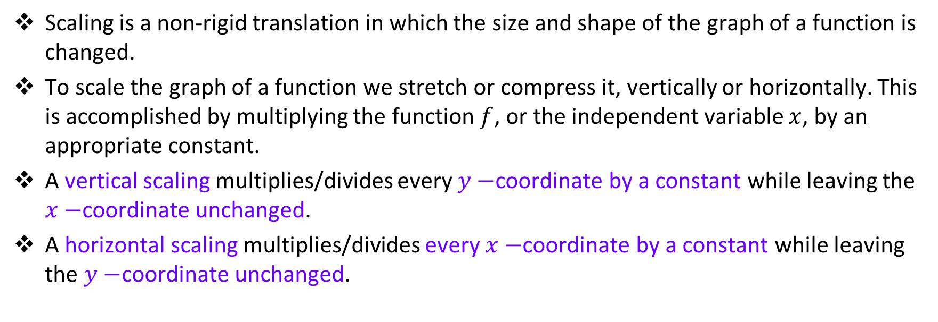
Scaling a graph of a function
Scaling is a non-rigid translation in which the size and shape of the graph of a function is changed.
To scale the graph of a function we stretch or compress it, vertically or horizontally. This is accomplished by multiplying the function $f$, or the independent variable $x$, by an appropriate constant.
A vertical scaling multiplies/divides every $y−$coordinate by a constant while leaving the $x−$coordinate unchanged.
A horizontal scaling multiplies/divides every $x−$coordinate by a constant while leaving the $y−$coordinate unchanged.

Slide 25
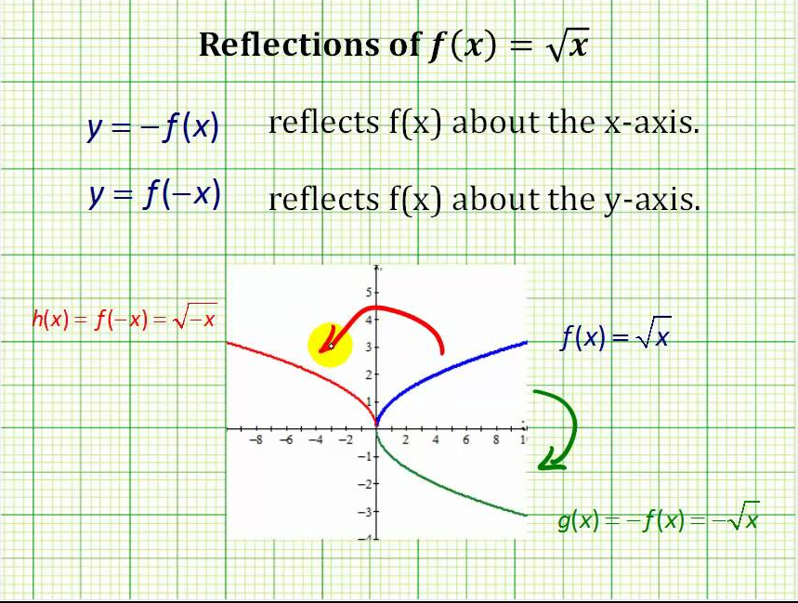

Reflection a graph of a function
A translation in which the graph of a function is mirrored about an axis.
Reflections are just a special case of the scaling.
To reflect about the $y−$axis, multiply every $x$ by $−1$ to get $−x$.
To reflect about the $x$-axis, multiply $f(x)$ by $−1$ to get $−f(x).$

Slide 26
