Slide 1
7cs OF EFFECTIVE COMMUNICATION
WEEK 3

Slide 2
LEARNING OUTCOMES:
WHAT is communication ?
WHY proper communication ?
7Cs of Effective communication.

Slide 3
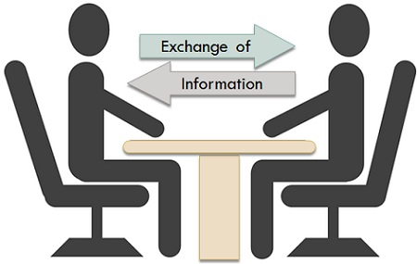
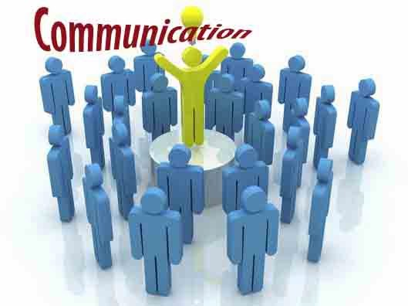
WHAT IS COMMUNICATION?
Communication is the exchange of
thoughts, ideas, emotions, information,
or understanding between two people or
groups where one is sender and other is
receiver.

Slide 4
WHY PROPER COMMUNICATION ?
WITH WITHOUT
Interpersonal harmony and Great ideas don’t get
effectiveness. Implemented
We can create and implement We miss the opportunities
opportunities. that we could co-create
with our co-workers.
Productivity level will get Productivity level will get
increased. decreased.
Provide peace of mind and Results in lower
satisfaction. satisfaction level.

Slide 5
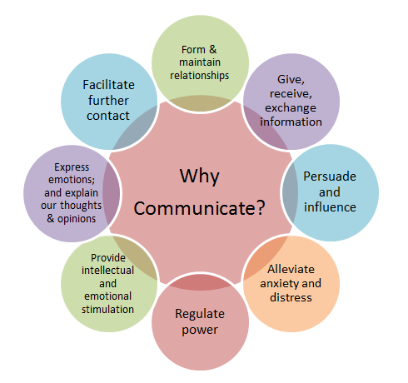
WHY PROPER COMMUNICATION ?

Slide 6
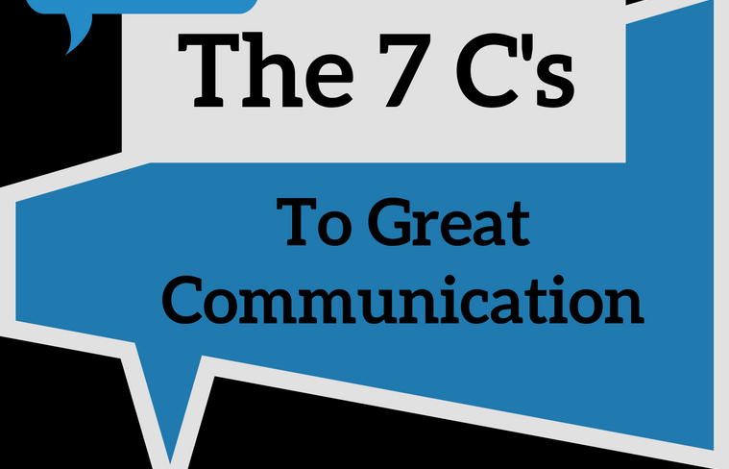
7cs OF COMMUNICATION.

Slide 7
7Cs OF EFFECTIVE COMMUNICATION
Completeness
Conciseness
Consideration
Concreteness
Clarity
Courtesy
Correctness

Slide 8
1.COMPLETENESS
The message must be complete.
It should convey all the facts required by the audience.
Leave no questions or doubts unanswered.
Must convey all the information.
The sender of the message must take into consideration the receiver and should communicate all the facts and figures related to the message.

Slide 9
FIVE W’s
One way to make your message effective is to answer five W’s.
Who?
What?
When?
Where?
Why?

Slide 10
COMPLETENESS: BENEFITS
Helps in better understanding.
Complete communication helps in better decision-making by the audience/readers/receivers of message as they get all desired and crucial information.
Complete information enhances your reputation as a person.
It persuades the audience.

Slide 11
2. CONCISENESS
Conciseness means “convey the message by using fewest words”.
By using least possible words.
“Conciseness is the prerequisite to effective communication.”
It underlines and highlights the main message as it avoids using excessive and needless words.
A concise message saves the time and expenses for both the parties.

Slide 12
HOW TO ACHIEVE CONCISENESS?
For achieving the conciseness you have to consider the following.
Avoid wordy expression
Include only relevant material
Avoid unnecessary repetition.

Slide 13
3. CONSIDERATION.
Consideration means – To consider the receiver’s Interest/Intention.
It is very important in effective communication while conveying a message you should always keep in mind your target group.
Consideration is very important “C” among all the seven C’s.

Slide 14
CONSIDERATION.
It means to prepare every message with the message receivers in the mind: put yourself at their place, being aware of their ideas, emotions, attitudes, desires, circumstances and probable reactions to your point.
Handle the matter from their point of view, called as “you-attitude”.

Slide 15
THREE WAYS TO INDICATE CONSIDERATION.
1-Focus on “you” instead of “I” or “We”
2-Show audience benefit or interest of the receiver
3-Emphasize positive, pleasant facts.
Using “you” help you, but over use lead a negative reaction.

Slide 16
4. CONCRETENESS
Communicating concretely means being specific, definite, and vivid rather than vague and general because misunderstanding of words creates problems for both parties (sender and receiver).
A concrete message is supported with proper facts and figures
The words used to convey message must be very clear that build the reputation.
Concrete messages are not misinterpreted.

Slide 17
CONCRETENESS
EXAMPLE
General: Azaan is very intelligent student of class and stood first in class.
Concrete: Azaan’s CGPA in BEE fall 2019 was 3.95/4.00 and he stood first in class.
Always provide information based on solid grounds. It definitely creates good impression as well.

Slide 18
5. CLARITY
Clarity implies emphasizing on a specific message or goal at a time, rather than trying to achieve too much at once. Clarity in communication has following benefits:
It makes understanding easier.
Complete clarity of thoughts and ideas enhances the meaning of message.
Clear message makes use of exact, appropriate and concrete words.

Slide 19
PURPOSE OF CLARITY: BEING ACCURATE
In effective business or general communication the message should be very much clear. So that reader can understand it easily.
You should always Choose precise words.
Always choose familiar and easy words.
Construct effective sentences and paragraphs

Slide 20
6. COURTESY
True courtesy involves being aware not only of the perspective of others, but also their feelings. courtesy stems from a sincere you-attitude.
Courtesy is to show good manners to your receiver.
Being Courteous is to:
Be tactful, thoughtful and appreciative.
Omit expressions that irritate.
Do not be blunt.

Slide 21
EXAMPLE:
TACTLESS, BLUNT | MORE TACTFUL
Stupid letter; I can’t understand Its your fault, you did not properly read my latest FAX | I should understand it, as there is no confusing word in this letter, could you please explain it once again ..? Sometimes my wording is not precise; let me try again

Slide 22
7. CORRECTNESS
Correctness in communication implies that there are no grammatical errors in communication. Correct communication has following features:
The message is exact, correct and well-timed.
If the communication is correct, it boosts up the confidence level.
Correct message has greater impact on the audience/readers.

Slide 23
CORRECTNESS
It checks for the precision and accurateness of facts and figures used in the message.
It makes use of appropriate and correct language in the message.

Slide 24
EXAMPLES

Slide 25
CONCISE THE STATEMENT
We hereby wish to let you know that our company is pleased with the confidence you have reposed in us.

Slide 26
SOLUTION
We appreciate your confidence.

Slide 27
COMPLETENESS
How come my request for an interview letter did not receive a response.

Slide 28
SOLUTION
When was the letter sent? Who sent it? To whom was it sent ?

Slide 29
CONCRETENESS
Please send us the following items by the end of this month.

Slide 30
SOLUTION
The following items should reach us on or before 21st May.

Slide 31
THANK YOU

