Slide 1

BASICS OF GRAMMAR
WEEK 3
Ms dania anwar

Slide 2
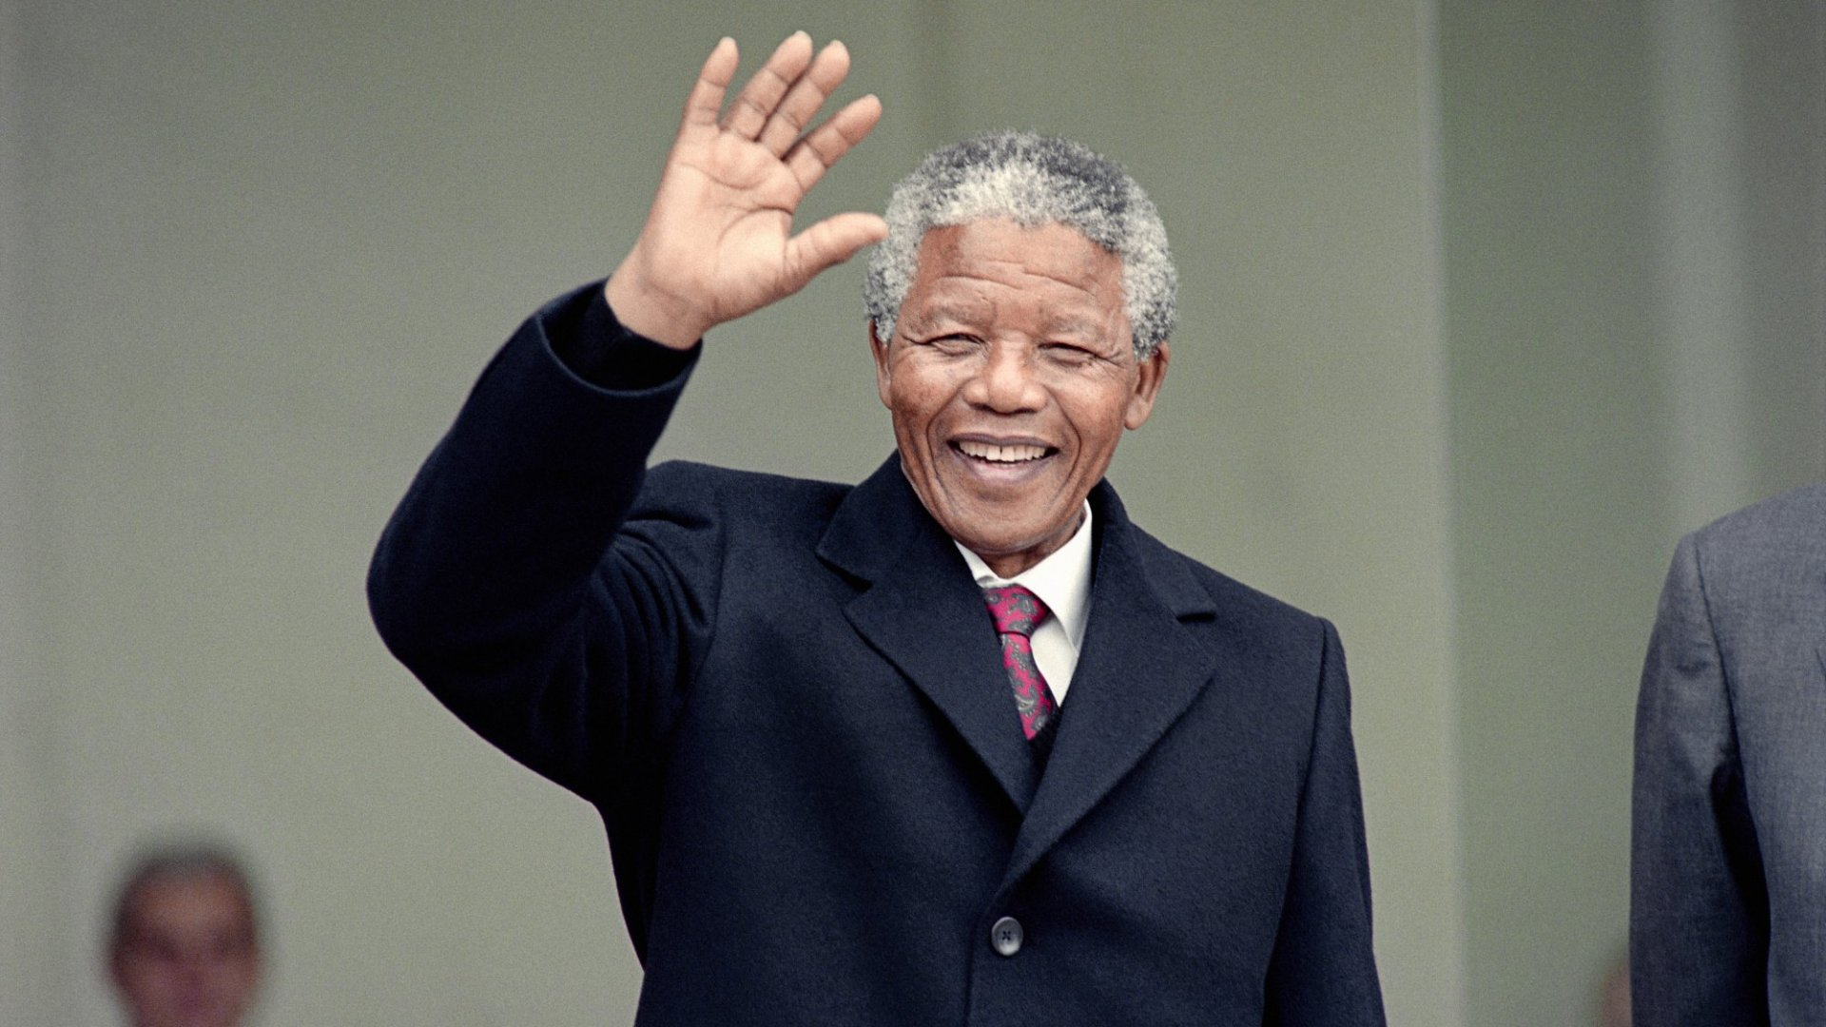


NOUN
Person
Place
Thing

Slide 3
IDENTIFY NOUN
TURKEY SELLS THOUGHT
COLD GOING FISH
SUFFERING FAN AND
HONEST UNIVERSITY ALI
THOUGHT BOOK LAPTOP

Slide 4
ADJECTIVE
Words that describe nouns.
Juicy pear
Red apples
Clever witch
Opportunistic villain
Authoritative leader
In these examples , nouns are modified by adjectives

Slide 5
DIFFERENT WAYS OF THEIR USAGE.
Attributive Adjectives : go before the noun. Juicy pear
Postpositive Adjectives : They go immediately after the noun
Paradise Lost. Something funny.
Time Immemorial. Nothing expensive.
People responsible. Someone evil.
Adjective
Noun
Something, nothing and someone are pronouns. Adjectives can also modify pronouns.

Slide 6
DIFFERENT WAYS OF THEIR USAGE.
Predicative Adjectives:
They go after the noun and complete a linking verb.
Tina is angry.
She seems frustrated
Noun
Linking verb
adjective
Pronoun
Linking verb
adjective

Slide 7
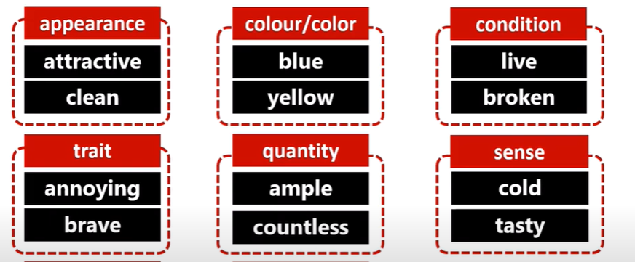
EXAMPLES

Slide 8
PARTICIPLES
A word formed from a verb that can be used as an adjective.
Annoying Broken
-ing -en, -ed, -n, -t
Boiling water Written word
A laughing man is stronger than a suffering man.
Present participle
Past participle

Slide 9
PARTICIPLES
Participles are not only used as adjectives. They are also used to form verb tenses.
He is walking. Someone is smiling.
Past participles are also used to form passive voice.
The painting was taken to the auction.
the tense of the verb is determined by when the action took place.

Slide 10
DETERMINERS
A determiner is a word placed in front of a noun to specify quantity.
e.g., "one dog," "many dogs"
or to clarify what the noun refers to (e.g., "my dog," "that dog," "the dog".

Slide 11
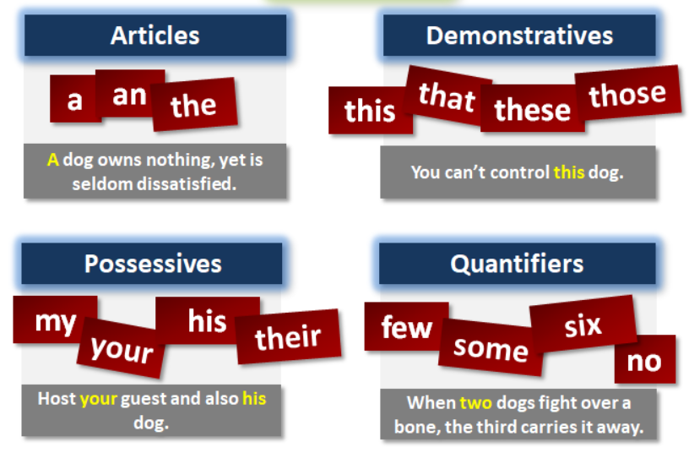
DIFFERENT FORMS OF DETERMINERS

Slide 12
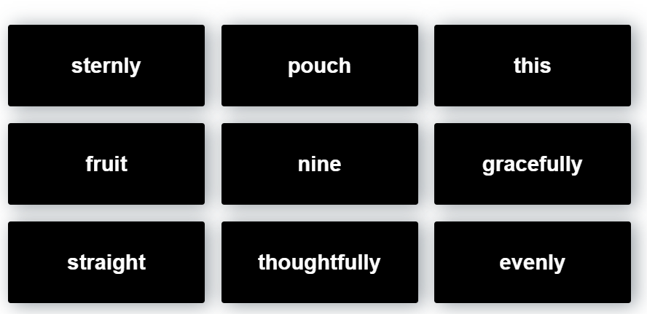
IDENTIFY DETERMINERS

Slide 13
Subject-verb agreement
It means the subject must match or agrees to the verb.
If your subject is singular , then you must use singular verb and if the subject is plural the verb should be plural as well.

Slide 14
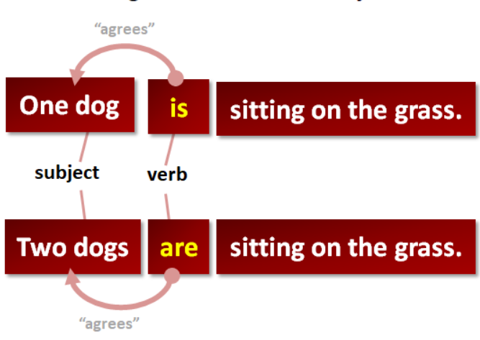
EXAMPLES

Slide 15
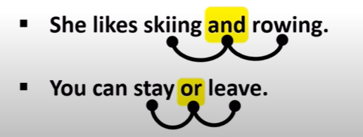
Conjunctions
Conjunctions are words used to connect words, phrases or clauses.
WORDS :

Slide 16
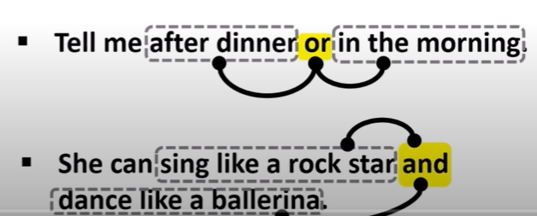
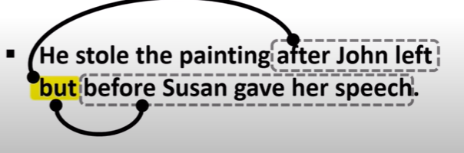
Conjunctions
PHRASES:
CLAUSES:

Slide 17
PRONOUN
A word that replaces the noun.
In Spain, apples are amazing. They look
like cartoon apples.
Trevor knows secrets. He is a smart boy.
A noun that is being replaced by the pronoun is called antecedent.

Slide 18
PRONOUN
A pronoun replaces anything that is functioning as a noun.
The arctic fox handles the cold better than most animals on Earth. It does not feel the cold until the temperature drops to –70°C.
A multi-word noun

Slide 19
DEMONSTRATIVE PRONOUN
A demonstrative pronoun can refer to something previously mentioned or to something in the speaker's surroundings (e.g., something being pointed at by the speaker).
This is my student.
That is my mother
These are my children.
Those are my friends.
This
That
These
Those

Slide 20
REFLEXIVE PRONOUN
A reflexive pronoun is paired with another noun or pronoun to show it is acting on itself.
Ayesha does not trust herself.
I did it to myself.
Myself
Himself
Herself
Yourself
Itself

Slide 21
RECIPROCAL PRONOUN
A reciprocal pronoun expresses the mutual action or relationship.
My dog and cat care about each other.
They all support one another.
Reciprocal pronoun
Reciprocal Pronoun

Slide 22
RELATIVE PRONOUN
A relative pronoun introduces a clause that describes a noun.
These pronouns introduce clauses that provide information necessary to identify their nouns.
Whom
Which
Whose
That
Who

Slide 23
EXAMPLES
Relative pronoun
No commas.
(If the relative pronoun heads the clause that defines the noun)
The man who stole your bike has been caught.
His car, which is two days old, broke down again.
Relative Pronoun
Commas
(If the relative pronoun heads the clause that just the additional information, use commas. )

Slide 24
IDENTIFY RELATIVE PRONOUN
Education is the most powerful weapon which you can use to change the world. (Nelson Mandela)
The man who won last week’s lottery gave all of his money to charity.
I know someone whose ring was found after thirty years.

Slide 25
SOLUTION
Education is the most powerful weapon which you can use to change the world. (Nelson Mandela)
The man who won last week’s lottery gave all of his money to charity.
I know someone whose ring was found after thirty years.

Slide 26
THANK YOU

