Slide 1

PHONETICS AND PHONOLOGY
WEEK 7

Slide 2
WHY is it important to study PHONETICS AND PHONOLOGY ?
This knowledge enables the learner of language
To give a description of the sounds of language and how they are made.
To point out the mistakes in learner’s pronunciation and help them learn the correct form.
To differentiate sounds of language from those of mother tongue.

Slide 3
PHONETICS AND PHONOLOGY
A general theory about speech sounds and how they are used in language; this theoretical context is called phonetics and phonology.

Slide 4
DIFFERENCE BETWEEN PHONETICS AND PHONOLOGY
PHONETICS
Looks at the actual sounds coming out of mouth .
Physical description of sounds
PHONOLOGY
looks it is more about system.
Deals with how the speech sounds are organized. E.g. how the sounds can be combined, the relation between them and how they effect each other.

Slide 5
Phoneme
A smallest unit of sound in speech. /p/ /b/ /t/
They don’t have meanings of their own but when we put phonemes together they make words. /b/ /a/ /t/.
They can change meanings when one sound is switched with another sound.
/b/ /a/ /t/ /m/ /a/ /t/

Slide 6
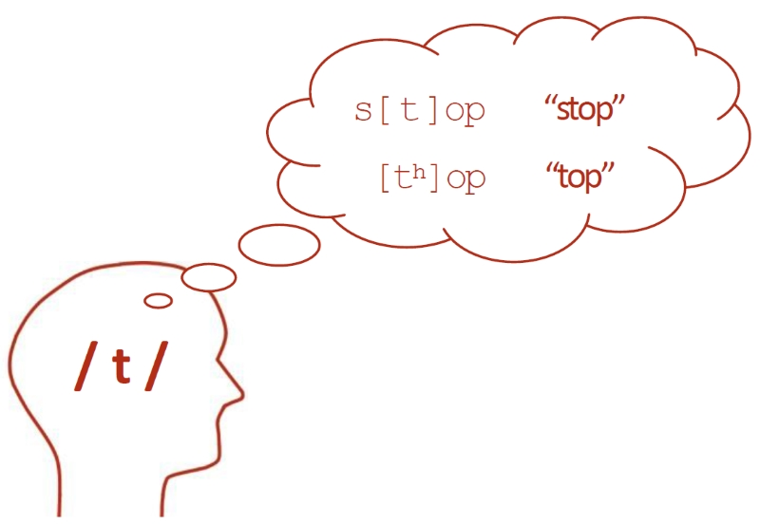
ALLOPHONE
A single phoneme can have different variants as well, that are called allophones.
They don’t change the meanings.

Slide 7
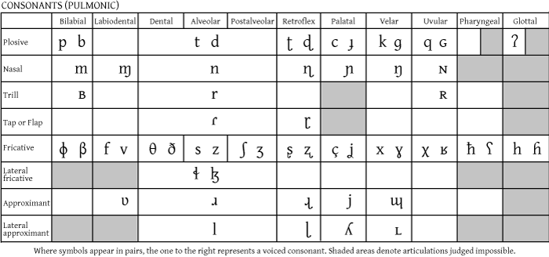
IPA CHART

Slide 8
SOME UNFAMILIAR SYMBOLS
/θ/ thigh or ether
/ð/ thy or either
/ʃ/ shy or motion
/ʒ/ measure or pleasure
/ʧ/ church or chair
/ʤ/ judge or edge

Slide 9
CLASSIFICATION OF ENGLISH SOUNDS
Consonants
Complete or partial closure of air stream while producing the consonant sound
Vowels
No Constriction of airflow.

Slide 10
CONSONANTS
Voicing
Place of articulation
Manner of articulation
Linguists use three criteria to describe the consonant sounds.

Slide 11
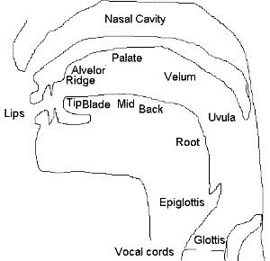

Slide 12
1. VOICING FOR CONSONANTS
VOICED CONSONANTS
VOICELESS CONSONANTS
Air passes through open vocal folds without causing any vibration.
When air pass through the vocal cords it creates vibration.
/g/ /z/ /v/
/s/ /p/ /t/

Slide 13
2. PLACE OF ARTICULATION
Where in the vocal tract is the constriction of airflow taking place.
There are several different places where it can happen.
Bilabial sounds: produced with two lips. /p/ /b/ /m/
Labiodental sounds : sounds produced with teeth and lips. Upper teeth and lower lip more specifically. /f/ /v/

Slide 14
PLACE OF ARTICULATION
Dental/ Interdental sounds: Tongue slightly in between your teeth.
/θ/ /ð/
Alveolar sounds : Produced at or near
the alveolar ridge.
/t/ /d/ /s/ /z/ /n/
If you start by putting your tongue right behind your front incisors, and then you move your tongue back, it is actually going to slide up and that’s where the alveolar ridge is, before you get to the roof of the mouth.

Slide 15
PLACE OF ARTICULATION
Palatal sounds: Sounds produced with the roof of the mouth.
/ʧ/ /ʤ/ /ʃ/
Velar sounds : Sounds produced at what is called the soft palate.
/k/ /g/
Glottal sounds : Sounds produced at the glottis.
/h/ /ʔ/
Glottal Stop
Little catch in the throat where the vocal folds close and then open very quickly.

Slide 16
3. manner OF ARTICULATION
How is the airflow being constricted when we are producing these sounds?
How the sound produced in the vocal tract?
Stops: sounds involve complete closure of the airflow followed by the release of that airflow. /p/ /b/ /t/ /k/ /g/
Fricatives: These sounds involve friction but the air doesn’t stop completely. We can produce these sounds for a long time. /f/ /v/ /s/ /z/

Slide 17
manner OF ARTICULATION
Affricates : Combination of stops and fricatives. /ʤ/ /ʧ/
Nasals: Articulated with the nose. /m/ /n/
Liquids
Glides

Slide 18
VOWELS
No constriction of airflow .
The position of the tongue is really important when producing vowel sound .
The middle of your tongue moves forward, backward, up and down when we make vowel sounds.
There are two general types of vowel sounds.
Monophthongs
(one vowel quality)
Diphthongs
(Two vowel quality )

Slide 19
VOWELS
There are three criteria linguists use to describe monophthongs.
HEIGHT | BACKNESS | ROUNDEDNESS
How high the tongue is in the mouth ? | Is the tongue back or front? | Whether the lips are rounded or not ?
High vowels : ee Mid vowels Low vowels : aa | ee: high front vowel oo: high back vowel | oo: Rounded Ee: unrounded

Slide 20
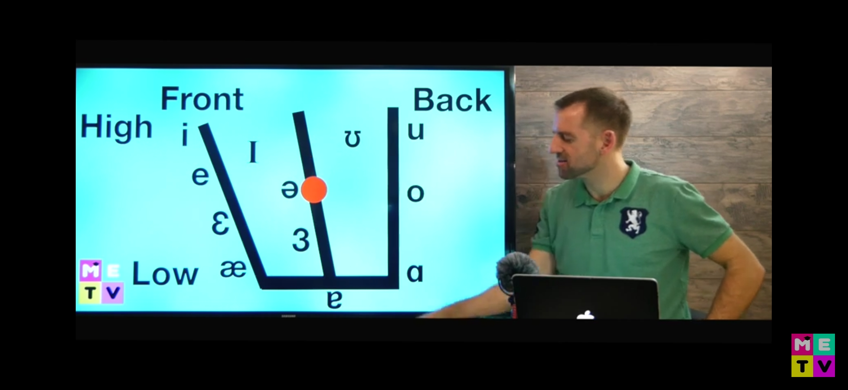
VOWELS

Slide 21
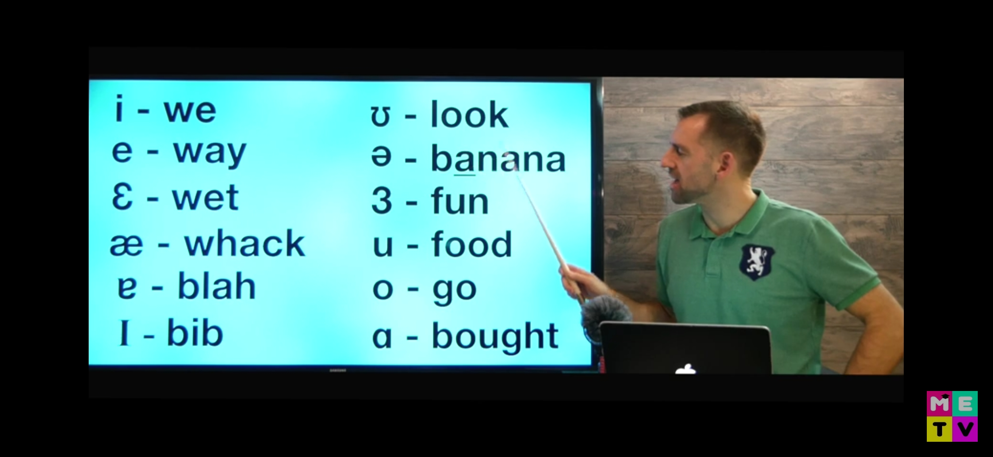
VOWELS

Slide 22
Pronunciation : VOWELS
Some tricks to pronounce vowels.
TWO VOWEL GUIDELINE: If two vowels are in one word then the first vowel will sound like an alphabet name and the second vowel will be silent. (long vowel sound)
Bake these fame dream
ONE VOWEL GUIDELINE: The vowel sound like a relative. (short vowel sound )
Bed Him Sum Pin hot (aw)

Slide 23
some other speech patterns
Stress (which could be roughly described as the relative strength of a syllable) and intonation (the use of the pitch of the voice to convey meaning).
As an example of stress, consider the difference between the pronunciation of‘ contract' as a noun ('they signed a contract') and 'contract' as a verb ('it started to contract'). In the former the stress is on the first syllable, while in the latter it is on the second syllable.
A possible example of intonation would be the different pitch movements on the word 'well' said as an exclamation and as a question: in the first case the pitch will usually fall from high to low, while in the second it will rise from low to high.

Slide 24
ACCENTS AND DIALECTS
Languages have different accents: they are pronounced differently by people from different geographical places, from different social classes, of different ages and different educational backgrounds.
We use the word dialect to refer to a variety of a language which is different from others not just in pronunciation but also in such matters as vocabulary, grammar and word order. Differences of accent, on the other hand, are pronunciation differences only.

Slide 25
THANK YOU

